Slide 1
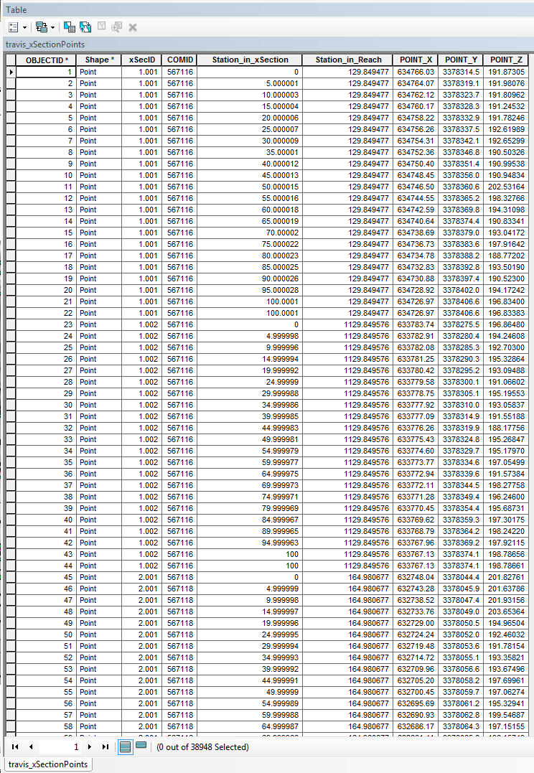
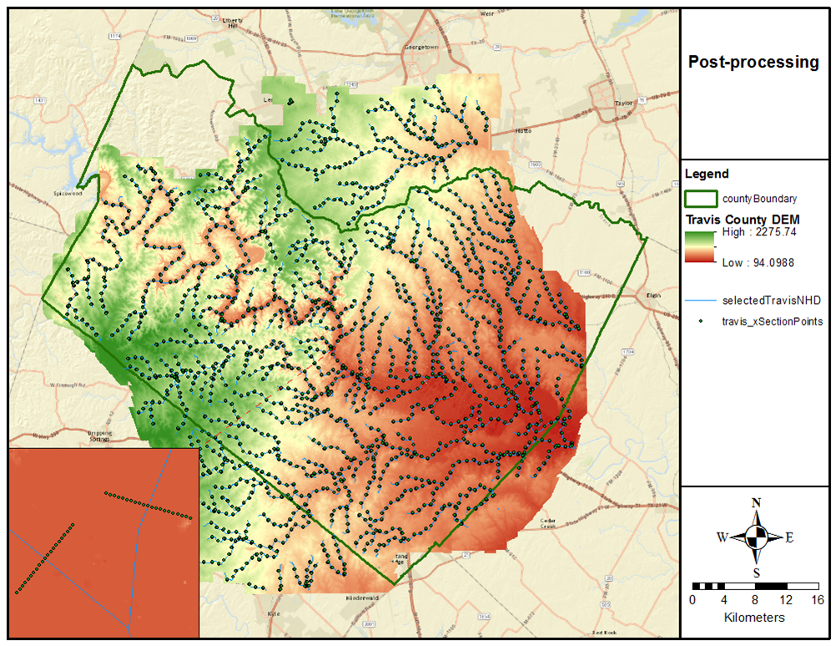
NHD xSection Feature extraction
a presentation and process by Richard Carothers

Slide 2
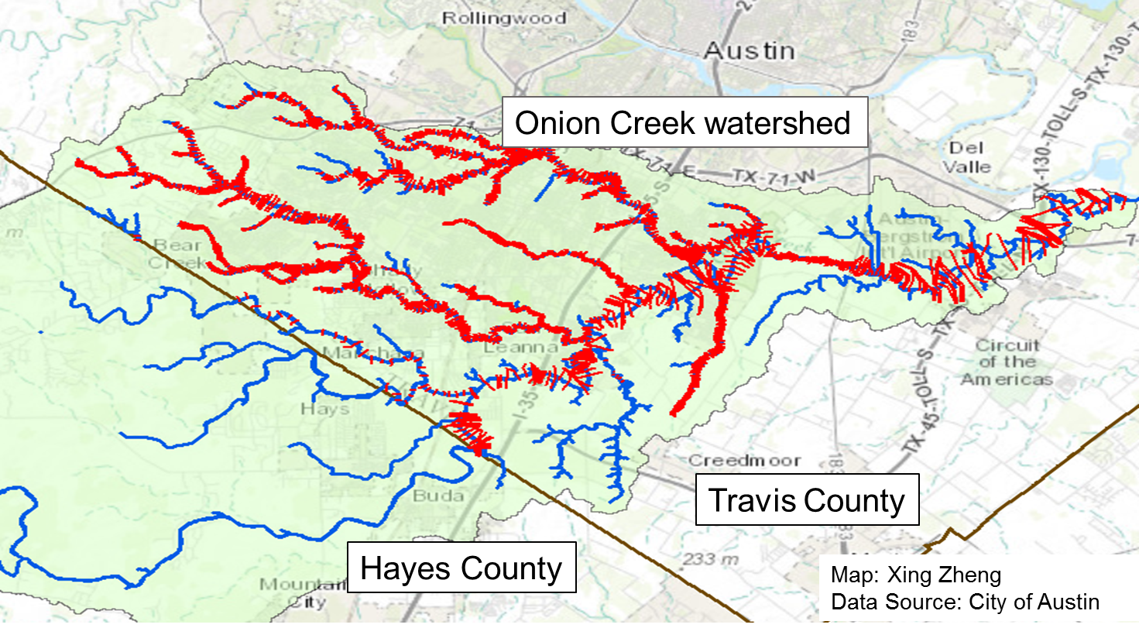
Introduction
NFIE-River is heavily dependent on local data
Local data in the form of xSections is generally only available where hydraulic models have previously been commissioned
Small stretches in limited areas
Disparate in origin, quality, etc.
Tool seeks to address this issue by extracting xSections from DEM data along the NHD flowlines
NFIE-Geo: National geospatial framework for hydrology
NFIE-Response: Wide area planning for flood emergency response
NFIE-Hydro: National high spatial resolution hydrologic forecasting
NFIE-River: River channel information and real-time flood inundation mapping
NFIE-Services: Web services for flood information

Slide 3
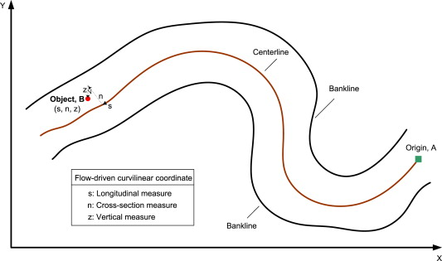
Requirements of Tool
Import DEM and NHD flowlines and deliver xSections at prescribed intervals in both Cartesian and curvilinear coordinates
Reminder: curvilinear coordinates locate xSection points upstream of reach discharge (s in figure) and along the xSection itself from left to right looking downstream (n in figure)
Optimizes flexibility of xSection data for modeling perposes

Slide 4
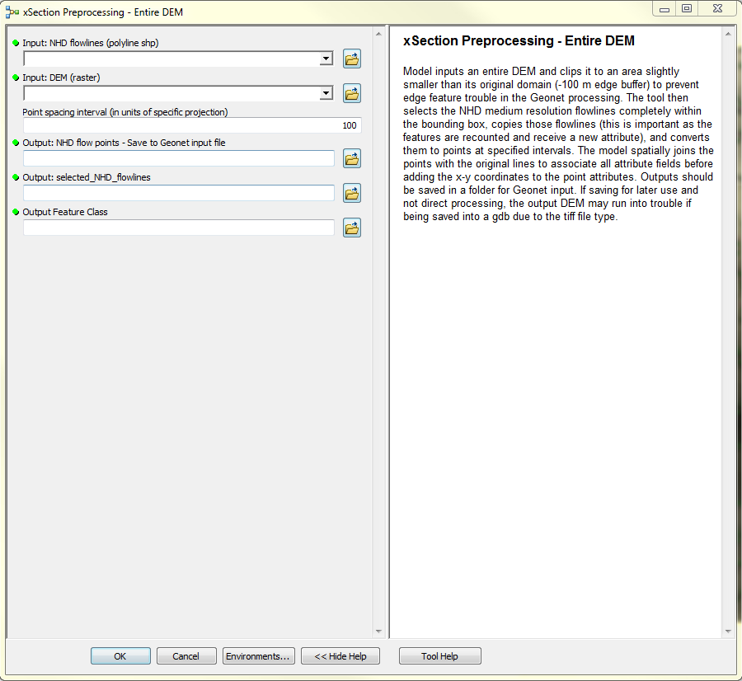
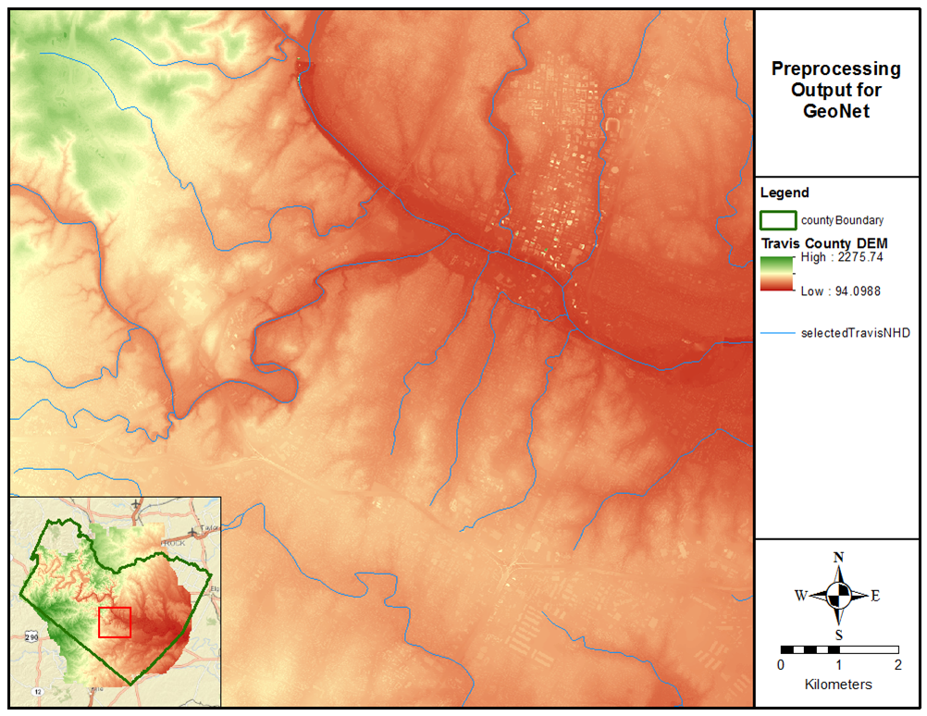
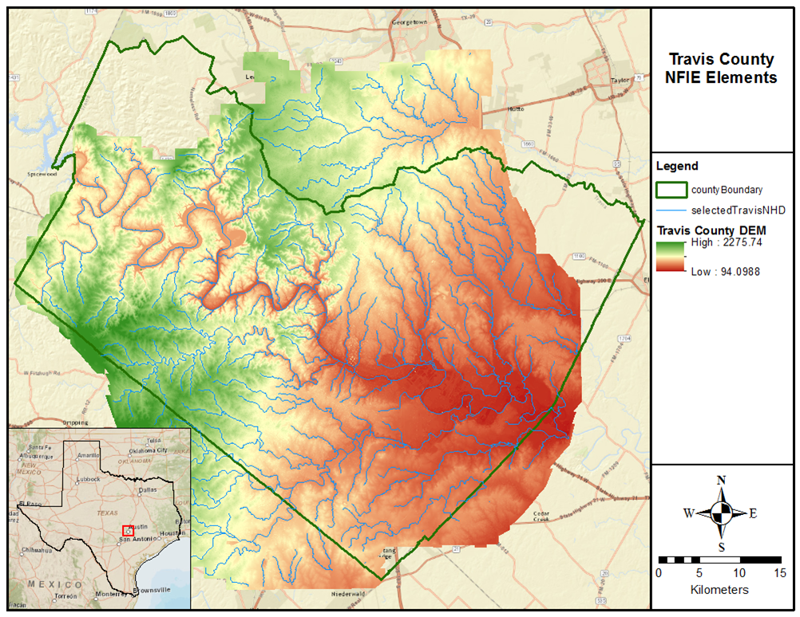
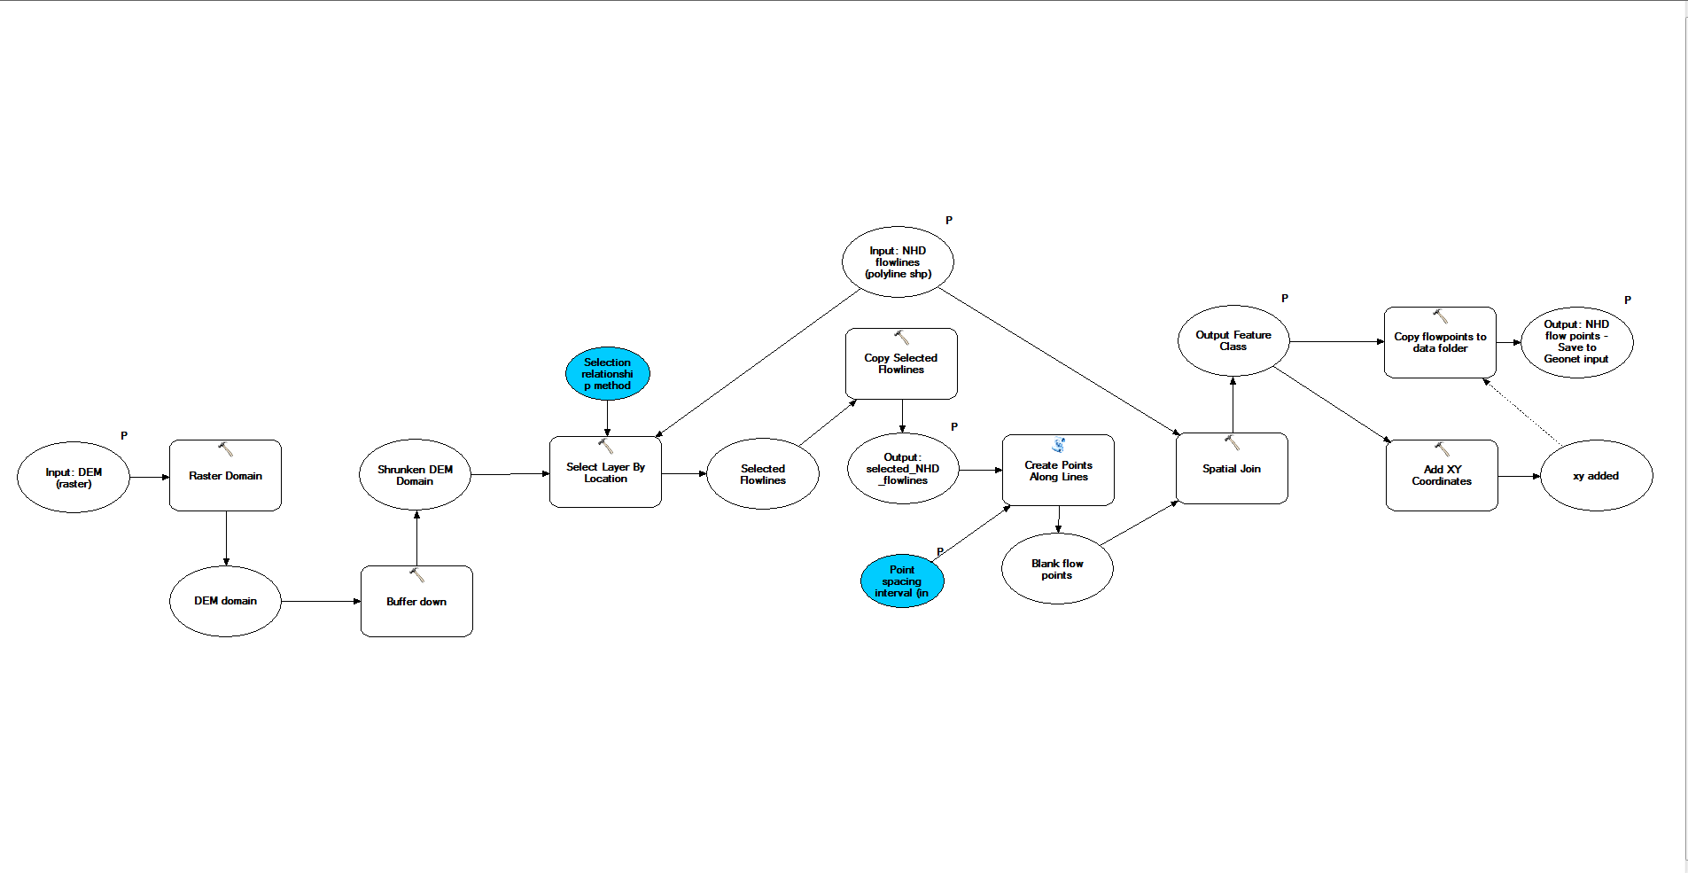
Preprocessing
ArcGIS model prepares input for GeoNet processing code
Converts NHD flowlines into a series of sequential points
Model inputs: NHD flowlines from gdb, DEM from gdb, and desired point spacing interval
Model outputs: point shapefile for GeoNet input and a copy for gdb, copy of selected flowlines for gdb,

Slide 5
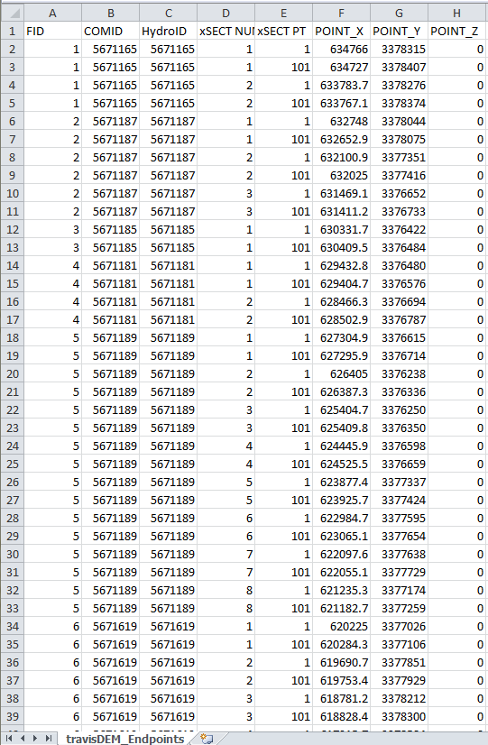
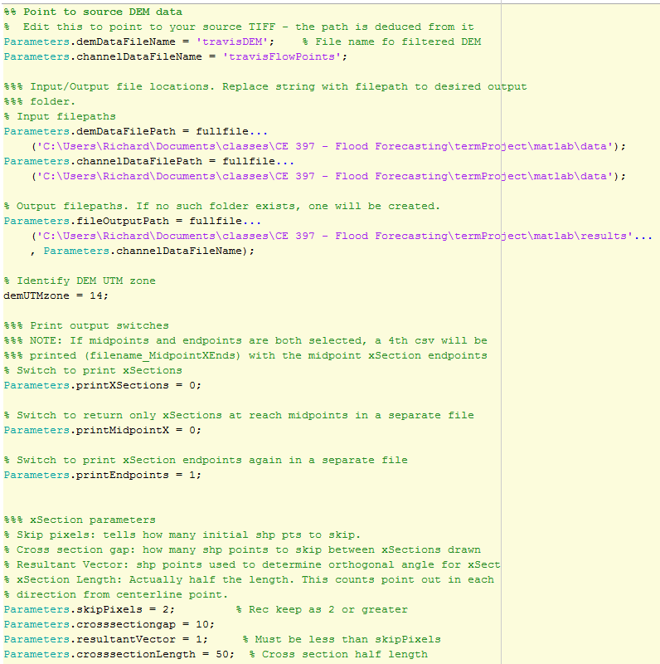
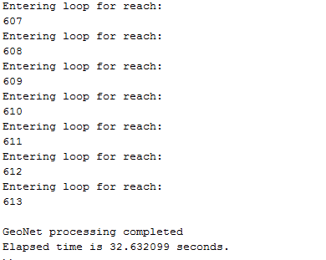
GeoNet Processing
Code walks along input shapefile points within individual reaches and creates xSection endpoints at specified intervals
Code inputs: NHD flow point shapefile from preprocessing, xSection parameters
Code output: csv of endpoint locations

Slide 6
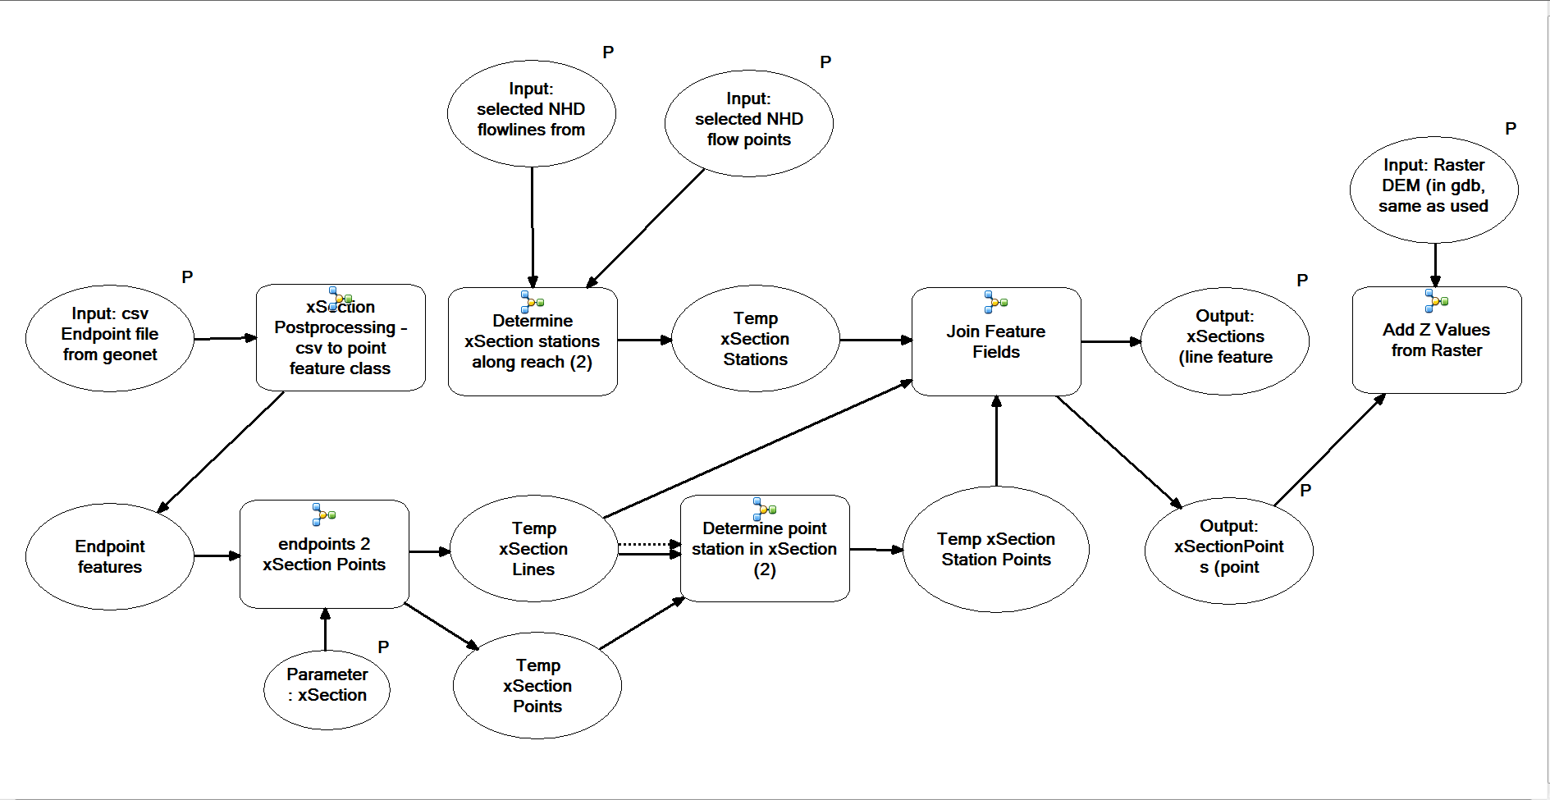
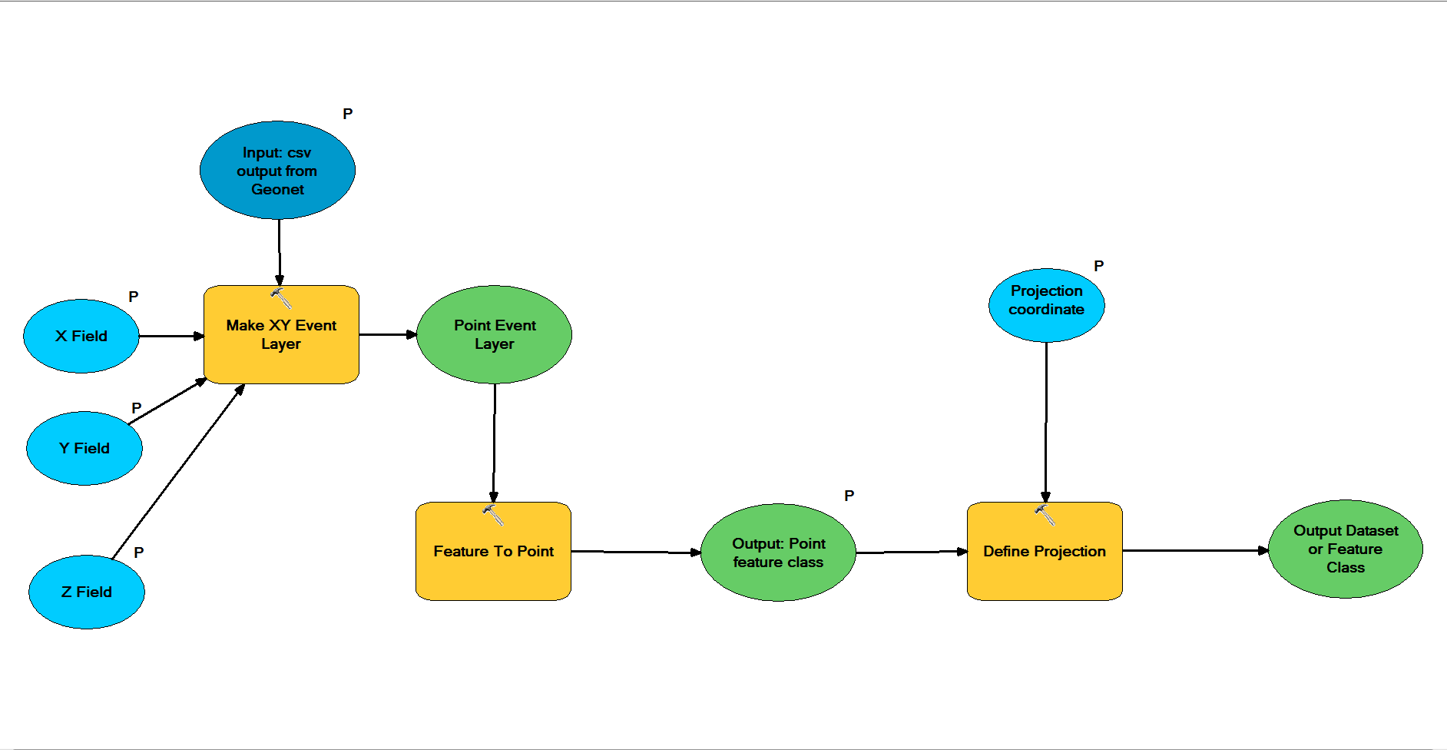
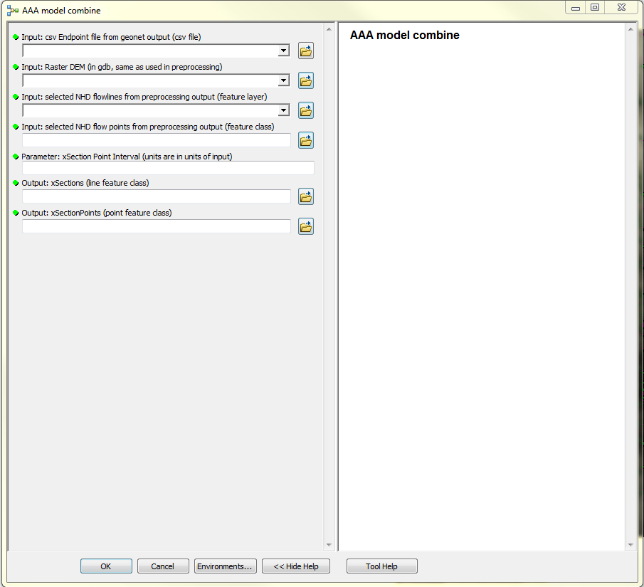
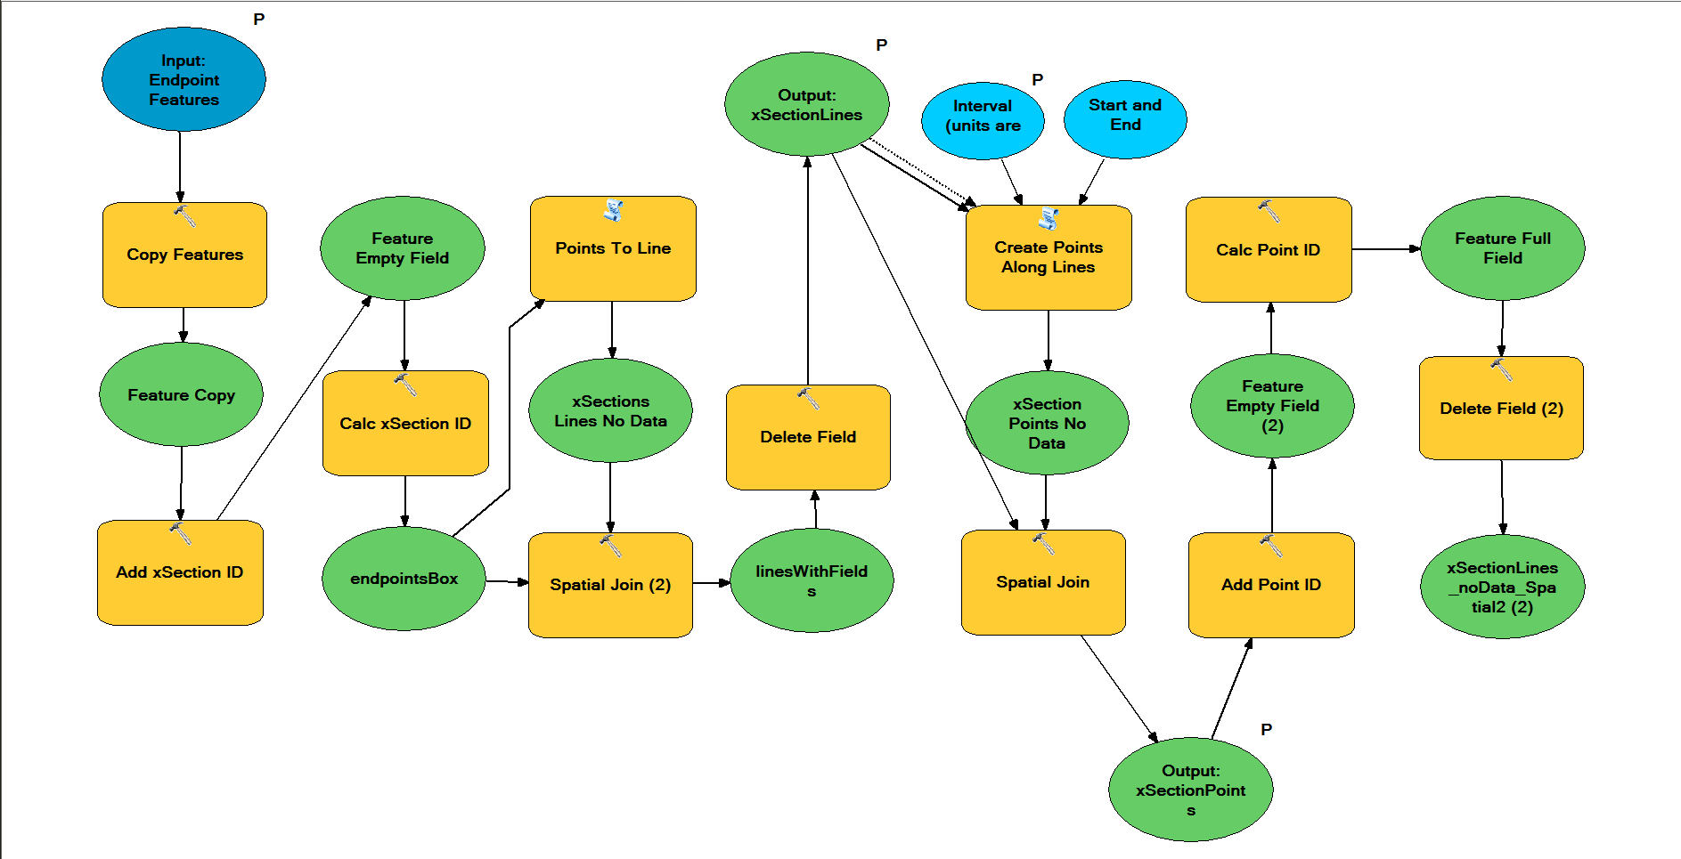
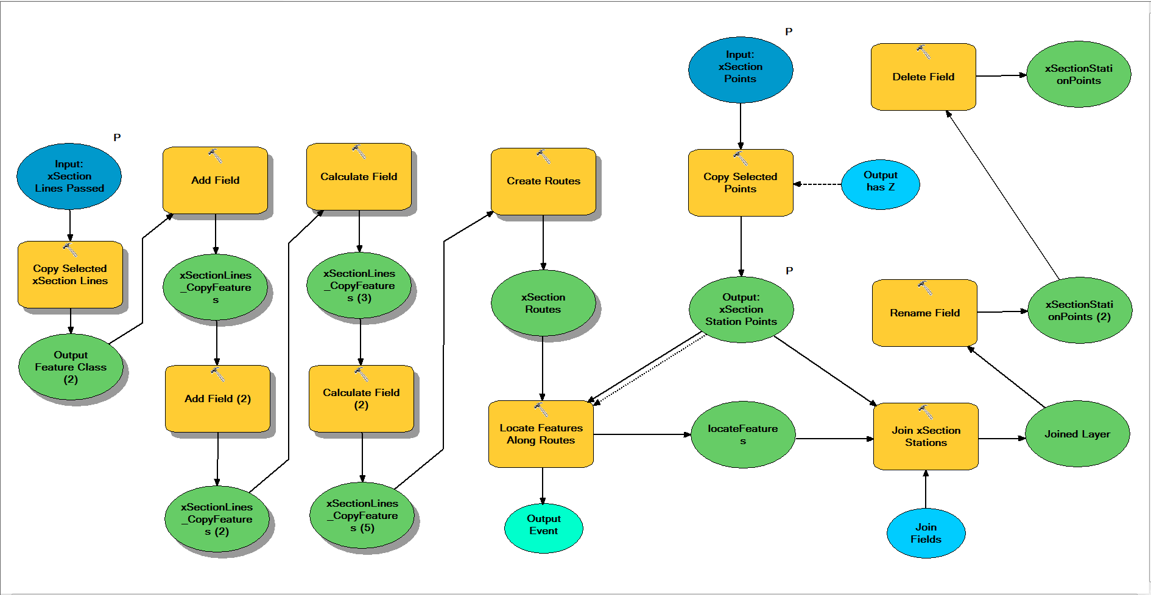
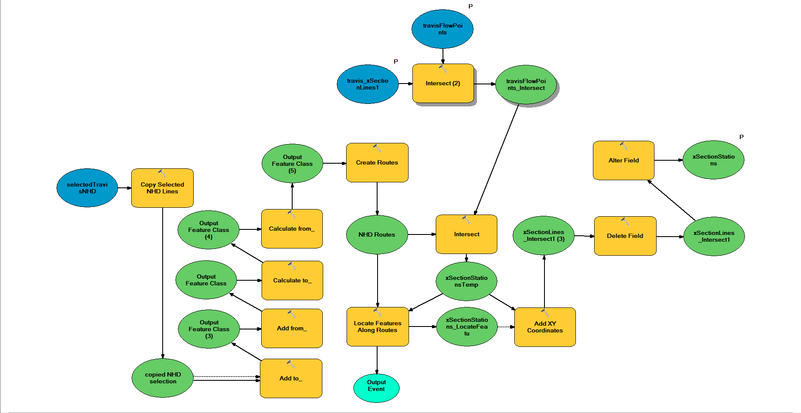
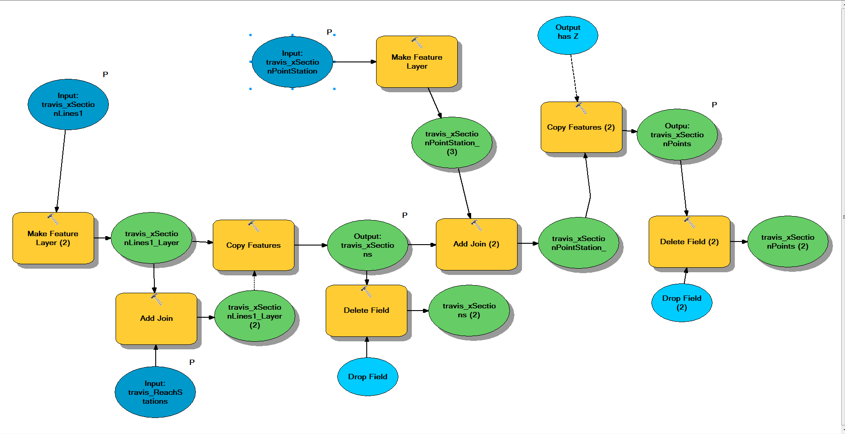
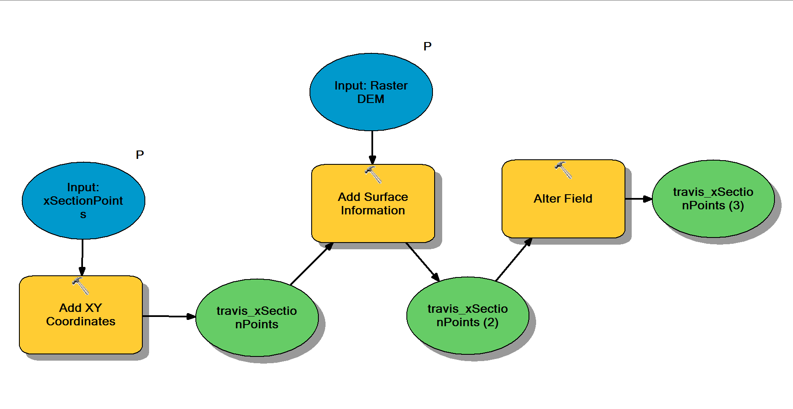
Post-processing
Csv to Feature
Features to xSection lines and points
Determine point station
Determine reach station
Assign reach stations to points
Add geometry to xSection Points
ArcGIS super model xSections between GeoNet output endpoints, converts them to points at specified intervals, and assigns cartesian and curvilinear coordinates
Inputs: csv GeoNet outputs, and DEM, flowline, and flow points from preprocessing output
Outputs: xSection and xSection Point features

Slide 7
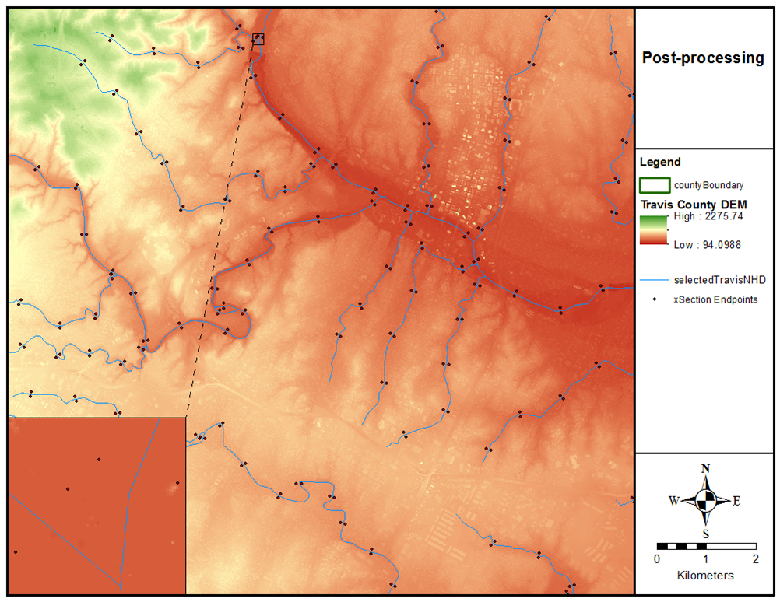
Post-processing
What does all that mean???
xSection endpoint features
xSection line features
xSection points features
Process takes place at DEM scale

Slide 8
Post-processing
Results: xSection and xSection point feature classes

Slide 9
Ongoing work, concerns, and lessons
Attempt to correct process aberrations
Troubleshoot combined post-processing model and add finishing touches
The process seems cumbersome convoluted… and it probably is
It is easier to design from scratch than to adapt

Slide 10
THE END
Questions?

