Slide 1
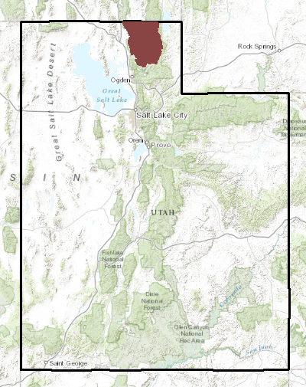
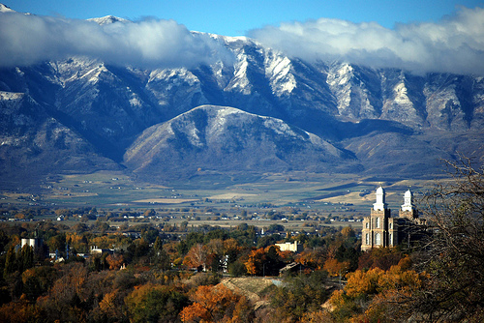
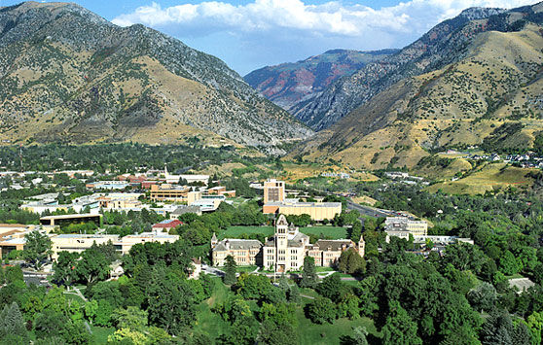
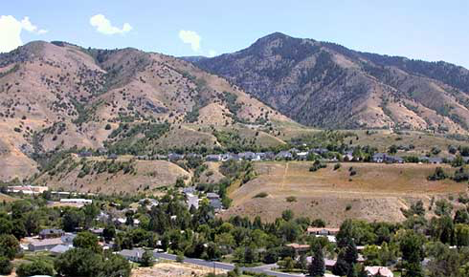
NFIE-Response in Cache County, Utah
Flood Forecasting, May 4, 2015
Madeline Merck
Source: greatsaltlakeinfo.org and usu.edu

Slide 2
Reminder…
NFIE-Response – a plan for flood response
developed with the local emergency response community such as city fire departments to support saving lives during flood events. This includes a planning phase to identify vulnerable people and infrastructure, including flooding of roads and streets , and an action phase that uses
flood forecasts from NFIE-Hydro and flood inundation mapping from NFIE-
River, if available, to indicate zones of flood risk during a flood event.
Notes:
Maidment: “Flood Emergency Response Planning has two parts – a pre-flood planning effort that studies the flood potential over a region and devises plans to cope with floods of various severities and locations, and a flood action plan that supports decision and deployment of resources before, during and after an actual flood event.”

Slide 3
Project Motivation, Intent, Goal
Motivation: case study of Cache county; to become familiar with Cache County and the emergency response community within the county…
Available Data: location, population, topography
Personnel: local emergency response organizations
Intent: learn what emergency response personnel do and
how to help make successful outcomes easier
Goal:
Create:
Maps & Statistics
Assess: Usefulness to Emergency Responders
Design:
Online Tool/App
Citizen Education
Event Response
(data)
(personnel)

Slide 4
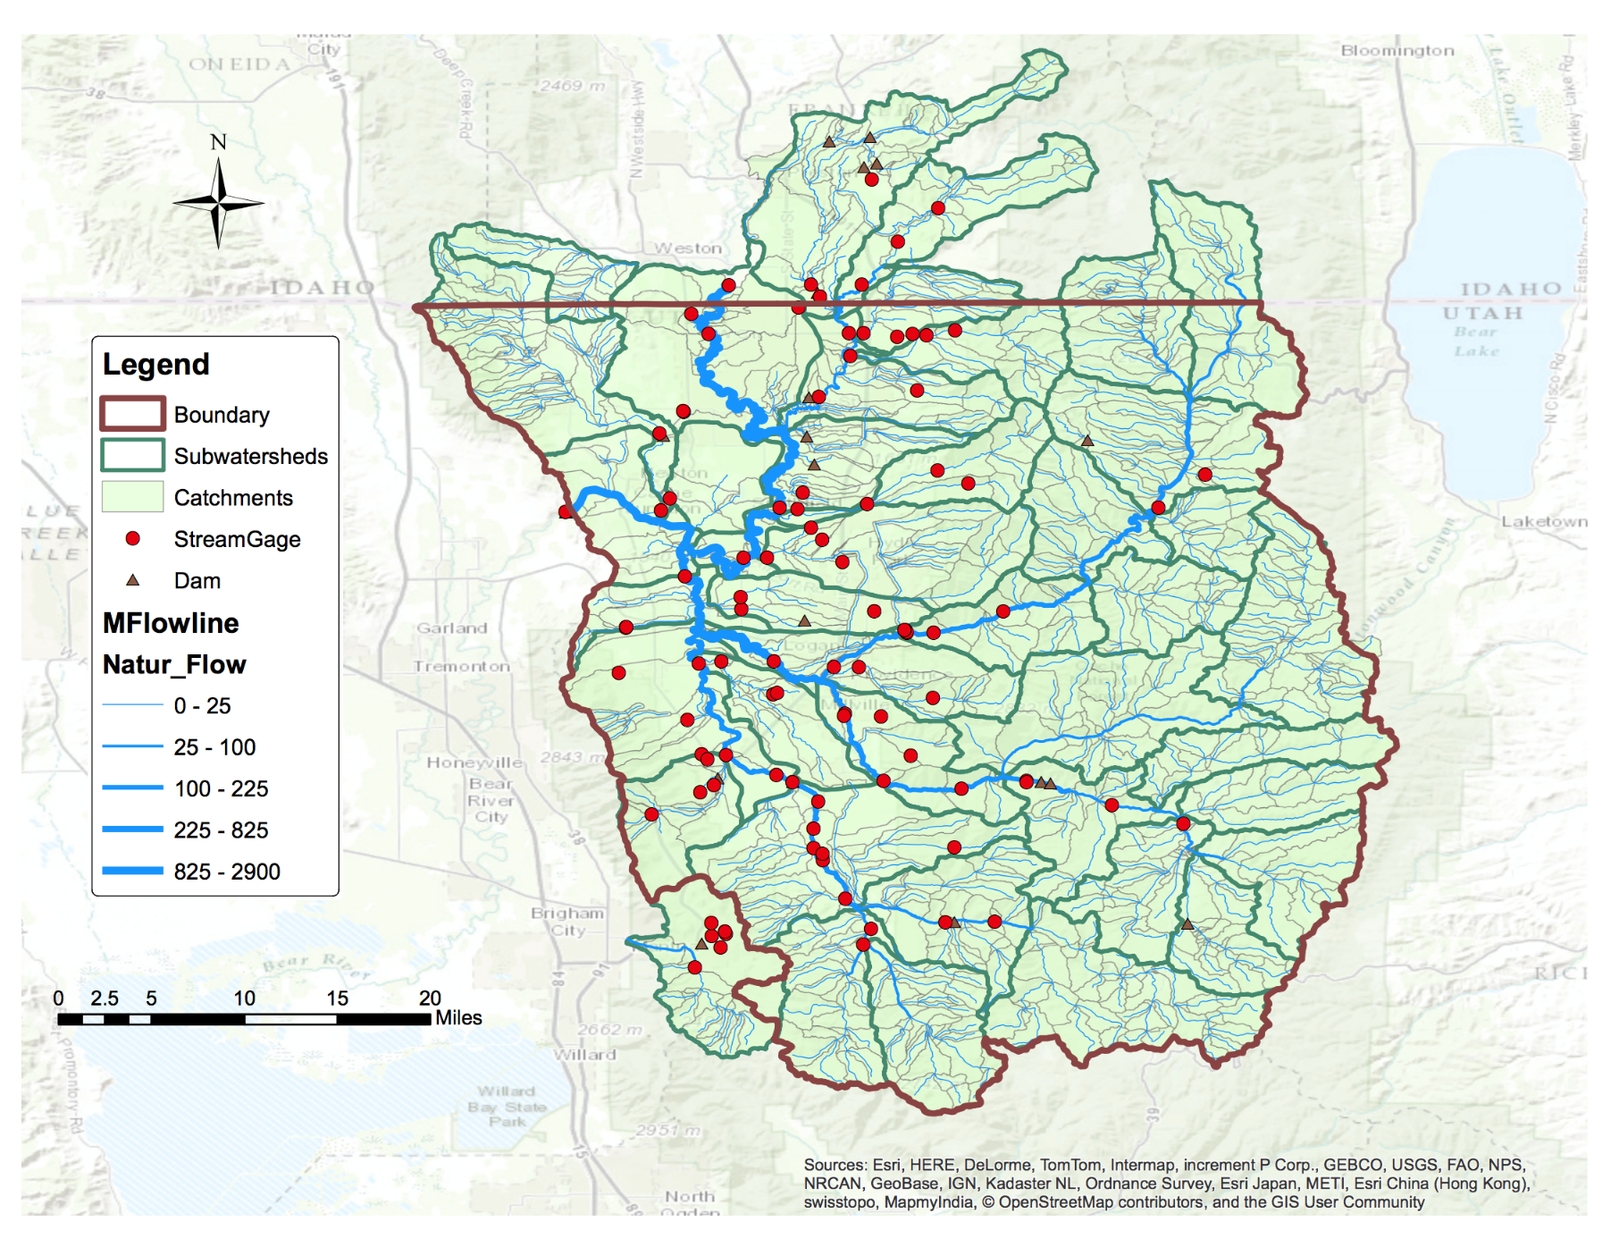
NFIE-Geo Database Cache County
NFIE-Geo database:
Subwatersheds
Catchments
Flowlines
Stream Gages
Dams

Slide 5
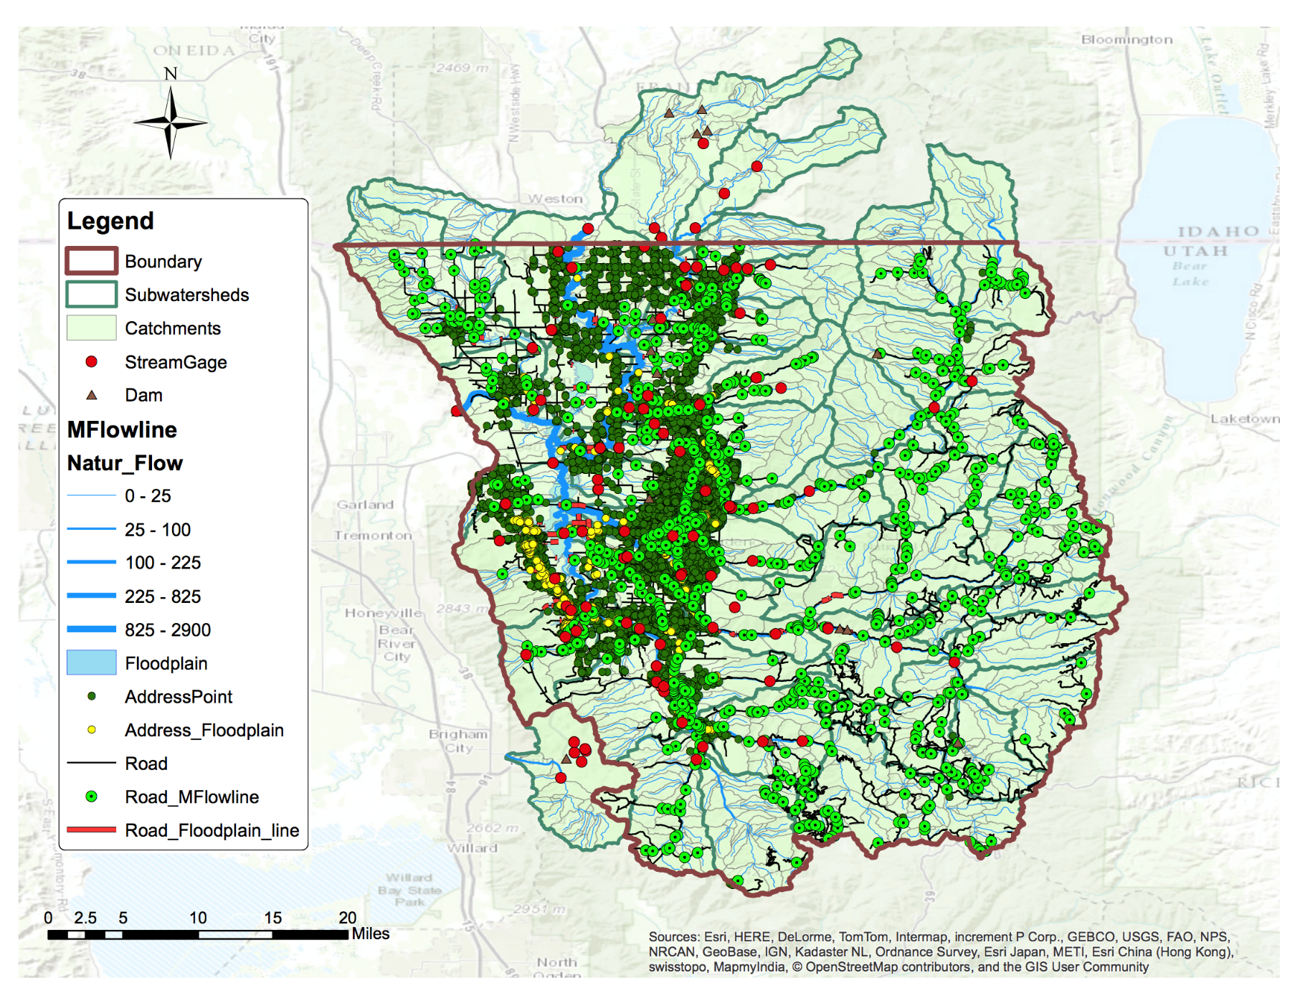
NFIE-Response Database Cache County
Additional Layers:
FEMA Floodplain
Address Points
Transportation Network
Census Data

Slide 6
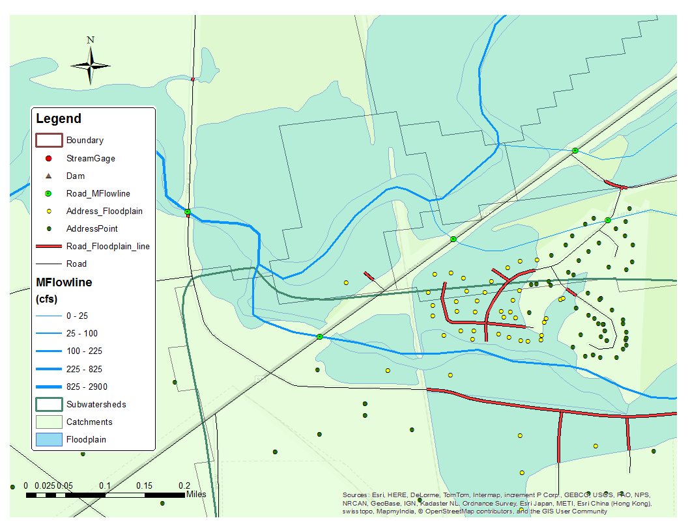
Intersection of Roads and Address Points with Rivers and FEMA Floodplains
Vulnerable People and Infrastructure
Vulnerable Roads
Notes:
This is a neighborhood just outside Logan where several homes and roads are within FEMA’s 100 yr floodplain. Several neighborhoods like this one experienced flooding during the 2011 Logan River flood. You can see that this neighborhood is cut-off from major roadways – but this is only according to this particular floodplain map.

Slide 7
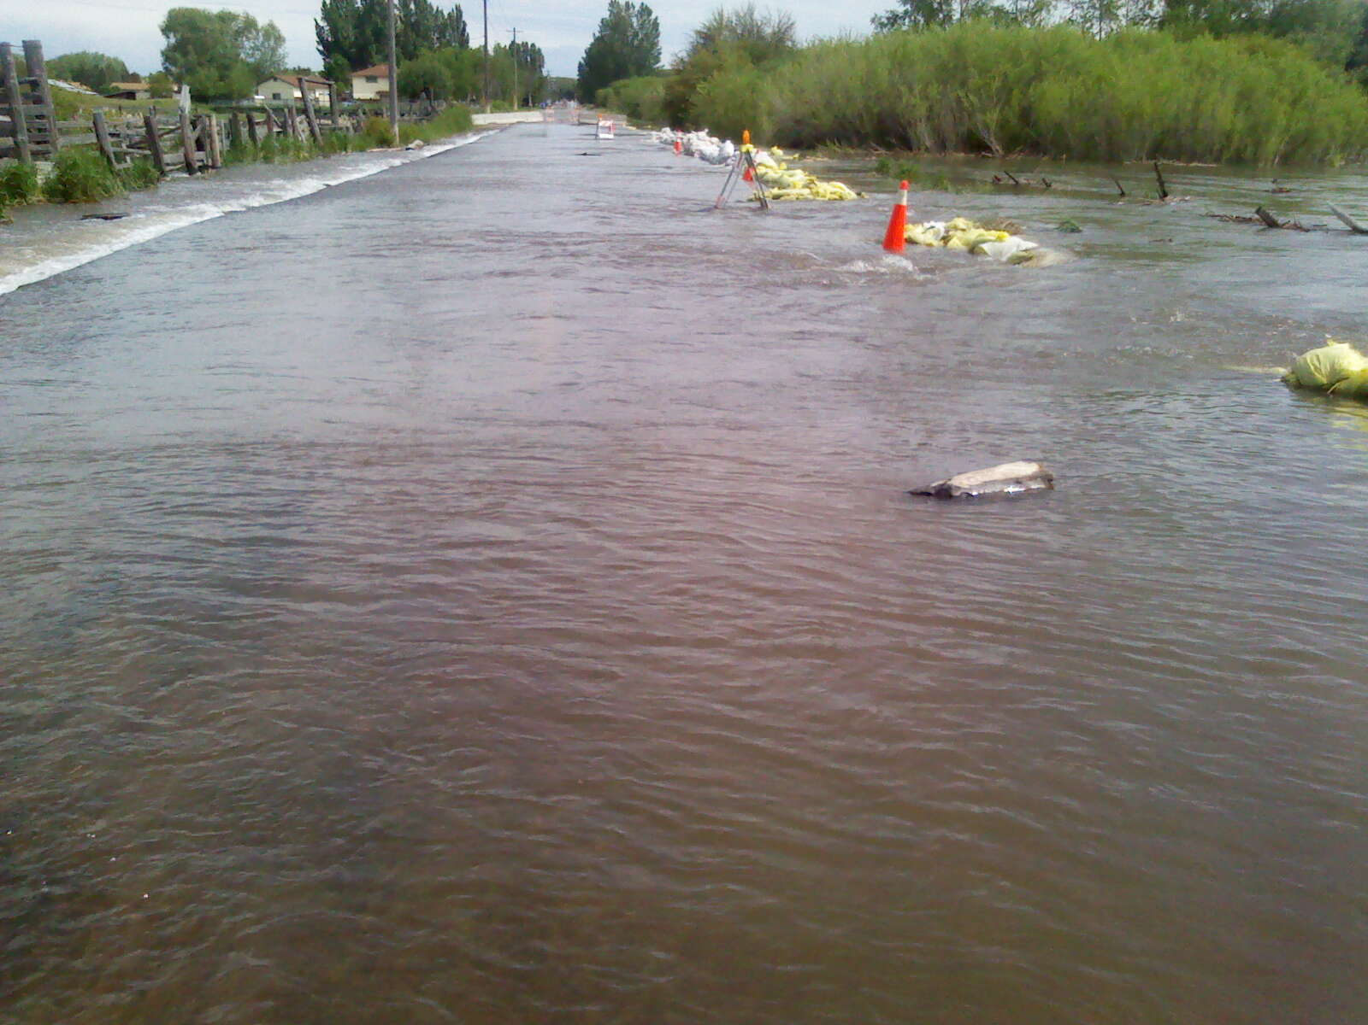
June 16, 2011: 1550 cfs, 5.2 ft
600 West 1600 South

Slide 8
Planned Project Resources
Data:
NFIE-Geo
Address points
Transportation network
FEMA inundation maps
Census data
Lidar of Logan River 2011 flood
River cross sections
Emergency response protocols for Cache County
Personnel:
Cache County Sheriff
Cache County Fire Chief
Cache County Emergency Manager
Cache County SAR Water Rescue Lead
Cache County Sergeant
Logan City Emergency Manager
Logan City Engineer
Logan City Asst. Engineer
Logan City 911 Call Center

Slide 9
Planned Project Resources
Actual
Data:
NFIE-Geo
Address points
Transportation network
FEMA inundation maps
Census data
Lidar of Logan River 2011 flood
River cross sections
Emergency response protocols for Cache County
Personnel:
Cache County Sheriff
Cache County Fire Chief
Cache County Emergency Manager
Cache County SAR Water Rescue Lead
Cache County Sergeant
Logan City Emergency Manager
Logan City Engineer
Logan City Asst. Engineer
Logan City 911 Call Center

Slide 10
Project Motivation, Intent, Goal
Motivation: become familiar with Cache County and emergency response within the county…
Available Data: location, population, topography
Personnel: local emergency response organizations
Intent: learn what emergency response personnel do and
how to help make successful outcomes easier
Goal:
Create:
Maps & Statistics
Assess: Usefulness to Emergency Responders
Design:
Online Tool/App
Citizen Education
Event Response
(data)
(personnel)

Slide 11
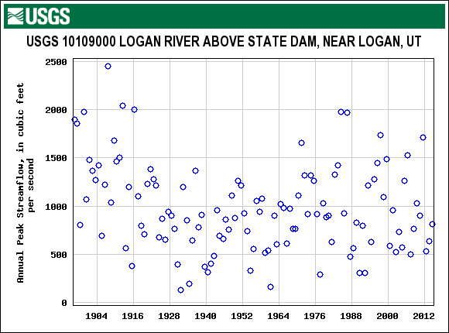
Flooding due to Spring Snowmelt Runoff

Slide 12
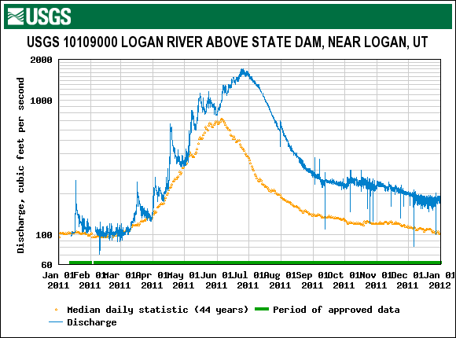
2011 Calendar Year

Slide 13
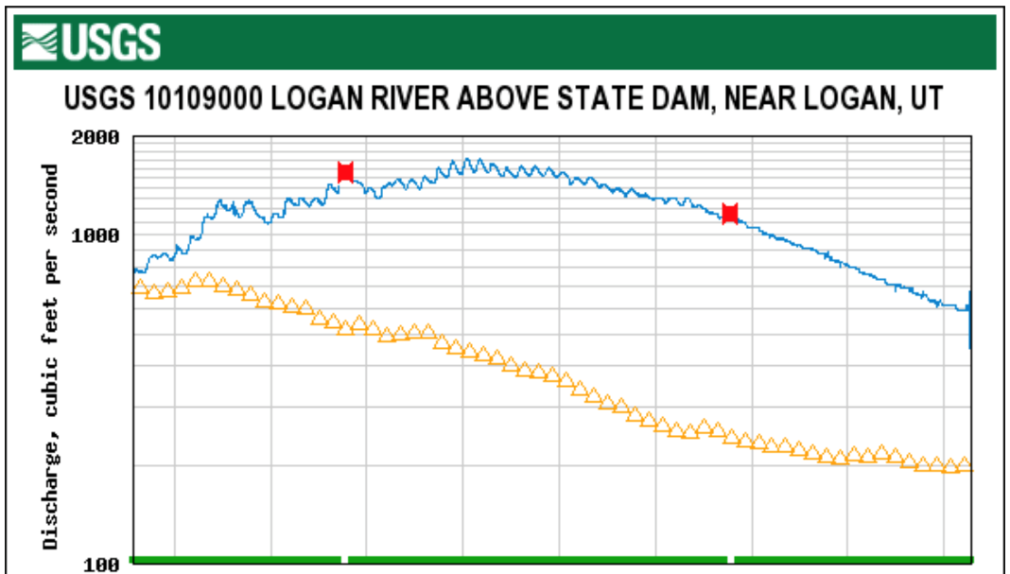
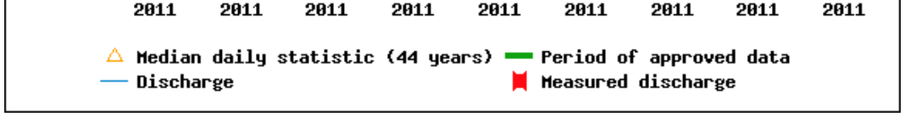
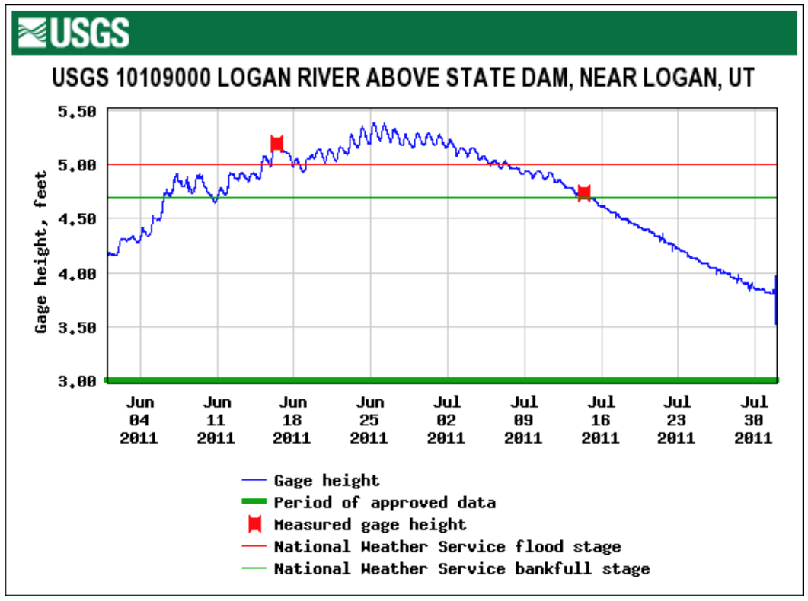
June – July, 2011:

Slide 14
Case Study: Madeline’s House
Madeline’s House
Vulnerable Bridges

Slide 15
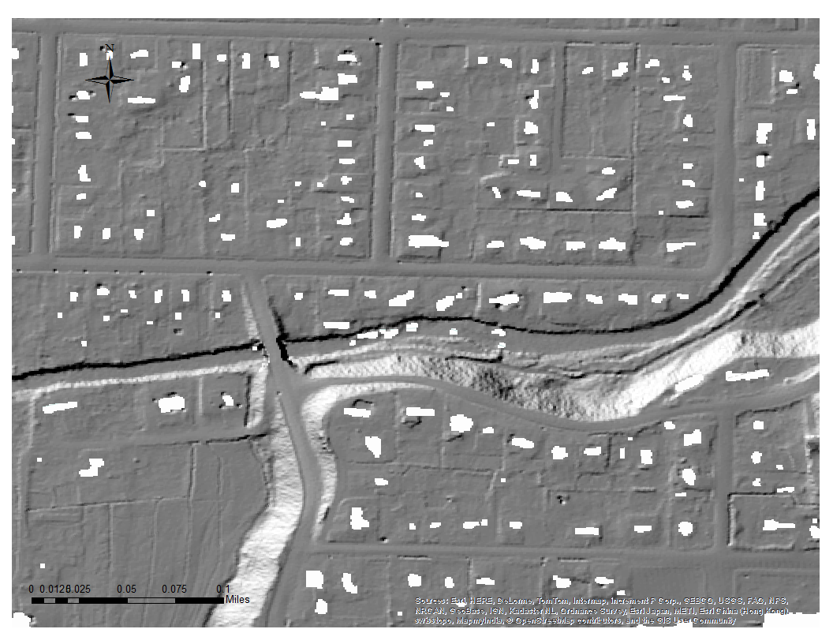
Case Study: Madeline’s House
Madeline’s House
Vulnerable Bridges

Slide 16
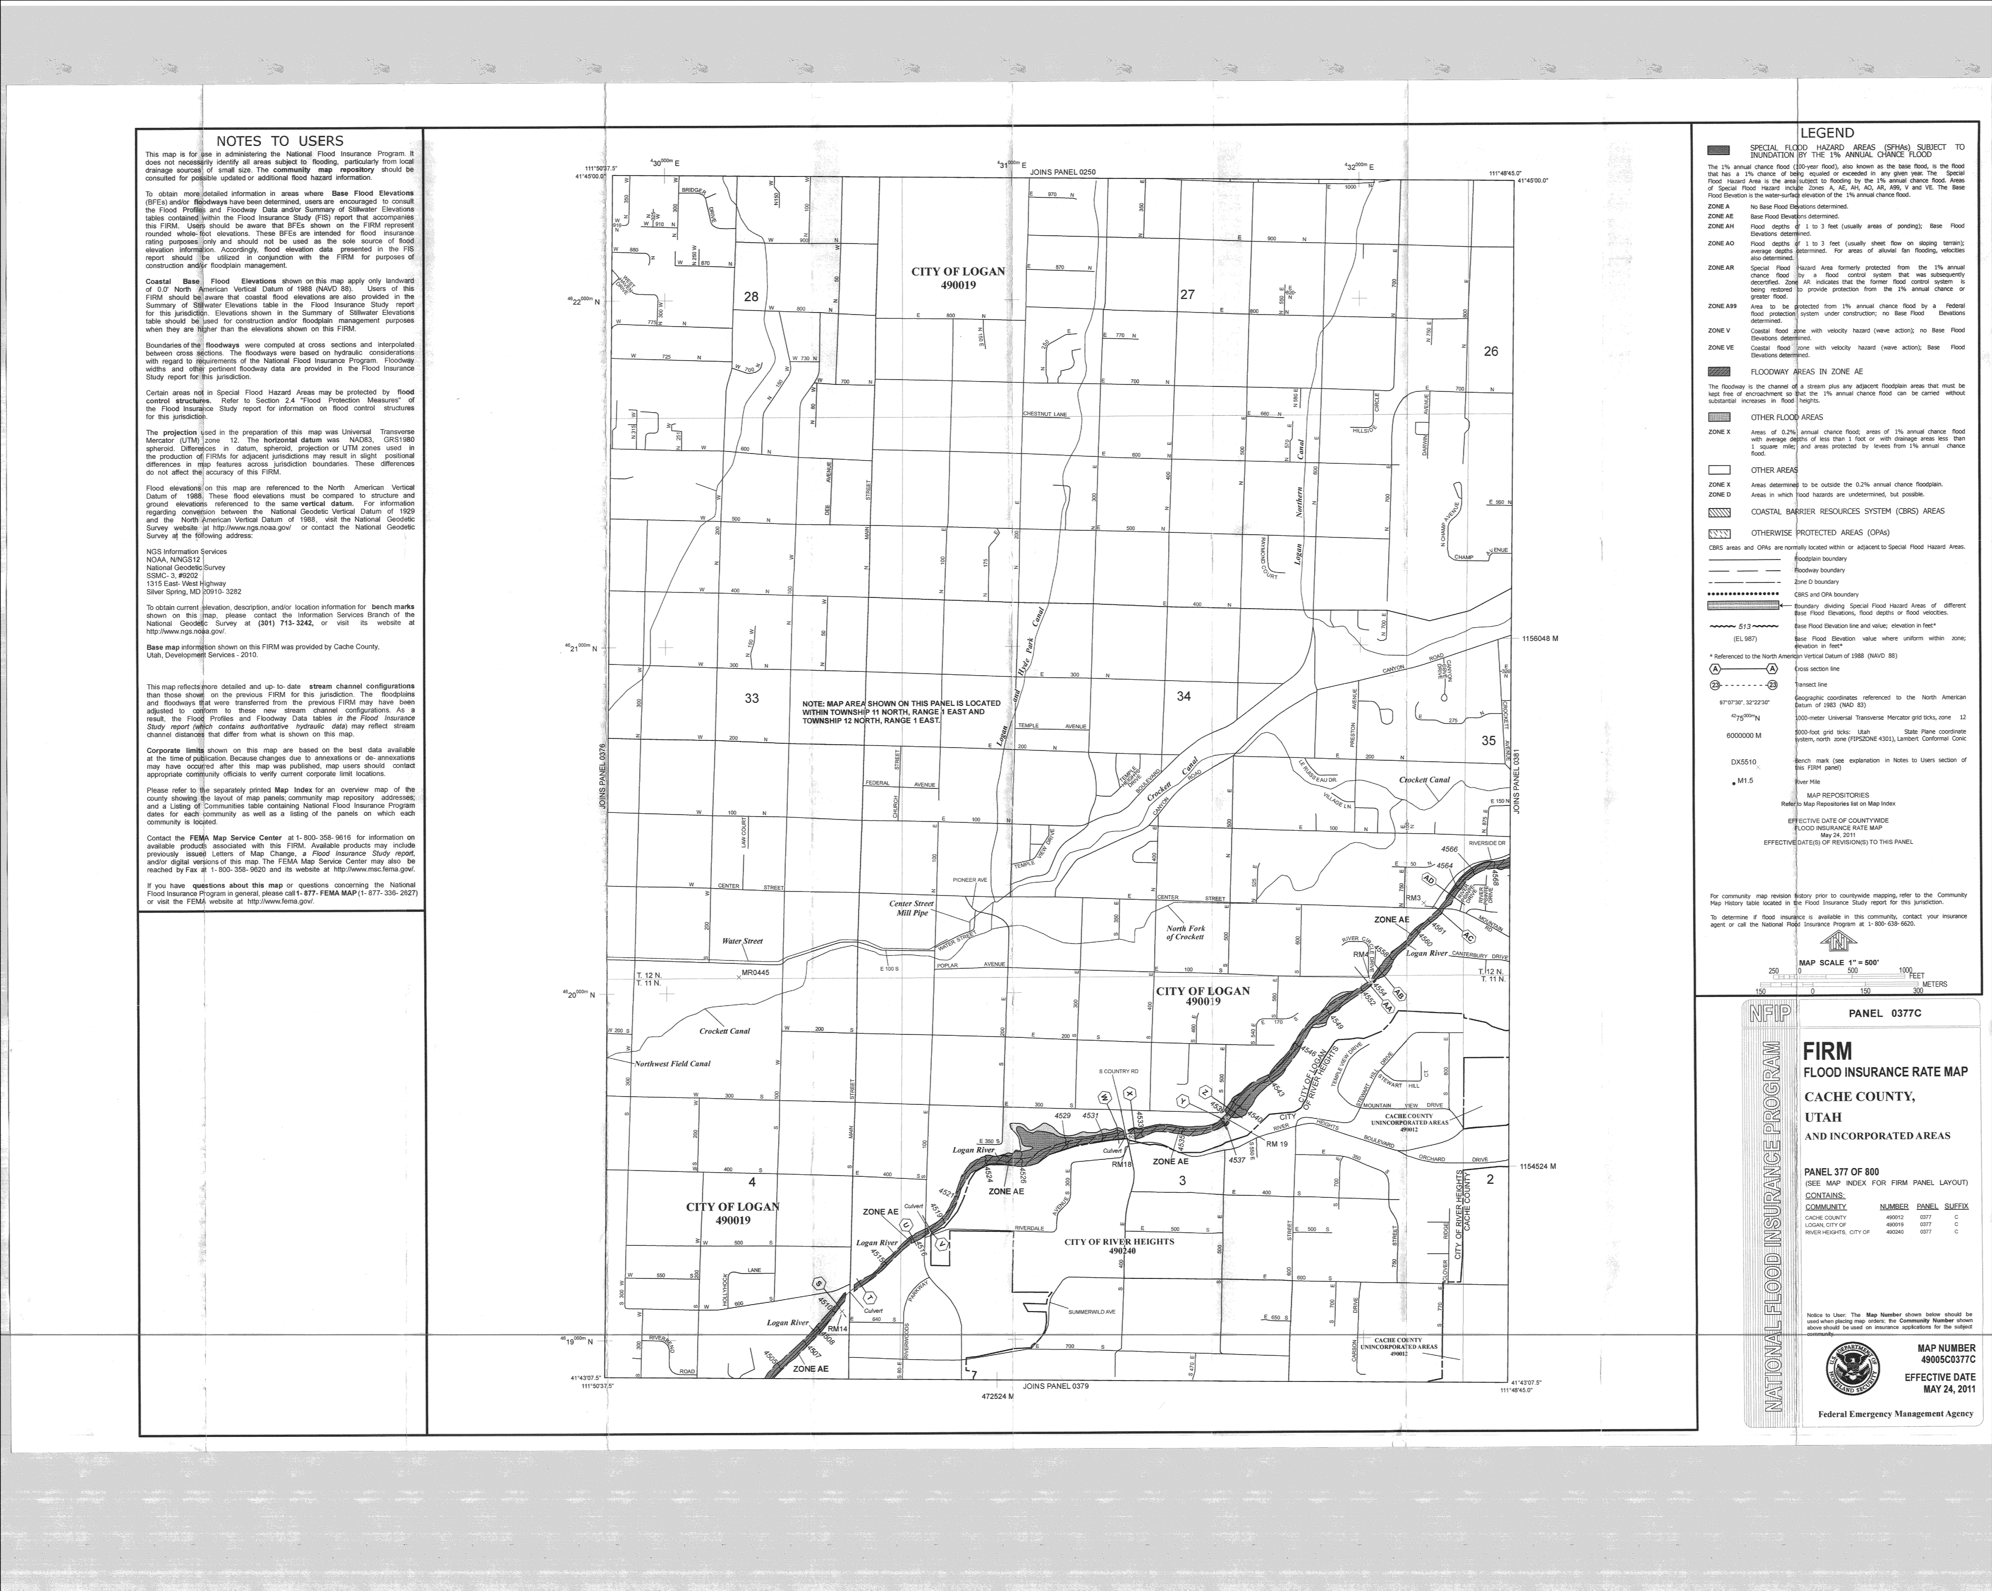
Case Study: Madeline’s House
Madeline’s House
Vulnerable Bridges
Notes:
House elevation = 4534 ft; both NED and FEMA NFIP use NAVD88

Slide 17

July 5, 2011: 1400 cfs, 5.05 ft
100-yr Flood

Slide 18
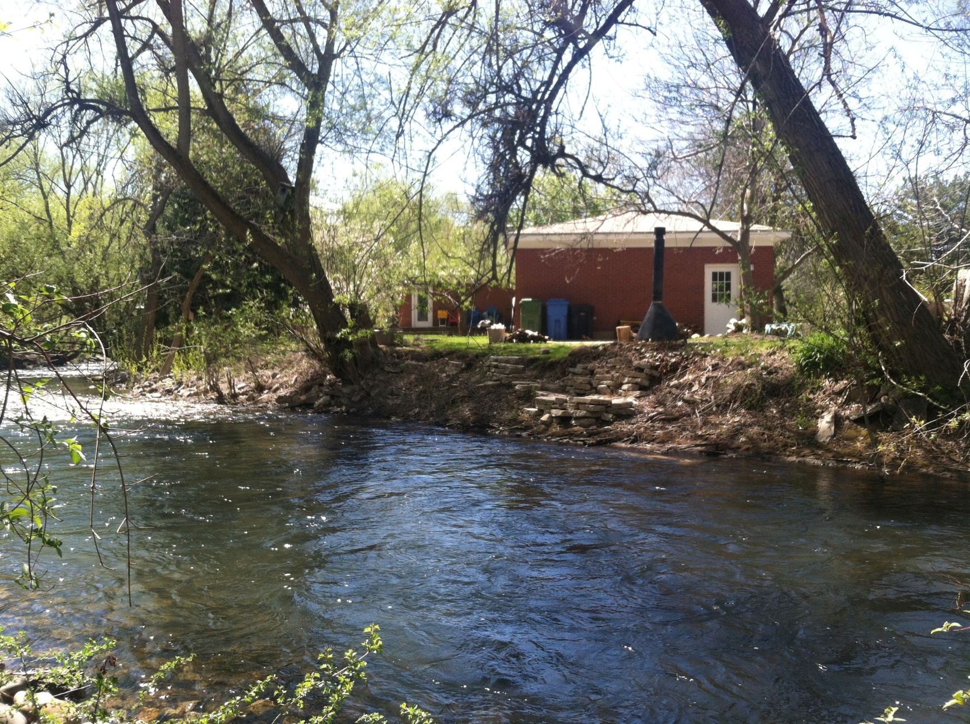
April 27, 2015: 165 cfs, 2.85 ft

Slide 19
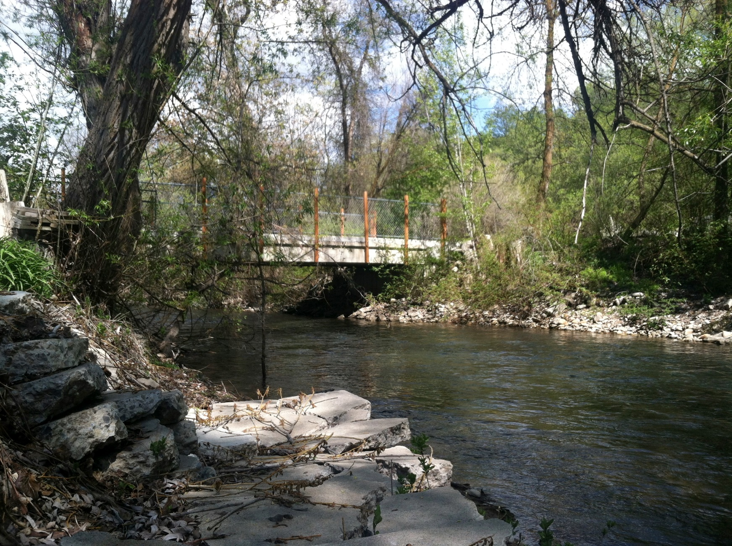
April 27, 2015: 165 cfs, 2.85 ft

Slide 20
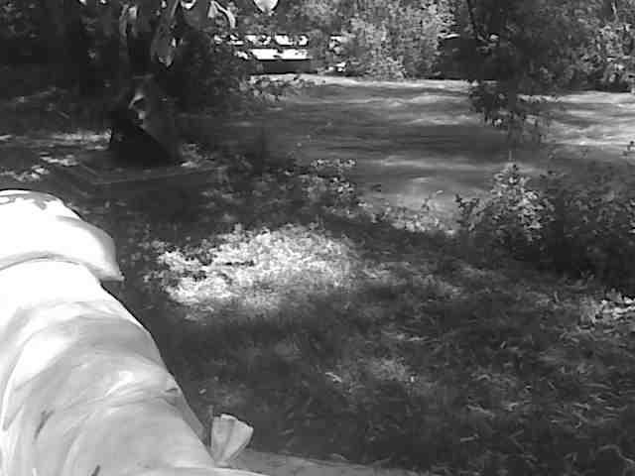
June 25, 2011: 1600 cfs, 5.3 ft

Slide 21
So many questions…
What is the location of the 100-yr floodplain?
What is the depth of the 100-yr floodplain?
Is the bridge being monitored? Or am I responsible?
What should I have done for pre-flood preparation?
Who do I call if I need help protecting my home?
Do I actually need flood insurance?
Who knows the answers to these questions??

Slide 22
Adjusted
Project Motivation, Intent, Goal
Motivation: Citizens are lacking information
Intent: Give citizens the information and knowledge
Goal: National coverage of the abbreviated dialing codes, in particular, 311 for non-emergency services.
211: Assigned for community information and referral services
311: Assigned nationwide for non-emergency police and other government services
411: Unassigned, but used virtually nationwide by carriers for directory assistance
511: Assigned for traffic and transportation information
611: Unassigned, but used broadly by carriers for repair service
711: Assigned nationwide for access to Telecom Relay Services
811: Unassigned, but used by local exchanged carriers for business office use
911: Unassigned, but used nationwide for emergency services
Notes:
1968, 9-1-1 became the national emergency number for the United States… but it took years for it to take off.

Slide 23
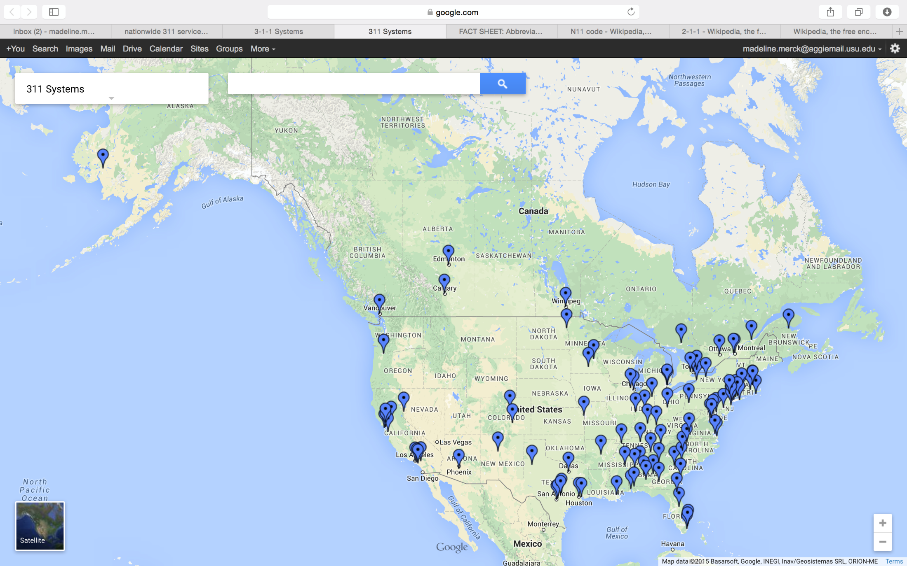
Nationwide Use of 311 in 2010 (?)

Slide 24

Provo 311 Customer Service

Slide 25
Thank You!
Questions?

