Slide 1
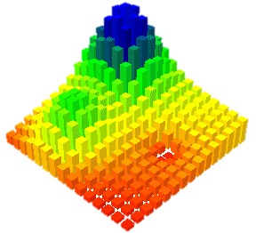
Using topography to estimate flood risk
Brendan Murphy
CE 397 Flood Forecasting
May 4, 2015

Slide 2
High-Resolution FEMA Flood Maps
Challenges:
Requires high-resolution topography
Requires detailed mapping & hydrologic records
High costs
Reality:
Global topography datasets limited to 10 - 90 m resolution
Costs are prohibitive
Not feasible for majority of areas

Slide 3
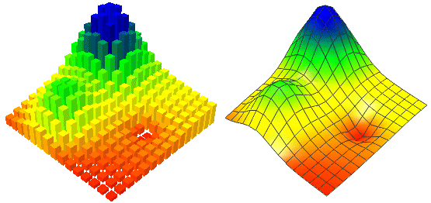
Can topography alone be used to estimate areas of flood risk?

Slide 4
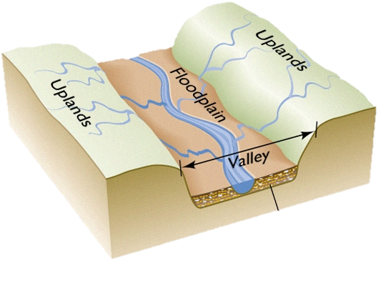
Which topographic metrics matter?
Low A
High S
High A
Low S
$$Area in Floodplain∝\frac{1}{S}$$
$$∝A$$

Slide 5
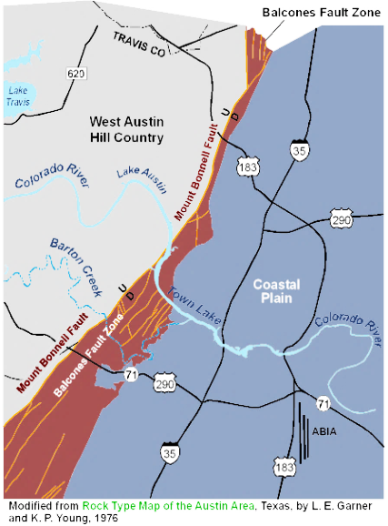
Travis County Topography
Balcones Fault
Last active ~ 15 mya
USGS NED 10 m

Slide 6
Travis County Flood Map
FEMA Flood Map

Slide 7
Methods: Data

Slide 8
Methods: Data
Lake
Travis

Slide 9
Methods: Data
Area of waterbodies removed from all relevant datasets

Slide 10
Methods: Data
Balcones Fault
Converted floodplain map to binary value raster at DEM resolution:
0 = not in floodplain
1 = in floodplain

Slide 11
Methods: Data
Binary raster averaged
over 1 km grid
Average is equivalent
to fractional area of floodplain for each 1 km² cell

Slide 12
Methods: Data
Slopes calculated from 10 m DEM
then averaged
over 1 km grid

Slide 13
Methods: Data
Flow Accumulation from 10 m DEM multiplied by cell area
Maximum value found for 1 km grid

Slide 14
Drainage Area
Slope
FEMA
Floodplain Area

Slide 15
Methods: Regressions
$$Floodplain Area∝\frac{1}{S^{0.95}}$$
$$Floodplain Area∝A^{0.3}$$
Total of 2395 points

Slide 16
Methods: Regressions
$$Predicted=K\frac{A^{0.3}}{S^{0.95}}$$
Concern over Error
Low: areas < 20%
Medium: Overestimates
High: Underestimates
*Forcing: Predicted Area > 1 is = 1

Slide 17
Predicted Floodplain Area

Slide 18
Model Comparison
FEMA
Predicted
Highland Lakes
Lady Bird Lake
Barton Creek
Onion Creek
* Biggest problem: underestimation of drainage area

Slide 19
Model Error
58% of area
within ± 10%
Under
Over

Slide 20
Considerations
Expand DEM to include complete drainage areas
Improve fitting of drainage area and slope relations
Power law relationships with fractional area probably not best
Calibrate against other FEMA mapped counties
Overall, topography can reasonably predict
flood risk at a low-resolution scale

Slide 21
Questions?

