Slide 1
Standards and Practices for Global Water Resources Data Exchange
David K. Arctur, PhD
david.arctur@utexas.edu
University of Texas at Austin
Open Geospatial Consortium (OGC)
CE 397 – Flood Forecasting
University of Texas at Austin
February 2015

Slide 2
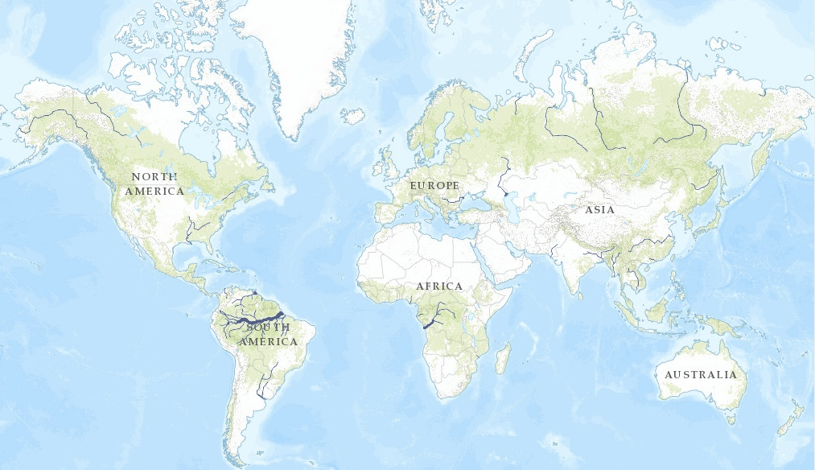
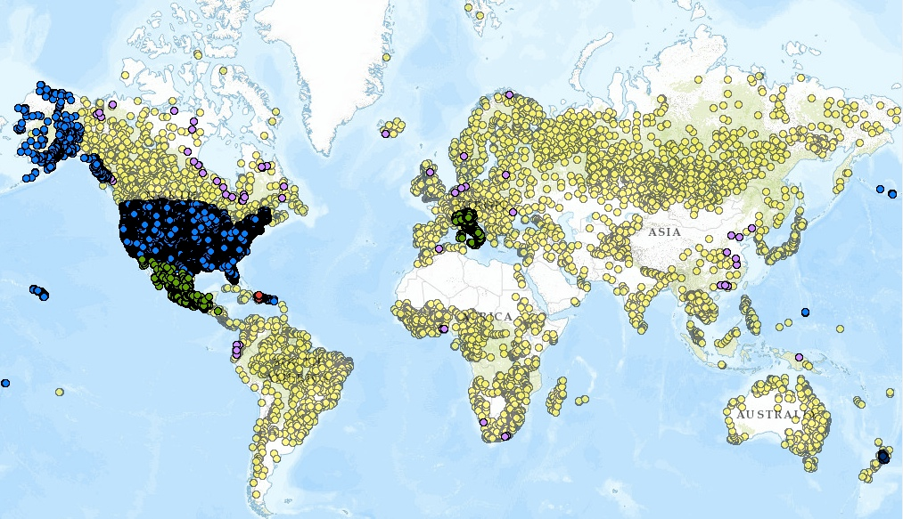
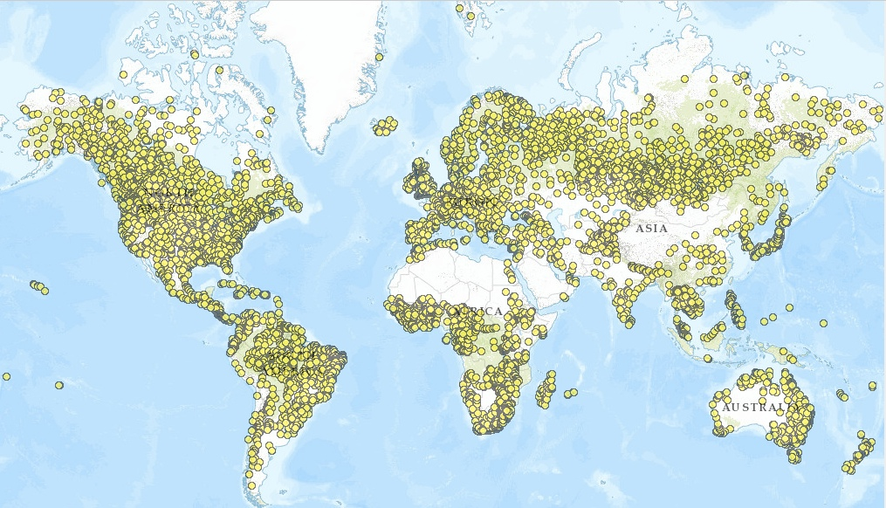
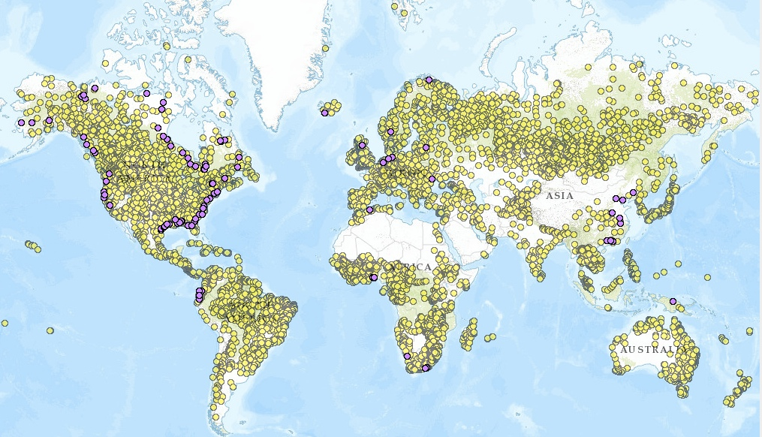
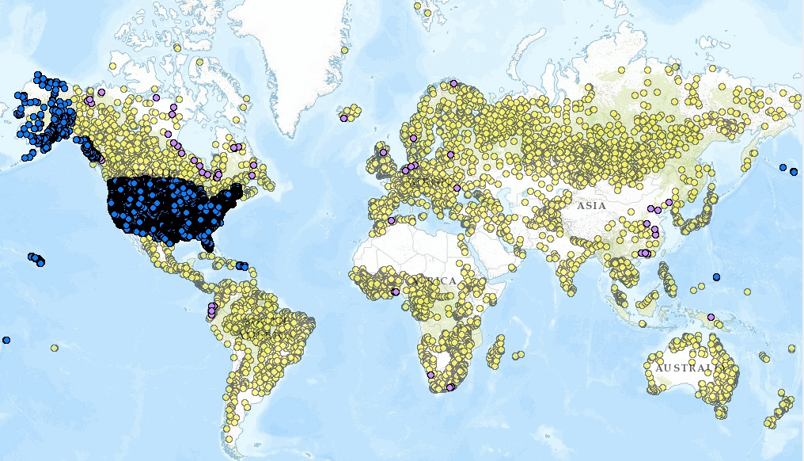
Example: Global map of stream gauges for getting data and hydrograph at one gauge
http://geoss.maps.arcgis.com/home/webmap/viewer.html?webmap=5efcdfb27d744e3ea65eaf58c06f9d0c
Esri ArcGIS Online web map viewer
Click to add layers
WMO GRDC (gauge descriptions only, no water data)
Kisters GRDC (WaterML 2 data for OGC Surface Water IE)
USGS NWIS (most have real-time data)
Mexico (some with historical data, hosted by Univ of Texas)
Dominican Republic (historical data hosted by BYU)
Italy & New Zealand (real-time data, developed for AIP-6)
http://bit.ly/1ERSyva
Notes:
Full link: http://geoss.maps.arcgis.com/home/webmap/viewer.html?webmap=5efcdfb27d744e3ea65eaf58c06f9d0c
Short link: http://bit.ly/1ERSyva
Here is a map of the world’s major rivers, and <click>
locations of about 20,000 stream gauges registered in WMO’s Global Runoff Data Center in Germany. While the yellow dots represent locations where data has been collected, that data is not available in a standardized format, nor is it necessarily available without restriction. <click>
The purple dots are mainly coastal sites where Kisters has developed a WaterML2 web service from the GRDC data. This was done for the OGC Surface Water Interoperability Experiment in 2011. <click>
The US <click> and Mexico maintain another 20,000 stream gauges, nearly all of which provide ongoing data services. <click>
The red dots are for Dominican Republic, which started publishing its water data in 2012. <click>
As a result of this project, we can now add regional agencies’ gauges and data in Italy and New Zealand. <click> (shows legends) <click> (next slide)

Slide 3
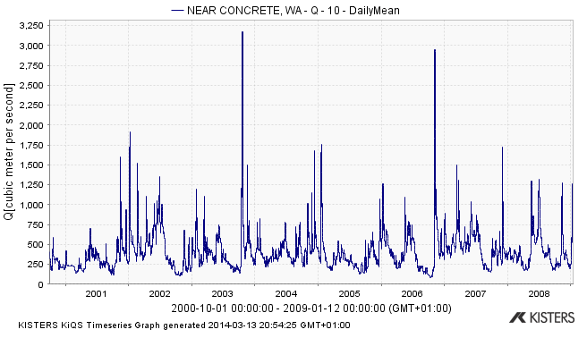
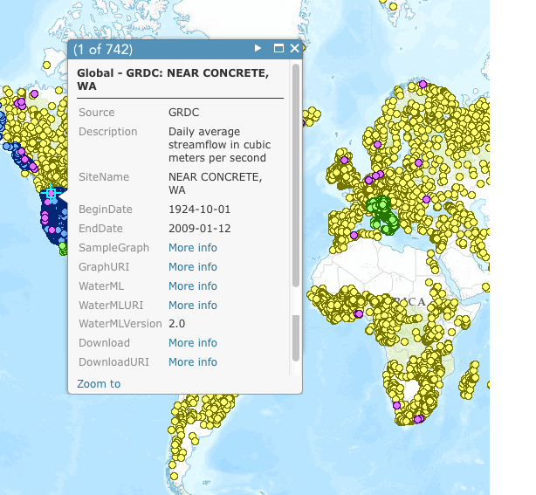
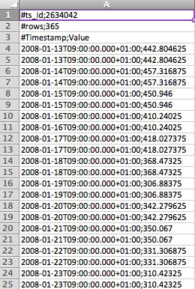
Gauge description and data links…
For quick overview
For easy analysis
WaterML for full details
Notes:
The interaction shown so far enables display of basic time series description information by clicking on a stream gauge site. <click>
This may include links to data and graphing services. The exact choice of time series description fields depends on the data provider. <click>

Slide 4
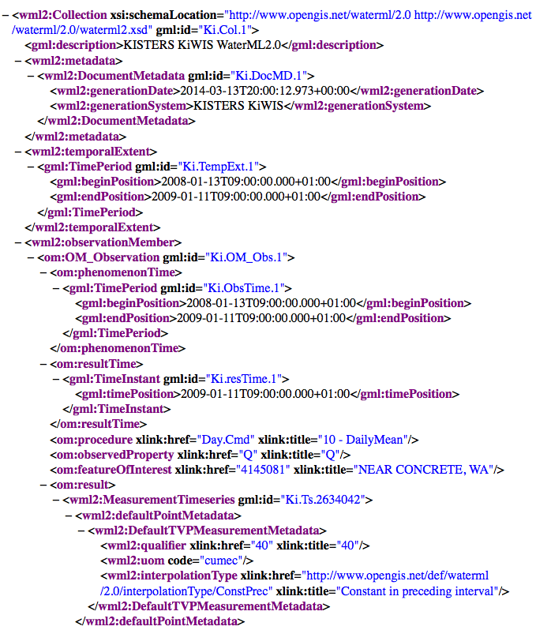
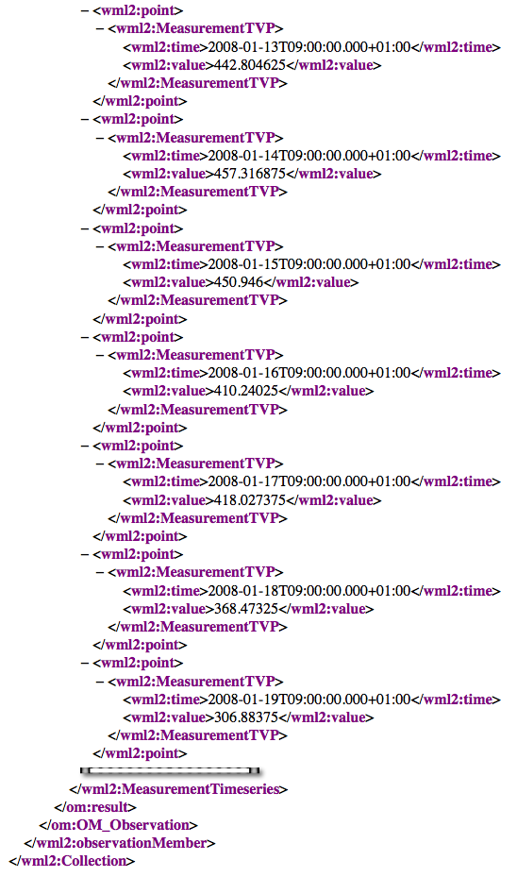

Slide 5
WaterML 2.0
Document metadata
Observation description
Feature of interest
Observed property
Procedure
Phenomena time
Result time
Result
Time series metadata
Time series data
Time series data, cont’d

Slide 6
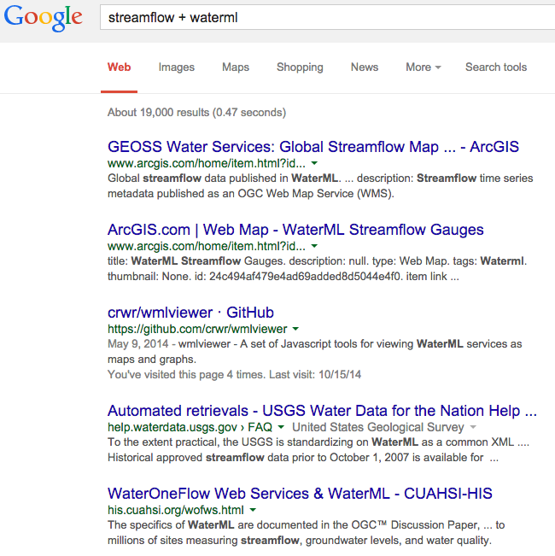
And how would you search for this web map?
This is okay if you’re looking for…
Slides
Websites
Source code
Other docs….
What about data?

Slide 7
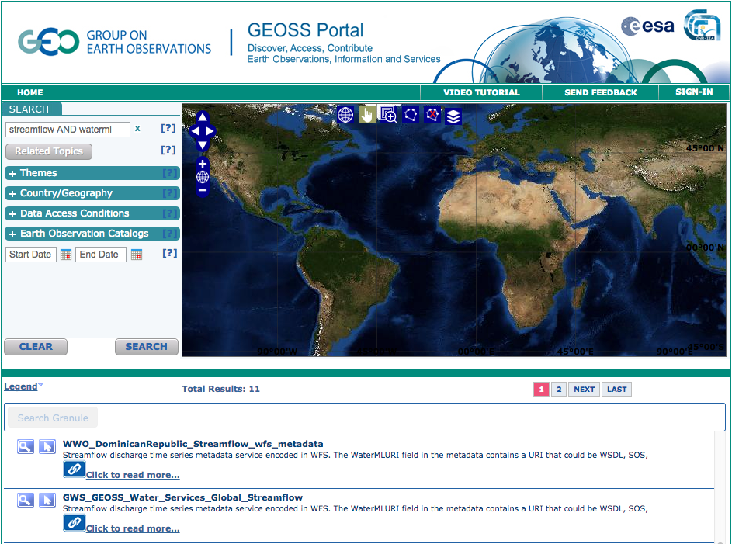
For data…. http://www.geoportal.org

Slide 8
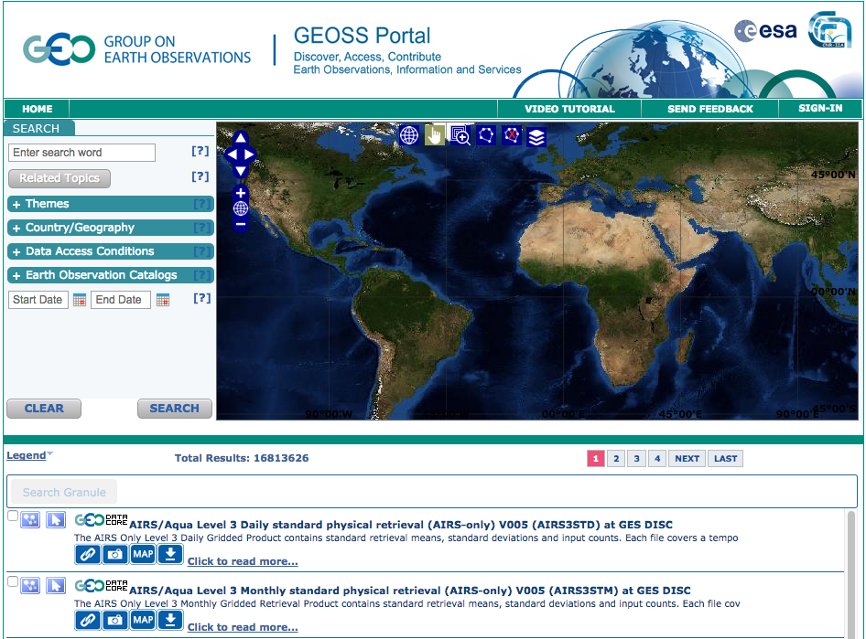
Clear search (no filters)

Slide 9
What are GEO and GEOSS?
GEOSS: Global Earth Observation System of Systems
Hosted by GEO (Group on Earth Observations) to catalog Earth observation datasets from 92 member countries
GEO home page: http://www.earthobservations.org/
GEOSS search portal: http://www.geoportal.org/
Enables distributed search among dozens of catalogs, accessing millions of data services
Data is organized around 9 Societal Benefit Areas (SBAs): Water, Weather, Climate, Biodiversity, Ecosystems, Energy, Agriculture, Health, Disasters
GEOSS AIP (Architecture Implementation Pilot)
Series of 1-year project cycles to implement GEOSS, started in 2007; AIP-7 completed November 2014; AIP-8 starts March 2015
Notes:
This slide is normally hidden for use with GEOSS-aware audiences; but is kept in the slide set for use among audiences less familiar with GEOSS and AIP-6.

Slide 10
GEOSS Water Services: Key Concepts
International, voluntary project for building & spreading community conventions, to enable:
Organizing regional & national water data around a common information model and service architecture
Cuts costs of development, training, maintenance
Integration of gridded & time series data sources
Education, mentoring, and internationalization support
In last 3 years we have engaged participation in over 12 countries
National agencies – data producers
Vendors – commercial products
Academia – research centers
Notes:
The goal of this project for AIP-6 was to make water data sharing easier, by improving discovery and access to the data; integrating gridded and time series data sources; and federating regional data within each country to develop a unified national picture. To accomplish these objectives, we formed a team comprising national agencies, academia, and commercial software companies.

Slide 11
Now using WaterML and related web services:
CSIRO & Bureau of Meteorology Australia http://www.bom.gov.au/water
CUAHSI Water Data Center, USA
Environment Canada: Rainfall Monitoring Network
Flemish Water Portal (Belgium) http://www.waterinfo.be
French Geological Survey (BRGM) Groundwater Level Monitoring Network
Italian National Water Agency (ISPRA)
New Zealand National Water Agency (NIWA) http://www.lawa.org.nz
Taiwan Monitoring Network (Feng Chia Univ)
USGS National Water Info System (NWIS) http://waterdata.usgs.gov/nwis
Commercial & open source: Esri, Kisters, 52North
and many others…
Notes:
The goal of this project for AIP-6 was to make water data sharing easier, by improving discovery and access to the data; integrating gridded and time series data sources; and federating regional data within each country to develop a unified national picture. To accomplish these objectives, we formed a team comprising national agencies, academia, and commercial software companies.

Slide 12
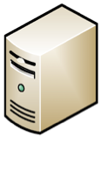
Behind the map, the graph and WaterML…
6
Return time series data or graph (WaterML, CSV)
(SOS)
Data service
for time series
at one gauge
Community
Web Portal
Discovery, Access
and Visualization
5
Request data service for time series of selected gauge
1
Request data about [observed property]
4
Return gauge locations as a map layer (GML SF)
2
Return list of Data Providers’ map layers
3
Request map from each
Data Provider about
[observed property]
(WFS)
Map of gauges (one layer
per observed property) for
one Data Provider
(CSW)
Catalog of
Data Providers’ gauge layers

Slide 13
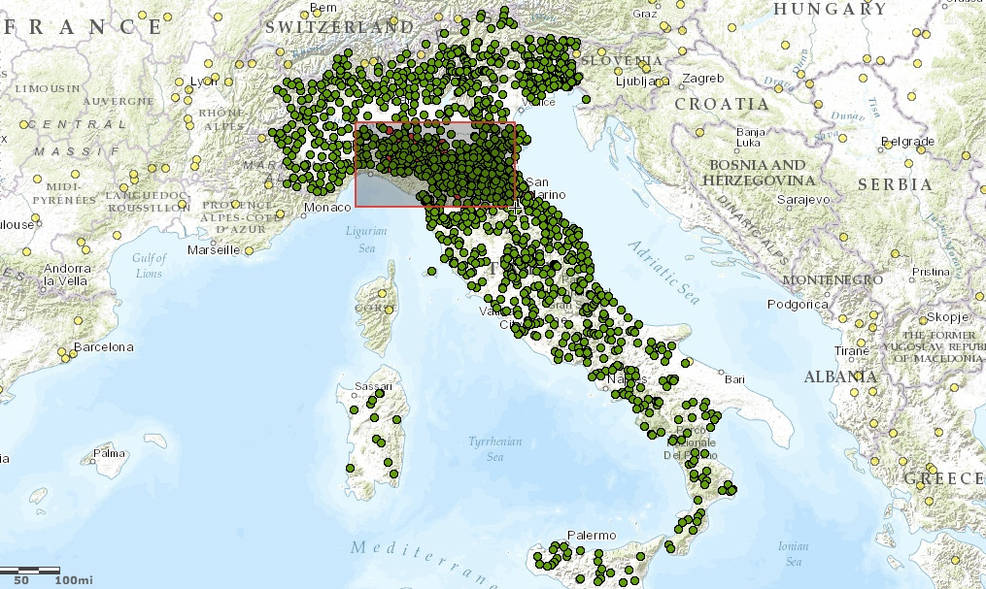
Water Data Maps: Italian Stream Gauges

Slide 14
Water Data Maps: Italian Stream Gauges

Slide 15
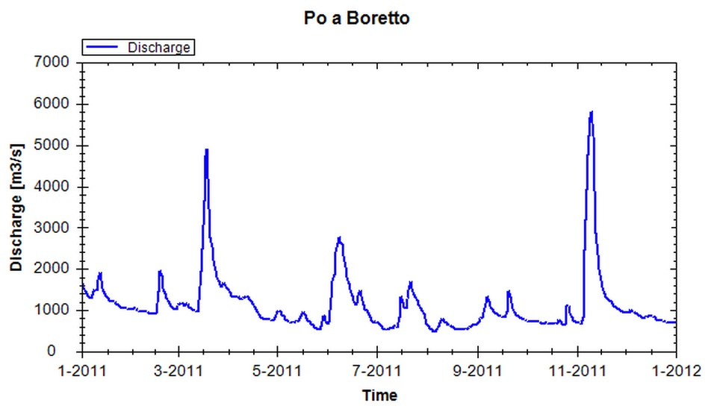
Water Data Maps: Time Series Data Access

Slide 16
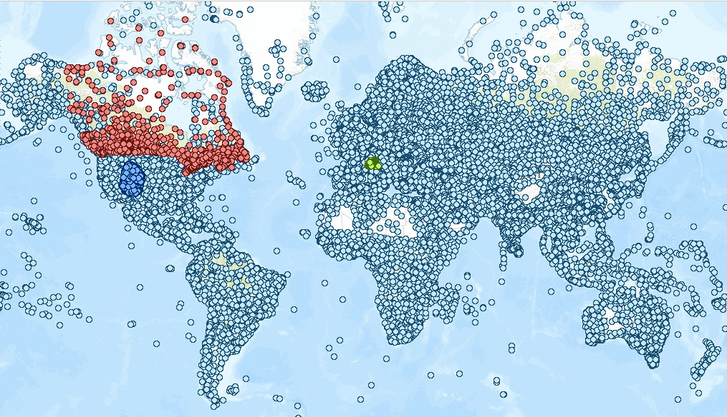
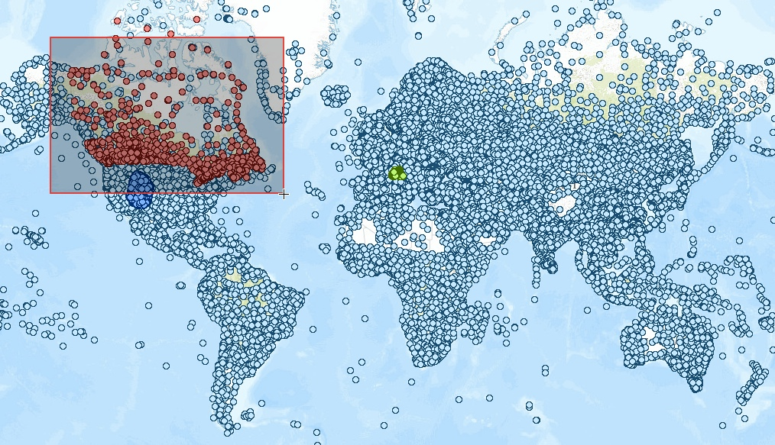
Water Data Maps: Global Precipitation Gauges
http://bit.ly/19fV1Tz
Notes:
Full link: http://www.arcgis.com/home/webmap/viewer.html?webmap=e8e4d6fd730e494c9f7db87fb010772e&extent=-179.3255,-62.1379,171.5339,77.2965
Short link: http://bit.ly/19fV1Tz

Slide 17
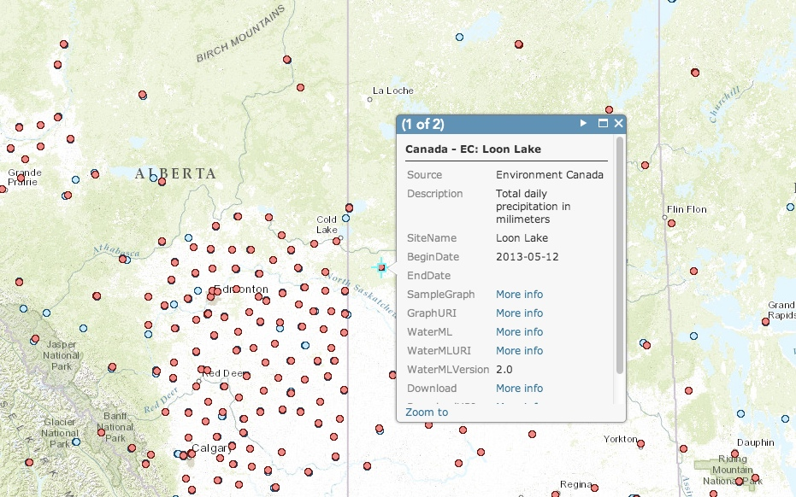
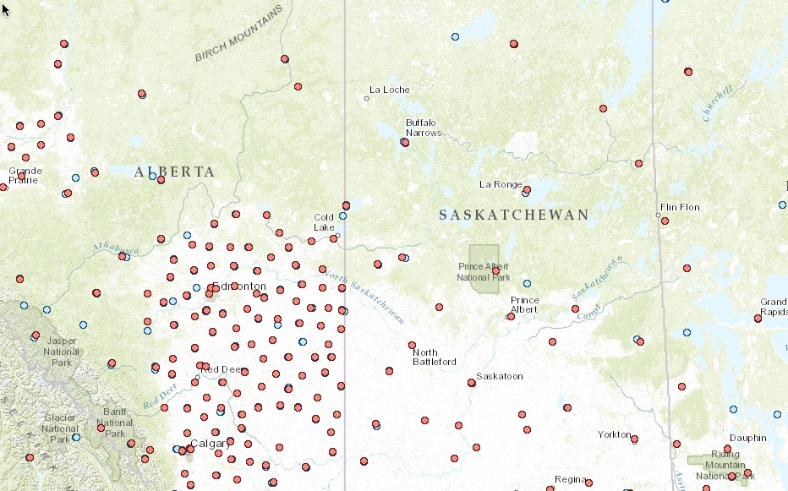
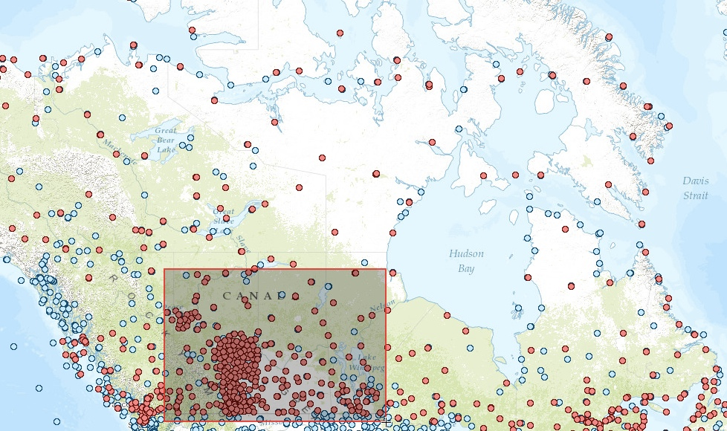
Water Data Maps: Canada Precipitation Gauges

Slide 18
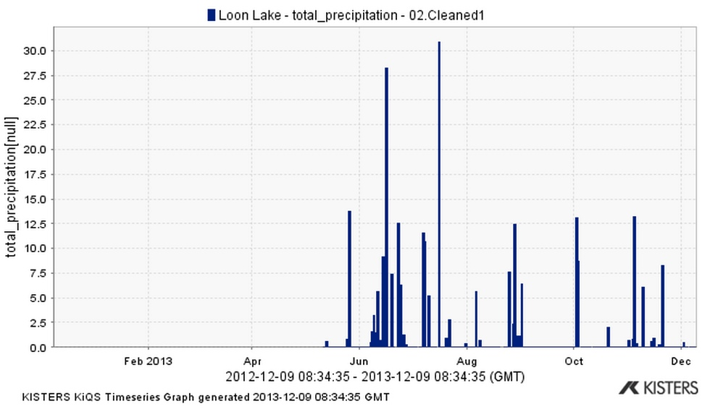
Water Data Maps: Canada Precipitation Data

Slide 19
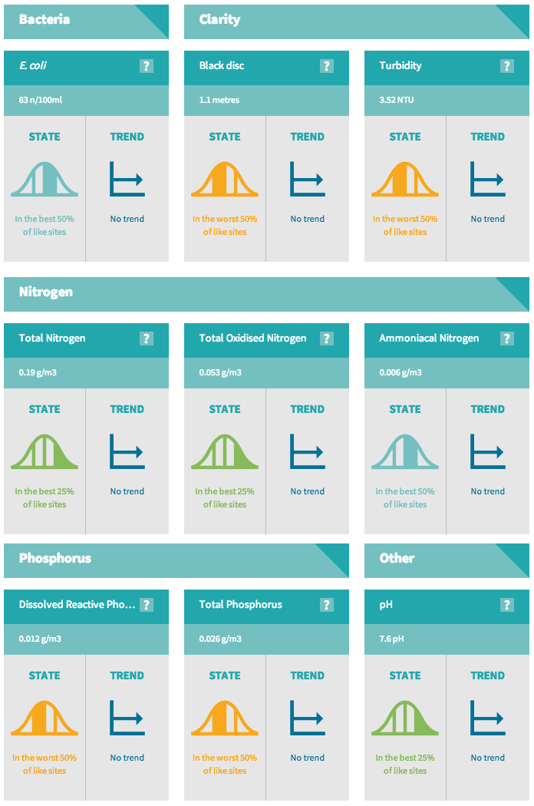
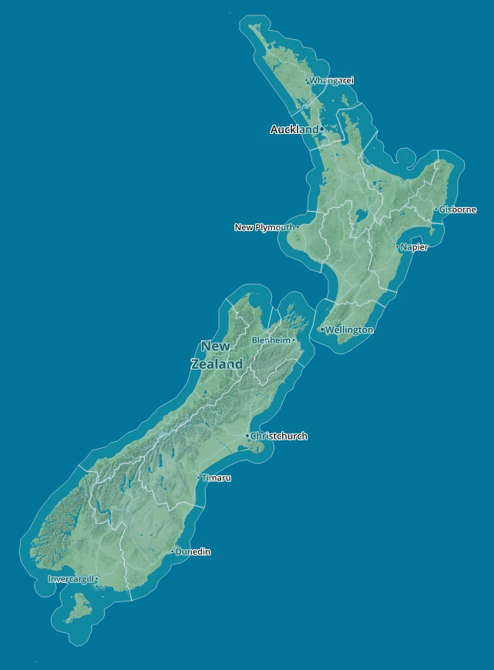
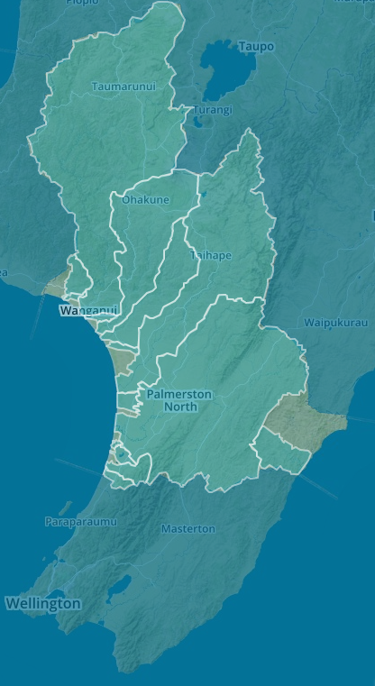
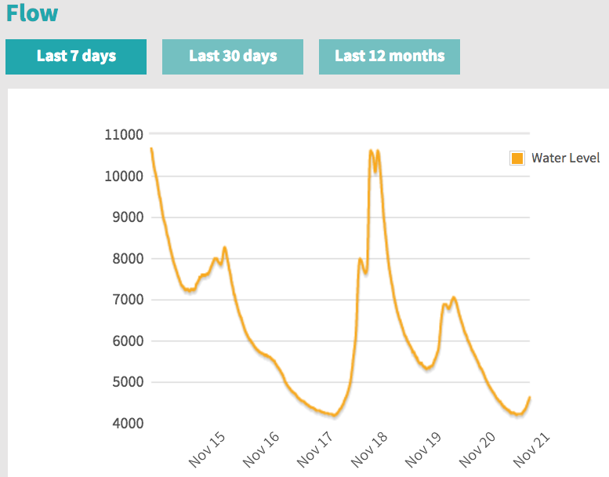
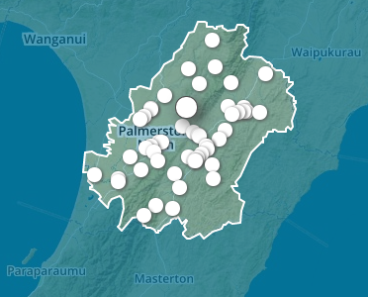
Water Data Maps: New Zealand Water Quality
http://www.lawa.org.nz/

Slide 20
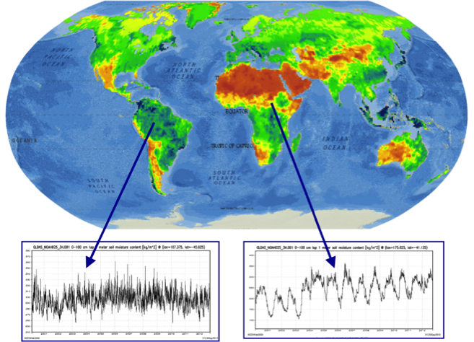
Integrated gridded & time series data sources
Many data sources and model-output are created as continuous grids of a variable over the earth at a point in time
NASA is integrating soil moisture grids to generate time series at discrete locations (data rods)
This grid is from NASA’s Global Land Data Assimilation System (GLDAS)

Slide 21
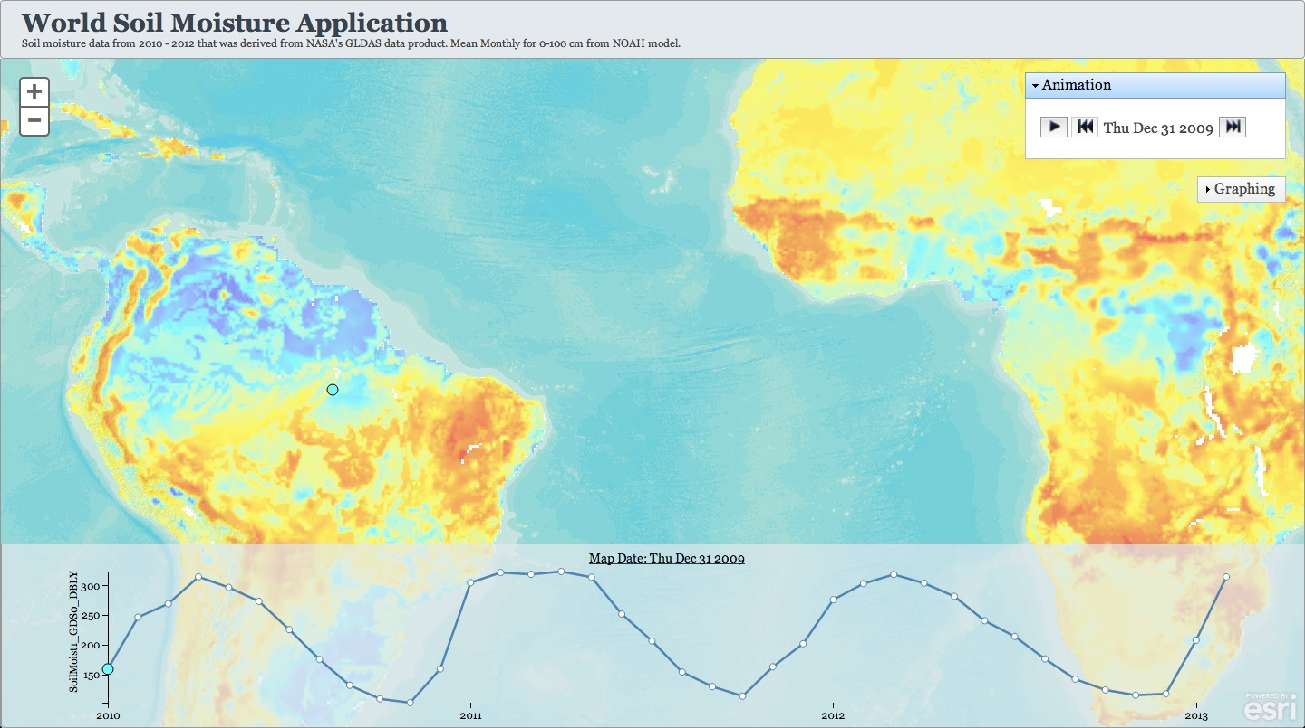
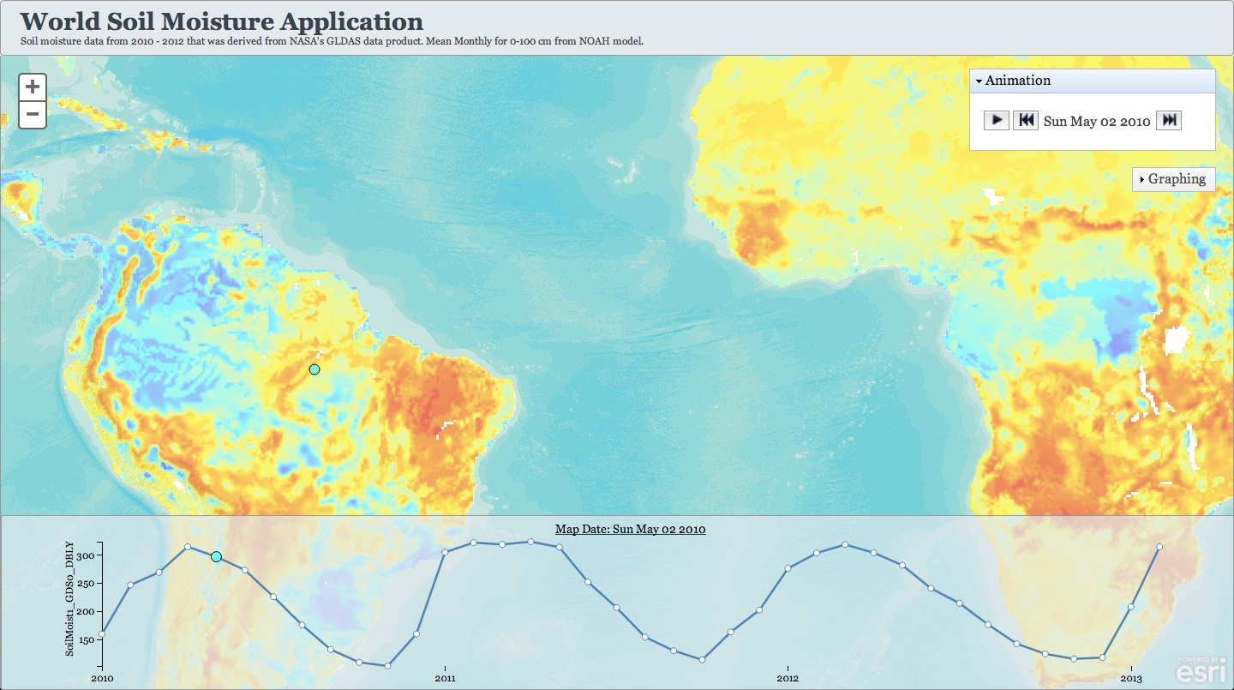
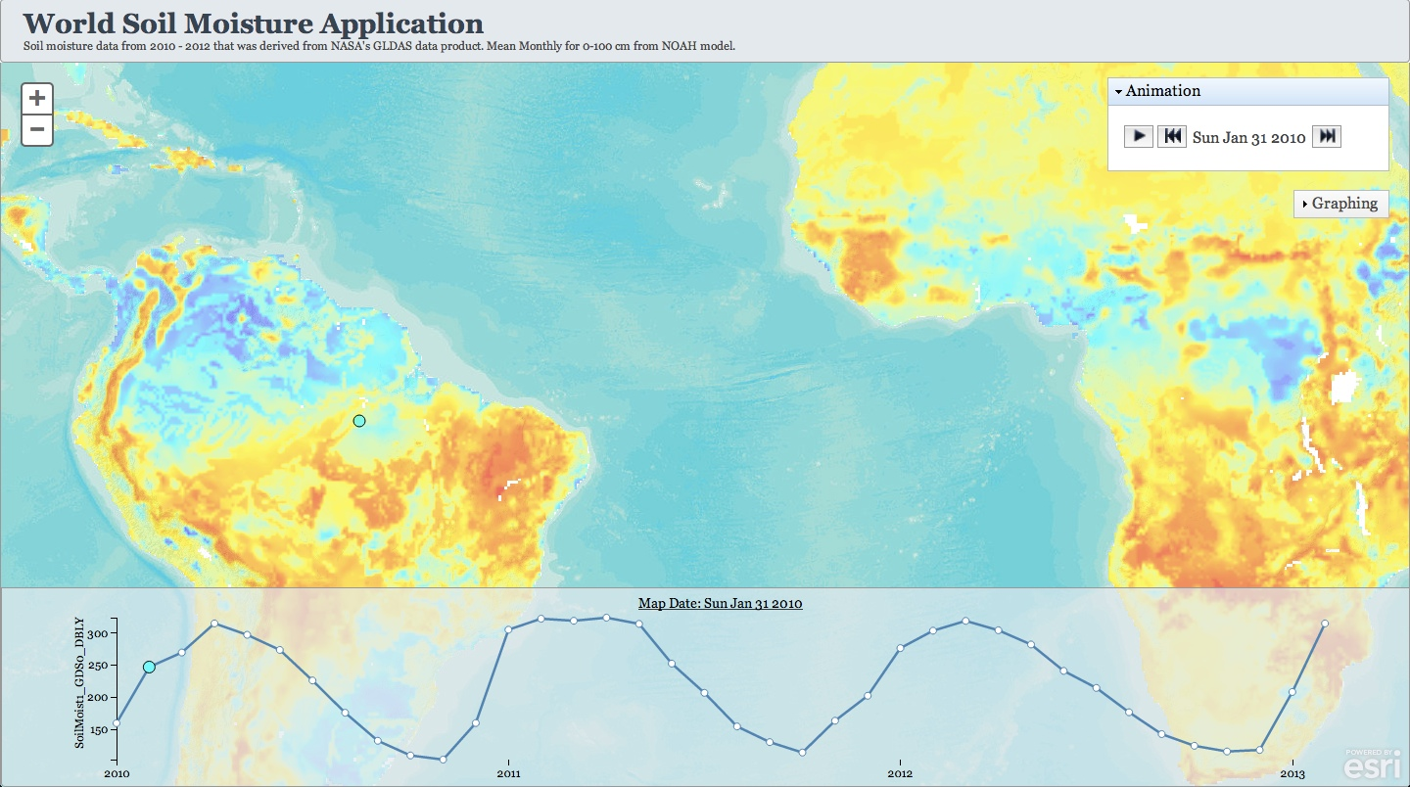
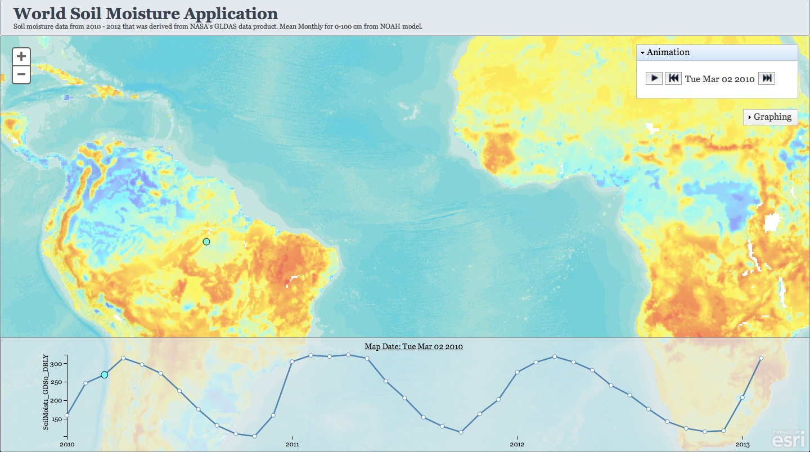
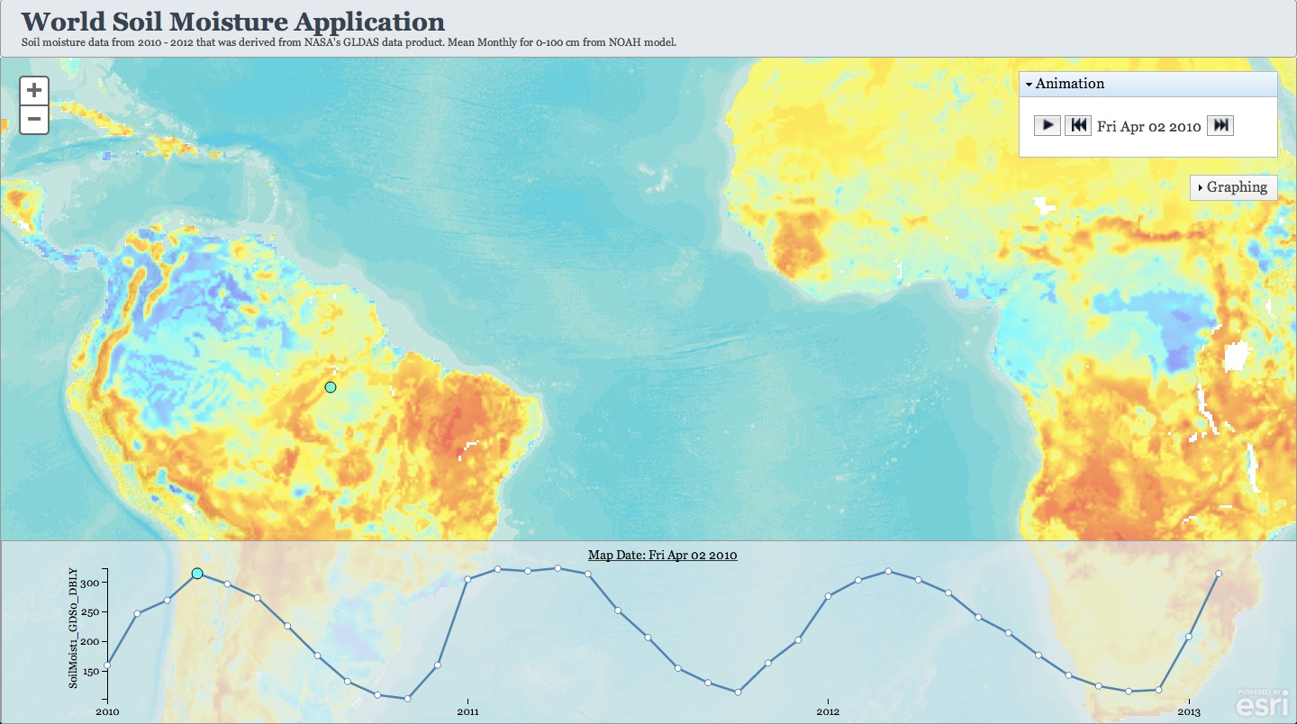
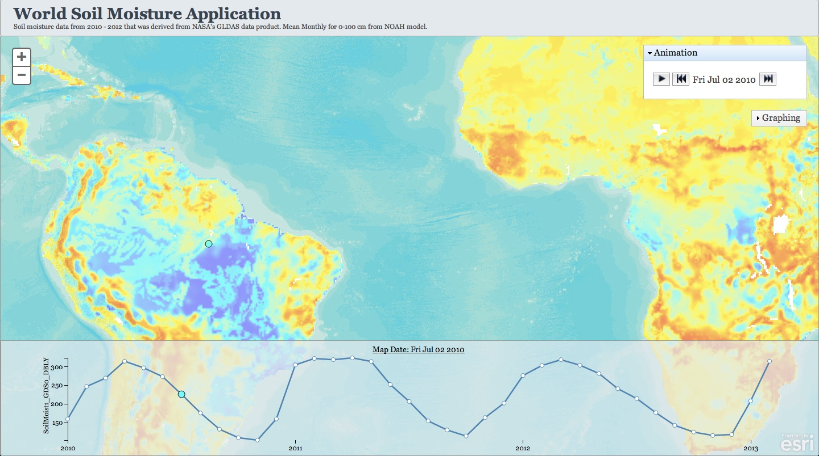
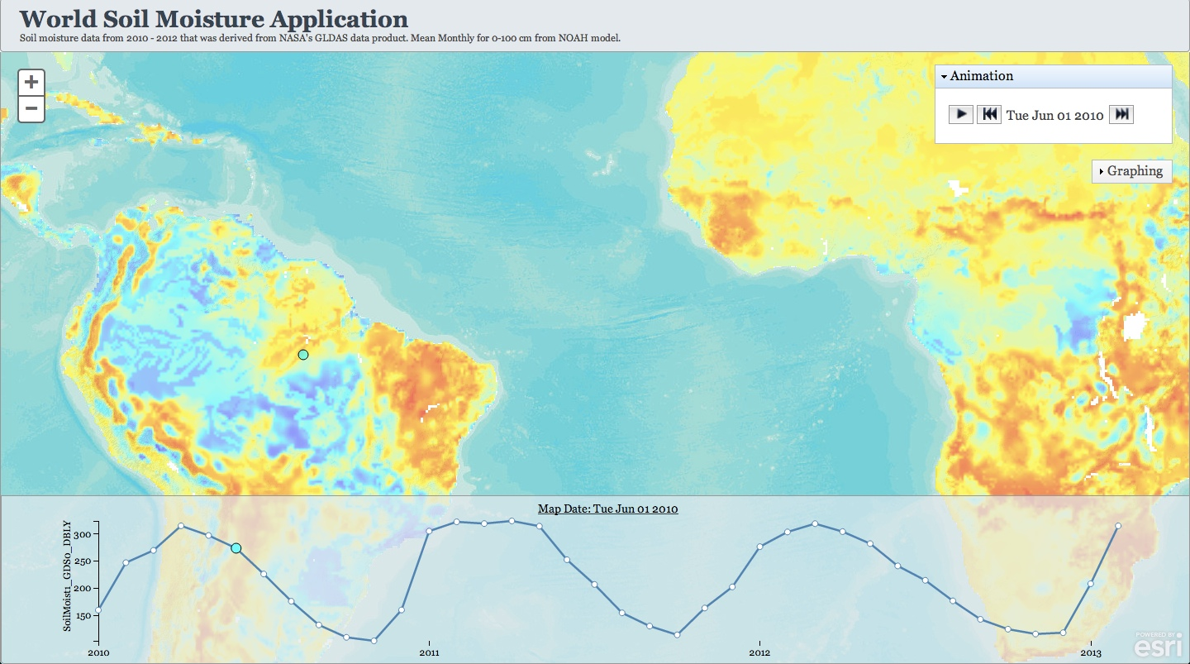
NASA Land Data Assimilation System: Grid and time series globally
http://bit.ly/J2I43m
Notes:
Full link: http://ec2-54-225-249-9.compute-1.amazonaws.com/MultidimensionalTemplate/index.html?appid=d73011dceb0e41d0af334912355bddd5
Short link: http://bit.ly/J2I43m

Slide 22
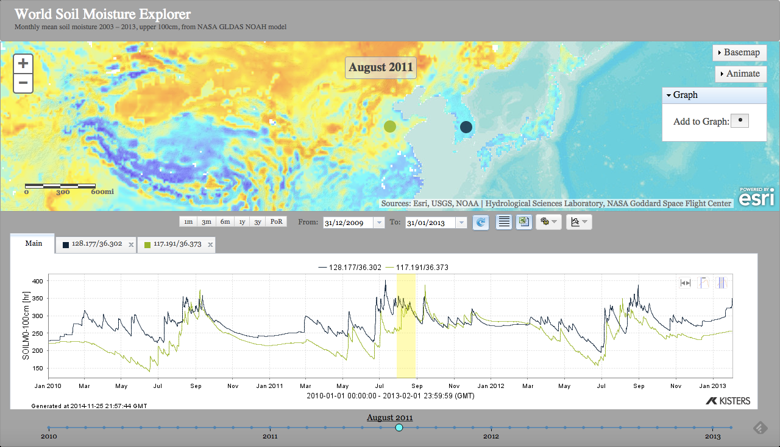
Comparing time series
http://bit.ly/1HFcGlO
Notes:
This web app displays a global soil moisture map (gridded data) with overlaid time series below for 2 selected locations. The user can change the global map by selecting a different date on the time line at bottom. Another option for the time series display is to overlay multiple years at a single location, for year-to-year comparisons.
Full link: http://ec2-54-225-249-9.compute-1.amazonaws.com/kisters/index.html?appid=eaaa17b657584efca519a7243d52624d
Short link: http://bit.ly/1HFcGlO
These relationships for water and atmospheric variables are analogous to physical properties in other domains, such as:
solid earth (seismic activity, soil chemistry over deep time, etc),
oceans (SST, acidification, etc),
cryosphere (ice thickness, trapped gas content, etc)

Slide 23
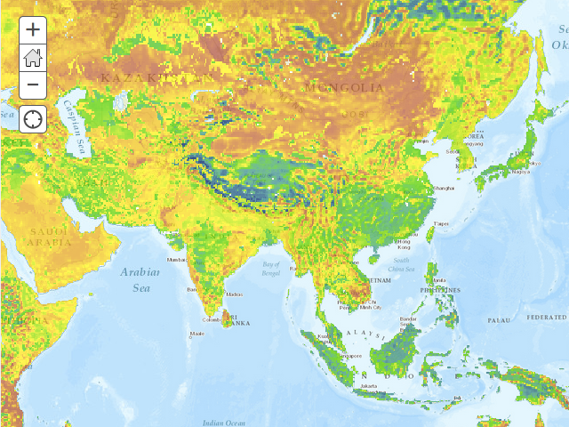
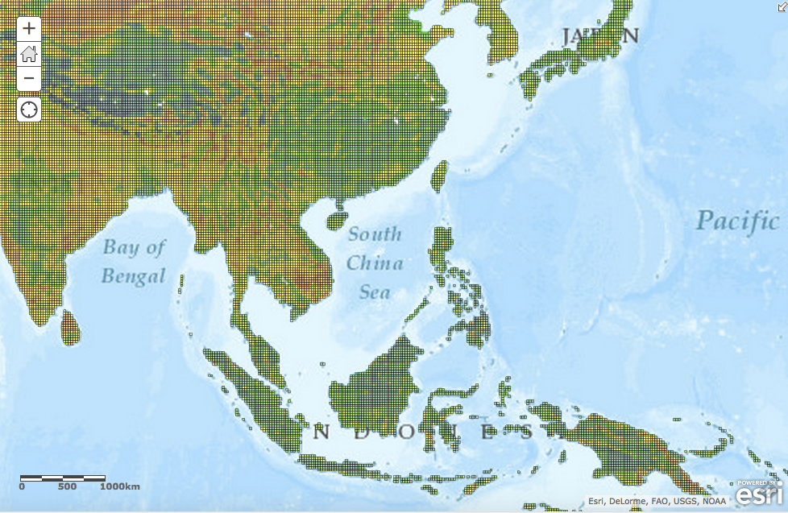
NASA GLDAS Prototype Viewer
http://bit.ly/1tkgyPi
NASA GLDAS application shows a “representative” (not current) soil moisture map
Zoom into the map to see 25km x 25km grid cell coverage
Continued next slide…
Notes:
This is a prototype map developed at the University of Texas at Austin, in cooperation with NASA Goddard Environmental Services DISC.
Full link: http://www.arcgis.com/home/webmap/viewer.html?webmap=43a5de9f17a3441bb1cc72779cf810df
Short link: http://bit.ly/1tkgyPi
Zoom into a region by holding <shift> while dragging mouse

Slide 24
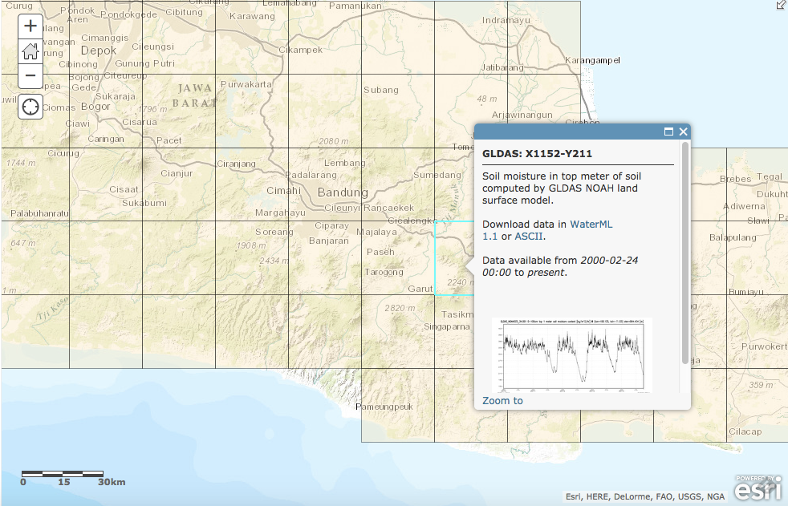
NASA GLDAS Prototype Viewer
As you zoom in far enough, the soil moisture color map becomes a topographical map, with outlines for the GLDAS soil moisture coverage. This map is centered at Bandung, capitol of Indonesia.
When you click in a square, the popup dialog allows to access the time series from 2000-present in WaterML or simple tabular formats. Click on graph for a bigger graph.

Slide 25
Summary & References
ISO, OGC & WMO develop international standards for hydrologic data exchange over the web
ISO 19156 - Observations & Measurements (O&M) Standard is the core information model (http://www.opengis.net/doc/IS/OMXML/2.0)
OGC WaterML 2.0 is a profile of O&M for:
Part 1: Time series (http://www.opengis.net/doc/IS/waterml/2.0)
Part 2: Ratings, gaugings and cross-sections (for determining flow volume as function of stream depth and streambed conditions)
OGC Sensor Observation Service (SOS) 2.0 is the standard for serving WaterML 2 over the web (http://www.opengis.net/doc/IS/SOS/2.0)
See OGC Best Practice: Sensor Observation Service 2.0 Hydrology Profile, (http://www.opengis.net/doc/BP/sos-hydrology/1.0)
OGC Web Map Service (WMS) and Web Feature Service (WFS) for mapping water monitors (http://www.opengeospatial.org/standards)
Can be used for linking to multiple data services for each monitoring station

Slide 26
Questions!
David K. Arctur
david.arctur@utexas.edu
University of Texas at Austin
Open Geospatial Consortium (OGC)

Slide 27
More References
Portele, Clemens (2012). OGC Implementation Specification: Geography Markup Language (GML) 3.2.1 (OGC 07-036), Open Geospatial Consortium, URL http://www.opengeospatial.org/standards/gml
Portele, Clemens (2012). OGC Implementation Specification: Geography Markup Language (GML) 3.3.0 - Extended Schemas and Encoding Rules (OGC 10-129r1), Open Geospatial Consortium, URL http://www.opengis.net/spec/GML/3.3
ISO TC 211 (2011). ISO 19156:2011 - Geographic information -- Observations and measurements - International Standard. Geneva, Switzerland, International Organization for Standardization.
Cox, Simon (2011). OGC Implementation Specification: Observations and Measurements (O&M) - XML Implementation 2.0 (10-025r1), Open Geospatial Consortium, URL http://www.opengis.net/doc/IS/OMXML/2.0
Botts, Mike and Alexandre Robin (2014). OGC Implementation Specification: Sensor Model Language (SensorML) 2.0.0 (OGC 12-000), Open Geospatial Consortium, URL http://www.opengis.net/doc/IS/SensorML/2.0

Slide 28
More References
Bröring, Arne, Christoph Stasch and Johannes Echterhoff (2012). OGC Implementation Specification: Sensor Observation Service (SOS) 2.0 (12-006), Open Geospatial Consortium, URL http://www.opengis.net/doc/IS/SOS/2.0
Taylor, Peter (2012). OGC Implementation Specification: WaterML 2.0: Part 1 - Timeseries (OGC 10-126r4), Open Geospatial Consortium, URL http://www.opengis.net/doc/IS/waterml/2.0
Fitch, Peter (2011). OGC Interoperability Experiment Report: OGC Surfacewater Interoperability Experiment – Final Report (OGC 12-018r2). Open Geospatial Consortium, URL http://www.opengis.net/doc/ie/swie
Andres, Volker, Simon Jirka and Michael Utech (2014) OGC Sensor Observation Service 2.0 Hydrology Profile, (OGC 14-004r1), Open Geospatial Consortium, URL http://www.opengis.net/doc/BP/sos-hydrology/1.0
Bröring, Arne, Christoph Stasch and Johannes Echterhoff (2012) SOS 2.0 Tutorial, URL http://www.ogcnetwork.net/SOS_2_0/

