Slide 1
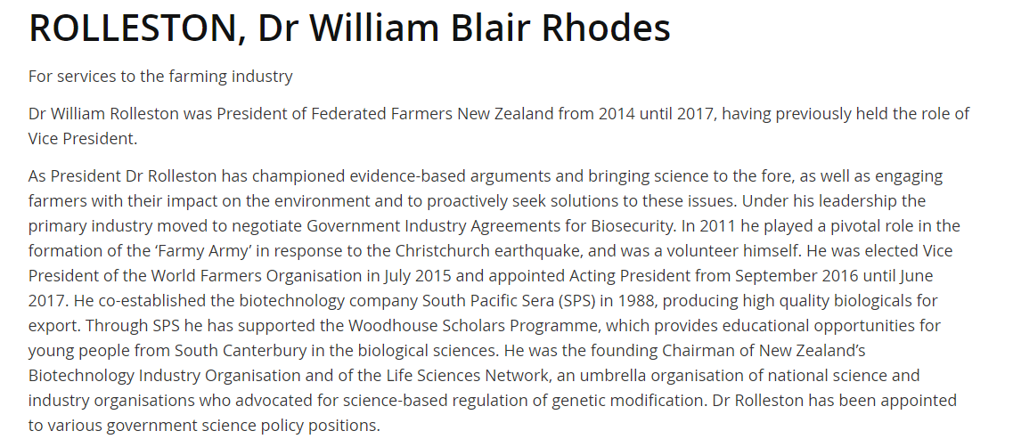

Slide 2
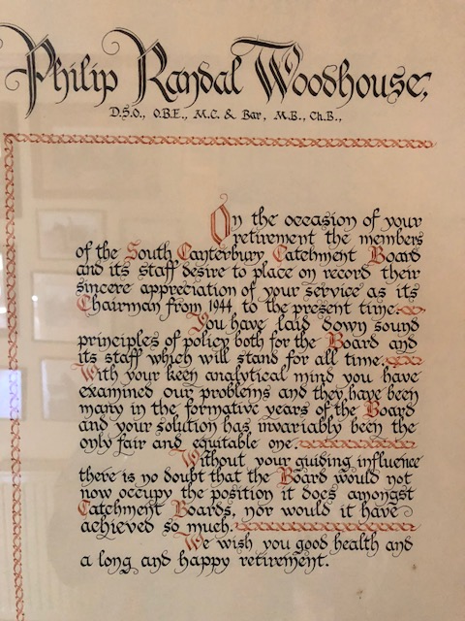
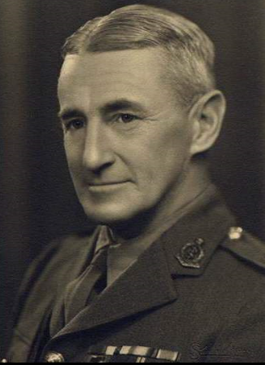

Slide 3
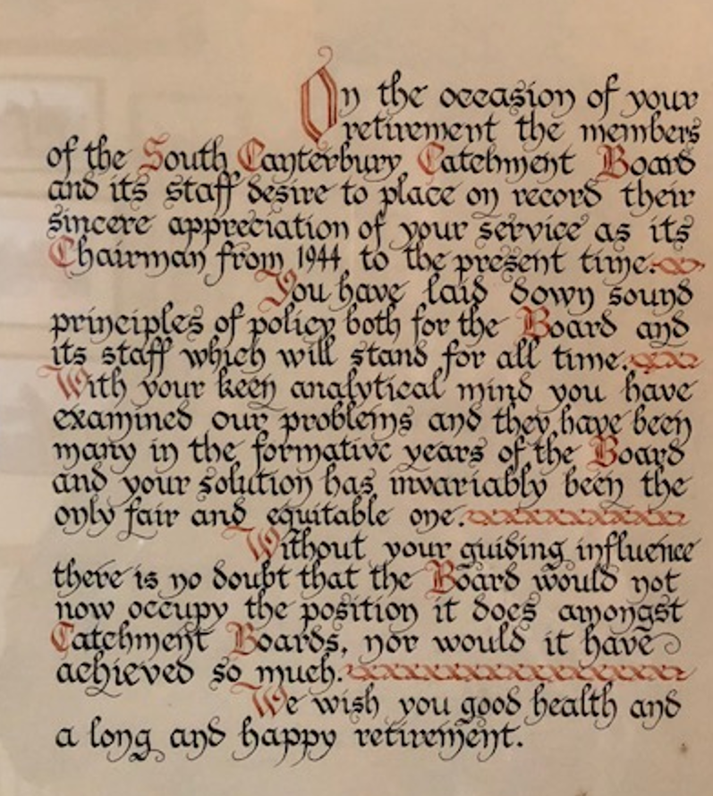
On the occasion of your retirement the members of the South Canterbury Catchment Board and its staff desire to place on record their sincere appreciation of your service as its Chairman from 1944 to the present time.
You have laid down sound principles of policy both for the Board and its staff which will stand for all time. With your keen analytical mind you have examined our problems and they have been many in the formative years of the Board and your solution has invariably been the only fair and equitable one.
Without your guiding influence there is no doubt that the Board would not now occupy the position it does amongst Catchment Boards, nor would it have achieved so much.
We wish you good health and a long and happy retirement.

Slide 4
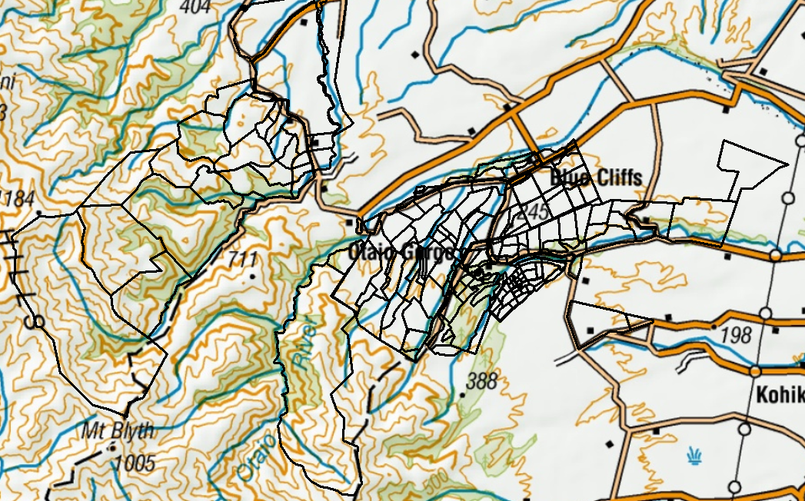
Blue Cliffs Station

Slide 5
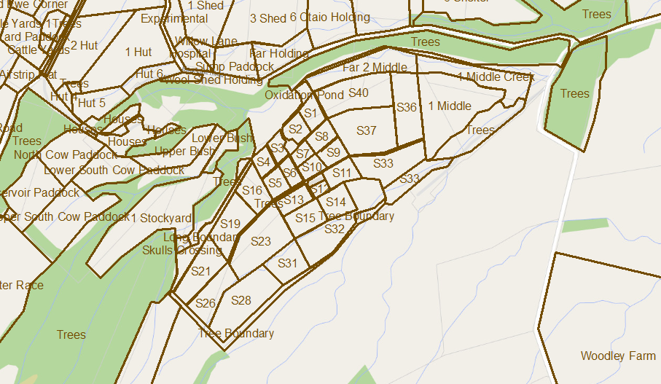
Paddocks at Blue Cliffs
225 paddocks x 22.8 ha per paddock (on average) = 5130 ha total

Slide 6
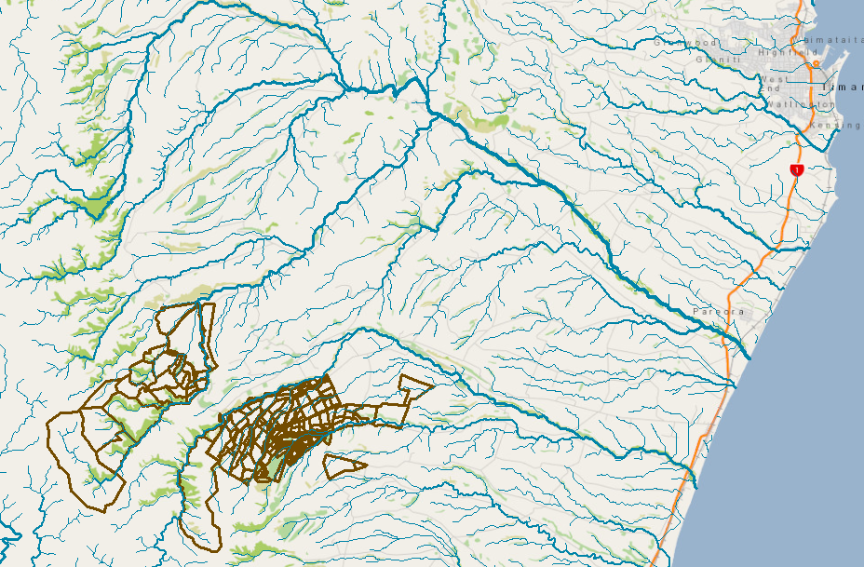
Blue Cliffs in Hydrological Context
Timaru
Pareora River
Otaio River

Slide 7
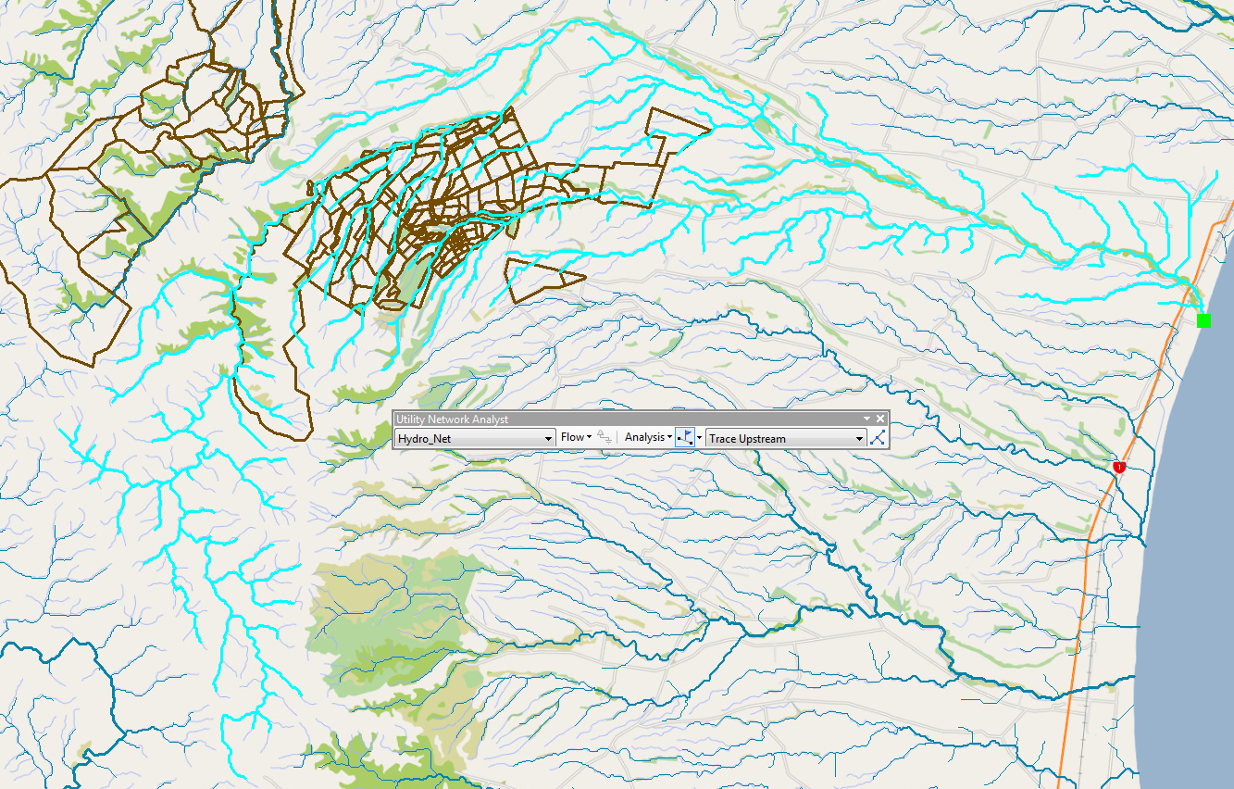
Upstream Trace on NZ Digital River Network for the Otaio River

Slide 8
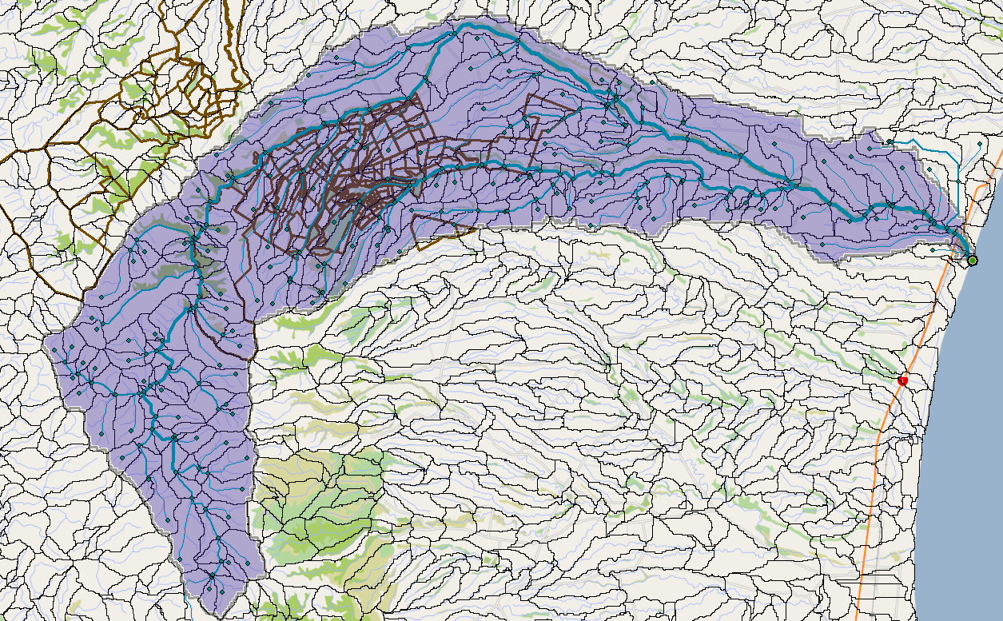
Watershed Delineation (using ESRI Hydro Services)

Slide 9
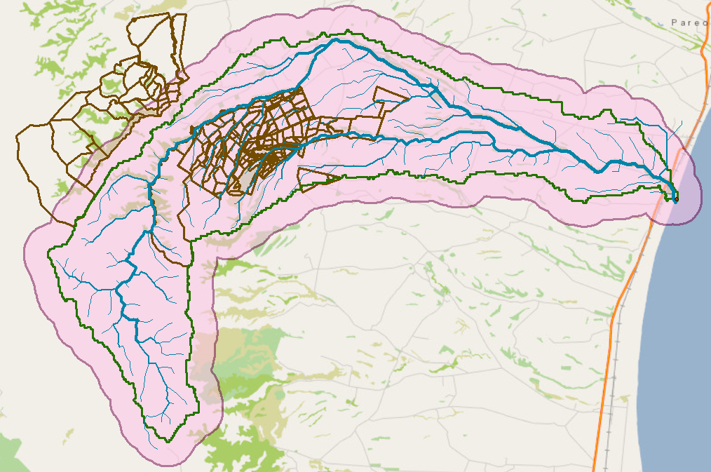
1 Km Buffer around Watershed

Slide 10
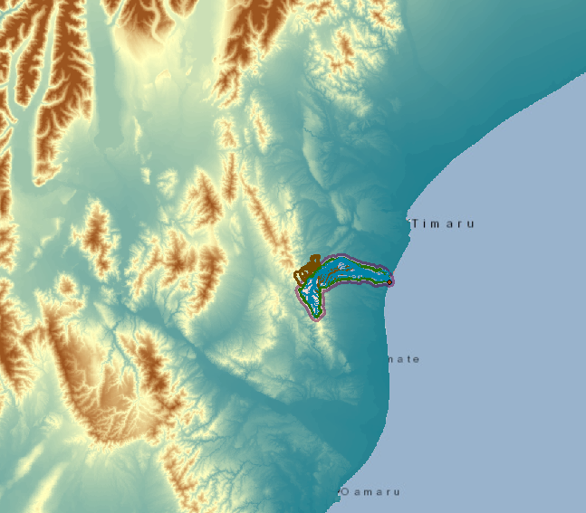
25m Digital Elevation Model

Slide 11
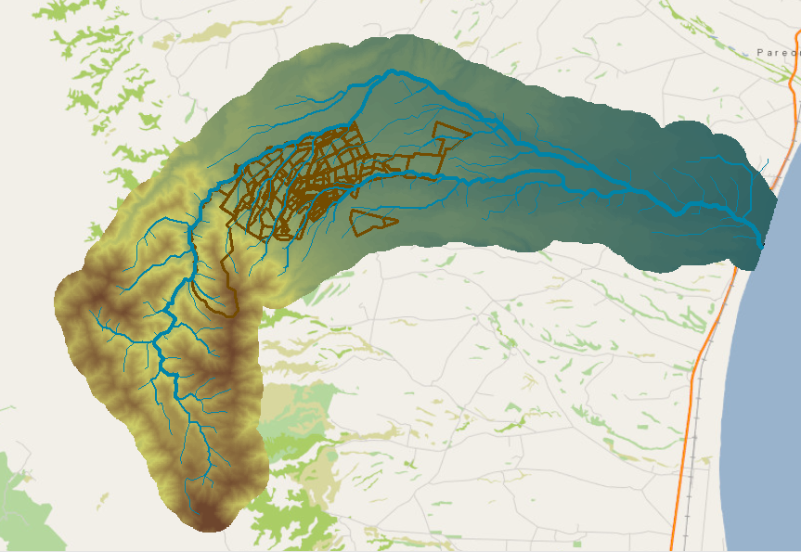
25m Digital Elevation Model of the Otaio Catchment

Slide 12
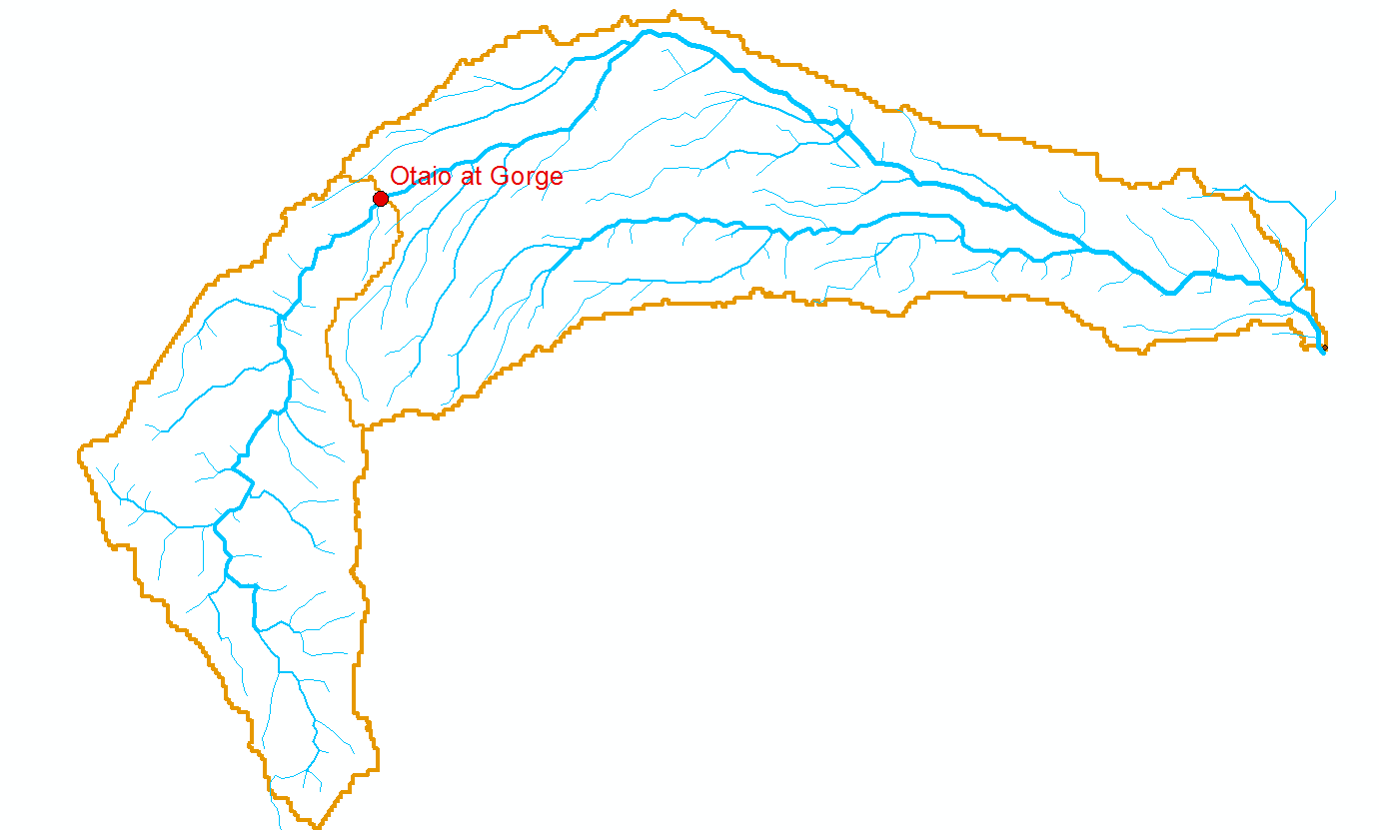
Two Drainage Areas
95 Km²
47 Km²
2/3 area below gorge
1/3 area above gorge

Slide 13
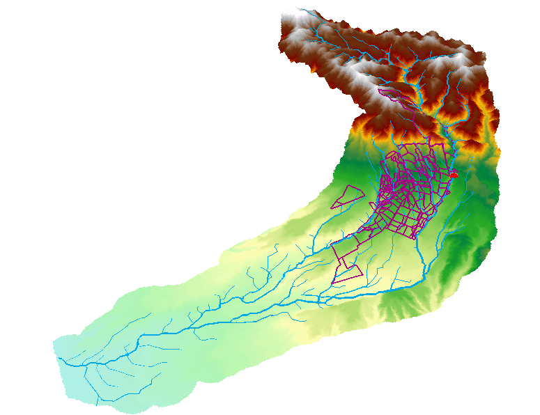
Otaio Catchment in ArcScene
1080 m
245 m at stream gage
0 m

Slide 14
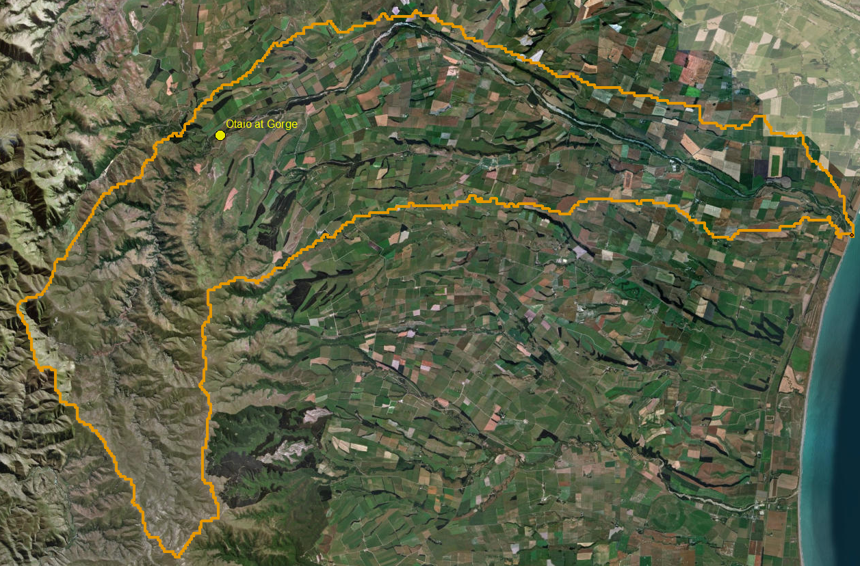
Landscape of Otaio River
Plains
Hills

Slide 15
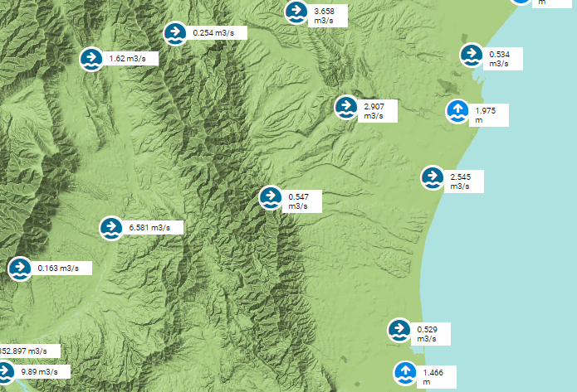
Gaging Stations in South Canterbury
Otaio River at Gorge

Slide 16
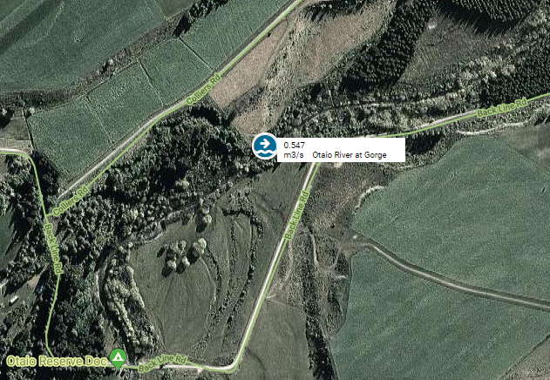
Otaio River at Gorge Gaging Station

Slide 17
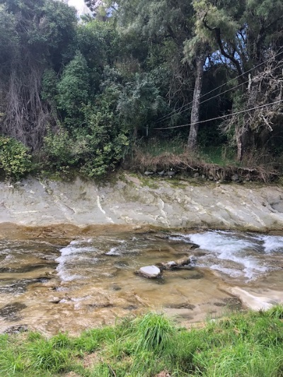
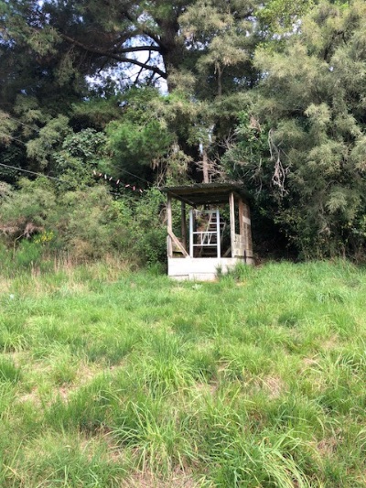
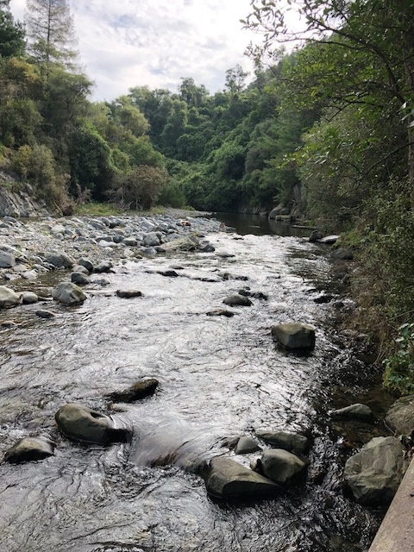
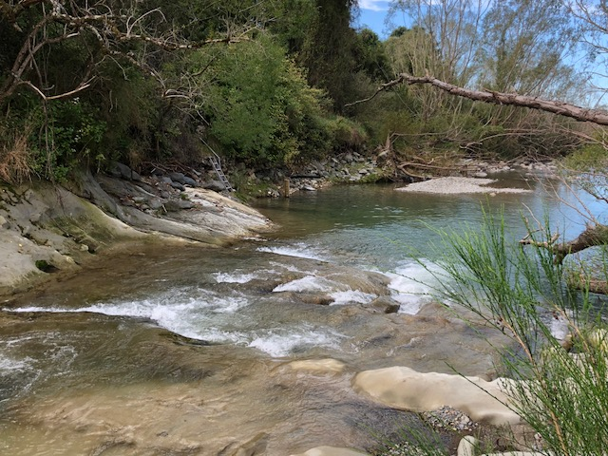
Otaio Gorge: Stream Gage Site
Cableway at stream gage site
Downstream Hydraulic Control

Slide 18
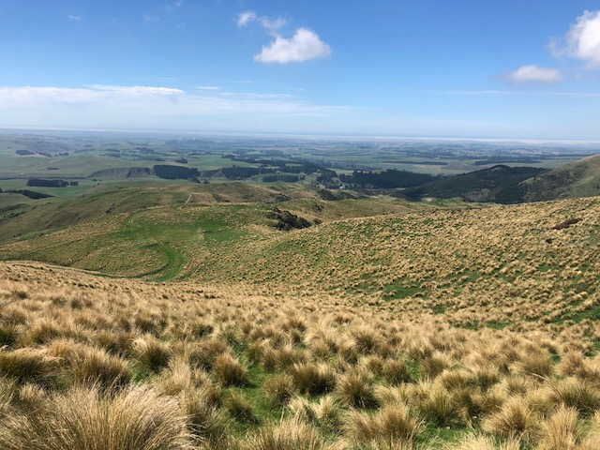
Tussock in the Hunter Hills

Slide 19
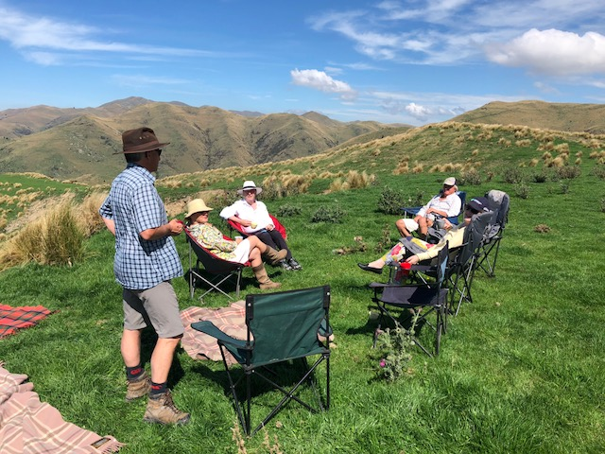
A picnic in the hills

Slide 20
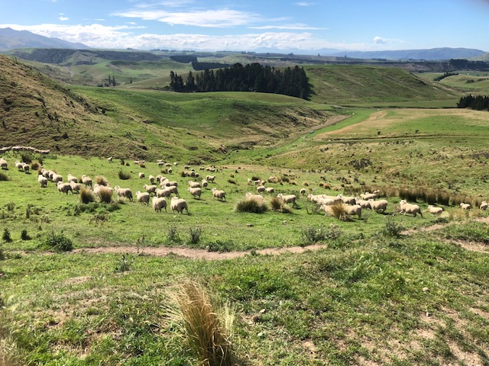
Sheep in the hills

Slide 21
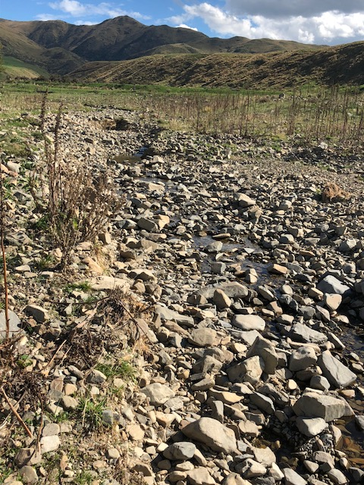
Disappearing Stream

Slide 22
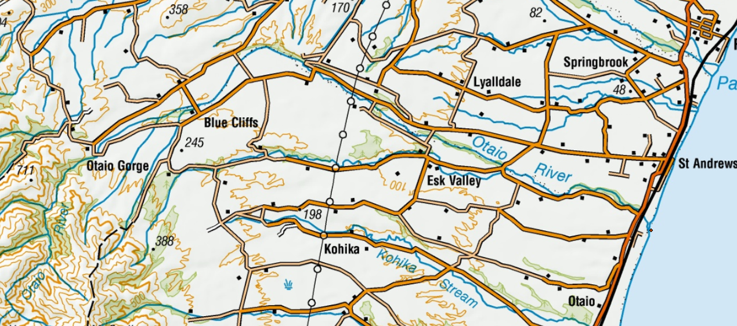
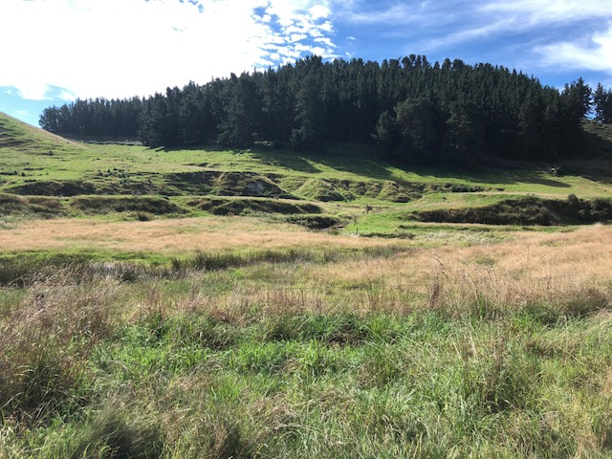
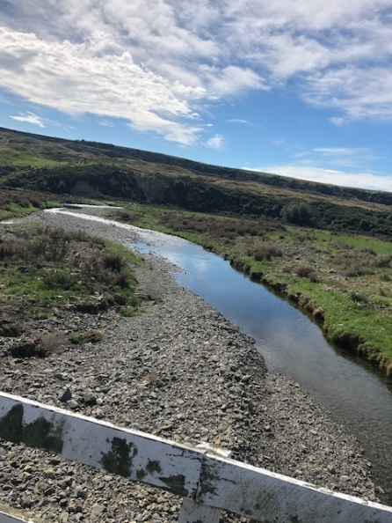
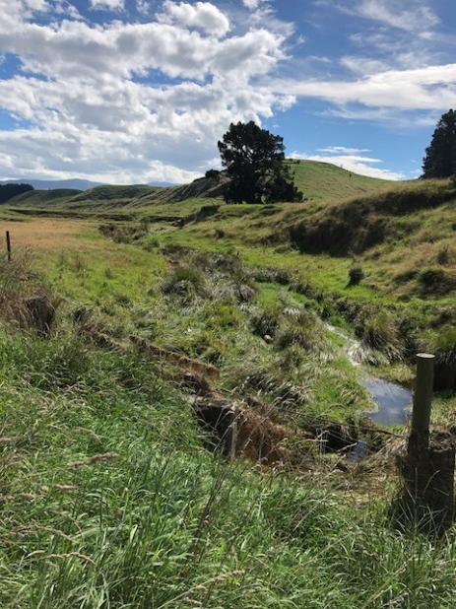
Lower Otaio River Catchment

Slide 23
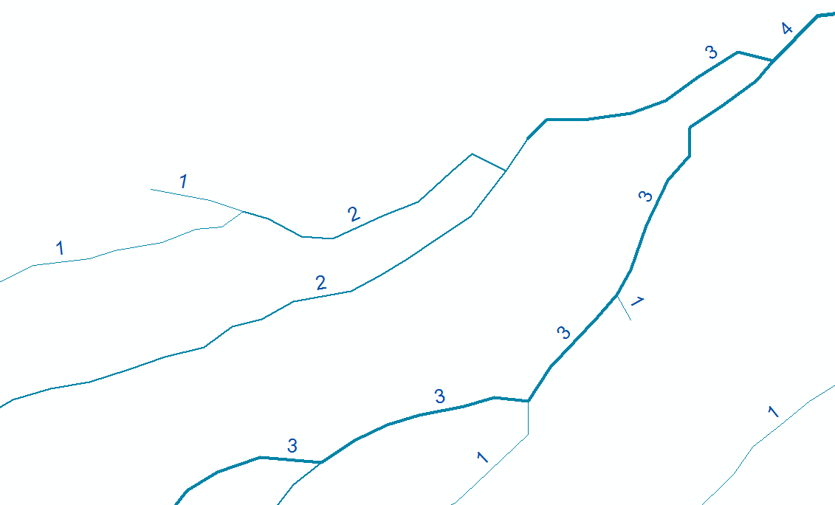
Stream Order
Two 3’s converge = 4
Two 2’s converge = 3
Two 1’s converge = 2
1 or 2 joins 3 has no effect

Slide 24
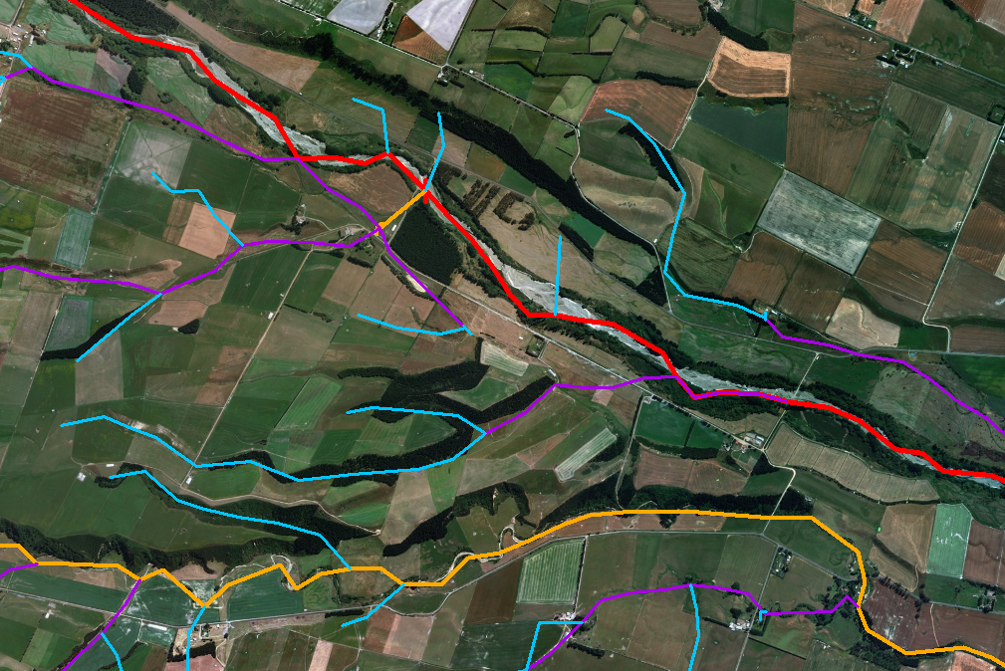
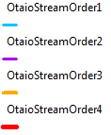
Otaio Streams – some errors and need for editing and checking

Slide 25
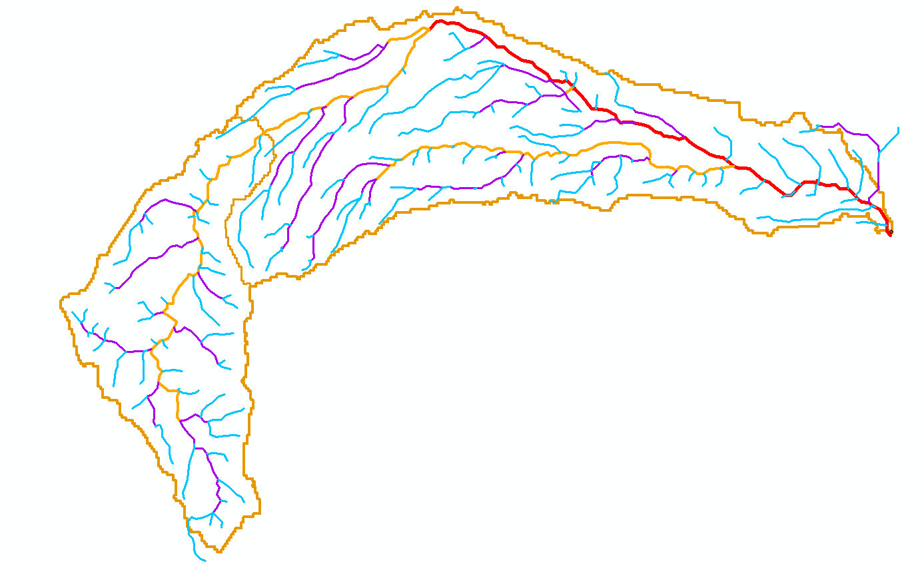
Distribution of Stream Orders
Stream Order | Number | Average (m) | Total (Km)
1 | 130 | 915 | 119
2 | 59 | 1011 | 57
3 | 49 | 704 | 34
4 | 21 | 860 | 18

Slide 26
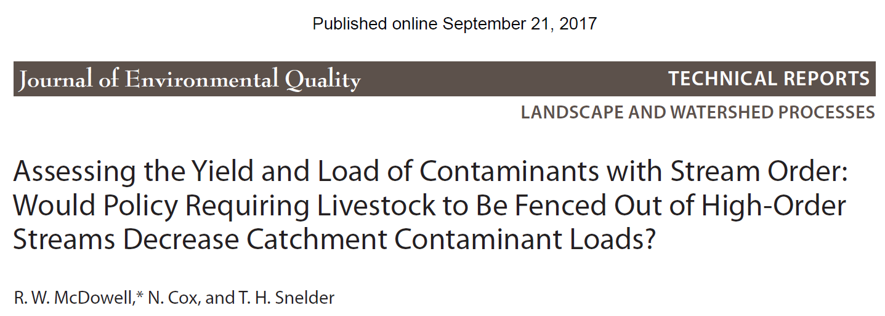

Slide 27
Assignment for Lincoln Students
To assess the percentage of pasture loss out of the central farm block (i.e., the block visited on the weekend), for each of the following scenarios;
Fencing off only the head of the stream catchments and creating a wetland area around the “Big Swamp” paddock
Fencing off the head of the stream catchments (top 500 m of first order stream catchments?), critical areas of the streams crossing pasture (arbitrarily allow for 20% of their length?) and within 500m (?) of the Otaio River for those streams draining to this river
Fencing off all waterways on the property
Using the guidelines of DairyNZ (https://www.dairynz.co.nz/environment/waterways/fencing-waterways/) for setback on fences, but use a minimum (horizontal) distance of 10m from all waterways.

