Slide 1
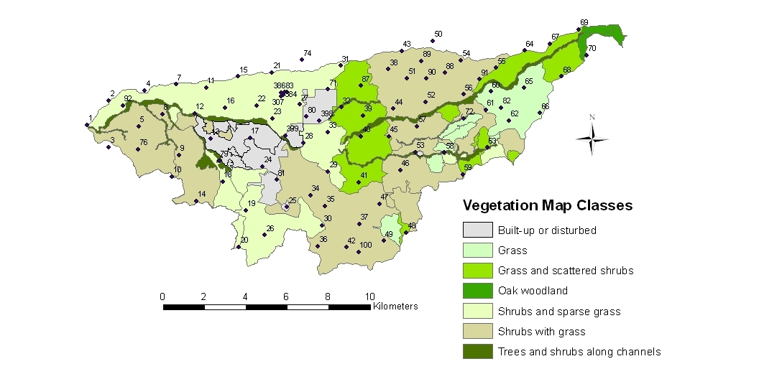
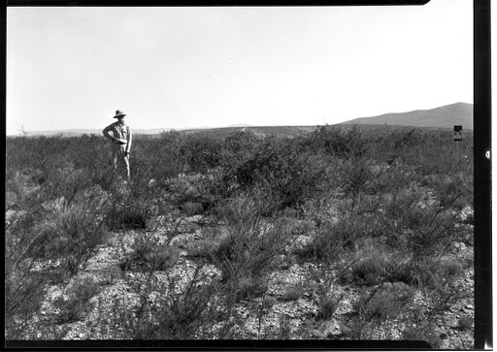
Hydrology of Walnut Gulch, Arizona
Unearthing a First-Order Approximate Correlation Between Regional Hydrology and Extent of Vegetative Land Cover

Slide 2
Why Relate Hydrology and Vegetation?
Energy Transfer in an Ecosystem begins with Primary Producers
Plants need Water…
Hydrologic Cycle dictates the sustainability of an Ecosystem

Slide 3
Methodology
Select model ecosystem
Select easily quantifiable hydrologic variables
Construct an “Average Hydrologic Year” model
Quantify Vegetative Land Cover
Correlate the average hydrologic year with the vegetative land cover

Slide 4
Model Ecosystem
Desert
RELATIVELY simple ecosystem
Most vegetation low shrub
Walnut Gulch is VERY well documented

Slide 5
http://www.tucson.ars.ag.gov/dap/DAPveg/default.htm

Slide 6
Hydrologic Variables
Precipitation
Easy to Measure
Easy to Average over watershed area
Atmospheric Moisture
Easy to Measure and Average over watershed
Soil Moisture
Difficult to Measure over any extent
Highly Heterogeneous over watershed area

Slide 7
Annual Rainfall Data in 20-min Intervals

Slide 8
Annual Daily Cumulative Rainfall

Slide 9
10-yr Average Rainfall Year

Slide 10
Same Process for Atmospheric Moisture

Slide 11
Quantifying Vegetative Cover
Fractional Absorbed Photosynthetically Active Radiation
faPAR = (PAR-rPAR)/PAR
rPAR = Reflected PAR
PAR
PAR
rPAR
rPAR

Slide 12
10-yr Average Daily Maximum faPAR

Slide 13
Correlation with Precipitation

Slide 14
Phase Shift

Slide 15
Conclusions and Future Work
For desert environments, Vegetative Land Cover seems to be predicted by Precipitation
Is this true for other, more hydrologically complex ecosystems?
What causes the phase shift?
Deeper exploration of Soil Moisture and Watershed Storage

