Slide 1
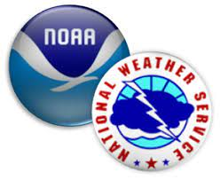
Public Private Partnerships in the Water Community:
Opportunities, Challenges and Next Steps Panel Discussion American Meteorological Society Annual Meeting, Denver, 11 January 2023
Flood Prediction Partnerships in Texas
Presented by
David R. Maidment
Center for Water and the Environment
University of Texas at Austin
Acknowledgments: Texas Department of Transportation, Texas Division of Emergency Management Colleagues at UT Austin Center for Water and the Environment, USGS, ESRI, KISTERS

Slide 2
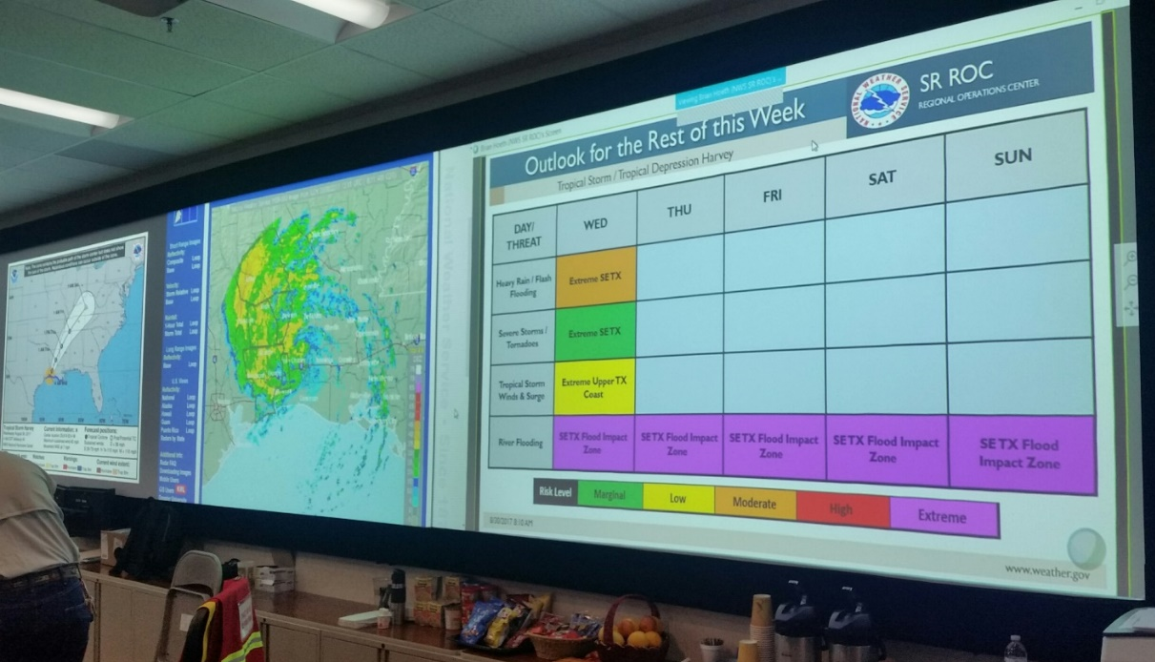
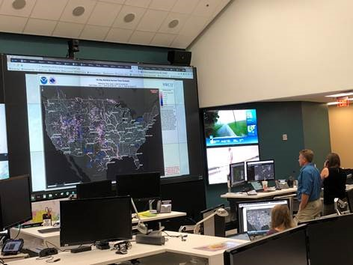
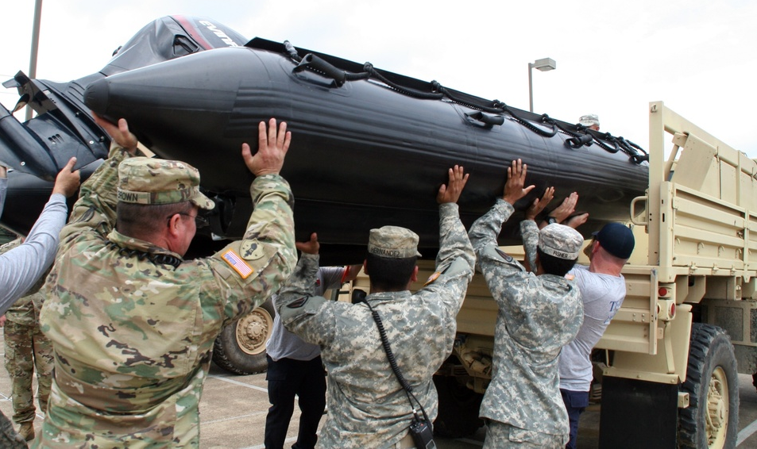
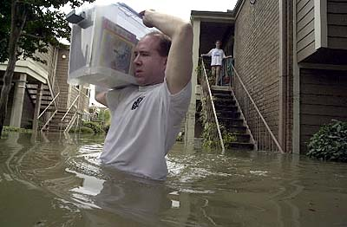
Goals of the National Flood Interoperability Experiment (2015)
Close the gap between National Flood Forecasting and Local Emergency Response
Demonstrate forecasting of flood impacts at “stream and street level”
Weather and Hydrology
National Weather Service and federal agencies
National Water Center
National
Local
River Flooding and Emergency Response
Local, State and Regional Agencies
Citizens

Slide 3
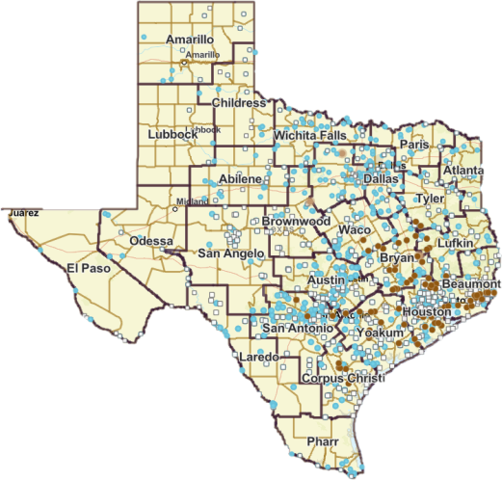
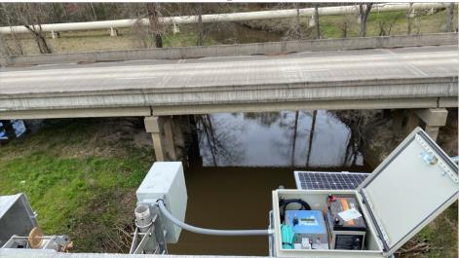
787 traditional USGS gages now supplemented by 80 TxDOT Bridge RQ-30 radar sensors
Radar Streamflow Measurement at TxDOT Bridges
USGS Traditional Gage
TxDOT Radar Sensor
Largest research project ever funded by TxDOT
Notes:
In Texas, the USGS operates 787 stream gages, 80 of which are part of this project.
Putting into perspective

Slide 4
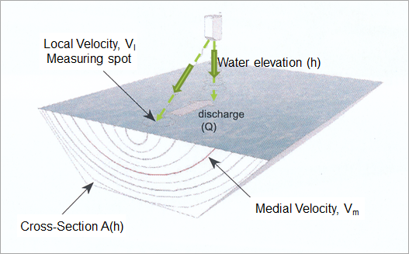
Measurement of Water Elevation and Velocity using RQ-30 Radar Gage
Disharge Computation:
Q = V_{m} * A(h)
TxDOT has the largest network of RQ-30’s in the United States
These gages produce discharge measurements directly
without needing a rating curve

Slide 5
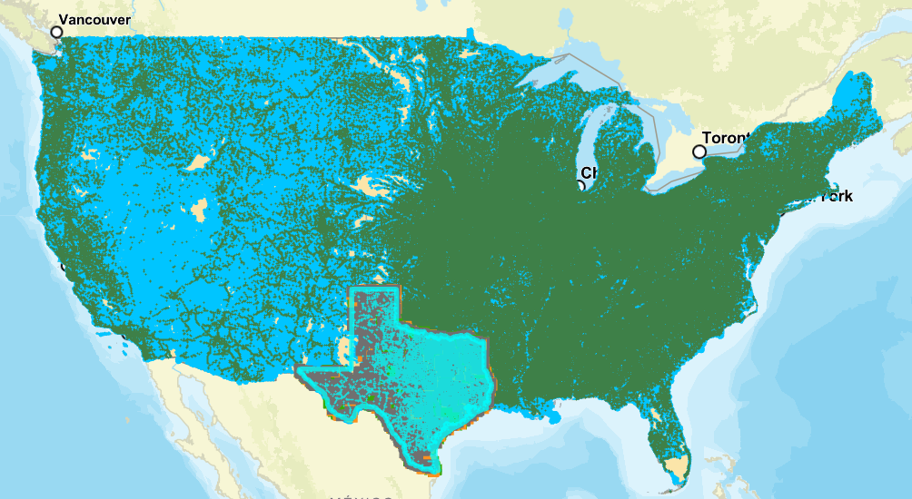
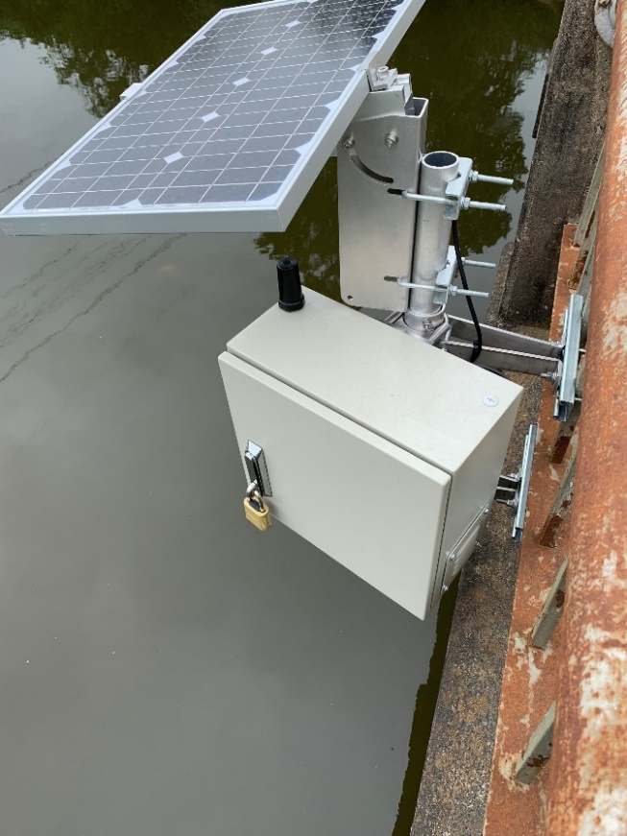
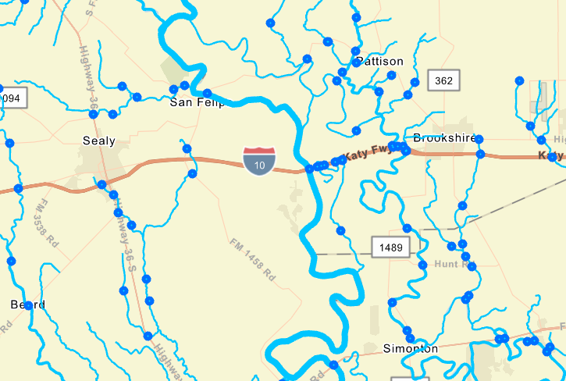
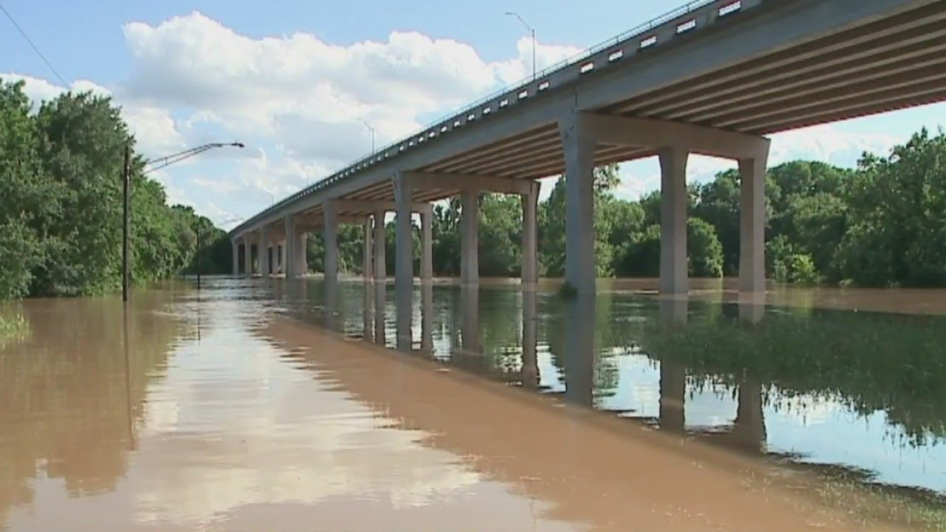
National Water Model (NWM) and National Bridge Inventory (NBI)
Radar gaging on bridges could be scaled across the country
100%
85%
72%
5%
NBI contains bridges
over 20 ft in length

Slide 6
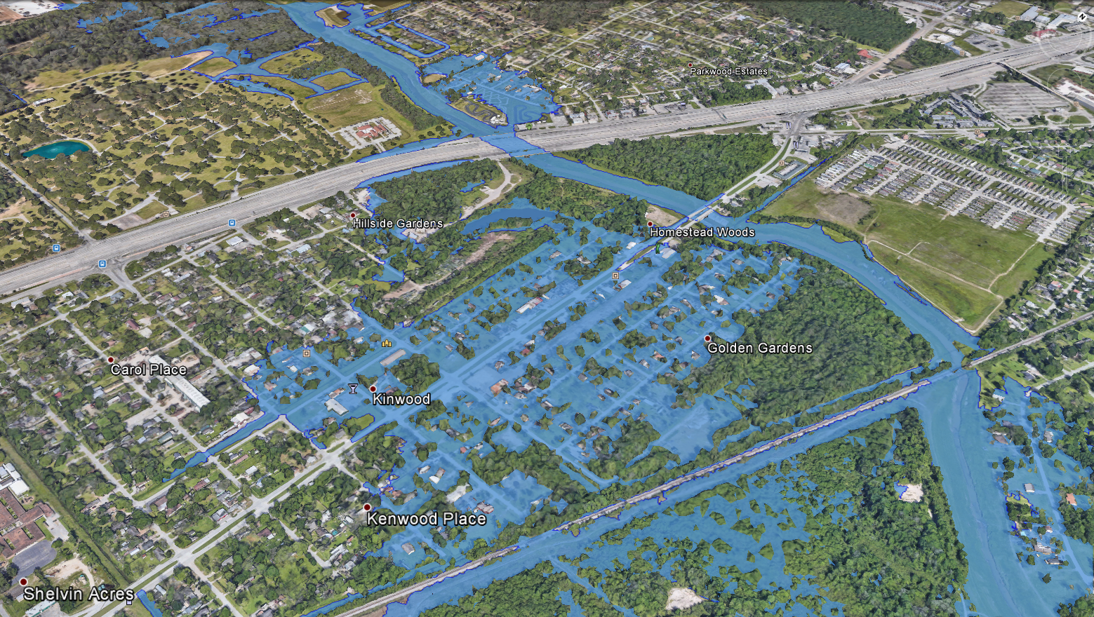
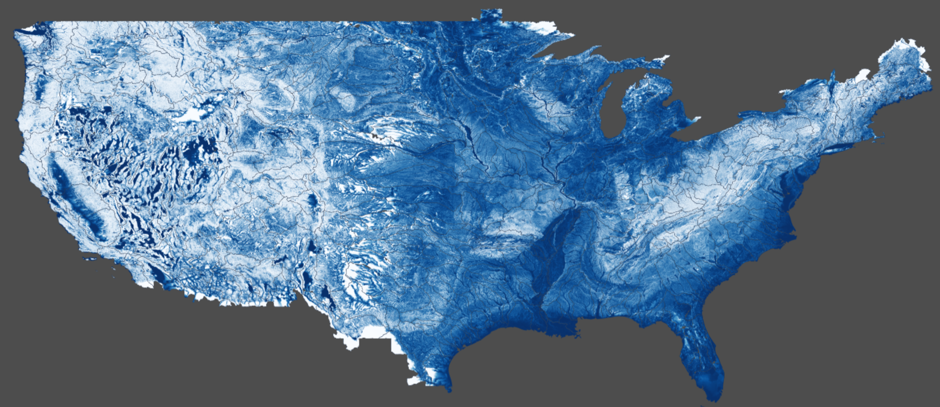
NWC Flood Inundation Map Services are based on …
Height Above Nearest Drainage (HAND)
Flooding occurs when Water Depth is greater than HAND
Flood
HAND
Normal

Slide 7
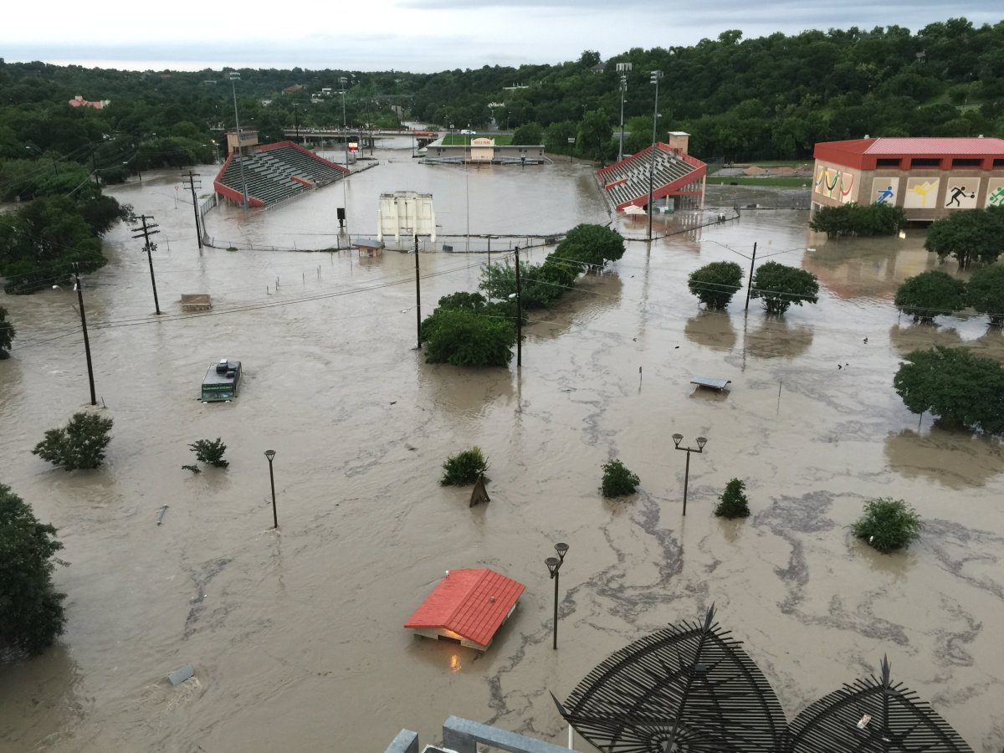
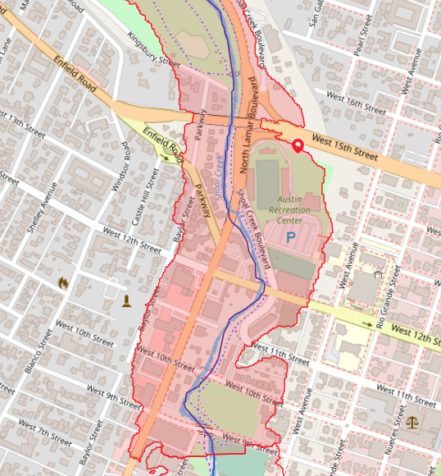
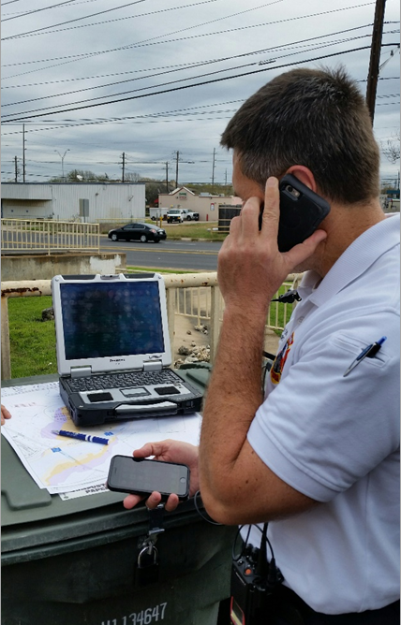
Cell Phone App for Observational Flood Mapping

Slide 8
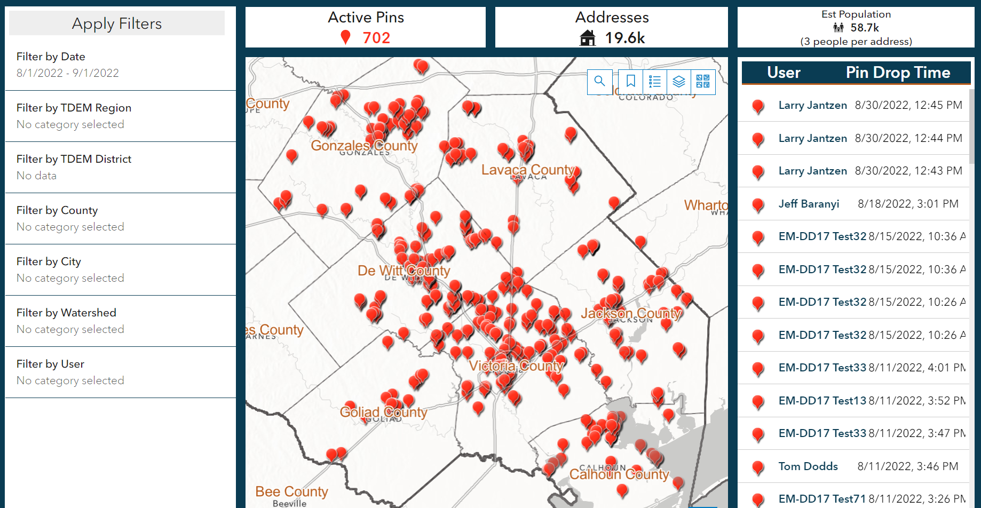
Pin2Flood Dashboard for Emergency Operations Center
Statewide deployment
in Texas in 2023

Slide 9
Field Verification for River Forecasters
Close the gap between National Flood Forecasting and Local Flood Emergency Response
National
Predictive
Flood
Mapping
Observational
Flood
Mapping
Greg Waller
West Gulf River Forecast Center
Local
Chief Todd Pomroy
Austin Fire Department

Slide 10
Conclusion
Public private partnerships lead to national prediction being supported by local observation
National
USGS Traditional Gage TxDOT Radar Sensor
Local

