Slide 1
FLOG/FIM Subcommittee
1 March 2024, 9-10AM
Update from National Water Center (Derek Giardino, Jim Coll, Laura Keys)
Presentation about flood modeling program of TxGLO (Shonda Mace, Stephanie Castillo)
Update from State Agencies (Trent Ellis)
Update from UT Austin (David Maidment)
Updates from others who wish to contribute.

Slide 2


Slide 3
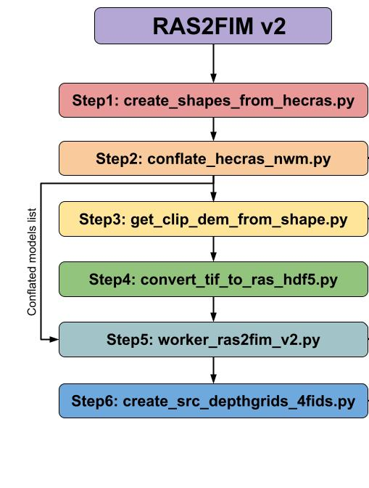
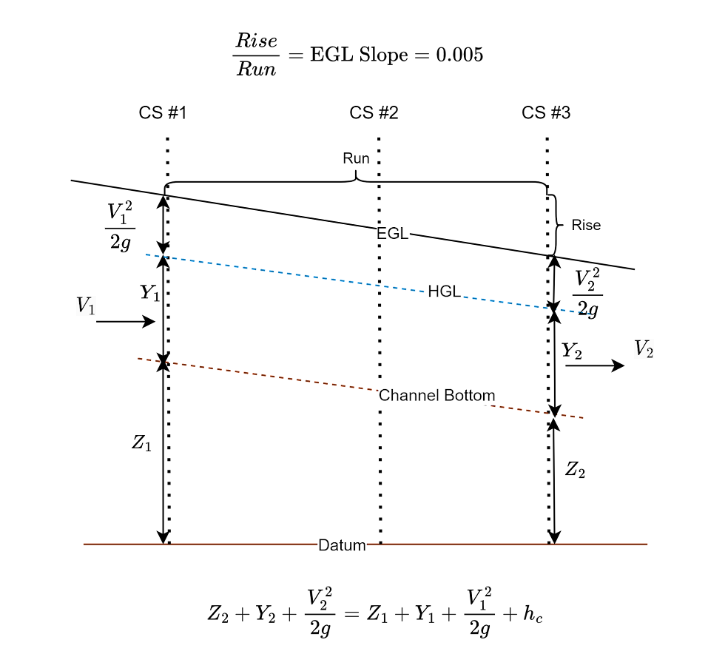
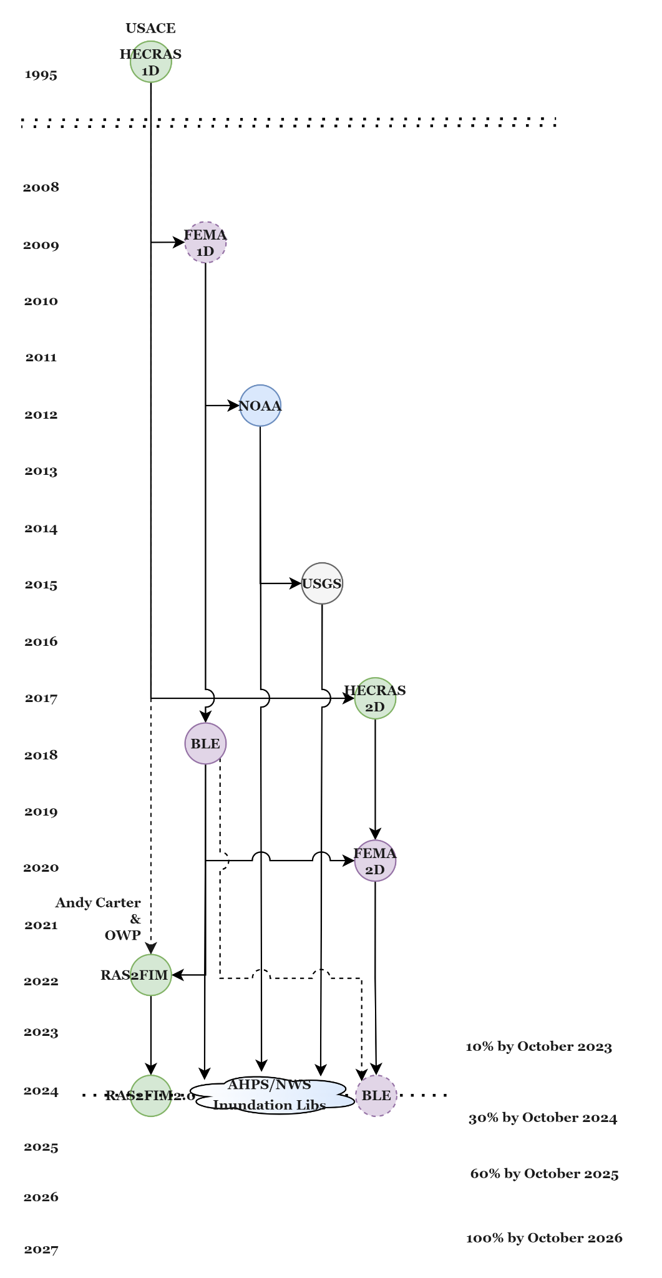
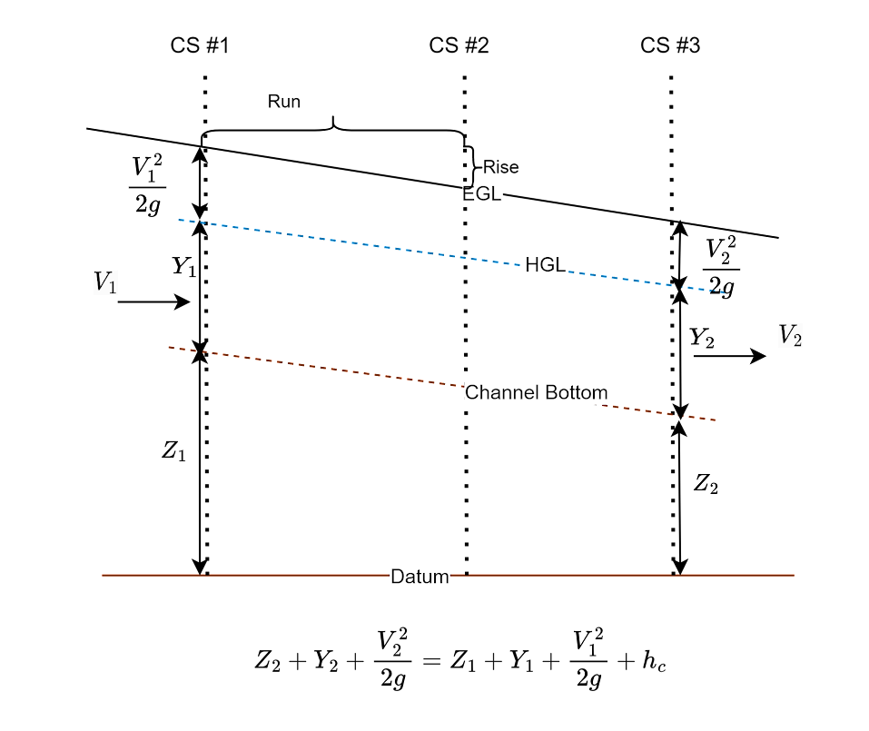
Notes:
12-15 hour runtime

Slide 4
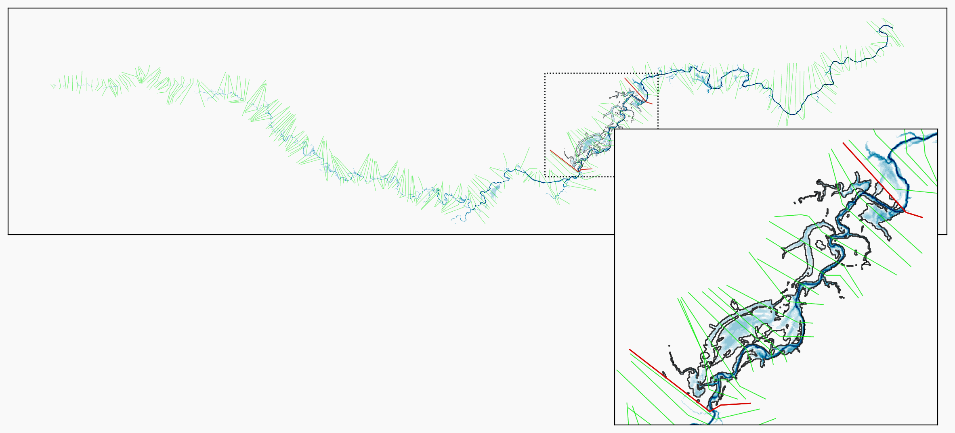
RAS2FIM v2: NWM Reach Discretization
1D HEC-RAS Model
NWM Reach
Boundary Cross-sections
HEC-RAS Cross-sections
FIM Extent Boundary
Boundary cross-sections identified by walking 2 upstream and downstream of NWM reach extent

Slide 5
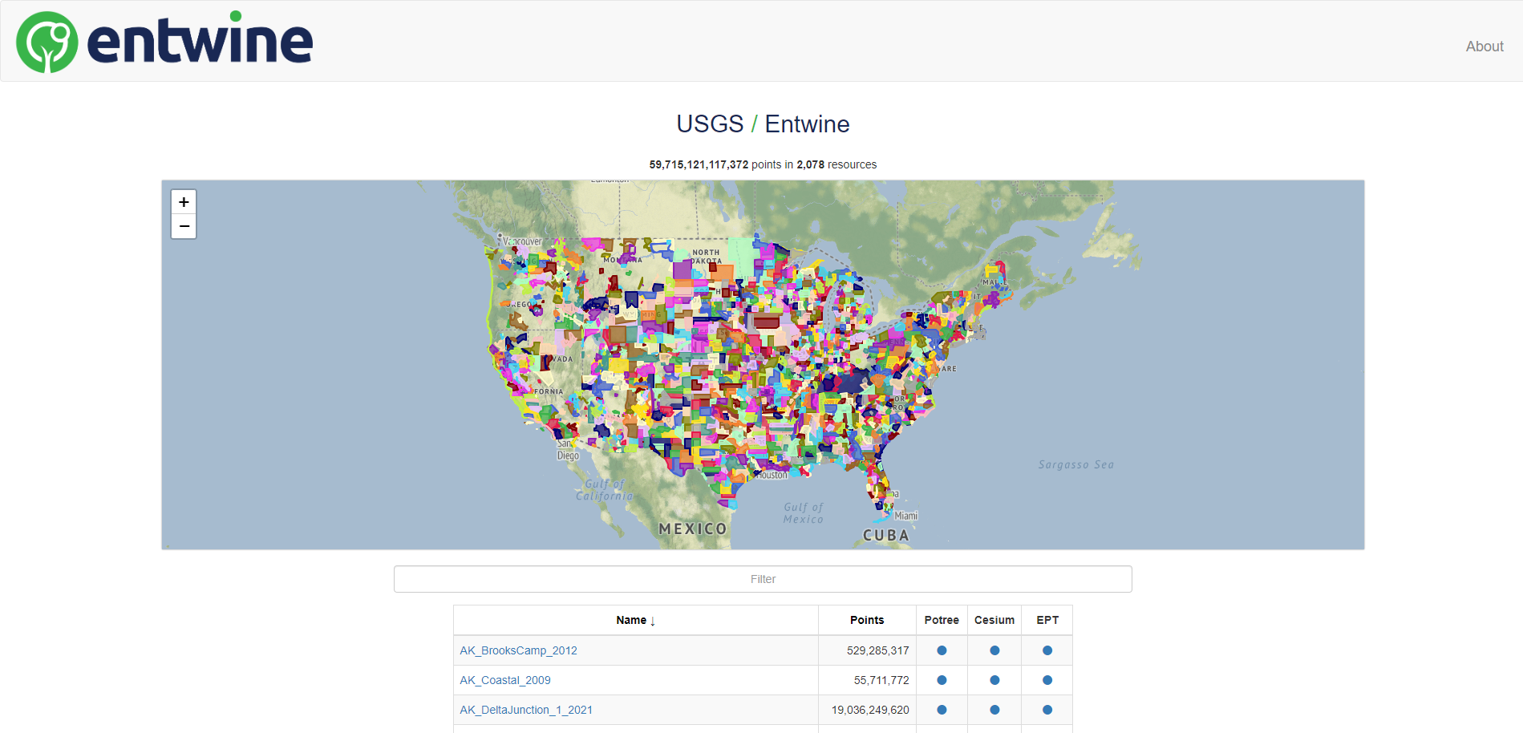
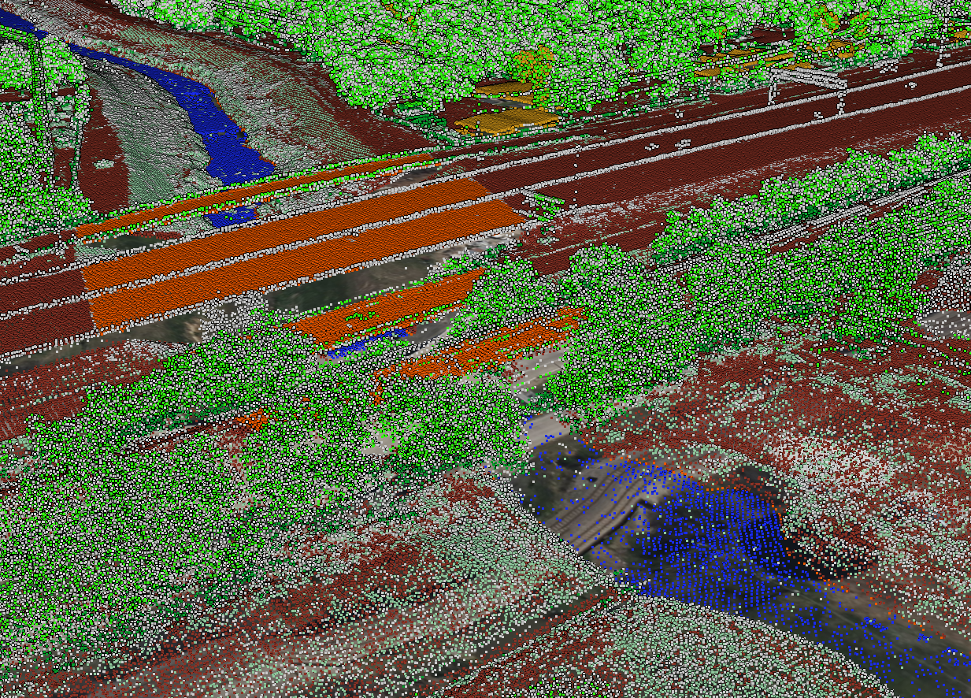
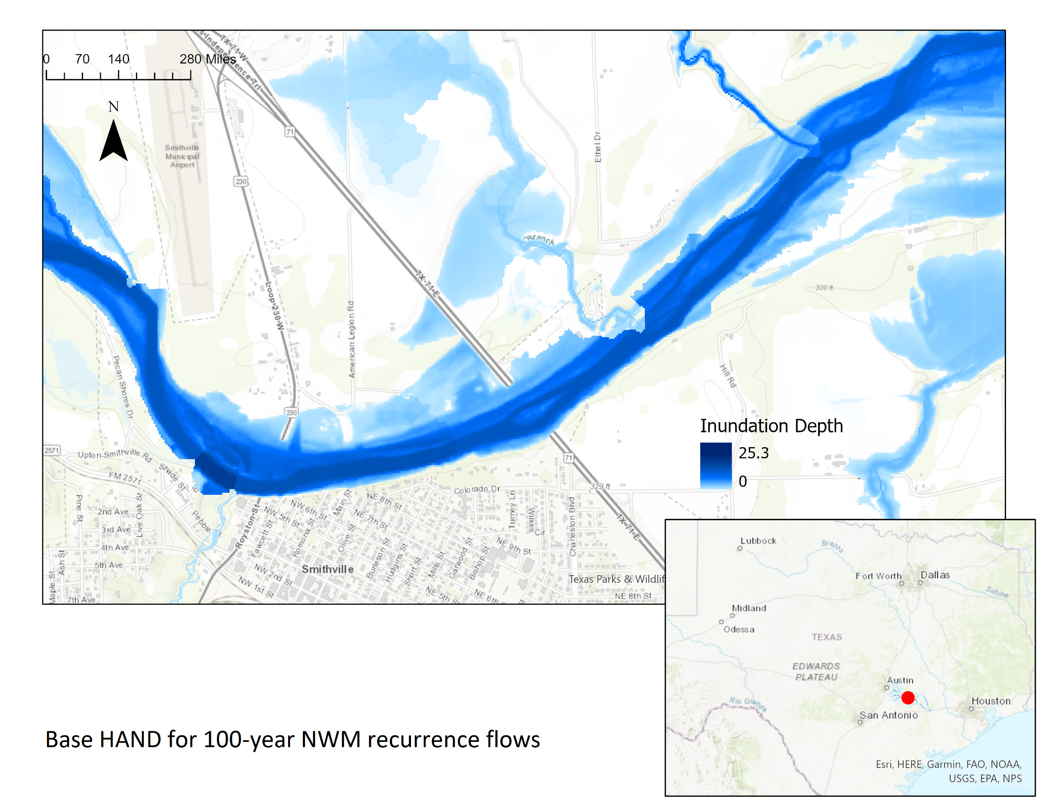
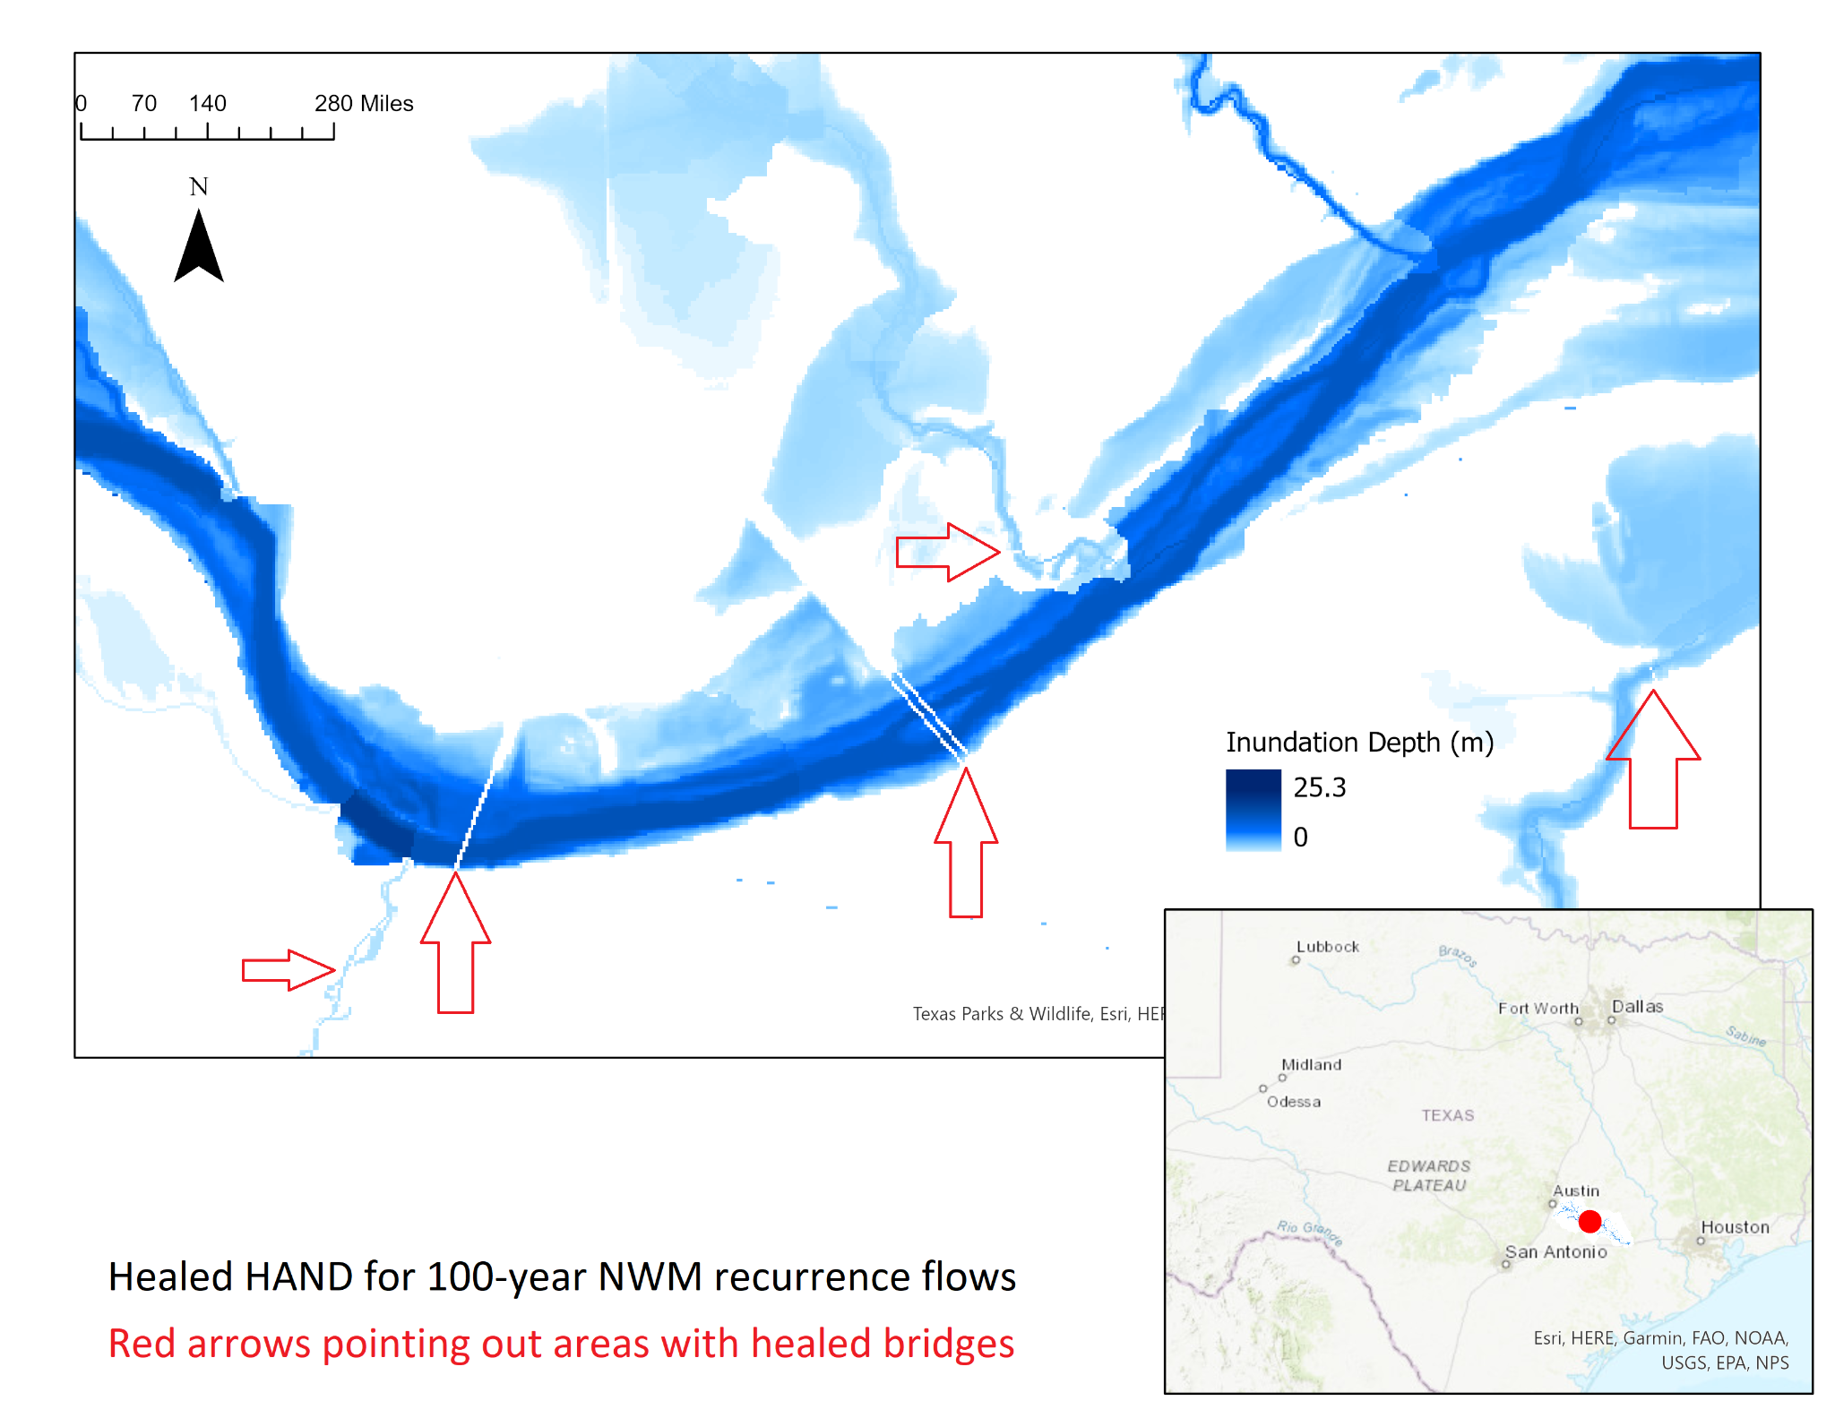
Example: Bridge Healing

Slide 6
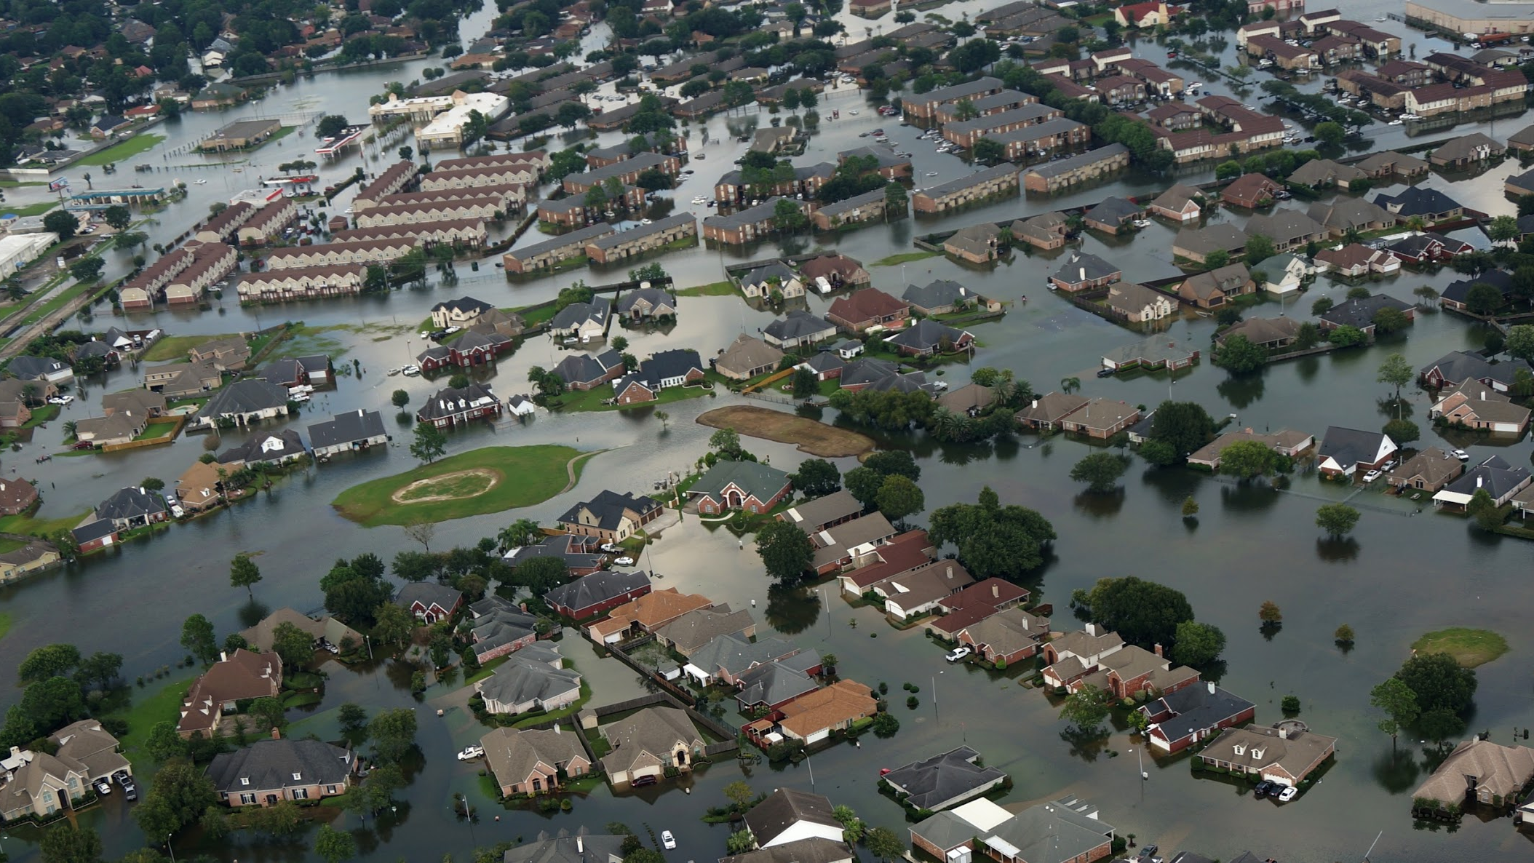

TEXAS GENERAL
LAND OFFICE
Community Development & Revitalization
Commissioner Dawn Buckingham, M.D.

Slide 7
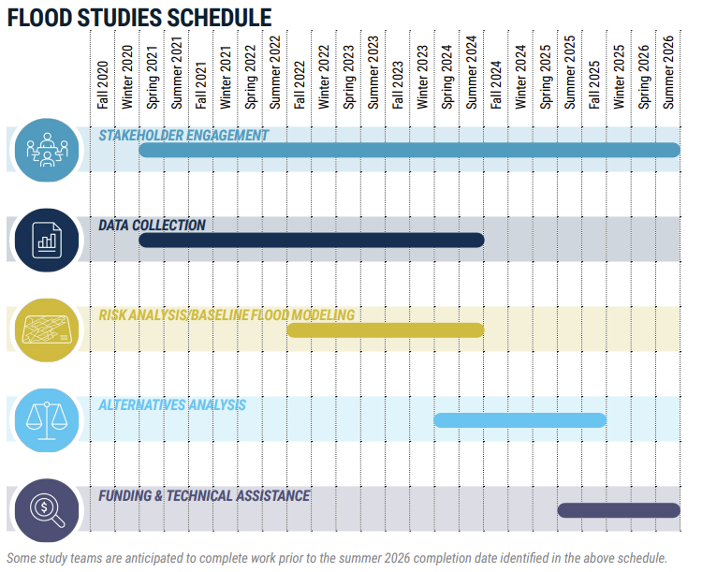
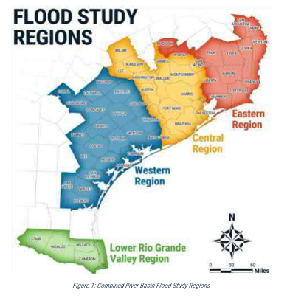

RBFS
Texas General Land Office | CDR
Commissioner Dawn Buckingham, M.D.

Slide 8
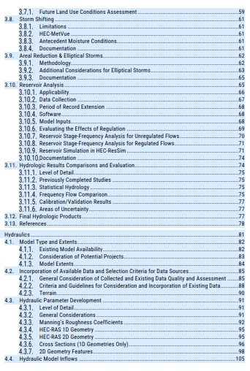
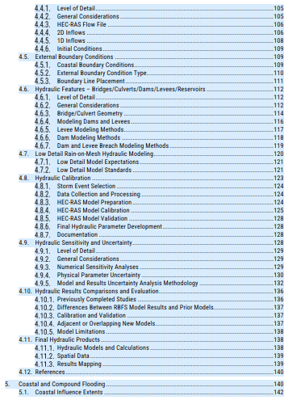
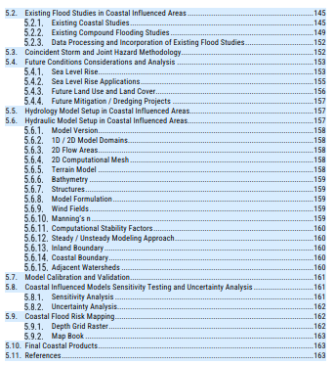
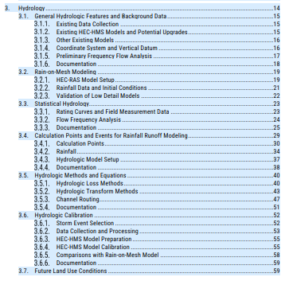
FMDP SOP (All Regions)
Texas General Land Office | CDR
Commissioner Dawn Buckingham, M.D.

Slide 9
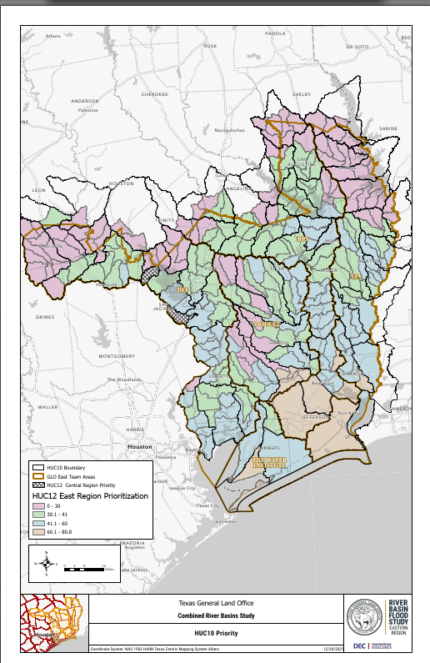
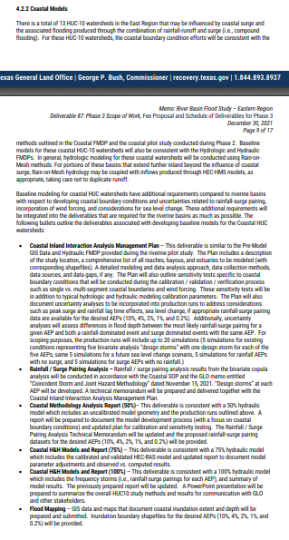
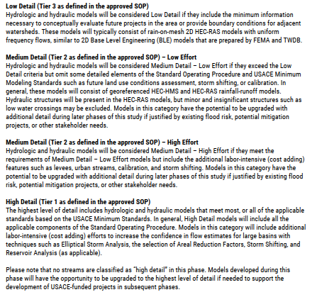
EAST
Phase 2-Deliverable 87-89
Texas General Land Office | CDR
Commissioner Dawn Buckingham, M.D.

Slide 10
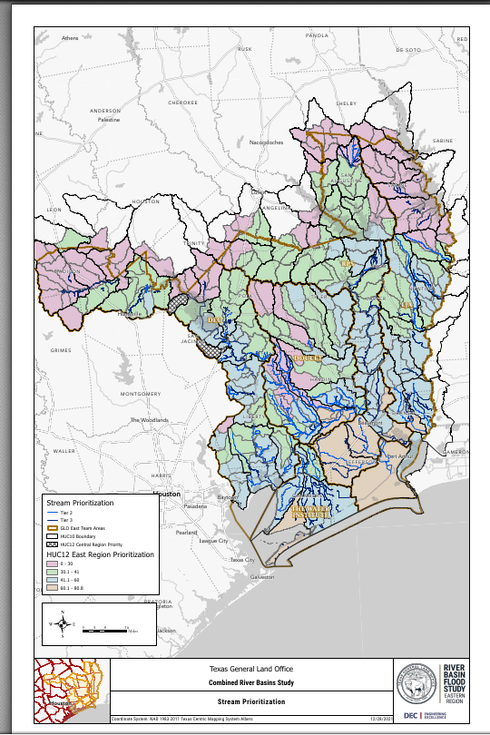
EAST
Texas General Land Office | CDR
Commissioner Dawn Buckingham, M.D.

Slide 11
EAST
Technical ACTION PLANS for Major watersheds at end of Phase 3
Texas General Land Office | CDR
Commissioner Dawn Buckingham, M.D.

Slide 12
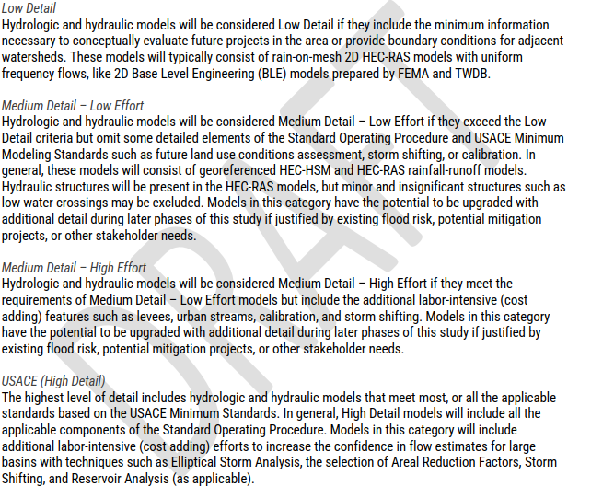
CENTRAL
CENTRA~2
Phase 2-4.3, Deliverables 87-89
Texas General Land Office | CDR
Commissioner Dawn Buckingham, M.D.

Slide 13
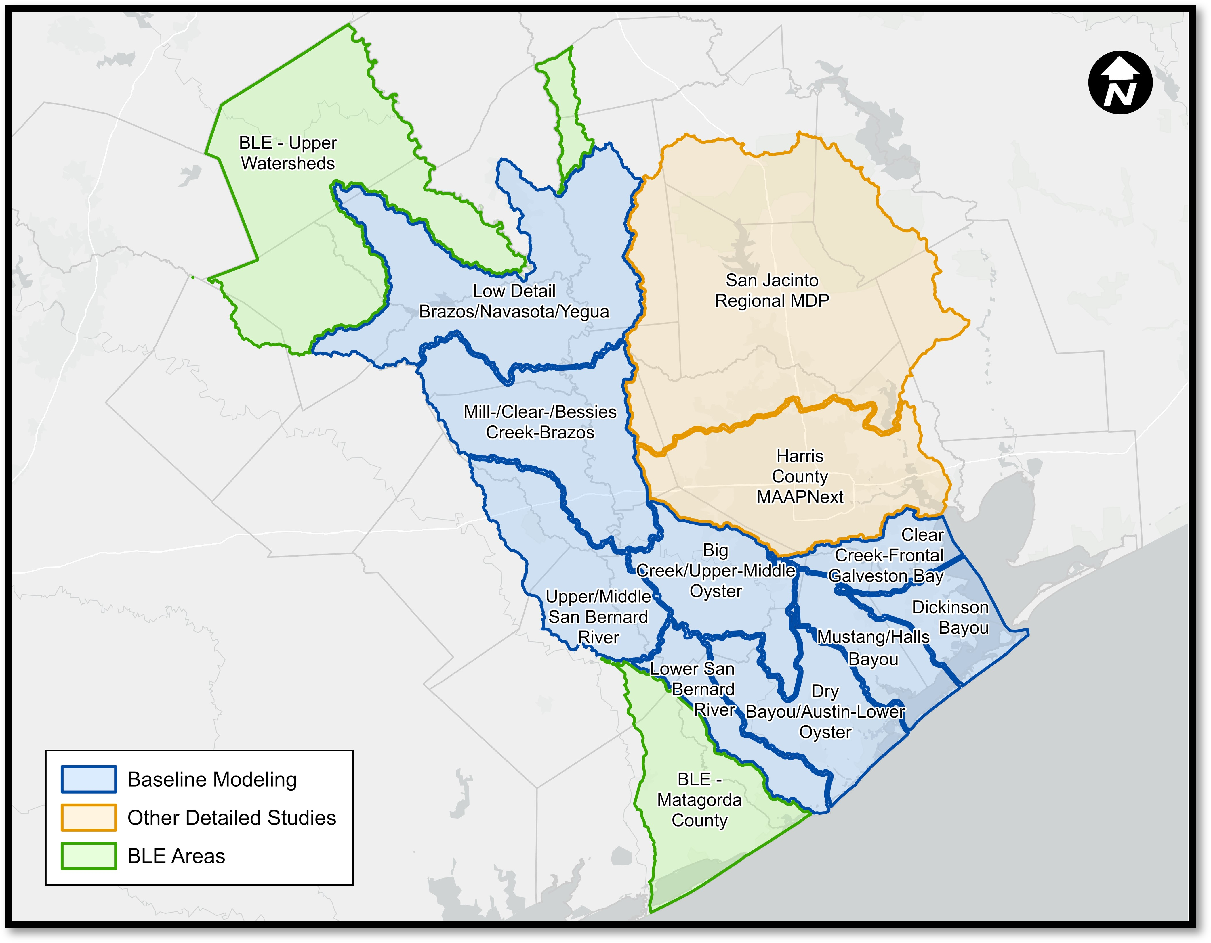
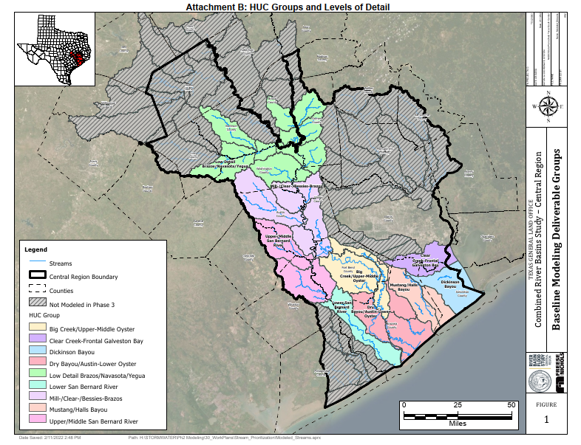
CENTRAL
CENTRA~2
Phase 2-4.3, Deliverables 87-89
Texas General Land Office | CDR
Commissioner Dawn Buckingham, M.D.

Slide 14
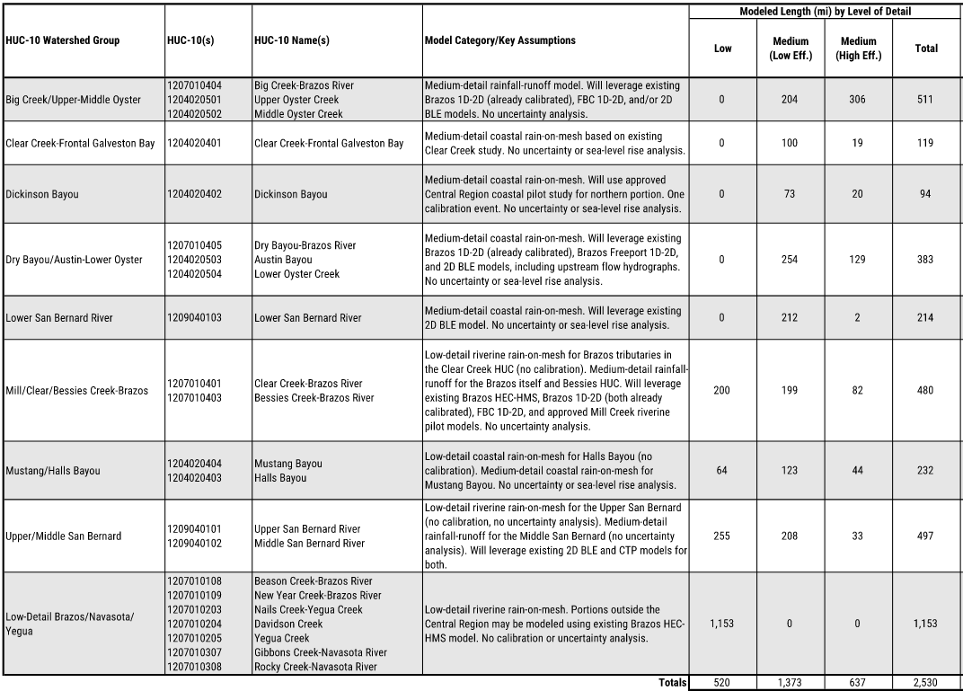
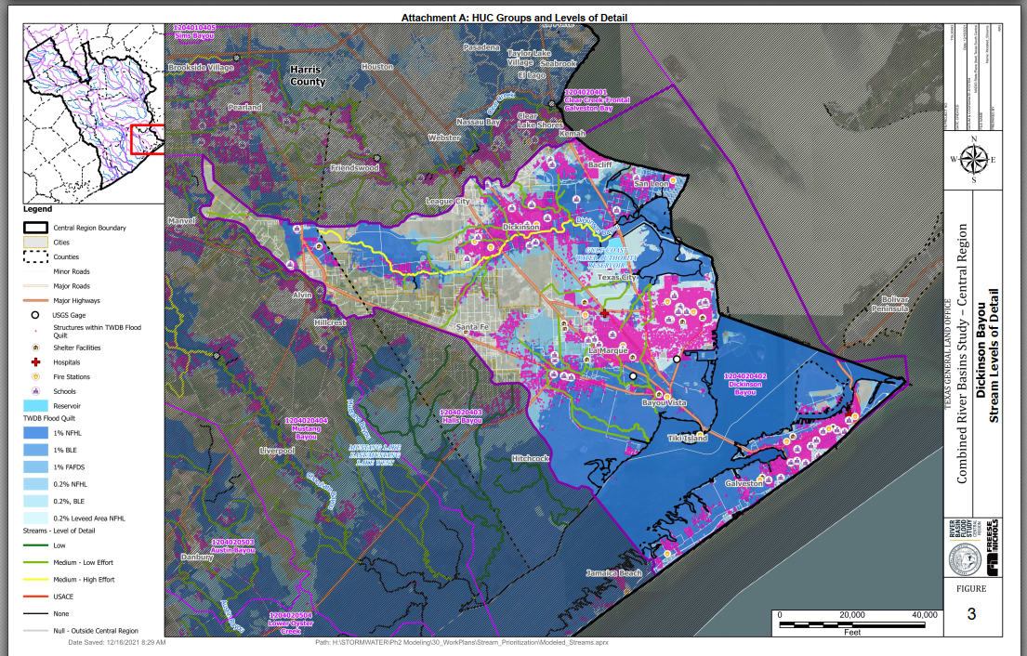
CENTRAL
Texas General Land Office | CDR
Commissioner Dawn Buckingham, M.D.

Slide 15
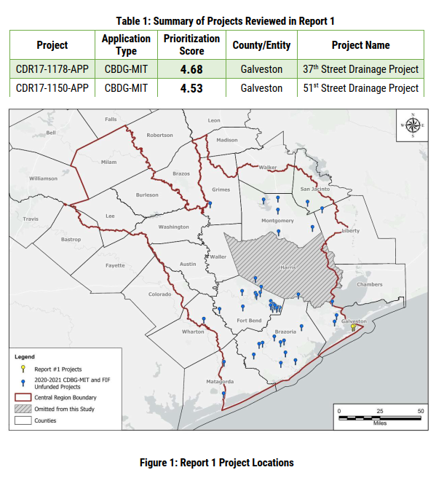
CENTRAL
Deliverable 5.0.0.1
Texas General Land Office | CDR
Commissioner Dawn Buckingham, M.D.

Slide 16
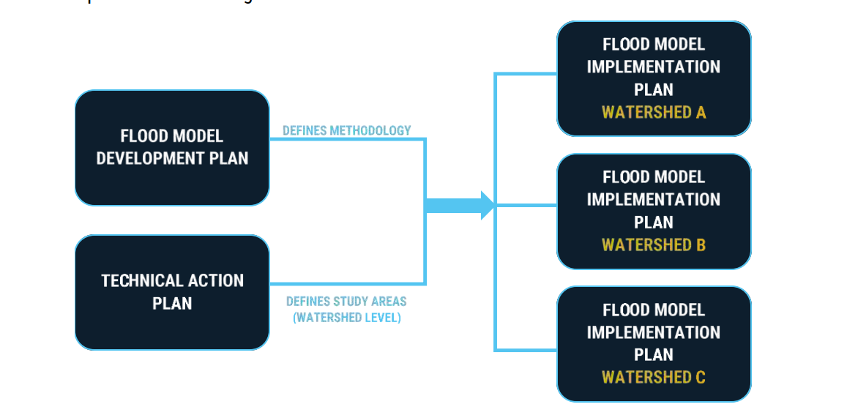
WEST
Texas General Land Office | CDR
Commissioner Dawn Buckingham, M.D.

Slide 17
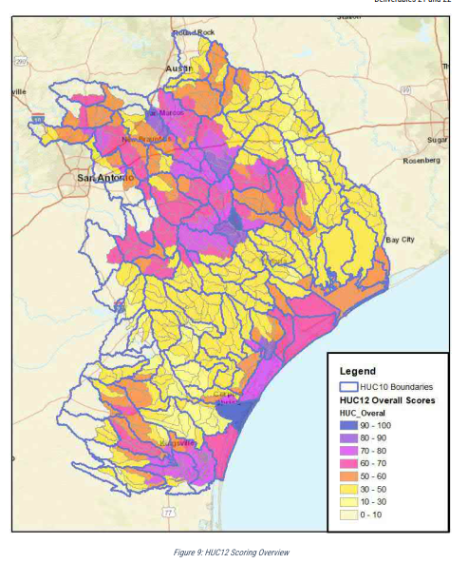
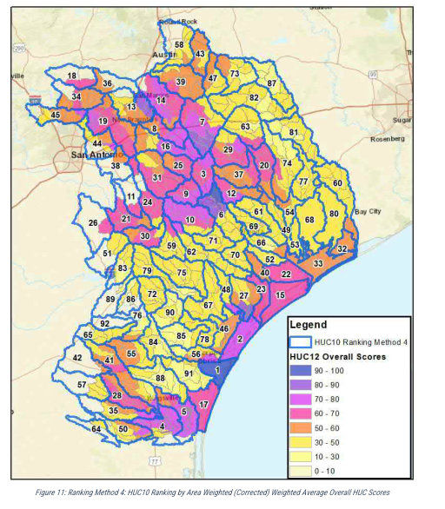
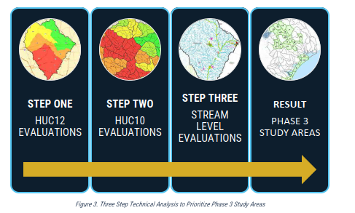
WEST-Technical Action Plan
Texas General Land Office | CDR
Commissioner Dawn Buckingham, M.D.

Slide 18
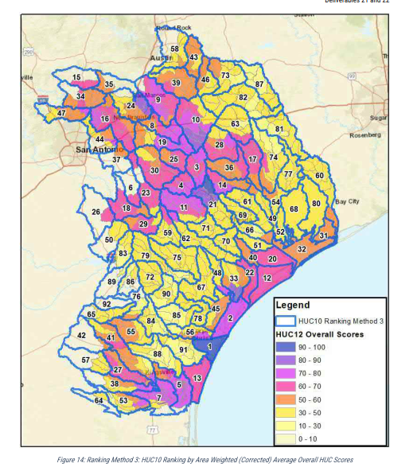
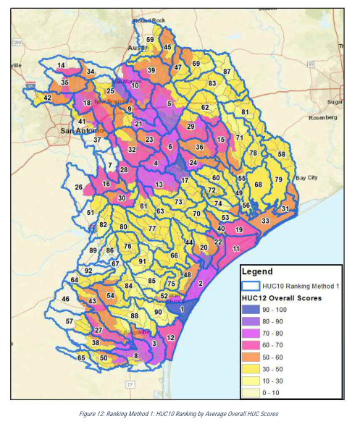
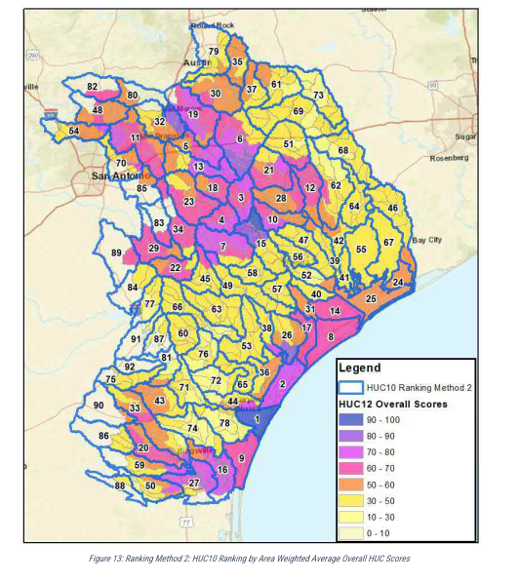
WEST-Technical Action Plan
Texas General Land Office | CDR
Commissioner Dawn Buckingham, M.D.

Slide 19
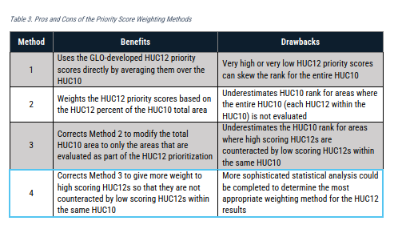
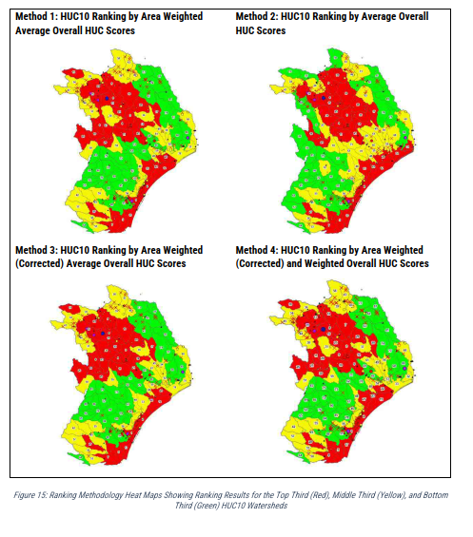
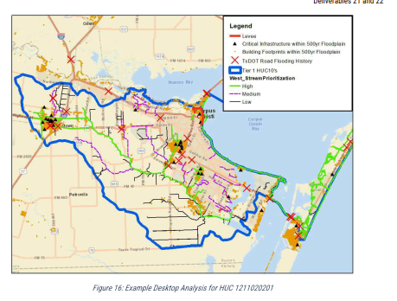
WEST-Technical Action Plan
Texas General Land Office | CDR
Commissioner Dawn Buckingham, M.D.

Slide 20
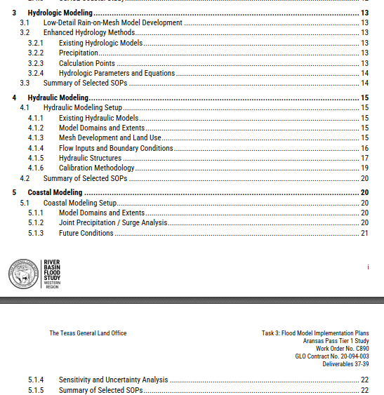
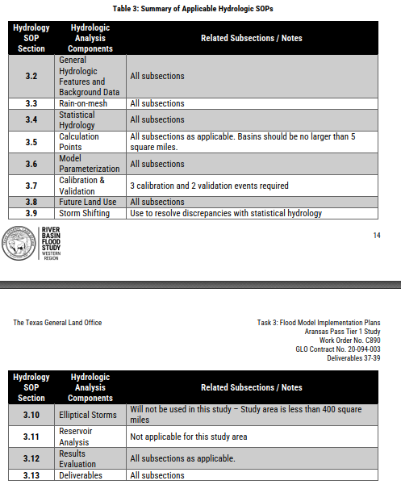
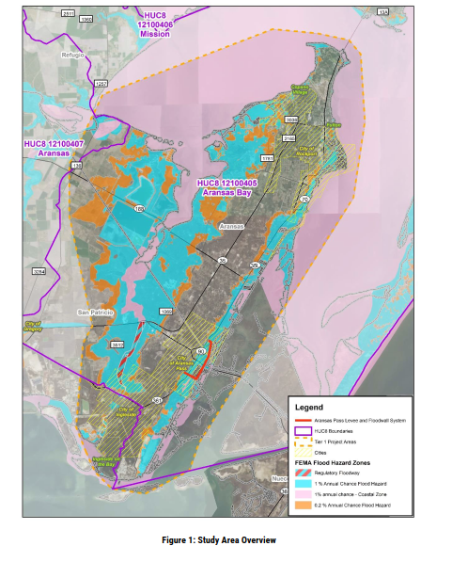
WEST-FMIP-Tier 1-ARANSAS BAY STUDY
Texas General Land Office | CDR
Commissioner Dawn Buckingham, M.D.

Slide 21
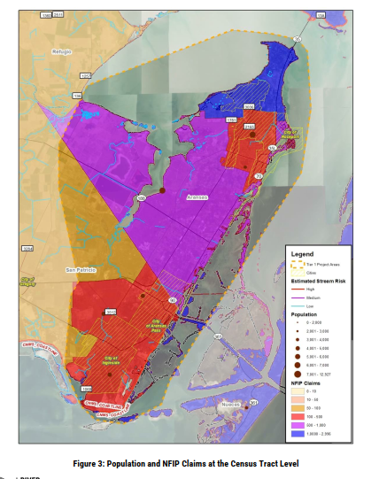
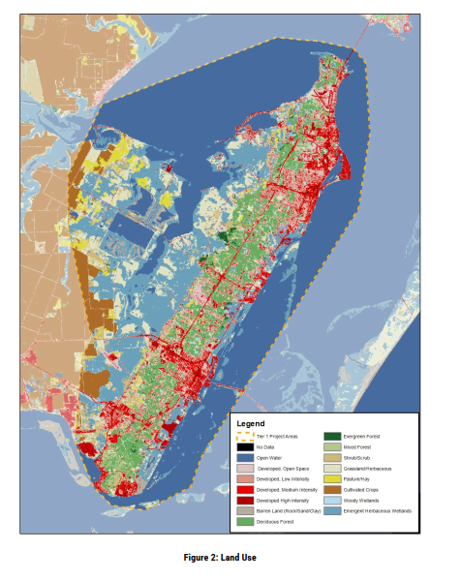
WEST-FMIP-Tier 1-ARANSAS BAY STUDY
Texas General Land Office | CDR
Commissioner Dawn Buckingham, M.D.

Slide 22
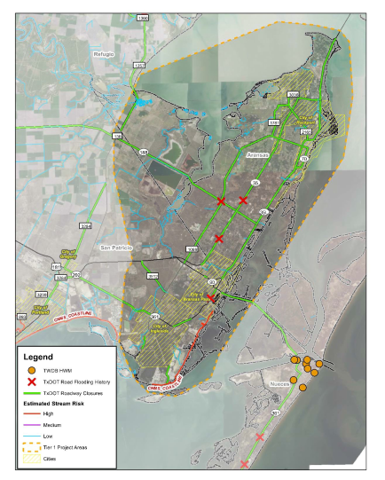
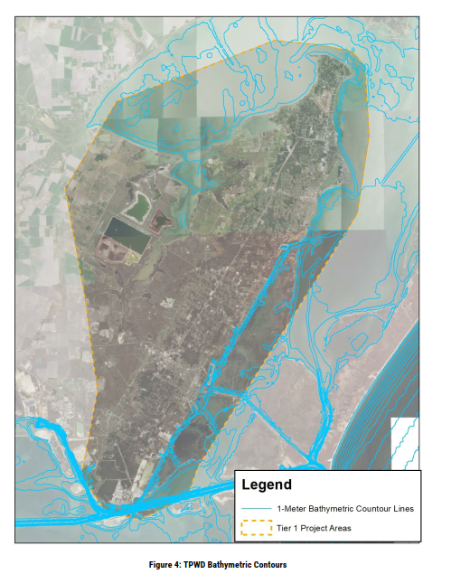
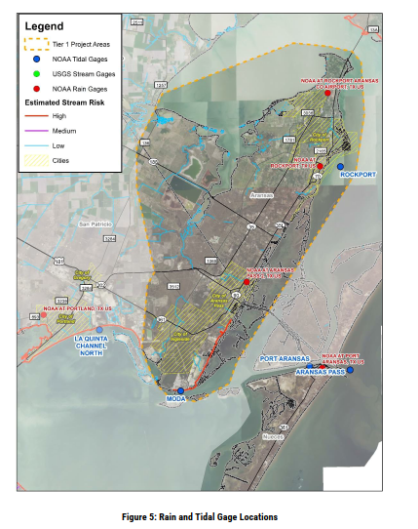
WEST-FMIP-Tier 1- ARANSAS BAY STUDY
Texas General Land Office | CDR
Commissioner Dawn Buckingham, M.D.

Slide 23
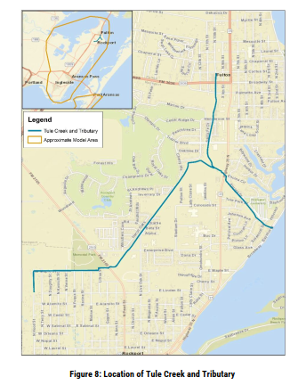
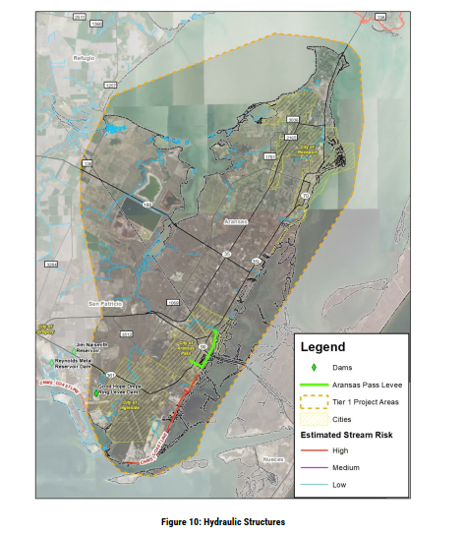
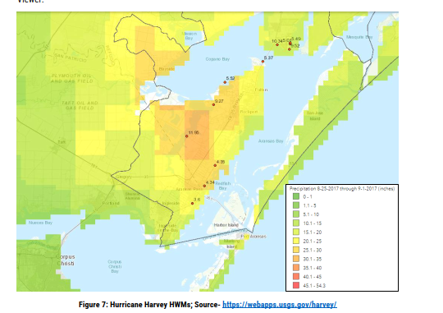
WEST-FMIP-Tier 1- ARANSAS BAY STUDY
Texas General Land Office | CDR
Commissioner Dawn Buckingham, M.D.

Slide 24
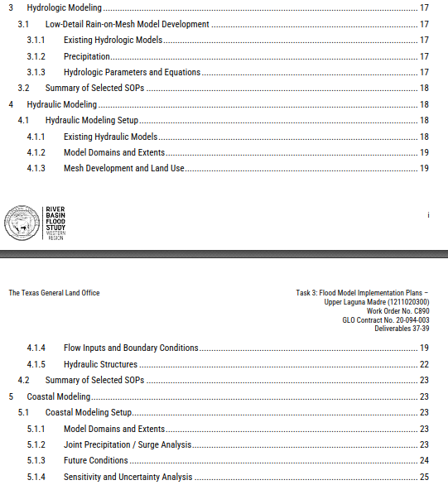
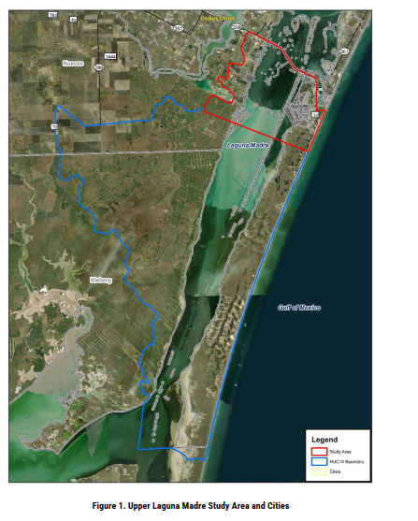
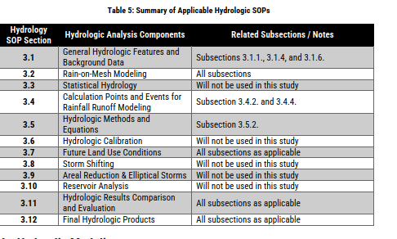
WEST-FMIP-Tier 2 – Upper Laguna Madre
Texas General Land Office | CDR
Commissioner Dawn Buckingham, M.D.

Slide 25

WEST-Baseline Modeling Extents
Texas General Land Office | CDR
Commissioner Dawn Buckingham, M.D.

Slide 26

LRGV
Texas General Land Office | CDR
Commissioner Dawn Buckingham, M.D.

Slide 27




LRGV-TAP-Riverine & Coastal
Phase 2:Deliverable 21-23
Texas General Land Office | CDR
Commissioner Dawn Buckingham, M.D.

Slide 28




LRGV- FMIP Riverine
Deliverable 25-phase 2
Leverage other studies
Deliverable 21-23 phase 2
Texas General Land Office | CDR
Commissioner Dawn Buckingham, M.D.

Slide 29




LRGV- FMIP Riverine
Texas General Land Office | CDR
Commissioner Dawn Buckingham, M.D.

Slide 30


LRGV-FMIP-COASTAL
Texas General Land Office | CDR
Commissioner Dawn Buckingham, M.D.

Slide 31



LRGV-FMIP-COASTAL
Texas General Land Office | CDR
Commissioner Dawn Buckingham, M.D.

Slide 32
100 Year Road Flood Inundation Map
Prepared by David R. Maidment
Center for Water and the Environment
University of Texas at Austin
With the assistance of Andy Carter and Tim Whiteaker, CWE
and Khushboo Agarwal, TWDB
For presentation to the TWDB FLOG/FIM Subcommittee
1 March 2024

Slide 33


Flood Risk Assessment Maps
Cursory Floodplain with Regions | Hub: GIS Resources, Flooding Planning, Texas (arcgis.com)
Fathom Flood Risk Assessment
(data come in 1° x 1° tiles)
FEMA National Flood Hazard Layer
(covers about half of Texas)
https://twdb-my.sharepoint.com/:f:/g/personal/twdb_fileshare_twdb_texas_gov/EnYjJiHwmZJGt548zwPgi_cBAB8QvB4WB8ctW9G53VK33Q?e=PPvh5G

Slide 34

Fathom 3m DEM of Texas
We used this DEM
extensively for our work
on Pin2Flood with TDEM
https://web.corral.tacc.utexas.edu/nfiedata/fathom3m/

Slide 35




Fathom Flood Tiles in the TxDOT Austin District
Four flood frequencies
5, 10, 100, 500 years
Pluvial
Fluvial
(30°N,98°W)
Each 1°x1° tile contains
3m raster data showing
flood depth in ft

Slide 36




Create Flood Water Surface Elevation Raster
1. Mosaic the fluvial and pluvial flood depth rasters and select the maximum value in each cell
2. Compute Water Surface Elevation = Land Surface Elevation (DEM) + Flood Water Depth

Slide 37



Road Elevation Model
TxDOT On-System Roads
Road Elevation Model as a 1m DEM

Slide 38




Road Inundation
70% of road flooding is eliminated by moving the analysis from 2D to 3D
5689 flooded road segments
288 miles total length
2051 flooded road segments
83 miles total length
Road Inundation 2D: The road crosses the inundated area
Road Inundation 3D: The water elevation is above the road elevation
Road Water Depth
= Water Surface Elevation – Road Elevation
Road Elevation Model as a 1m DEM

Slide 39



Road Flooding in FEMA Special Flood Hazard Area
Fathom:
2051 flooded road segments
83 miles total length
FEMA:
552 flooded road segments
20 miles total length
One quarter of road flooding is
within the FEMA Special Flood Hazard area
No FEMA map
in Milam County

Slide 40



Flood Extent Comparison
San Gabriel River
Similar results from different flood simulation models
Fathom 100 Year
inundation extent
(from TWDB)
HEC-RAS 2D Base Level Engineering Model
with 100 year discharge as a “firehose”
(Andy Carter)
FEMA Special Flood Hazard Area
(from National Flood Hazard Layer)

Slide 41


Flood Elevation Contours
FEMA Base Flood Elevation
Fathom Water Surface Elevation

Slide 42
Why are these road inundation maps useful?
Simple method:
Road flood depth = water surface elevation – road elevation
Road elevation model is derived from LIDAR data and is authoritative
The methodology is independent of the method by which the flood water surface elevation map is created
Can be adapted for application in real time ( by creating a road inundation map library)
Provides a basis for “blue sky” flood operations planning at TxDOT

