Slide 1
The USGS StreamStats Web Application
Arc Hydro River Meeting
December 1-3, 2010 Austin, TX
Kernell Ries U.S. Geological Survey Office of Surface Water Baltimore, MD kries@usgs.gov

Slide 2
What is StreamStats?
A map-based Web application that provides information that can be used by engineers, managers, planners, and others to make informed decisions on water-related activities
Primary product is streamflow statistics, such as 100-year flood, mean flow, 7-day, 10-year low flow, etc.
Allows analysis of upstream/downstream relations along streams
Provides summaries of water use (MD only)

Slide 3
Development Team
USGS
John Guthrie, RMMC, programmer
Al Rea, ID WSC, GIS specialist
Kernell Ries, OSW, hydrologist, coordinator
Pete Steeves, MA WSC, GIS specialist
Dave Stewart, OSW, GIS specialist
ESRI
Christine Dartiguenave
Dean Djokic
Zichuen Ye

Slide 4
State Implementation Process
Usually funded through cooperative agreements with local agencies
Local Water Science Centers
Prepare GIS datasets
Populate database of statistics for USGS stations
Development team sets up internal test site
WSC evaluates accuracy of internal test site
Development team and/or WSC makes any needed changes
Site is made available to public

Slide 5
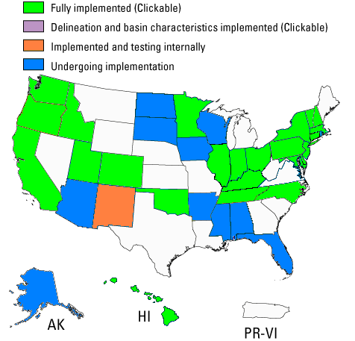
Implementation Status
24 states fully implemented
1 state partly implemented
10 states in implementation process
Navigation working

Slide 6
Rapidly Increasing Usage

Slide 7
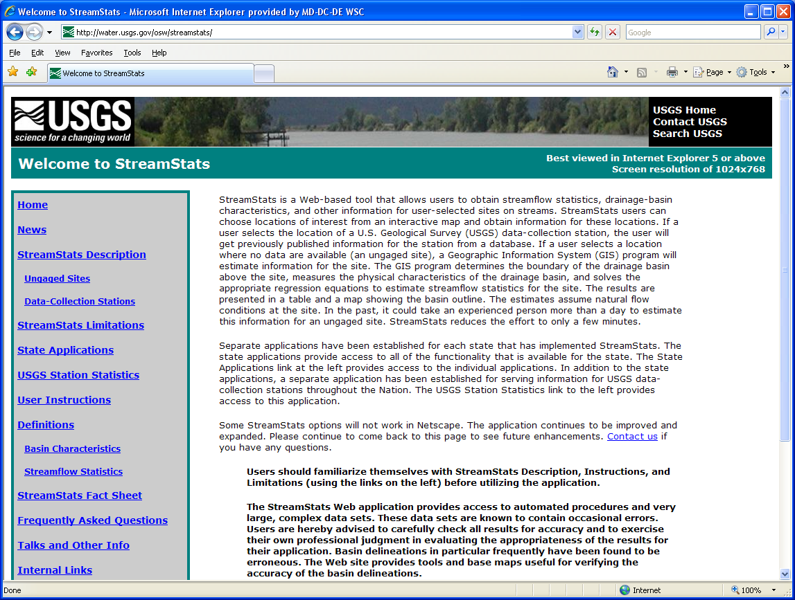
StreamStats Home Page http://streamstats.usgs.gov
Notes:
Now we’re back to the StreamStats home page. Each state has a separate application that allows users to get information for ungaged sites. These applications also allow users to get information for USGS stations, like what is available from the national station statistics application. Click on the State Applications link to get another page that allows you to select a state of interest.

Slide 8
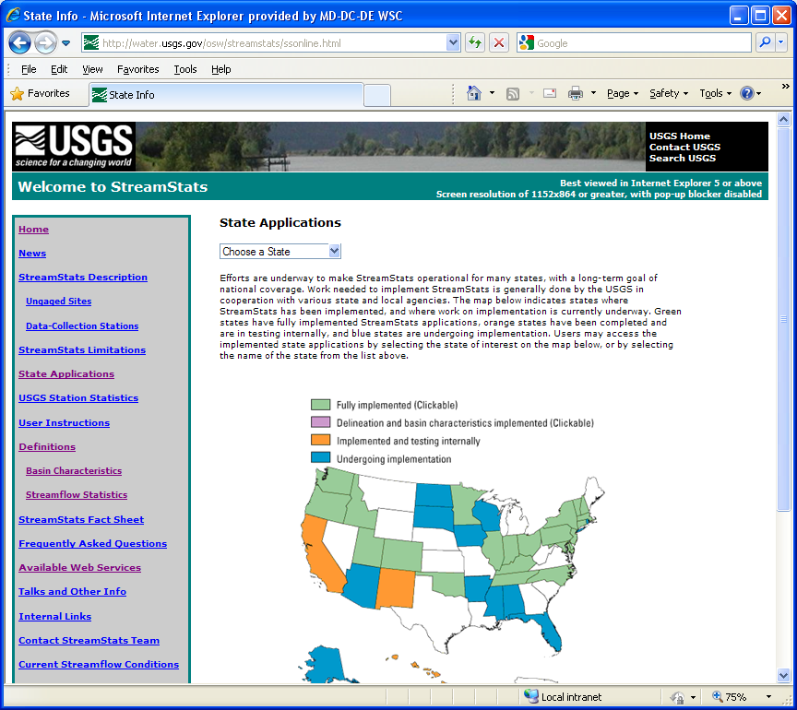
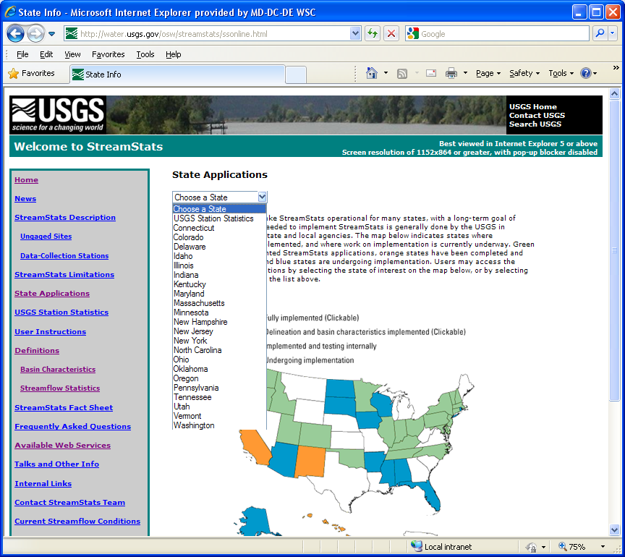
State Applications
Notes:
This is the State Applications page. At the top, it provides a list box that allows you to select a state of interest. (Click once to make an arrow point to and display the list). Alternately, you can select a state by clicking on its location on the status map. (Click again to make an arrow point to Massachusetts.)

Slide 9
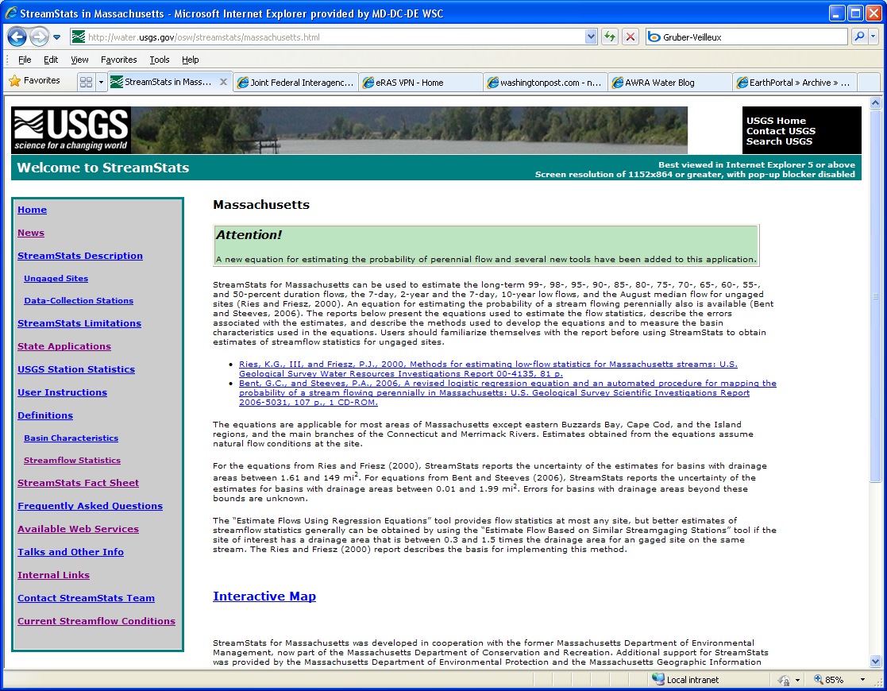
Massachusetts Introductory Page
Notes:
Click on the Interactive Map link to start the MA application.

Slide 10
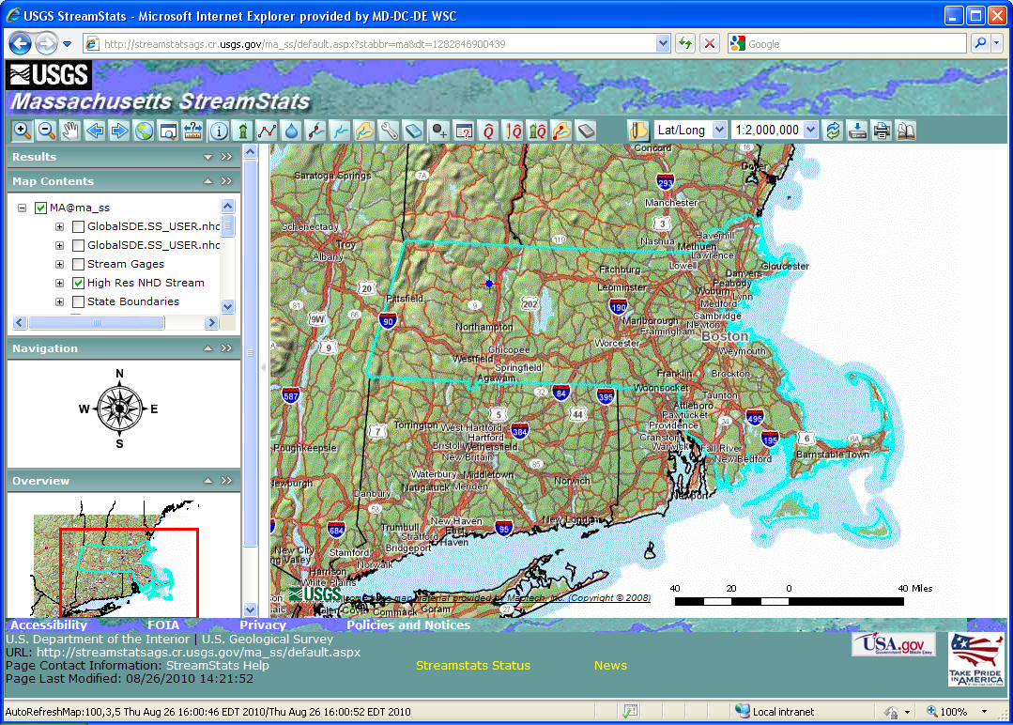
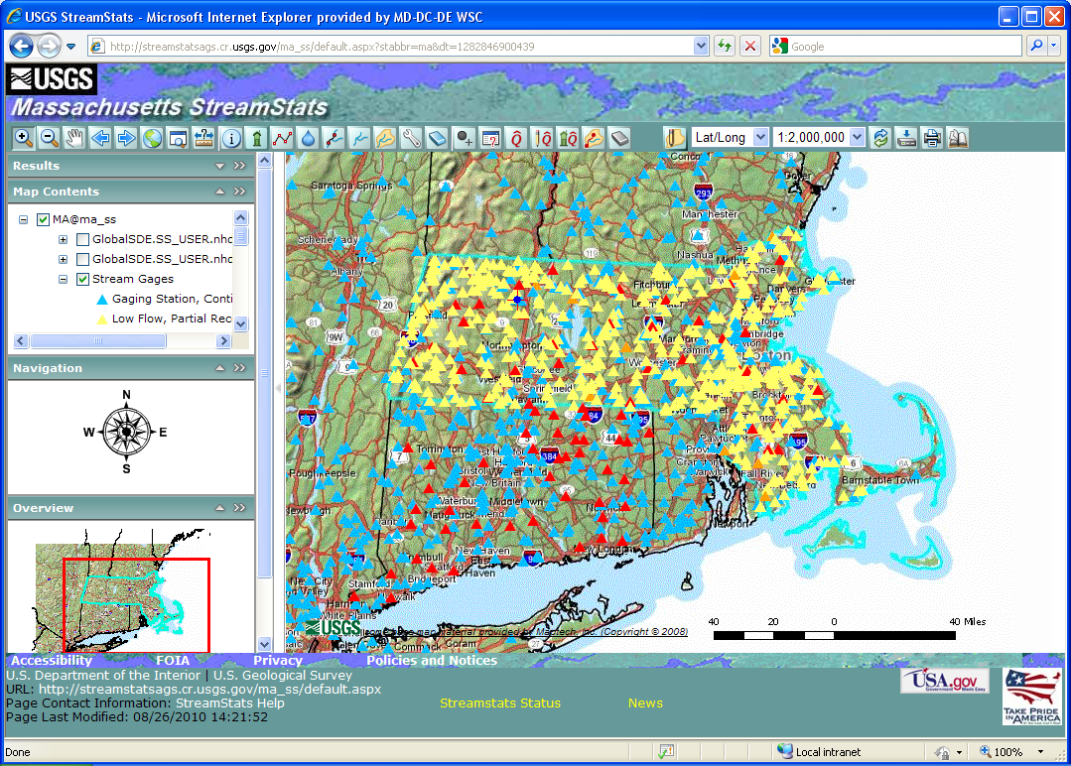
User Interface with Streamgages

Slide 11
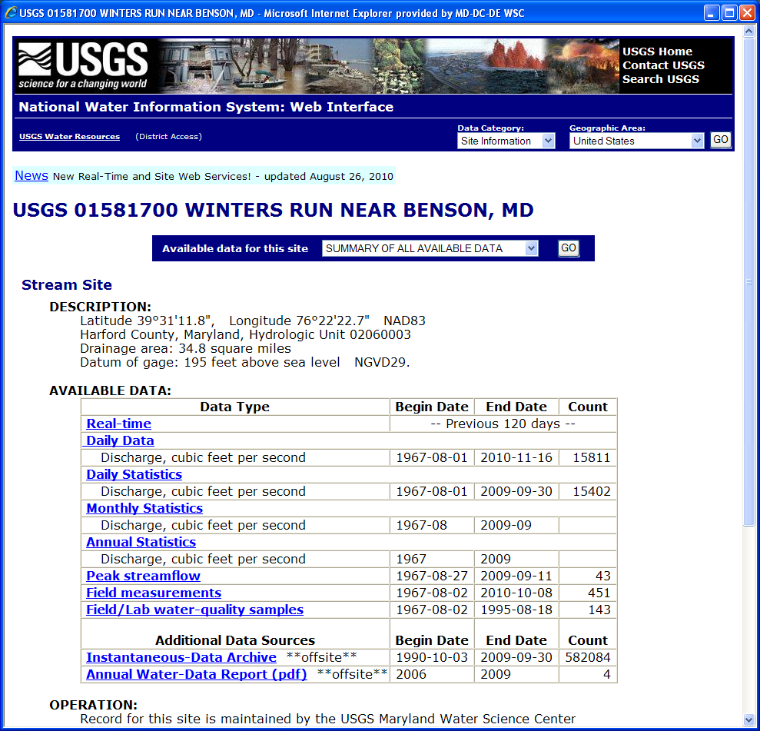
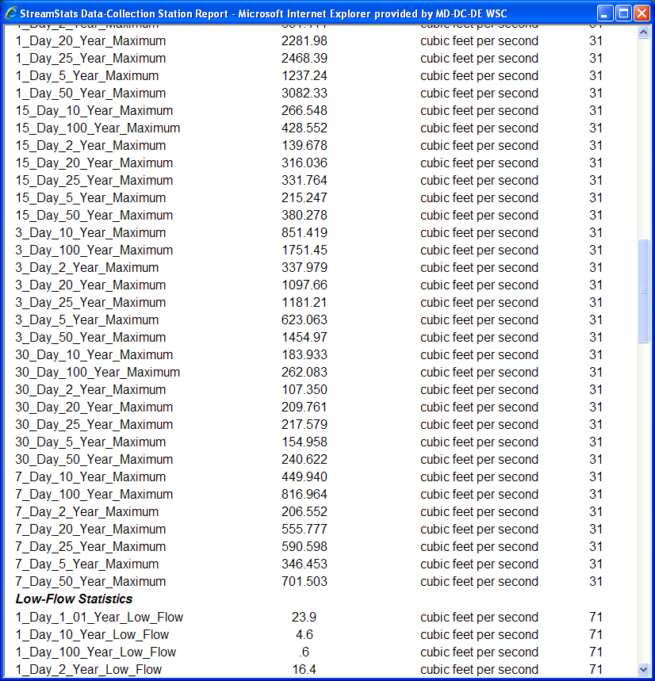
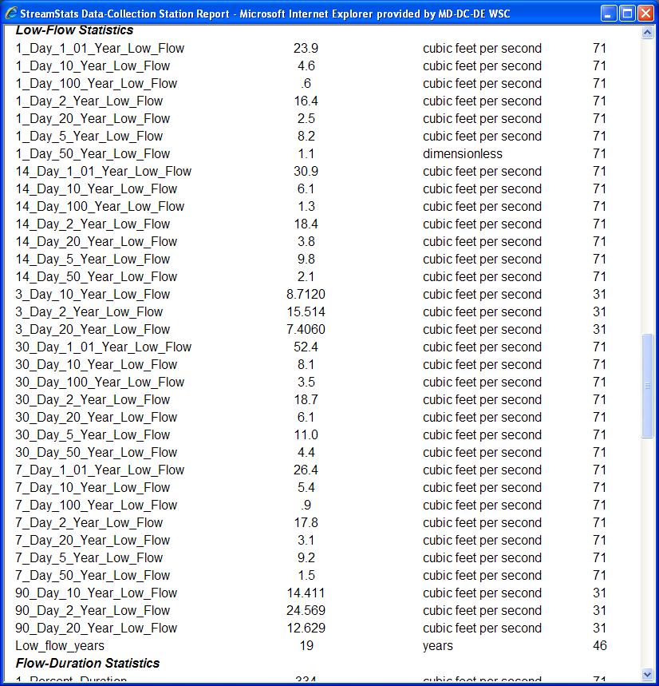
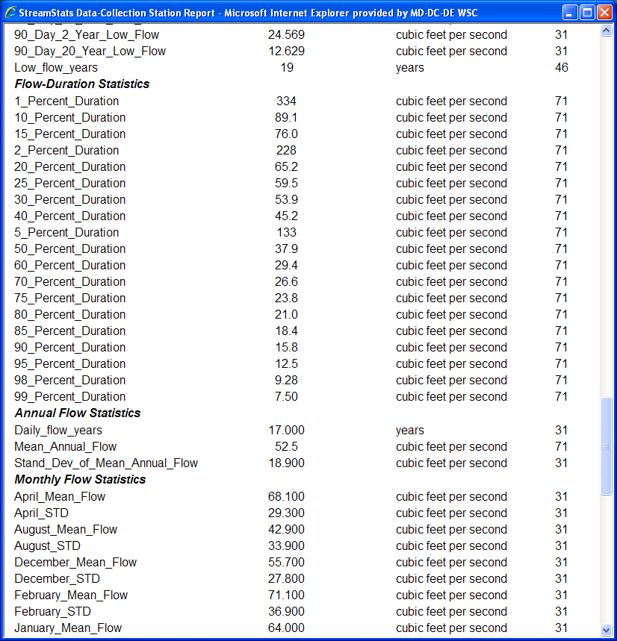
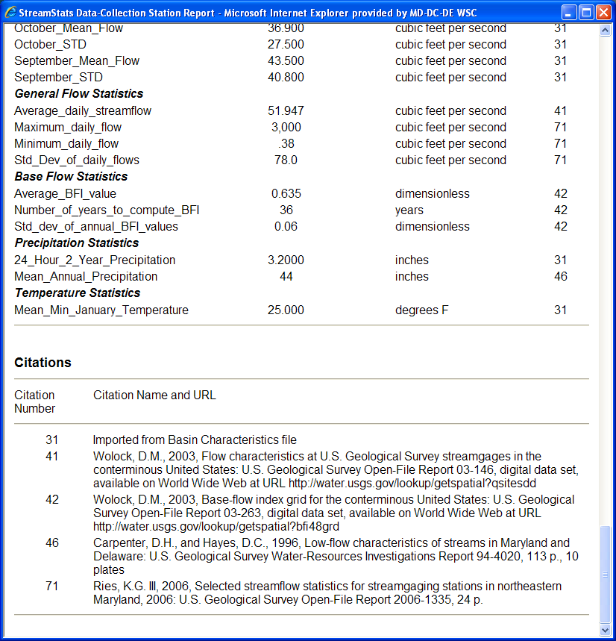
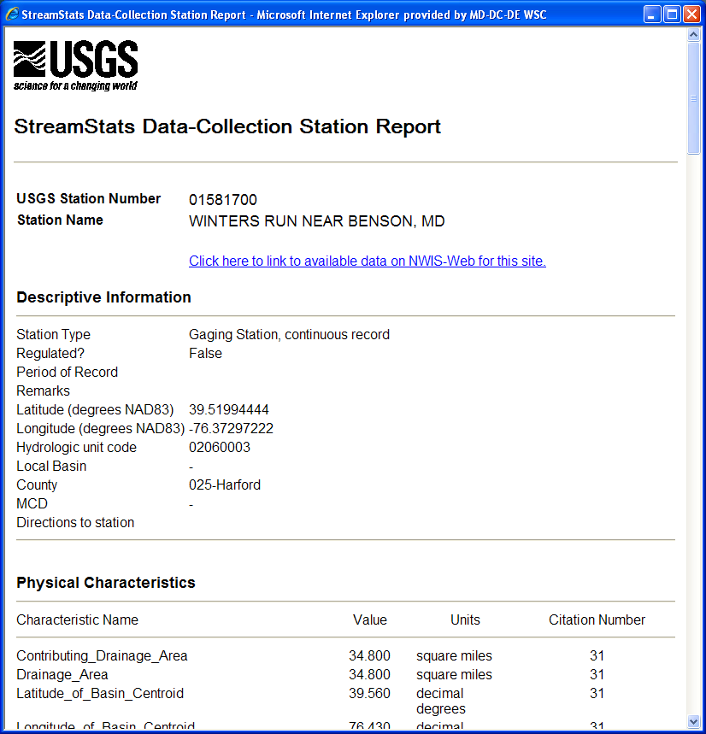
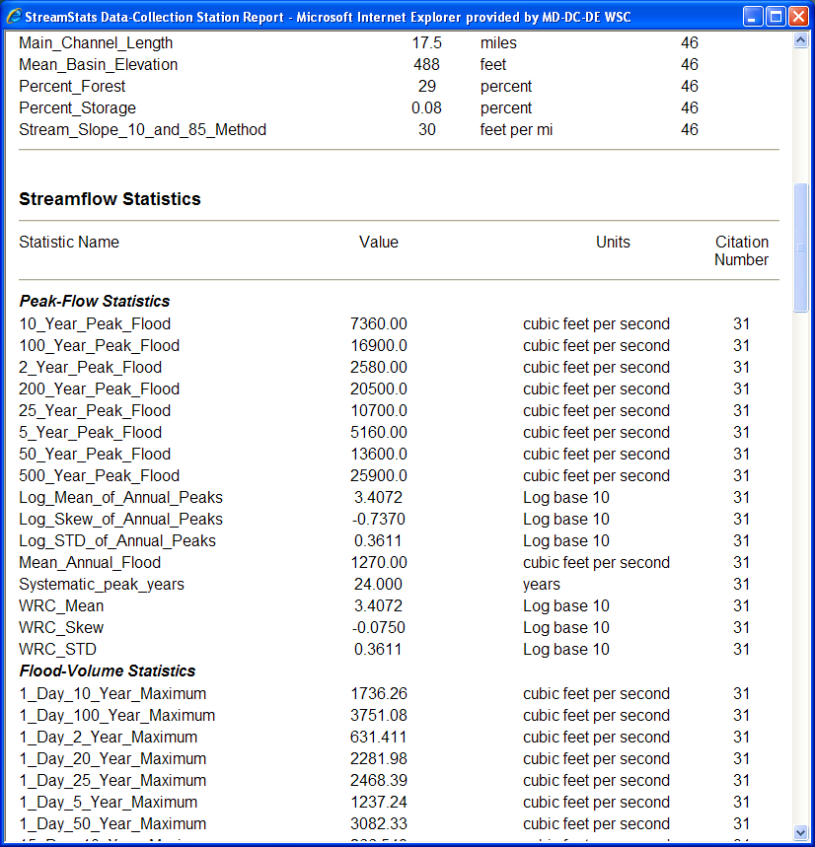
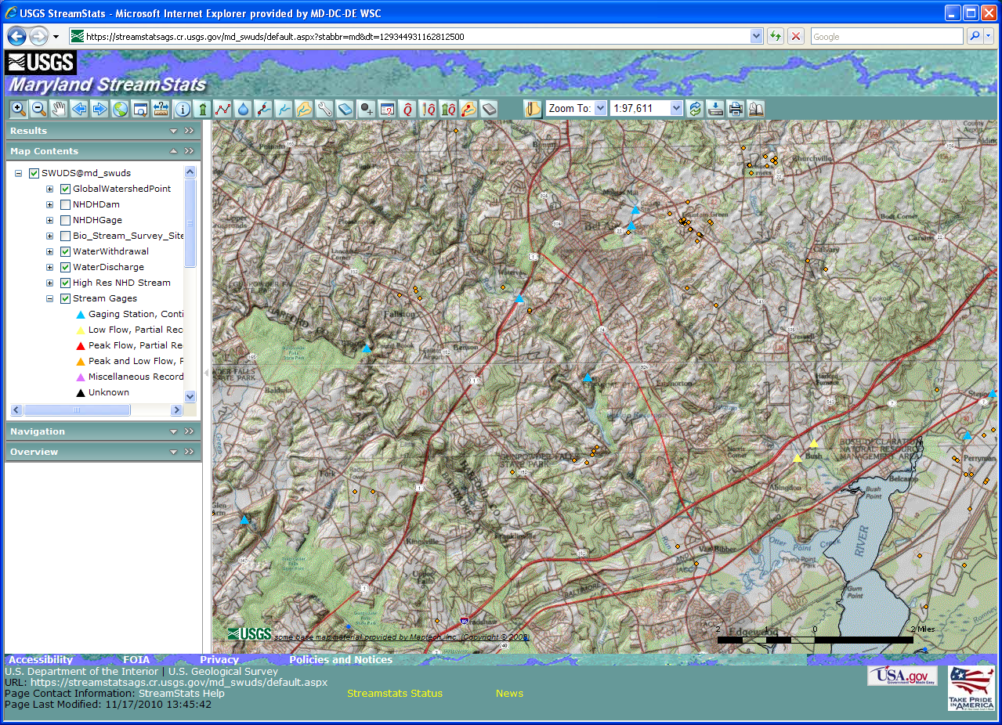
Get Information for Streamgage

Slide 12
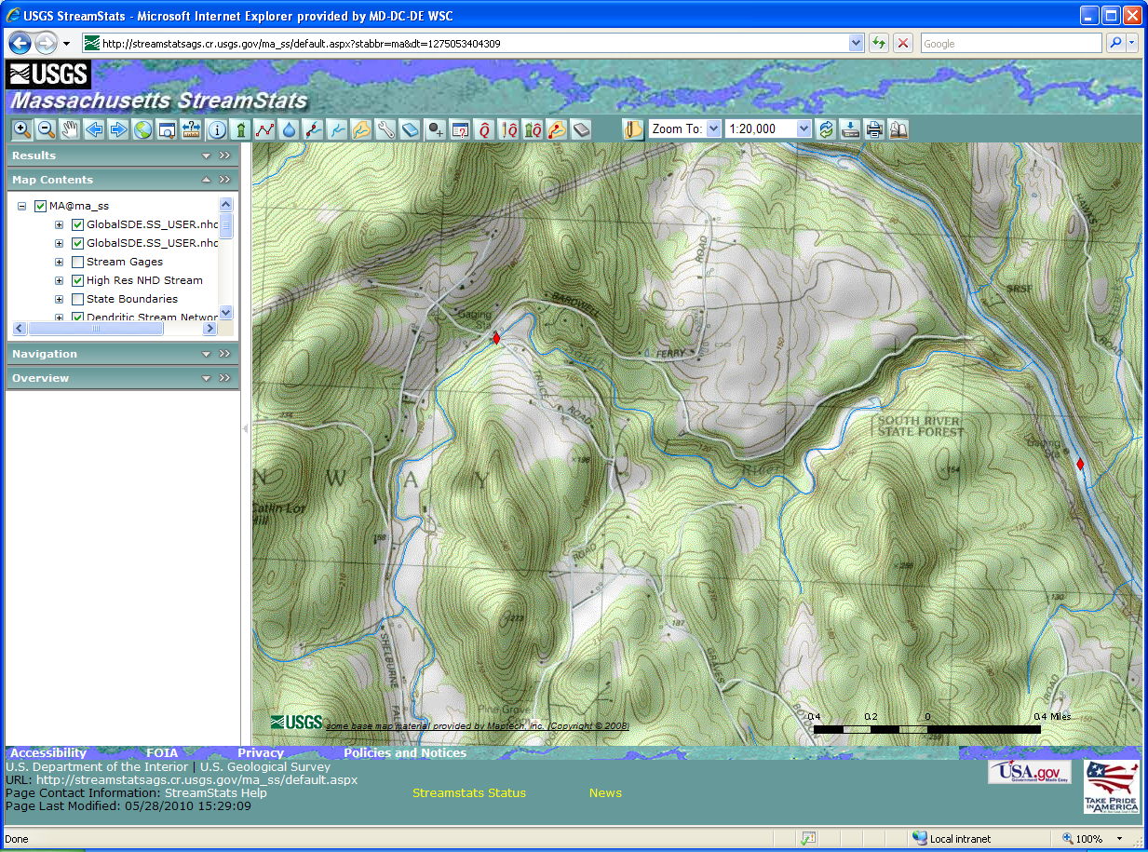
Select Ungaged Site
Note: Scale must be at least 1:24,000
Click on Point Delineation button
Notes:
Here we’ve zoomed into an area of interest. We click on the Point Delineation button (click) before we can select the point of interest on the stream. Note that you must be zoomed into a scale of at least 1:24,000 before the Point Delineation button will work. Also note that the point should be selected on the grid representation of the stream, not on the stream shown on the base map, if they differ. On the MA site, there are rarely differences between the two stream representations, but some other state applications use lower resolution data than we have on the MA site, and differences will be apparent. Now we’ll select the point. (click twice)

Slide 13
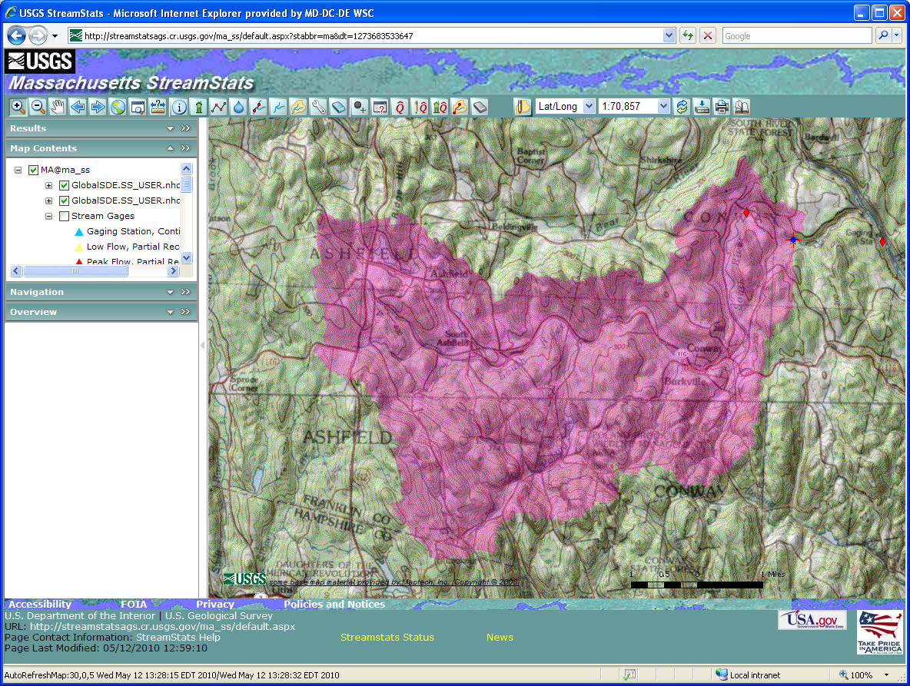
Delineated Basin

Slide 14
GIS Data Preparation
Data preparation and watershed characteristics measurements done using ArcHydro Data Model and Tools http://support.esri.com/index.cfm?fa=downloads.dataModels.filteredGateway&dmid=15
Data for boundary delineation
DEM – usually 10-m NED (http://ned.usgs.gov)
Stream network – Usually NHD (http://nhd.usgs.gov)
Basin boundaries – Usually WBD (http://www.ncgc.nrcs.usda.gov/products/datasets/watershed/)
DEM forced to conform with stream network and basin boundary datasets

Slide 15
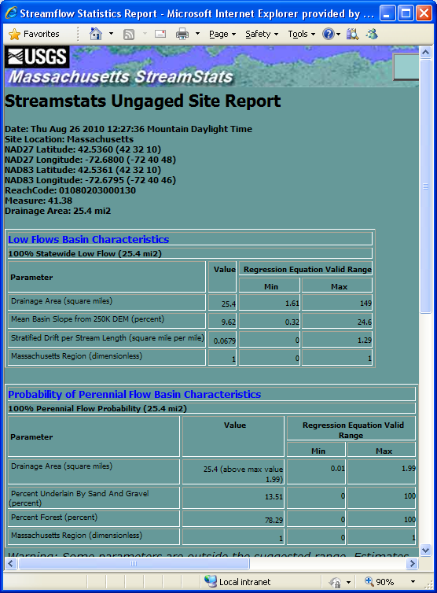
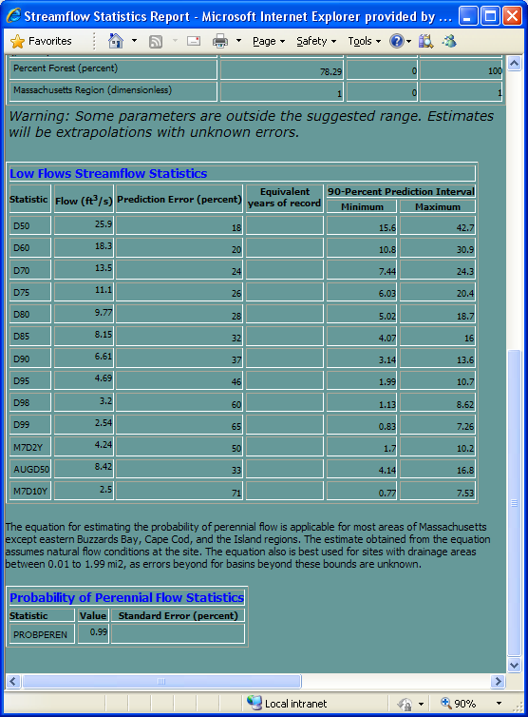
Flow Statistics from Regression Equations
Click on Estimate Flows Using Regression Equations
Regression equation estimates assume natural flow conditions at the selected site
Notes:
Now that we are happy with the basin delineation, we can get basin characteristics for the selected site and estimates of flow statistics determined from regression equations. To do this, click on the Generate flow statistics button (click). Usually within a minute a new window will pop up with an ungaged site report. The top of the report tells you when the report was created, the location of the selected point, and the total drainage area. The report also contains at least one table of basin characteristics and a table of streamflow statistics. The basin characteristics table contains only the characteristics that were used as explanatory variables in the regression equations used to estimate the streamflow statistics. This table gives the names of the characteristics, the computed values, and minimum and maximum values of the characteristics for the streamgages that were used to develop the regression equations. The streamflow statistics table gives short names for the statistics, the estimated values, the prediction error (average standard error of prediction), in percent, the equivalent years of record, and the 90-percent prediction interval, if available.
If the one or more of the basin characteristics for your selected site are outside the given minimum and maximum values, then you will get a message to warn you about it. You will still get estimated flow statistics, but you will not get any indicators of the errors associated with the estimates, as they are not known. (click) We are working add hyperlinks to the names of the basin characteristics and streamflow statistics so that users can easily get definitions for the statistics. Currently, definitions are available on the Definitions links from the StreamStats home page and several other pages.

Slide 16
Regression Equation Availability
State | Peak Flows | Low Flows | Mean Flows | Flow Durations | Other
California | X
Colorado | X | X
Connecticut | X |  |  | X
Delaware | X
Hawaii | X
Idaho | X | X | X | X | X
Illinois | X
Indiana | X | X
Kentucky | X
Maryland | X | X
Massachusetts |  | X |  | X | X
Minnesota | X | X
New Hampshire | X
New Jersey | X
New York | X
North Carolina | X
Ohio | X |  | X | X
Oklahoma | X
Oregon | X | X |  | X
Pennsylvania | X | X | X | X | X
Tennessee | X | X
Utah | X
Vermont | X |  |  | X
Washington | X

Slide 17
Other Tools for Use With Delineated Basins
Edit a Delineated Basin
Add or remove areas
Basin Characteristics
Computes additional BCs
Edit Parameters and Recompute Flows
Allows testing of scenarios
Estimate Flows Based on Similar Streamgaging Stations
Estimates flows using nearby streamgages and drainage-area ratio method
Relies on stream network navigation

Slide 18
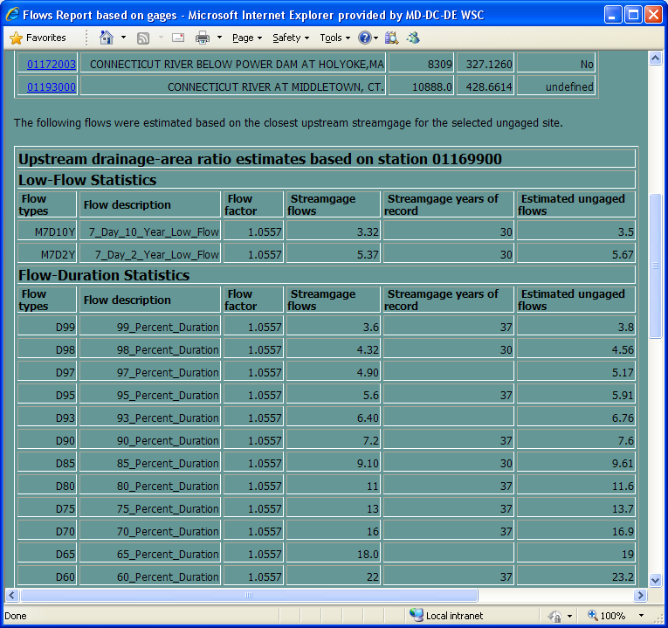
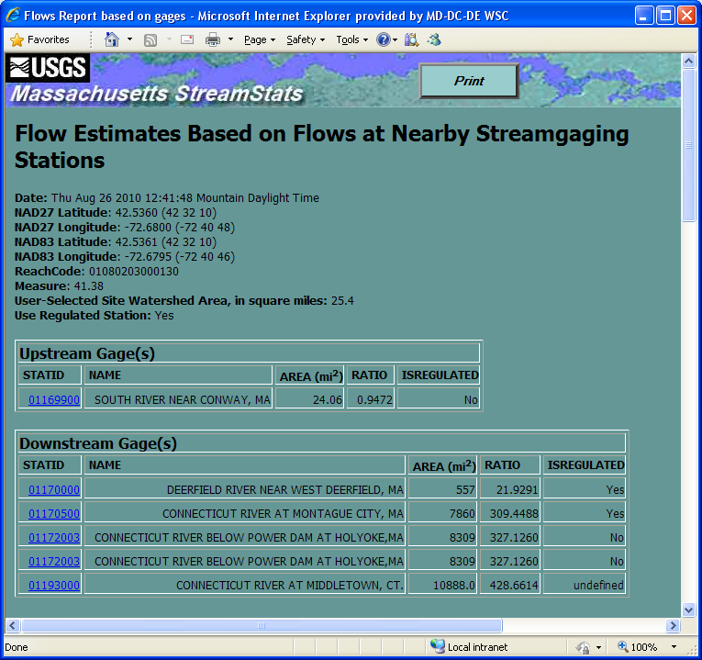
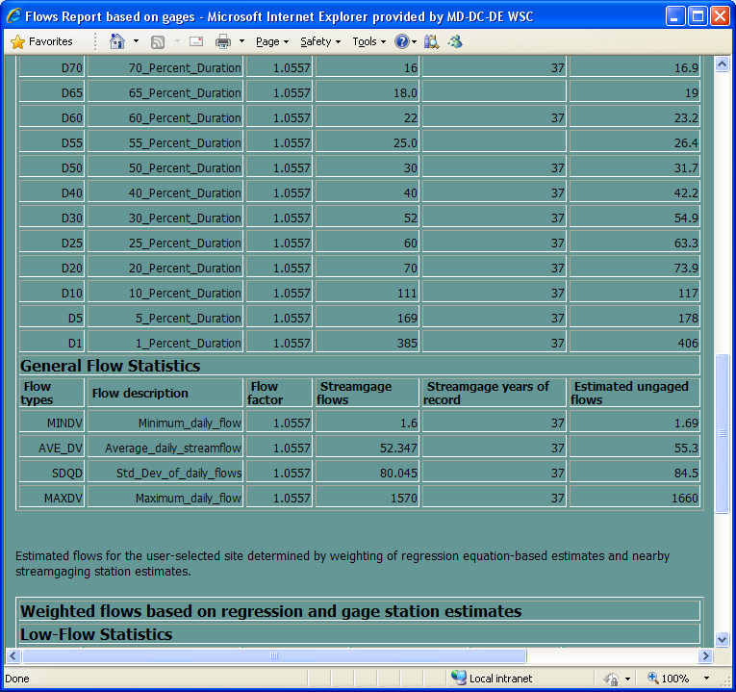
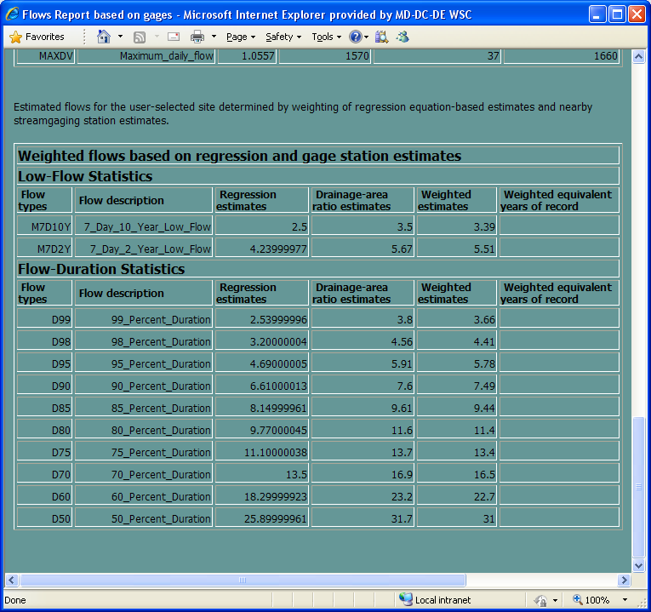
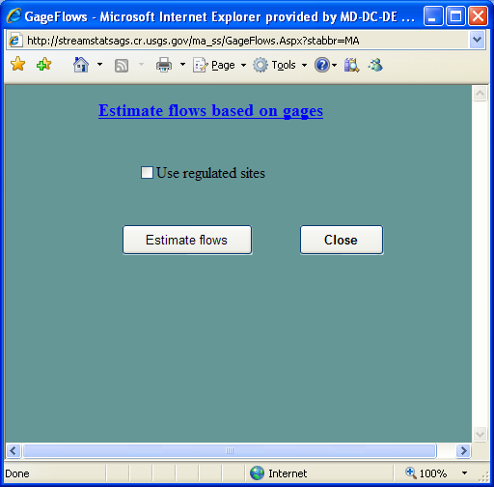
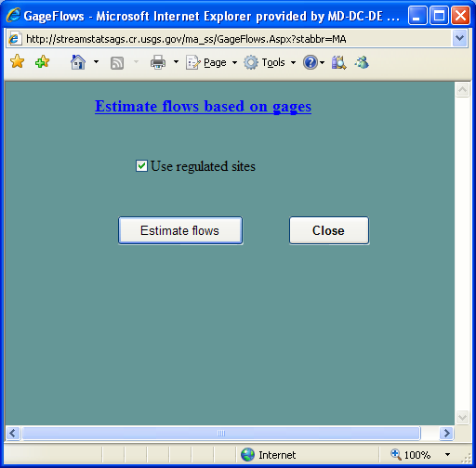
Flow Estimation Based on a Similar Gage
Click on Estimate Flows Based on Similar Streamgaging Stations
Estimates provided if RATIO >= 0.5 and <= 1.5

Slide 19
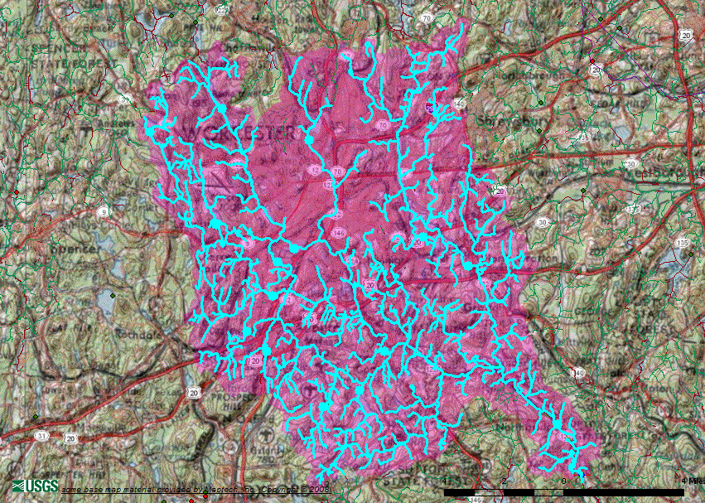
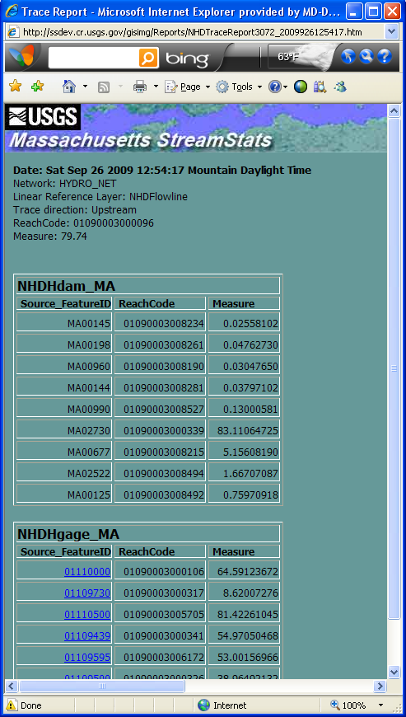
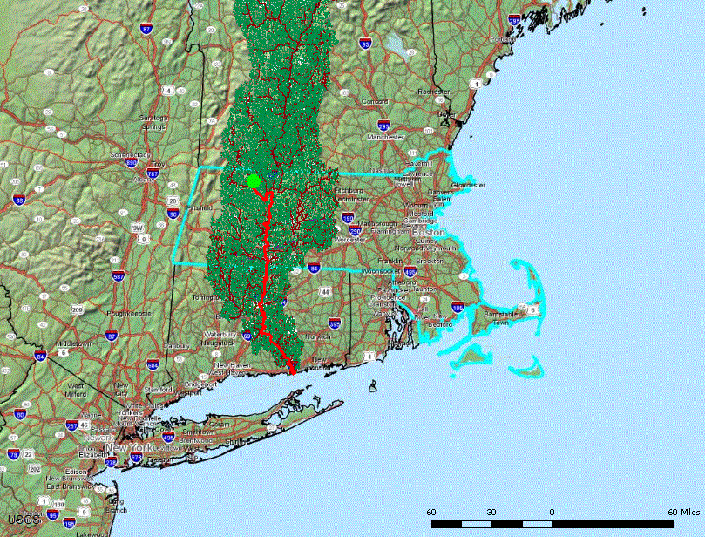
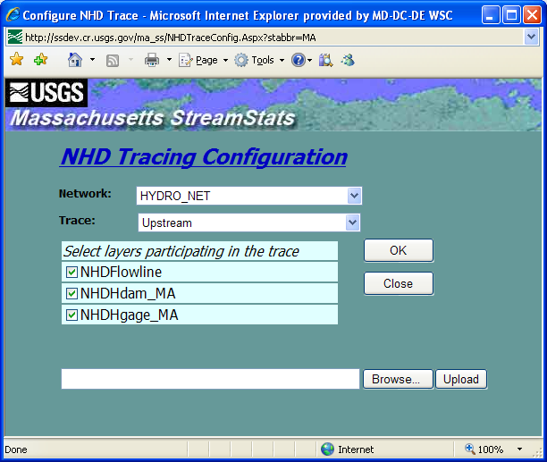
Network Tracing in StreamStats
Configure trace
Specify layer used (NHD, NHDPlus, etc.)
Direction of tracing (upstream, downstream, both)
Participating event layers (gages, dams, etc.)
Trace from delineated or ad-hoc point
Display identified reaches
Identify point events
Raindrop trace to network
Display path from point to network, and downstream
Compute reach address at point on network

Slide 20
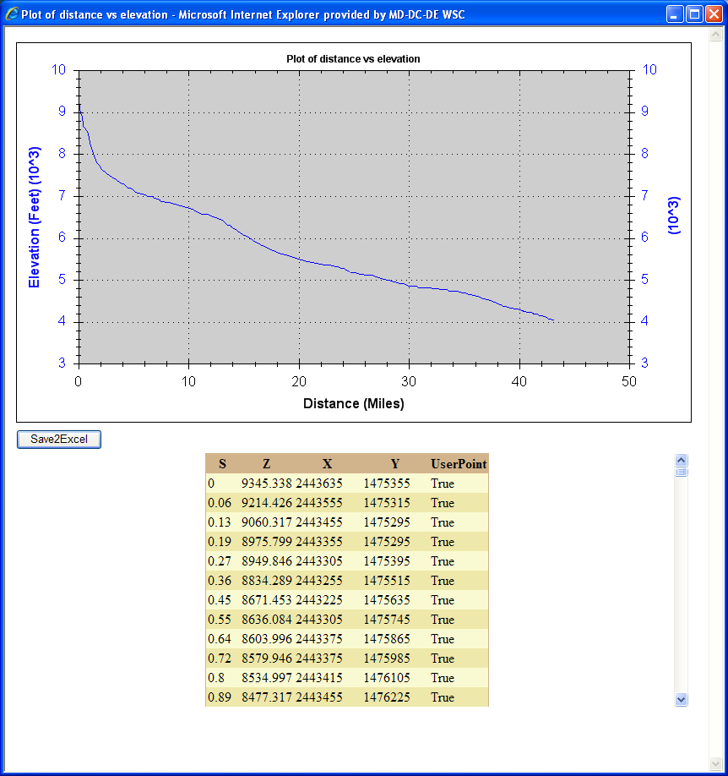
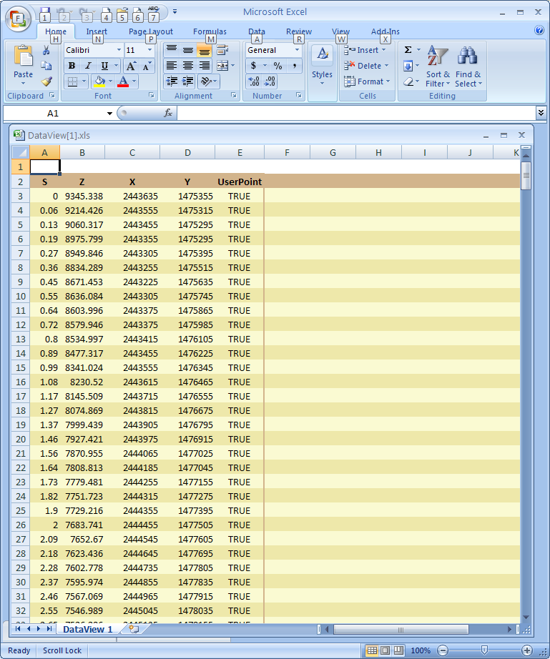
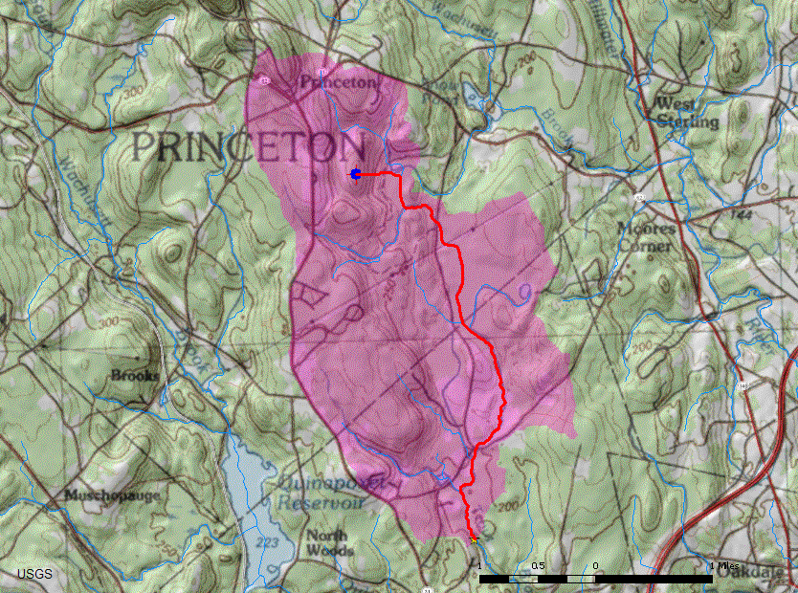
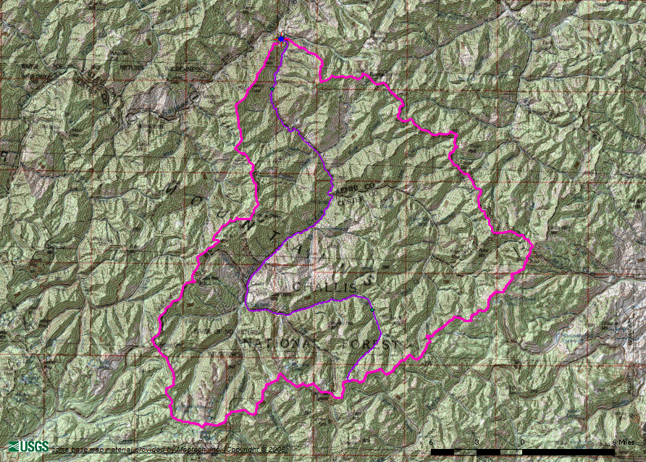
Network Profile Plots
Trace flow path within a delineated watershed
Show network path and profile
Show main channel flow path and profile

Slide 21
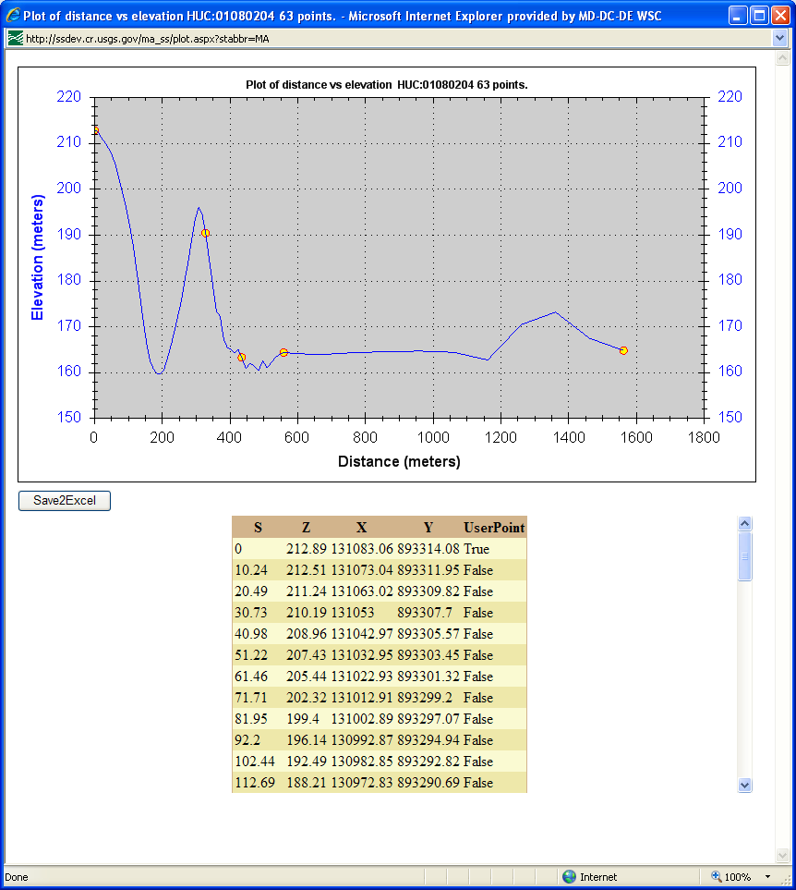
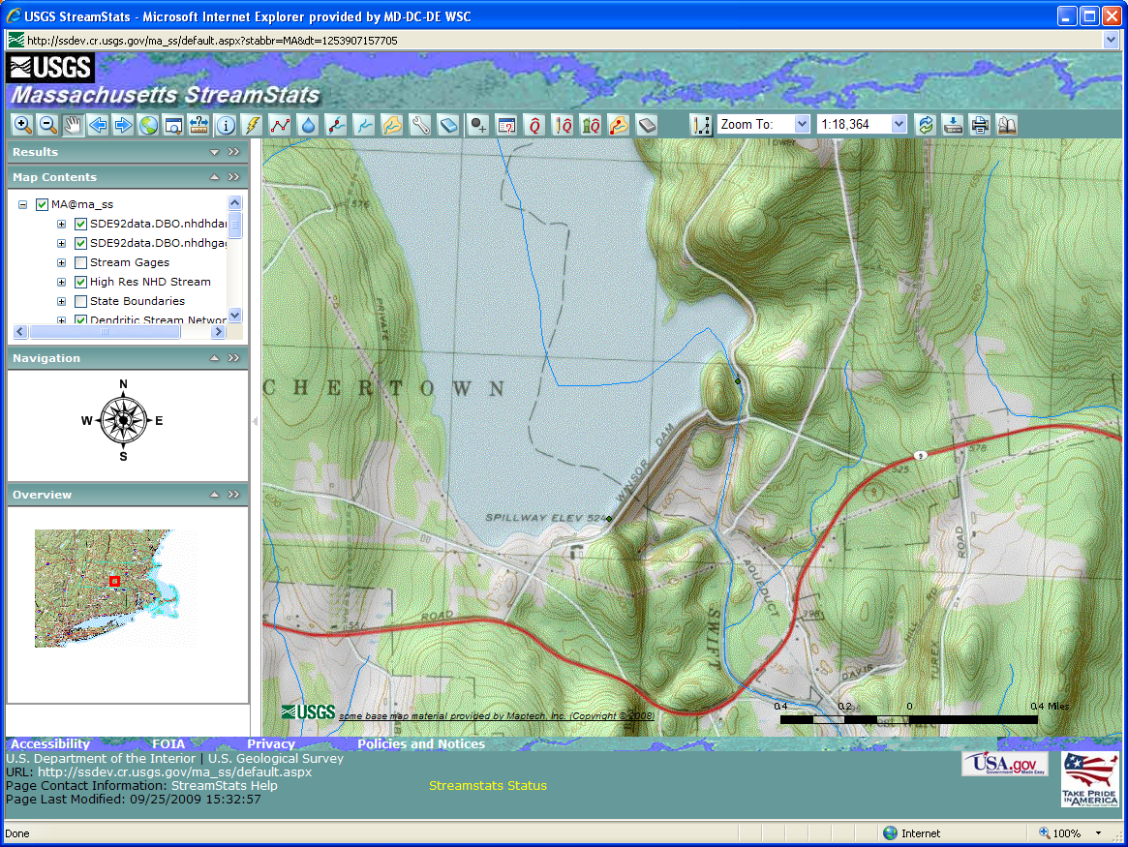
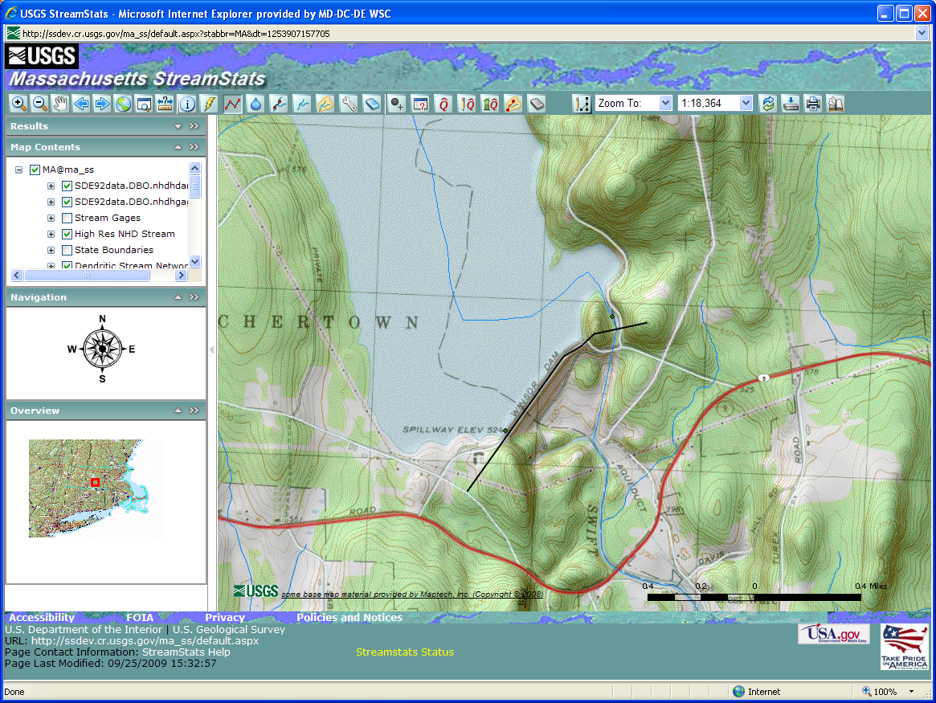
Terrain Profile Tool
Notes:
Click once to make arrow point to Terrain Profile tool.
Click again to make arrow point to first end of line.
Click again to make arrow point to end of line. (In actuality, users double-click to end drawing of the line.)
Click again to show graph of profile and data points.
Click again to download data points to Excel and display.

Slide 22
Water-Use Summaries for Maryland
Available to all users
Net = Σ Discharges – Σ Withdrawals

Slide 23
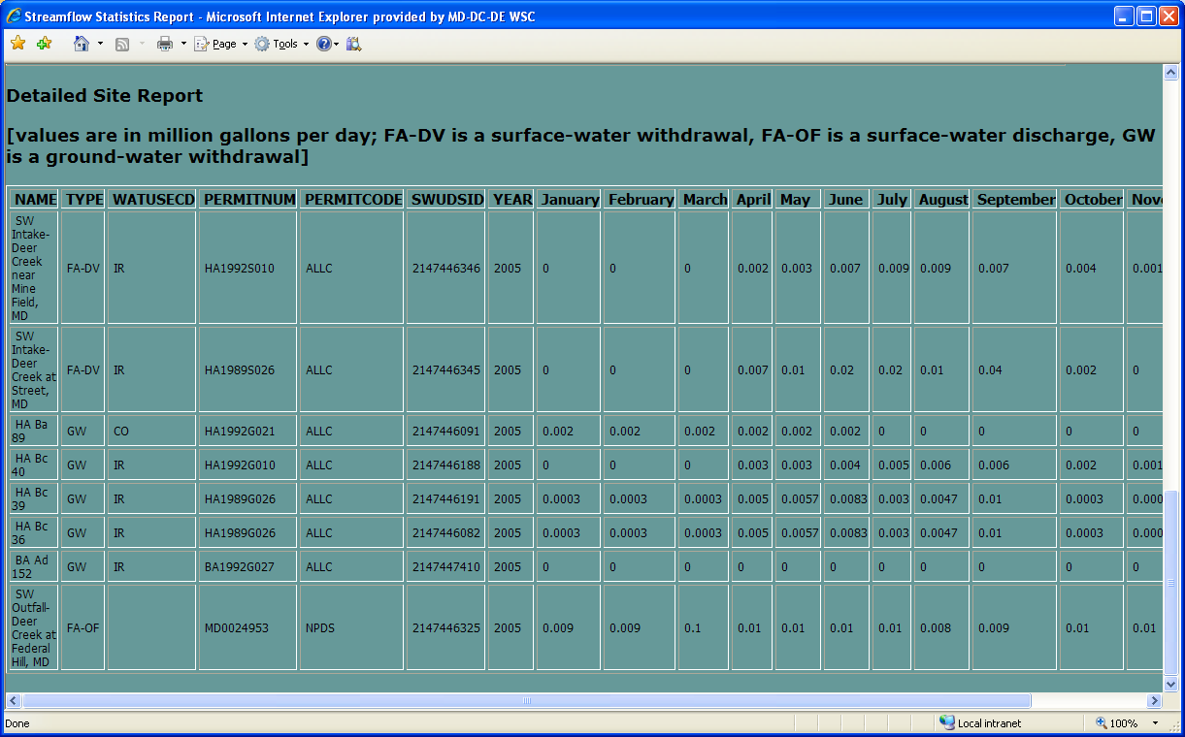
Detailed Water-Use Site Information
Available only for users with login privileges (mostly gov’t agencies)

Slide 24
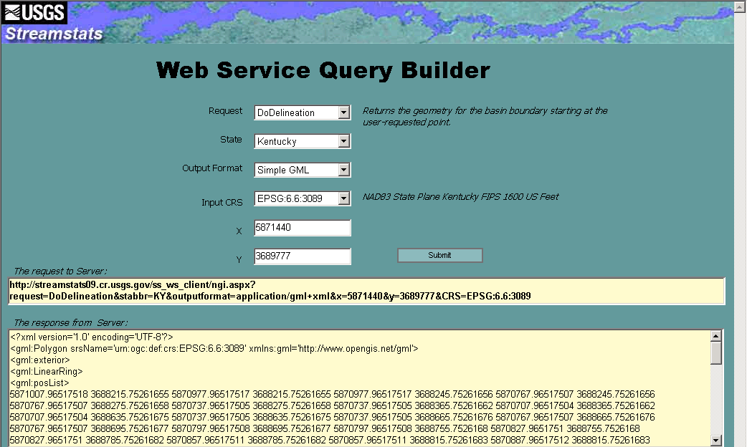
StreamStats Web Services
Available for:
Basin delineation
Gaging station statistics
Ungaged site statistics
Compute NHD reach and measure
Batch process
More coming
See Available Web Services link from StreamStats home page for more information
Notes:
We have developed a query builder to allow others to configure their queries and get sample output in various formats.

Slide 25
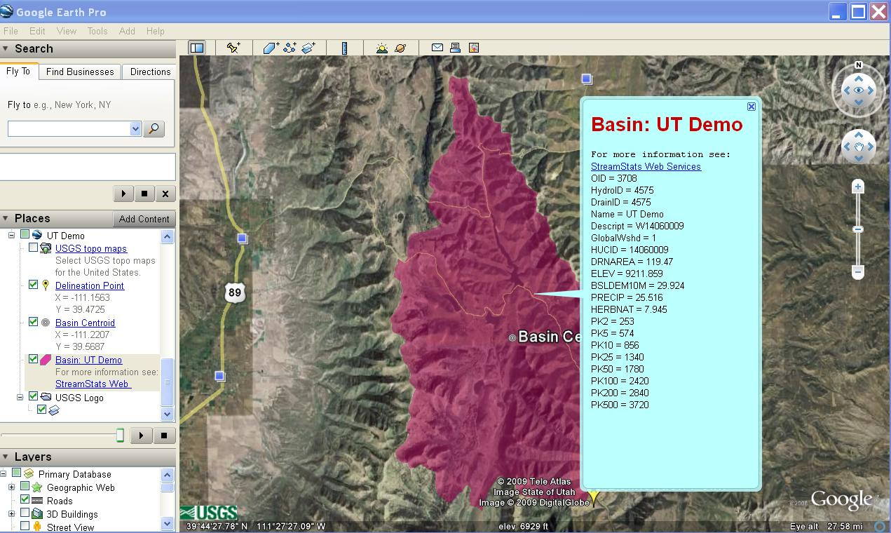
StreamStats Results in Google Earth
Notes:
Example of a demo KML query that allows display of boundary, basin characteristics, and flow statistics through GoogleEarth.

Slide 26
Planned Enhancements
Migrate all functionality to web services
Enable network navigation for all states
Add navigation to and query of EPA and other datasets
Access to all State applications from a single user interface
Automated weighting of regression estimates for basins that cross State lines based on percentage of basin in each State
Estimation of daily flows (MA and PA)

Slide 27
Suggested Improvements for AHR
Need a more scalable "global" system in ArcHydro Tools to realize the "patchwork quilt" integrated raster-vector dream
More emphasis on the vector network needed, to take advantage of:
Better handling of divergent flows
VAA query-based navigation for speed
Populate the Z-values on NHD--3D network
Tree-walking approach to develop main flow paths/channels
Need for a common identifier for a "chunk-o-water" across scales
More detailed tracking of water use to allow more accurate water budgets

Slide 28
Wish List for ArcHydro River
A more scalable "global" system for ArcHydro Tools (multi-scale network, catchments, integrated raster-vector framework)
More emphasis on the vector network, to take advantage of:
Better handling of divergent flows
VAA query-based navigations for speed
tree-walking approach to develop main flow paths/channels
Populate the Z-values on NHD--3D network
Precompute basin characteristics at the catchment level
Either a common identifier for a "chunk-o-water" across scales – or some way to link features between scales
Network interpolation/modeling from observation data, e.g. real-time streamflow interpolation network-wide from gage observations
More detailed tracking of water use to allow more accurate water budgets

Slide 29
Rea's Corollaries to Moore's Law:
Rea's First Corollary: GIS practitioners are inexorably drawn into a vortex--the never ending pursuit of increasing resolution. The rate of increase in resolution achieved roughly mirrors the rate of improving computer storage capacity and processing speed, which is governed by Moore's Law. Basically, we'll process as much data as we can stand to wait for.

Slide 30
Rea's Corollaries (cont):
Rea's Second Corollary to Moore's Law: As the scale of GIS data approaches 1:1 and absent a drastic improvement in our ability to model the physical processes represented, the amount of real information gained with increasing resolution approaches zero.
Rea's Third Corollary to Moore's Law: Nothing in Rea's Second Corollary negates Rea's First Corollary.

Slide 31
Questions or Suggestions?
URL
http://streamstats.usgs.gov
Team email
GS-W StreamStats@usgs.gov

