Slide 1
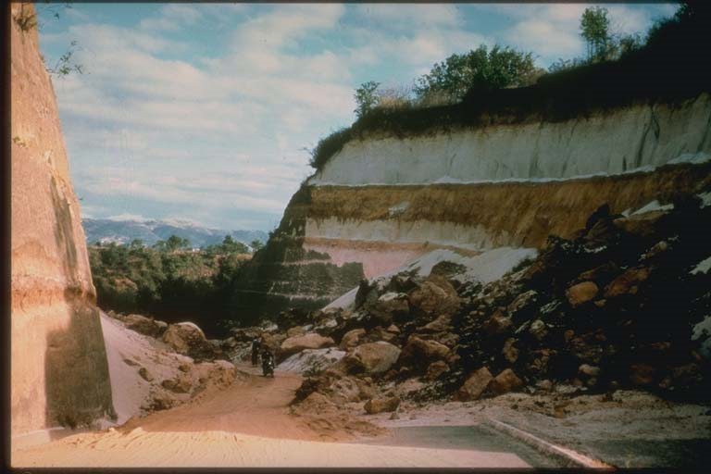
Effect of Rainfall on landslides in Guatemala during hurricane stan
Rachel Chisolm: EWRE, GIS in Water Resources
[1]

Slide 2
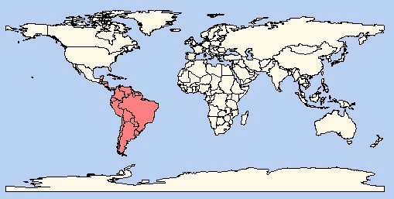
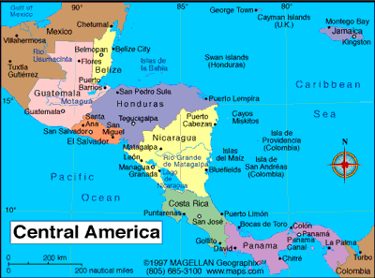
Where in the world is Guatemala?
[2]

Slide 3
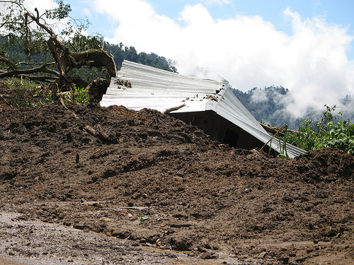
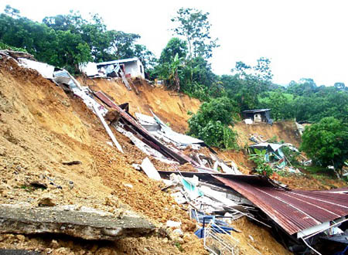
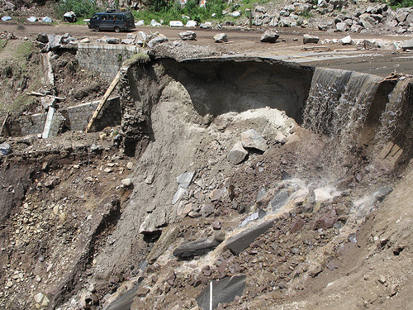
Background
[3]
[4]

Slide 4
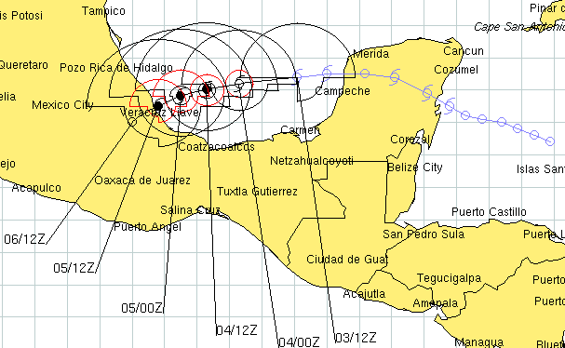
Path of hurricane/tropical storm Stan
[5]
October 1-4, 2005

Slide 5
Topography of Guatemala
Data downloaded from USGS Global 30 arc-second Elevation Dataset (GTOPO30)

Slide 6
Rainfall during stan
Up to 34 inches of accumulated rain from October 1-10, 2005
Up to 10.5 inches of rain in a 24 hour period (6 in. at higher elevations where the majority of landslides occurred) _{[6]}

Slide 7
Precipitation Trends in Guatemala
Rainy Season
Dry Season

Slide 8
SInmap
A STABILITY INDEX APPROACH TO TERRAIN STABILITY HAZARD MAPPING
Measures slope stability taking into account wetness, slope, and soil cohesion
Factor of Safety:
[7]
C_{r} = root cohesion; C_{s} = soil cohesion; θ = slope angle; ρ_{s} = wet soil density; ρ_{w} = density of water; g = gravitational acceleration; D = vertical soil depth; D_{W} = vertical height of water table; φ = internal friction angle of soil

Slide 13
Contributing Area

Slide 14
From Sinmap sample data

Slide 15
Known Land Slide locations During Stan

Slide 16
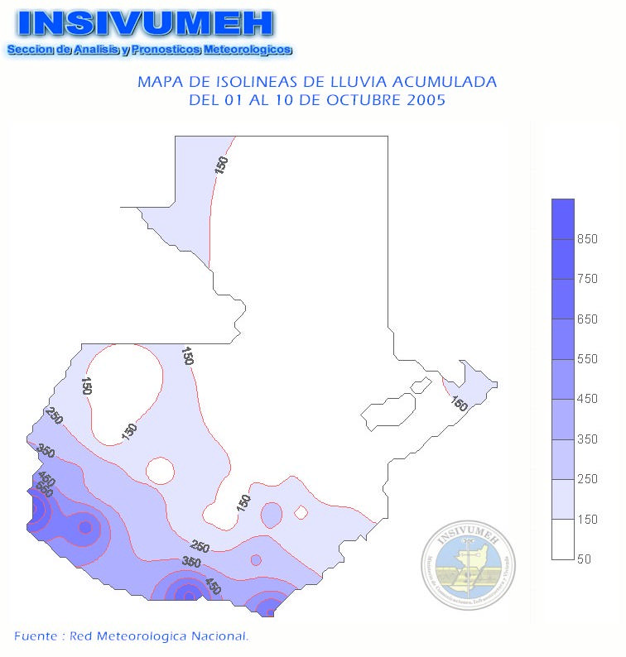
Elevation and Precipitation Effects on Landslides During Stan
Accumulated Precipitation

Slide 17
Conclusions
Areas with the greatest slope combined with higher precipitation levels saw the highest concentration of landslides.
Need more refined DEM to accurately map potential landslide areas.
Couple with field work.

Slide 18
References
http://www.smate.wwu.edu/teched/geology/GeoHaz/eq-general/eq-general-14.JPG
http://www.retiredexpat.com//map-central-america.php
http://english.peopledaily.com.cn/90001/90777/90852/6454594.html
http://www.javno.com/en/world/clanak.php?id=167091
Byron Yury Medina, Fundación Defensores de la Naturaleza, Deslizamientos e Impactos Ambientales de los Huracanes Mitch y Stan, en Guatemala, http://hercules.cedex.es/hidraulica/PROHIMET/Br07/Comunicaciones/Medina.pdf
Resumen del Impacto Asociado al Huracan “Stan” en Guatemala, Instituto Nacional de Sismología, Vulcanología, Meteorología e HidrologíaI (INSIVUMEH), Octubre de 2005.
SINMAP User’s Manual, R.T. Pack, et al, Utah State University
http://www.oxfamamerica.org/newsandpublications/news_updates/archive2005/news_update.2005-10-12.9620309335

Slide 19
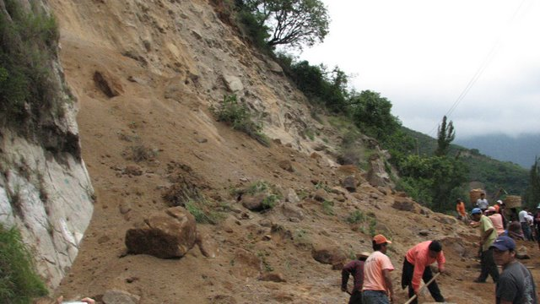
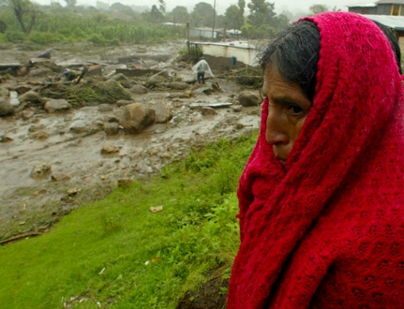
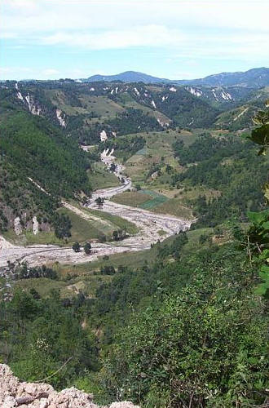
Questions???????
[8]

