Slide 1
Evaluating Harris County’s Road Network
Focusing on Congestion and Flooding
Eleni Pappas
November 20, 2008

Slide 2
Outline
Project Scope
Initial Goals
Current Status
Challenges
Future Goals

Slide 3
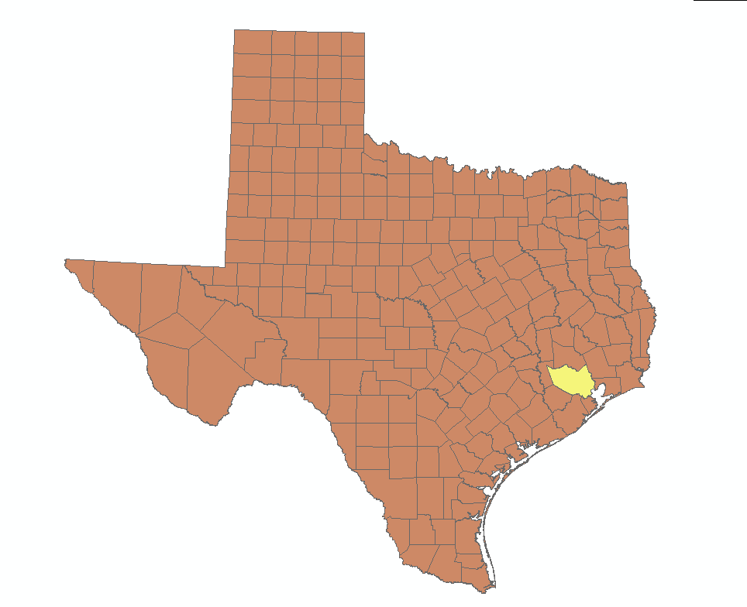
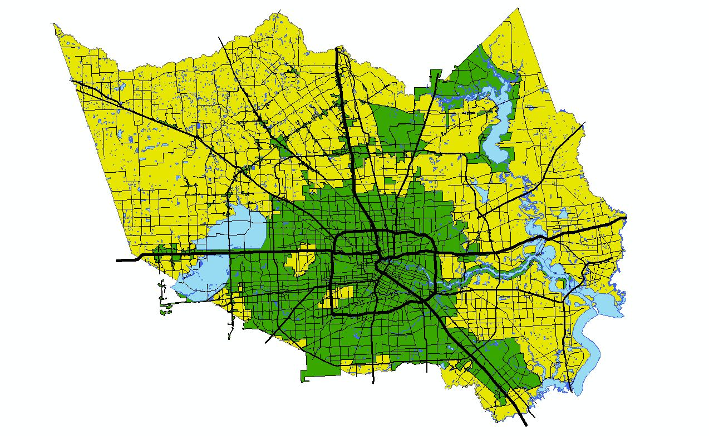
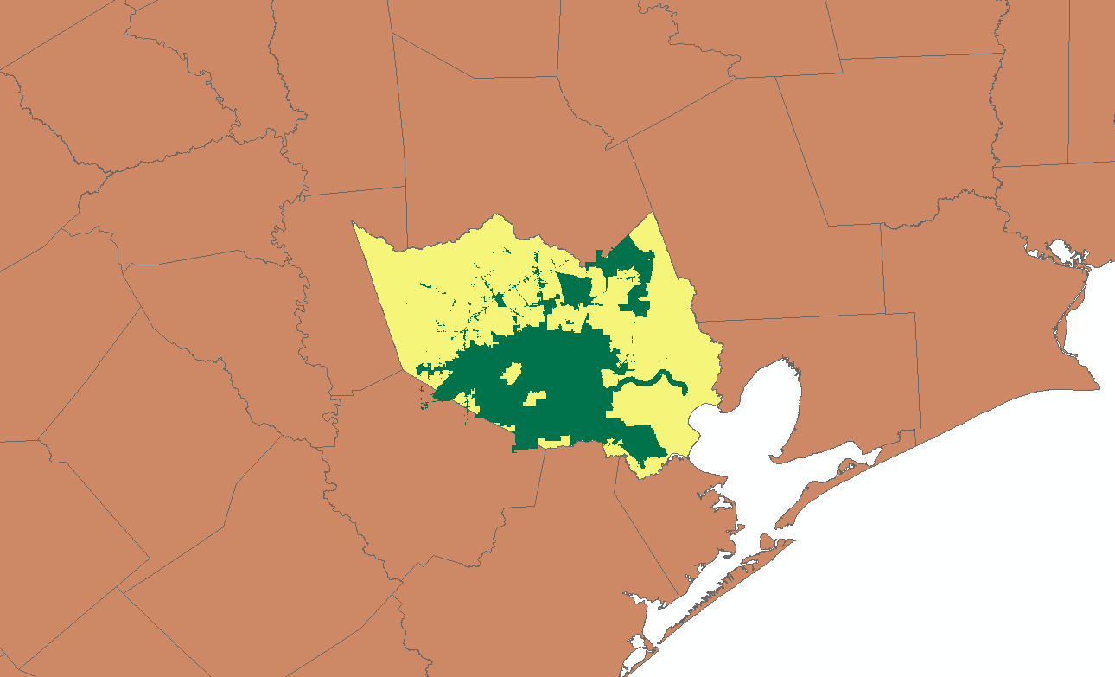

Slide 4
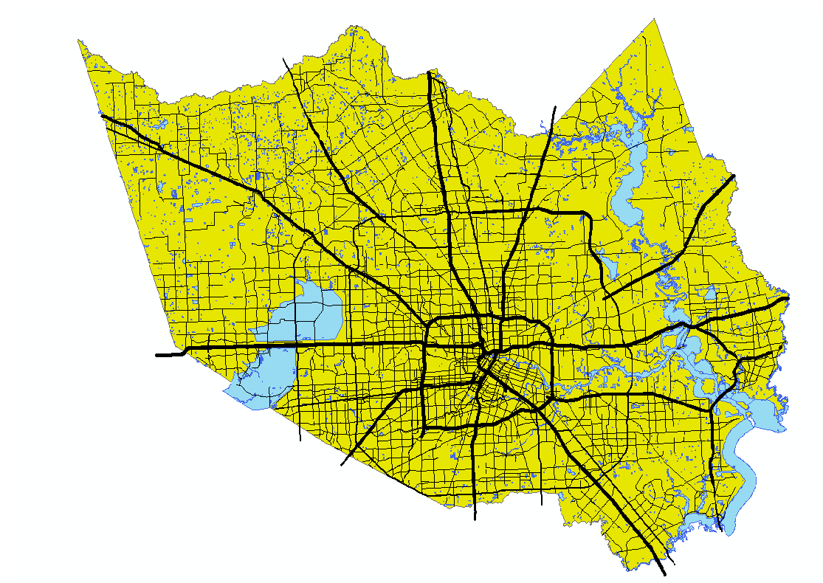
Study Area: Harris County

Slide 5
Harris County Statistics
Houston - Sugarland - Baytown
Population: 3,935,855 (2007 est.)
Pop. Density: 1,966.8 /mi²
Elevation
Range: 11 – 291 ft above MSL
Average: 88.5 ft above MSL
Total Road Mileage: 9,171mi
3545.591: Major Roads
6.4% of all Roads in Texas (143,578.10 mi)
2007 Road and Bridge expenditure: $50,119,666
4.5% of Total ($1,120,984,398)
Notes:
Most Populous in Texas

Slide 6
Initial Project Goals
Identify Harris County Traffic “Hotspots”
Roads where the demand outweighs the capacity
Identify Harris County roads with a potential for flooding

Slide 7
Harris County Floodplains
Notes:
Addicts Reservoir
Barker Reservoir
Houston Ship Channel
Buffalo Bayou “bayou city”
San Jacinto River
Lake Houston

Slide 8
Floodplain Risk
100-Year Flood Plain
1% chance of being flooded in any given year
26% chance of flooding during a 30-year period
500-Year Flood Plain
0.2% chance of being flooded in any given year
6% chance of flooding during a 30-year period
But, localized street flooding can happen anywhere in a heavy rain

Slide 9
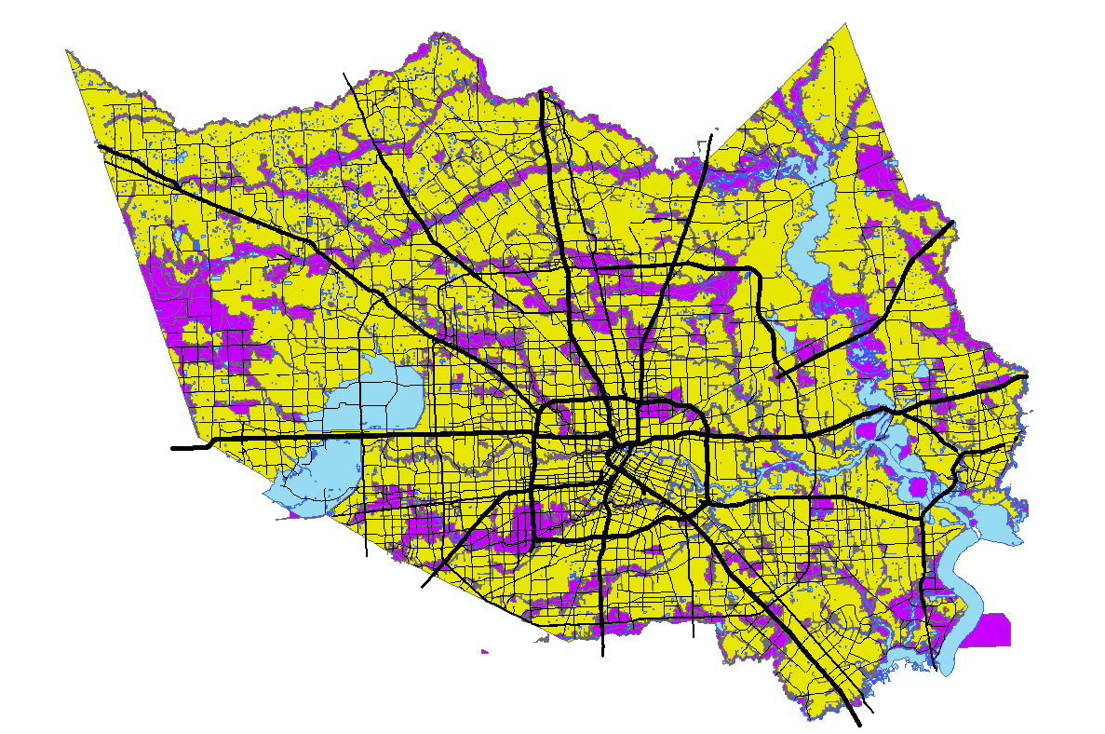
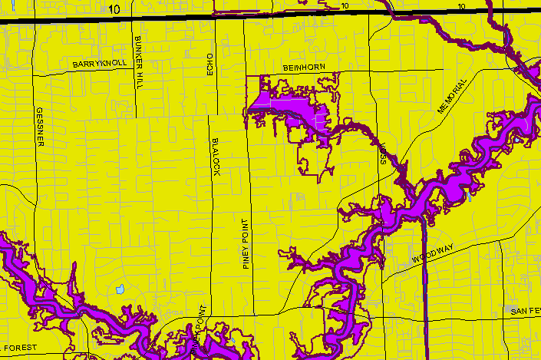

Slide 10
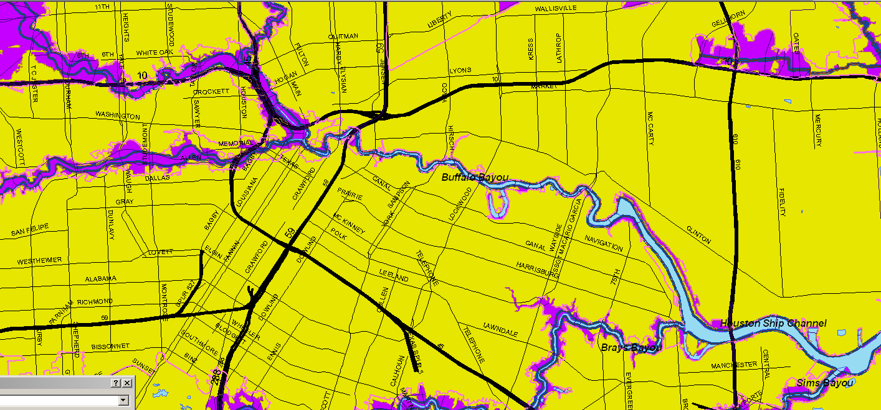
Roads within Floodplains
1010 miles of major Harris County roadways are within a floodplain
6348 major Roadways segments are within a floodplain
44,350 minor Roadway segments are within a floodplain

Slide 11
Challenges
Localized street flooding can happen anywhere in a heavy rain
Only have rainfall averages for year
Unable to acquire accurate geometric statistics for roads
Unable to acquire historical data of roads

Slide 12
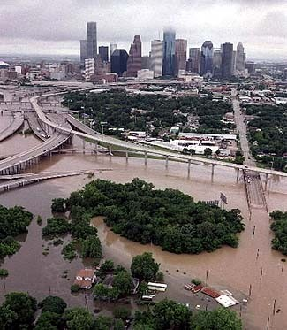
Future Goals
Find historical storm data
Alicia (1983), Allison (2001), Ike (2008)
Compare flooded areas to floodplains
http://www.kjmconst.com/images/flood2.jpg

Slide 13
Traffic Hotspots
Find Traffic Counts for highways and major arterials
Calculated V/C (volume/capacity)
High V/C ratios = Traffic Hotspot
Can relate V/C to LOS
Identify highways and major arterials with low LOS

Slide 14
Challenges
Unable to acquire accurate statistics for highways and roads
Traffic count data not in a compatible format
Only AADT counts available

Slide 15
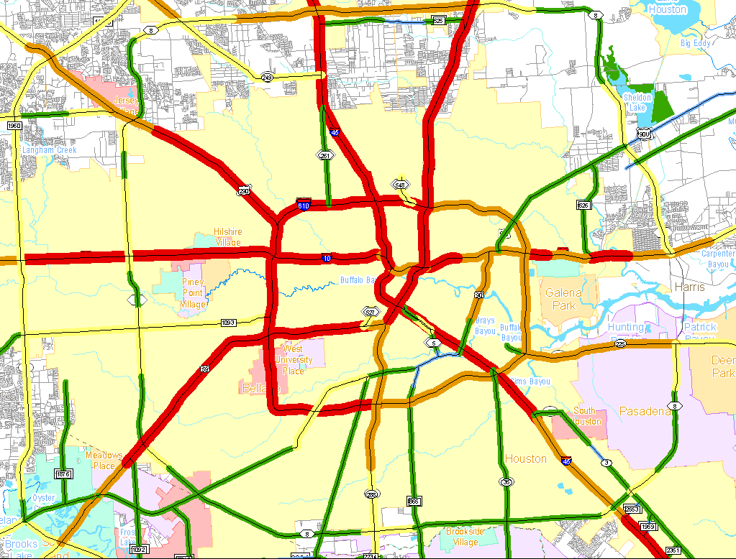
Source: TxDOT Statewide Planning Map

Slide 16
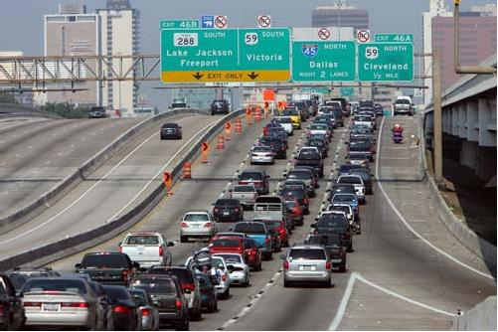
Future Goals
Acquire better traffic count data
Houston-Galveston Area Council
TxDOT
Develop AADT Thresholds depending on road category
http://outhouserag.typepad.com/photos/uncategorized/201.JPG

Slide 17
Questions & Comments
Thanks!

