Slide 1
Effects of Nutrient Nonpoint Source Pollution on Seagrasses in Redfish Bay
Kelly Darnell
GISWR Fall 2009

Slide 2
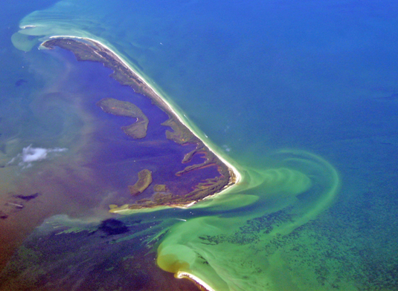
Eutrophication
Increase in nutrient concentration
Coastal eutrophication increasing
Anthropogenic impacts: nutrient nonpoint source (NPS) pollution
Negative effects on coastal organisms, systems
Decreased light irradiance, hypoxia, anoxia, decreased water quality, stress species
www.marietta.edu

Slide 3
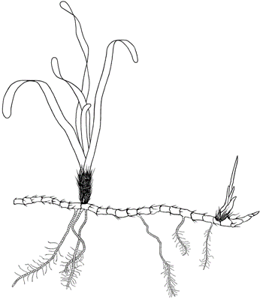
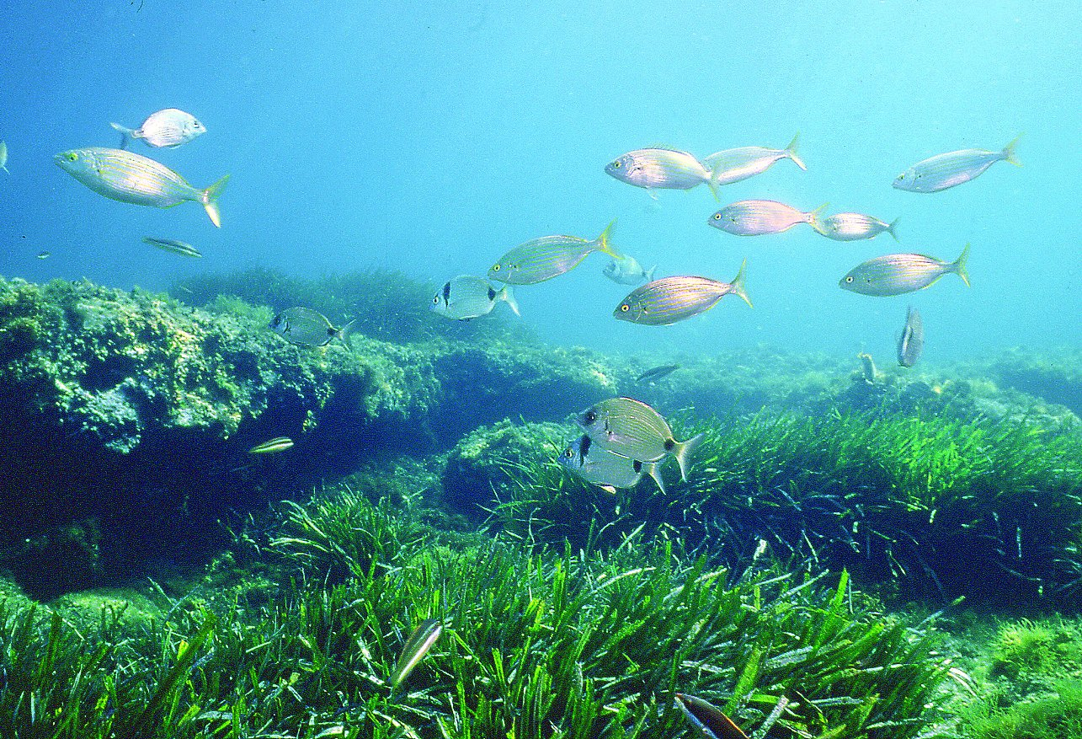
Seagrasses
Submerged marine plants
Ecosystem services
Sediment stabilization, particle settlement, food, habitat, nursery → proper ecosystem functioning
High light requirements make seagrasses sensitive to decreased water quality
Declining worldwide, TX
Anthropogenic impacts
www.dep.state.fl.us
www.unep-wcmc.org
Notes:
A type of coastal submerged aquatic vegetation that perform a variety of ecosystem services such as…
They have high light requirements to perform

Slide 4
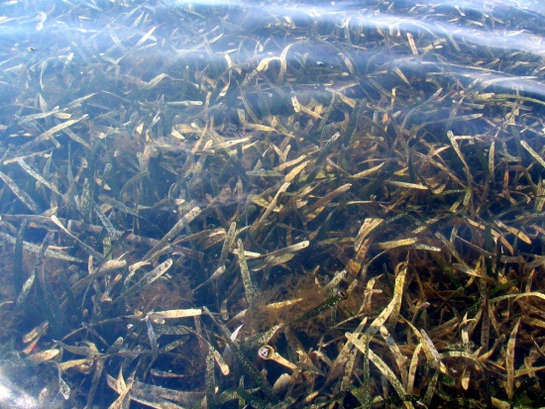
Seagrass Monitoring in Texas
Dunton et al. (2005)
Monitoring program for seagrass health indicators in Redfish Bay
Abiotic: water column nutrients, chlorophyll a, total suspended solids (TSS), sediment nutrients
Biotic: seagrass cover, biomass, morphology
Suggest input of nutrient NPS pollution
Water column nutrients
Notes:
A type of coastal submerged aquatic vegetation that perform a variety of ecosystem services such as…
They have high light requirements to perform
4

Slide 5
Objectives
Obtain a visual representation of suggested nutrient NPS pollution in Redfish Bay
Better understanding of NPS pollution inputs
Cascading effects on seagrasses
Water column, sediment and seagrass nutrients, seagrass morphology
Dunton et al. (2005)

Slide 6
Monitoring Sites: Redfish Bay, TX
Site 1
30 sites
2002-2005
Summer data
Site 30

Slide 7
Phosphate (PO₄): 2002-2005
No clear trends

Slide 8
Nitrate (NO₃): 2002-2005
No clear trends

Slide 9
Phosphate and Nitrate:
Water column nutrients spatially and temporally variable
Suggested nutrient NPS input in 2002
Notes:
Nitrate and phosphate

Slide 10
Water Column and Sediment Quality: 2002
TSS and average porewater NH₄ higher in Northern part of Bay
TSS possibly detrimental to seagrasses
NH₄ stimulate seagrass growth

Slide 11
Seagrass Parameters: 2002
Dominant seagrass
Turtlegrass leaf length and aboveground biomass slightly lower in Northern part of Bay
Seagrass may be stressed

Slide 12
Conclusions So Far
Results support existence of nutrient NPS pollution in Redfish Bay
Results suggest seagrass may be negatively affected by indicated NPS pollution

Slide 13
Future Plans
Compare nutrient inputs to local precipitation
Obtain an indication of runoff
Visually represent:
Water column nutrient concentrations by site
Seagrass leaf nutrients by site and year
Seagrass above- and below-ground biomass by site and year

Slide 14
Questions?

Slide 15
Sources
Dunton KH, Kopecky AL, Maidment D (2005) Monitoring design criteria and biological indicators for seagrass conservation in Texas coastal waters. Final Report for Regional Environmental Monitoring and Assessment Program, EPA
Texas World Imagery Basemap obtained from ESRI (resources.esri.com)

