Slide 1
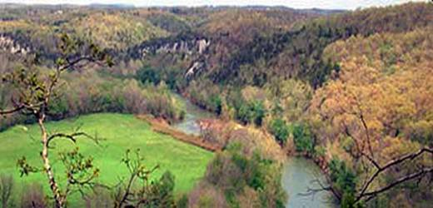
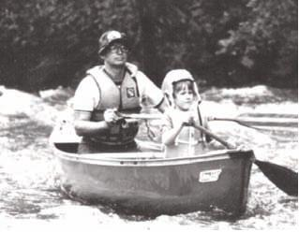
Herbicide Use in the Buffalo River Watershed
Cody Hudson

Slide 2
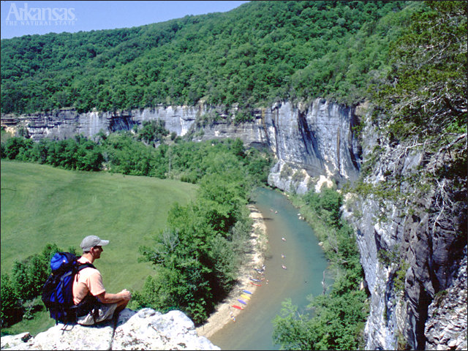
Background
America’s First National River
Over 95,000 acres of protected land
Over 1 million visitors every year

Slide 3
Motivation
Herbicide is being used in an effort to control vegetation along power lines
Escort©
Partition Coefficient
Measure of Hydrophobicity
K_{ow}<10 , Hydophilic ☺
K_{ow}(Escort)=.018
Half-Life= 6 weeks
Density=1.74 g/mL @ 25° C
Notes:
-power line locations assumed to be in same locations as roadways

Slide 4
Time of Concentration
Time in cell function of slope, T(S)
Kirpich Equation
L=Length of Cell (ft)
N=0.8
Forrest/Dense Grass areas
Notes:
-Kirpich equation describes overland flow
-used raster calculator to determine time of concentration based on slope

Slide 5
Chemical Decay
K=0.000011 min⁻¹
Notes:
-K calculated from half life data
-tc used to calculate decay multiplier by using raster calculator

Slide 6
Mass Grid
Manufacturer’s Suggested Application Rate
4 oz-weight/acre
0.54 oz-weight/30m² grid
Notes:
-Oz per grid calculated based on 60 ft of right of way times 30 meters in length

Slide 7
Dinf Decaying Accumulation
Inputs
Dinf Flow Direction
Decay Grid
Mass Grid
Maximum Value
33,370 oz-weight
143 gal
4.6 barrels

Slide 8
Concentration
Boxley Gage
16 mg/L
St. Joe Gage
30 mg/L

Slide 9
Conclusions
Concentration level greater than MCL of many other chemicals in EPA drinking water standards
2,4-D Herbicide MCL=0.07 mg/L
Numbers reflect “perfect storm” situation
No accumulation in soils or vegetation
Herbicide transport modeled as overland flow
Concentration based on application of herbicide to entire area at one instant
Notes:
-Kow very low so most will not adsorb
-If spray is applied prior to rain event, with antecedent wet conditions, herbicide will be majority overland flow
-in reality area may be sprayed over a period of months
-http://www.epa.gov/safewater/contaminants/index.html , EPA Standards
-MCL (maximum contaminant level)

Slide 10
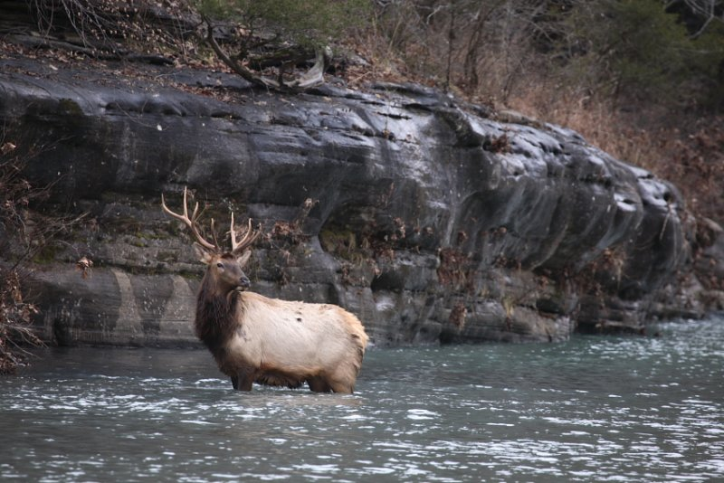
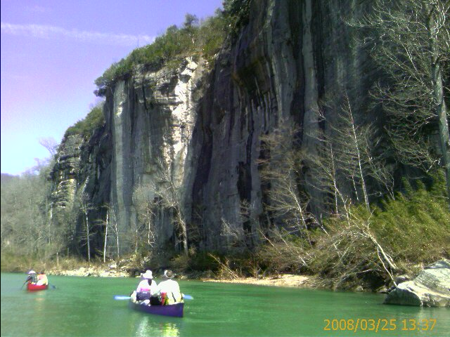
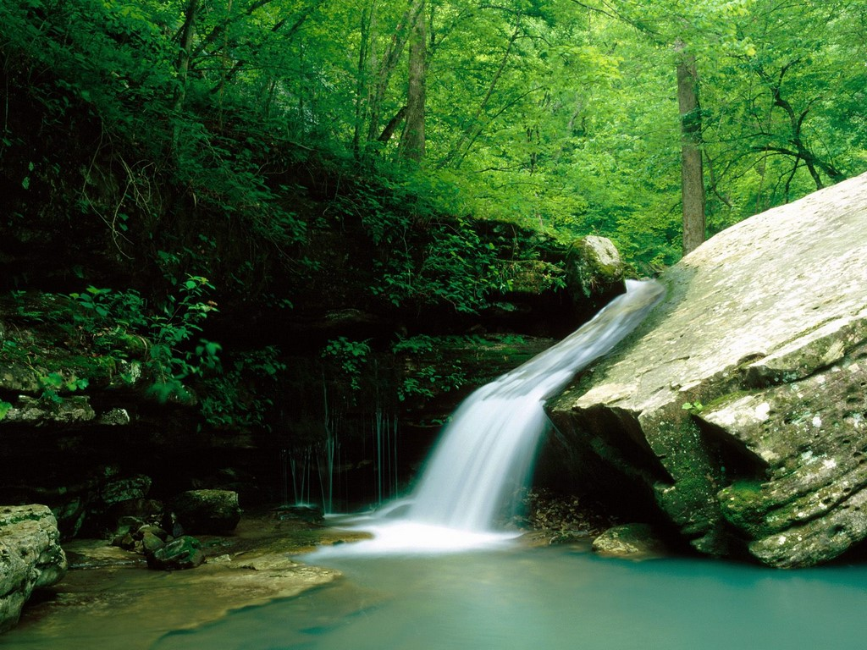
Questions?

