Slide 1
Land Use and Urban Recharge in the Brushy Creek Watershed
Jonathan Snatic

Slide 2
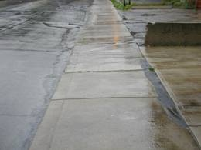
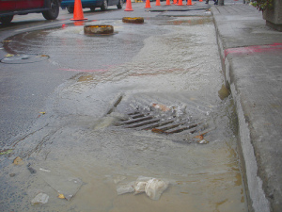
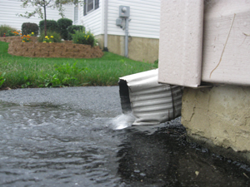
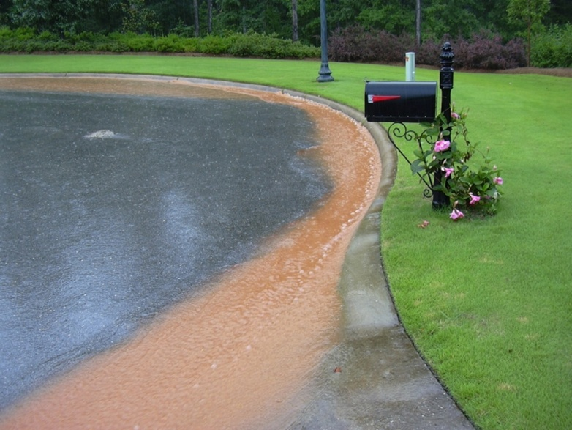
Urban Recharge
Notes:
Impervious cover, storm sewers…

Slide 3
Urban Recharge
Leaking water mains and sewers
Infiltration of excess irrigation
Notes:
Leaking pipes, sewers, and infiltration of excess irrigation

Slide 4
Brushy Creek Basin
Notes:
World map with flowlines, rapid urbanization over the last 20 years, Cp & L water from LCRA

Slide 5
Land Use 1992

Slide 6
Land Use 2001

Slide 7
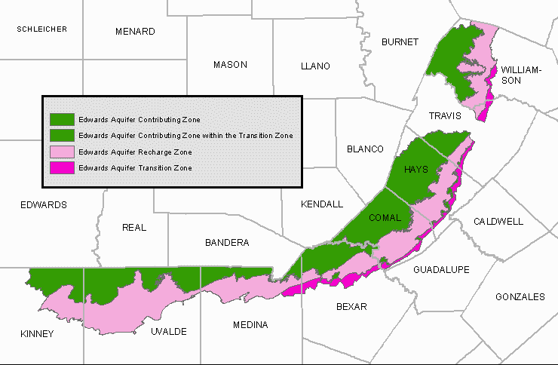
Contributing Zone
Notes:
to monitor and potentially manage the effects of urban development in the contributing and recharge zones of the Edwards aquifer

Slide 8
LCRA- municipal supply

Slide 9
Llano Uplift

Slide 10
Llano Uplift
Pedernales River
Llano River

Slide 11
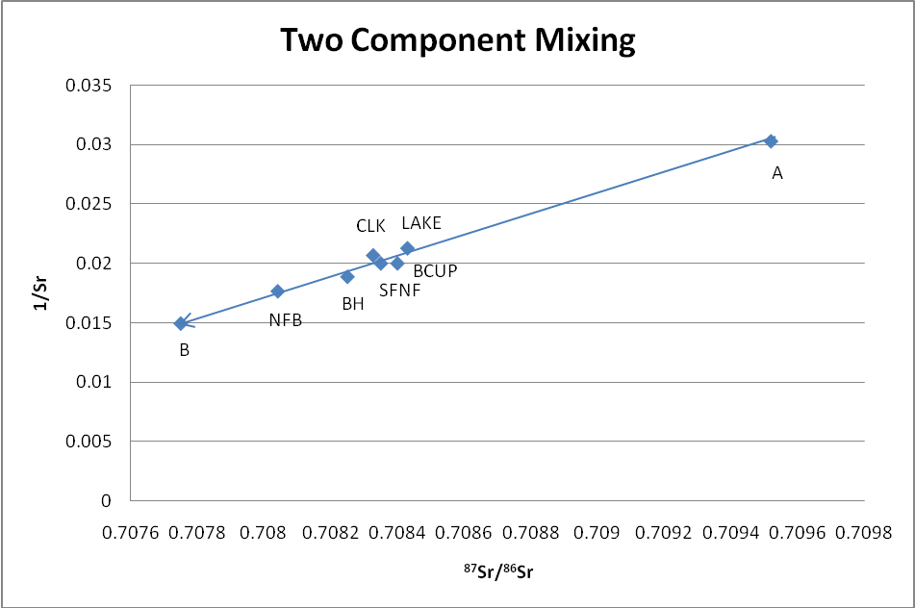
(⁸⁷Sr/⁸⁶Sr)_{MIX} = (⁸⁷Sr/⁸⁶Sr)_{A} ( f_{A}) (Sr_{A}/ Sr_{M}) + (⁸⁷Sr/⁸⁶Sr)_{B} (1-f_{A}) (Sr_{B/}Sr_{A})

Slide 12
Brushy Creek Basin
Lake Creek
Mason Creek

Slide 13
Can determine the urban recharge component to base flow in the Brushy Creek Basin.
Sampling
2 component mixing model
Is there a correlation between urban recharge and land use in the sampled watersheds?
Delineate sampled watersheds
Compare land use in watersheds
Notes:
Sample streams at base flow, determine amount of urban water, correlation with land use

Slide 14
30m DEM

Slide 15
NHD Flowlines

Slide 16
Flow Accumulation

Slide 17
World Map

Slide 18
Sample Locations- Point Delineation
Notes:
Point delineation

Slide 19
Watersheds

Slide 20
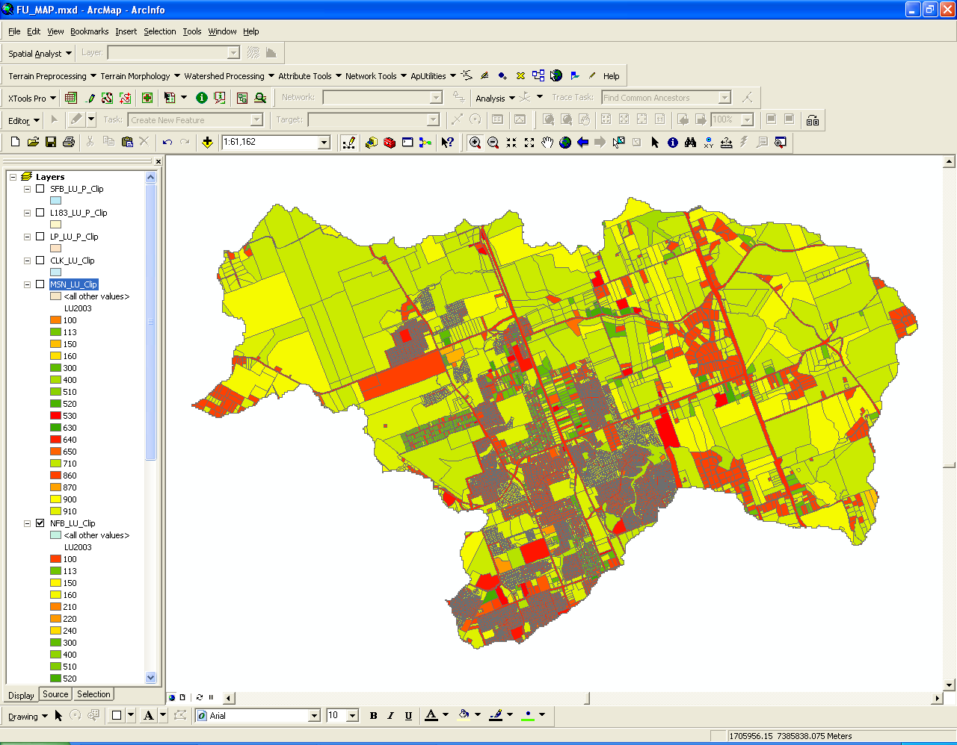
Land Use

Slide 21
Urban vs. Rural Land Use
Urban
Rural
100- Single Family Res.
300- Commercial
400- Office
530- Misc. Industrial
900- Undeveloped
160- Large Lot Single Family
910- Agricultural
710- Parks

Slide 22
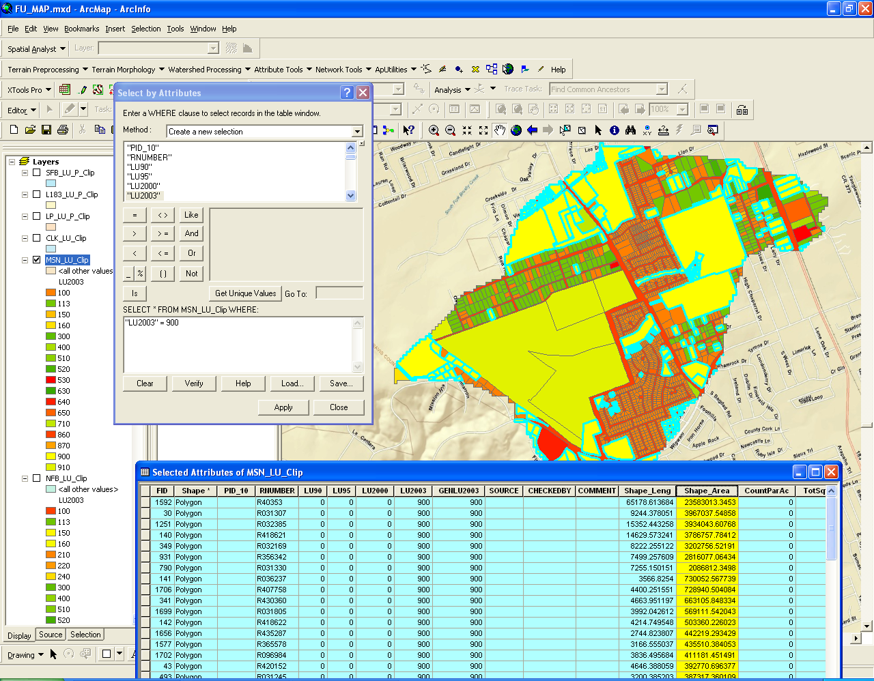
Notes:
% urban area for each watershed.

Slide 24
Questions?

