Slide 1
Climate Change and Runoff in Western Wisconsin
John Nowinski, Department of Geological Sciences

Slide 2
Project Question:
How will stream discharge in western Wisconsin be influenced by future climate perturbations?
Best case vs. Worst case scenarios
Precipitation vs. Evapotranspiration
How can a GIS help?

Slide 3
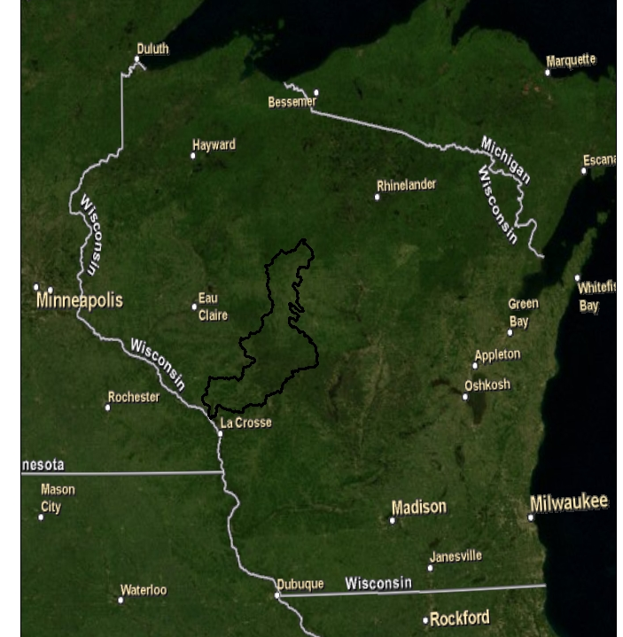
Study Area

Slide 4
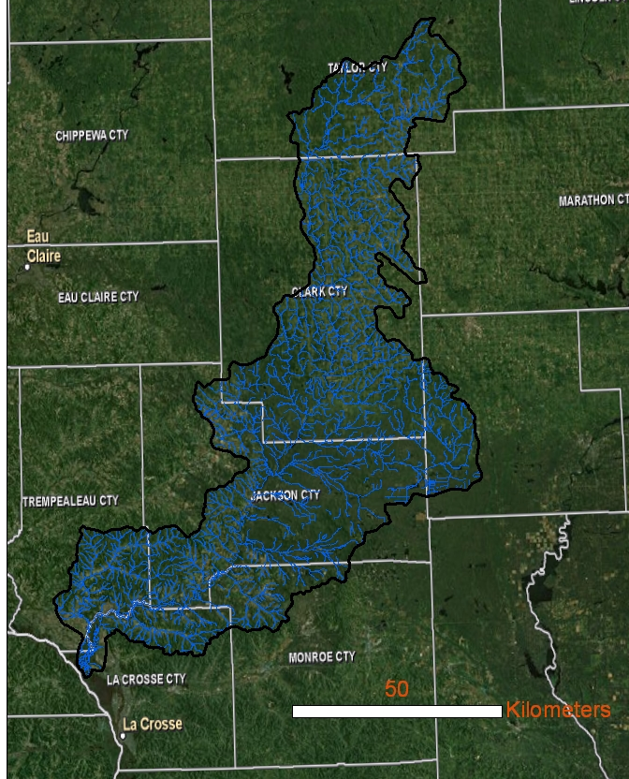
Study Area
Drainage Area: 5757 km²
Stream Length: 4480 km

Slide 5
Basic Methodology
Discharge=Precipitation-Evapotranspiration
Long Term
Assumes ∆Storage=0
Model Current Discharge Accurately
Use mild and severe climate projections to predict future conditions

Slide 6
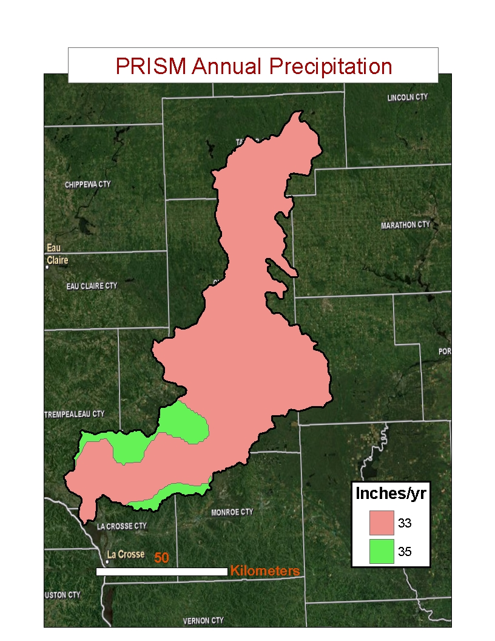
Precip (+ Temp)
~Uniform Distribution
Monthly data from1 station for simplicity

Slide 7
Evapotranspiration: empirical approach
PET and W in mm/month,
ea* in kPa,
Ta in C
(Malmstrom, 1969), (Pike, 1964)

Slide 8
Discharge Calculation
q_{cell} =Flow Accumulation*(W-ET)*Cell Area
NHD FAC grid
Raster Calculator
Comparisons for 7 USGS NWIS Sites

Slide 9
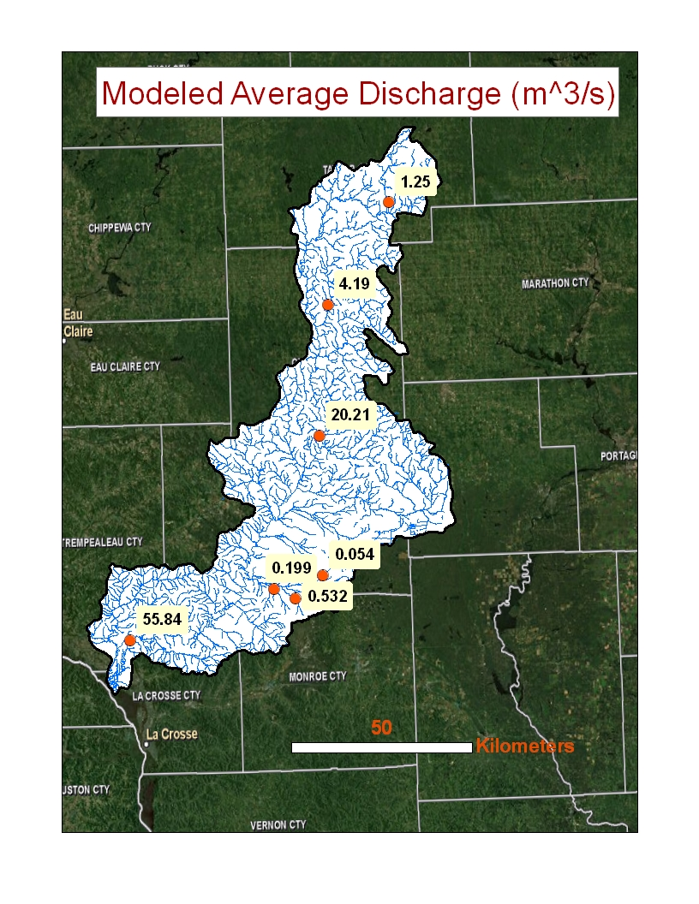

Slide 10
Model Accuracy
Model slightly overestimates observed discharge

Slide 11
Low Emissions (HadCM3+PCM)
Winter Precip
+5%
Summer Precip
+15%
Winter Temp
+4 C
Summer Temp
+4 C

Slide 12
High Emissions (HadCM3+PCM)
Winter Precip
-5%
Summer Precip
+15%
Winter Temp
+8 C
Summer Temp
+7 C

Slide 13
Evapotranspiration: empirical approach
PET and W in mm/month,
ea* in kPa,
Ta in C
(Malmstrom, 1969), (Pike, 1964)

Slide 14
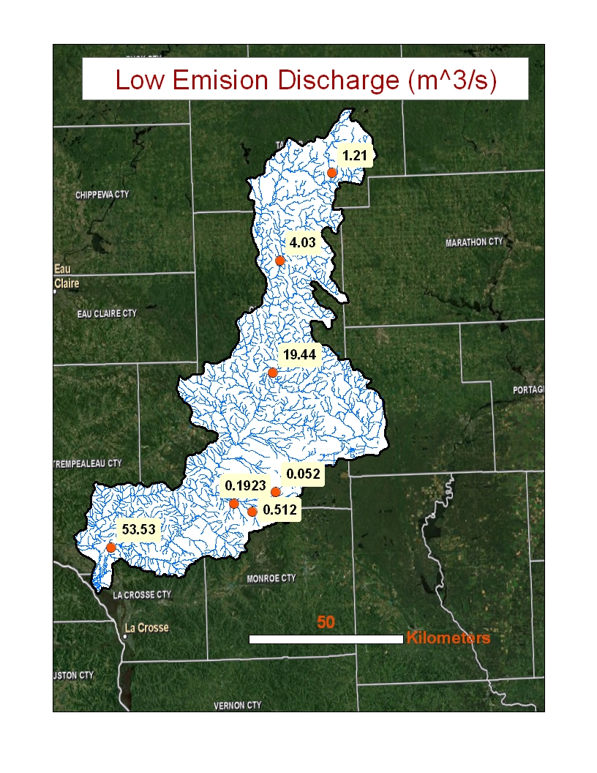

Slide 15
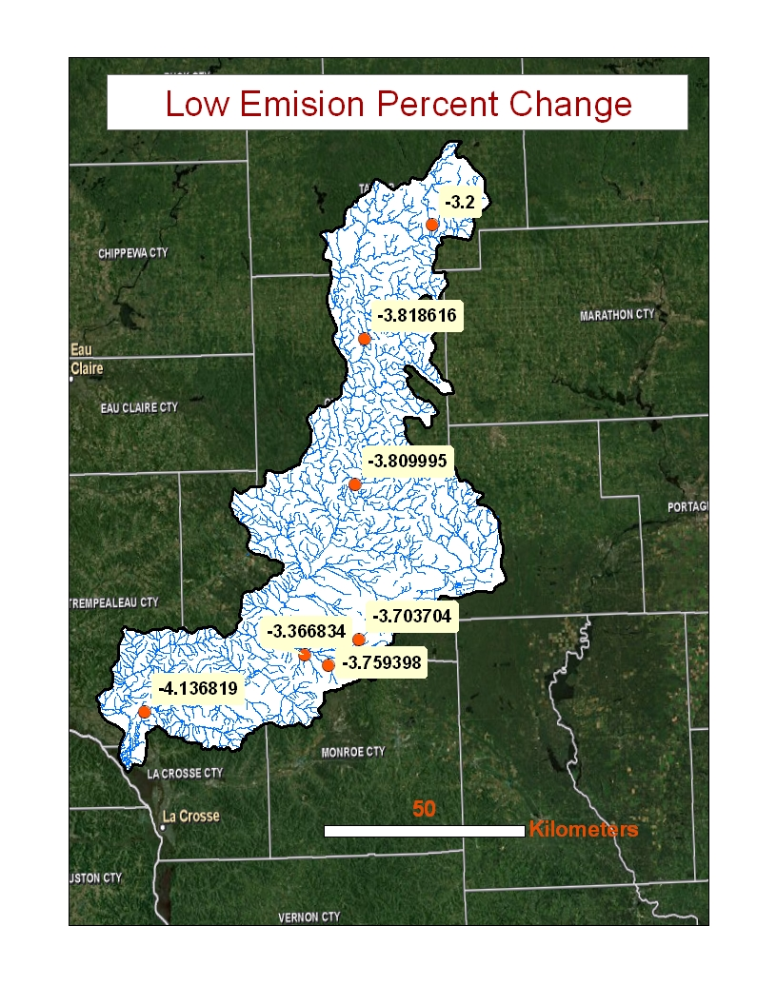

Slide 17
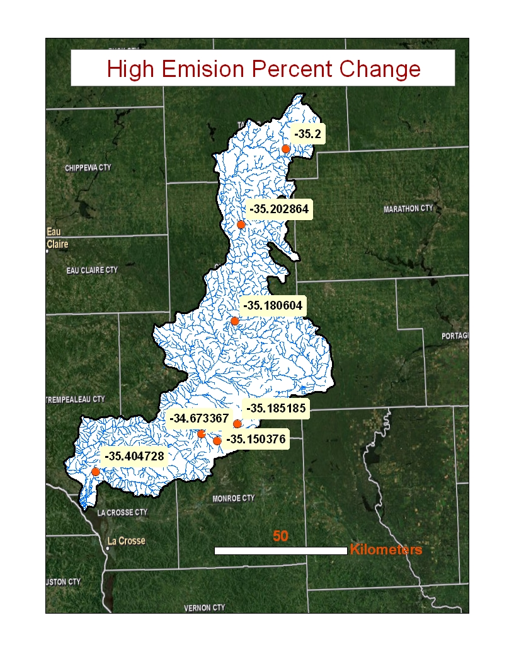

Slide 18
Conclusion
Discharge decrease for both low emission and high emission scenarios (ET beats precip)
High scenario is much more severe

Slide 19
Limitations and Future Work
Empirical Equations have limited accuracy
Model overestimates q
Monthly Discharge Calculations
Need for dams?

Slide 20
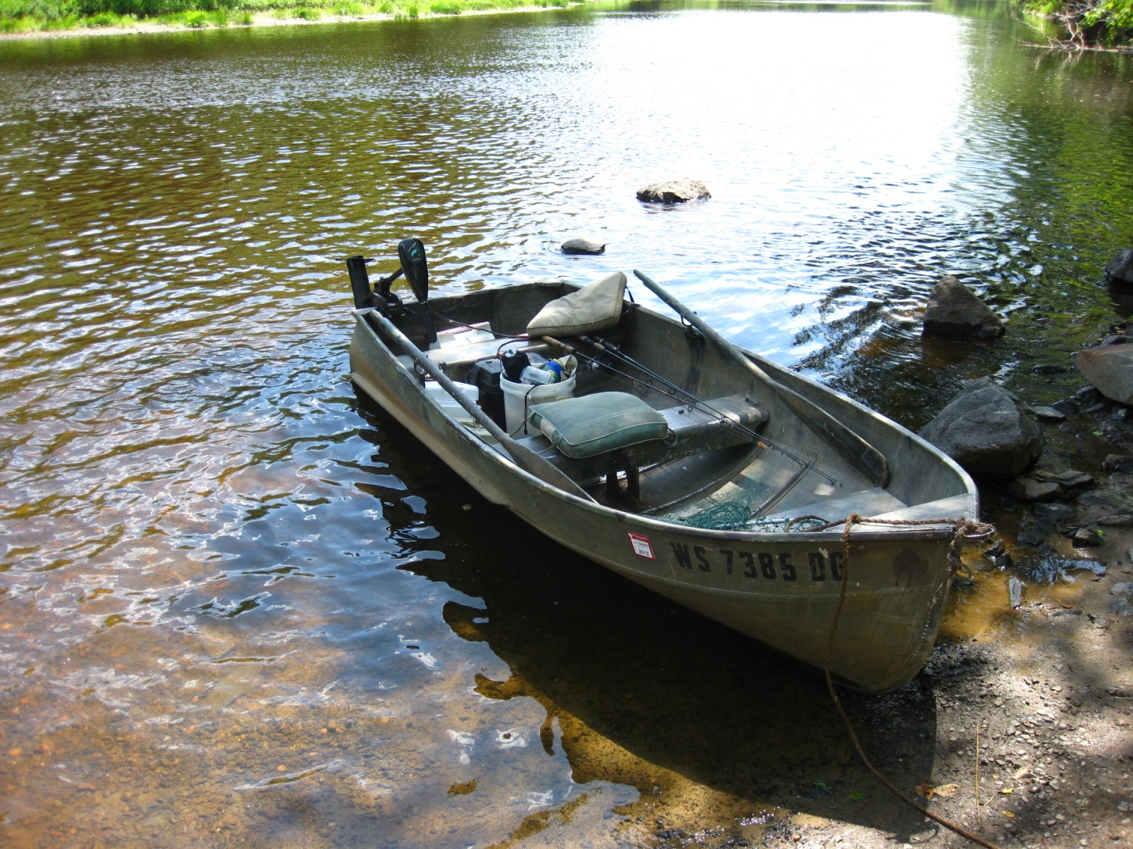
Questions?

Slide 21
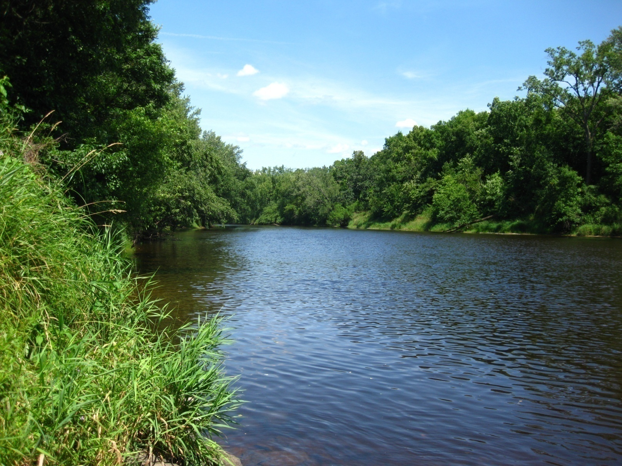
Thanks!

