Slide 1
Water Resources of the Atlanta Region
Jason Allard

Slide 2
Water Shortage in Atlanta Region
Why does Atlanta experience water shortages?
How has Atlanta’s growth contributed to the shortages?
Will the local water resources be able to keep up with Atlanta’s future growth?

Slide 3
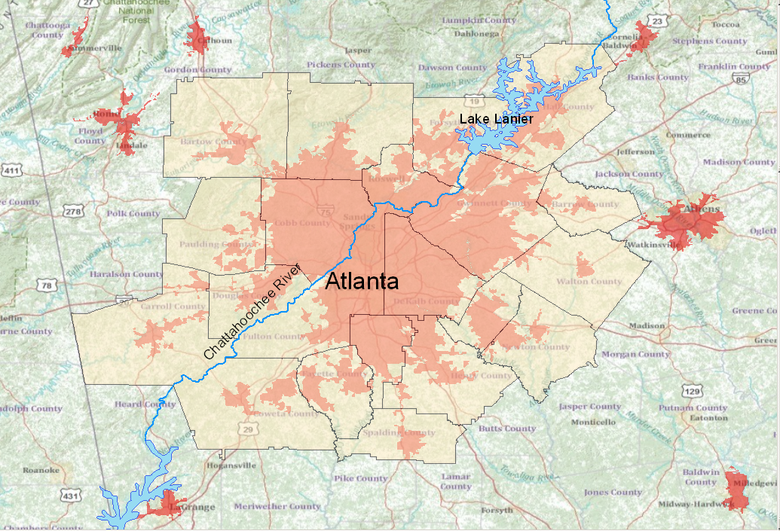
Population Growth

Slide 4
Atlanta Sprawl
Light Blue cells represent conversion to urban land between 1992 and 2001
15.1% increase in urban land, from 1028 to 1183 sq. mi.

Slide 5
Water Supply

Slide 6
Regional Issues
Eastern U.S. water law says equal rights among users, i.e. states.
Endangered species in Apalachicola Bay

Slide 7
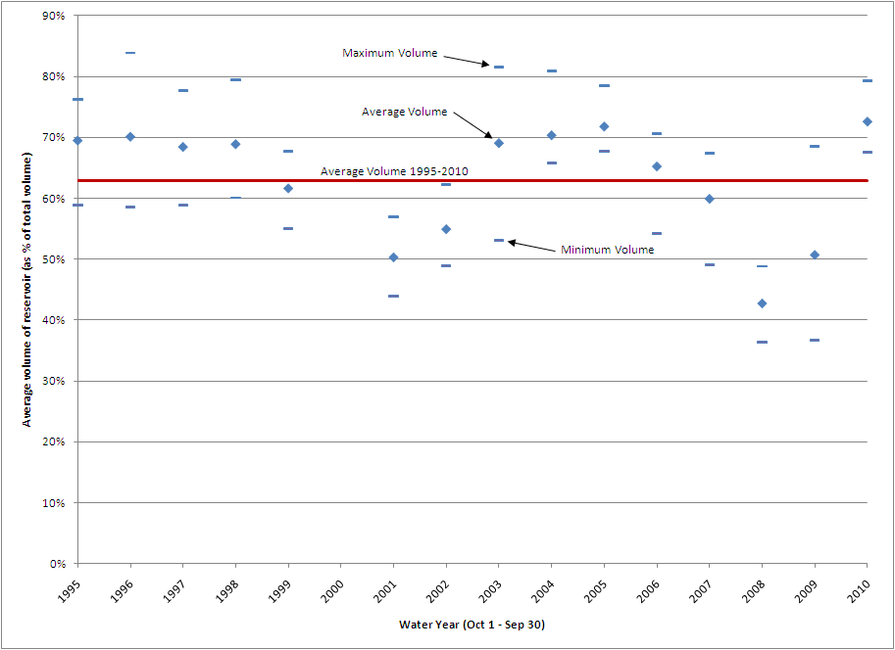
Lake Lanier

Slide 8
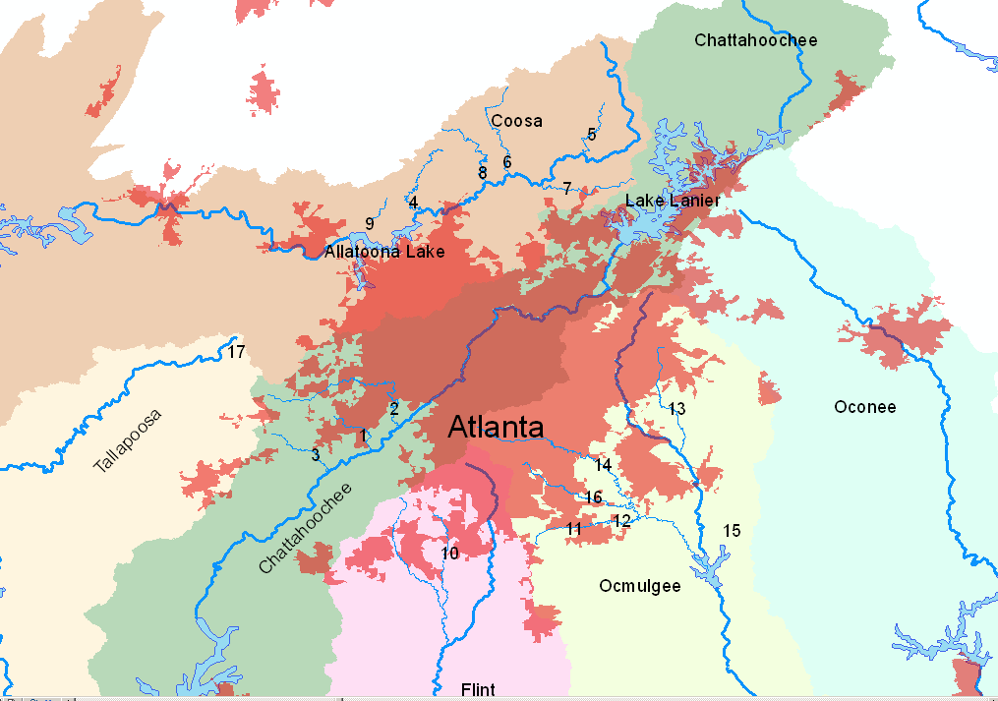
Solutions
Groundwater – 1% of future supply due to bedrock.
More Reservoirs

Slide 9
Solutions
Water Conservation/Reuse

Slide 10
Conclusion
Atlanta has water shortages due to location in upper watersheds.
Future growth could be seriously inhibited by Court rulings or prolonged drought periods.
No easy solutions.
More reservoir storage, better conservation.
There are numerous other regions in the U.S. that will have to address water shortages in the near future.

