Slide 1
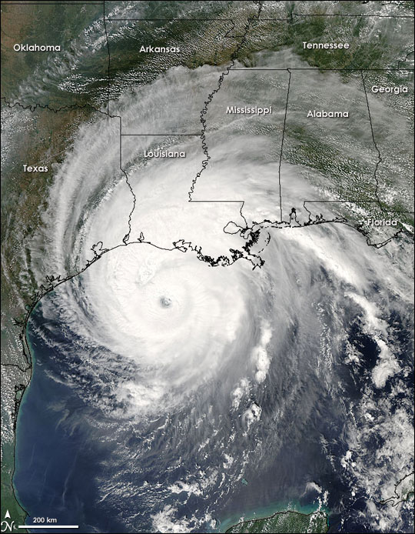
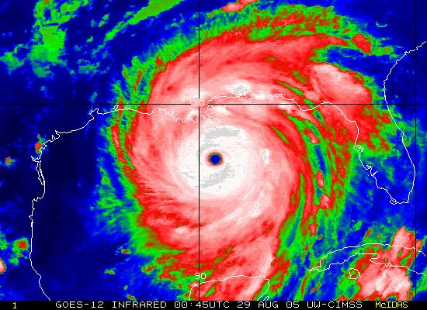
Impact of Hurricanes Katrina and Rita on the Water Quality in Lake Pontchartrain and New Orleans
Cameron Faxon
GIS in Water Resources
11/16/2010

Slide 2
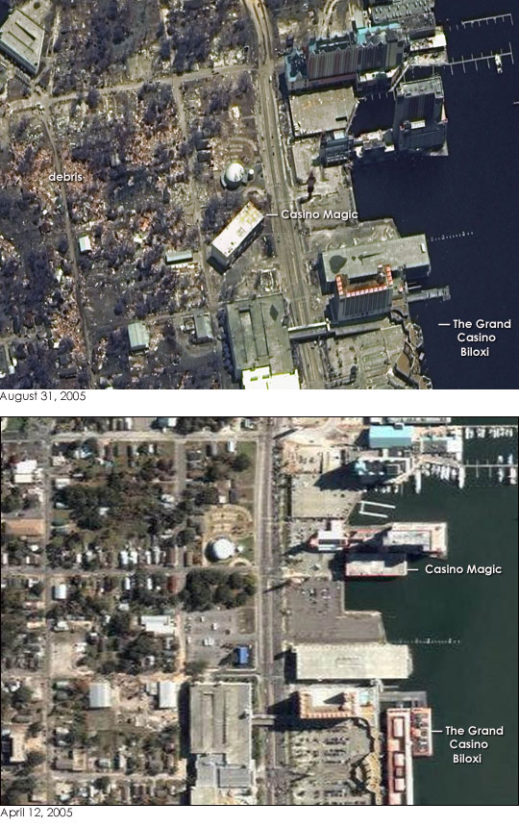
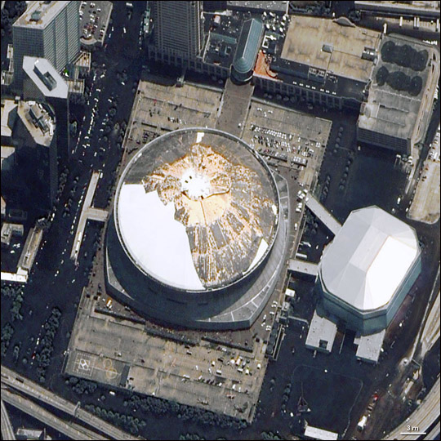
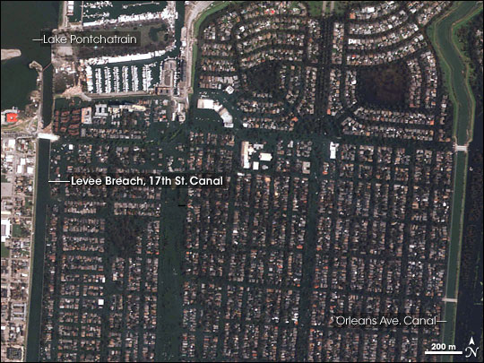
Hurricane Katrina (category 3)
Date of Landfall: August 29th
Point of Landfall: Buras, LA
Approximately 1200 deaths
10-20 feet over normal tide levels

Slide 3
Important Waterways

Slide 4
Storm Surge

Slide 5
Levee Breaches

Slide 6
Extent of Flooding

Slide 7
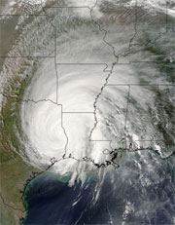
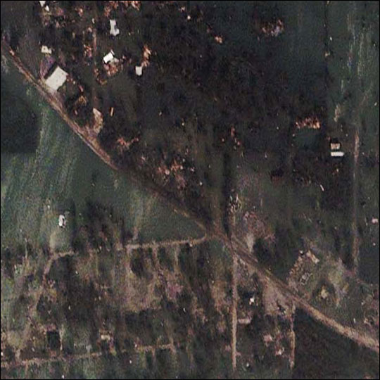
Hurricane Rita (category 3)
Date of Landfall: September 24th
Point of Landfall: Sabine Pass/Johnson’s Bayou
90 tornadoes
Up to 10-15 inches of rain

Slide 8
Sediment/Water Monitoring and Sampling Locations

Slide 9
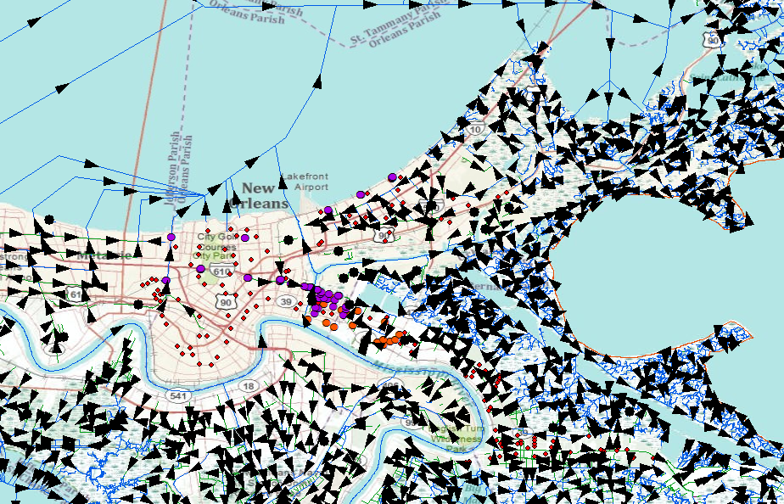
Stream Flow at New Orleans-Lake Pontchartrain Interface

Slide 10
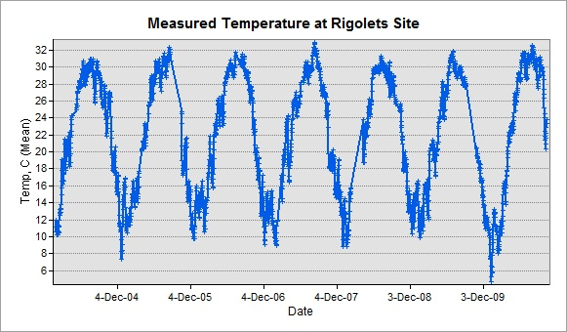
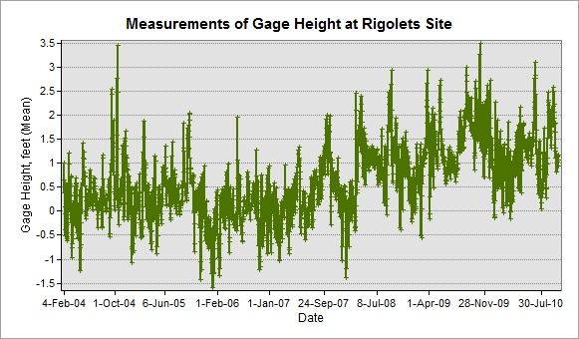
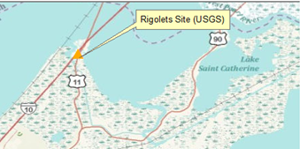
Observations from Rigolets Site (2004-2010)
Average gage height increase

Slide 11
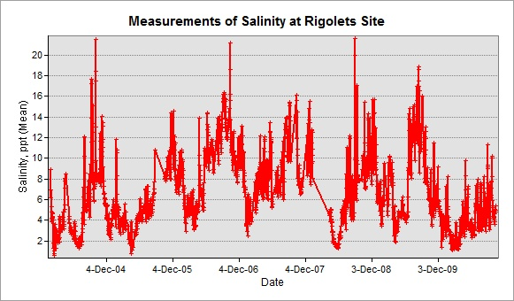
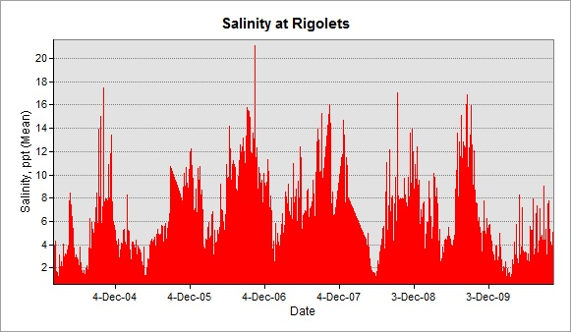
Water Quality at Rigolets (2004-2010)
Slight elevation of salinity and specific conductance
≈Oct 2005-Jan 2008

Slide 12
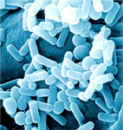
Coliform Bacteria
Members of the Enterobacteriaceae family
Gram-negative, non-spore forming
Rod shaped morphology
Presence indicates pathogen presence is possible
Bacterial, viral and parasitic
Enterobacter
Citrobacter

Slide 13
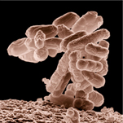
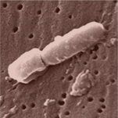
Fecal Coliform Bacteria Contamination
W.H.O. designates E. coli as primary fecal contamination indicator bacteria
USEPA Maximum Recommended Levels:
Recreational use: 200 cfu/100ml
Fishing/Boating: 1000 cfu/100ml
Drinking water: 1 cfu/100ml
Biosolids (residential): 1000 cfu/g
E. coli
Klebsiella

Slide 14
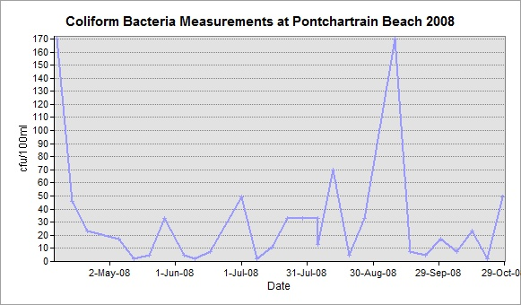
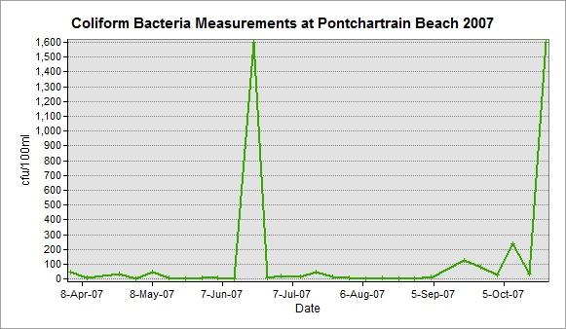
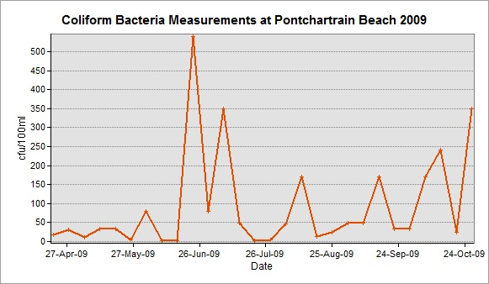
History of Coliform Contamination at Pontchartrain Beach
Maximum observed fecal coliforms (cfu/100ml):
1600 (2004/2007)
170 (2008)
540 (2009)

Slide 15
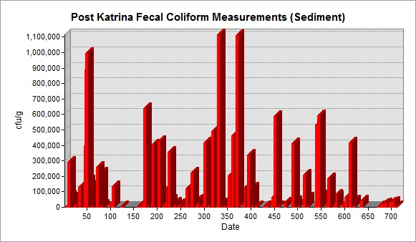
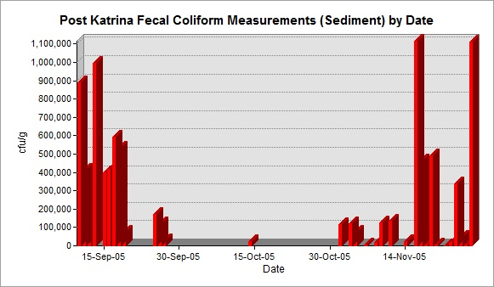
Region 6 Katrina Emergency Monitoring Data
Average: 101,778 cfu/(g-sediment)
Maximum: 1,115,800 cfu/(g-sediment)

Slide 16
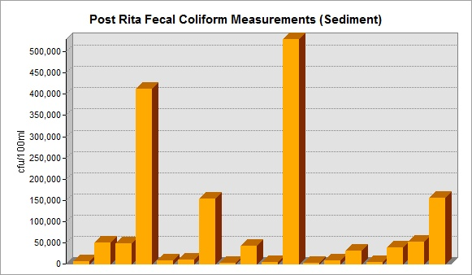
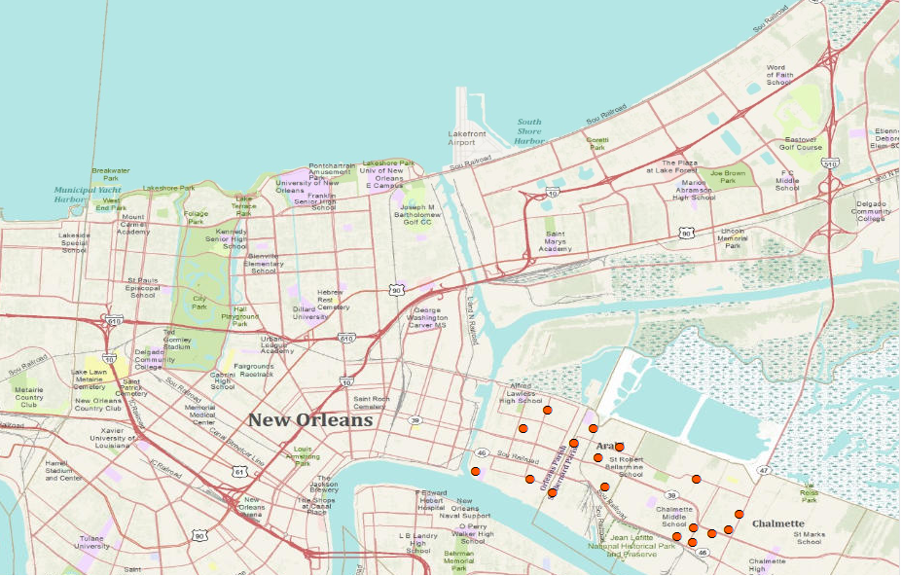
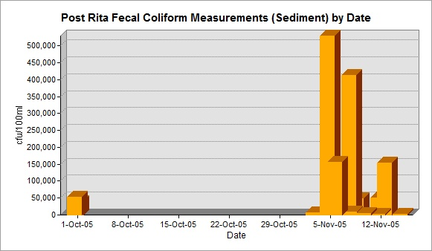
Results of Post-Rita Sediment Sampling
Average: 86335 cfu/100ml
Maximum: 529140 cfu/100ml

Slide 17
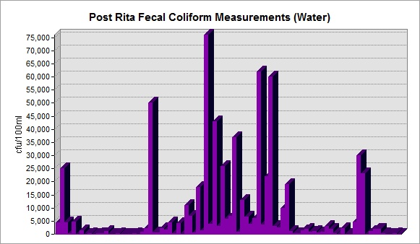
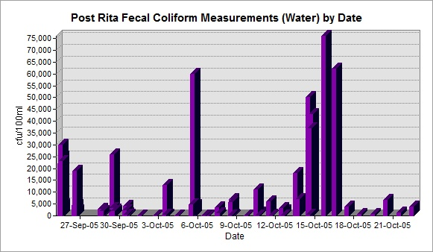
Results of Post-Rita Sampling Water Sampling
Average: 7443 cfu/100ml
Maximum: 76000 cfu/100ml

Slide 18
Conclusions
Significantly elevated fecal coliform levels in sediment and water near populated areas
Extremely high fecal coliform levels in areas that drain into lake Pontchartrain
Before flooding:
Highest observed levels were 8 times EPA recommended maximums for body-contact water use (Pontchartrain Beach).
After flooding:
Average water samples had were > 37 times EPA recommended maximums (body contact)
Average sediment samples after Katrina were > 86 times EPA recommended maximums (biosolids)

Slide 19
Further work
Include salinity measurements
Include dissolved oxygen levels
Analyze these parameters to find correlation between data and storm surge/flooding.
Estimate total volume increase in lake from storm surge.

Slide 20
References
Works Cited
Brandys, Dr. Bob. H. Quantifying Bacteria Levels in Water Categories 1-3. Hinsdale, Illinois: Occupational and Environmental Health Consulting Services Inc., 2007.
Campanella, Catherine. "New Orleans History~~Lake Pontchartrain." 15 January 2000. 29 September 2010 <http://www.stphilipneri.org/teacher/pontchartrain/section.php?id=79>.
Cobos-Roa, Robert Bea and Diego. "Failure of the I-Wall Flood Protection Structures at the New Orleans Lower 9th Ward During Hurricane Katrina." Electronic Journal of Geotechnical Engineering, Vol. 13 (2008): 1-43.
Furey, John S. "Post-Katrina Fecal Contamination in Violet Marsh near New Orleans." International Journal of Environmental Research and Public Health, 4(2) (2007): 84-92.
"How could coliform bacteria affect water quality?" 2010. APEC presents: Free Drinking Water.com. 15 November 2010 <http://www.freedrinkingwater.com/water_quality/quality1/1-how-coliform-bacteria-affect-water-quality.htm>.
Jeff Schmaltz, MODIS Rapid Response Team at NASA GSFC. Visible Earth: A catalog of NASA images and animations of our home planet. 24 August 2005. 15 November 2010 <http://visibleearth.nasa.gov/view_rec.php?id=17314>.
Light Rail Now! News Log. 21 September 2005. 15th November 2010 <http://www.lightrailnow.org/news/n_newslog004.htm>.
NASA. "NASA Facilities Weather Hurricane Rita." 27 September 2005. NASA Official Web Site. 15 November 2010 <http://www.nasa.gov/vision/earth/lookingatearth/rita_main.html>.
NOAA. Hurricane Preparedness: Hurricane History. 2010. 15 November 2010 <http://www.nhc.noaa.gov/HAW2/english/history.shtml>.
Oram, Brian. "Fecal Coliform Bacteria in Water." Water Research Center. 15 November 2010 <http://www.water-research.net/Watershed/fecalbacteria.htm>.
Pesce, Katie. "Hurricane Katrina: Levee Breaches." 2010. Mission 2010: New Orleans. 9 November 2010 <http://web.mit.edu/12.000/www/m2010/finalwebsite/katrina/damage/damage-leveebreach.html>.
Punsalan, Derek. {saltwater intrusion} lake pontchartrain. 2 February 2010.
Wikipedia. "Mississippi River - Gulf Outlet Canal." 23 September 2010. Wikipedia. 29 September 2010 <http://en.wikipedia.org/wiki/Mississippi_River_%E2%80%93_Gulf_Outlet_Canal>.

Slide 21
Questions?

