Slide 1
An Overview of Water Management and Planning in Nevada
Maria E. Jauregui
November 16, 2010

Slide 2
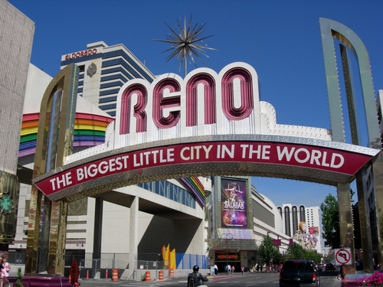
Overview
History
Population Characteristics
Environmental Considerations

Slide 3
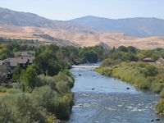
Early History
Las Vegas first visited by Spanish in 1830s
Deposits of silver, gold attract miners 1859
Admitted as 36th state in 1863
Became outpost of railroad in 1905

Slide 4
Where does the water come from?
Las Vegas valley served by artesian springs until 1962
Unexpected growth and ignorance of region’s hydrology lead to subsidence
Need for reliable, accessible source

Slide 5
The “Law of the River”
1922: Colorado River Compact
1928: Boulder Canyon Project
Nevada receives 300,000 acre feet/yr (less than 3%)
California received 4.4 million a year, Arizona 2.8 million

Slide 6
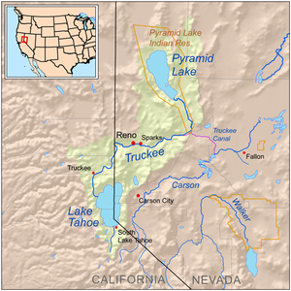
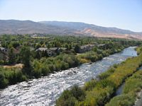
Where does the water come from in Northern Nevada?
Truckee River provides 40-80 million gallons/day
Fed by Sierra Nevada, low evapotranspiration
85% from Truckee, 15% groundwater wells

Slide 7
Who uses the water?
Nearly 90% of Southern Nevada’s water is drawn from Colorado River
Agricultural users account for nearly 70% of all consumptive use
In Southern Nevada outdoor uses account for 70% of municipal consumption

Slide 8
Population Changes
Washoe Co. (Reno):
1900- 9,000
1950- 50,000
2008- 400,000
Southern NV:
1900-< 20
1950- < 48,000
2008- 1.8 million

Slide 9
Population Projections
Northern NV: Up to 20,000/year
400 acre ft surplus, plus banked supply
Southern NV: Between 20,000-60,000/year
Lake Mead dry by 2021!

Slide 10
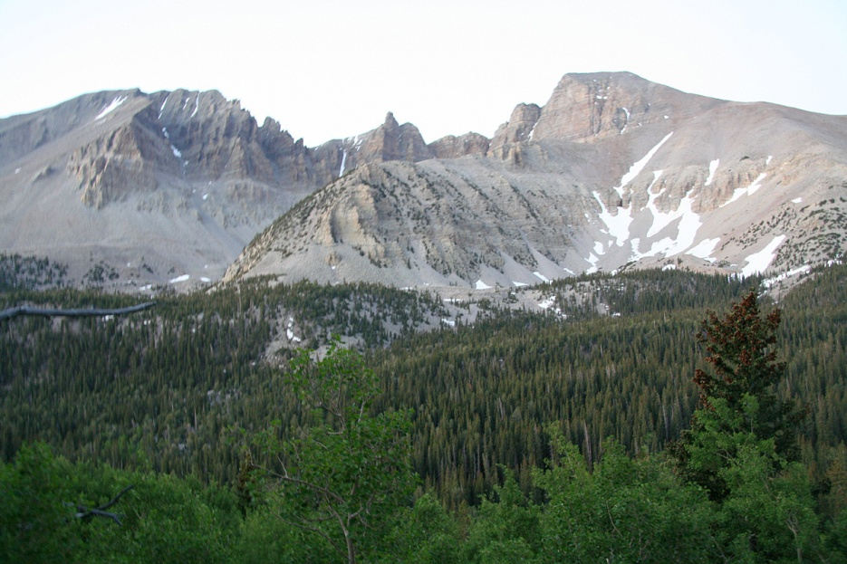
Pipe Dreams
Spring Valley & Snake Valley claims could deliver up to 90,000 af/year
Opponents include residents, Great Basin Water Network, Sierra Club, The Church of Latter Day Saints, The State of Utah, U.S. Parks and Wildlife
Hydrological studies show conflicting projections of availability
Reservoirs, “banked” water only augment supply
Sources: Forestry Images, Wikipedia

Slide 11
National problem?
Lake Mead at lowest levels since 1937
Shortages not limited to arid West
Top 10 Cities Impacted: Los Angeles, Houston, Fort Worth, Orlando, Atlanta, SF Bay Area

Slide 12
Water Quality
SNWA, TMWA annual report indicate water meets or exceeds federal guidelines
Chlorination
Contaminants include: Arsenic, cryptosporidium, fluoride, giardia, pharmaceuticals, radon, sulfate, and perchlorate (rocket fuel!)
Urban runoff, ag contaminants, suspended solids from returned flows
Source: Las Vegas Valley Water District

Slide 13
Nevada Test Site
From 1951-1962 approximately 100 above ground tests conducted
From 1962-1992 over 800 subsurface tests conducted, several in aquifers or within 1000 feet of water table

Slide 14
Nuclear Fallout
Dept. of Energy “monitors” migration of radioactive particles with wells
NTS not considered a “top priority” despite potential magnitude of contamination
1992, 2000 Radiation Exposure Compensation Act (RECA): Provides pre-determined lump sum to uranium miners/ mill workers/ transporters, “onsite participants,” “downwinders”
Clark, Nye, Lincoln, White Pine Counties included in affected area

Slide 15
Conclusions
Unforeseen growth and lack of deep hydrologic knowledge have greatly contributed to current crisis
Water managers across the state and region are obligated to pursue various courses of action to secure water for their customers
Thorough environmental studies should be conducted to assess water quality and threats posed by projects
Rural/Urban interests must be balanced
Conservation, cooperation with local and state government to control growth must be firmly implemented

