Slide 1
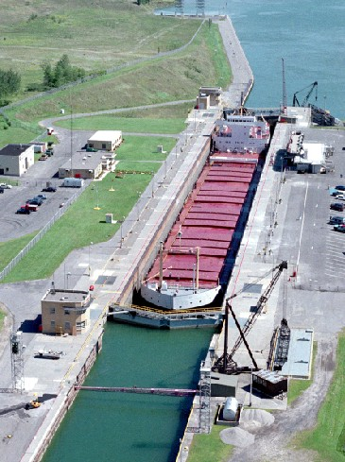
Identifying the Source Storm Events for Closures of the St. Lawrence Seaway
Itay Rosenzweig
GIS in Water Resources
Fall 2010
Image Courtesy of St. Lawrence Seaway System Directory 2009-10 - The Eisenhower Locks , Massena, NY

Slide 2
Objectives
Identify all in-season closures of the St. Lawrence Seaway since 2000
Filter the closures caused by hydrologic conditions in the river for study
Trace river peak flows to their Source Storm Events
Identify patterns in storm events causing Seaway Closure

Slide 3
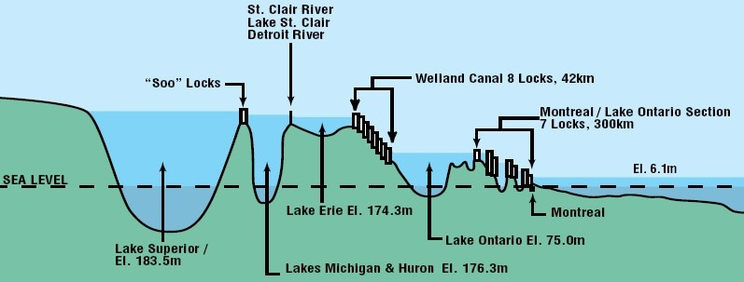
The St. Lawrence Seaway
Opened in 1959
Combined tonnage shipped through: 160 million metric tonnes
3,700 km long
15 locks

Slide 4
St. Lawrence River Section
8 locks
42 km
Montreal
Lake Ontario
Soo Locks
Welland Canal Section
8 locks
42 km
Lake Eire

Slide 5
HydroSHEDS
Hydrological data and maps based on
SHuttle Elevation Derivatives at multiple Scales
Data Available Through http://hydrosheds.cr.usgs.gov/ or from Add Data from ArcGIS Online…

Slide 6
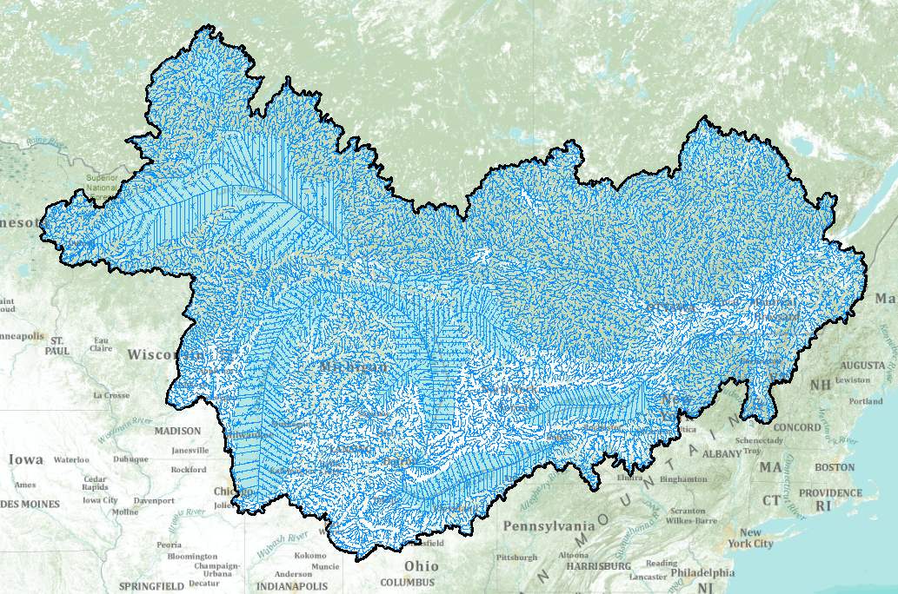
The St. Lawrence River Watershed
Drainage Area: 1,050,000 sq.km

Slide 7
North American Regional Reanalysis
Historic “Reanalysis” model of climate conditions in North America
Data from 1979 to present (through mid2009)
Precipitation, Atmospheric Pressure, Soil Conditions, Groundwater flow, Air Temp, Surface Albedo
Appx. 32km grid resolution
3-hr temporal resolution
HUGE Thanks to Glenn Rutledge and Dan Swank at NOAA

Slide 8
Closures of the Seaway since 2000
Date of Closure | Section Closed
08/12/2000 | Welland Canal
08/21/2001 | Welland Canal
09/15/2001 | Welland Canal
09/08/2003 | Soo Locks
09/12/2003 | Welland Canal
08/30/2004 | Welland Canal
10/03/2005 | Welland Canal
09/22/2007 | Welland Canal
08/04/2008 | St. Lawrence River
08/18/2008 | Welland Canal
09/19/2009 | Welland Canal

Slide 9
What’s Next?
Use NARR to get rainfall data in the basin for the week preceding each closure
Identify patterns in the storm events
Currently waiting on reply from St. Lawrence Seaway Development Corporation – Objective Criteria for closing the Seaway?

