Slide 1
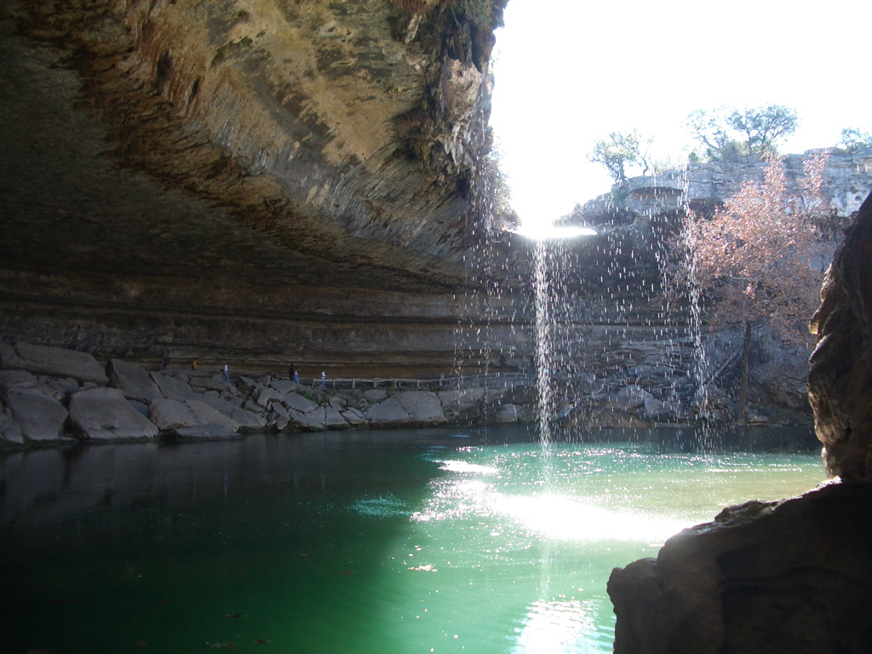
Visualization of Texas Groundwater Water Policy for the Layperson
By Carl Edwards

Slide 2
Outline
Texas groundwater planning since 2001
Overview of state sanctioned water resource organizations in Texas
Mapping Desired Future Conditions (DFC) for GMA’s
Desired Future Conditions for GCD’s
Future Work
Data: http://www.twdb.state.tx.us/home/index.asp

Slide 3
2001: Reorganization of Texas Groundwater Policy
Why? Texas derives 60% of its water wealth from subsurface resources
Purpose from Chapter 36 of the Texas Water Code: to provide for the conservation, preservation, protection, recharging, and prevention of waste of groundwater, and of groundwater reservoirs or their subdivisions, and to control subsidence caused by withdrawal of water from those groundwater reservoirs
Groundwater is subject to the Rule of Capture: landowner may withdraw
groundwater without limitations and without being liable to neighboring landowners for any harmful effects resulting from the withdrawal.

Slide 4
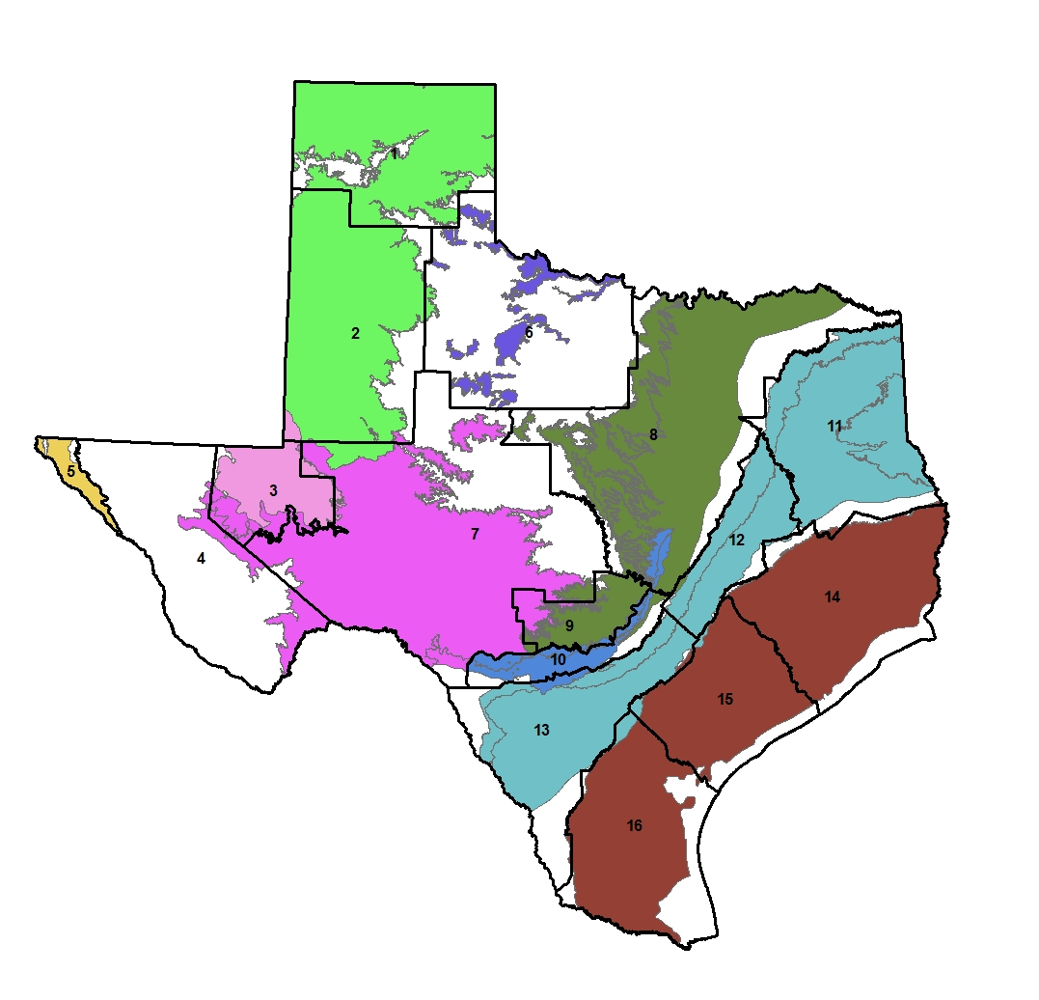
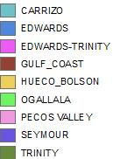
GMA: Groundwater Management Areas
Approved through the Texas Water Development Board (TWDB)
Management areas generally follow major aquifer boundaries
Some major aquifers are split based on water users, or hydrogeologic parameters
GMA’s provide a forum for water planning amongst the GCD’s

Slide 5
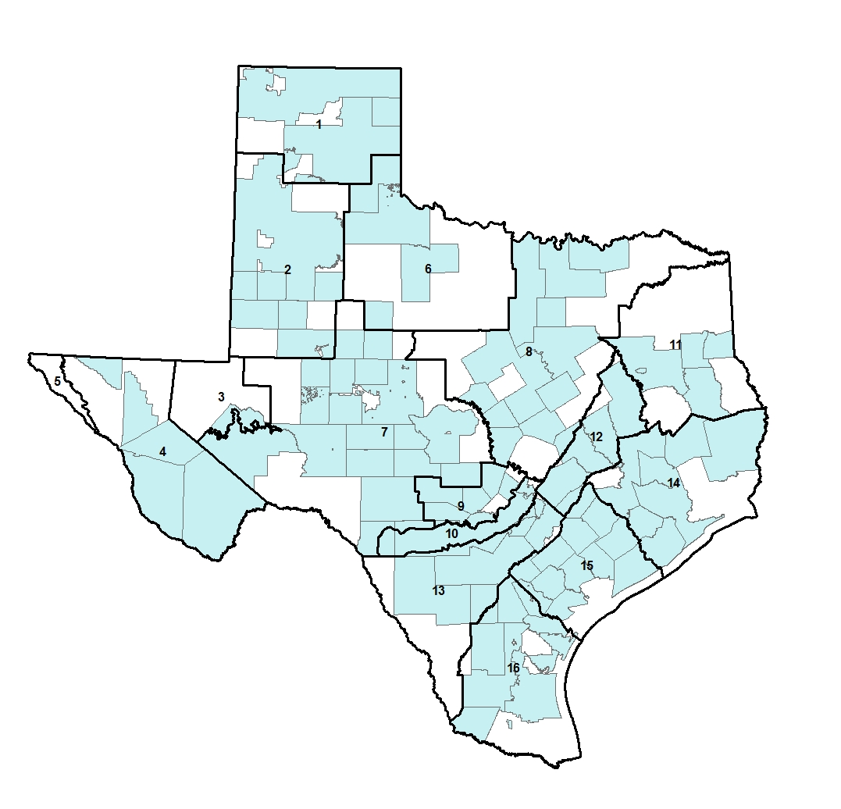
GCD: Groundwater Conservation District
Approved by the TWDB
Generally follow county lines
Priority for GCD’s is to determine DFC: Project water needs for 50 years (Developed through groundwater availability models)
Areas in white do not have districts
Incentive for district formation: State Funding for water resource projects

Slide 6
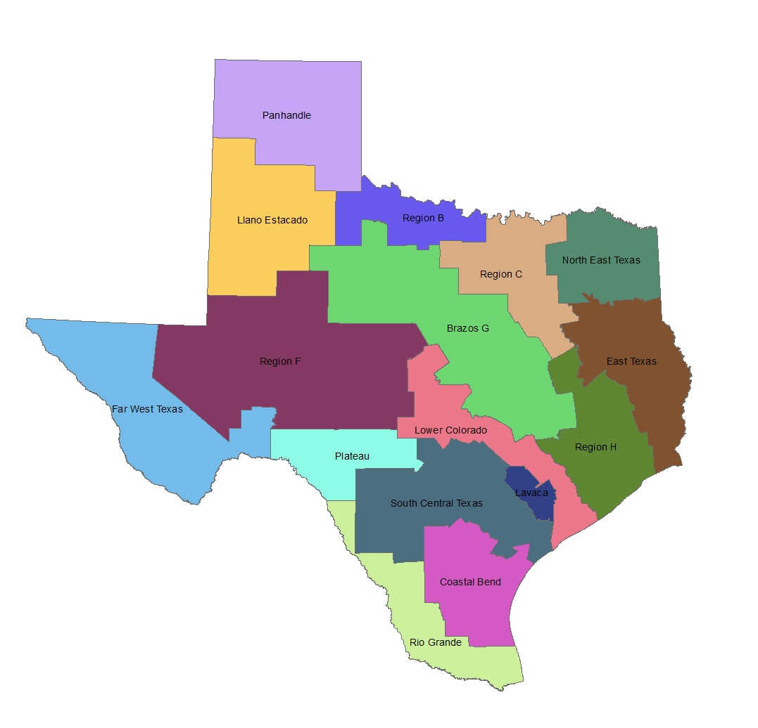
RWPG: Regional Water Planning Groups
Receive and report data for desired future conditions to the State Water Plan
Responsible for Surface & Groundwater Planning
Boundaries based on:
cities
surface water systems
groundwater systems
large water service areas
metropolitan statistical areas
existing regional water supply studies and areas
groundwater management districts

Slide 7
Carl’s Flow Chart for Texas Water Policy
TWDB
Surface & Groundwater
RWPG
GCD (Stakeholders)
GMA
TCEQ
Individual Landowners
GMA: Groundwater Management Area
GCD: Groundwater Conservation District
RWPG: Regional Water Planning Group
TCEQ: Texas Commission on Environmental Quality

Slide 8
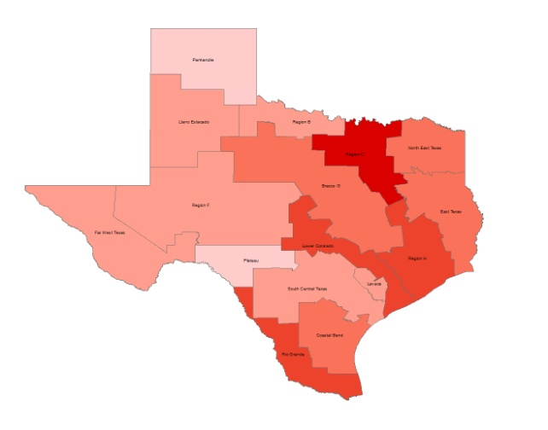
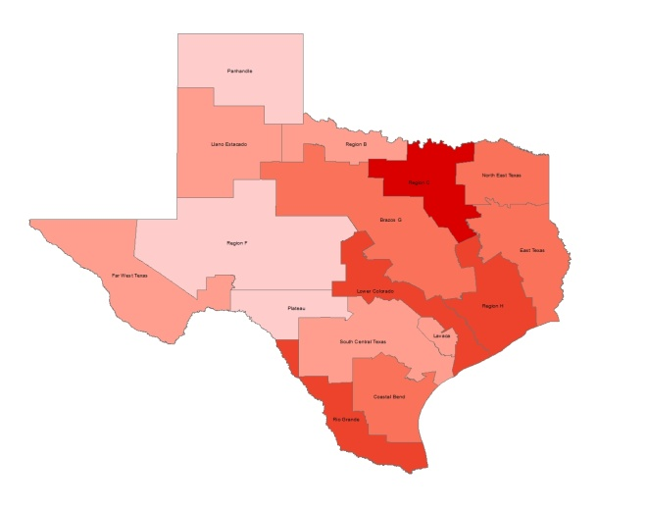
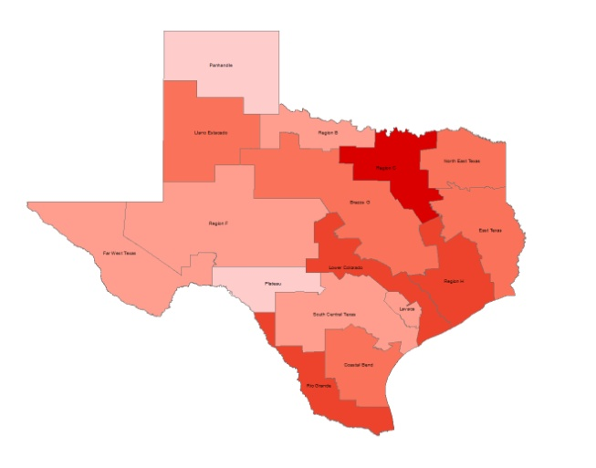
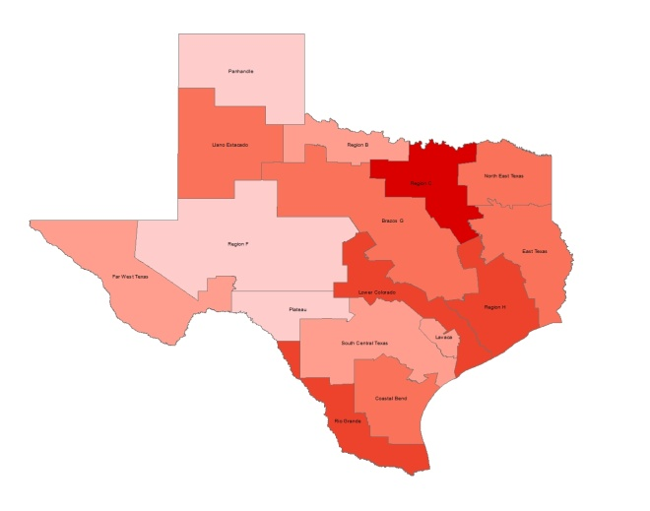
Water Demand / Total Groundwater Supply
2010 2020 2030
2040 2050 2060

Slide 9
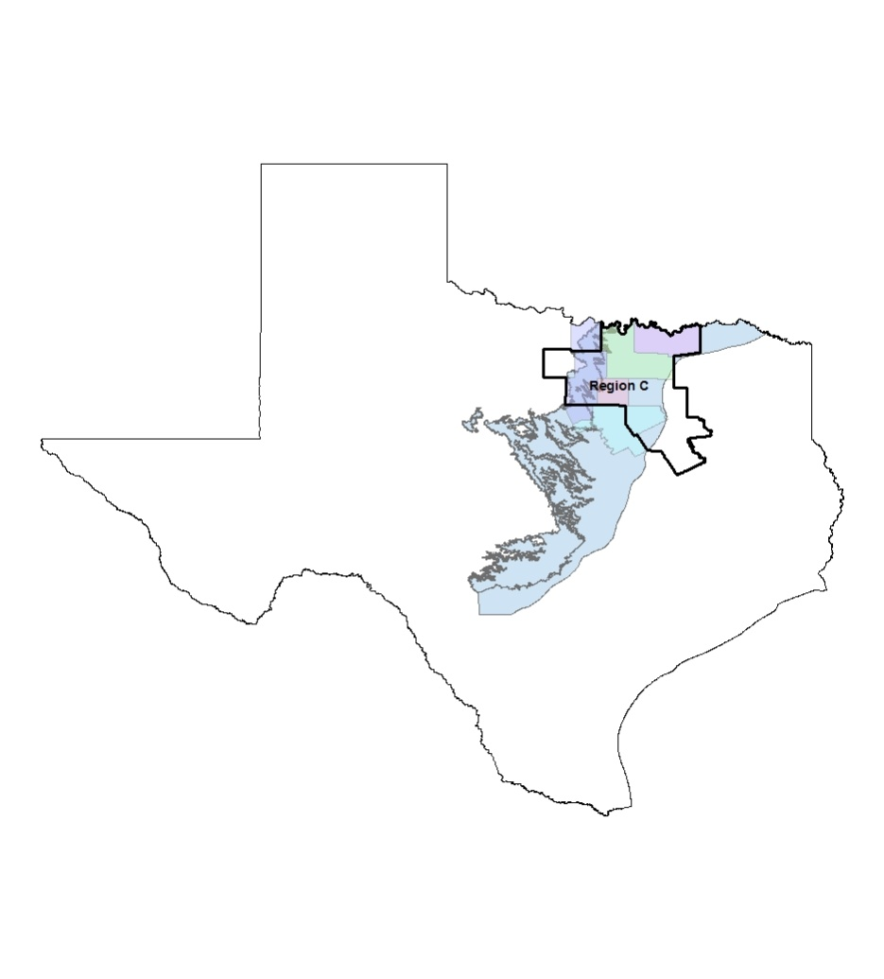
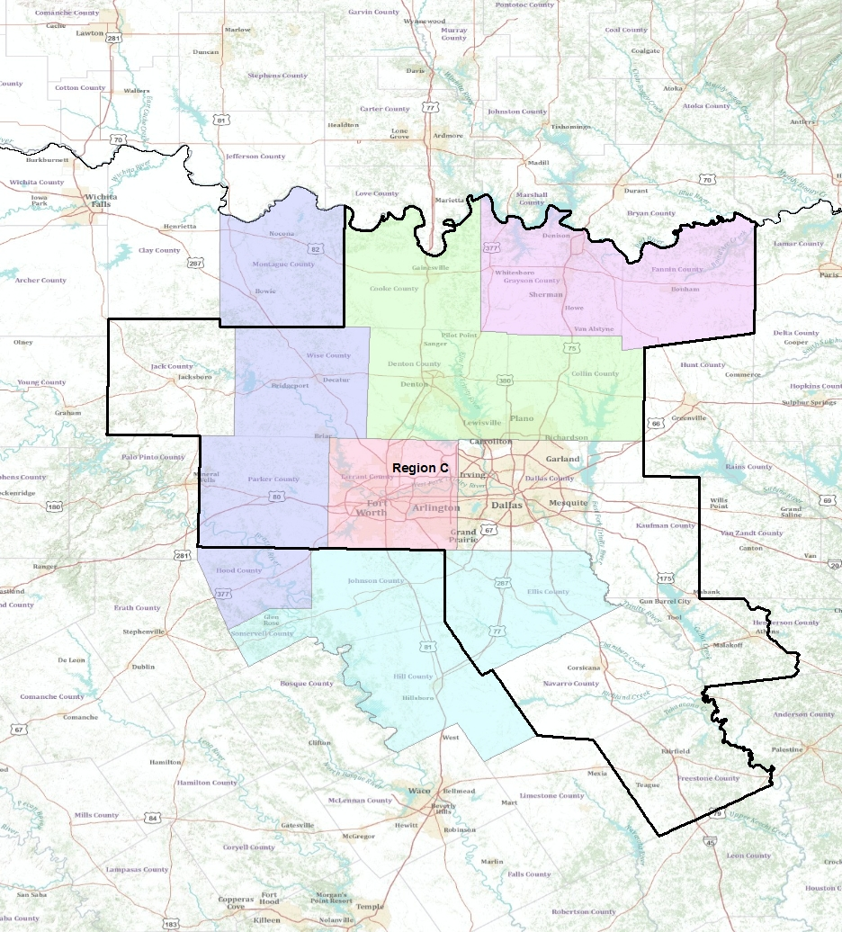

Slide 10
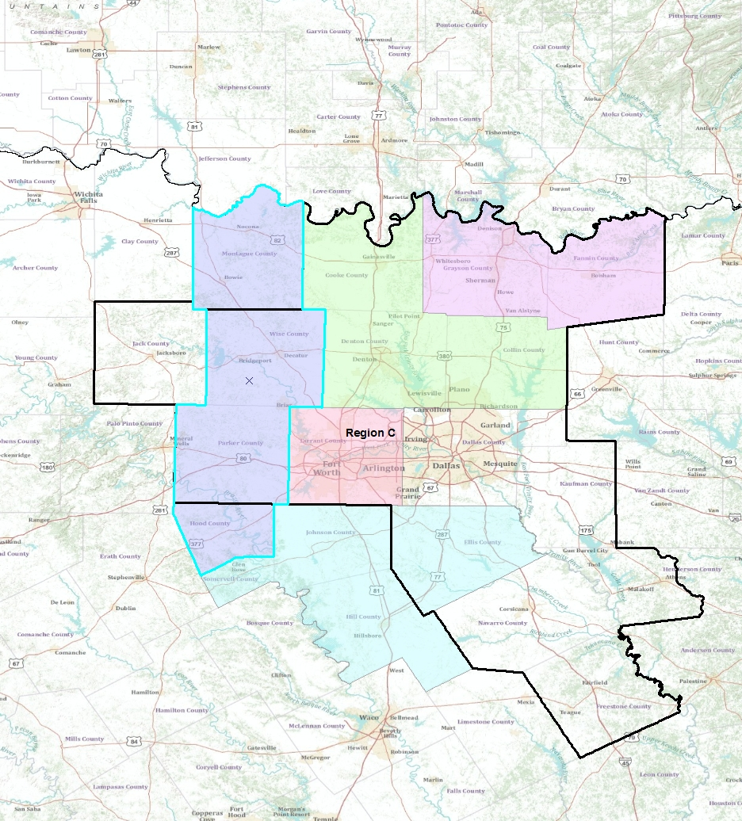
GCD’s affected by Priority Groundwater Management Area Designation
Only the Upper Trinity GCD has set desired future conditions
90,777 acre ft./yr
Is this sustainable? Not likely. The Trinity Aquifer has low recharge rates.
Annual Recharge = .10 MAF
Pumping = 0.19 MAF

Slide 11
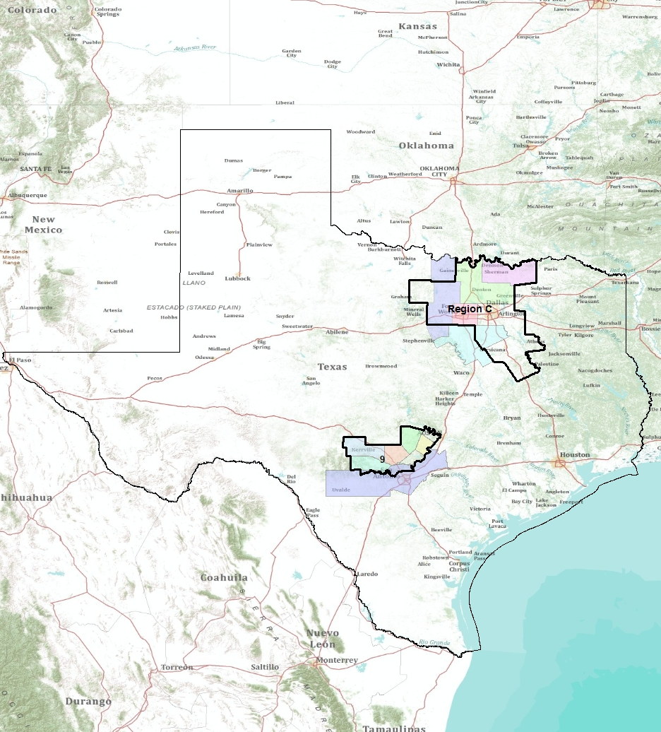
Future Work
If Groundwater Availability Models determine desired future conditions, how are these models developed?
The saturated thickness varies greatly (Ogallala: 30m-100m). Is one desired future condition per GMA acceptable?

