Slide 1
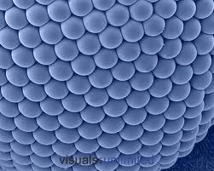
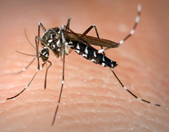
The Dreaded Asian Tiger Mosquito aka Aedes Ambopictus
Danny Fox-Baker
GIS for
Water Resources

Slide 2
Problem
Disease
West Nile virus, St. Louis encephalitis, Dengue fever, Yellow fever, LaCross Virus, Chikungunya fever and dog heartworm
Social Nuissance
Daytime Biter
Disrupts Outdoor Recreation/Tourism
Ecological Threat: Recent Invasive Species Outcompetes Natives
Notes:
nonendemic arboviruses such as dengue, yellow fever, and chikungunya. With globalization and modern travel patterns, it may be only a matter of time before an infected traveler imports one of these exotic diseases. Chikungunya epidemic on the French Island La Réunion in 2005-2006. By September 2006, there were an estimated 266,000 people infected with the virus, and 248 fatalities on the island

Slide 3
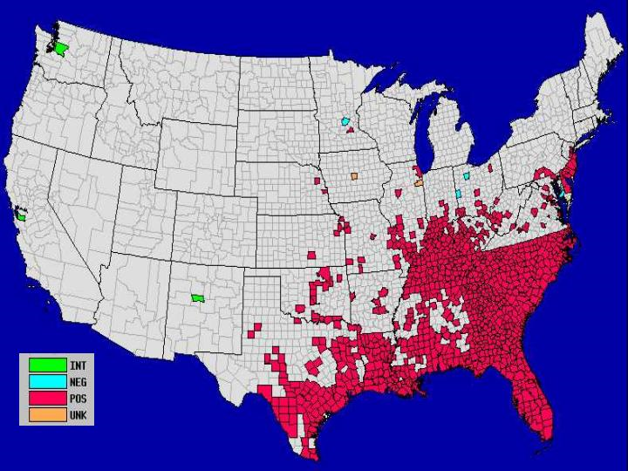
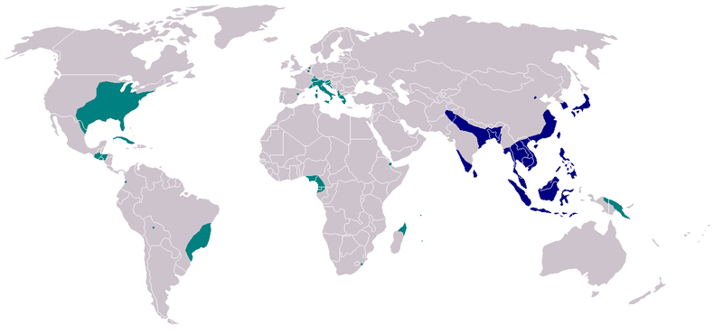
Problem is Spreading
Arrive in S.Europe in late 1980s….U.S. 1987- mid 1990s
Notes:
native to tropical and subtropical regions, they are successfully adapting themselves to cooler regions. In the warm and humid tropical regions, they are active the entire year long; however, in temperate regions they hibernate over winter. Eggs from strains in the temperate zones are more tolerant to the cold than ones from warmer regions.^{[24][25]} They can even tolerate snow and temperatures under freezing. In addition, adult tiger mosquitoes can survive throughout winter in suitable microhabitats

Slide 4
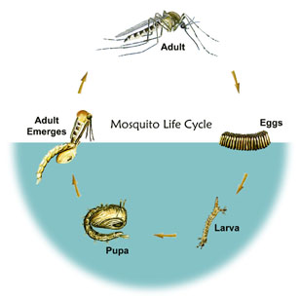
Lifecycle

Slide 5
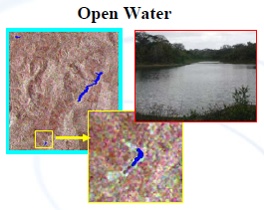
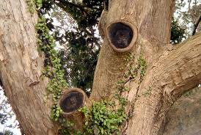
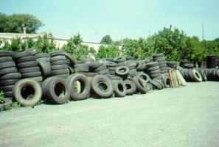
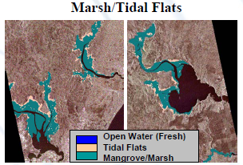
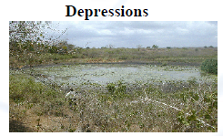
Breeding Sources
Tree Holes
Tires

Slide 6
Remote Sensing and GIS as aTool
Notes:
SRTM shuttle radar topography

Slide 7
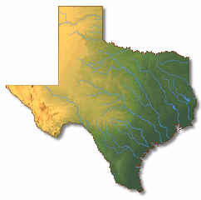
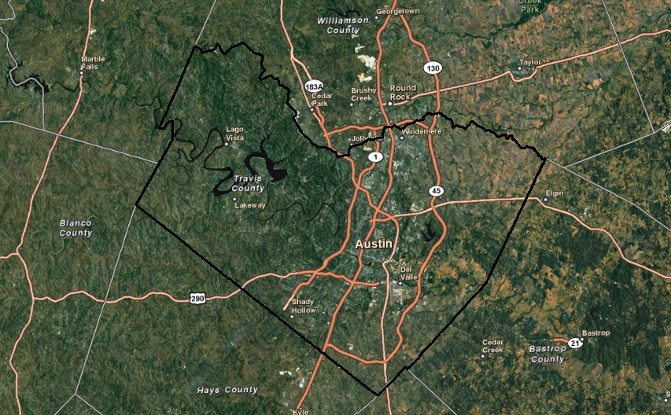
Travis County

Slide 8
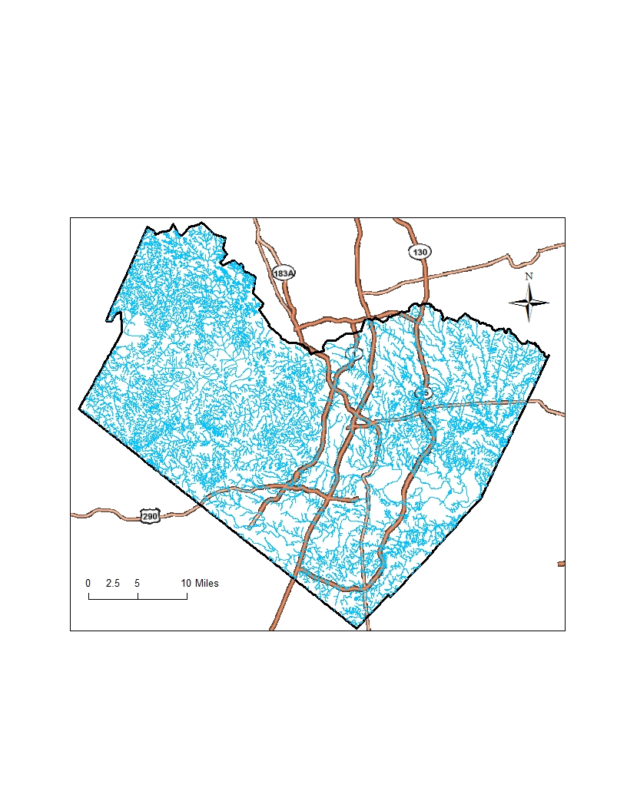
Rivers and Creeks

Slide 9
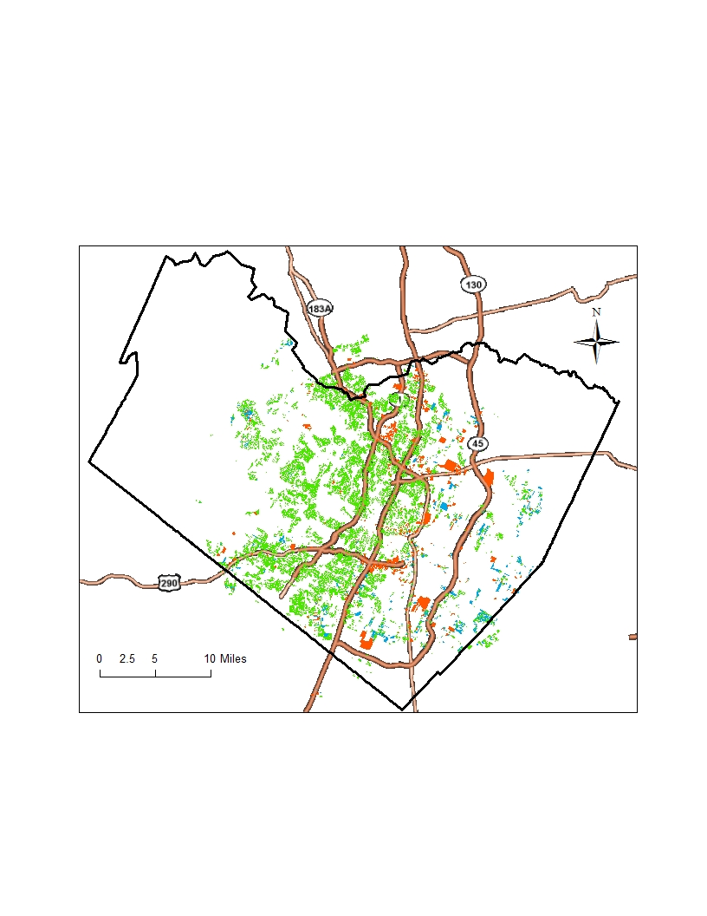
Vulnerable Land Use
Notes:
Within ETJ

Slide 10
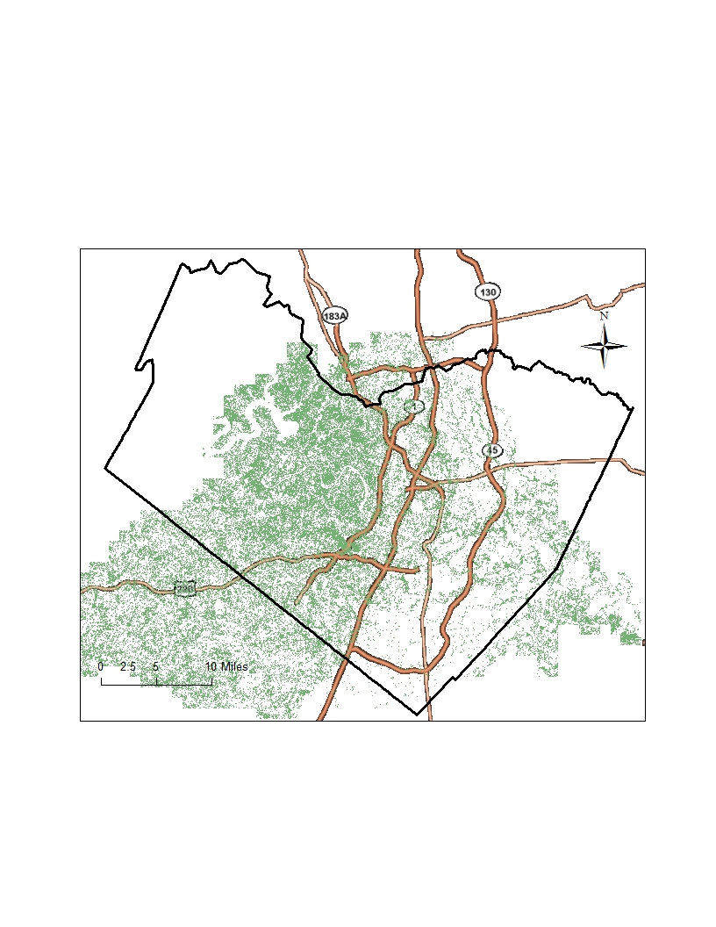
Gross Tree Canopy Cover

Slide 11
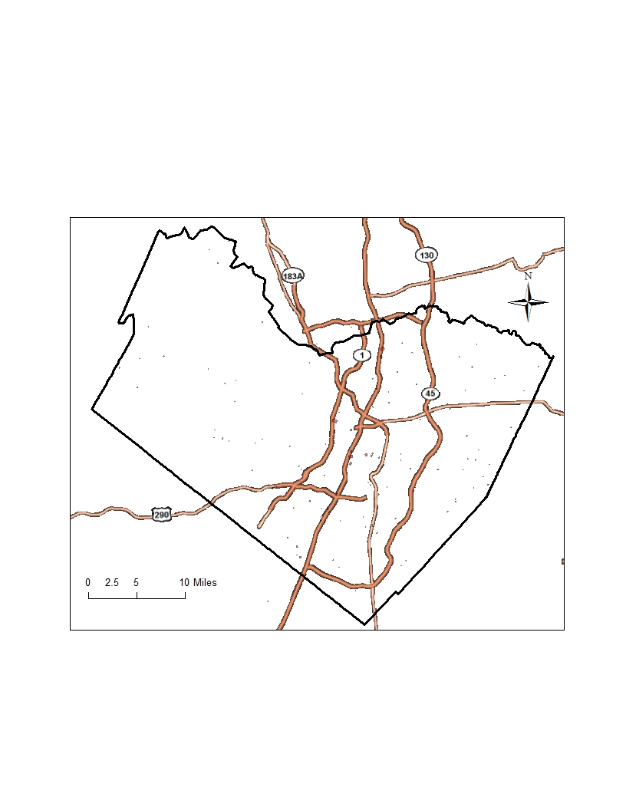
City Cemeteries

Slide 12
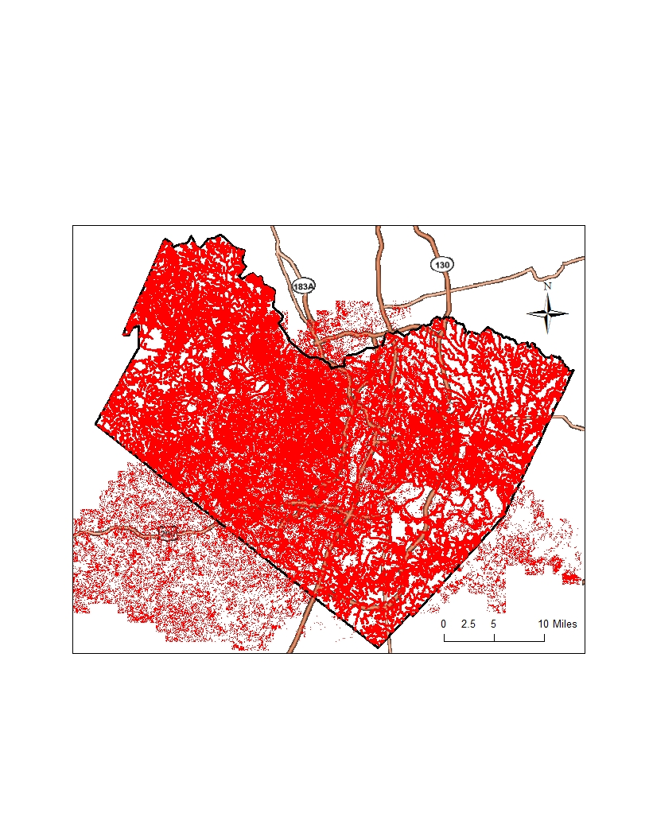
Hazard Analysis

Slide 13
Further Work
Spatio-temporal Data
Precipitation
Temperature
Stream level change
Flow Accumulation
Impervious Surfaces
Pits/Depressions
Soil Type (moisture) Lansat5?
Slope Analysis

Slide 14
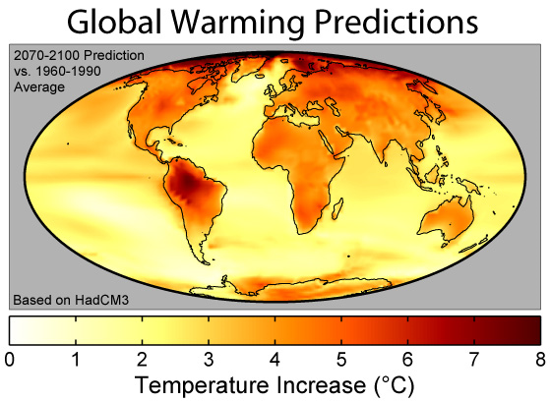
Future Trends
Climate Change
Globalization
Density – (Good&Bad)
Storm Water BMPs
Insecticide Resistance

Slide 15
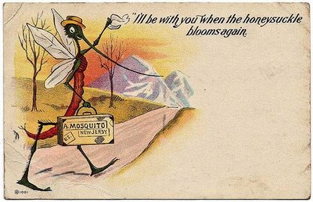
Questions?

