Slide 1
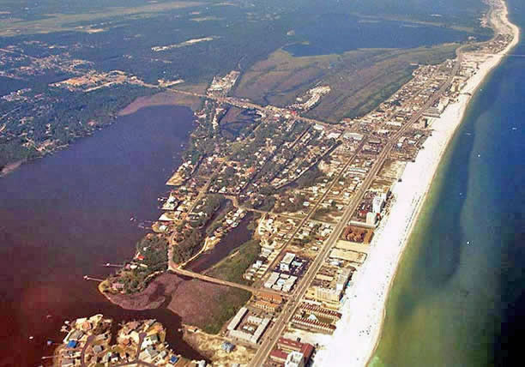
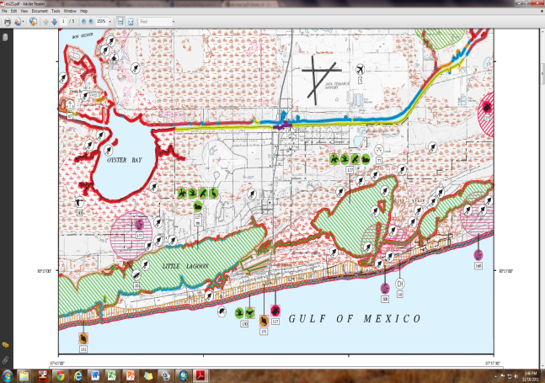
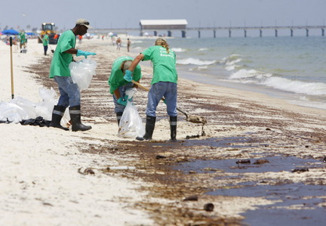
Environmental Sensitivity to Oil Spills in Gulf Shores, AL
Prepared by: Matthew Dobbertien
12/01/2011
GIS in Water Resources

Slide 2
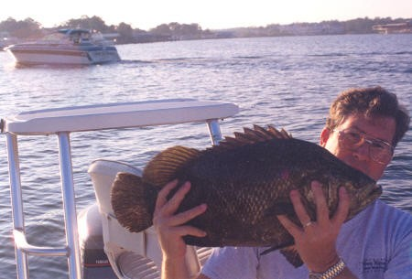
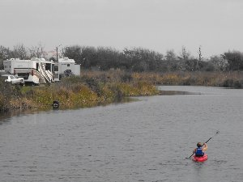
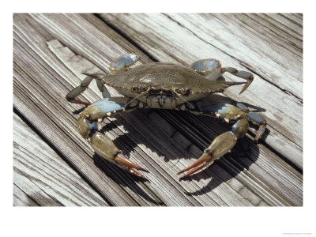
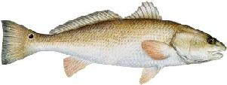
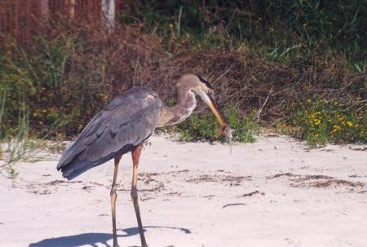
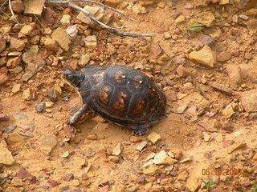
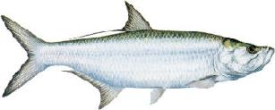
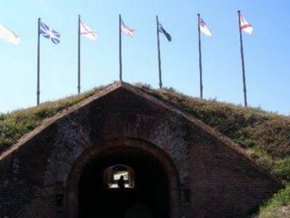
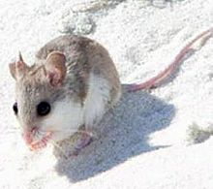
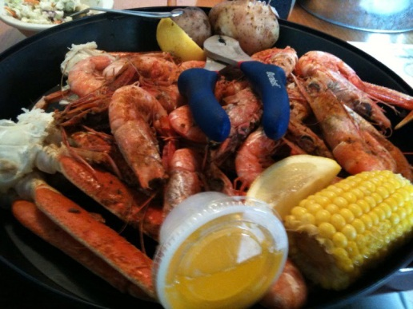
Why Gulf Shores?

Slide 3
Environmental Sensitivity Index Dataset
Biological
Sensitive Species
High Concentrations
Early Life Stages
Likelihood of Exposure
7 General Categories
Bird, Fish, Marine Mammal, Shellfish, Terrestrial Mammal, Reptile, and Rare Plants
Polygon Symbol
Marine Mammal
Human Use
High Use Shoreline
Boat Ramps
Public Beaches
Sporting Areas
Protected Resources
Commercial Fisheries
Mining Resources
Surface Water Intakes
Historic Sites
Wildlife Refuges
Polygon Symbol
Shorelines & Habitats
Ecological Sensitivity
Biological productivity
Exposure to waves
Ease of Restoration
Scale 1-10
Increasing susceptibility to damage by oiling
Polyline Symbol

Slide 4
Shoreline & Habitats in ArcGIS
Percent @ Maximum Classifiable Risk
80.7 % of Habitats
80.5 % of Shorelines

Slide 5
ESI Biological Resources in ArcGIS

Slide 6
ESI Report

Slide 7
ESI Human Use Resources in ArcGIS

Slide 8
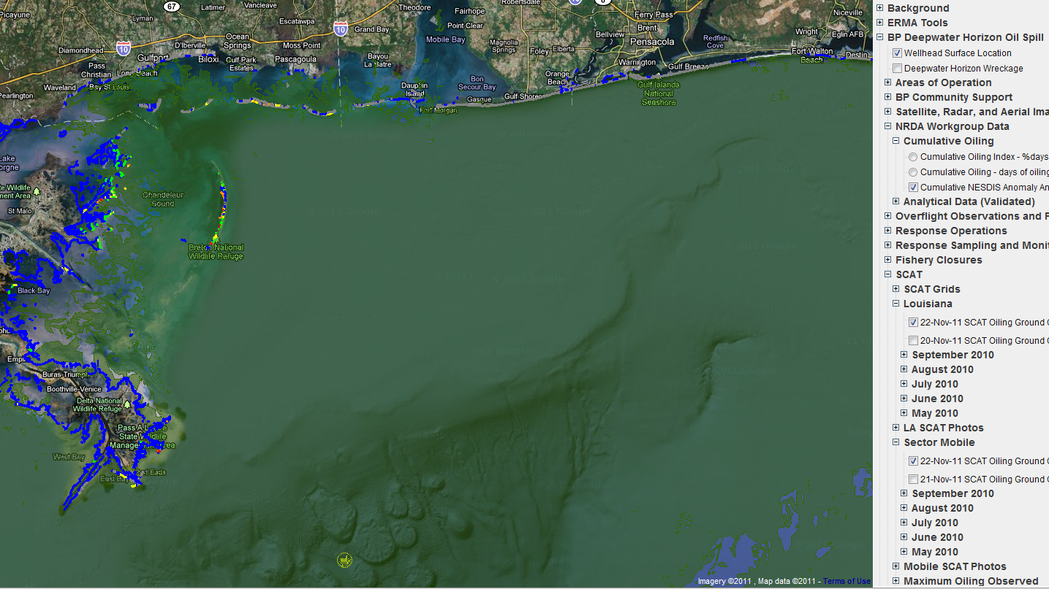
ERMA Environmental Response Management Application
Web- Based GIS
Gulf Oil Spill
Great for Visualization
Emergency Responders
Environmental Resource Managers
Central Data Hub
Forecasts
Photos
Chemistry
Biology
ESI (generates reports)

Slide 9
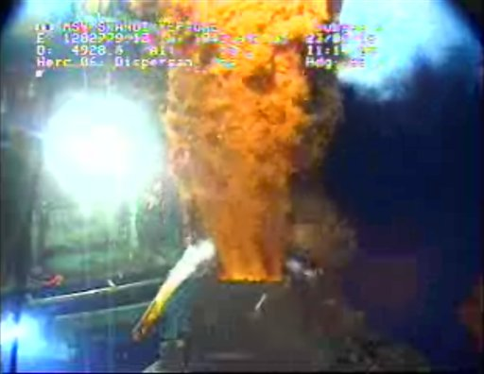
Case Study: Deepwater Horizon BP Oil Spill
20 April 2010
Explosion
Dead Toll: 11
Injured: 17
15 July 2010
Well was capped
Environmental Concerns
Oil Related
Dispersant Related
Measured Chemically and Biologically

Slide 10
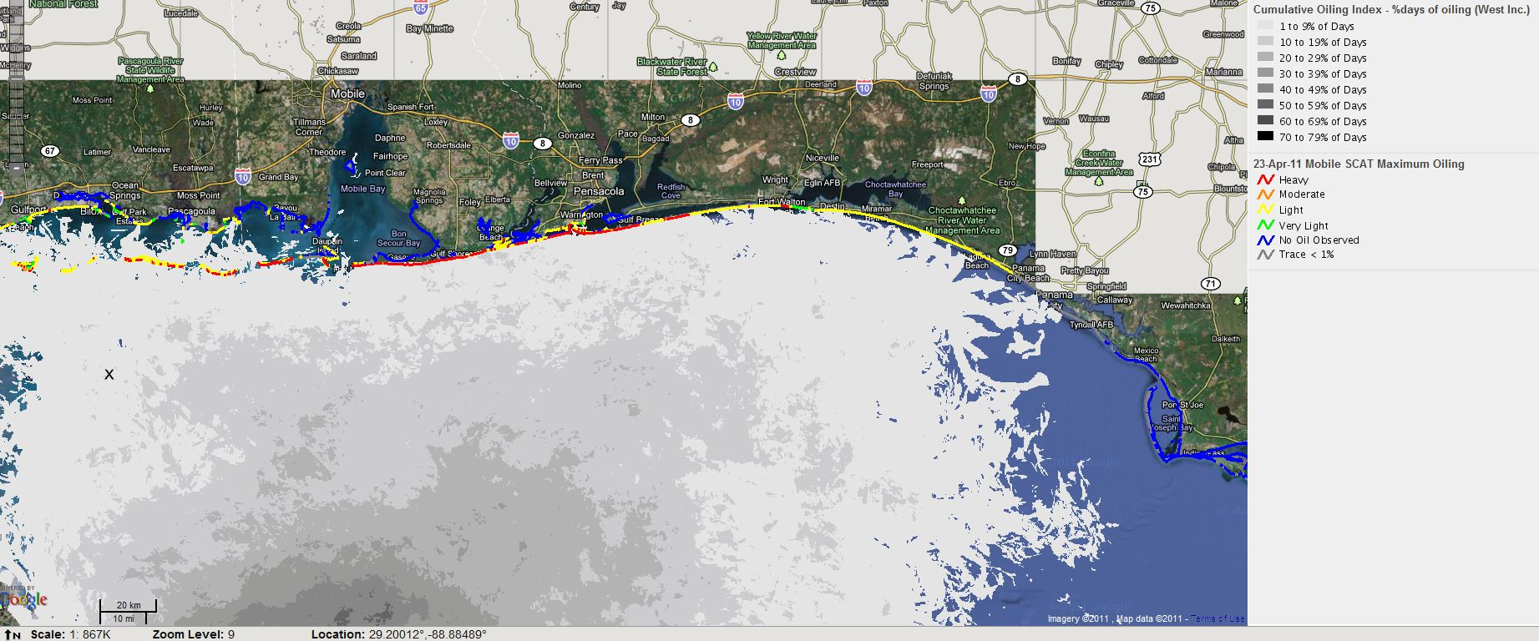
ERMA: Extent of Oiling

Slide 11
PAH Concentration, Oiling Photos, and Integrated Chemical Analysis

Slide 12
Biological Observation

Slide 13
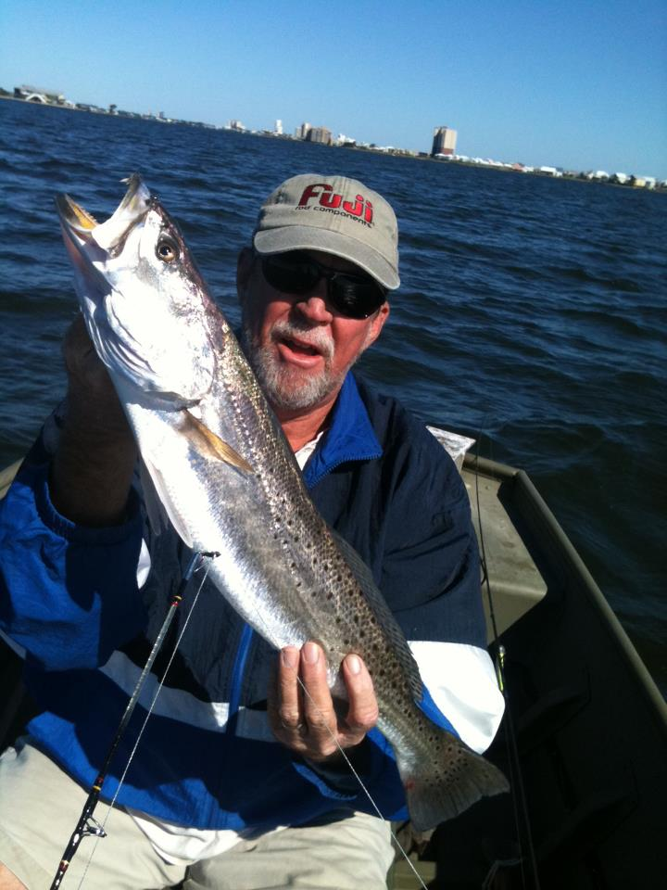
Local Experience- “Big Jim”
“Water was beautiful the entire summer, few tar balls some days, no sheen. THE BEST FISHING I’VE EVER SEEN. All fishing was shut down but I did some incredible catch and release on a beach with NO ONE ON IT IN JULY AND AUGUST...amazing. No sores, no dead fish, no dead birds, crabs...it was really pretty wonderful.”
“Look for info on the West Beach Pass. Lots of history and one of the most interesting environmental SCREW UPS in the area.”
SUMMARY
Tar Balls
Major Problem @ West Beach Pass
No Surface Oil Sheen
Beautiful Beaches
Great Fishing
No Crowds

Slide 14
ArcGIS & Web-Based GIS (ERMA)
ArcGIS Desktop
ERMA: A Web- Based GIS
Pros
Excellent for General Analysis
Possibilities and Scope are HUGE
Developed for Years
Cons
Obtaining Data
Integrating Data
Requires General Software Knowledge
Pros
Excellent for Specific Analyses
Great Visualization
Seamless Integration of Data
Public Access
Easy to Use (Point and Click)
Cons
Requires Significant Developer Effort
Limited in Scope
Small Toolkit

Slide 15
Conclusions
Gulf Shores, AL is an environmentally sensitive area to oil spills
NOAA predictions mesh well with observed data from the Gulf Oil Spill
Deepwater Horizon has had a significant, but not catastrophic effect on the biological and commercial resources in Gulf Shores

