Slide 1
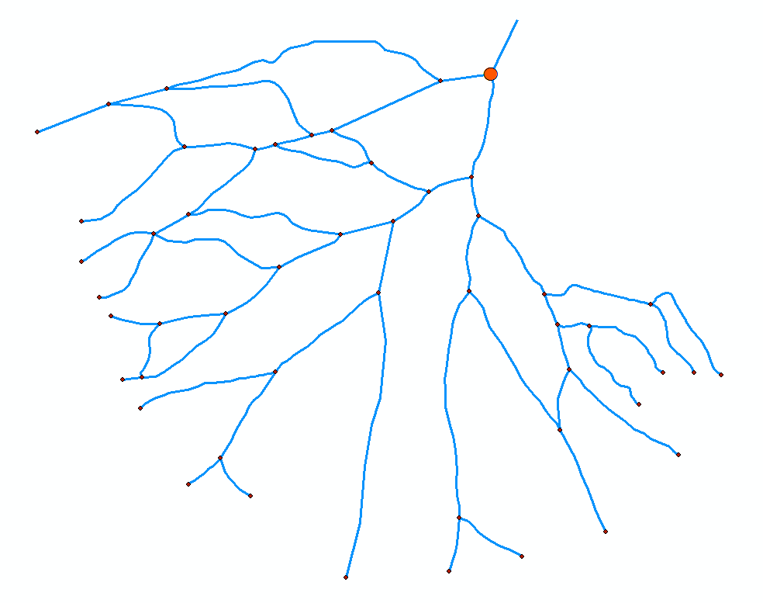
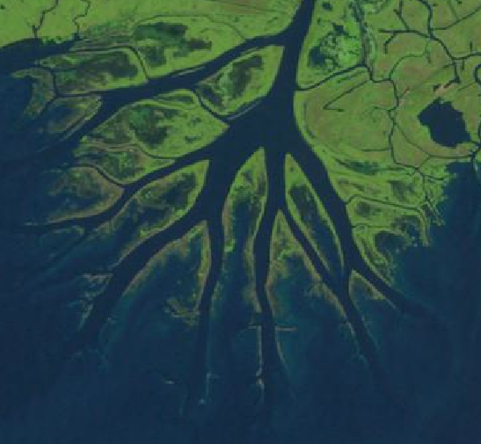
On the topology of Wax Lake Delta
Matthew Hiatt

Slide 2
Outline
Why do we care?
Wax Lake Delta
Why statistics?
Directed Network Analysis
Results
Conclusion

Slide 3
Why are river deltas important?
River deltas are home to over half a billion people [Syvitsky, 2009]
Ecological and societal centers [Foufoula-Georgiou et al., 2011]
Dynamic systems for sustainability research
Flood control
Restoration practices
Food sources
Image:
Ricemap.org

Slide 4
Wax Lake Delta
Study site located in coastal Louisiana just south of Morgan City and 200 km west of the Mississippi birdsfoot.

Slide 5
Why?
The development of metrics may lead to a predictive understanding of delta behavior

Slide 6
Network Analysis using a directed graph [Smart & Moruzzi, 1972]
A network tree is created from links and nodes
Nodes are assigned a “type” (O = outlet, F = fork, J = join)
Links receive names corresponding to upstream and downstream nodes
Statistical Analysis…
α = 0.32 < 0.5
Bifurcating network

Slide 7
Results – Some distributions
Link Length Distribution
Island Size Distribution
Short Channels
Small Islands

Slide 8
Width Function

Slide 9
Results – Width Function
Width function measures the amount of water
Analyzed for topologic and geometric networks
Geometric width increases as a function of radial distance

Slide 10
Conclusions
Wax Lake Delta is a bifurcating system
Near-edge distance may predict inland lake locations
Short links and small islands
Network increases in width with increasing radial distance

Slide 11
References
Paola Passalcqua, David Mohrig, John Shaw
Edmonds, D. A., C. Paola, D. C.J.D. Hoyal, and B. A. Sheets (2011), Quantitative metrics that describe river deltas and their channel networks, J. Geophys. Res., doi:10.1029/2010JF001955, in press
Edmonds, D. A., and R.L. Slingerland (2007), Mechanics of river mouth bar formation: Implications for the morphodynamics of delta distributary networks, J. Geophys. Res., 112, F02034.
Falcini, F., and D. J. Jerolmack (2010), A potential vorticity theory for the formation of elongate channels in river
deltas and lakes, J. Geophys. Res., 115, F04038, doi:10.1029/2010JF001802.
Foufoula-Georgiou, E., J. Syvitski, C. Paola, C. T. Hoanh, P. Tuong, C. Vörösmarty, H. Kremer, E. Brondizio, Y. Saito, and R. Twilley (2011), International Year of Deltas 2013: A proposal, Eos Trans. AGU, 92(40), 340, doi:10.1029/2011EO400006.
Feola, A (2006). Hydrological and Geomorphological Studies in Transition Environments. PhD Thesis, Università degli Studi di Padova.
Morisawa, M (Ed.) (1985). Topologic Properties of delta distributary networks, 239-268, St Leonards, NSW, Australia
NCED (National Center for Earth Surface Dynamics, Wax Lake Delta, University of Minnesota, http://www.nced.umn.edu/content/wax-lake-delta, Accessed Oct 15, 2011.
Syvitski, James P M. (2005). The morphodynamics of deltas and their distributary channels. River Coastal and Estuarine Morphodynamics Proceedings of the 4th IAHR Symposium on River Coastal and Estuarine Morphodynamics RCEM 2005 Urbana Illinois USA 47 October 2005 RCEM 2005, 143.
Smart, J. S. and Moruzzi, V. L., (1972), Quantitative properties of delta channel networks. Zeit. Geomorph. 16(3), 268-82
Wright, L.D. (1977), Sediment transport and deposition at river mouths: A synthesis, Geological Society of America Bulletin, v. 88, p. 857-868

Slide 12
2013 is the YEAR OF THE DELTA!
Image: Google Earth, from user metamorphoman

