Slide 1
Evaluating Hydrodynamic Uncertainty in Oil Spill Modeling
GIS in Water Resources (CE 394K)
Term Project
Fall 2011
Xianlong Hou
Cockrell School of Engineering
12/1/2011

Slide 2
Agenda
Introduction
Motivation
Methods
Results and discussion
Conclusions
Comments and questions

Slide 3
Introduction

Slide 4
Motivation
To obtain the observed wind/tide data in order to analyze the distribution of wind and tide time series
To provide a general insight of how wind and tide factors would impact the uncertainty of oil spill
To provide reference for the future models of oil spill

Slide 5
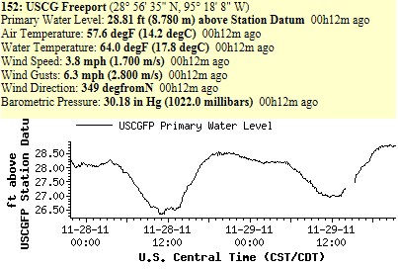
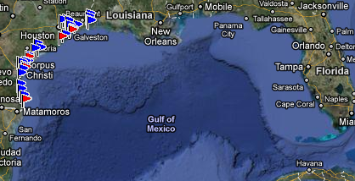
Methods
Data source and selection
The station collects meteorological data every 6 minutes. In order to ensure the accuracy of a random sample of data, the project selects the time series from 11/21/2010 to 11/21/2011 to investigate.

Slide 6
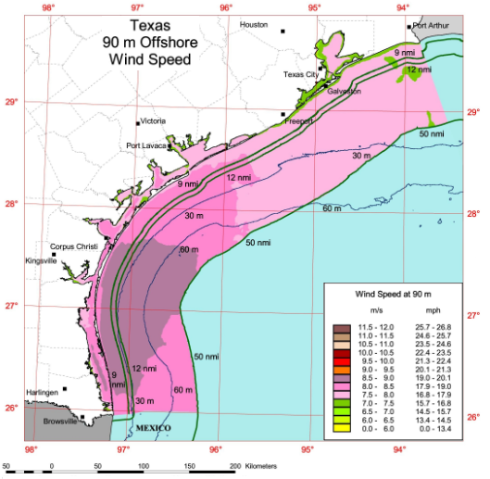
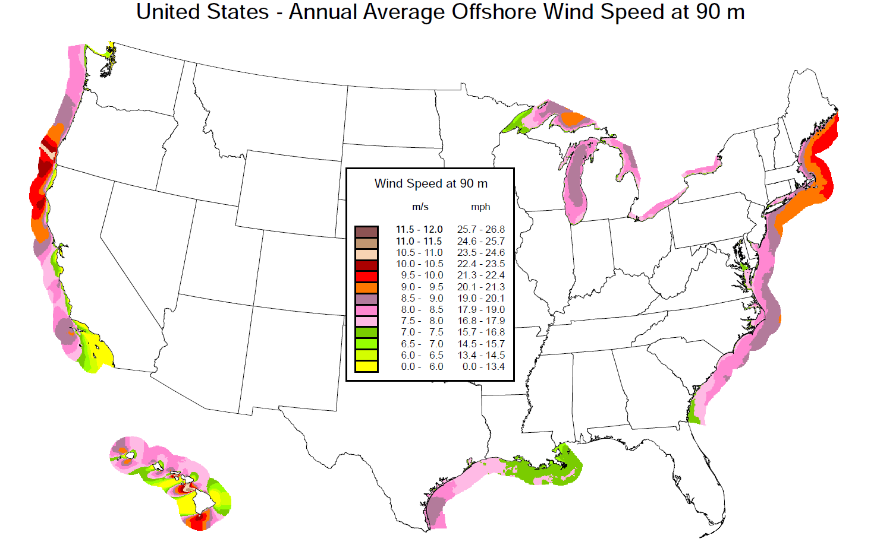
Methods
Wind analysis
Generally, the average offshore wind speed of the country including Texas coast do not show any sudden range or instability.

Slide 7
Methods
Wind analysis
The maximum of the wind speed
The monthly-mean wind speed distribution
The average wind directions
The Monthly-mean Wind Speed Difference Ratio
The corresponding characters of gusts

Slide 8
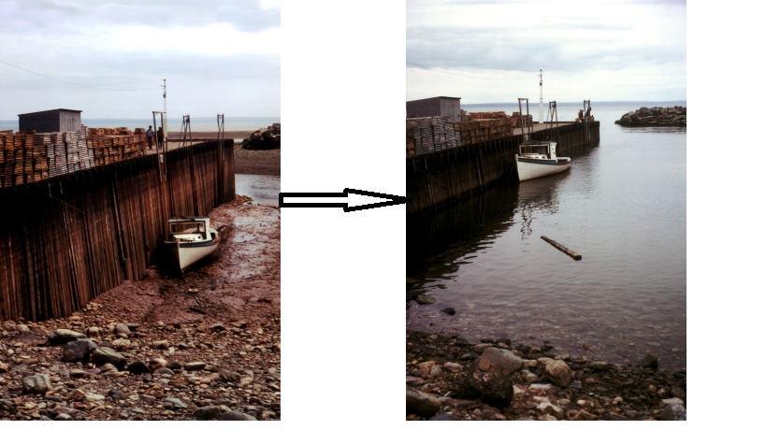
Methods
Tide is the rise and fall of sea levels caused by the combined effects of the gravitational forces exerted by the moon and the sun and the rotation of the Earth.
Tide analysis
Thus, not as wind, it is easier to analyze the tide characteristics for the reason of its regular time pattern. The study would only focus on the time period when the tide is coming and check the different parameters to verify if they follow the natural regulation.

Slide 9
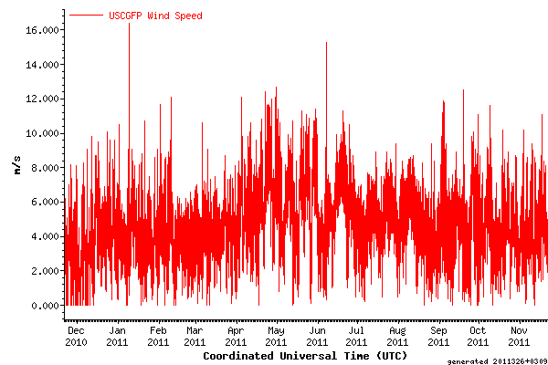
Results and discussion
Wind analysis results
Wind distribution via unit test time (6 minutes)

Slide 10
Results and discussion
(Monthly mean wind speed – Average monthly mean wind speed)/ Average monthly mean wind speed
From the results, we know that the March, April, May and October are the months which would have increasing uncertainty in oil spill.

Slide 11
Results and discussion
We can see that the monthly mean wind direction changes in a small range but the moment wind direction changes a lot which will lead to a great uncertainty for the oil spill.

Slide 12
Results and discussion
From the analysis of the gusts, we come up with the same result as the analysis of wind speed. March, April, May and October show a much higher possibility of increasing oil spill uncertainty.

Slide 13
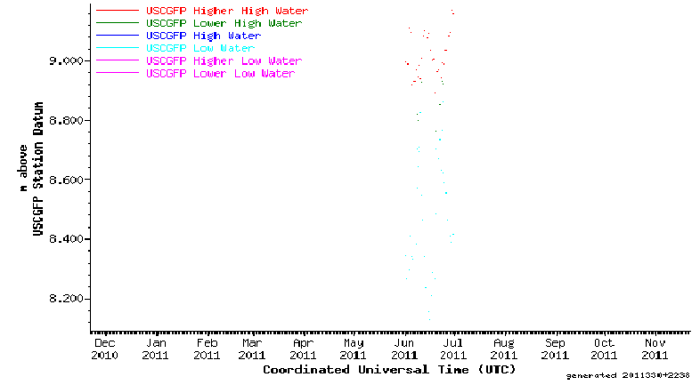
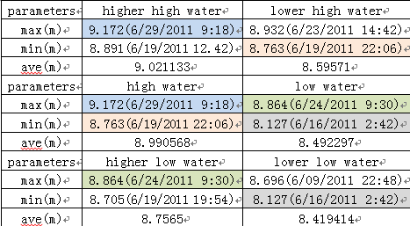
Results and discussion
Based on the result, it is explicit to figure out that June is very time period that the tide would happen.
Tide analysis results

Slide 14
Conclusions
The wind speed changes significantly via corresponding short time period which will lead to the increasing of uncertainty
The monthly mean wind direction changes in a small range but the moment wind direction changes a lot which will lead to a great uncertainty for the oil spill
March, April, May and October will have a higher possibility of increasing the uncertainty of oil spill
Tide will also increase the uncertainty of oil spill in June

Slide 15
Thanks!
Any comments or questions?

