Slide 1
Investigating nitrogen levels in Hornsby Bend monitoring wells by Justin Davis
Hornsby Bend BMF

Slide 2
Monitoring well locations, Hornbsy Bend Biosolids Manufacturing Facility

Slide 3
Chemical speciation of aqueous nitrogen for various pH and pε values
Stumm, W., & Morgan, J. J. (1996). Aquatic Chemistry (3rd ed.).
605 Third Avenue, New York, NY 10158-0012: John Wiley & Sons, Inc.

Slide 4
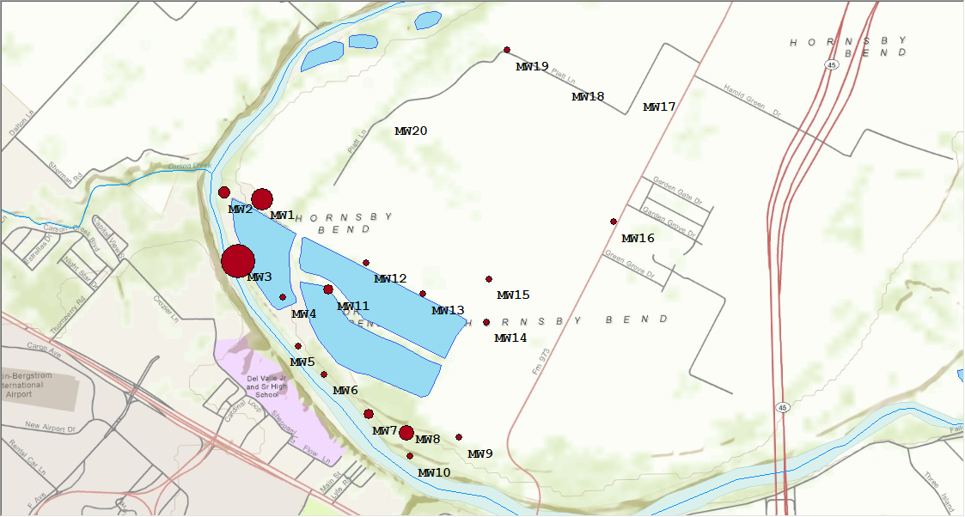
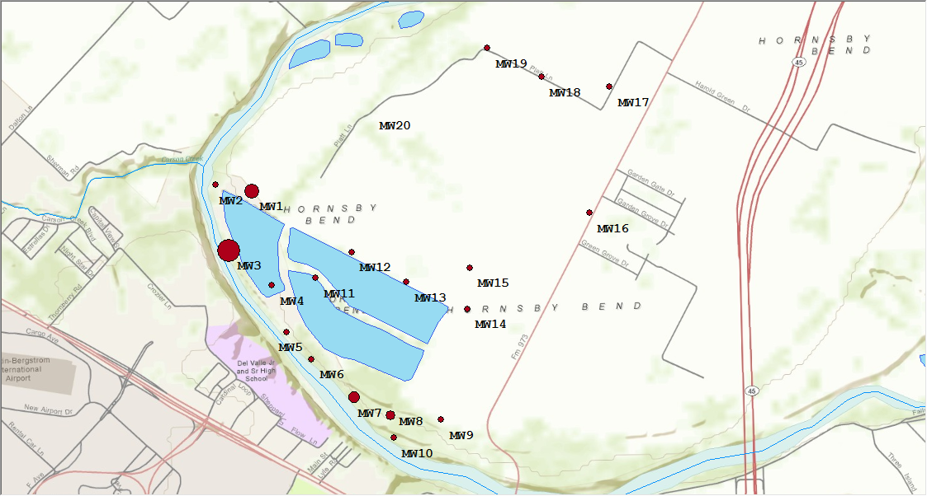
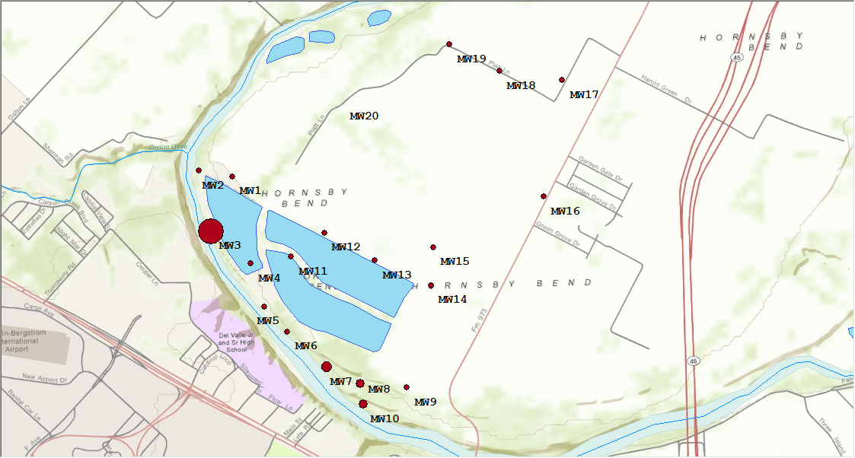
Biannual time series: NH4-NH3 values from 2005-2011
2005
2011
2007
2009

Slide 5
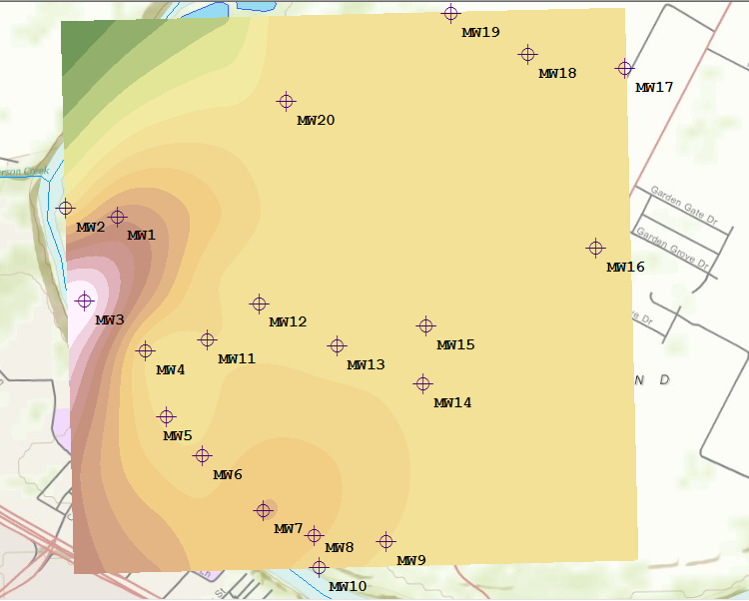
Spline interpolation NH4-NH3 time-averaged values

Slide 6
Analytical nitrogen parameters and the total nitrogen
equation
NH4-NH3 + Organic Nitrogen + NO3-NO2 = TOT-N
TKN

Slide 7
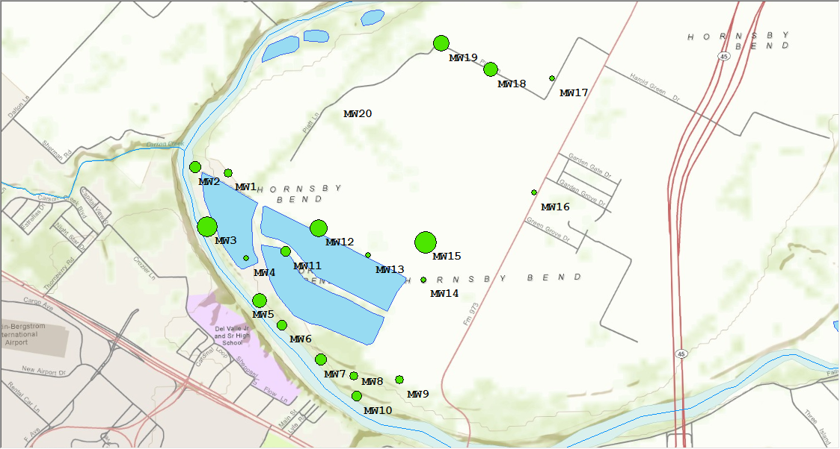
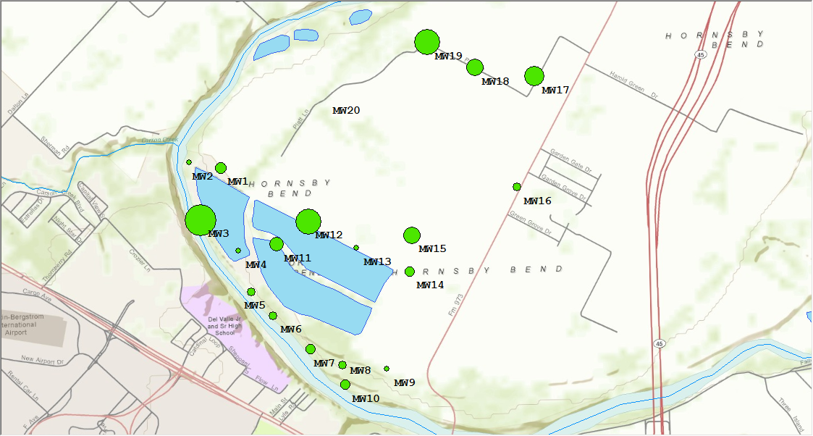
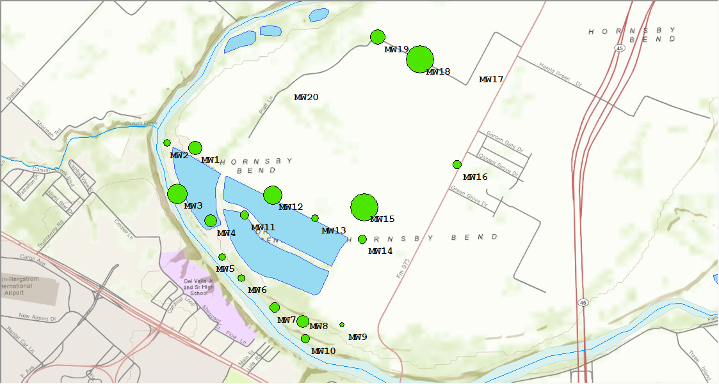
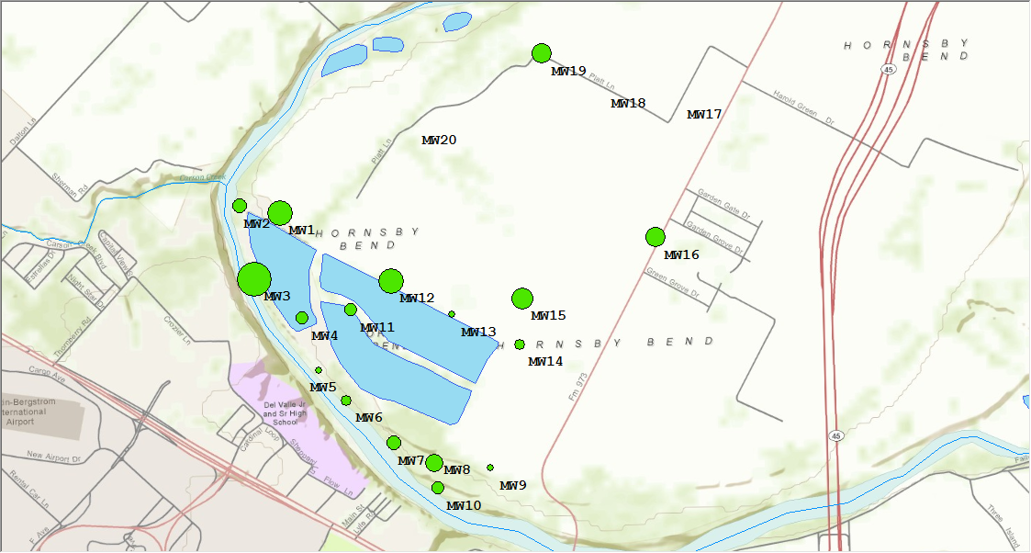
Biannual time series: TOT-N values from 2005-2011
2011
2005
2007
2009

Slide 8
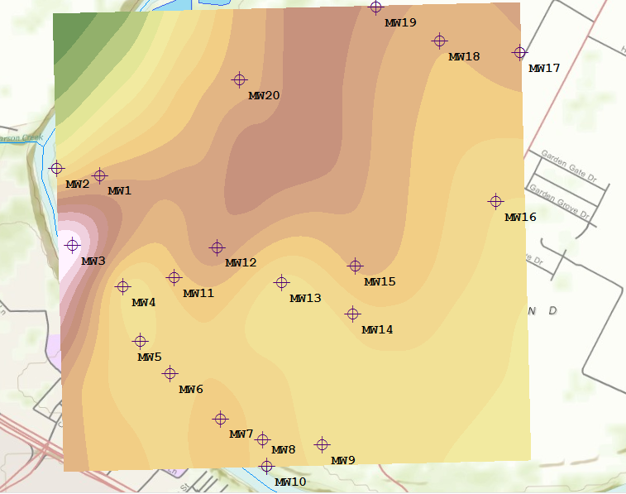
Spline interpolation TOT-N time-averaged values

Slide 9
Future work
Groundwater depth time series
Newly collected monthly data
Other indicator parameters?

