Slide 1
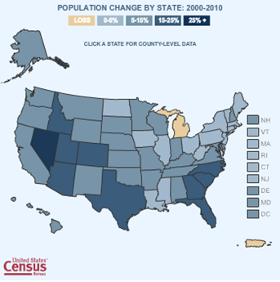
U.S. Census Bureau
3 Censuses:
Decennial Census
Age
Race
Sex
Relationship to householder
Economic Census
Census of Governments

Slide 2
Profile Maps of States
http://www.census.gov/geo/www/maps/2010_census_profile_maps/census_profile_2010_main.html

Slide 3
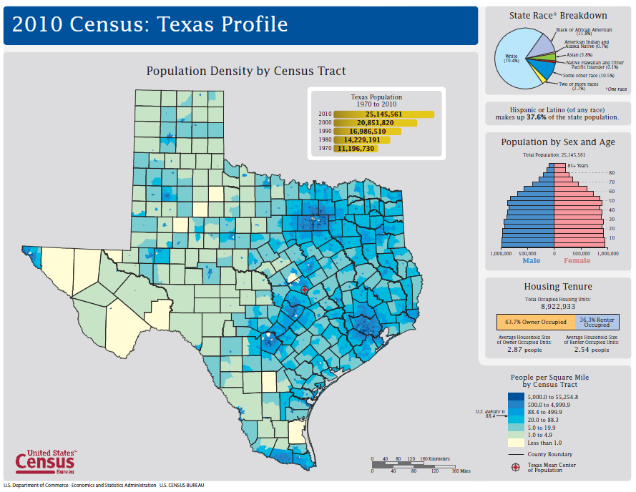

Slide 4
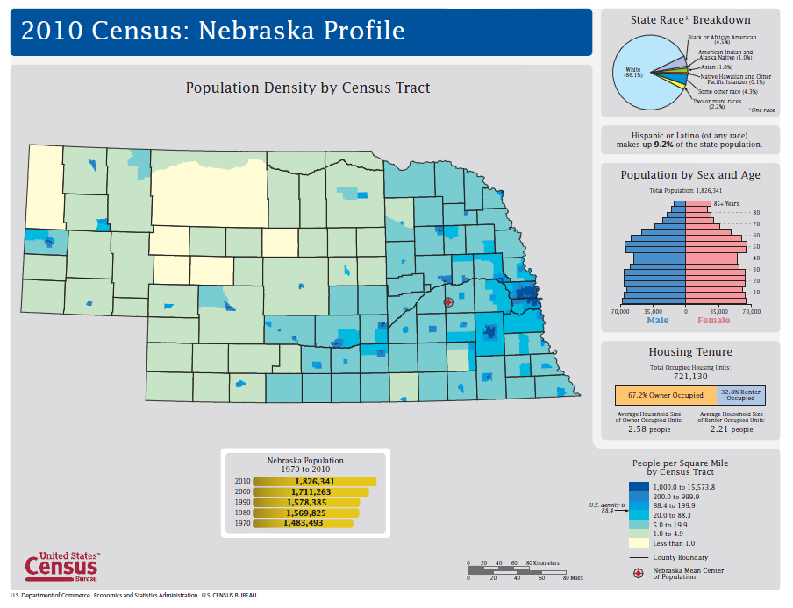

Slide 5
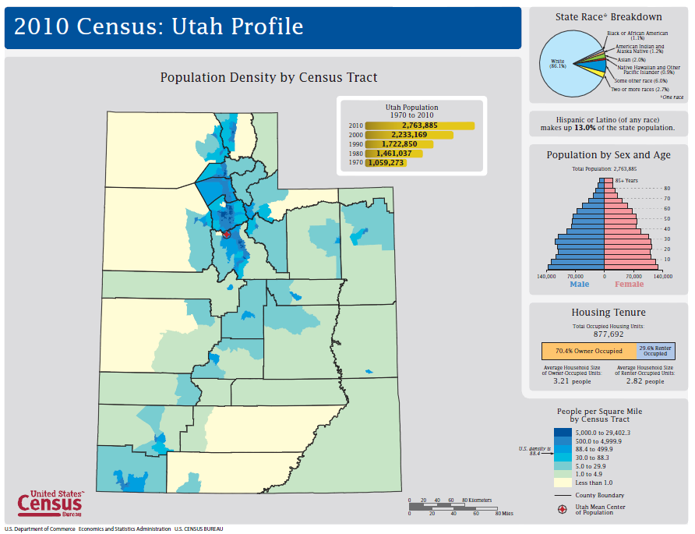

Slide 6
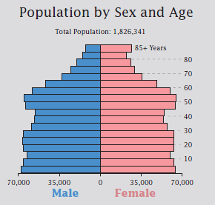
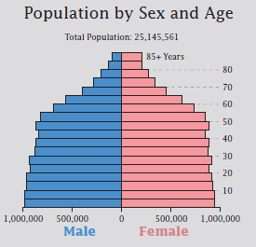
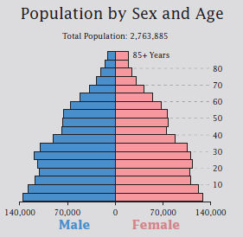
Age Distribution of Population
Nebraska
Texas
Utah

Slide 7
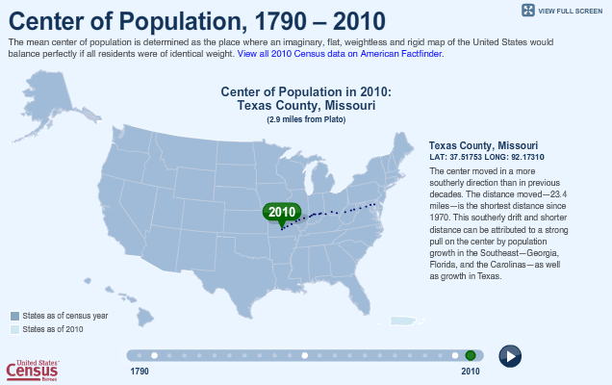
Center of Population of the United States
http://2010.census.gov/2010census/data/center-of-population.php

Slide 8
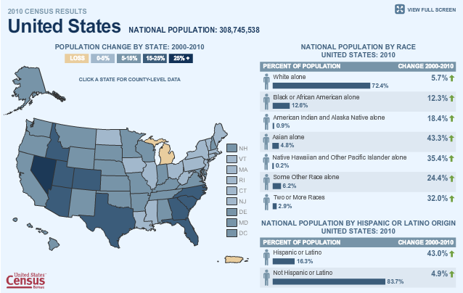
Population Change 2000-2010
http://2010.census.gov/2010census/data/

Slide 9
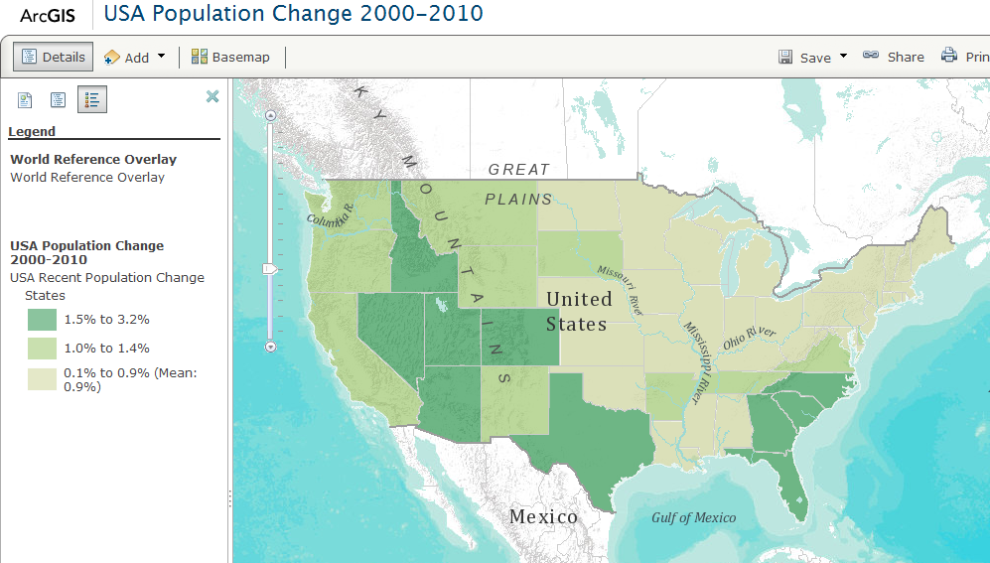
Population Change 2000-2010 in ArcGIS Online
http://www.arcgis.com/home/webmap/viewer.html?webmap=0a27f5cb1f07478fbdf117b70231c5c2

Slide 10
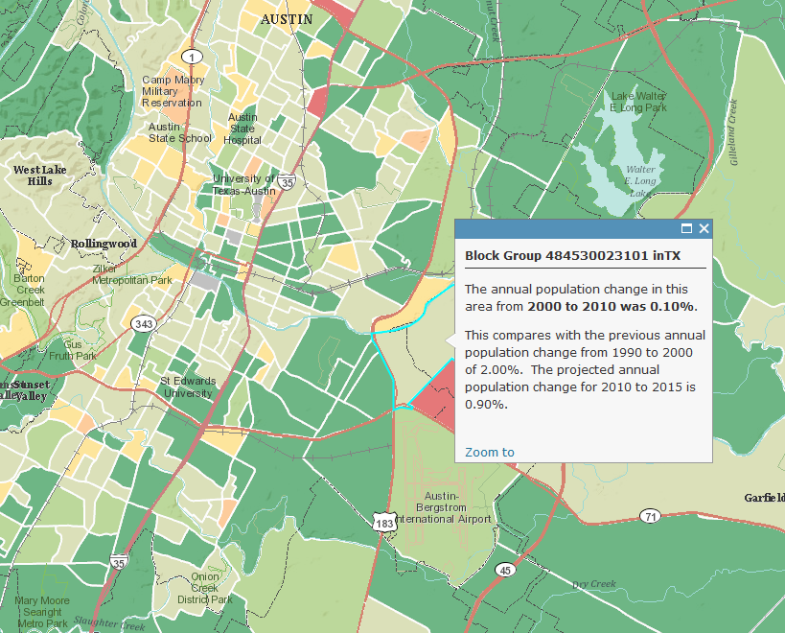
Population Change in Travis County

Slide 11
Finding the Right Data
Population, housing, economic & geographic data
Shapefiles prepared for GIS users
http://www.census.gov/

Slide 12
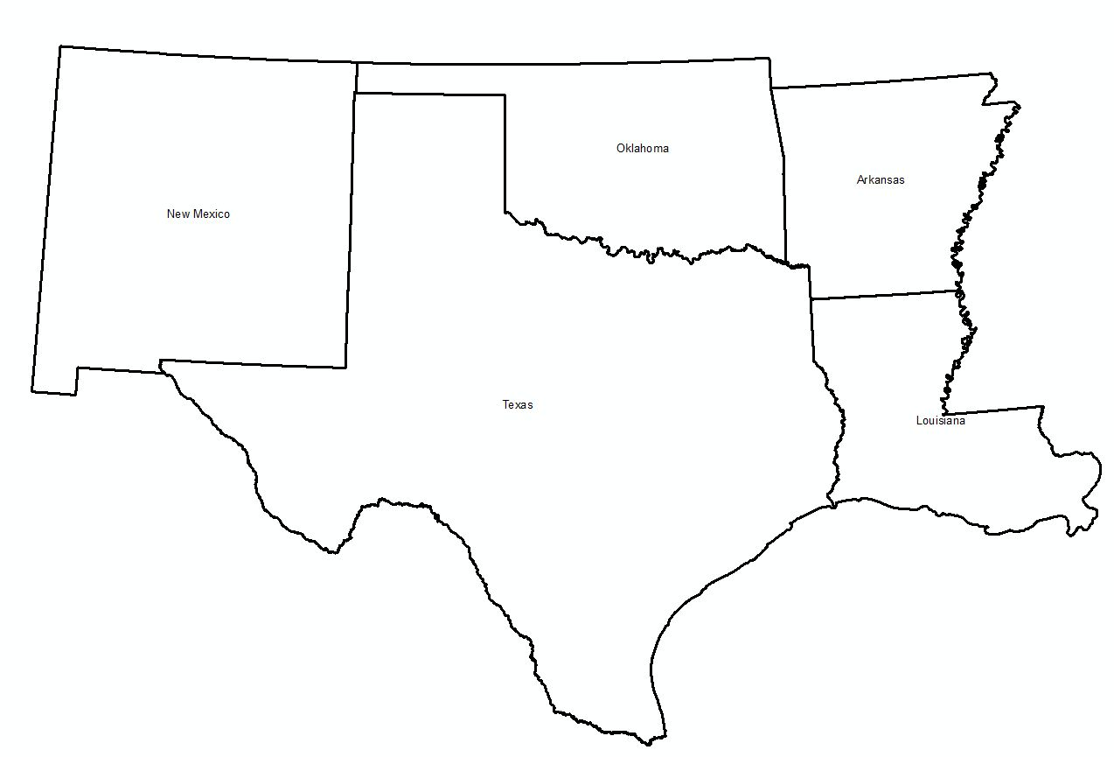
TIGER Topologically Integrated Geographic Encoding and Referencing System
TIGER is geographic data
State and county lines
Updated annually
For census data, American FactFinder (http://factfinder2.census.gov)

Slide 13
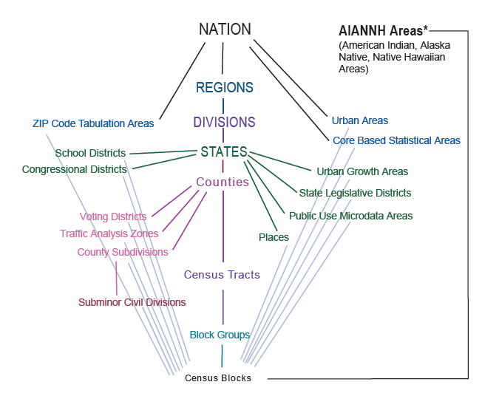
Standard Hierarchy of Census Geographic Entities

Slide 14
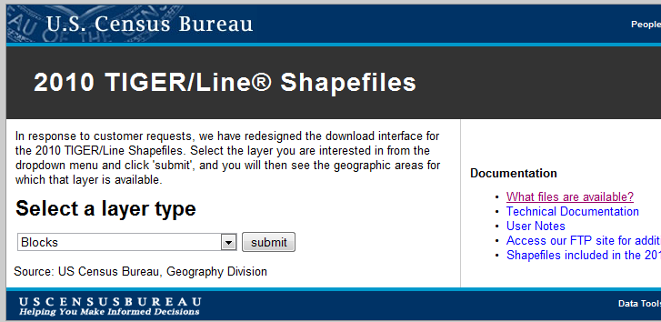
Getting TIGER Shapefiles
http://www.census.gov/cgi-bin/geo/shapefiles2010/main

Slide 15
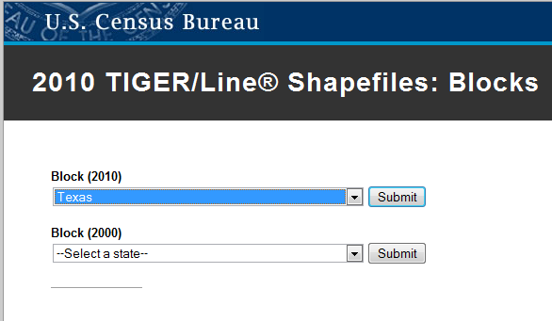
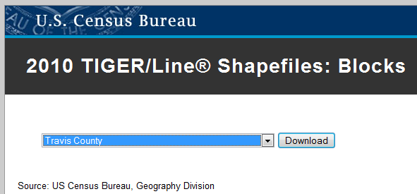
Selecting Travis County, Texas
Pick a State
Pick a County

Slide 16
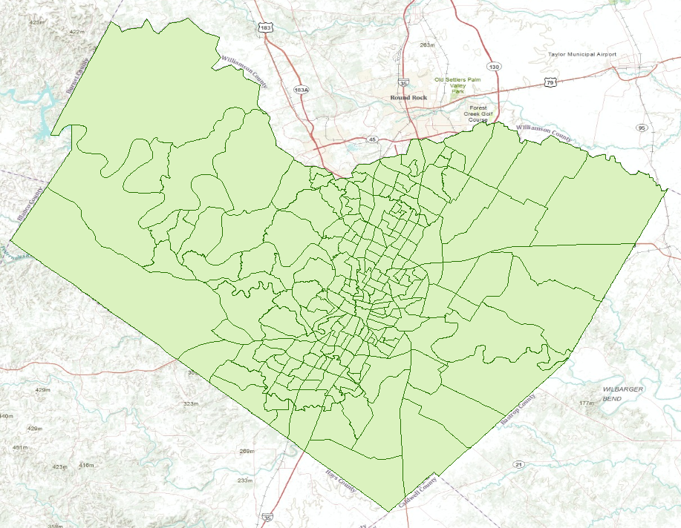
Travis County Census Tracts (218)

Slide 17
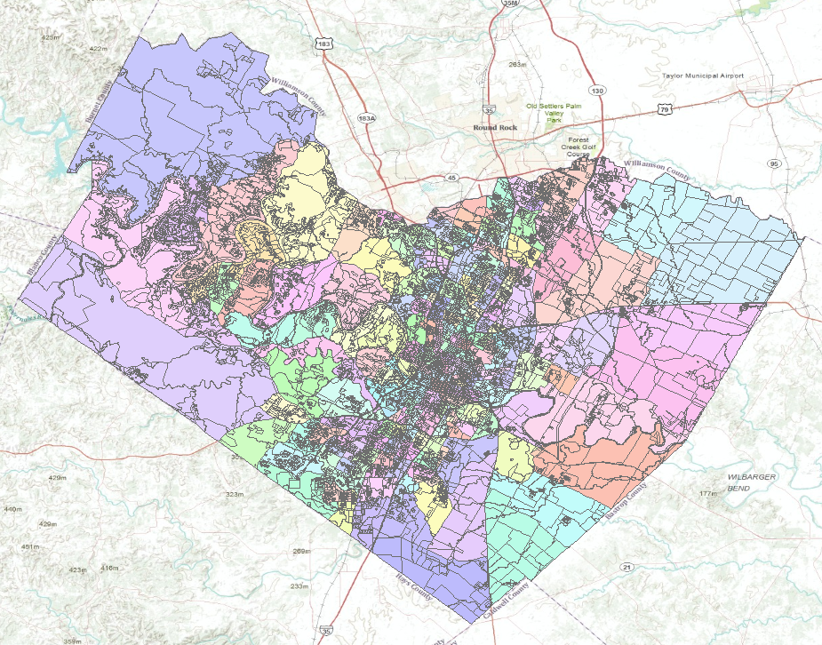
Travis County Census Blocks (15922)
Average of 73 Blocks per Tract

Slide 18
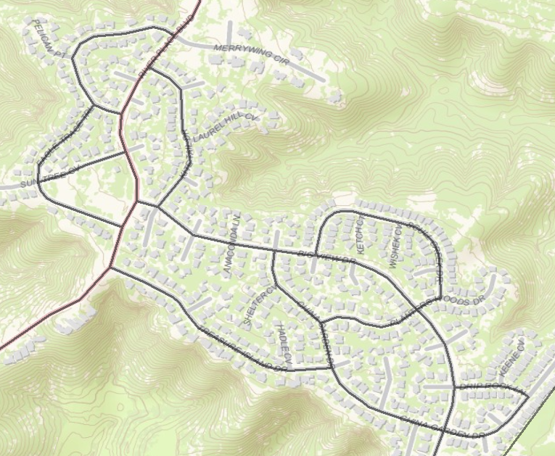
Census Blocks

Slide 19
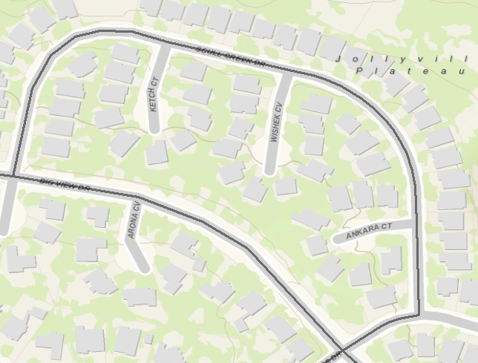
A Census Block (38 houses)
Texas
Travis

Slide 20
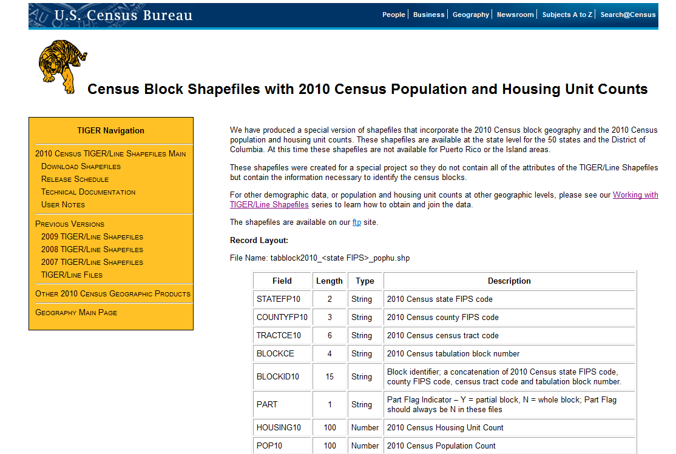
Census Shapefiles with Population
ftp://ftp2.census.gov/geo/tiger/TIGER2010BLKPOPHU/
http://www.census.gov/geo/www/tiger/tgrshp2010/pophu.html

Slide 21
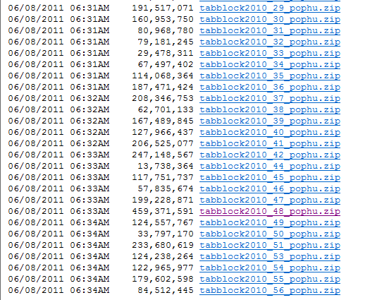
All the Census Blocks for a State
ftp://ftp2.census.gov/geo/tiger/TIGER2010BLKPOPHU/

Slide 22
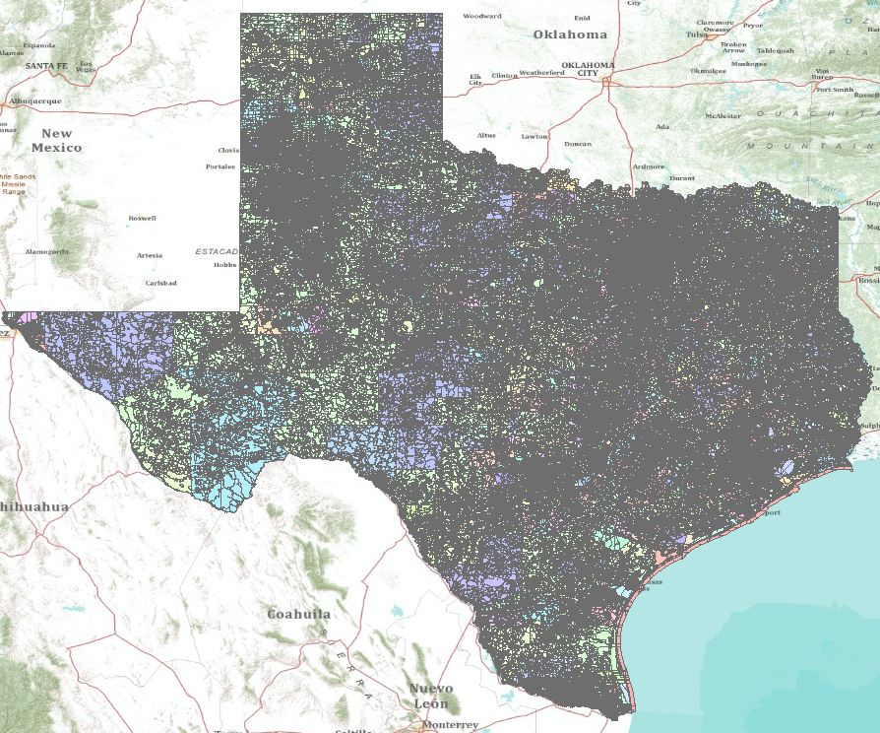
Census Blocks for Texas (914,231)

Slide 23
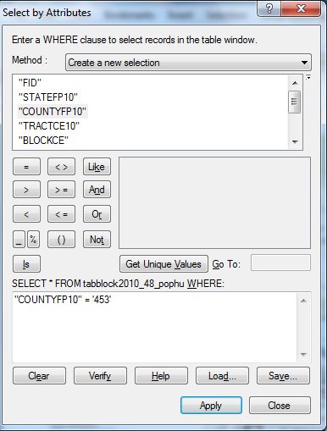
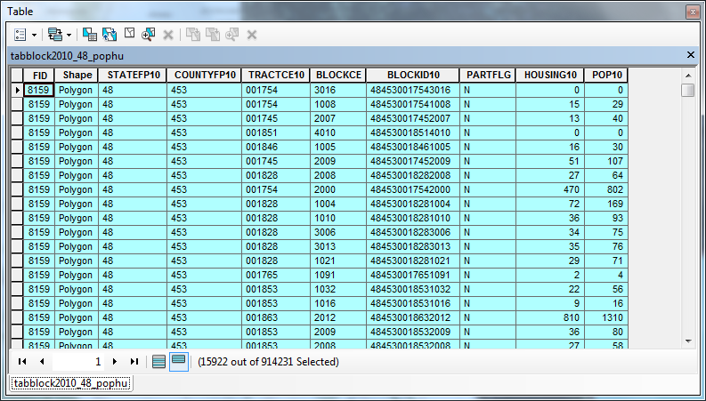
Census Blocks in Travis County

Slide 24
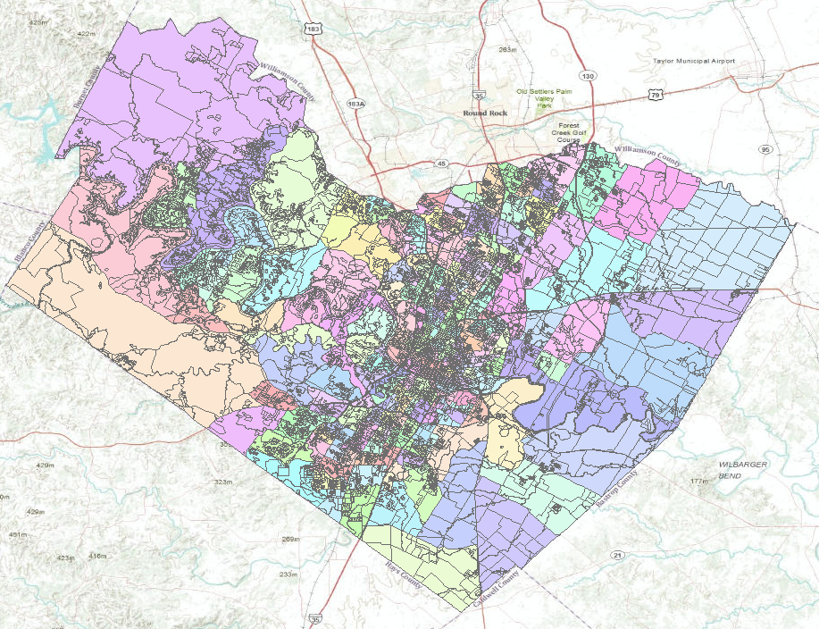
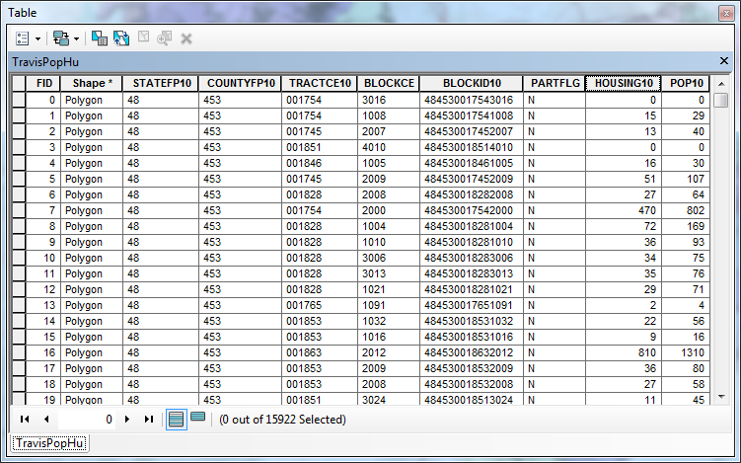
Population and Housing Units

Slide 25
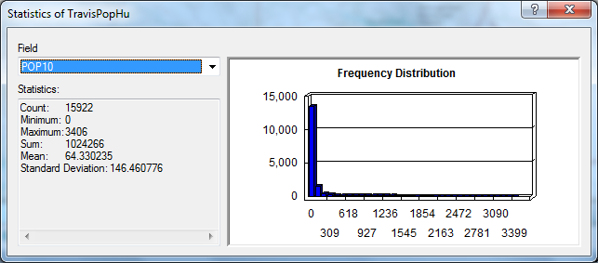
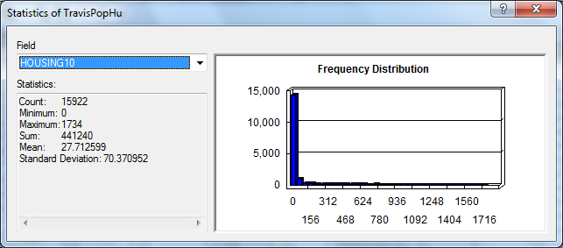
Population and Housing Units in Travis County
Population = 1,024,266
Pop/HU = 2.32
Housing Units = 441,240

Slide 26
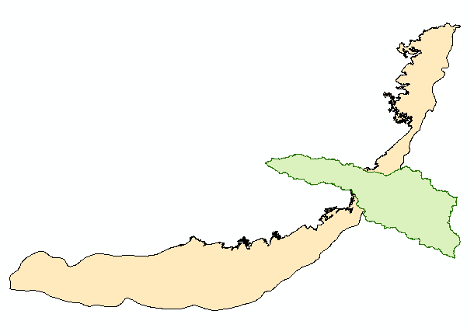
Surface and Groundwater Systems

Slide 27
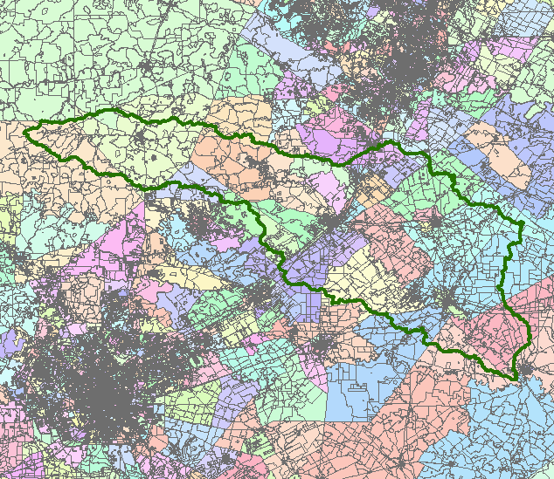
San Marcos Basin
Austin
San Antonio

Slide 28
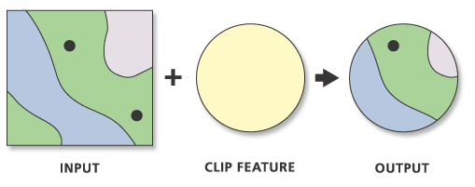
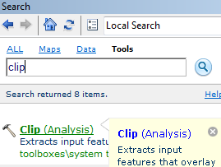
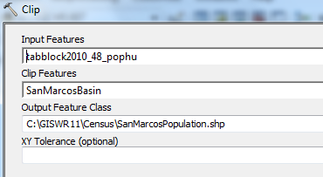
Clip Function

Slide 29
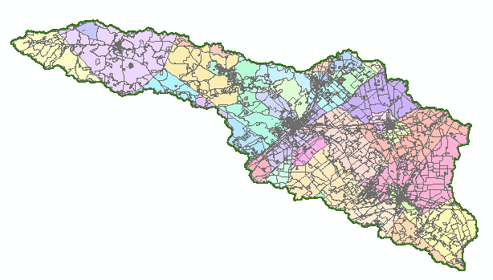
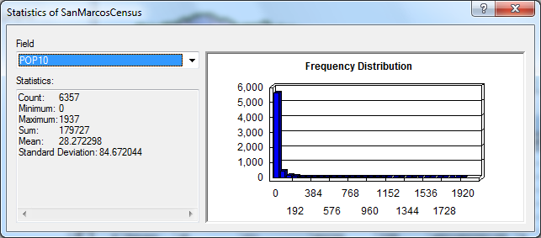
Population of the San Marcos Basin
Population (2010) = 179,727

Slide 30
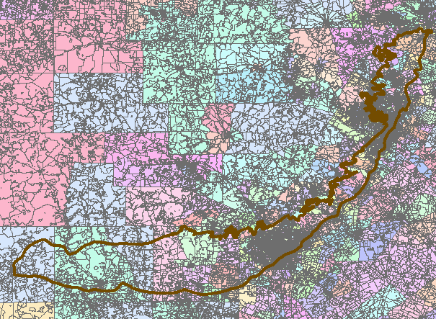
Edwards Aquifer

Slide 31
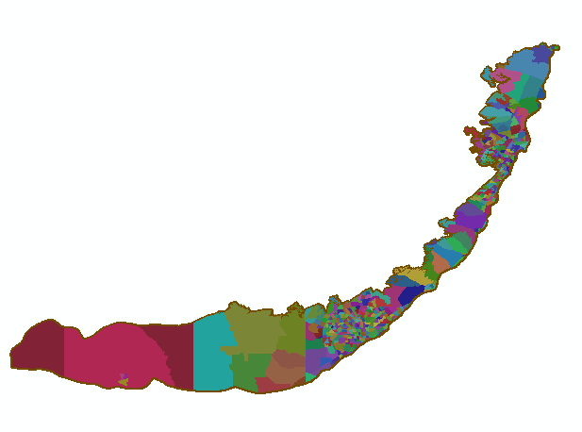
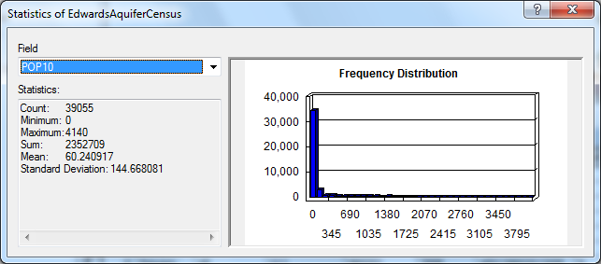
Population Living Over the Edwards Aquifer
Population (2010) = 2,352,709
Small Tracts in High Population Areas
Large Tracts in Low Population Areas

