Slide 1
ArcGIS Mapping of the Six Basins Groundwater Basin in Claremont, CA
Nicholas Brethorst
CE394K.3 GIS in Water Resources
Dr. Maidment, Fall 2012

Slide 2
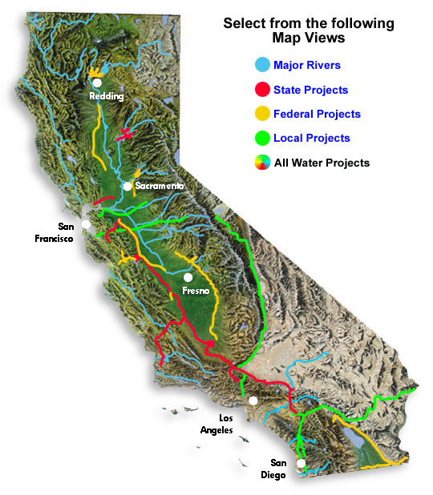
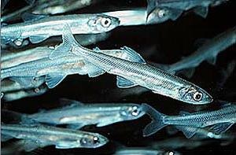
The Water Supply Problems
Imported Water Supply in 2009
Delta Smelt Fish (Google Images, 2012)
Saving the Delta Smelt is apparently more important than providing water to 24 million people.
Thank you Northern California
tree-hugging hippies!!!
Colorado River
Aqueduct
1.2 billion gallons per day
30% Supply Cut
California Aqueduct
(State Water Project)
9 billion gallons per day
10% Supply Cut
(Three Valleys Municipal Water District, 2012)

Slide 3
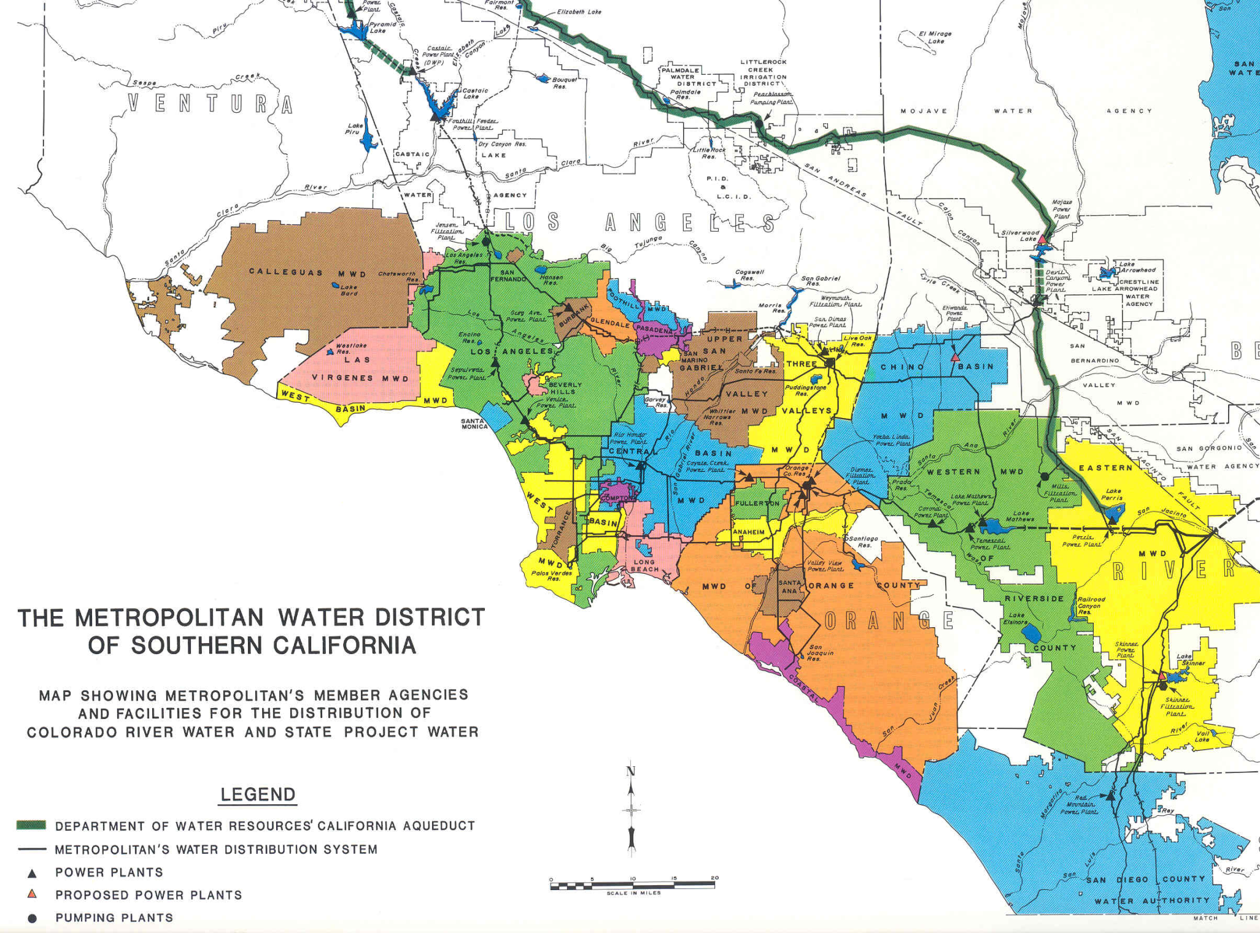
Three Valleys MWD
Metropolitan Water District
of Southern California
Service Area
Largest Water District in USA
5,200 square mile service area
1.7 billion gallons per day
24 million people (and growing)

Slide 4
Six Basins
Six Basins
Located in Claremont, CA
45 miles east of Los Angeles
Claremont is a:
- Tree-huggin’
- Whale-savin’
- Prius-drivin’
- Recycled grocery bag-usin’
Kind of a Town!
Six Basins Groundwater Basin
Project Objectives:
Six Basins Storage Capacity
GW Pumping Effects
I love
you
tree!
(Google Images, 2012)

Slide 5
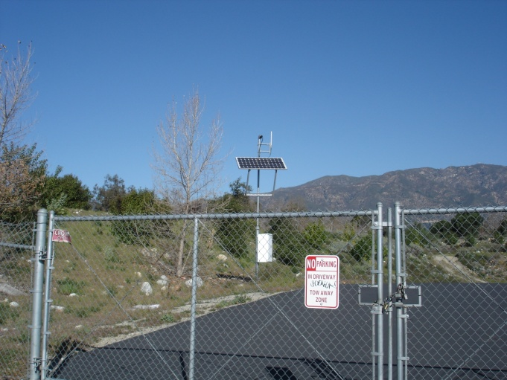
Six Basins Monitoring Wells
Record Static GW Elevations
Radio Pulses (every 5 seconds)
Transmitted to Three Valleys
Compiled on Excel
Added to ArcGIS
Six Basins Monitoring Wells
Monitoring Well Static Groundwater Elevation Time Series Hydrograph
Monitoring Well

Slide 6
Six Basins Member Agencies
City of La Verne
City of Pomona
City of Upland
Golden State Water Company
West End Consolidated Water Company
San Antonio Water Company
Three Valleys Municipal Water District
La Verne Production Wells in Six Basins
Well Name | State Well # | Latitude ºN | Longitude ºW | GSE (ft) | DTW Pump (ft) | DTW Static (ft) | Well Depth (ft) | Upper Screen Depth (ft) | Lower Screen Depth (ft)
Amherst | 1S08W06A03 | 34.117411 | -117.756047 | 1,219.0 | 116 | 105.0 | 162.0 | 112.0 | 135.0
Beech | 1S08W06A01 | 34.119056 | -117.753858 | 1,238.0 | 212.5 | 212.5 | 450.0 | 250.0 | 435.0
LV Heights 1 | 01S08W06A02 | 34.118133 | -117.749950 | 1,266.0 | 165.9 | 165.9 | 450.0 | 185.0 | 435.0
LV Heights 3 | 01S08W05B01 | 34.122331 | -117.739328 | 1,288.0 | 116 | 116.0 | 309.0 | 185.0 | 210.0
Lincoln | 01S08W07F01 | 34.101153 | -117.762147 | 1,078.0 | 110.1 | 110.1 | 309.0 | 150.0 | 210.0
Mills Tract | 01S08W07F02 | 34.101886 | -117.762781 | 1,080.0 | 112.1 | 112.1 | 309.0 | 150.0 | 210.0
Old Baldy | 01S08W07F03 | 34.102947 | -117.780281 | 1,040.0 | 65.1 | 65.1 | 162.0 | 112.0 | 135.0

Slide 7
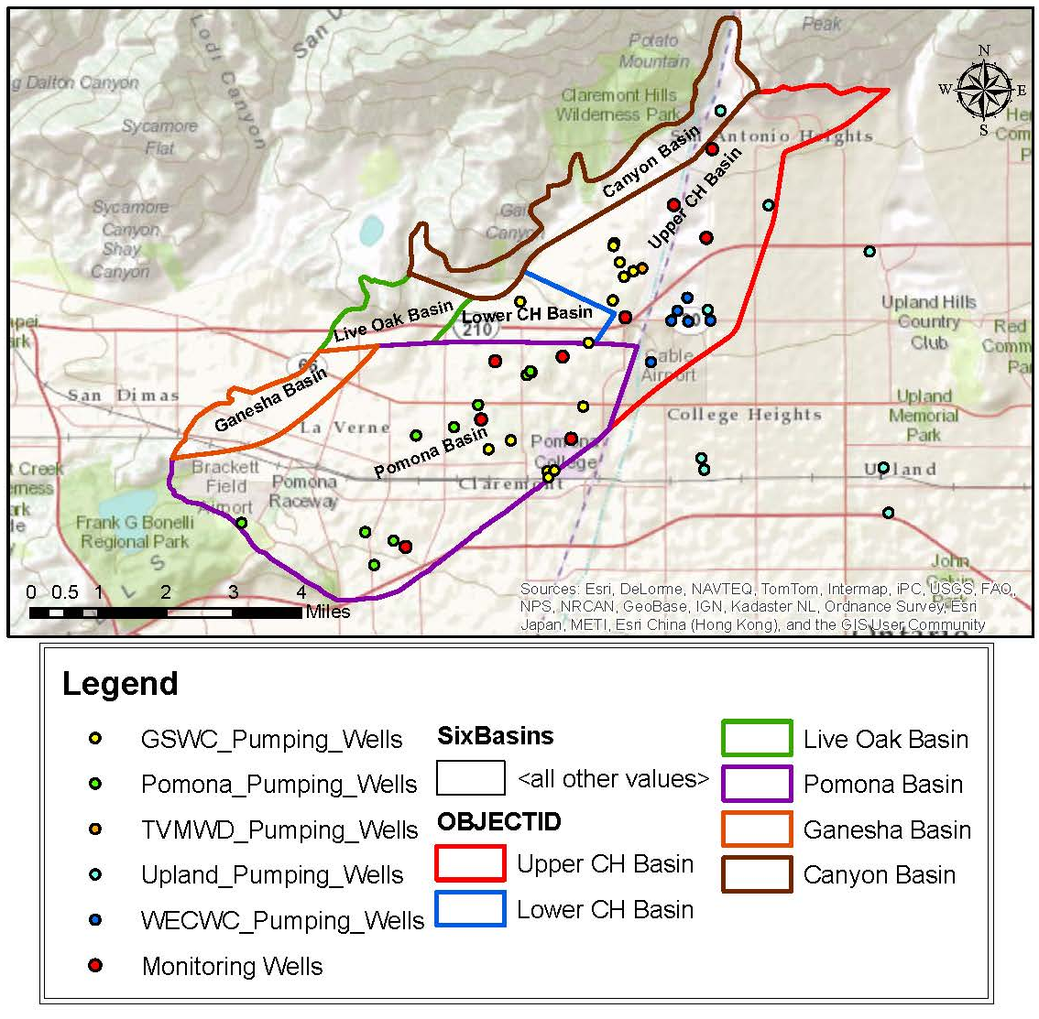
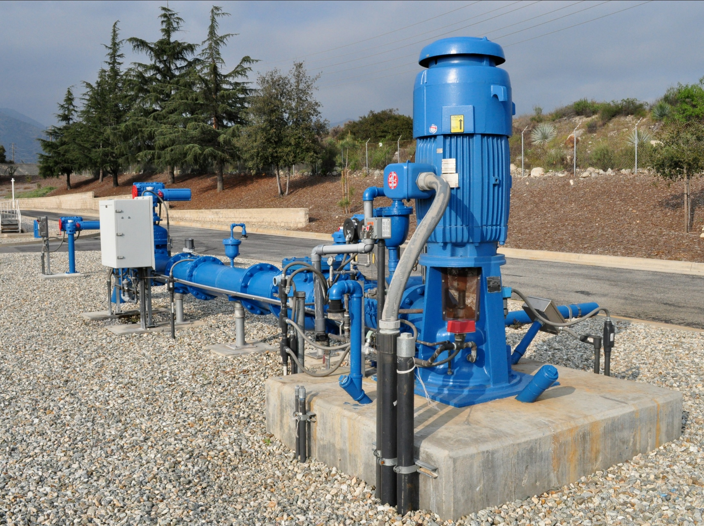
Six Basins Production Wells
TVMWD Production Well
Six Basins Production Well Locations

Slide 8
Six Basins Production Wells
Thiessen Polygons Tool
Determined GW Elevations
Thiessen GWE Equations Used
Six Basins Wells -Thiessen Polygon Attribute Table
Thiessen Polygons Created Using ArcGIS in the Six Basins
Month | ƩA_{k} (ft²) | ƩGWE_{STAT}-A_{k} (ft³) | ƩGWE_{PUMP}-A_{k} (ft³) | GWE_{STAT} (ft) | GWE_{PUMP} (ft) | ∆GWE (ft)
January | 622,844,540 | 70,291,236,329 | 69,248,069,013 | 1,214.7 | 1,196.7 | 18.0
February | 622,844,540 | 70,342,823,699 | 69,394,224,565 | 1,215.6 | 1,199.2 | 16.4
March | 622,844,540 | 70,234,292,493 | 69,309,143,713 | 1,213.7 | 1,197.8 | 16.0
April | 622,844,540 | 70,168,207,401 | 69,058,396,599 | 1,212.6 | 1,193.4 | 19.2
May | 622,844,540 | 69,911,553,847 | 68,858,956,188 | 1,208.2 | 1,190.0 | 18.2
June | 622,844,540 | 69,732,120,645 | 68,697,562,235 | 1,205.1 | 1,187.2 | 17.9
July | 622,844,540 | 69,802,992,186 | 68,488,889,124 | 1,206.3 | 1,183.6 | 22.7
August | 622,844,540 | 69,825,560,860 | 68,309,478,276 | 1,206.7 | 1,180.5 | 26.2
September | 622,844,540 | 69,691,768,432 | 68,456,649,540 | 1,204.4 | 1,183.0 | 21.3
October | 622,844,540 | 69,890,083,934 | 68,784,028,980 | 1,207.8 | 1,188.7 | 19.1
November | 622,844,540 | 69,699,147,387 | 68,582,890,361 | 1,204.5 | 1,185.2 | 19.3
December | 622,844,540 | 69,877,084,175 | 69,098,720,353 | 1,207.6 | 1,194.1 | 13.5

Slide 9
Six Basins Borelog Table
Borelog Table for MW-1, MW-2, MW-3
WellID | Monitoring Well | TopElev (ft) | BottomElev (ft) | Soil Material | SoilLayer
1 | MW #1 | 1,852.786 | 1,591.786 | Sand and Gravel | Younger Alluvium
1 | MW #1 | 1,591.786 | 1,411.786 | Sand | Younger Alluvium
1 | MW #1 | 1,411.786 | 1,405.786 | Silts and Clays | Semi Confining Unit
1 | MW #1 | 1,405.786 | 0.000 | Gravel and Bedrock | Bedrock
2 | MW #2 | 1,527.155 | 1,356.155 | Sand & Gravel | Younger Alluvium
2 | MW #2 | 1,356.155 | 1,239.155 | Sand | Older Alluvium
2 | MW #2 | 1,239.155 | 726.155 | Silts and Clays | Older Alluvium
2 | MW #2 | 726.155 | 0 | Gravel and Bedrock | Bedrock
3 | MW #3 | 1,228.759 | 877.759 | Sand & Gravel | Younger Alluvium
3 | MW #3 | 877.759 | 634.759 | Sand | Older Alluvium
3 | MW #3 | 634.759 | 517.759 | Silts and Clays | Older Alluvium
3 | MW #3 | 517.759 | 0 | Gravel and Bedrock | Bedrock
Borehole Points of MW-1, MW-2, MW-3
Borehole Profiles of MW-1, MW-2, MW-3

Slide 10
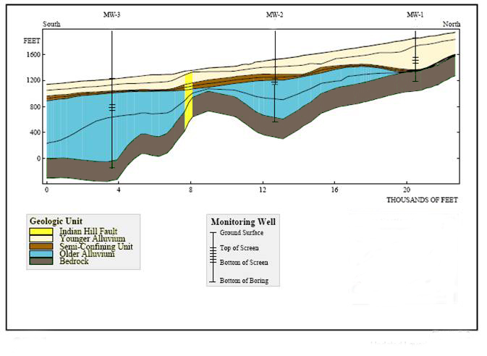
Six Basins Production Wells
Average Weighted Porosity = 0.27
Six Basins 2D Soil Profile at Monitoring Wells

Slide 11
Six Basins Storage Capacity
Six Basins Annual Storage Capacity
Month | GWE_{STAT} (ft) | GWE_{PUMP} (ft) | Six Basins Area (ft²) | Weighted Porosity | Storage_{STAT} (AF) | Storage_{PUMP} (AF) | ∆Storage (AF)
January | 1,214.7 | 1,196.7 | 622,844,540.5 | 0.27 | 46,896 | 46,200 | 696
February | 1,215.6 | 1,199.2 | 622,844,540.5 | 0.27 | 46,930 | 46,297 | 633
March | 1,213.7 | 1,197.8 | 622,844,540.5 | 0.27 | 46,858 | 46,240 | 617
April | 1,212.6 | 1,193.4 | 622,844,540.5 | 0.27 | 46,814 | 46,073 | 740
May | 1,208.2 | 1,190.0 | 622,844,540.5 | 0.27 | 46,642 | 45,940 | 702
June | 1,205.1 | 1,187.2 | 622,844,540.5 | 0.27 | 46,523 | 45,832 | 690
July | 1,206.3 | 1,183.6 | 622,844,540.5 | 0.27 | 46,570 | 45,693 | 877
August | 1,206.7 | 1,180.5 | 622,844,540.5 | 0.27 | 46,585 | 45,574 | 1,011
September | 1,204.4 | 1,183.0 | 622,844,540.5 | 0.27 | 46,496 | 45,672 | 824
October | 1,207.8 | 1,188.7 | 622,844,540.5 | 0.27 | 46,628 | 45,890 | 738
November | 1,204.5 | 1,185.2 | 622,844,540.5 | 0.27 | 46,501 | 45,756 | 745
December | 1,207.6 | 1,194.1 | 622,844,541.5 | 0.27 | 46,619 | 46,100 | 519
 |  |  |  | Total = | 560,061 | 551,268 | 8,793
Storage Capacity
Equations Used

Slide 12
Six Basins GWE Modeling
Kriging Bayesian Interpolation Tools
Static & Pumping Groundwater Levels
Repeated for every month
Groundwater Modeling
Static GWE (January 2010)
Groundwater Modeling
Pumping GWE (January 2010)

Slide 13
Six Basins GWE Modeling
Kriging Bayesian Interpolation Tools
Static & Pumping Groundwater Levels
Repeated for every month
Groundwater Modeling
Static GWE (July 2010)
Groundwater Modeling
Pumping GWE (July 2010)

Slide 14
Six Basins GWE Modeling
Kriging Bayesian Interpolation Tools
Static & Pumping Groundwater Levels
Repeated for every month
Groundwater Modeling
Static GWE (December 2010)
Groundwater Modeling
Pumping GWE (December 2010)

Slide 15
Six Basins GWE Modeling Results

Slide 16
Six Basins GWE Modeling Results
Greatest Static GWE Difference in Pomona Basin (Break 1)
Lowest Static GWE Difference in Upper CH Basin (Break 6)
2010 Monthly Groundwater Elevations Difference
Month | Break 1 (ft) |  | Break 2 (ft) |  | Break 3 (ft) |  | Break 4 (ft) |  | Break 5 (ft) |  | Break 6 (ft)
 | Low | High | Low | High | Low | High | Low | High | Low | High | Low | High
Jan | 70.5 | 35.4 | 35.4 | 37.5 | 37.5 | 34.0 | 34.0 | 28.2 | 28.2 | 25.4 | 25.4 | 0.9
Feb | 56.1 | 42.1 | 42.1 | 46.4 | 46.4 | 50.4 | 50.4 | 47.8 | 47.8 | 33.6 | 33.6 | 7.8
Mar | 55.0 | 24.3 | 24.3 | 28.4 | 28.4 | 32.0 | 32.0 | 33.7 | 33.7 | 28.4 | 28.4 | 0.8
Apr | 76.3 | 29.8 | 29.8 | 21.8 | 21.8 | 18.3 | 18.3 | 17.8 | 17.8 | 10.3 | 10.3 | 5.9
May | 94.2 | 11.4 | 11.4 | 7.1 | 7.1 | 7.7 | 7.7 | 5.3 | 5.3 | 1.1 | 1.1 | 16.2
Jun | 86.9 | 16.7 | 16.7 | 17.5 | 17.5 | 18.0 | 18.0 | 10.4 | 10.4 | 1.3 | 1.3 | 6.1
Jul | 73.2 | 26.0 | 26.0 | 28.5 | 28.5 | 41.1 | 41.1 | 35.6 | 35.6 | 28.6 | 28.6 | 4.5
Aug | 50.2 | 35.4 | 35.4 | 40.3 | 40.3 | 50.5 | 50.5 | 43.1 | 43.1 | 29.6 | 29.6 | 4.6
Sep | 48.4 | 31.0 | 31.0 | 26.8 | 26.8 | 32.6 | 32.6 | 26.6 | 26.6 | 24.7 | 24.7 | 17.3
Oct | 72.5 | 56.1 | 56.1 | 54.7 | 54.7 | 53.0 | 53.0 | 39.3 | 39.3 | 34.1 | 34.1 | 22.9
Nov | 119.0 | 56.1 | 56.1 | 72.6 | 72.6 | 72.1 | 72.1 | 40.7 | 40.7 | 1.5 | 1.5 | 7.4
Dec | 69.6 | 1.9 | 1.9 | 2.5 | 2.5 | 18.1 | 18.1 | 10.5 | 10.5 | 14.4 | 14.4 | 9.9
Groundwater Modeling
Static GWE (July 2010)

Slide 17
Summary
Six Basins Parameters | Value
Six Basins Area | 622,844,540.5 ft²
Static GWE | ~1,200.0 ft
Pumping GWE | ~1,190.0 ft
Storage Capacity | 560,000 acre-ft
Weighted Porosity | 0.27
Greatest GWE Change | Pomona & Upper Claremont Heights Basins

Slide 18
Questions?

Slide 19
References
Google Maps. (2012). Delta Smelt. <www.google.com/search>.
(December 1, 2012).
Google Maps. (2012). Tree Huggers. <www.google.com/search>. (December 1, 2012).
Three Valleys Municipal Water District. (2012). Six Basins Annual Report 2010.
<http://www.threevalleys.com/downloads.aspx?DloadTypeID=2>.
(September 23, 2012).

Slide 20
Definition of Porosity
Definition of Porosity
Porosity Equation

Slide 21
Types of Water Sources

Slide 22
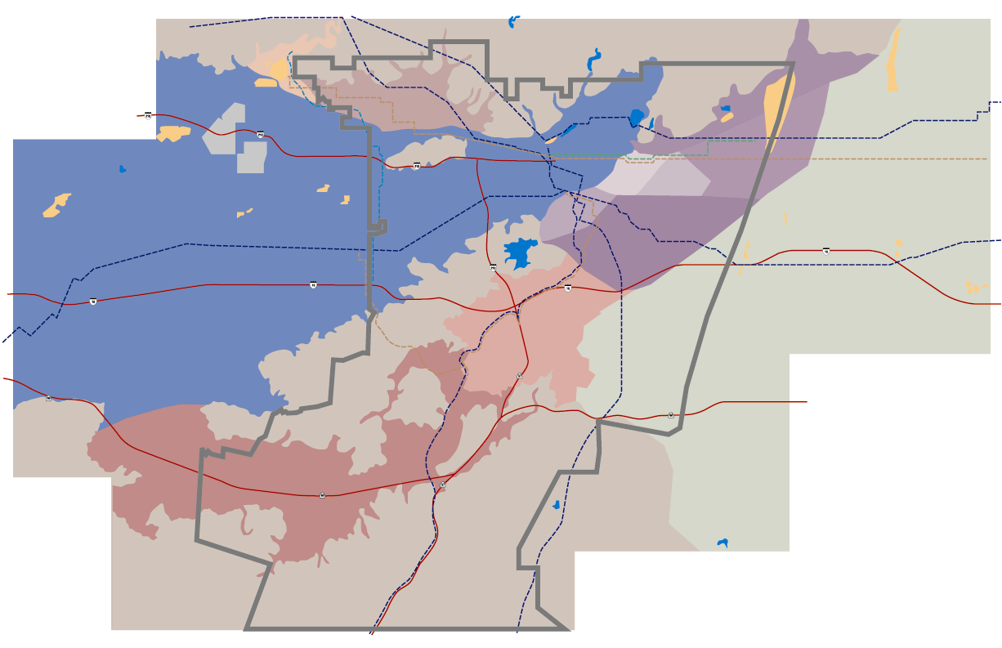
Three Valleys Municipal Water District Service Area
Glendora
Claremont
La Verne
San Dimas
Covina
Pomona
Walnut
133 square mile service area
25 MGD
600,000 people
Rowland Hgts
Diamond Bar

