Slide 1
Runoff and geomorphic properties of North Carolina Rivers
Michael Kanarek
Jackson School of Geosciences

Slide 2
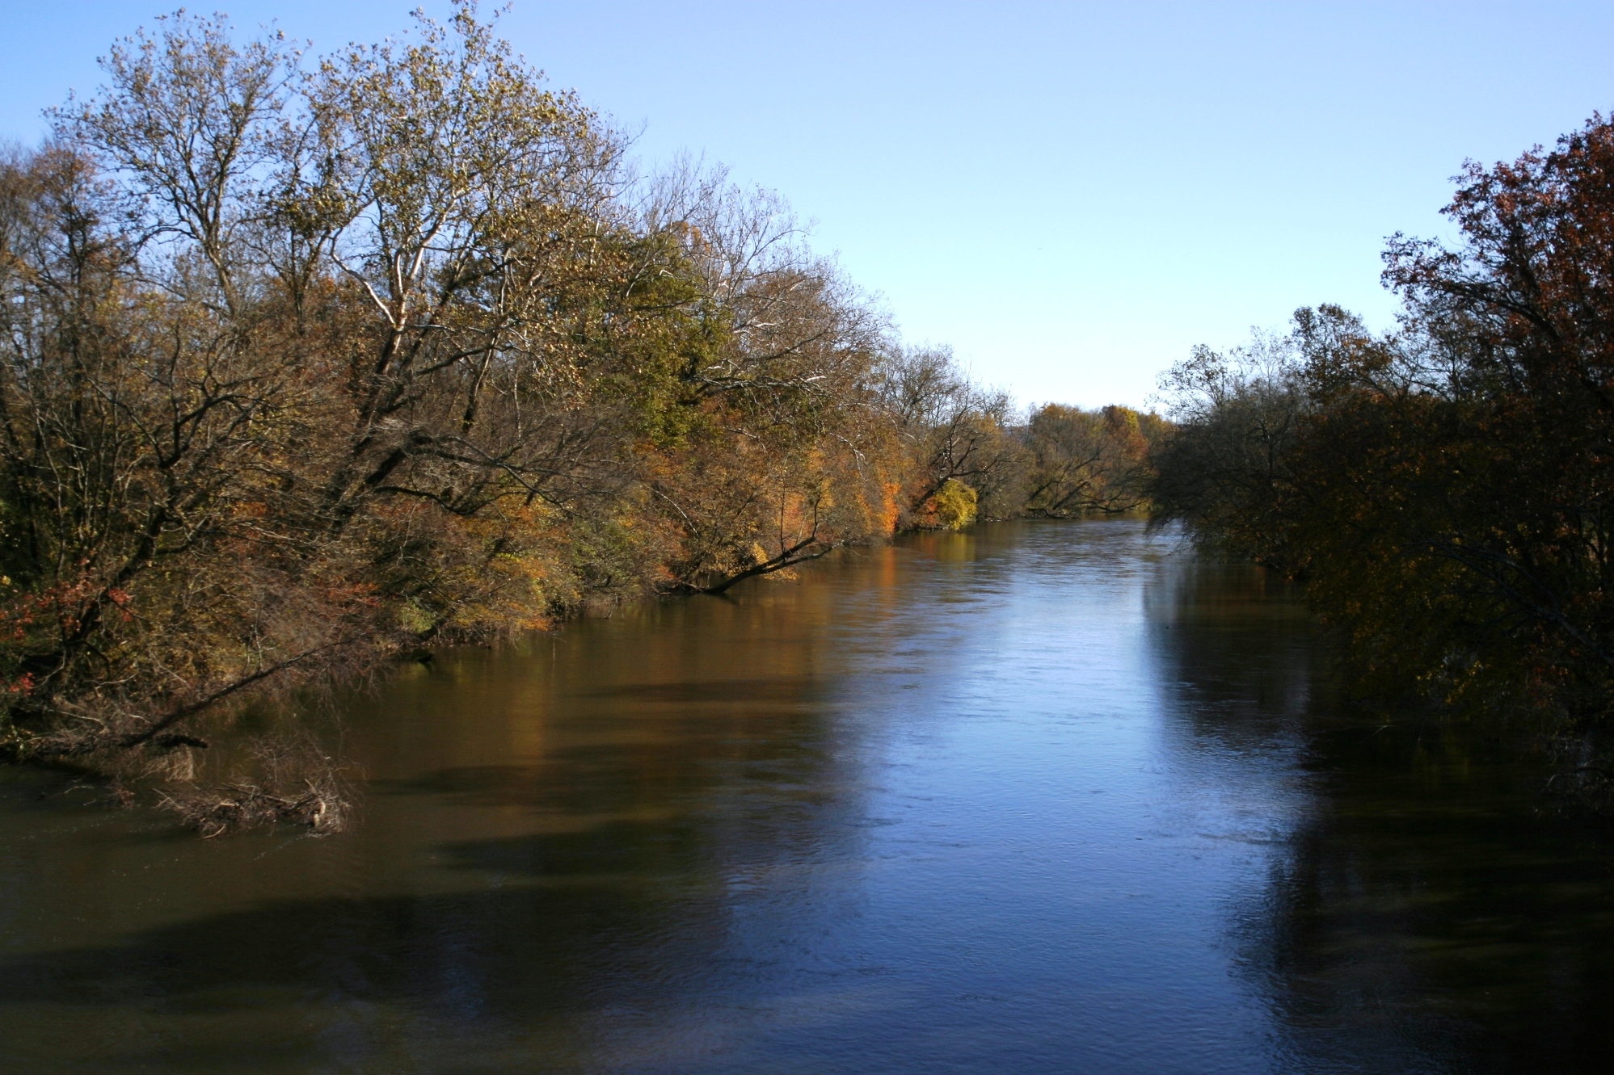
Location
The Broad and French Broad rivers originate in western North Carolina, in the Blue Ridge and Appalachian mountains, respectively
The French Broad River in Henderson County, N.C.
Wikipedia.org

Slide 3
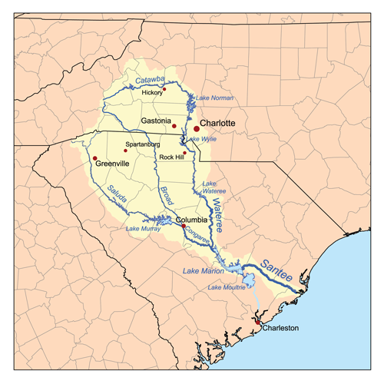
Broad River
Originates in Buncombe County, N.C., and flows for 150 miles
Merges with the Saluda River in Columbia, S.C., to form the Congaree River
Wikipedia.org

Slide 4
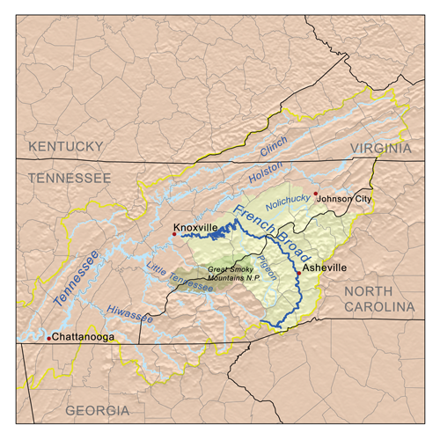
French Broad River
Flows for 213 miles from Transylvania County, N.C., to Knoxville, TN, where it merges with the Holston River, forming the start of the Tennessee River
Flows through greater topography than Broad River
Upper French Broad watershed is ~ 4868 km²
Wikipedia.org

Slide 5
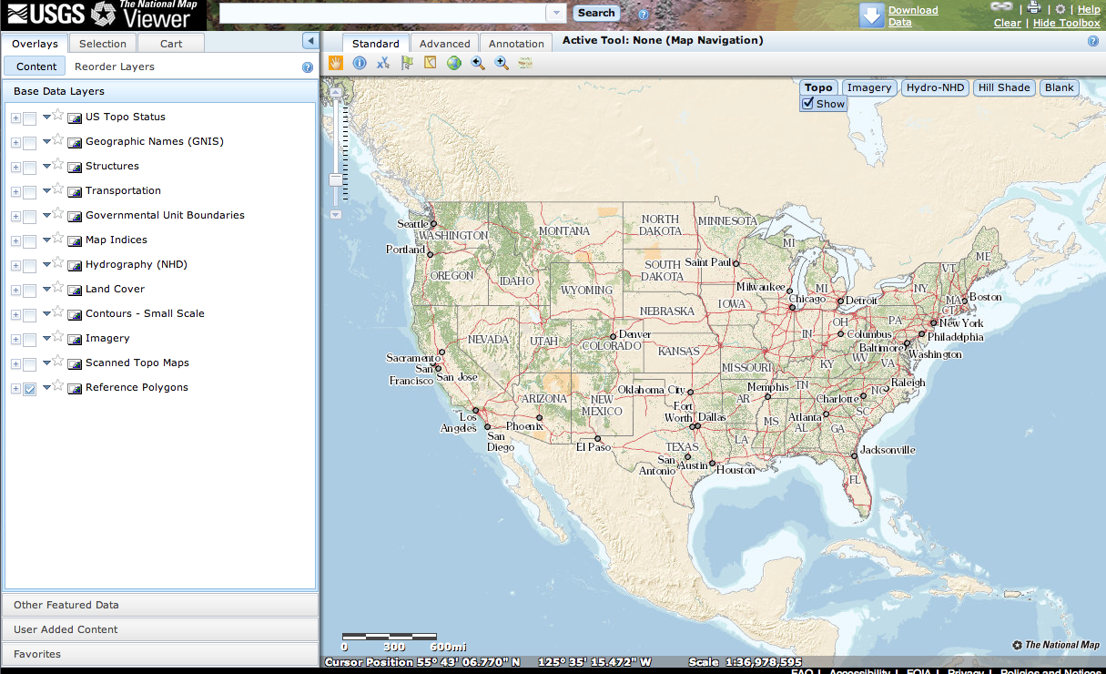
Data acquisition
DEMs and hydrographic data acquired from the USGS’ National Map Viewer
Precipitation and discharge data retrieved from the USGS’ National Water Information System (NWIS)

Slide 6
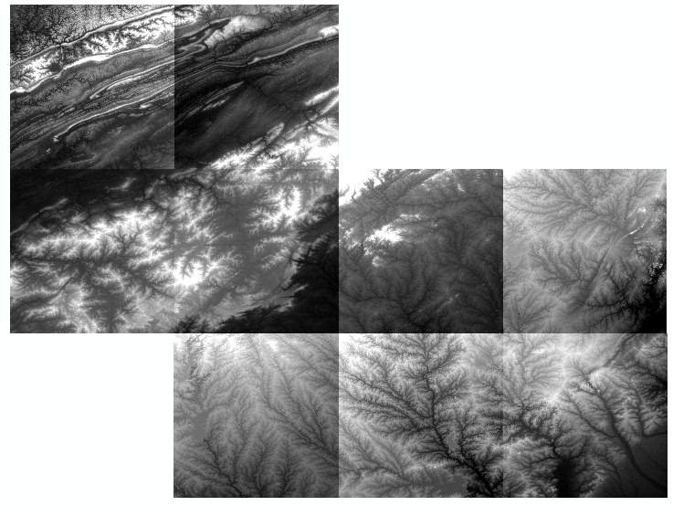
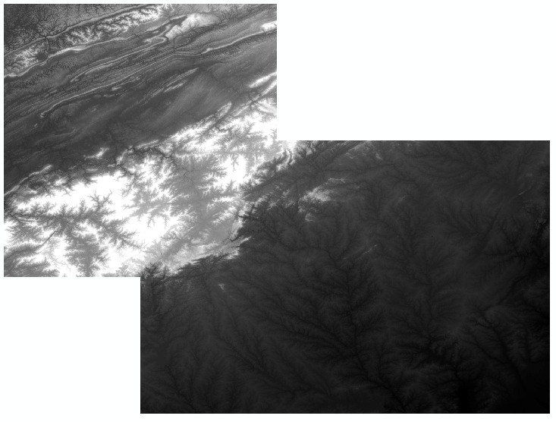
Data processing
9 individual 1/3 arcsecond DEMs in GeoTIFF format were stitched together using the Mosaic to New Raster tool in ArcGIS

Slide 7
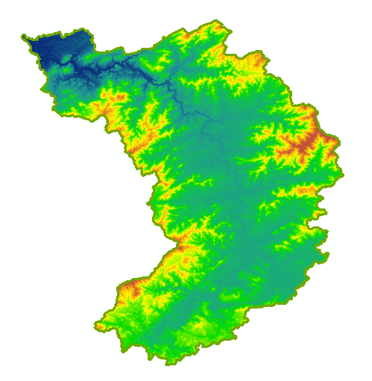
Data processing
The Extract by Mask tool was used to clip the new DEM to just the watershed
The Fill tool in the Spatial Analyst toolbox was used to remove small imperfections in the data
Here high elevations in the Upper French Broad River watershed are symbolized in reds and oranges, low elevations in blues

Slide 8
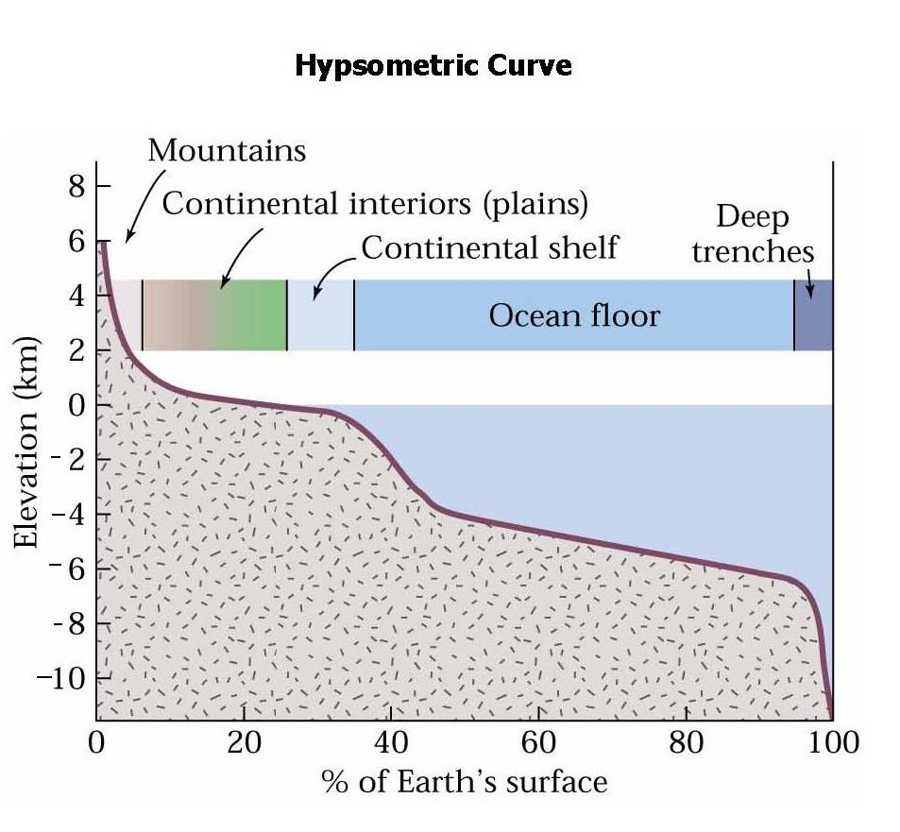
Hypsometry
One goal is to evaluate hypsometry, the relationship between elevation and land area, in the watershed
Can use data from DEMs to generate curve for a watershed
Higher elevations with steeper slopes generate more runoff
Marshak, "Earth - Portrait of the Planet" 2nd ed.

Slide 9
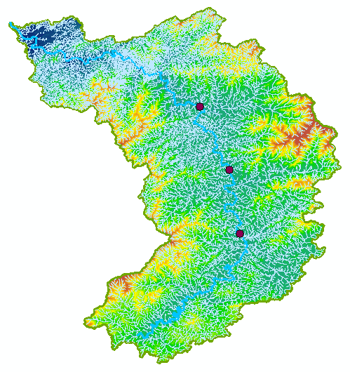
Runoff ratio
The fraction of precipitation that becomes streamflow
w = Q / P, where Q is streamflow and P is precipitation
Near Fletcher, N.C., w = .293
At Asheville, N.C., w = .358
At Marshall, N.C., w = .429

