Slide 1
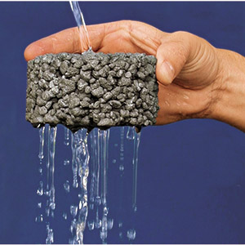
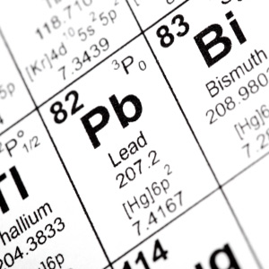
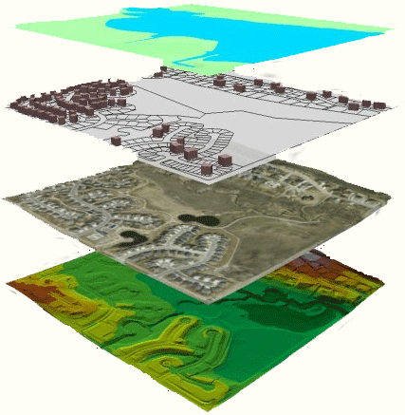
The Environmental Benefits of PFC on Mopac
Reducing Stormwater Contaminants

Slide 2
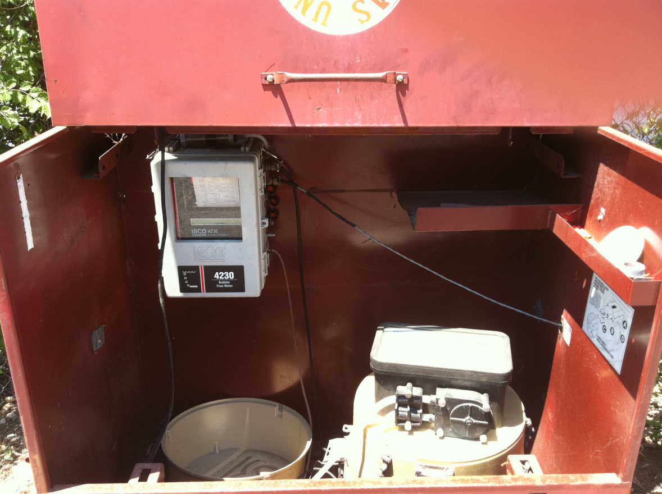
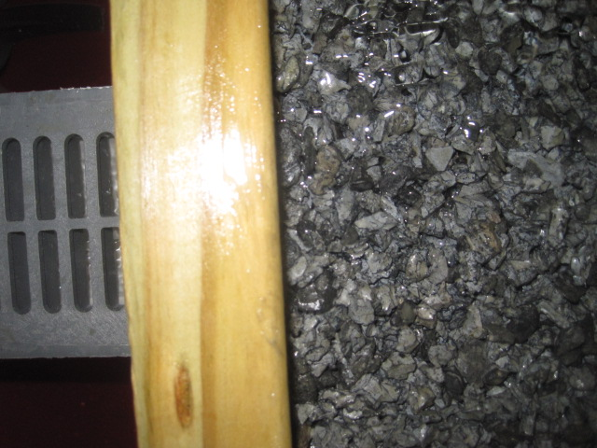
Motivation

Slide 3
Goals
What % of Mopac can currently support PFC? PFC with Underdrains?
What contaminant load could be kept from entering the environment?
Which watersheds would benefit?

Slide 4
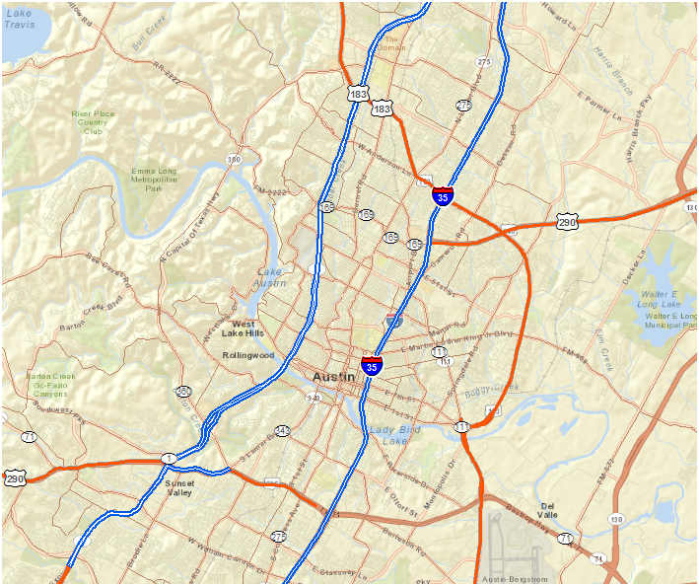
MOPAC
N

Slide 5
Digitalization

Slide 6
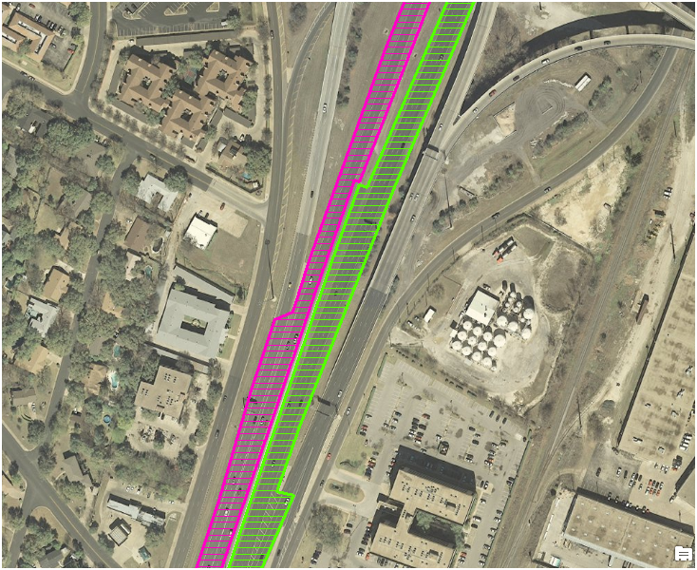
Northbound
Direction | Length(miles) | Area(ft^2) | square miles
North Bound | 23.5 | 7820725.88 | 0.281
South Bound | 23.6 | 7833837.92 | 0.281
Total: | 47.1 | 15654563.8 | 0.6
Southbound

Slide 7
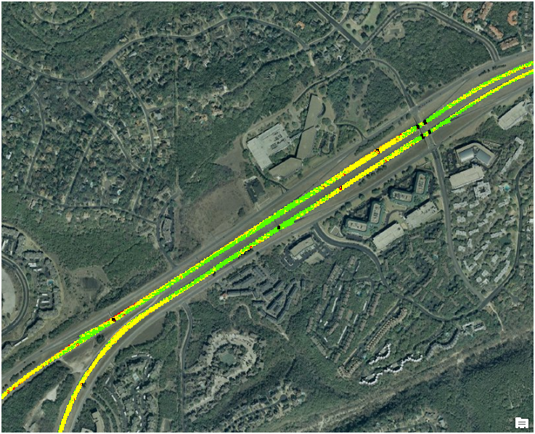
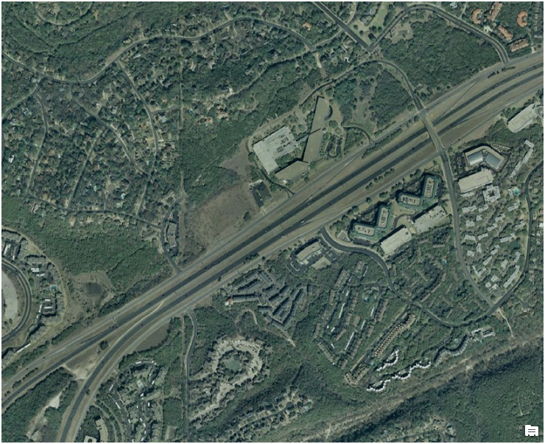
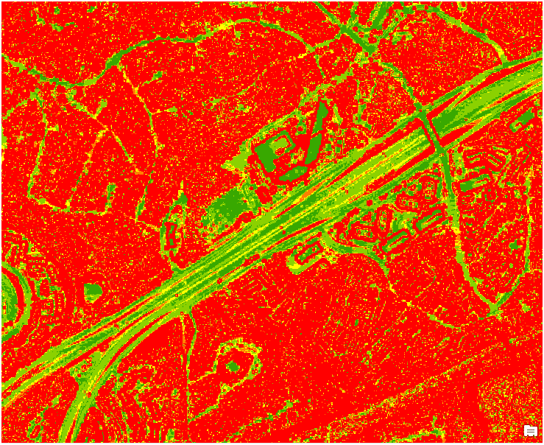
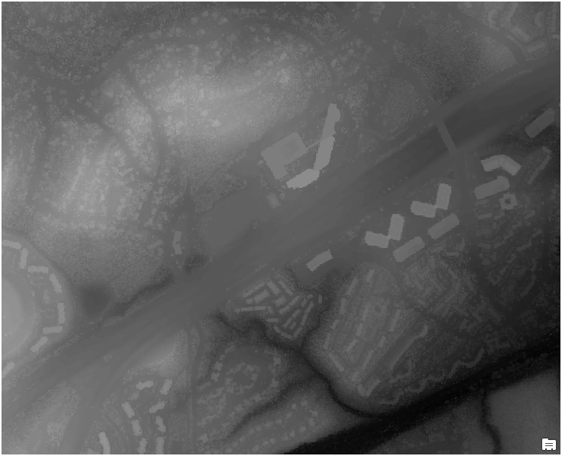
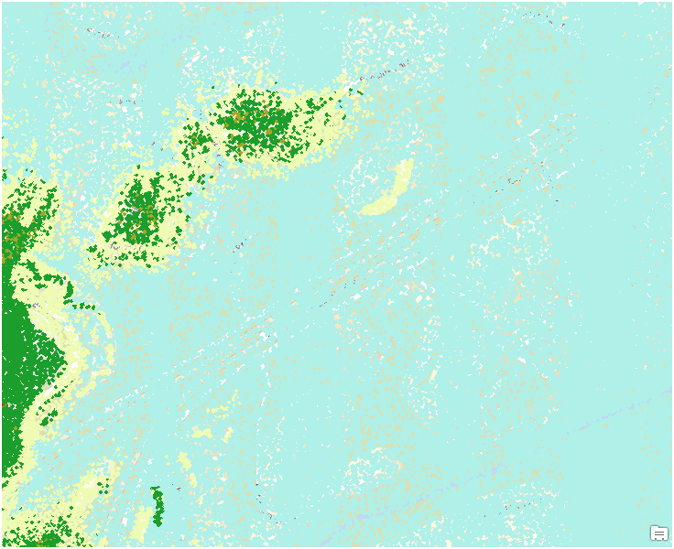
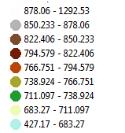
LIDAR Processing
LEGEND
LEGEND
LEGEND
LEGEND

Slide 8
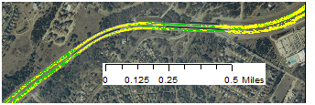
Slope Results
slope | Raster calculator | raster cells | Fraction | Area(sq. ft)
0-5 | "mopac_slope"< = 5 | 96031 | 1 | 15,654,564
0-2 | "mopac_slope"< = 2 | 53969 | 0.56 | 8,797,796
2-5 | "0-5" - "0-2" | 42062 | 0.44 | 6,856,768

Slide 9
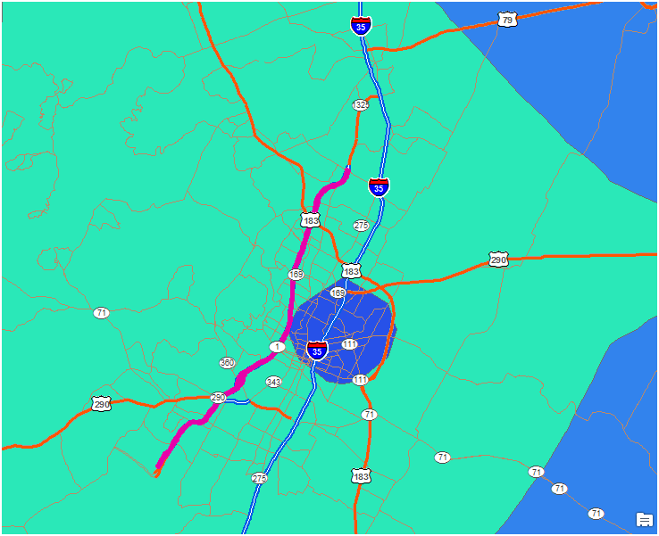
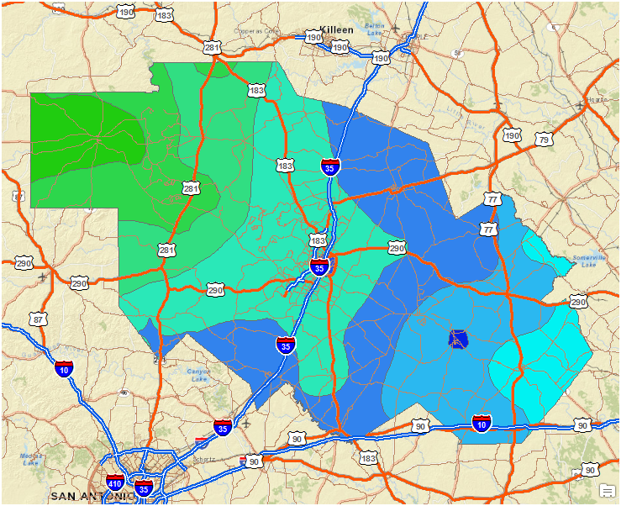
MOPAC
MOPAC
Rainfall (in)
Rainfall (in)

Slide 10
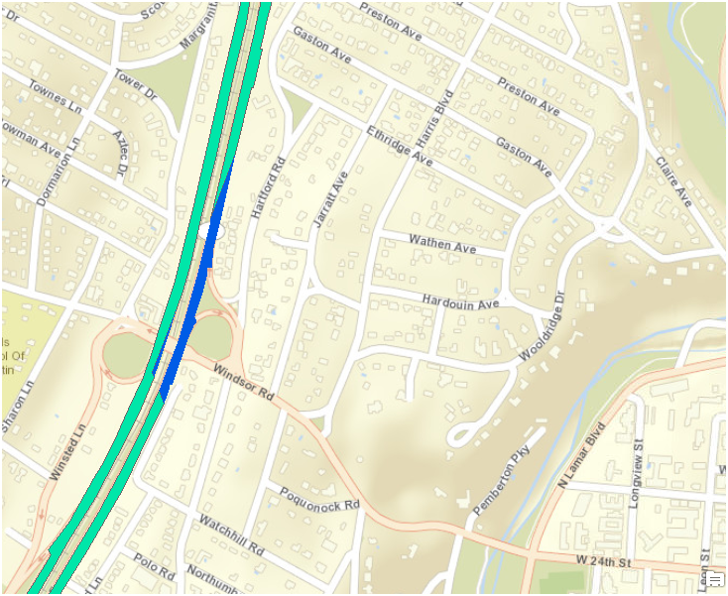
Rainfall (in)
582,366,731 L/yr

Slide 11
Rainfall Results
Rainfall (in) | Rainfall (ft) | Area (ft^3) | Total Precip(ft^3) | Total Precip(L/yr)
15 | 1.25 | 15533608 | 19417010 | 549889723
114 | 9.5 | 120956 | 1149077 | 32541861
Total: |  |  | 20566087 | 582,431,584
Implementation | slope | rainfall effected (L/yr)
PFC Only | 0-2% | 326,161,687
PFC+Underdrain | 0-5% | 582,431,584

Slide 12
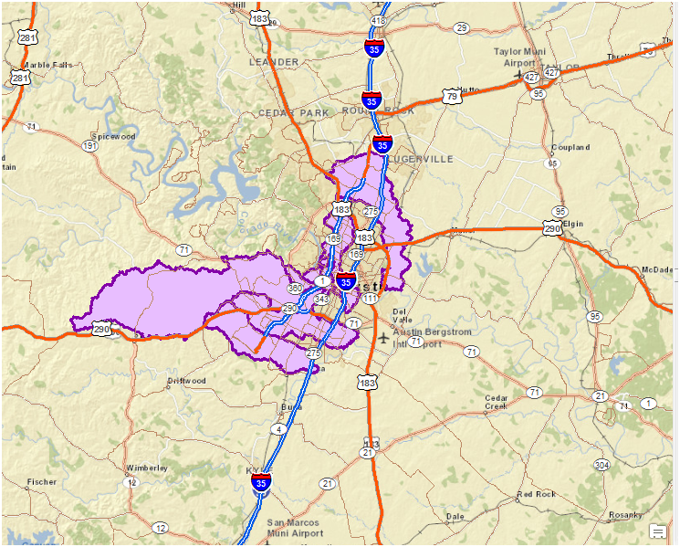
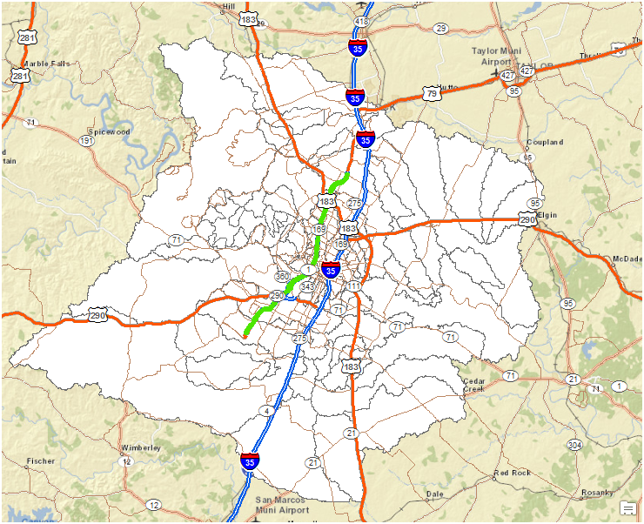
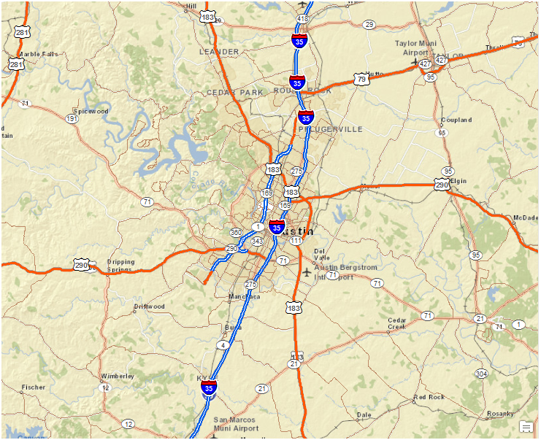
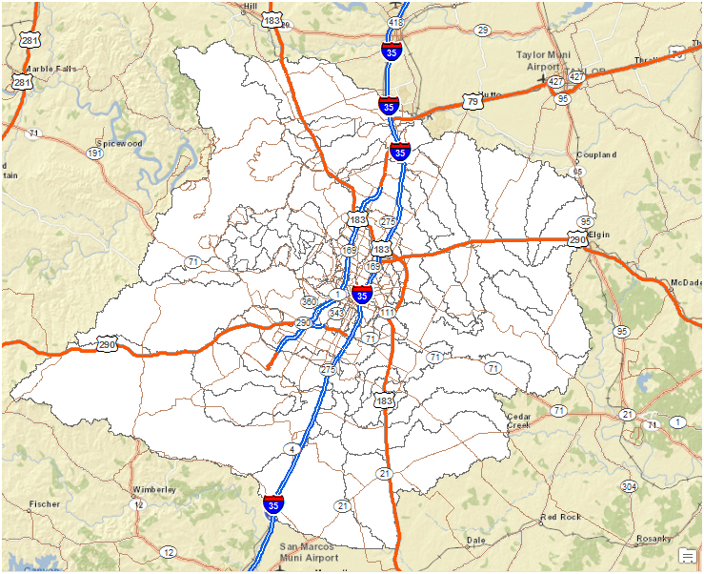
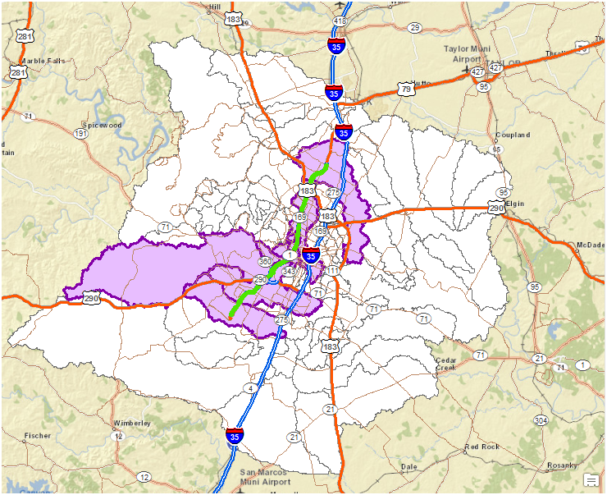
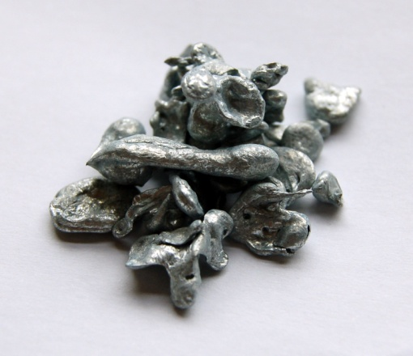
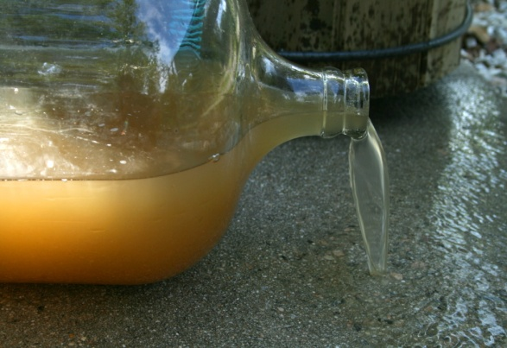
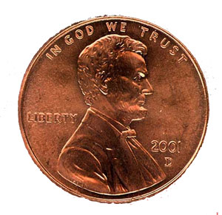
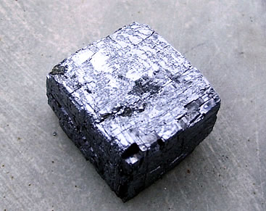
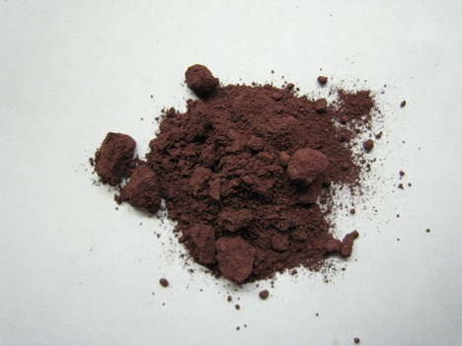
kg/yr reduced
75
134
Suspended Solids
Zinc
kg/yr reduced
69,617
124,315
Copper
kg/yr reduced
10
19
kg/yr reduced
69,617
124,315
kg/yr reduced
49
87
Lead
kg/yr reduced
0.10
0.18
Phosphorous

Slide 13
Acknowledgements
Dr. Maidment
Dr. Barrett, Alex Houston(CRWR)
Melinda Luna, Miguel Pavon (TNRIS)
Roxana Darvari, Gonzalo Espinoza
CAPCOG, City of Austin

