Slide 1
The Impact of Drought on Leaf Area Index (LAI) over Texas
Ling Huang
12/04/2012

Slide 2
Background – Why LAI is concerned?
Leaf Area Index (LAI): one half the total leaf area per unit of ground area
Importance: critical parameter controlling many biological and physical processes involving vegetation
LAI is a key variable controlling ozone production!

Slide 3
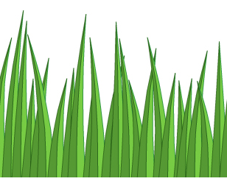
Background – Why LAI is concerned?
Drought
?
Biogenic Emissions
Biogenic Emissions
LAI
LAI
Accumulation!
….
RO₂
VOC
O₂
RO
NO
NO₂
sunlight
O₃
How LAI is affected by drought?
No ozone accumulation!!
O(³P)
Air O₂

Slide 4
Data and Method
2011 (drought) vs. 2010 (wet)
MODIS LAI product (Moderate Resolution Imaging Spectroradiometer)
Area: Texas
Period: May to September
Model Builder in ArcGIS
Mosaic
Apply QC mask
Scaling
Clip
Raw LAI
Final LAI

Slide 5
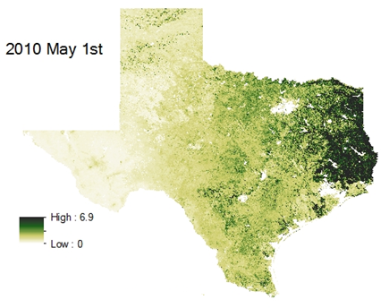
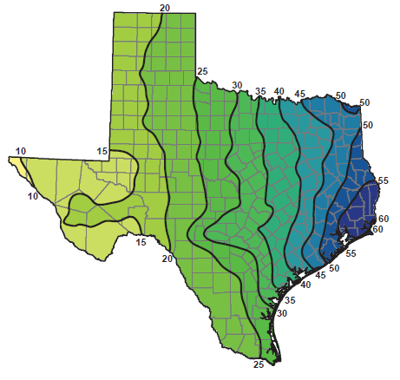
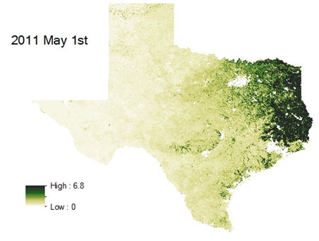
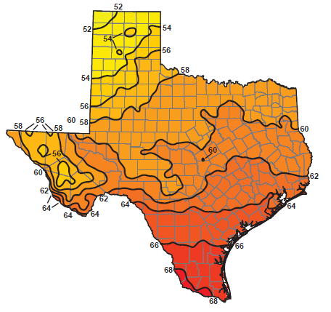
Results – LAI distribution over Texas
Precipitation
Temperature

Slide 6
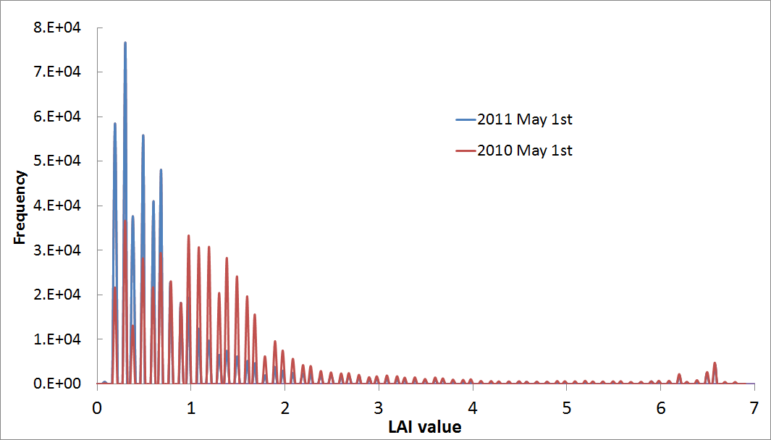
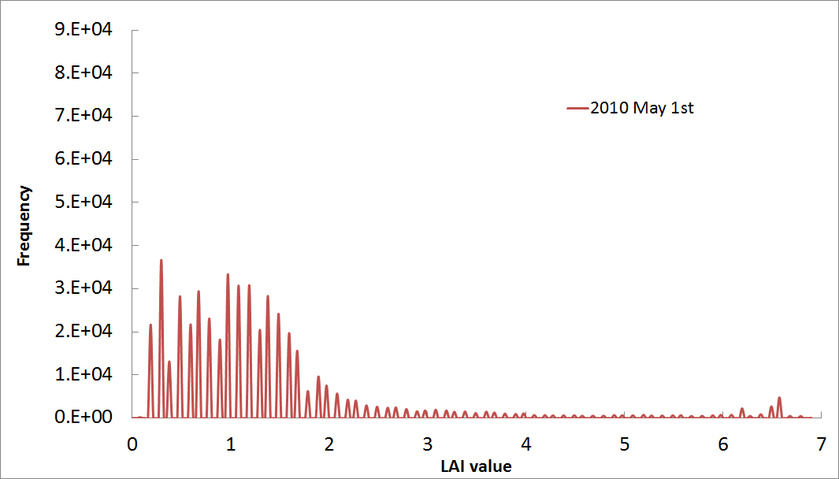
Results – Statistical comparison

Slide 7
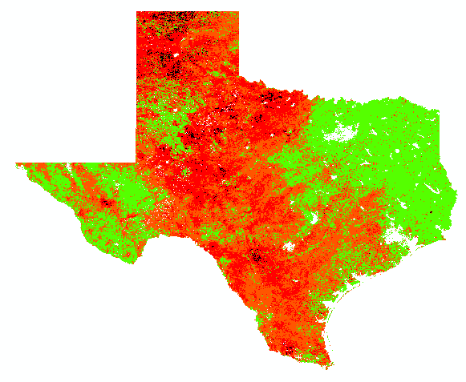
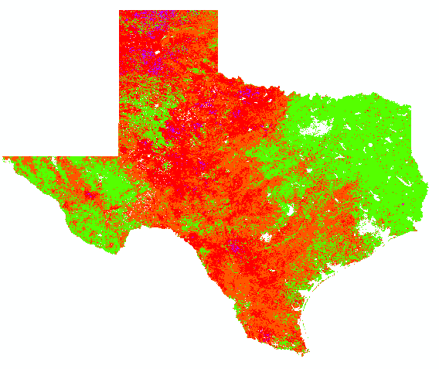
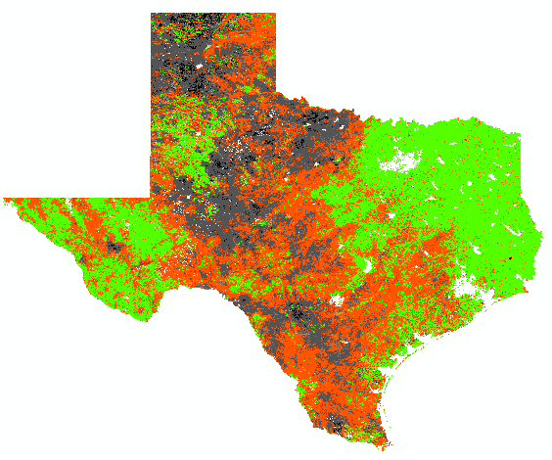
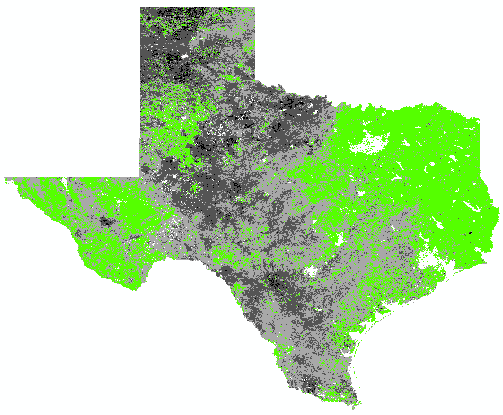
Results – geographical comparison
Impact of Drought
>0.75 No impact
0.5-0.75 Moderate
0.25-0.5 Significant
<0.25 Extreme

Slide 8
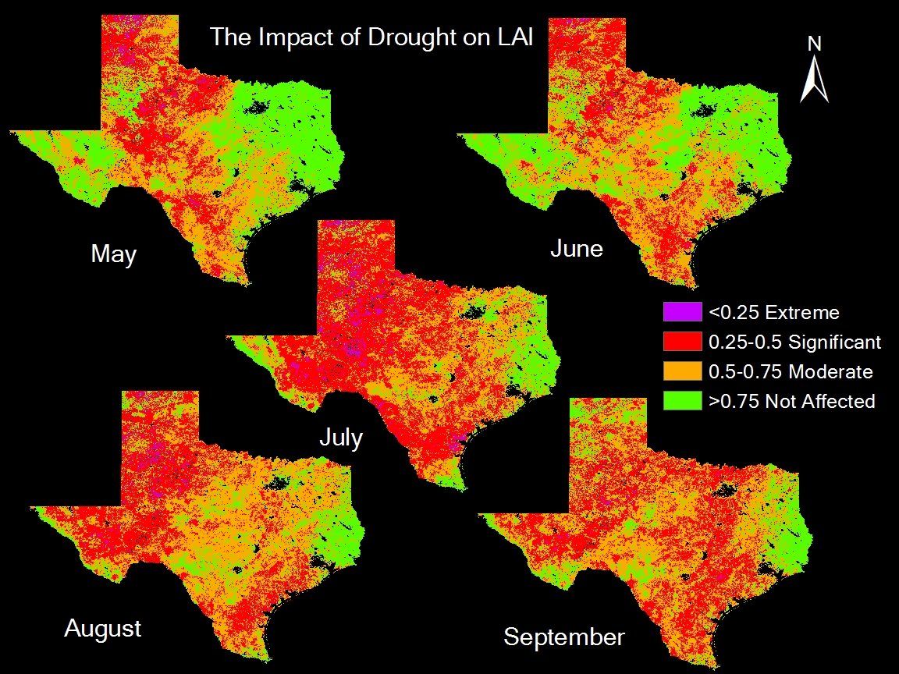
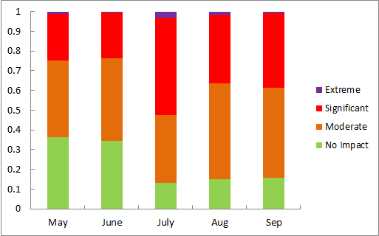

Slide 9
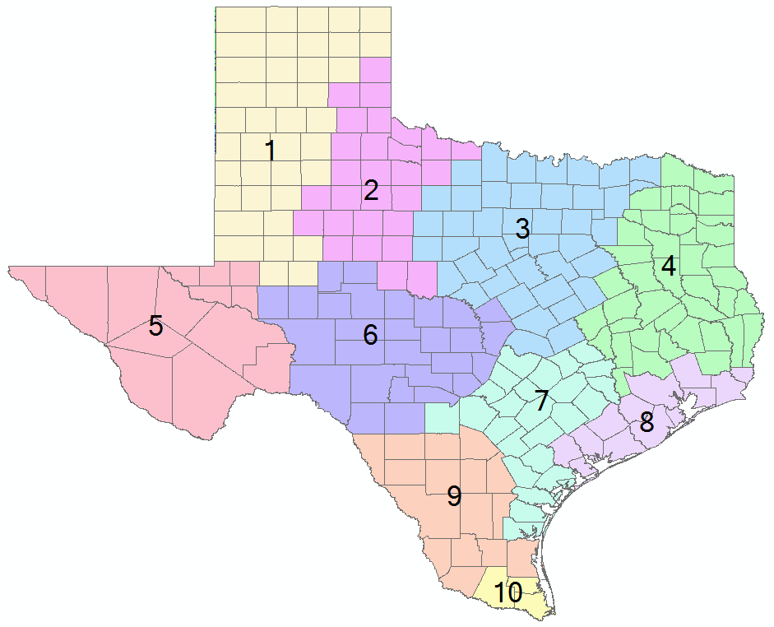
Results – Texas climate divisions
NCDC: 10 climate divisions in Texas
Similar characteristics: vegetation, temperature, humidity, rainfall, seasonal weather changes

Slide 10
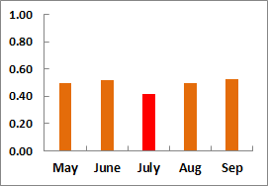
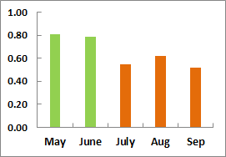
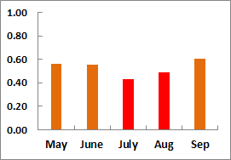
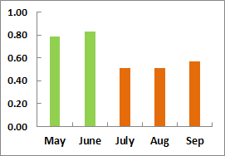
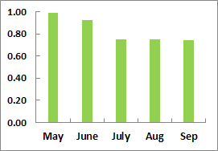
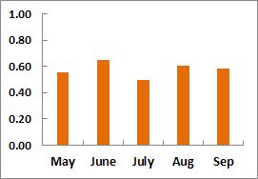
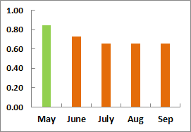
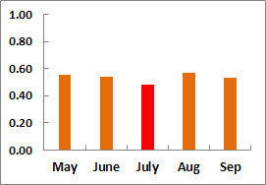
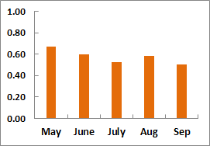
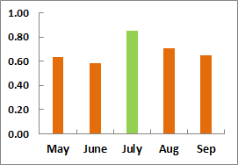
semi-arid savanna
semi-arid savanna
Transition Zone!
semi-arid brushland
and savanna
Sub-arid brushland
Sub-humid savanna
and woodland

Slide 11
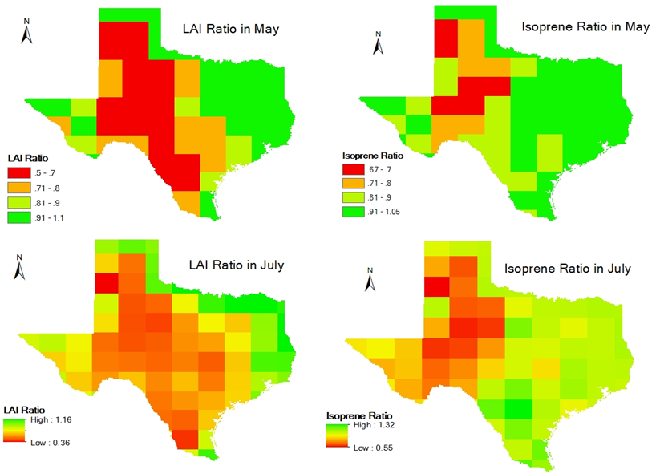

Slide 12
Conclusions
1.
Ozone concentrations
LAI
Biogenic Emissions
Temperature
2.
LAI
Precipitation
In July 2011, nearly 90% of areas saw the impact of drought and over 50% were significantly affected.
3.
Drought
LAI
4.
Transition zones
6.
Less Ozone Production, especially in VOC-limited regions
5.
GIS is an excellent tool to view the impact of drought geographically.

Slide 13
Acknowledgements
Dr. Maidment
Gonzalo Espinoza Dávalos
Yosuke Kimura
Dr. Allen
Thank you!

