Slide 1
Jordan’s Water Resource Challenges and Prospects for Sustainability Amelia Altz-Stamm GIS for Water Resources Fall 2012

Slide 2
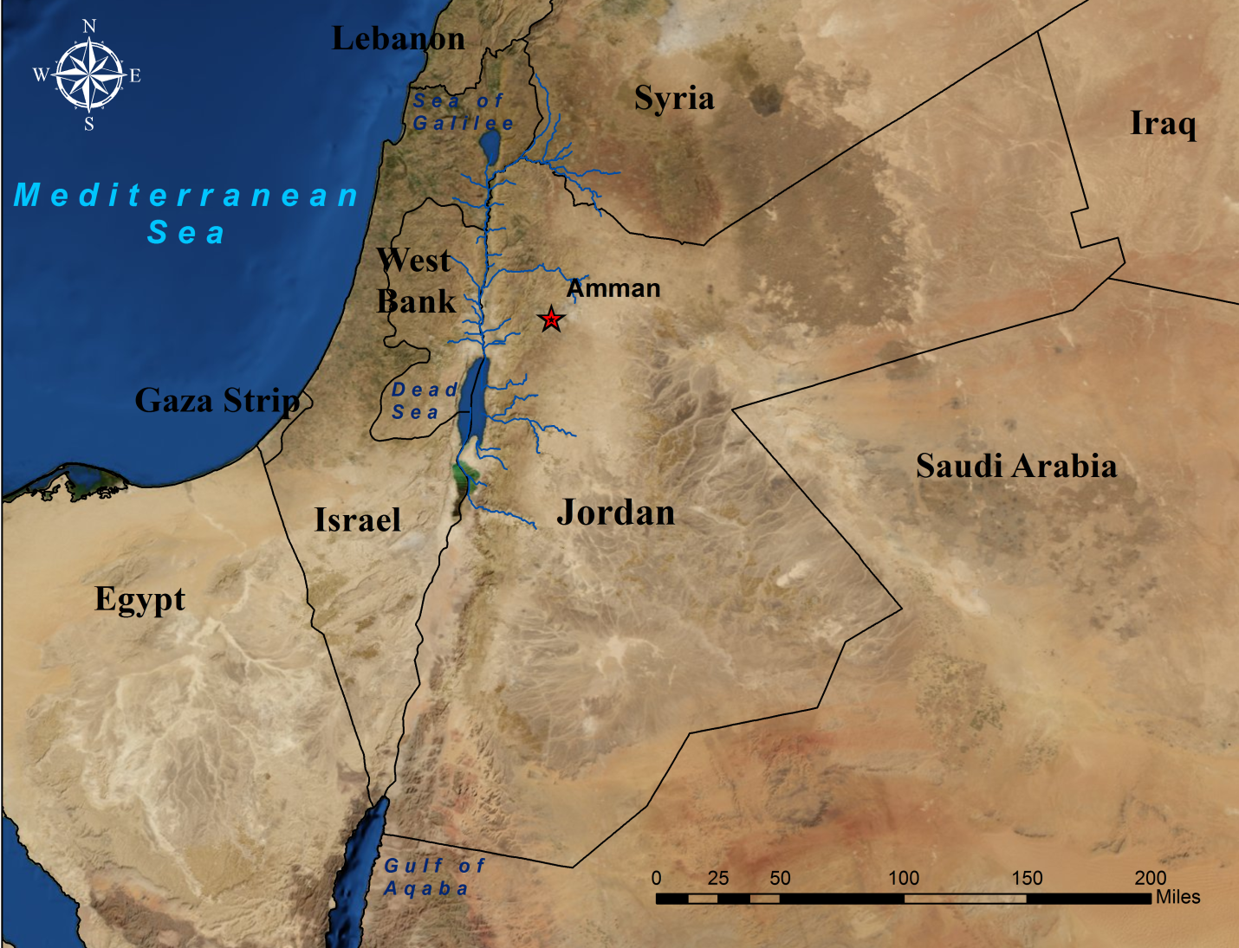
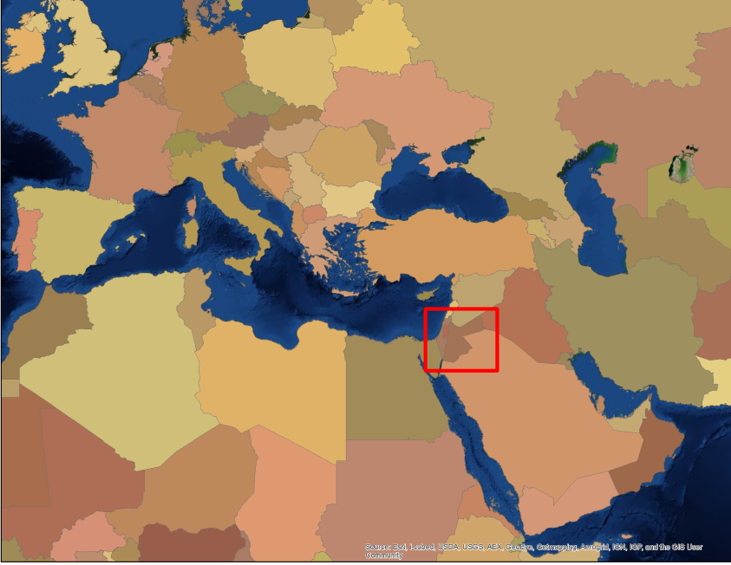
The Hashemite Kingdom of Jordan
Jordan………….…140 m³/person/year
Poverty Line….….500 m³/person/year
US………….……9,000 m³/person/year

Slide 3
Water Demand vs. Supply
Water Demand
Who needs the water?
Water Supply
Where are the conventional or natural water resources?
Harnessing and Enhancing the Supply
How is the supply able to meet the demands?
955 MCM/year
780-850 MCM/year

Slide 4
Water Demand
Agriculture
Municipal/Industrial Needs
Additional Municipal Needs - Refugees
Tourism

Slide 5
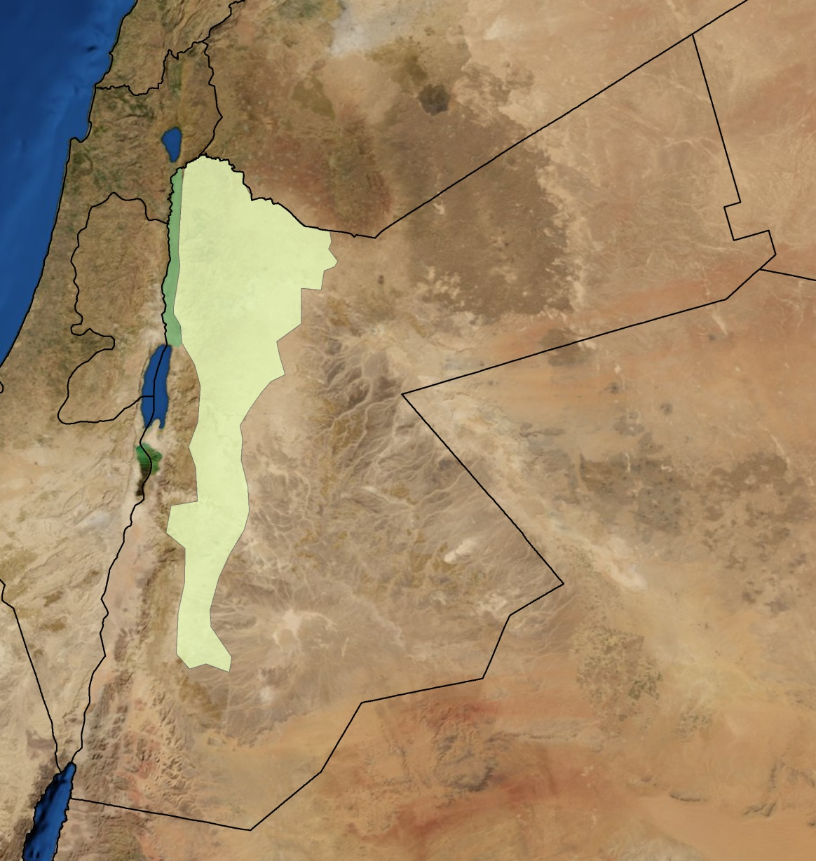
Agricultural Water Needs
Jordan Valley
The Highlands

Slide 6
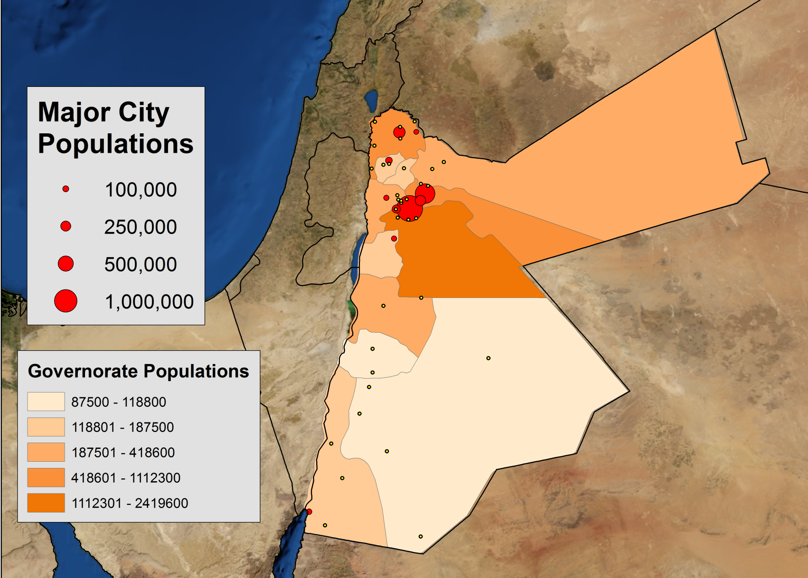
Municipal/Industrial Needs
Irbid
Ramtha
Ajlun
Salt
Zarqa
Wadi as Sir
Russiefa
Amman
Madaba
Aqaba
o Small Towns
Notes:
Population pressure in general and centered in certain areas

Slide 7
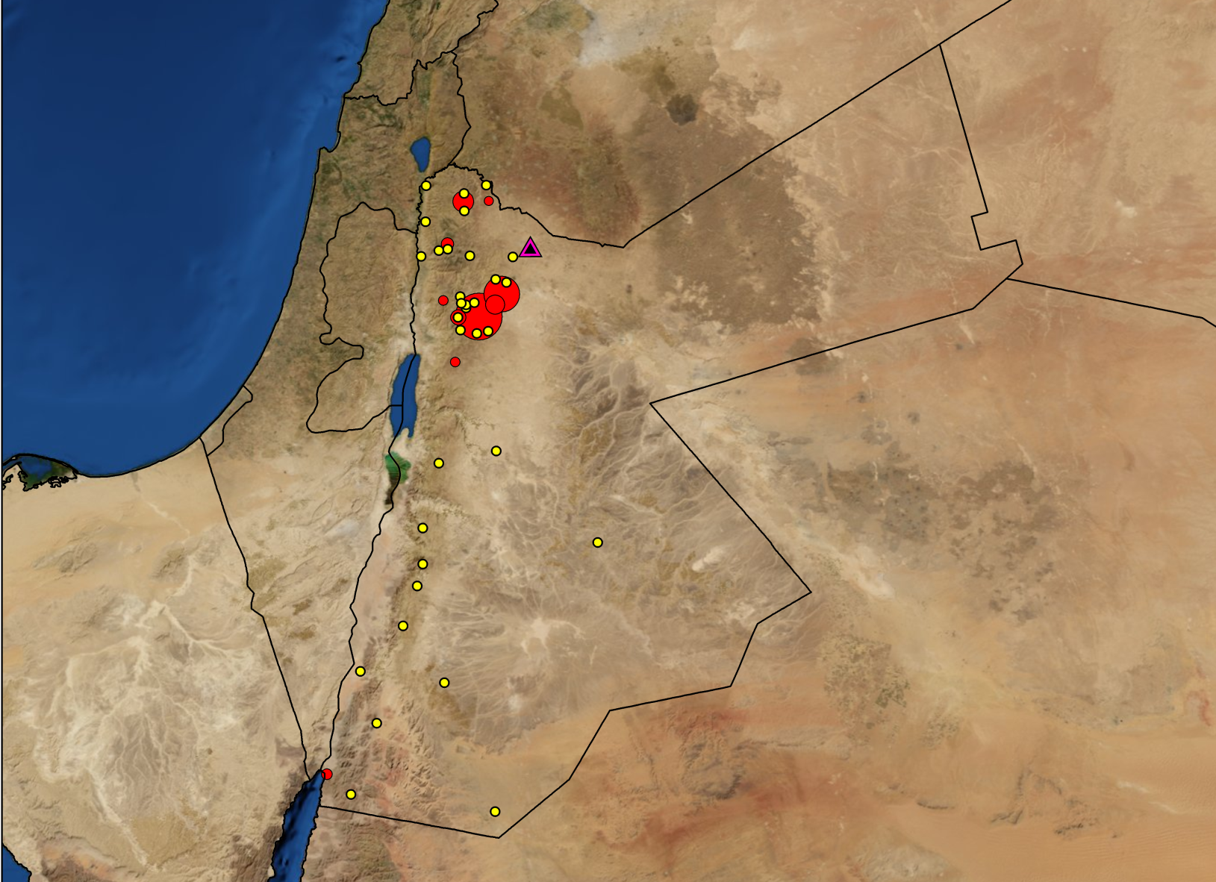
Refugees Add to Municipal Needs
Syria Conflict 2011
(185,00 Syrian refugees)
Iraq War 2003
(451,700 Iraqis currently remaining)
1948 War
(1,983,733 registered Palestinian refugees)
Zaatari Refugee Camp

Slide 8
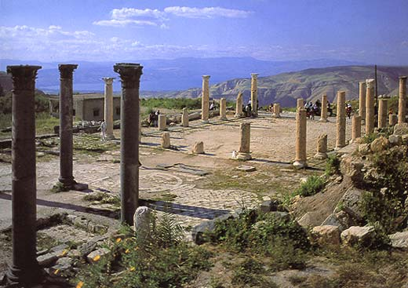
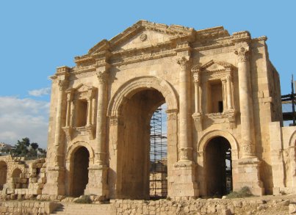
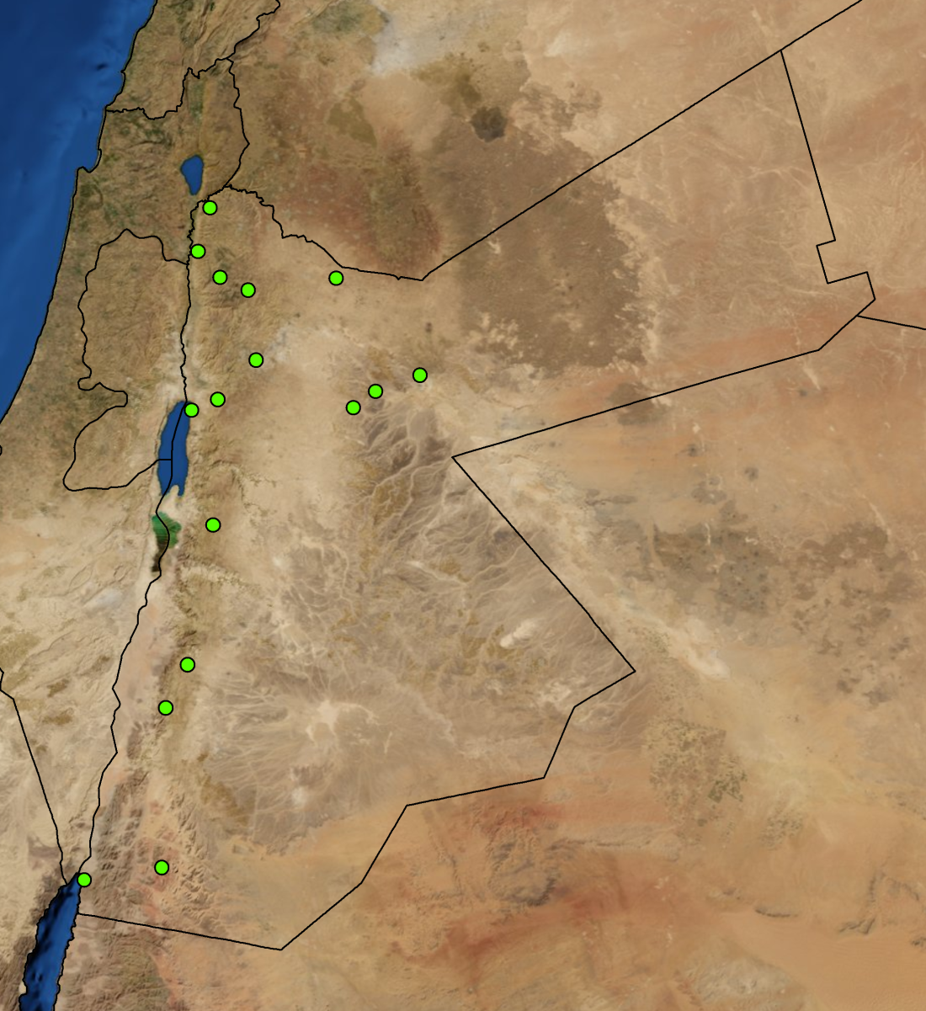
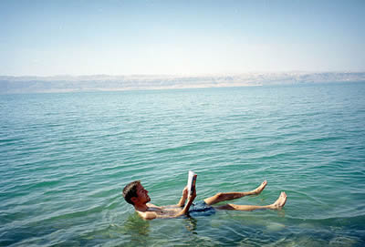
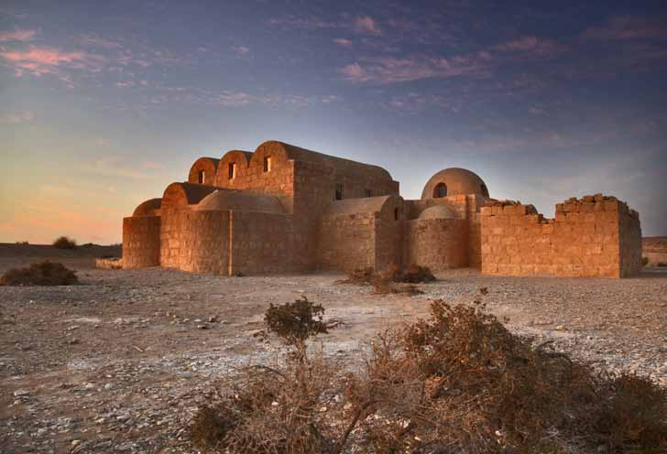
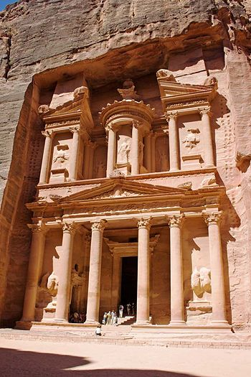
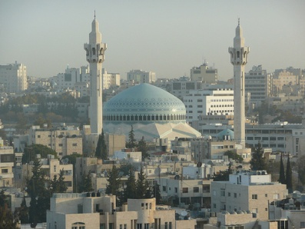
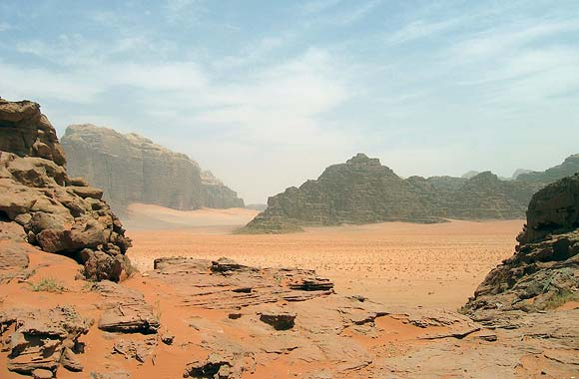
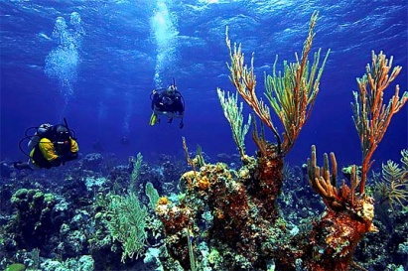
Tourism Needs
Umm Qais
Jerash
Dead Sea
Pella
Ajlun Castle
Mt. Nebo
Eastern Castles
Karak Castle
Showbak Castle
Amman
Petra
4 Million Tourists Every Year
Aqaba
Wadi Rum

Slide 9
Conventional Water Supply
Rainfall
Groundwater
Surface Waters: Rivers
Seasonal Streams

Slide 10
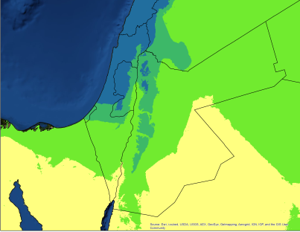
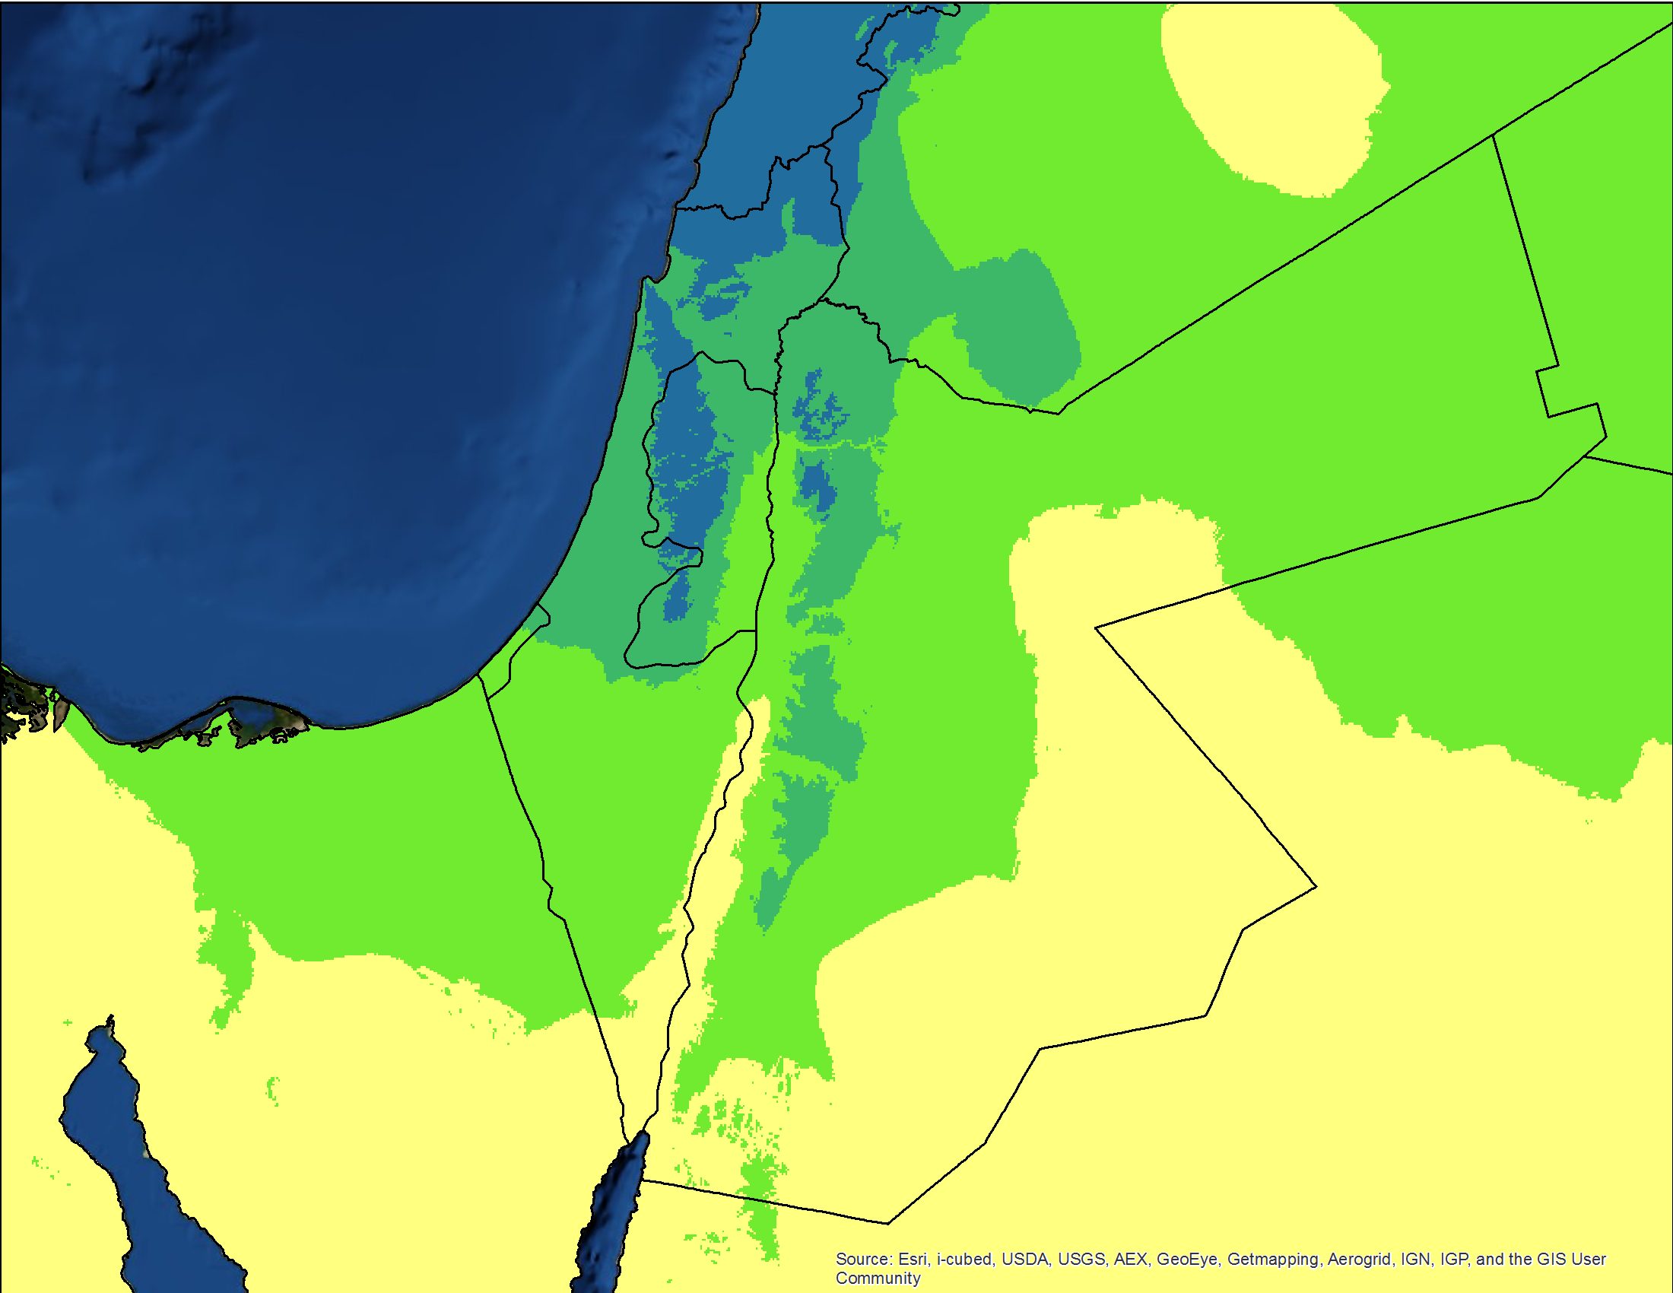
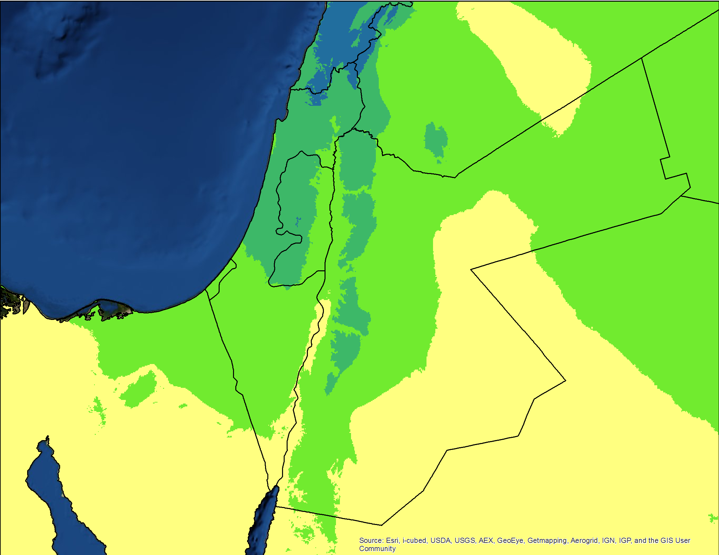
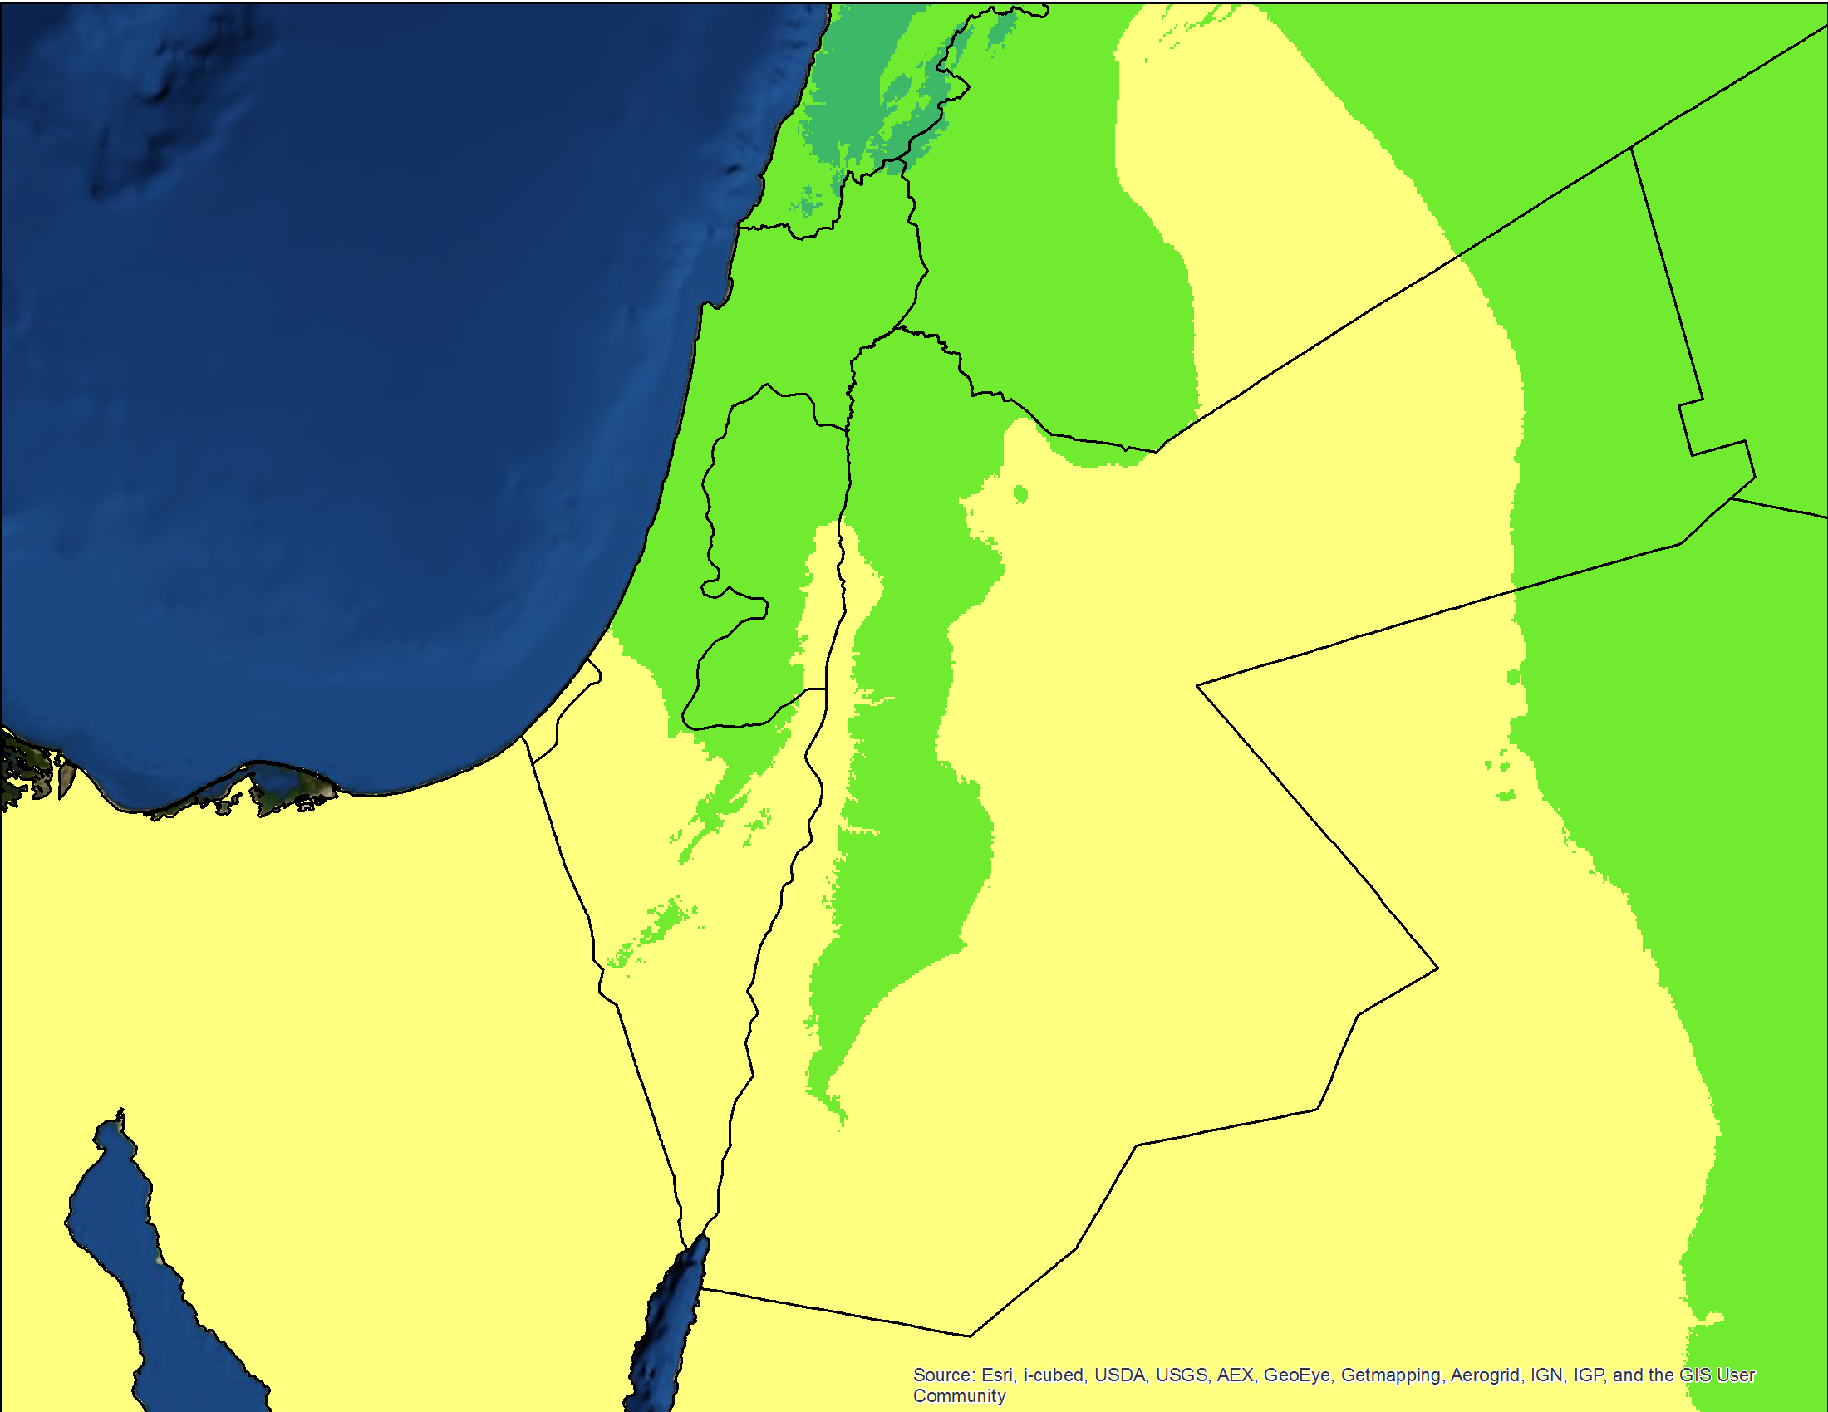
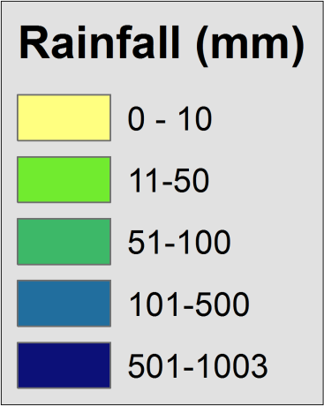
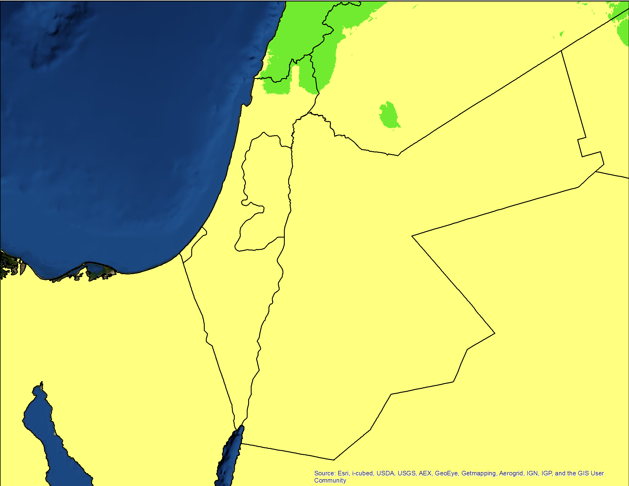
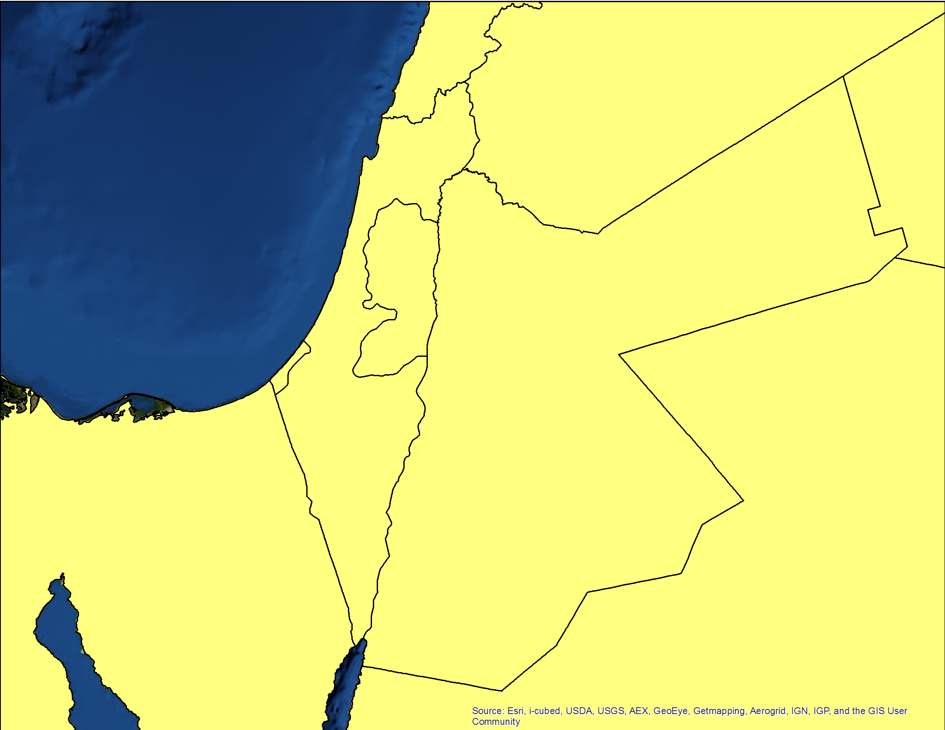
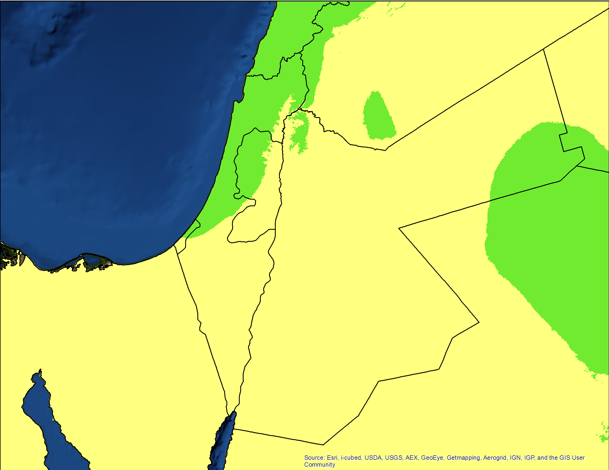
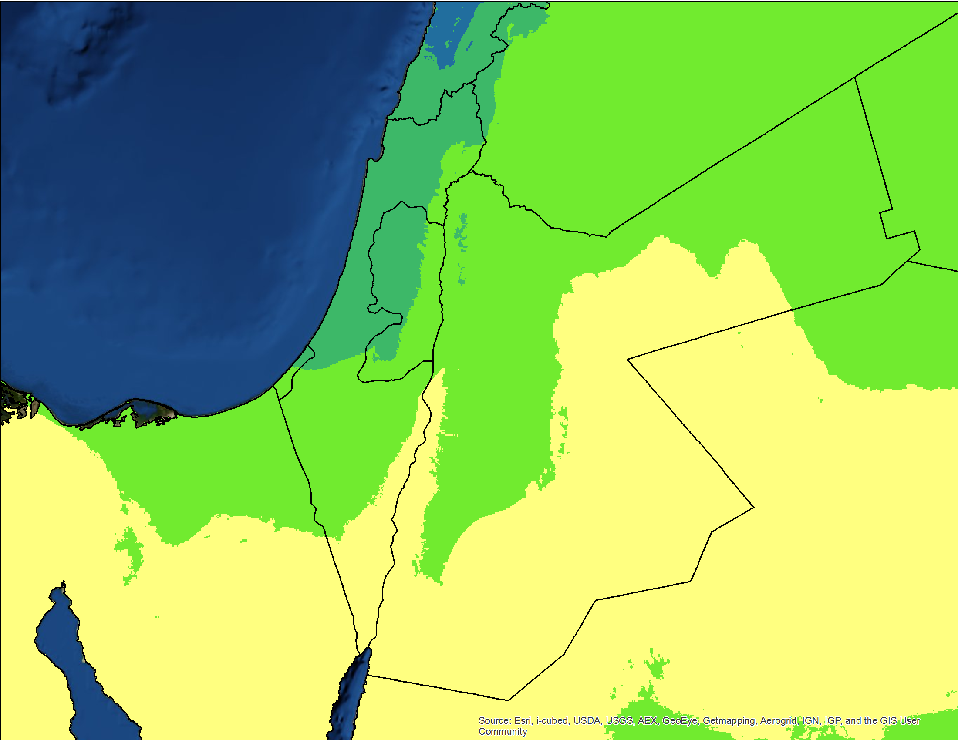
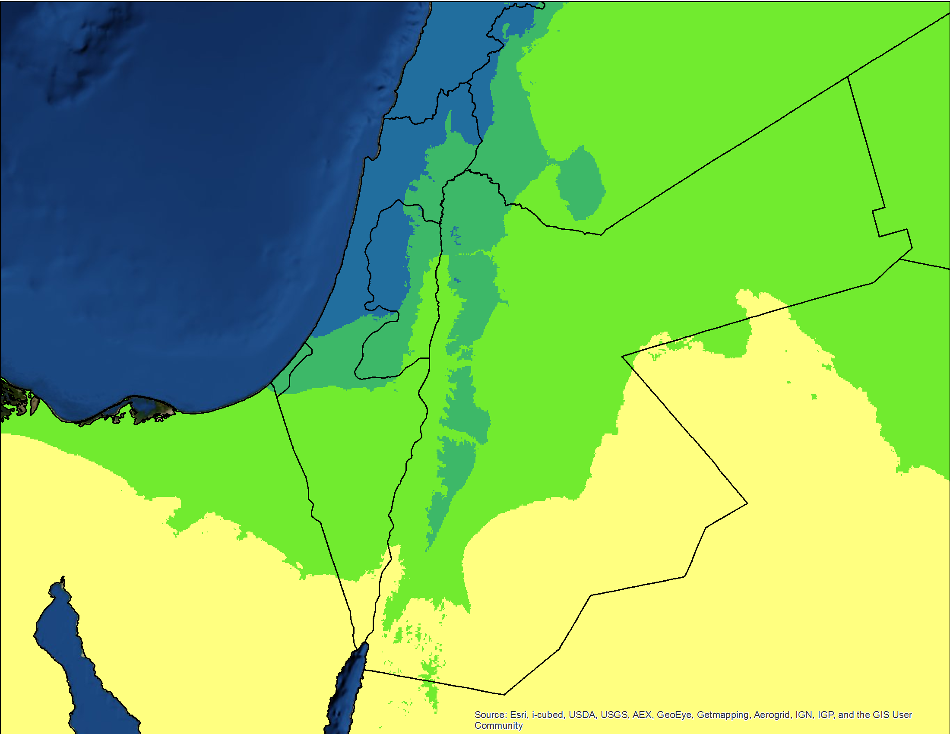
Rainfall
January | February | March | April
May | June | July | August
September | October | November | December
92% evaporates anyway!
Essentially
No Rain

Slide 11
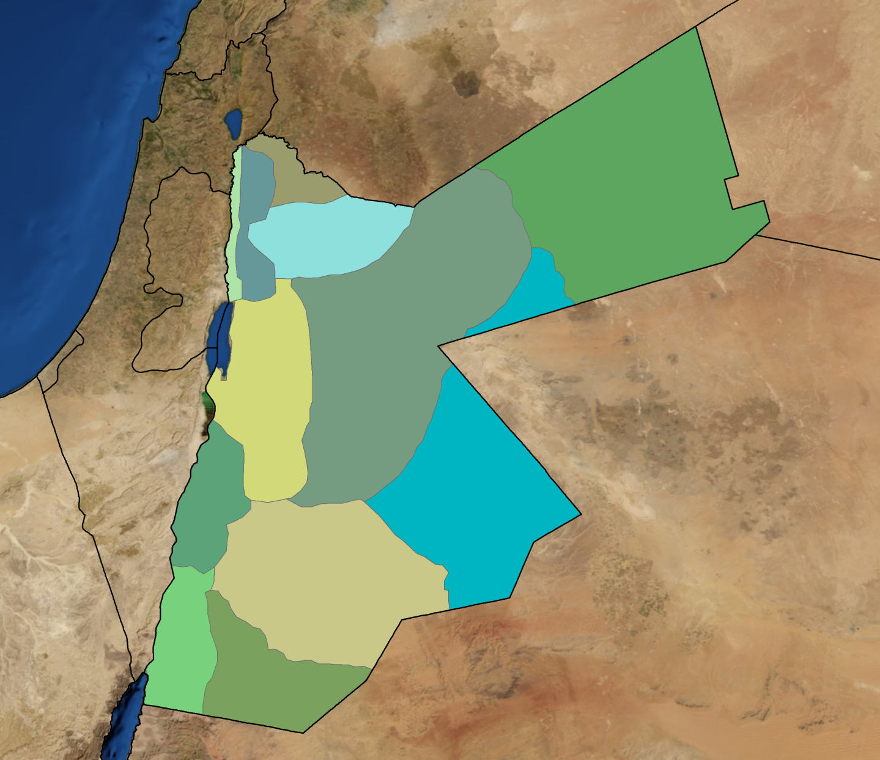
Groundwater Basins (safe yield in million cubic meters/year)
Yarmouk
(30-35)
Jordan River Side Valleys
(28-32)
Amman/Zarqa
(60-70)
Himad
(12-16)
Jordan Valley
(15-20)
Azraq
(30-35)
Dead Sea
(40-50)
Northern Araba Valley
(5-7)
Sarhan
(7-10)
Jafar
(7-10)
Southern Araba Valley
(4-6)
Safe Yield/Year | 240-294 MCM
Actual Abstraction/Year | 473 MCM
An extra 100 MCM/year by January 2013
Disi
(2-3)

Slide 12
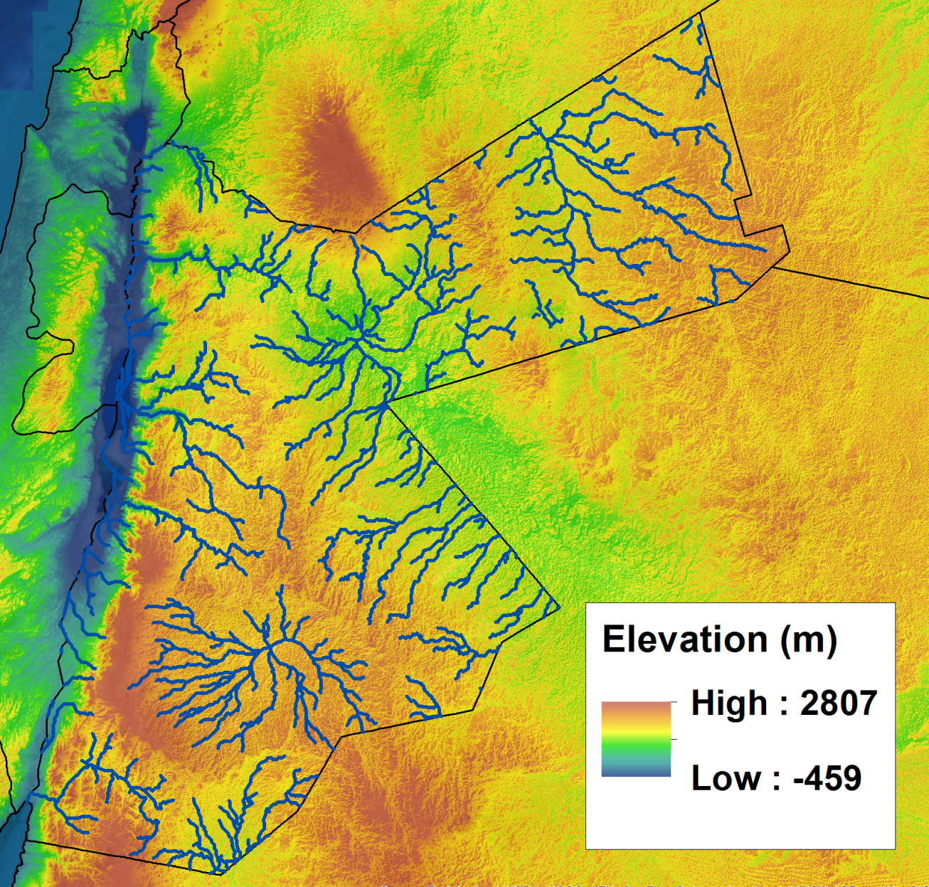
Surface Water
Where there is actual surface flow

Slide 13
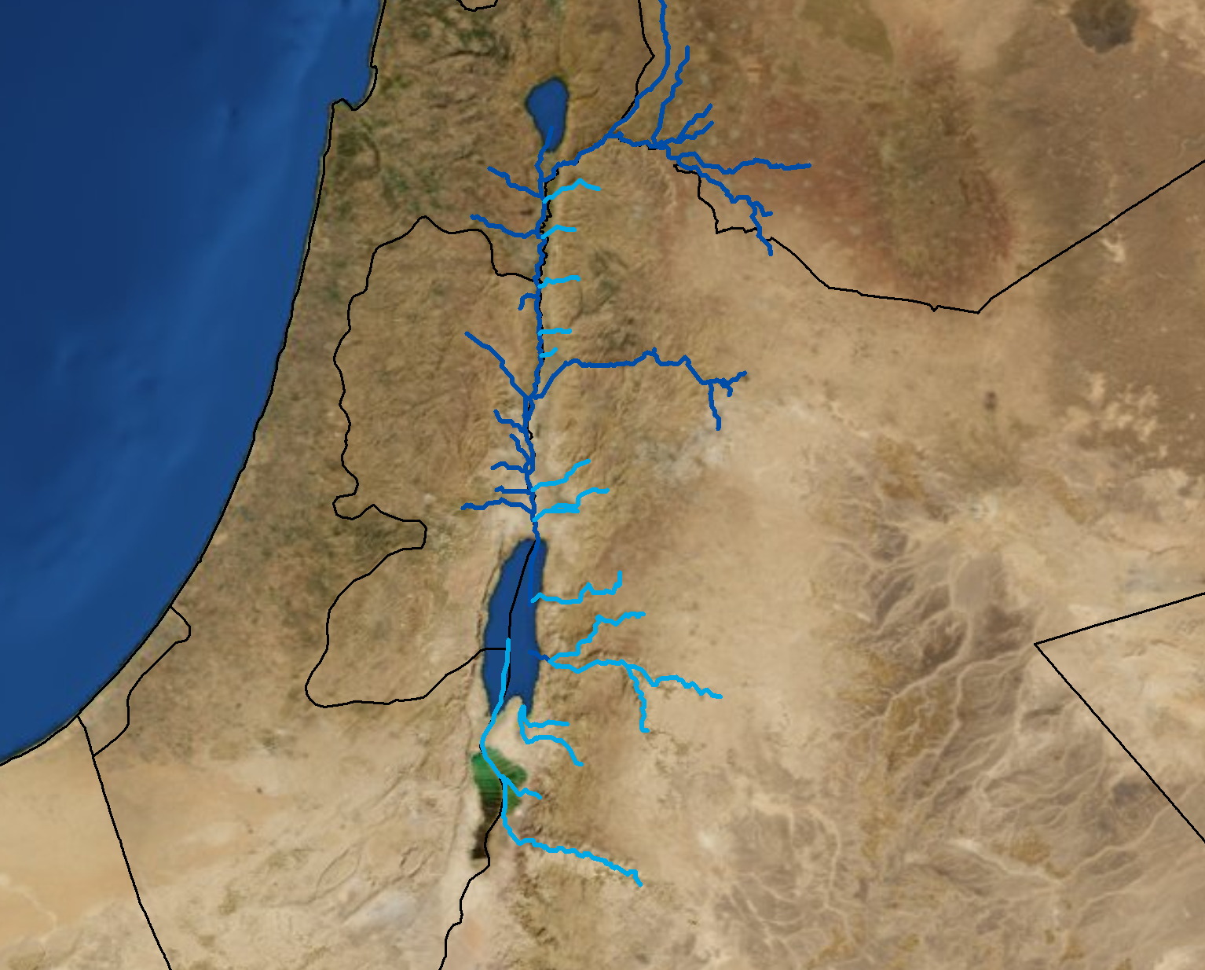
Rivers and Streams
Sea of Galilee
Yarmouk River
(171 MCM/year)
Zarqa River
(65 MCM/year)
River | MCM/year
Amazon | 5389537
Congo | 1270203
Yangtze | 905141
Mississippi | 537319
Ganges | 379679
Danube | 203739
Zambezi | 105311
Indus | 88525
Nile | 39571
Seine | 10527
Colorado | 4155
Thames | 2521
Rio Grande | 1499
Lower
Jordan River
(20-30
MCM/year)
Seasonal Streams in Northern and Southern Side Wadis
(100 MCM/year)
Dead Sea

Slide 14
Harnessing and Enhancing the Supply
Dams Along Side Valleys
King Abdullah Canal
Water transfer from Jordan Valley to Amman
Treated wastewater
Red Sea-Dead Sea Canal Project

Slide 15
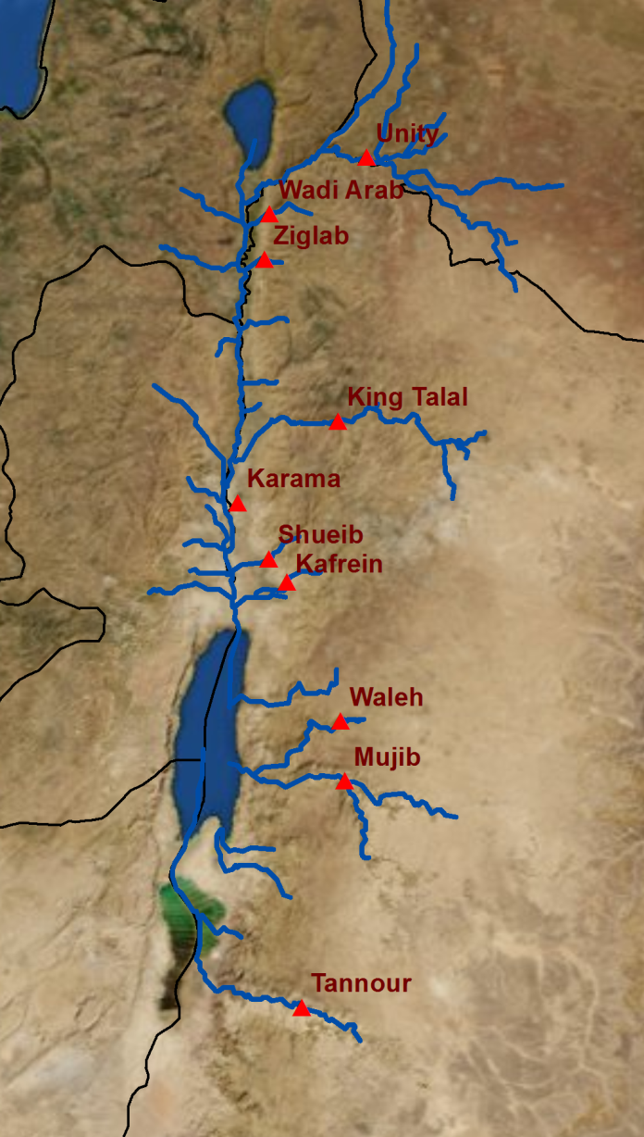
Dams Along Side Valleys
Dam | Storage (MCM/year)
Unity Dam | 110.0
Wadi Arab | 17.0
Ziglab | 3.8
King Talal | 75.0
Karama | 55.0
Shueib | 1.4
Kafrein | 8.4
Waleh | 9.3
Mujib | 35.0
Tannour | 16.8
Total | 331.7

Slide 16
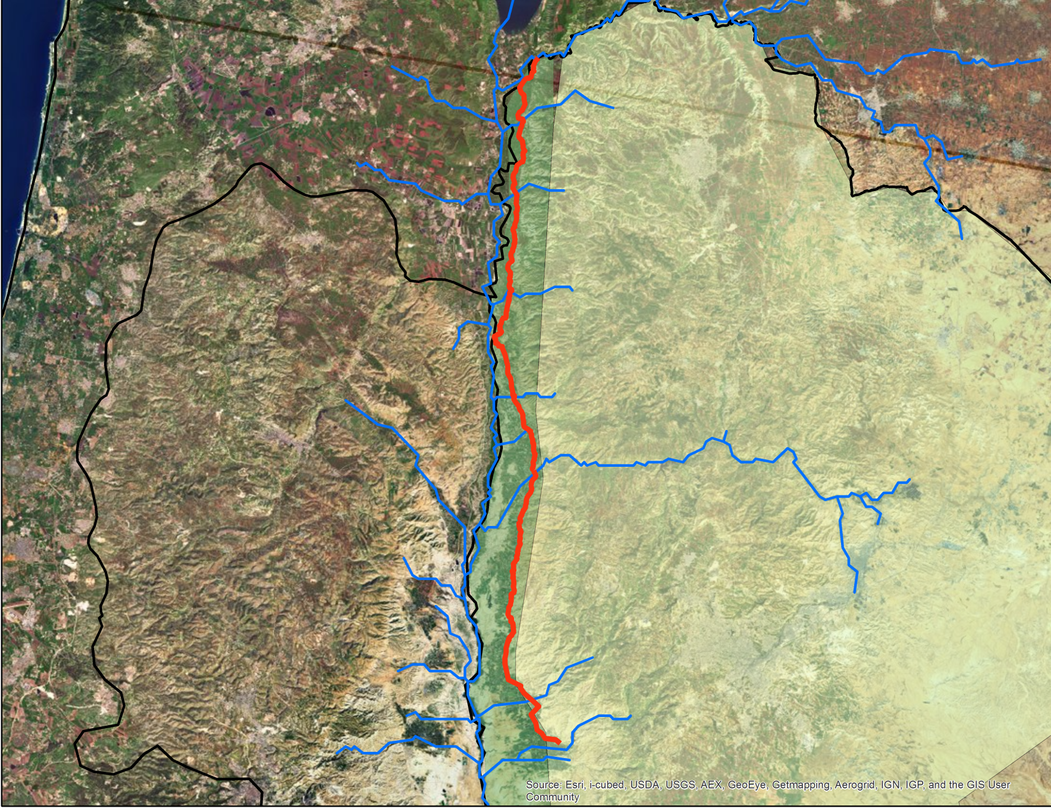
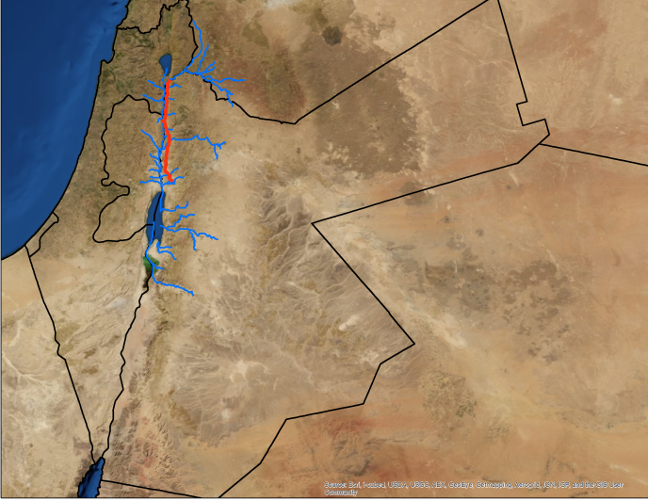
King Abdullah Canal
Highlands
Jordan
Valley
King Abdullah Canal

Slide 17
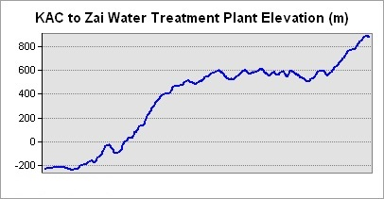
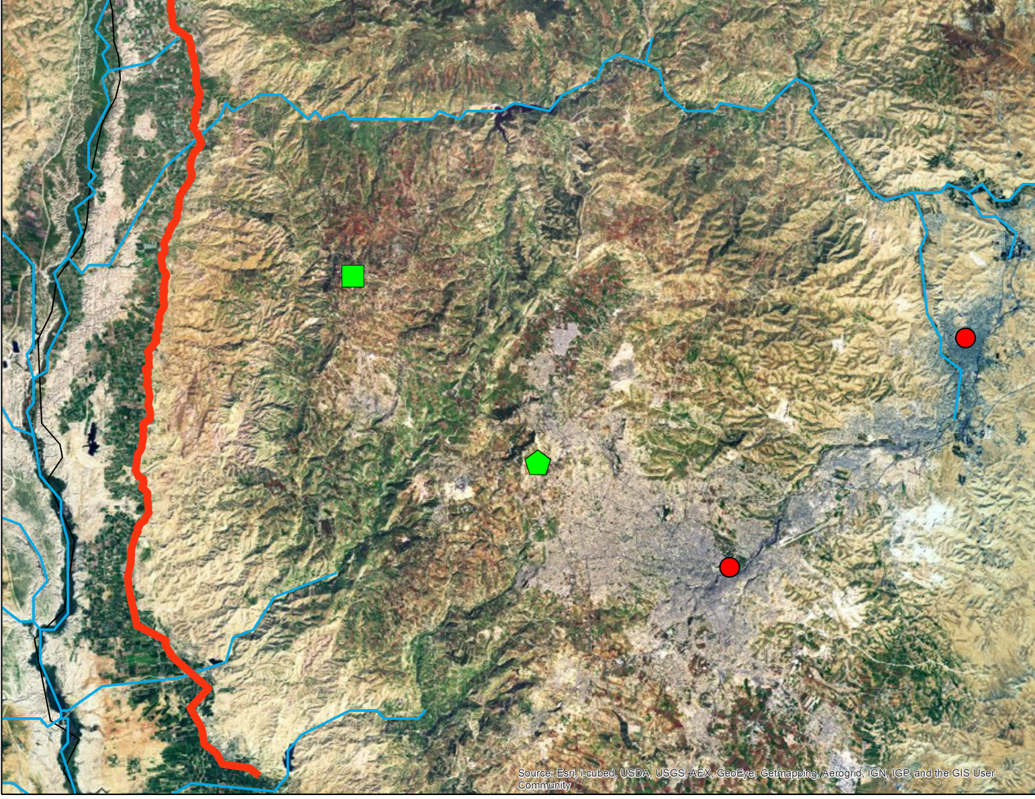
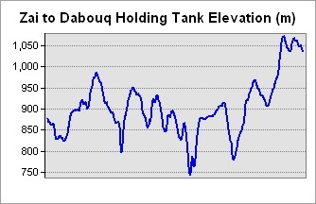
Water Transfer to Amman
King Abdullah Canal
-200 to 880 m
Jordan River
Zai Water Treatment Plant
Zarqa
Dabouq Holding Tank
Amman
880 to 1035 m
Notes:
Zai: http://www.miyahuna.com.jo/index.php?option=com_content&view=article&id=44&Itemid=44&lang=en

Slide 18
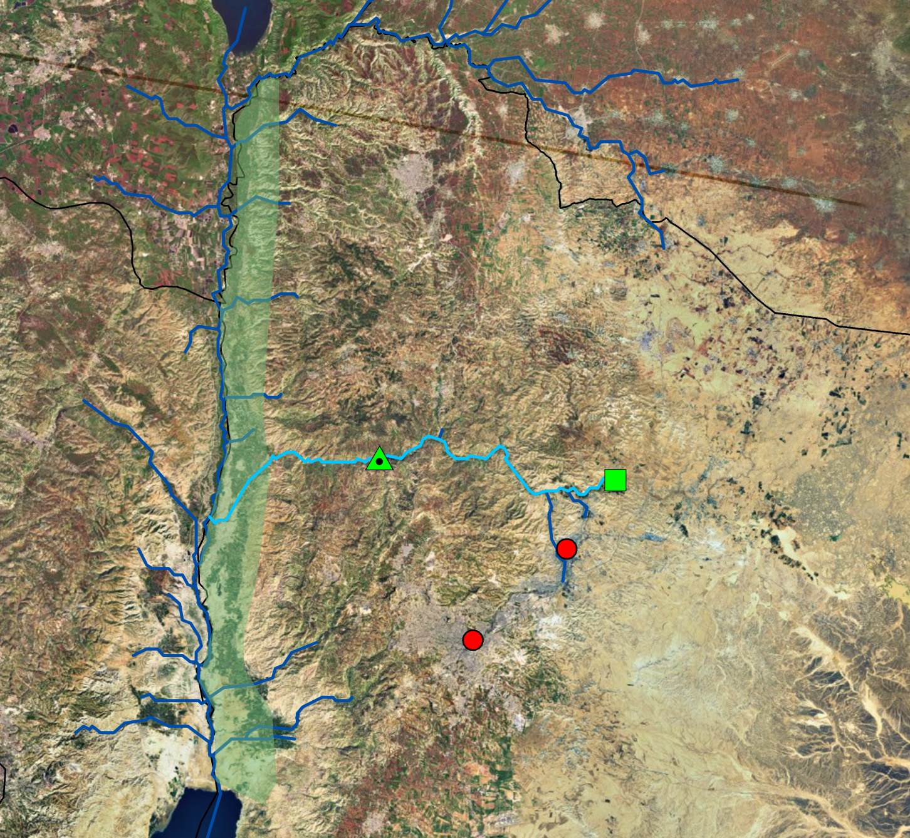
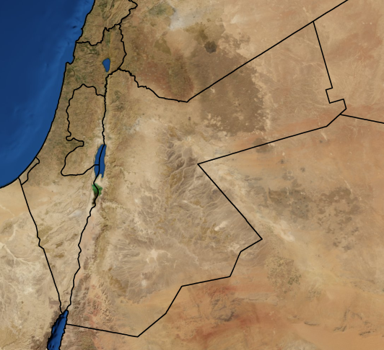
Treated Wastewater
King Talal Dam
Khirbat as-Samra Treatment Plant
Middle and Southern Jordan Valley Farms Supplied with Treated Wastewater
Zarqa
110 MCM of wastewater
Amman

Slide 19
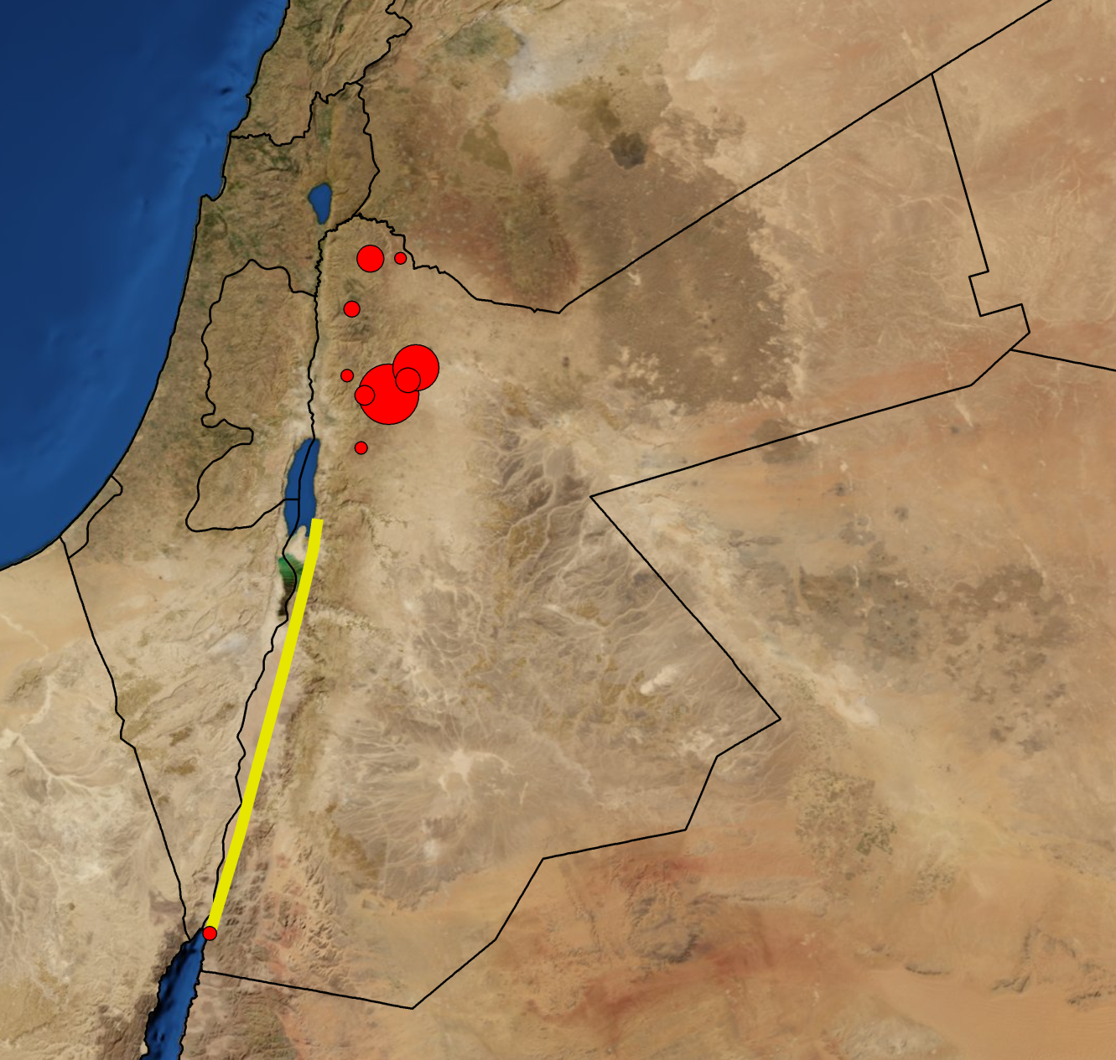
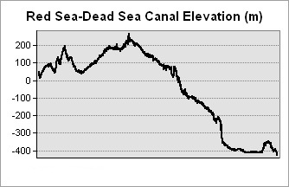
Red Sea-Dead Sea Canal Project
Potentially an extra 850 MCM/year
of freshwater!
Zarqa
Dead Sea
Amman
Saltwater
Freshwater
Red Sea-Dead Sea
Proposed Pipeline
0 to 230 to -420 m
Red Sea

Slide 20
In Sum…
Supplying water under conditions of water scarcity is an extremely difficult and complex task that requires constant innovation.

Slide 21
Information and GIS Sources
Raster Data:
USGS HydroSHEDS: http://hydrosheds.cr.usgs.gov/
Precipitation Data:
WorldClim Global Climate Data: http://www.worldclim.org/current
Jordan-specific data:
Jordan Valley Authority, Deir Alla Office
Jordan Department of Statistics
Umm el-Jimal Project: http://ummeljimal.org/en/gis.html
NationMaster.com (Jordan Maps)
CityPopulation: http://www.citypopulation.de/Jordan.html
Miyahuna: www.miyahuna.com.jo
Flow Data:
Gafny, S., et al. (2010) Towards a Living Jordan River: An Environmental Flows Report on the Rehabilitation of the Lower Jordan River. Amman: Friends of the Earth Middle East.
Suleiman, R. (2003) The Historical Evoluation of the Water Resources Development in the Jordan River Basin in Jordan. International Water Management Institute and Mission Régionale Eau et Agriculture.
Courcier, R., et al. (2005) Historical Transformations of the Lower Jordan Rriver Basin (in Jordan): Changes in Water Use and Projections (1950-2025). Comprehensive Assessment Research Report 9. Colombo, Sri Lanka: Comprehensive Assessment Secretariat.
World Rivers: Dai, A., T. Qian, K. E. Trenberth, and J. D Milliman, 2009: Changes in continental freshwater discharge from 1948-2004. J. Climate, 22, 2773-2791.
ArcGIS Resource Center

