Slide 1
Sediment and Water Column Chlorophyll Levels and Salinity in the Chukchi Sea
COMIDA-Hanna Shoal Ecosystem Study
Prepared by Jordann K. Young
Marine Science Department
University of Texas at Austin
GIS in Water Resources
Fall 2012

Slide 2
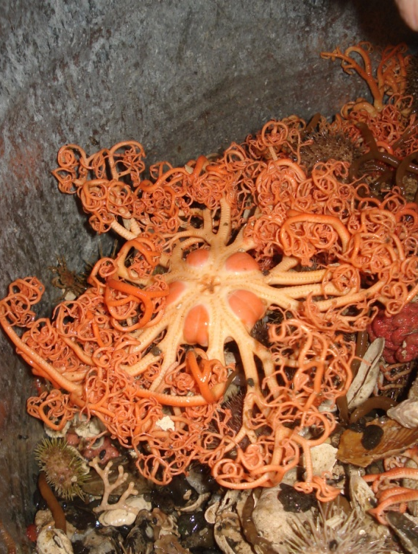
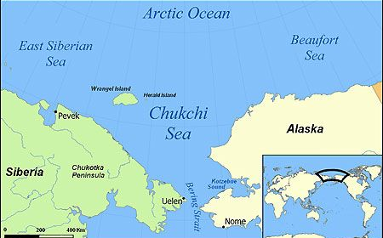
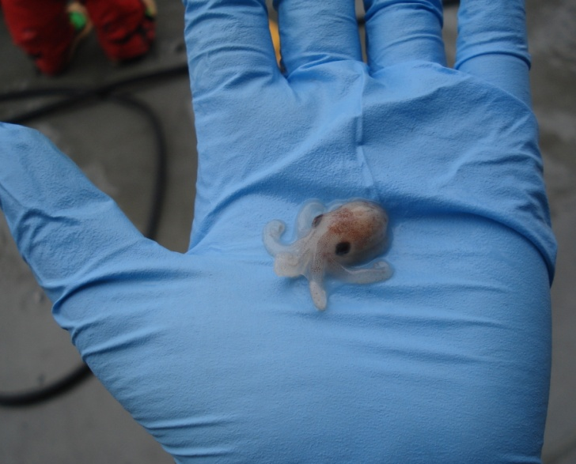
The Chukchi Sea
Seasonal ice cover
High primary productivity
Shallow and highly productive sea floor
Photo: Kathy Kuletz, U.S. Fish and Wildlife

Slide 3
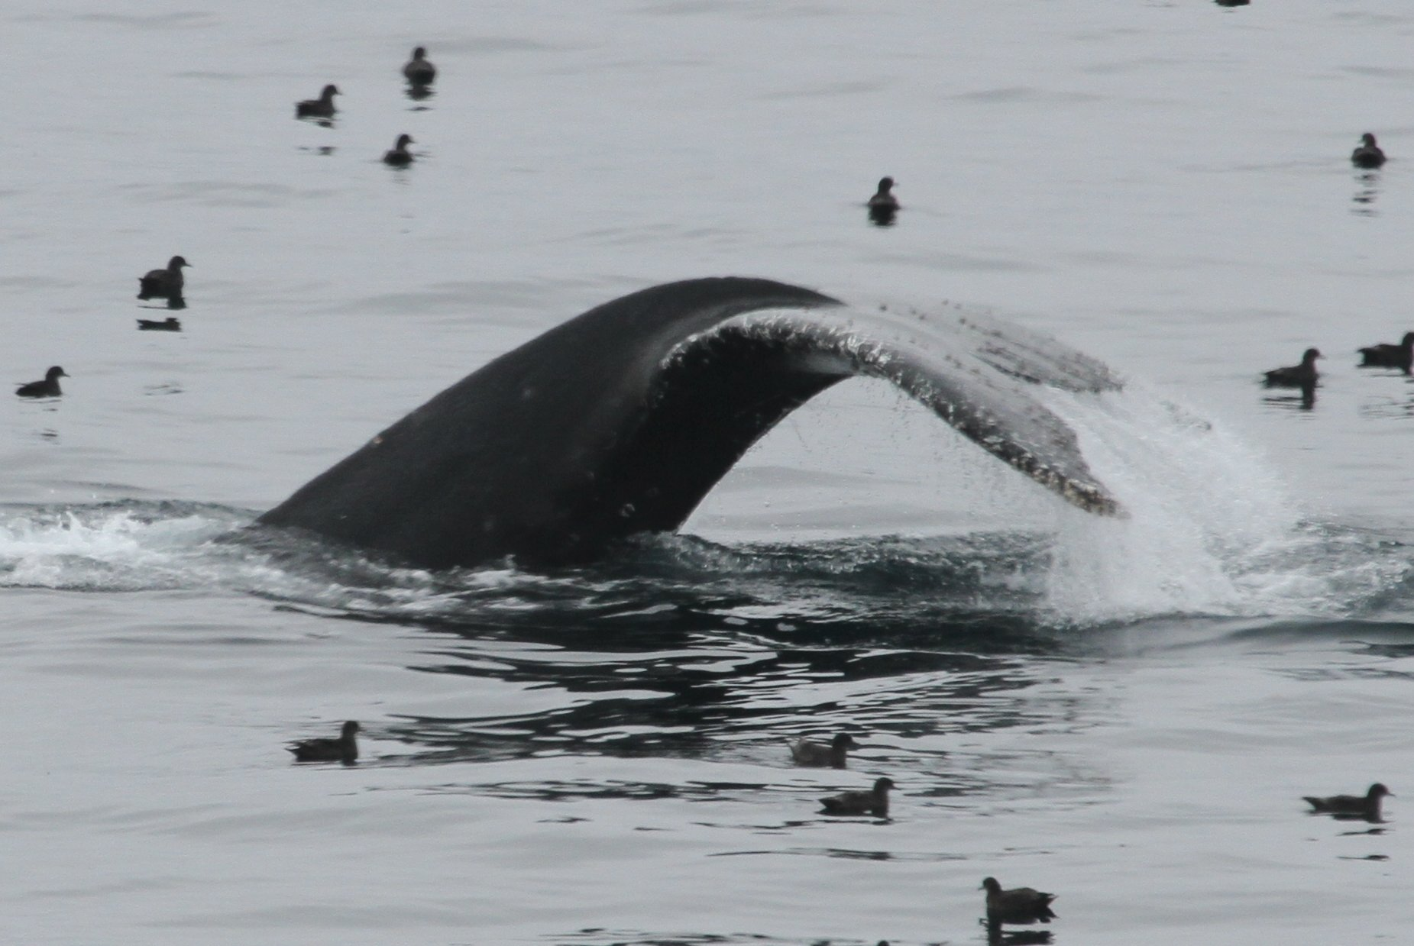
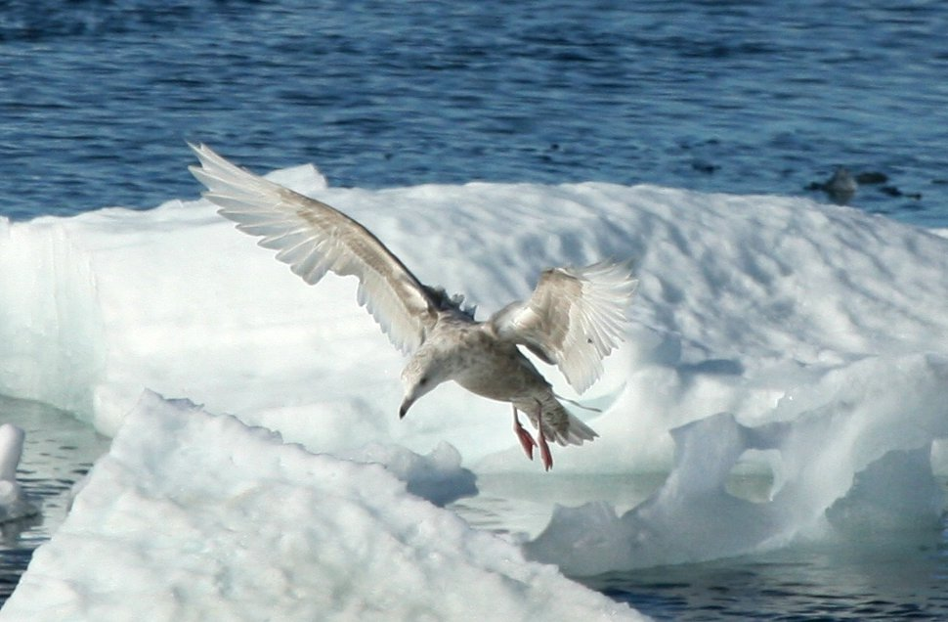
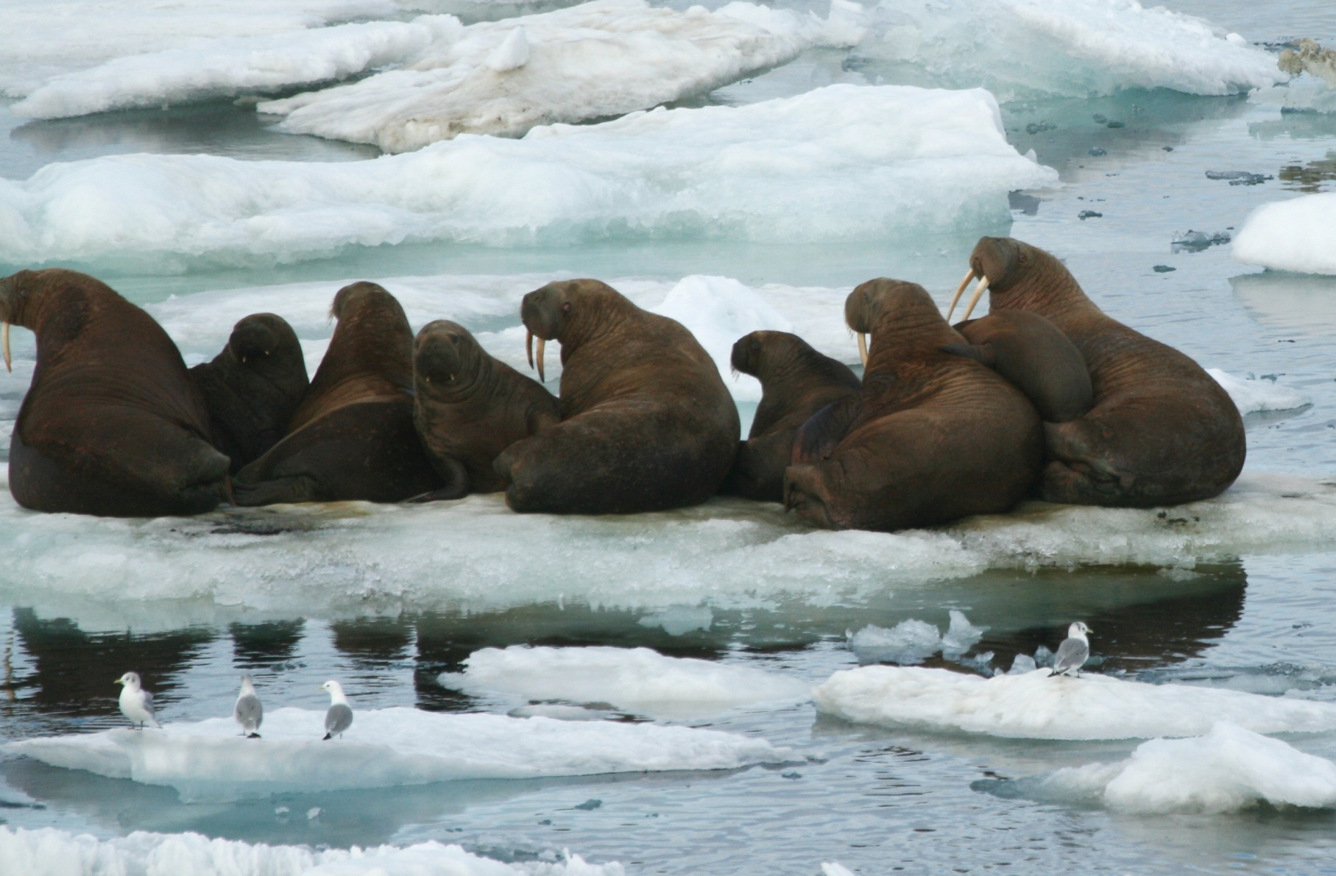
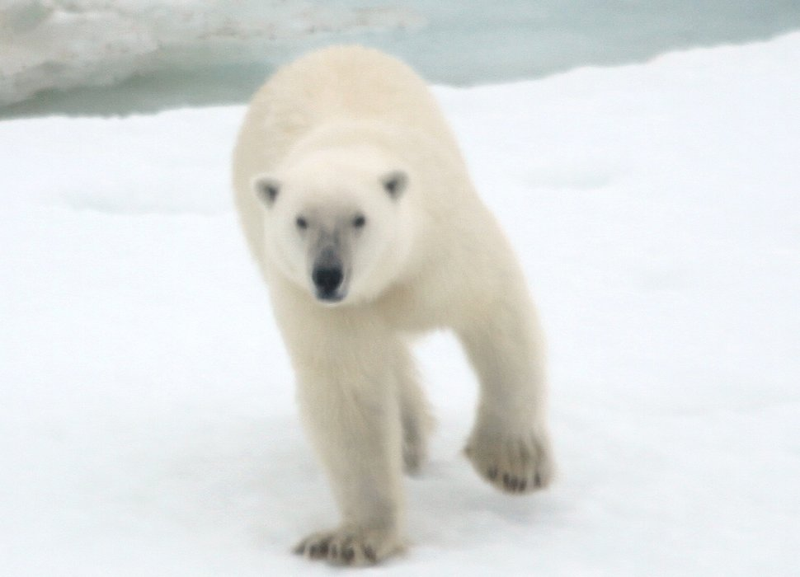
Photo: Tim Sullivan, U.S. Coast Guard
Photo: Kathy Kuletz, U.S. Fish and Wildlife
Photo: Kathy Kuletz, U.S. Fish and Wildlife
Photo: Tim Sullivan, U.S. Coast Guard

Slide 4
Challenges of Arctic Research
Remote location
Extreme conditions
Inaccessible for most of the year
Photo: Kathy Kuletz, U.S. Fish and Wildlife

Slide 5
Oil and the Arctic
The Arctic may hold up to 90 billion barrels of oil, 1669 trillion cubic feet of natural gas and 44 billion barrels of natural gas liquids, 84% of which is expected to be found offshore (USGS 2008).
Photo: Kathy Kuletz, U.S. Fish and Wildlife

Slide 6
Chukchi Lease Sale 193, 2008
Sold rights to drill in the Chukchi for the next decade
COMIDA projects (Chukchi Offshore Monitoring in Drilling Area)

Slide 7
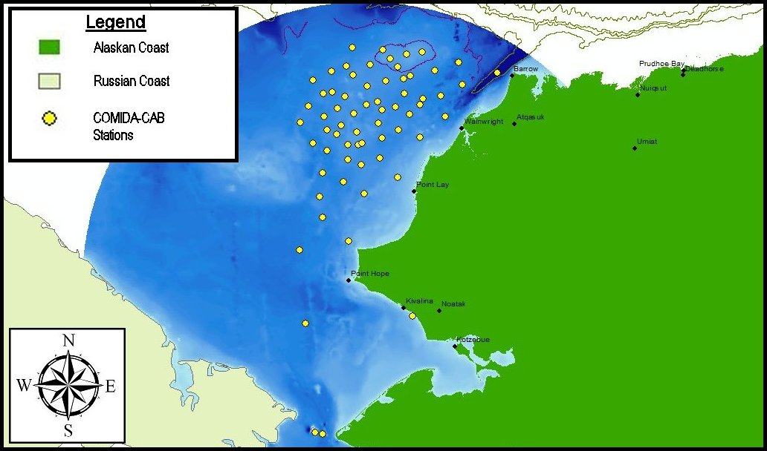
COMIDA-CAB
CAB = Chemistry and Benthos
2009-2010
Multidisciplinary study of Chukchi lease area
Multiple universities and government agencies

Slide 8
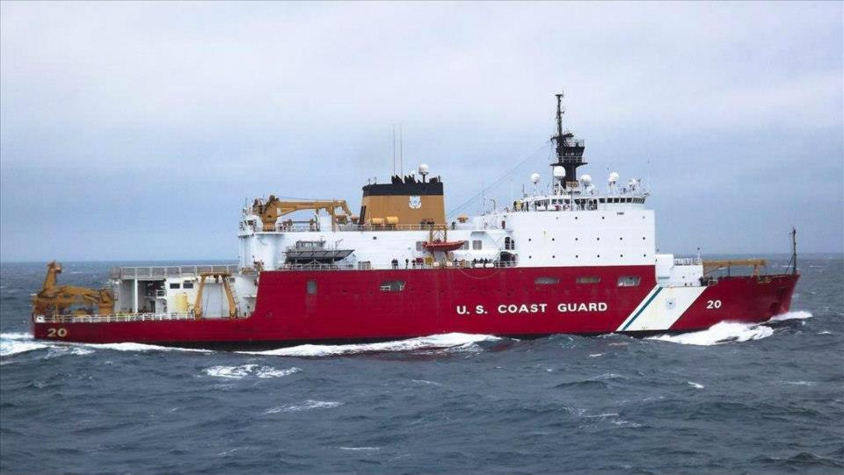
COMIDA – Hanna Shoal
2012-2013
Continues monitoring from COMIDA-CAB
Refocused on biological hotspots
USCGC Healy
Photo: Kathy Kuletz, U.S. Fish and Wildlife
Photo: U.S. Coast Guard

Slide 9
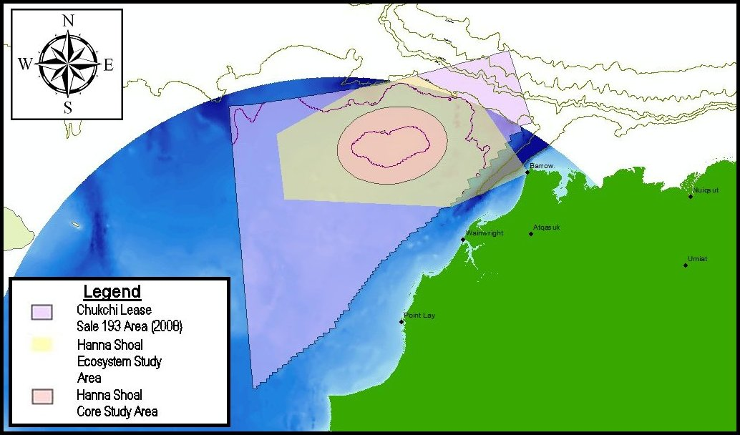
Study Area

Slide 10
COMIDA-Hanna Shoal Stations

Slide 11
Project Goals
Produce maps of
Stations
Study area
Bathymetry
Salinity
Fluorescence
Integrated water column and sediment chlorophyll a
Diatoms, a type of phytoplankton (Wikipedia)

Slide 12
Project Questions
What can salinity maps tell us about water flow in the Chukchi?
How do the levels of water column chlorophyll a and sediment chlorophyll a compare?
What trends (if any) are seen in the chlorophyll maps?
What can the chlorophyll maps tell us about conditions in the Hanna Shoal region at the time of the study?

Slide 13
Surface Salinity

Slide 14
Surface Salinity
AW

Slide 15
Surface Salinity
ACW
AW

Slide 16
Surface Salinity
BSW
ACW
AW

Slide 17
Bottom Salinity

Slide 18
Integrated (Water Column) Chlorophyll a

Slide 19
Sediment Chlorophyll a

Slide 20
Water Column vs. Sediment Chlorophyll a

Slide 21
Deep Water Fluorescence

Slide 22
Surface Fluorescence

Slide 23
To Summarize…
High levels of chlorophyll a in both water column and on seafloor in Hanna Shoal
Higher levels of chlorophyll a in water column than on seafloor
Higher levels of chlorophyll a in lower waters than in surface waters

Slide 24
What does it all mean?
Best hypothesis: sampling took place at the beginning of a bloom, before all the phytoplankton settled to the seafloor.
Large amounts of open water and fractured ice supports this hypothesis
Hanna Shoal region shows evidence of high levels of primary productivity.
Surface salinity map may depict influence of the main currents in the Chukchi.

Slide 25
Acknowledgements
Captain Havlik and the crew of the USCGC Healy
COMIDA-HS Scientists, especially
Dr. Ken Dunton
Dr. Lee Cooper
Dr. David Maidment
Nathan McTigue
Special thanks to Gonzalo Espinoza, Eric Hersh, Johnny Sullivan, Fengyan Yang and Timothy Whiteaker for their invaluable assistance in polar mapping!

Slide 26
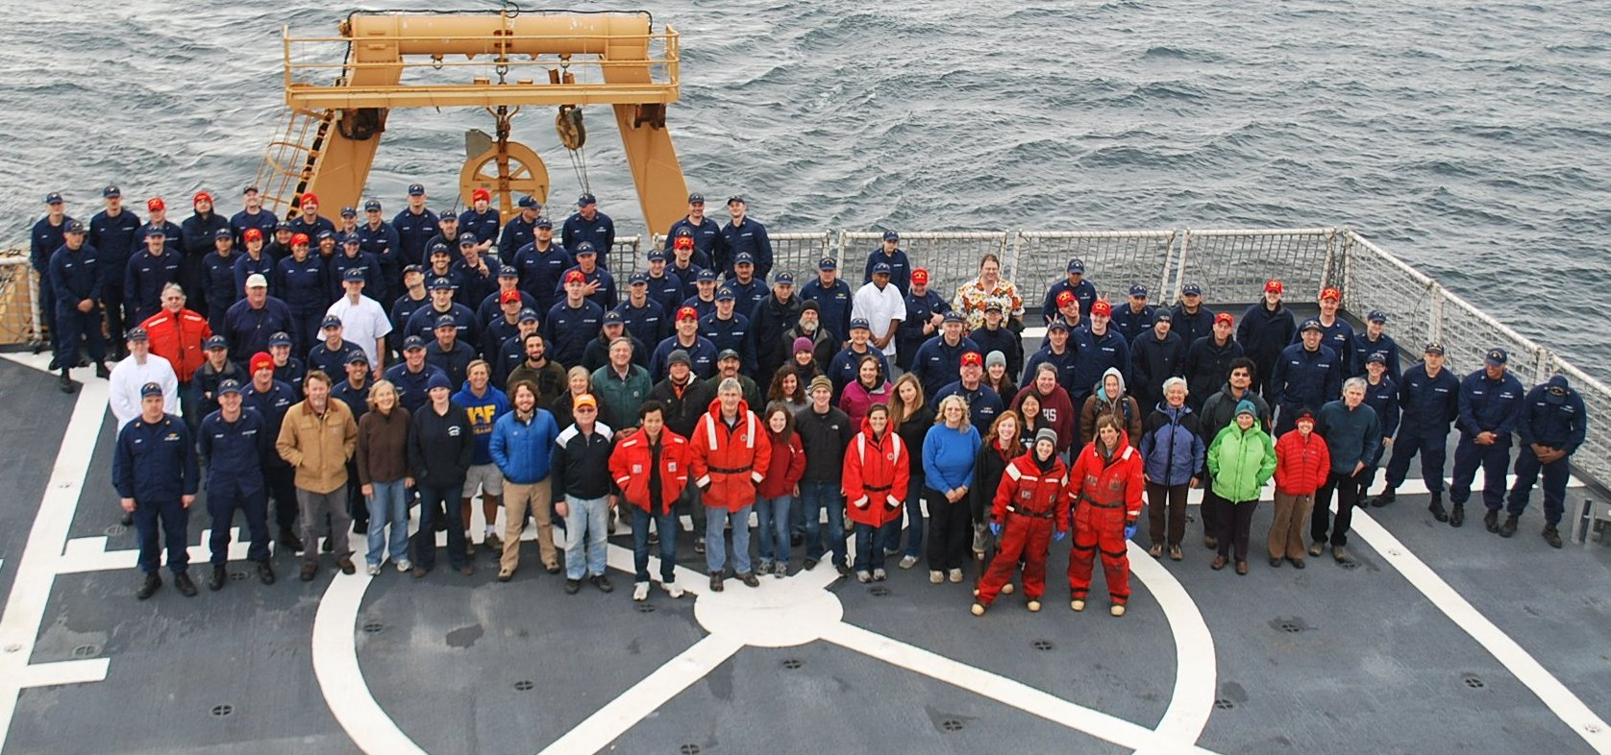
Thanks!
The 2012 COMIDA-Hanna Shoal Science Team and Healy Crew

