Slide 1
Morphodynamics of the Madeira River in Brazil
Christine Bonthius
The University of Texas at Austin
Department of Geography and the Environment
cmbonthius@gmail.com

Slide 2
Goals of Term Project
Inventory hydraulic variables from ADCP data
Analyze preliminary results for geomorphic and hydraulic relationships
Inform plans for field work (December 2012)

Slide 3
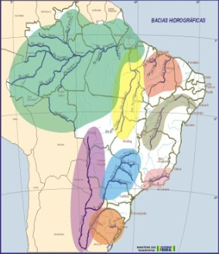
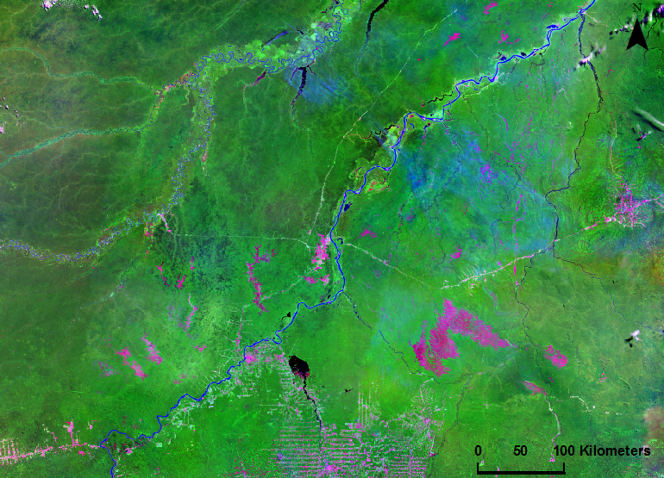
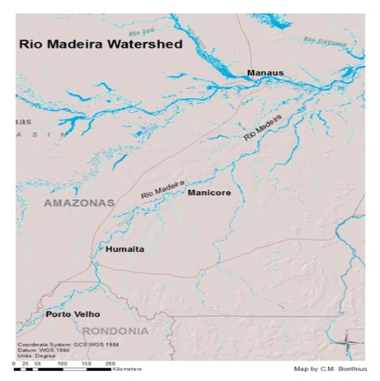
The Madeira River in Brazil
Average Annual Discharge: 32,000 m³/sec
Drainage Area: 1.36 million km²
Average Annual Sediment Yield: 330 tons/km² per year
(Latrubesse, 2008)

Slide 4
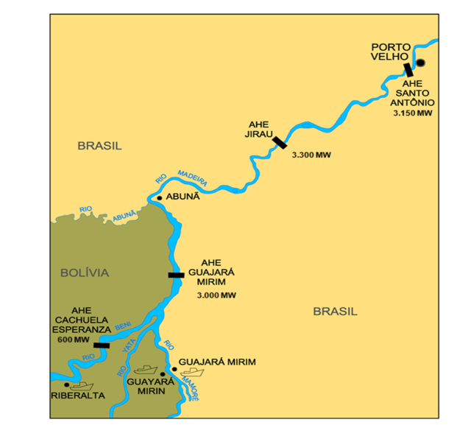
Dams on the Madeira River
(Moreira 2007)
(InternationalRivers.org)

Slide 5
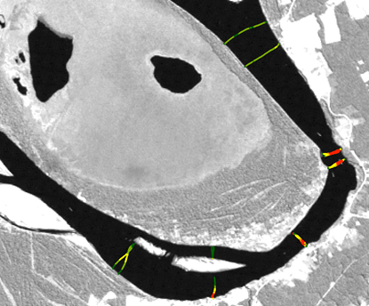
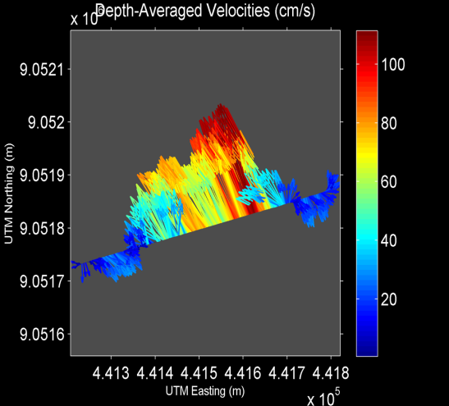
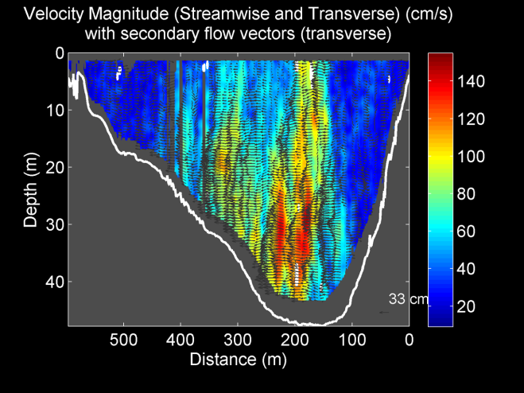
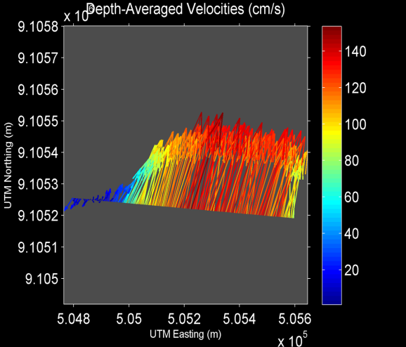
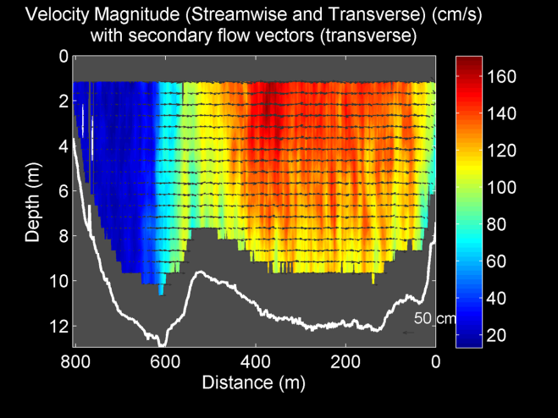
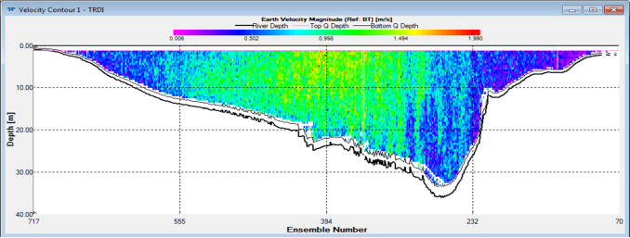
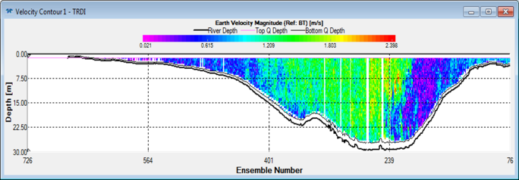
ADCP Processing
Above: Maximum depths (shown in red) are found in the meandering stretch and correspond to the narrowest sections of the channel.
Below: WinRiver II transect profiles (15 and 18, respectively) reveal differences in channel shape, bathymetric forms, and suspended sediment and water velocity distributions.
Above: Transect 24 in the meandering reach shows turbulent secondary flow structures in the deepest section (approximately 40 m) with the highest flow velocity. Below: Transect 58 at the end of the anabranching reach shows remnant bathymetry of the island upstream. About 25% of the channel seems to be inactivated with little water velocity. In the middle of the channel, the highest water velocities penetrate even to the bottom of the channel.

Slide 6
Building the Database
Data outputs from ADCP processing were entered into an Excel table, then joined to the ADCP transect shapefile

Slide 7
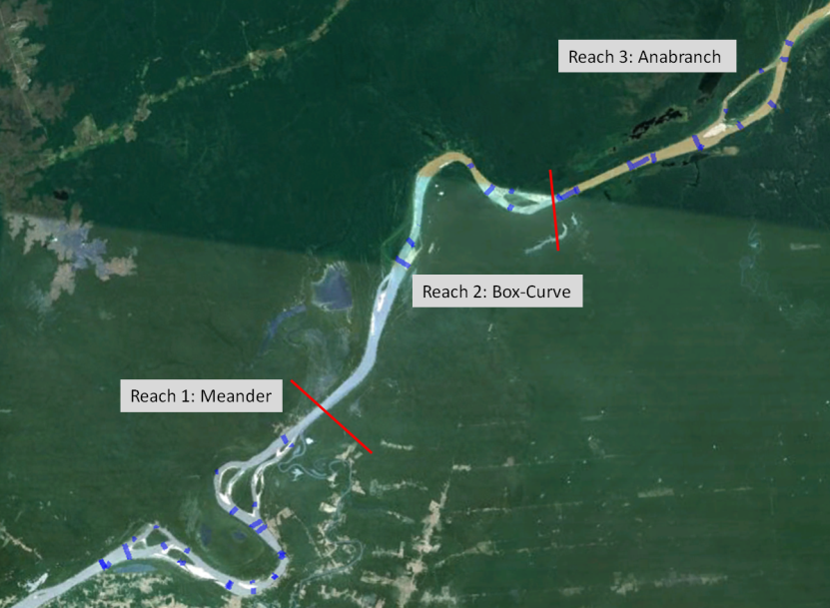
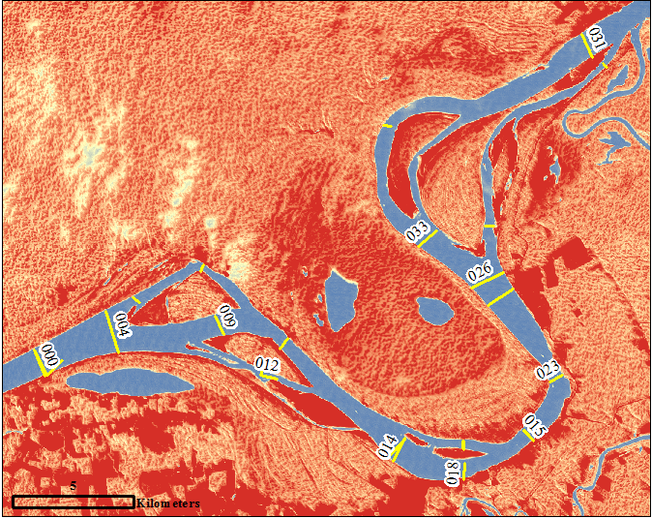
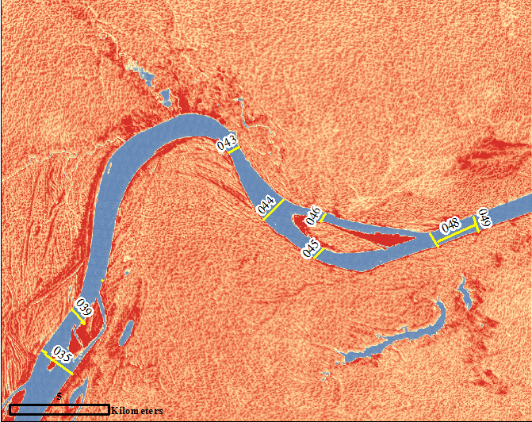
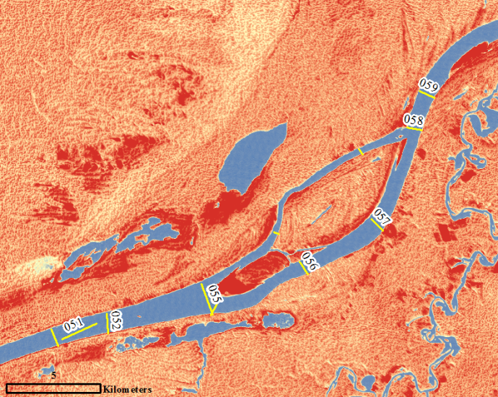
Current Analysis
Hydraulic Variable | Reach 1 | Reach 2 | Reach 3
Average Depth (m) | -8.293 | -6.663 | -6.697
Average Max Depth (m) | -23.208 | -18.548 | -16.651
Average Discharge (m³/sec) | 5288.116 | 4291.828 | 5734.088
Average Width (m) | 758.041 | 1207.548 | 1032.999
Average w/d ratio | 117.485 | 225.779 | 142.435
Meandering Reach
Transects 000-131
Box-Curve Reach
Transects 032-049
Anabranching Reach
Transects 050-061
Notes:
ADCP transects that had been collected on a previous field campaign were processed using softwares WinRiverII and VMT (velocity mapping toolbox). An ADCP, or acoustic doppler current profiler, was used on Dr. Latrubesse’s field trip to the site to collect data about water discharge, suspended sediment transport, water velocity and river bed forms.
What these softwares do is extract the data from the ADCP and convert them into visual images of the channel

Slide 8
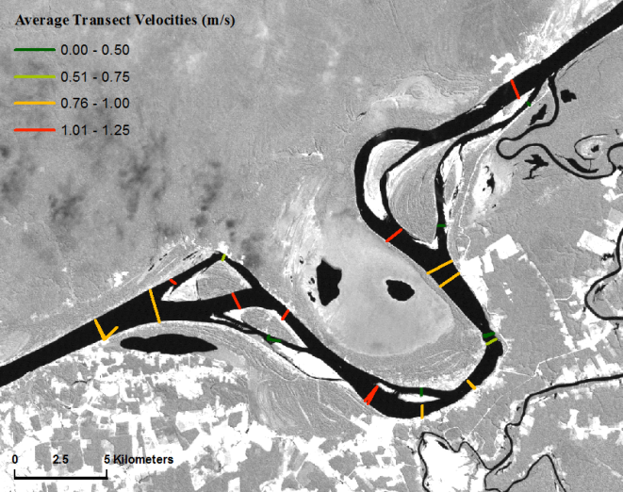
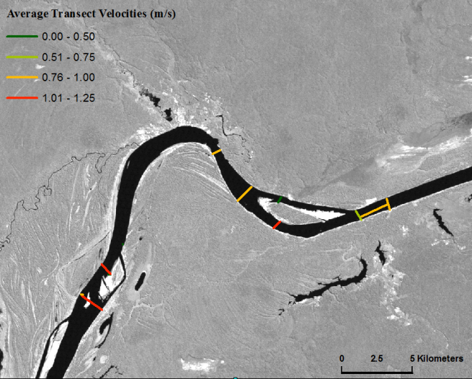
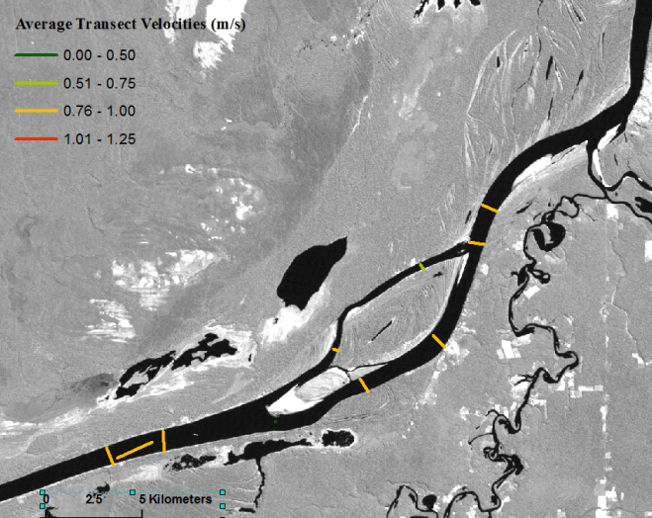
Current Analysis
Spatial Distributions of Velocity and Channel Widths in the Study Reach
Reach 1
Reach 2
Reach 3
River Channel (km)

Slide 9
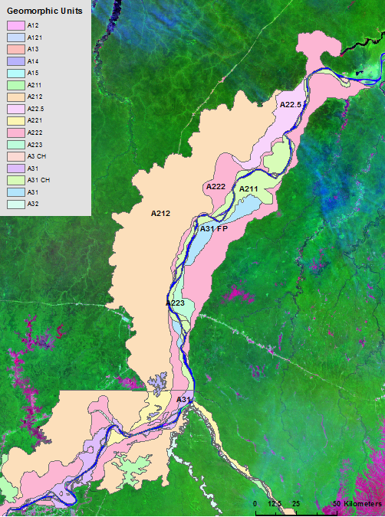
Geomorphic Mapping
Major geomorphic units include: - Fluvial terraces with little to no dissection (A212, A222)
Fluvial plains in channel and floodplain area (A31)
Units constraining the lateral movement of the channel are remnant terraces

Slide 10
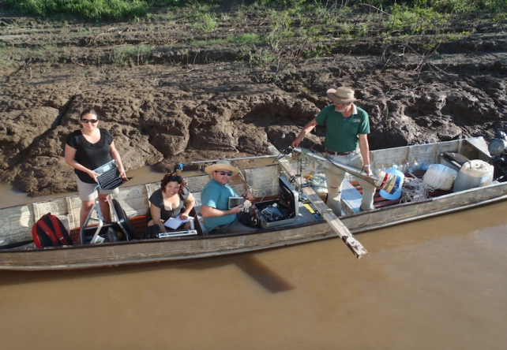
Future Work
Delineation of direct and indirect effects of dams (SRTM)
Evaluation of transboundary watershed issues (Bolivia)
More field work in December with Latrubesse Research Group

