Slide 1
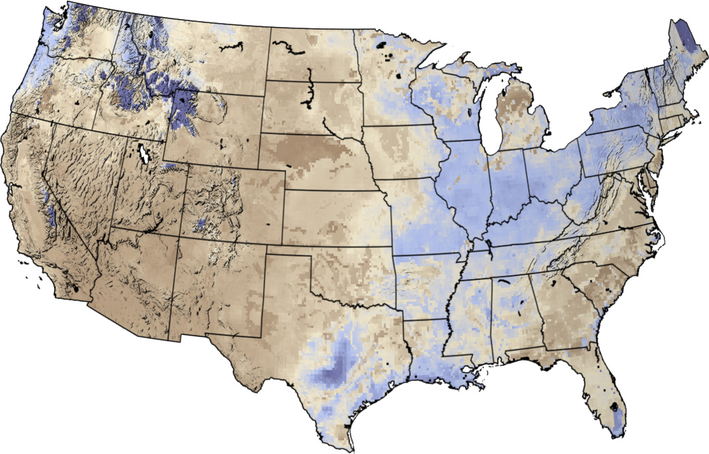
Factors of available soil water in Texas: Map Comparison project
Brandon J. Okafor
Jackson School of Geosciences
Water Resources Arc GIS

Slide 2
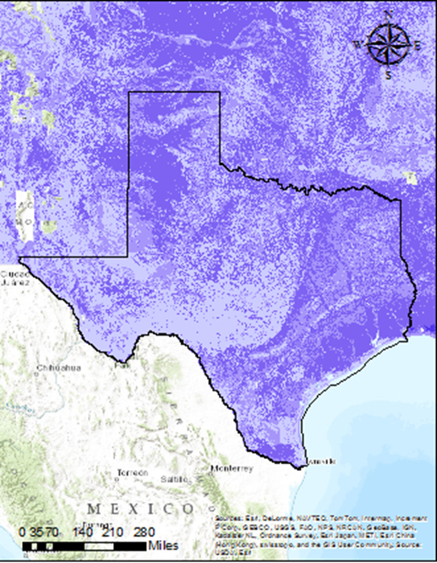
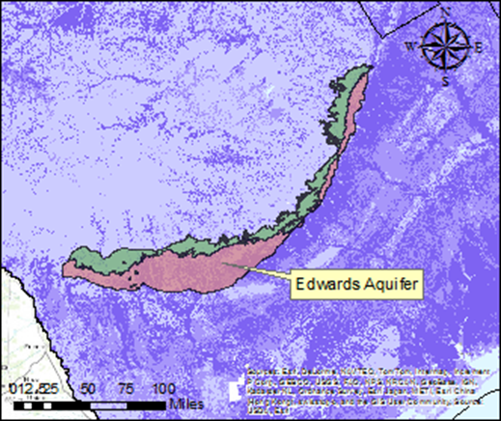
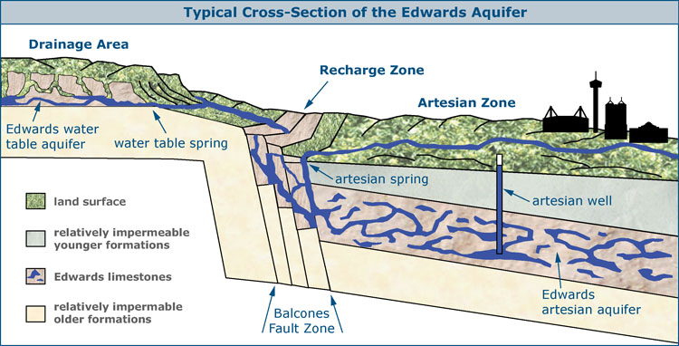
Exercise 2: Why the difference in available soil water in Texas?
Edwards Aquifer two hydrogeological zones: Contributing and Recharge Zone
Southeastern Dipping limestone formations in recharge zone = Greater amount of soil = more available soil water
But is that it? What about soil type, land cover, topographical relief, or actual geological units

Slide 3
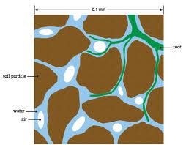
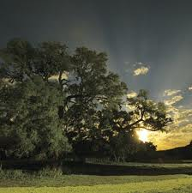
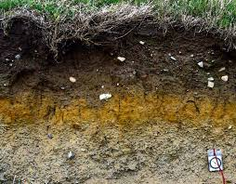
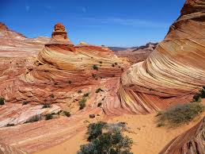
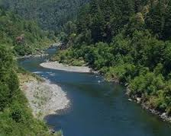
What did I do?
Compared the available soil water map with soil type, land cover, geological units, and river locations. (And if I have time topographical relief)
Looked at Texas as a whole and my field site (river dominated system)

Slide 4
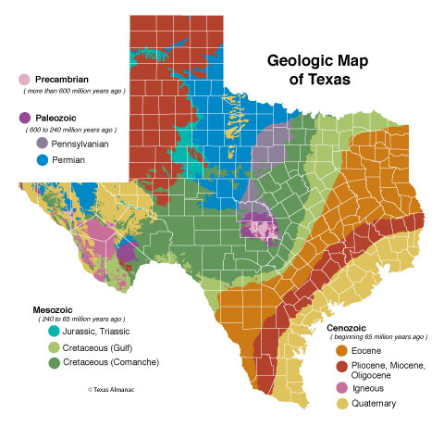
Geological History of Texas
Collision between North American Plate with Eurpoean-African –South American Plate building a mounting range
River system that flowed westward creating a deltas on the coastline
Plates separated and geological events switched he flowing rivers eastward.
Sediment pile led to the subsidence of the coast, creation of Balcones Fault Zone (Edwards Aquifer)
Sea level change creates the different Cenzoic sediment rocks
Llano uplift exposing precambrian rocks at the surface

Slide 5
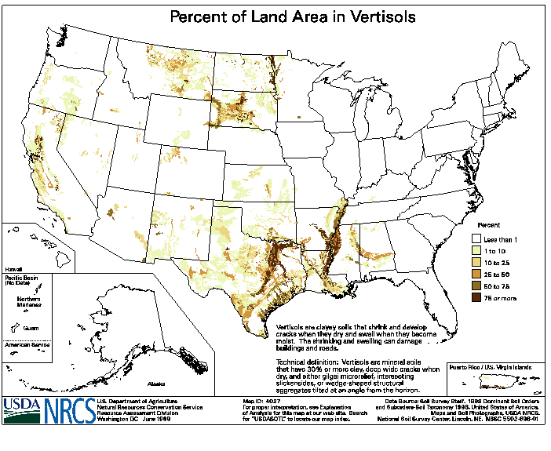
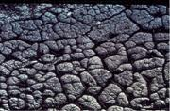
Soil Formations and Orders
S = ∫(Cl,o,r,p,t); Climate, Organisms, Relief, parent rock, time
12 soil orders, but only 3 will be important to this project
Vertisols
Clay rich soils that shrinks and swells due to water content
Typically located in Texas

Slide 6
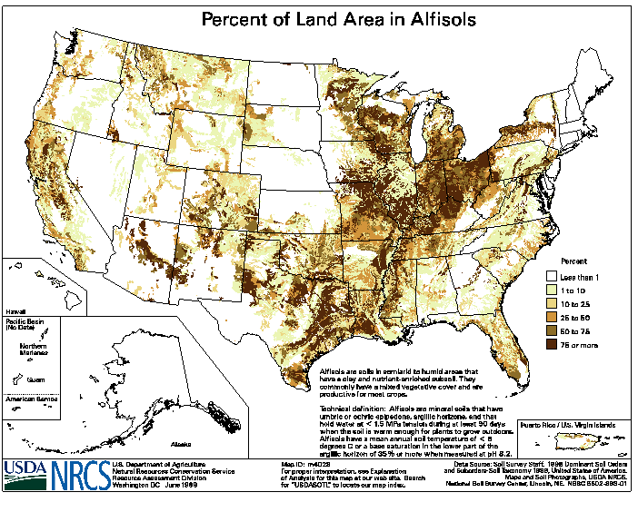
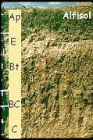
Soil Formations and Orders
S = ∫(Cl,o,r,p,t); Climate, Organisms, Relief, parent rock, time
12 soil orders, but only 3 will be important to this project
Alfisols
Moderately leached soils formed under forests
Typically located in warm and humid/sub-humid regions

Slide 7
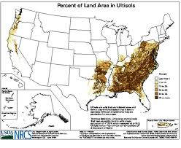
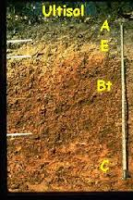
Soil Formations and Orders
S = ∫(Cl,o,r,p,t); Climate, Organisms, Relief, parent rock, time
12 soil orders, but only 3 will be important to this project
Ultisols
Acidic soils with strong leaching of nutrient to plants ( Ca, Mg, K)
Typically located in humid, temperate, and tropical regions

Slide 8
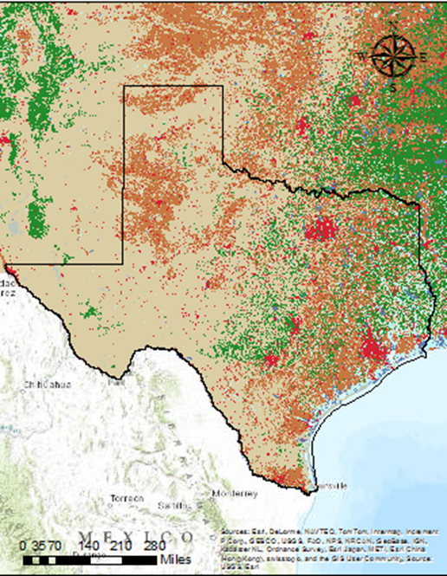
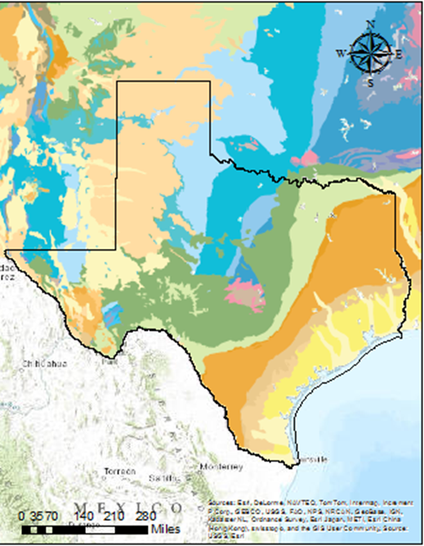
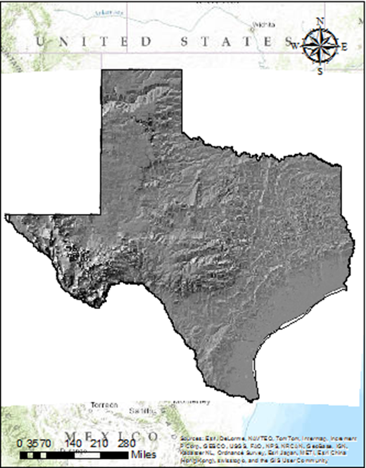
Results: Texas

Slide 9
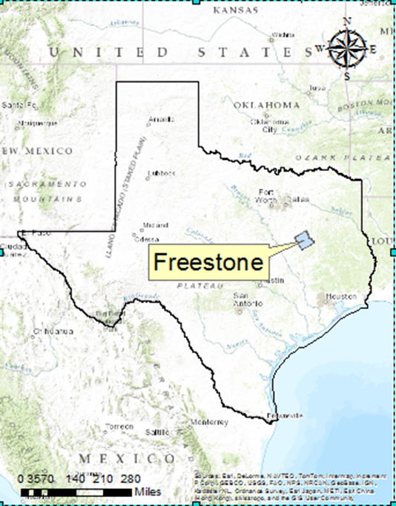
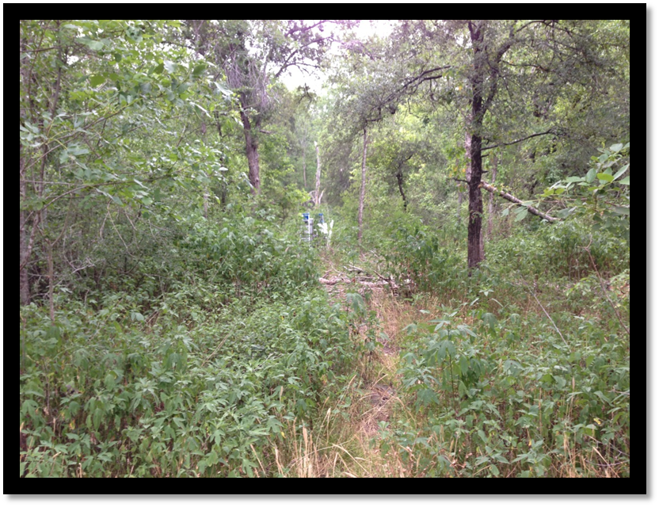
Where is the field site?
Richland Creek Wildlife Management Area, Fairfield, TX
Floodplain of the Trinity river
Highly vegetated and mostly covered with Vertisols

Slide 10
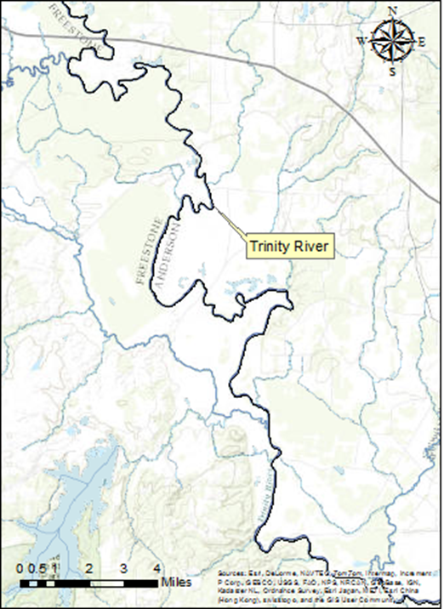
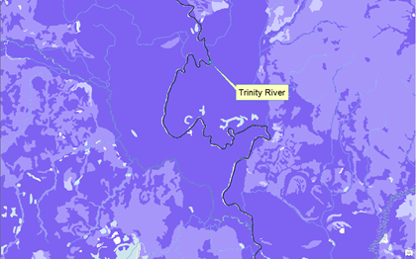
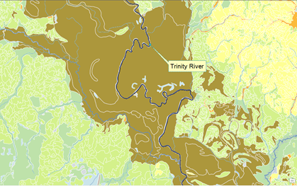
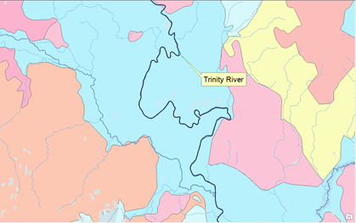
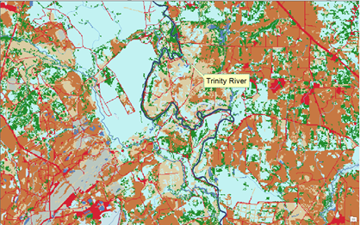
Results: Field Site
Notes:
Open Water (pixel value = 11)
Snow/Ice/Barren (pixel values = 12, 31)
Development (pixel values = 21, 22, 23, 24)
Forest (pixel values = 41, 42, 43)
Shrub/Scrub/Grassland (pixel values = 52, 71)
Agriculture (pixel values = 81, 82)
Wetland (pixel values = 90, 95)

Slide 11
Conclusion
There are multiple factors that affect available soil water, making this property of soil very complex.
These factors are all connected and leads to the development of soils.
Rivers channels will not change the relationship between available soil water and the other factors, but will alter each factor individually.

Slide 12
Thank You! Any Question? Oh and Thank you David Maidment!

