Slide 1
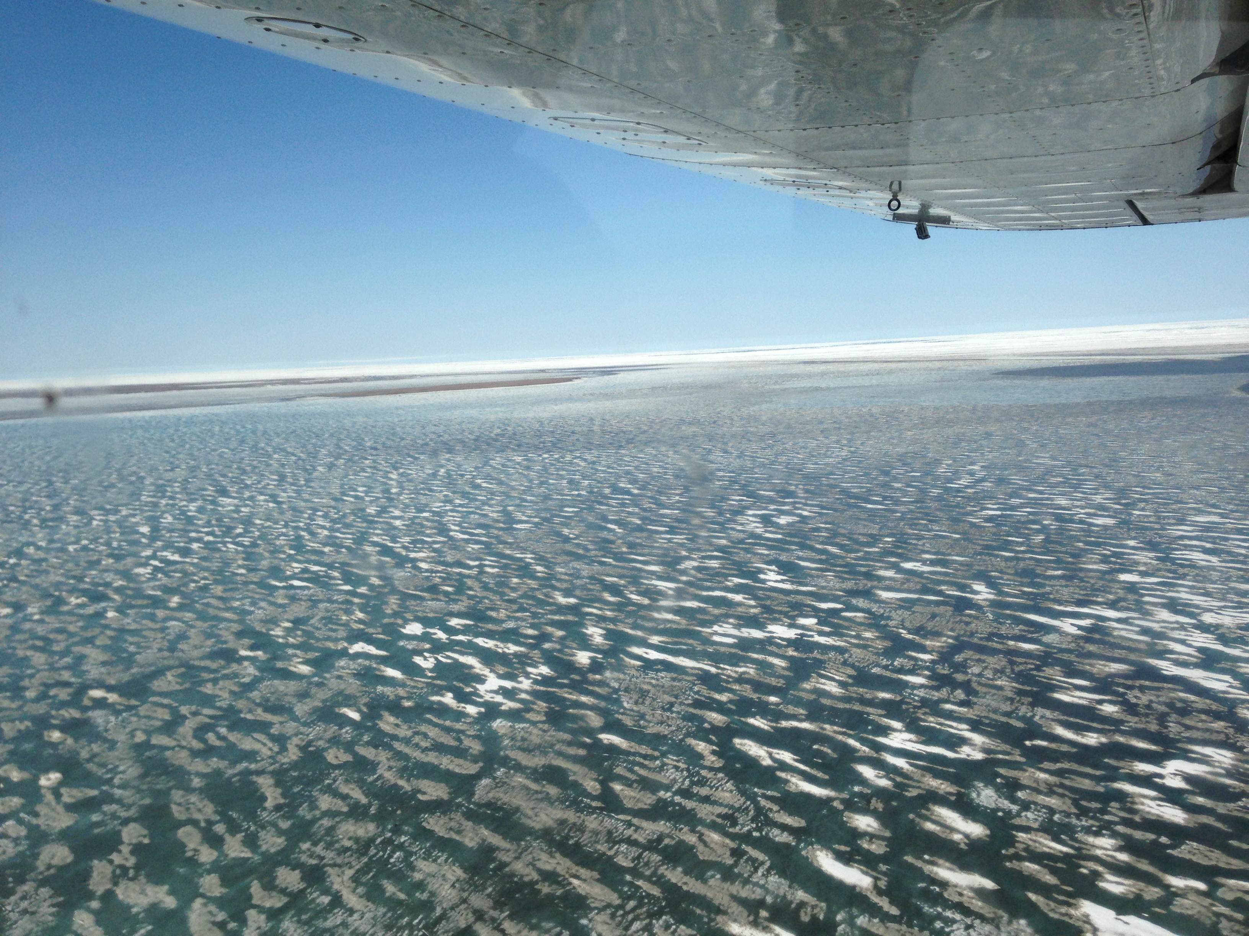
Isoscapes in the Arctic Ocean
Carrie Harris
Marine Science Department

Slide 2
What is an isoscape?
Map that predicts the spatial distribution of stable isotope values
  δ¹³C, δ¹⁵N, δD and δ¹⁸O
Isotope landscape
Notes:
Stable isotope analysis is used a lot to determine the provenance or source of certain materials. For example, tap water del18O varies spatially, as indicated in this map. Variations are mainly due to phase change reactions in the hydrological cycle. When people drink tap water, this signature is recorded in their hair, so you could theoretically use stable isotope analysis to determine (generally) where an individual of unknown origin came from.

Slide 3
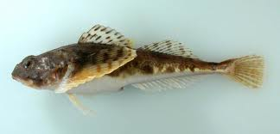
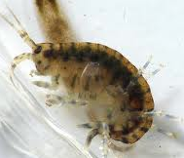
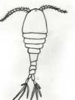

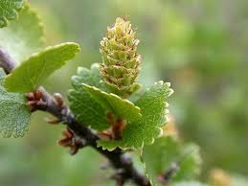
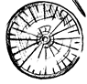
Stable Isotope Analysis (SIA) is used to track flow of energy and organic matter
0 1 2 3 4 5 6 7 8 9 10
δ¹³C: indicates basal energy source
δ¹⁵N: indicates trophic level
δ¹⁵N
-31 -30 -29 -28 -27 -26
δ¹³C

Slide 4
Goals
Generate δ¹³C and δ¹⁵N isoscapes for food sources in the Arctic Ocean
    Particulate organic matter (POM)
    Sediment
    Phytoplankton
Generate isoscapes for benthic invertebrates… what are they eating?
Examine temporal trends

Slide 5
Pacific Marine Arctic Regional Synthesis (pacMARS)
Beaufort Sea
Chukchi Sea
Bering Sea
Notes:
Goal: gather data to understand coastal shelf of the Arctic Ocean, which is influenced by the Pacific
pacMARS contains 4,000 data points--- type of organism or organic matter with a stable isotope value. Span 1985- 2011.

Slide 6
Process
Particulate Organic Matter (POM)
δ¹³C values (‰)

Slide 7
Isoscapes!
Spline
Natural Neighbor
Kriging
Inverse
Distance

Slide 8
Food Sources
δ¹³C (‰)
POM
δ¹³C
Sediment
δ¹³C
< -31
-31.01 – -28
-28.01 – -25
-25.01 – -22
-22.01 – -19
-19.01 – -16
> -16
Phytoplankton
δ¹³C
POM and Sed: E-W Gradient
  Chukchi more enriched (+), Beaufort more depleted (-)
  Follows currents, carrying org. matter
Phyto: More enriched (+) at Colville River mouth
Notes:
High productivity area (aka at river mouths) phytoplanky use a lot of inorganic carbon (fractionating diss. CO2 less, because they are using more of it)

Slide 9
Food Sources
δ¹⁵N (‰)
POM
δ¹⁵N
Sediment
δ¹⁵N
< 2
2.01 – 4
4.01 – 6
6.01 – 8
8.01 – 10
10.01 – 12
> 12
Phytoplankton
δ¹⁵N
Large range
POM and sediment similar
Phytoplankton more enriched
What does it mean?

Slide 10
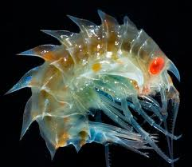
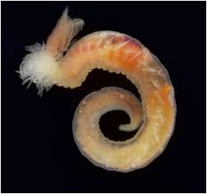
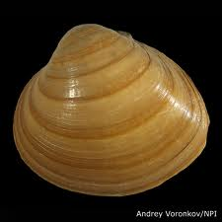
What’s Next?
Improve current maps
Map benthic invertebrates!
  Amphipod
  Polychaete
  Bivalve
Temporal trends?
  Seasonal
  Annual

Slide 11
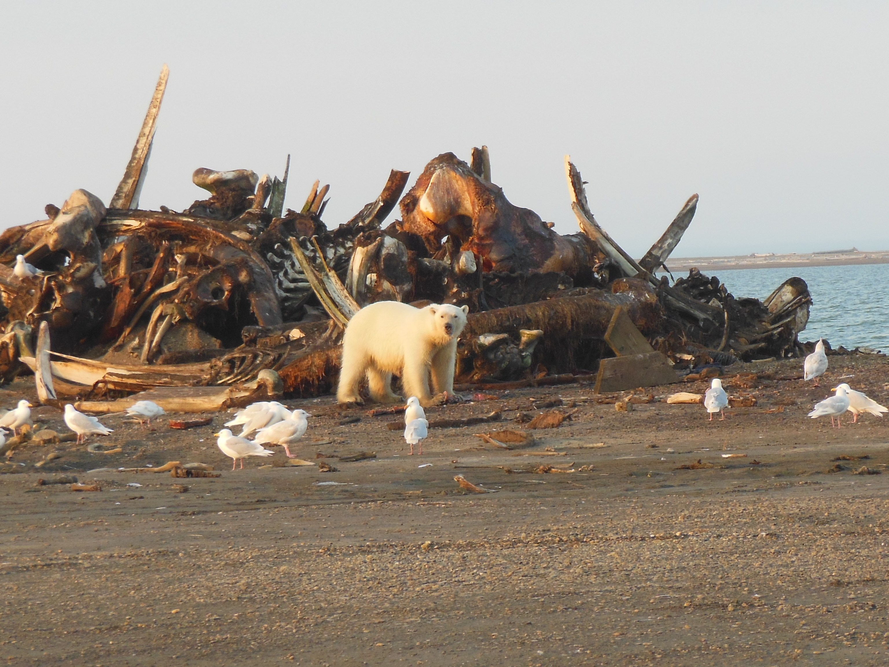
Acknowledgements
Questions?
Tim Whitacker
Dr. Ken Dunton
Carlos Galdeano
Stephen Jackson
William Daniels
Christina Bonsell

Slide 12
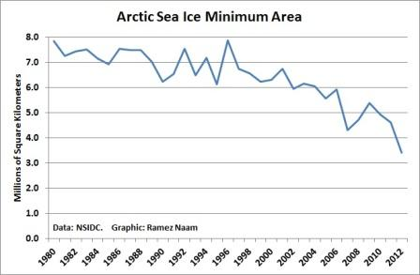
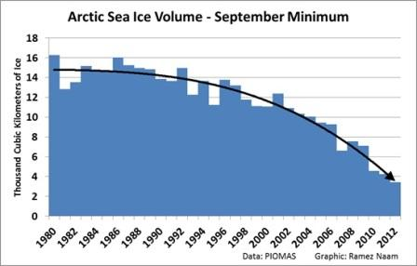
Recent Change in Arctic
Summer will be “ice free” in 20-100 years
National Snow and Ice Data Set
“Ice free” < 1 mill sq. km sea ice
Navigators: <15% ice cover

