Slide 1
Hydraulic and Breach Analysis of a Dam in North Texas
Trina Muenzer
CE 394K.3
GIS in Water Resources
November 21, 2013

Slide 2
Why is this important?
TCEQ regulates Dam Safety through Texas Administrative Code Ch. 299
Hydrology – safe passage of the probable maximum flood (PMF)
Hydraulics - Breach Analysis
Safety of people and property downstream
Emergency Action Planning

Slide 3
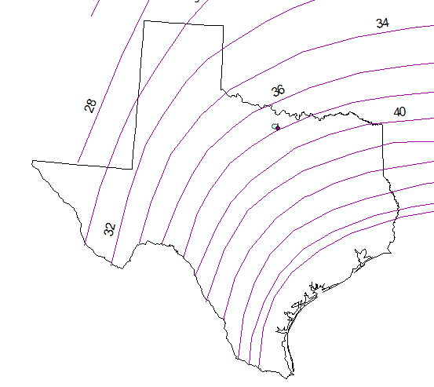
Hydrology
HMR-51
Distribution
72-hr PMF
Area ≤ 200 mi²
Notes:
HYDROMETEOROLOGICAL REPORT NO. 51

Slide 4
Hydraulics
Dam Characteristics
Height, Length
Spillway Dimensions
Elevation, Storage, & Discharge Data
Stream Characteristics
Cross-Sections

Slide 5
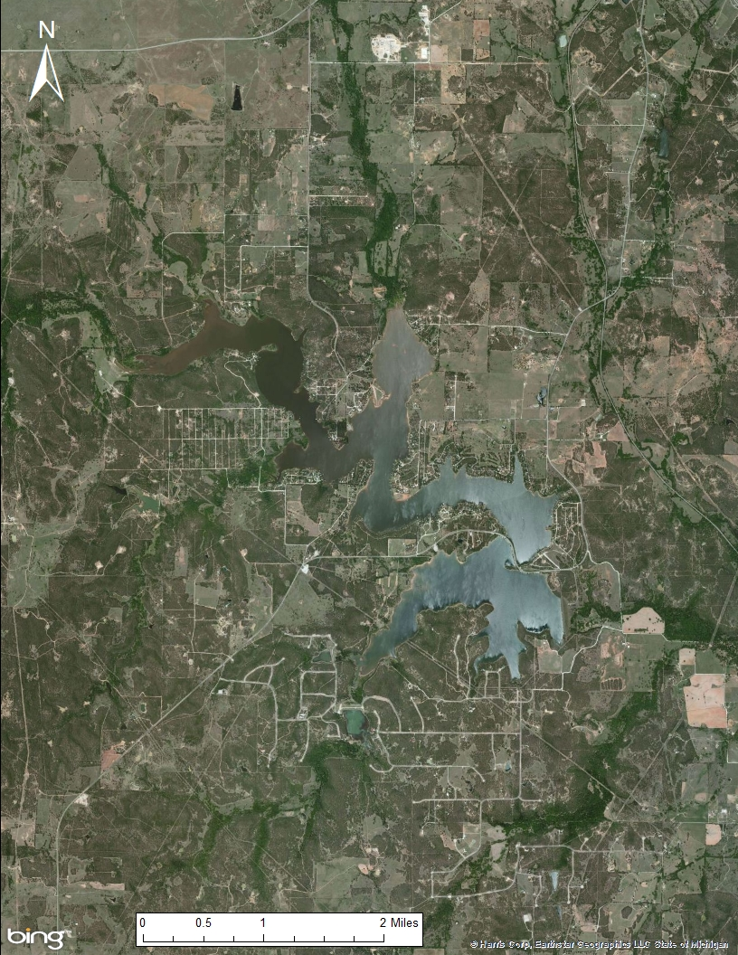
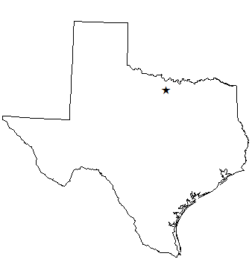
A Dam in North Texas
Upper Dam:
67 feet tall
2,500 feet long
Top of Dam = 934.7 ft-msl
Spillway = 96-inch concrete pipe
at 920 ft-msl
Lower Dam:
80 feet tall
1,750 feet long
Top of Dam = 944.8 ft-msl
Spillway = 72-inch concrete pipe
at 920 ft-msl
Total Max. Storage = 102,250 ac-ft
Notes:
Upper Dam was built in 1955 – point to original principal and emergency spillways
Lower Dam was built in 1980 – added boat pass, new emergency spillway
When the Lower Dam is at the top of dam, the two reservoirs become one….causing problems for modeling!!

Slide 6
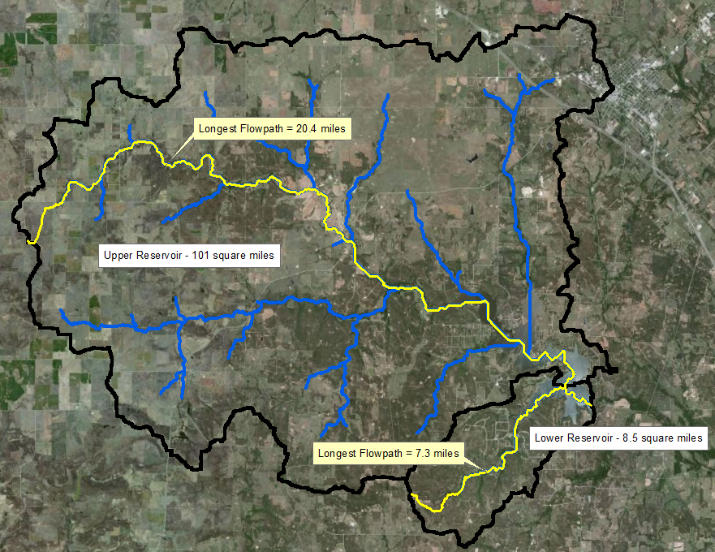

Slide 7
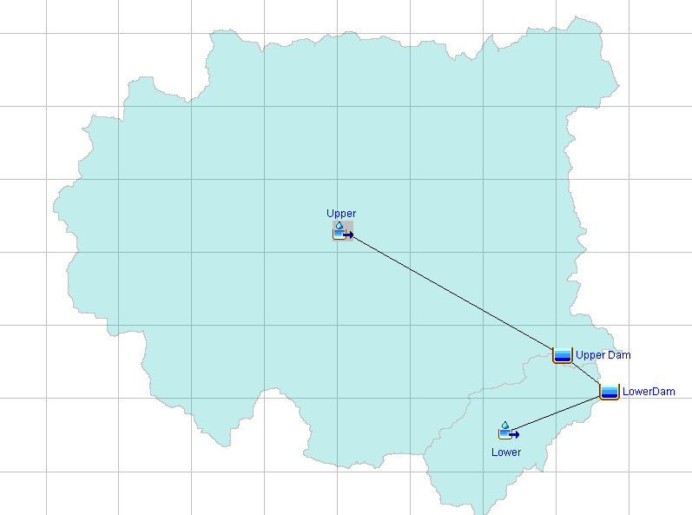
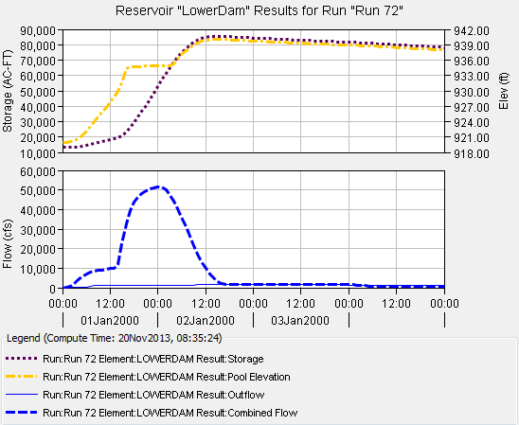
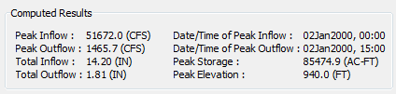
HEC-HMS Modeling
Notes:
ADD MODEL RESULTS after fixing the model to run!

Slide 8
HMS Results
Top of Dam (944.8 ft msl)
Water Level

Slide 9
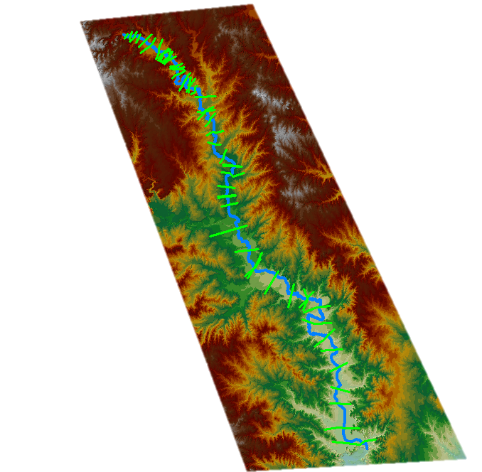
Elevation Data
– converted to a TIN
River traced from NHD
Cross-sections added
Data exported to HEC-RAS
Notes:
TIN - Triangulated Irregular network…..
Problems encountered – converting to a TIN takes up a lot of memory, make the DEM as small as possible before converting!
- use topography map or TIN to draw cross-sections, make sure cross sections aren’t too wide.

Slide 10
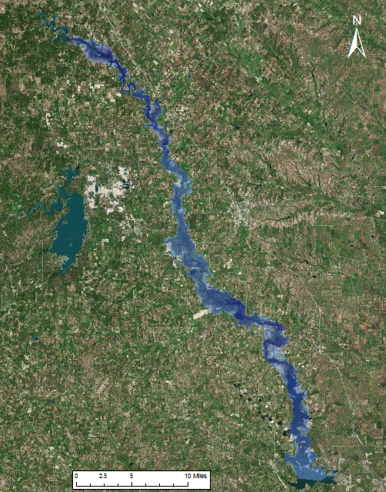
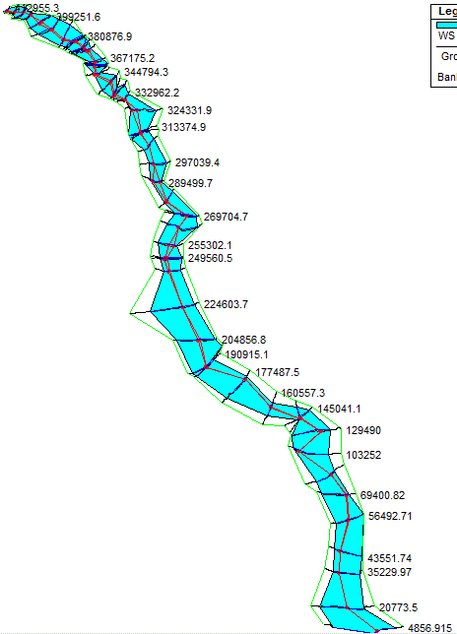
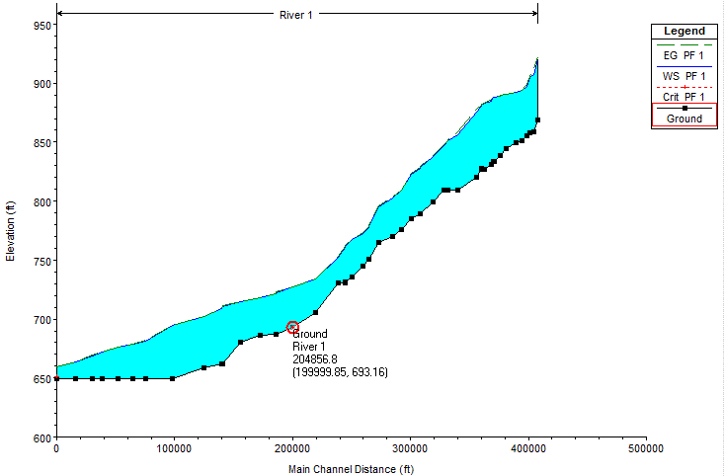
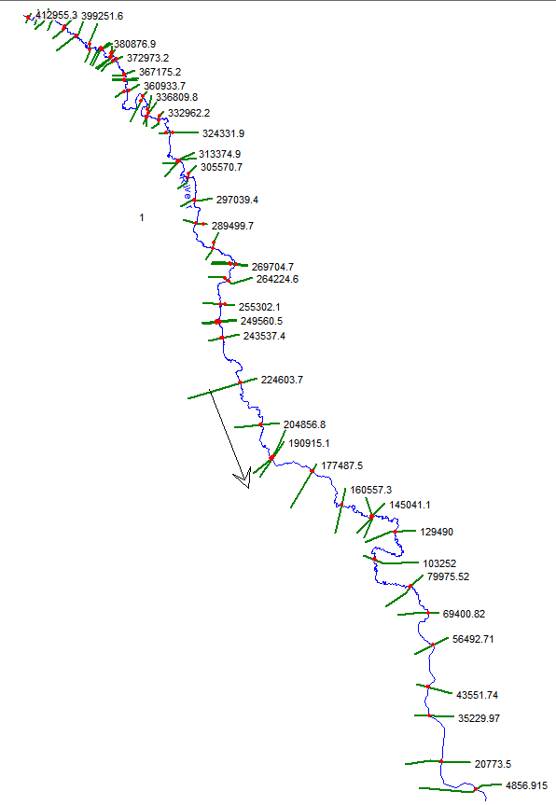
HEC-RAS Results

Slide 12
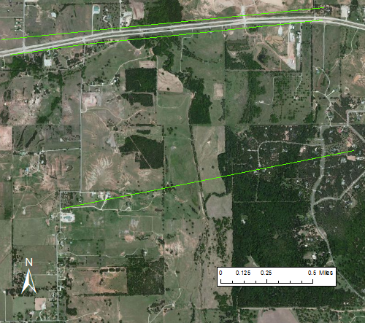
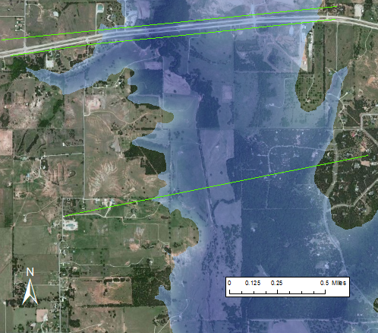
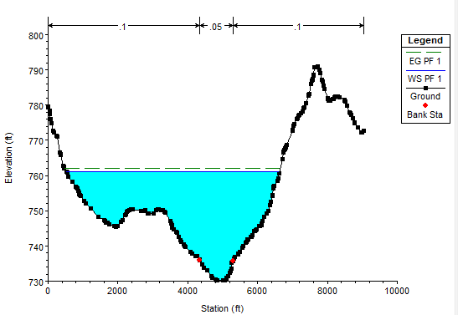
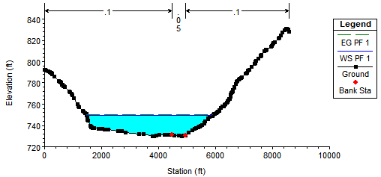
30 ft
31 ft
18 ft
19.5 ft

Slide 13
Remaining Work
Modify HEC-HMS model
Sunny Day Breach
PMF Breach
Extend river cross sections

Slide 14
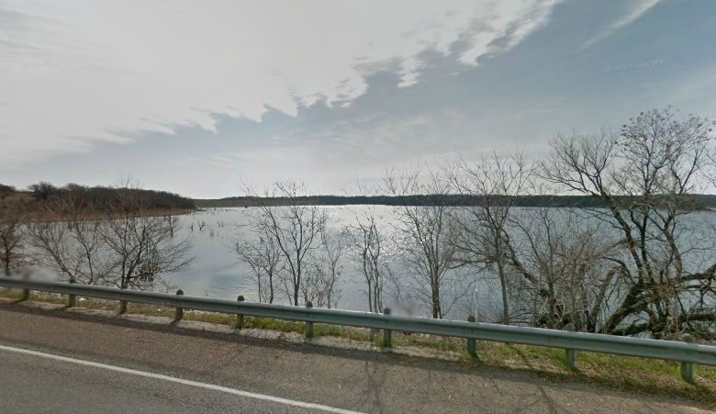
Questions?

