Slide 1
IFSAR and terrestrial LIDAR for vegetation study in Sonora, Texas
Created for GIS in Water Resources 2013 by Kendall Ernst

Slide 2
Agenda
Background
Method and Results
Future Work
Acknowledgments
Questions

Slide 3
Background
Purpose: improve existing carbon biomass estimation techniques by applying higher resolution remote sensing data
Furthering current methods
Broader impacts for developing countries through the UN Collabrative Programme on Reducing Emissions from Deforestation and Forest Degredation in Developing Countries (UN-REDD)
Research team at Texas A&M and UT Knoxville
Image source: http://storiesrhymesandsingalongtimes.blogspot.com

Slide 4
Background
Study Site: Sonora, TX
Texas Sonora AgriLife Research Station (SARS)
divided into 5 different prescribed fire frequencies
Representative vegetation

Slide 5
Method and Results
Technology
NEXTmap interferometric synthetic aperture RADAR (IFSAR)
± 30-cm to 3-m vertical accuracy
0.9-m baseline at 5-m X 5-m pixel resolution
Terrestrial laser scanning (TLS)
360° horizontal and a 270° vertical field of view
532 nm green laser with a pulse of 55,000 points per second
spot diameter size up to a range of 50-m of 4.5mm with a ± 2mm ranging accuracy
DSM
DTM
Specs provided by Washington-Allen and Delgado

Slide 6
Method and Results
Sampling
TLS samples taken in 30 m x 30m plots
Six 5 m x 5 m IFSAR cells in each sample area
Error
Radar penetrates tree cover, which necessitates calibration. TLS provides highly accurate height data and is used to calibrate height across the plot
Plot 5

Slide 7
Method and Results: DSM Heights

Slide 8
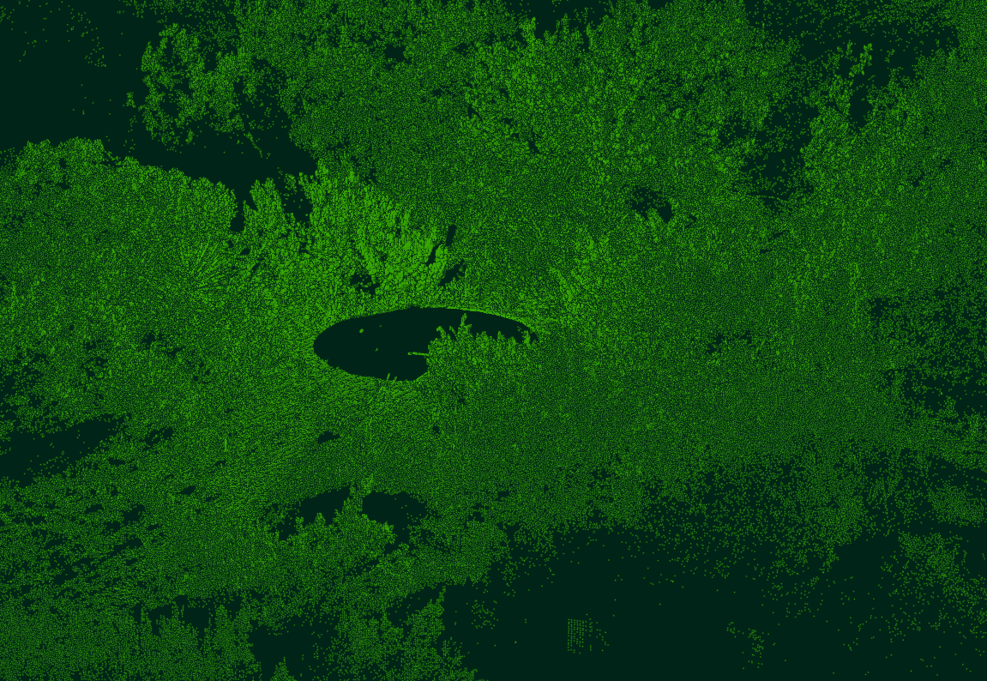
TLS Data: Plot 5

Slide 9
Future Work
Extract height data for only 30 m x 30 m plots
Perform statistical analysis to calibrate height data
Potentially extract tree data using TreeVaw or ArcGIS
Density
Crown width
Etc.
Potentially apply allometric equations to determine carbon content

Slide 10
Ackowledgements
Dr. Robert Washington-Allen
Alfredo Delgado
Dr. Maidment and Dr. Tarboton

Slide 11
Questions?

