Slide 1
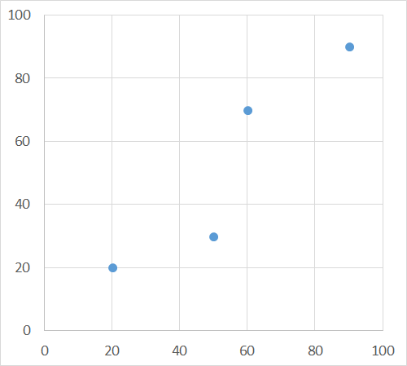
Location of Points and Lines
D
C
B
A

Slide 2
98
Elevation of Points
Z = 100 – 0.01*(X + Y)
D
C
99
B
A
100

Slide 3
L = AB+BC+CD
Absolute Measure, M_{a} M_{a} = distance along line from A
Relative Measure, M_{r}
M_{r} = M_{a}/L
D
C
B
A

Slide 4
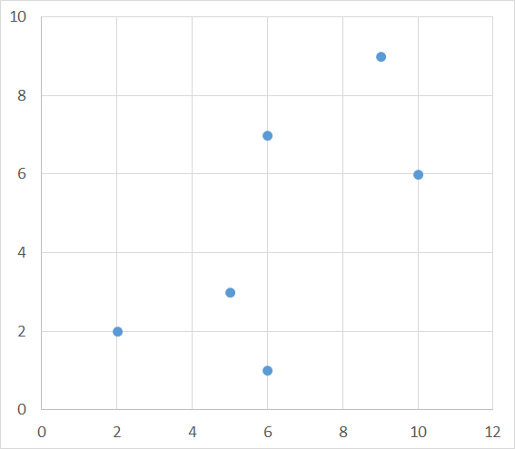
J4
E3
E5
J3
J6
E2
J2
E1
J1
E4
J5

