Slide 1
HydroShare and River Channel Information
David R. Maidment
GIS in Water Resources, Fall 2013
Contributions from Stephen Jackson, Ben Hodges and Venkatesh Merwade

Slide 2
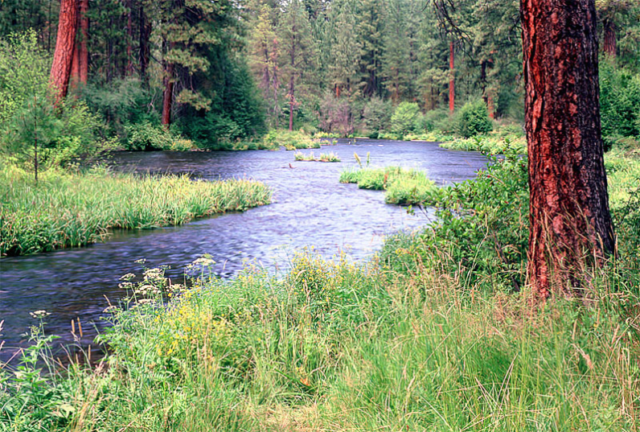
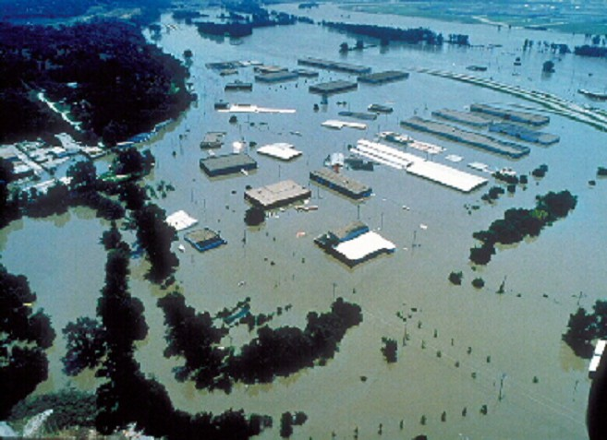
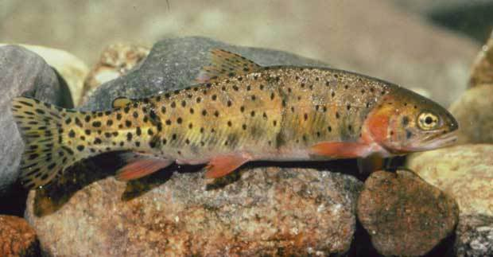
River Channels
River Network
Channel Shape
Geography
Flooding
Aquatic Biology
Applications

Slide 3
In the beginning…. (1970’s)
We had paper topographic maps
Computers had been invented
There was no GIS
But, there were various “map-related” things
  Digital drawing systems for map cartography
  Hydrologic simulation models
  Surveyed cross-sections of rivers for flood studies
  Databases in various binary file formats for water observations

Slide 4
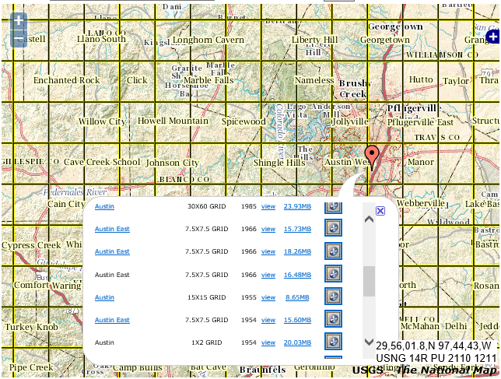
USGS Topographic Maps for Austin
http://nationalmap.gov/ustopo/

Slide 5
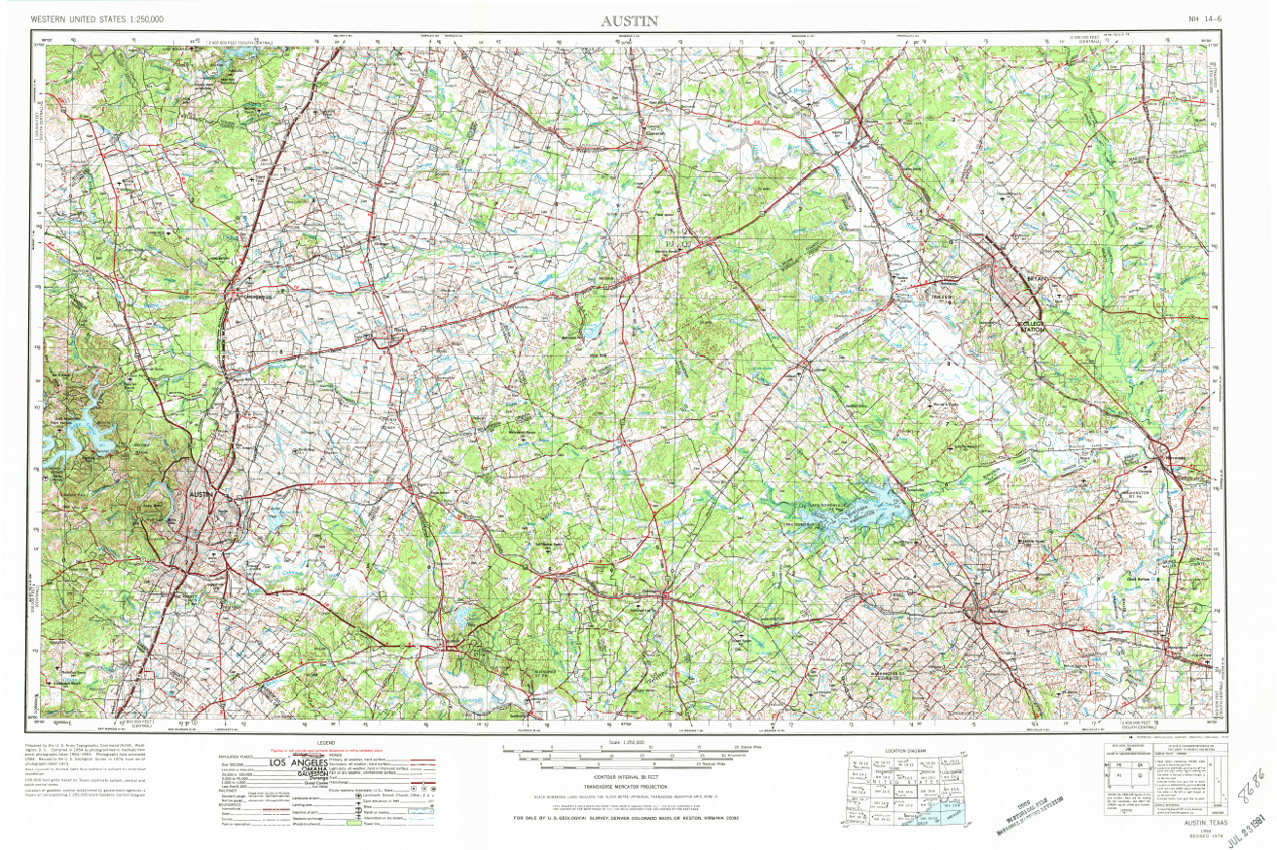
1:250,000 scale topographic map -- 1° x 2°

Slide 6
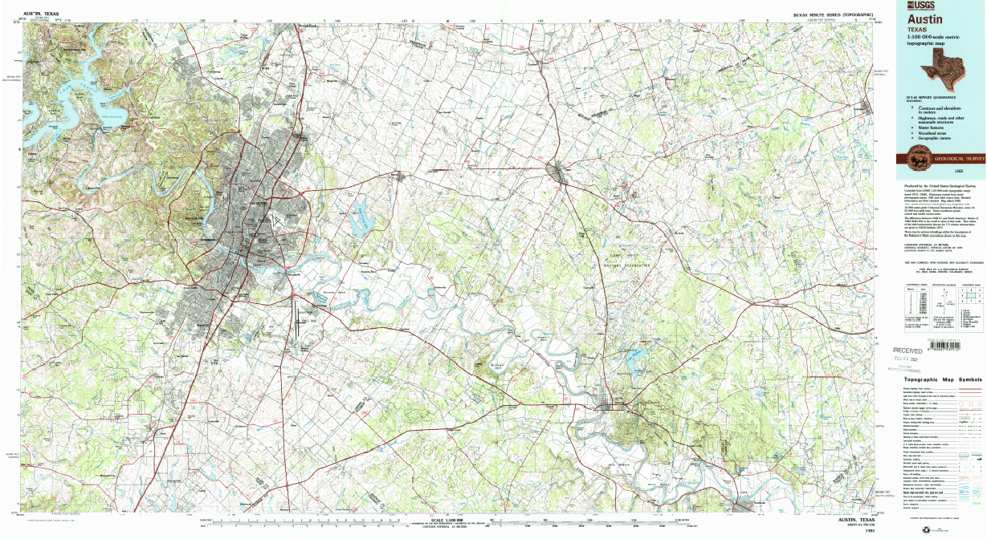
1:100,000 Scale Topographic map – 30’ x 60’ (0.5° x 1°)

Slide 7
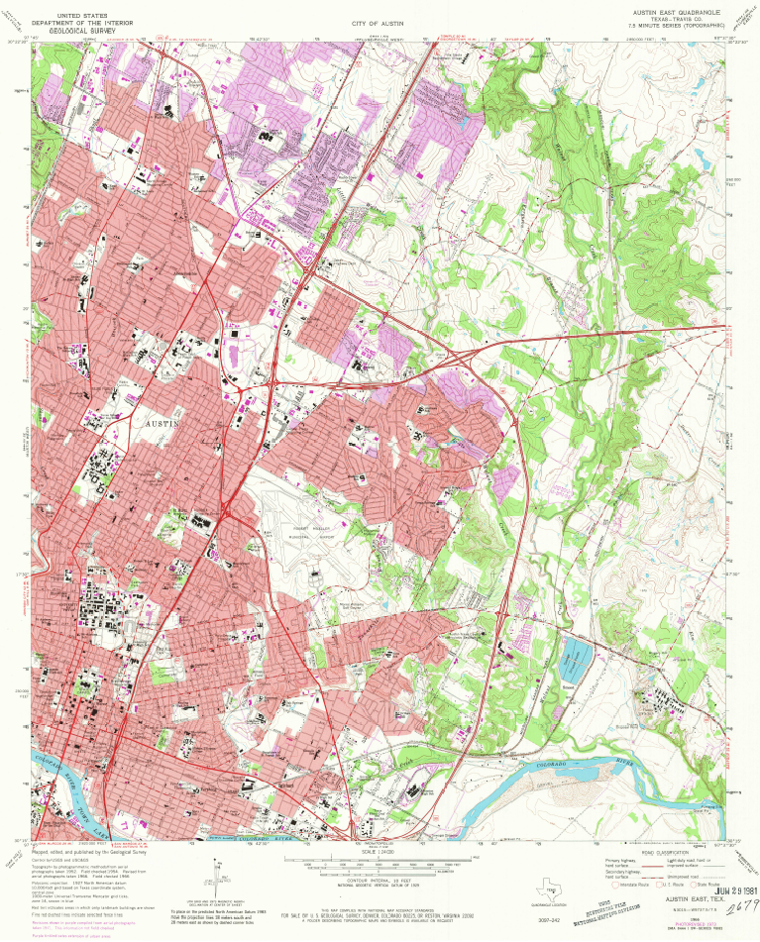
1:24,000 scale topographic map
7.5’ x 7.5’
(1/8°x 1/8°)
(30°22’30”N, 97°37’30”W)
(30°15’N, 97°45’W)

Slide 8
Then came GIS (1980’s, 1990’s)
People started doing lots of digitization of maps to produce GIS coverages for their projects
Lots of duplicated effort
Emergence of a plan for a “National Spatial Data Infrastructure”
Build standardized layers of base geographic information for the country

Slide 9
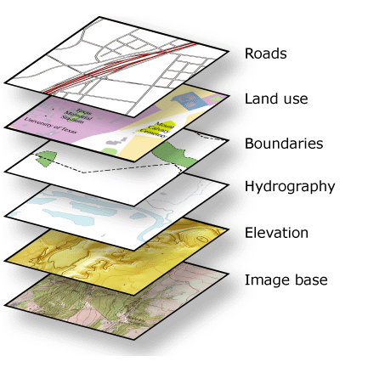
Thematic maps have layers
One of these is hydrography – all the blue line stuff on maps
Another is topography – elevation contours
These were traditionally stored on “map separates” or individual sheets, one for each theme
These were electronically scanned

Slide 10
What next?
We have big piles of electronically scanned images, called Digital Raster Graphics
They were automatically converted into vector objects (points, lines, areas) and edited for correctness.
Now we have digital map features
GIS can handle attributes. Ok, cool! We’ll add names, identifying numbers, etc.
Lots of work for GIS specialists ….

Slide 11
National Hydrography Dataset (mid-1990’s to mid-2000’s)
US Geological Survey has digital raster graphics and vector map features with descriptive attributes
Two versions
  1:100,000 scale (medium resolution)
  1:24,000 scale (high resolution)
EPA has a “Reach File” as a tabular system that knows which reach flows into what reach and where points of water discharge and withdrawal are located on them
A “marriage” happens and the reach connectivity from EPA is coupled with the GIS features from USGS – Kumbaya!

Slide 12
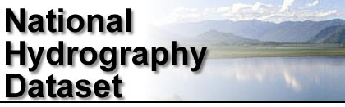
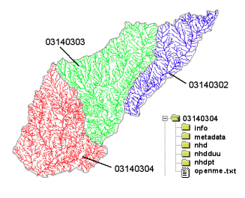
River networks
for 8-digit HUC
watersheds
http://nhd.usgs.gov/

Slide 13
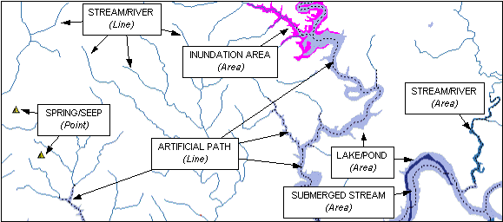

Slide 14
And while all this was going on…
A similar thing was happening with topography
Contours were scanned, converted to vector objects, and labelled with their elevation value
Interpolation methods were used to get a “grid” of elevation points from the contours
  3” cells (or 90m) was the standard in 1990’s
  1” cells (or 30m) came in 2000’s from 1:24,000 scale maps
Thus arose the National Elevation Dataset – seamless DEM for the nation

Slide 15
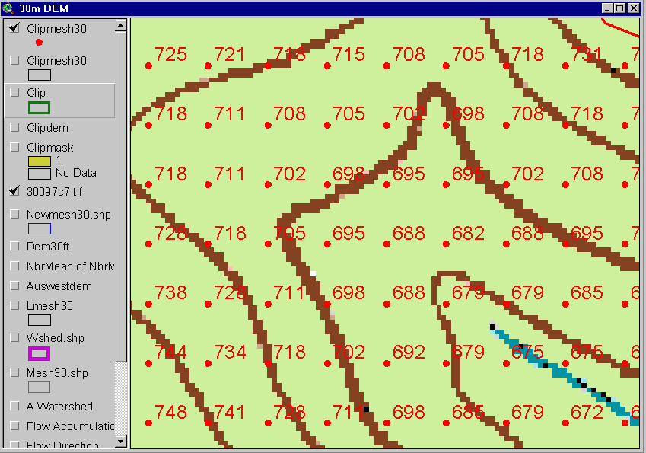
Digital Elevation Model (DEM)
720
720
Contours
740
720
700
680
740
720
700
680

Slide 16
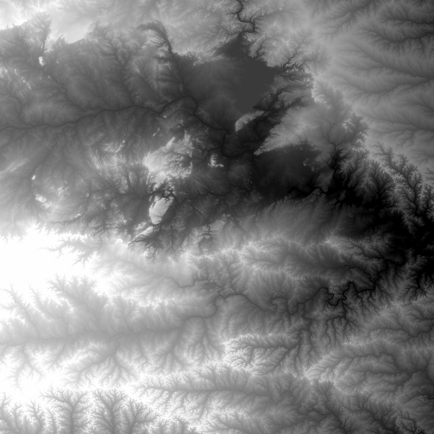
National Elevation Dataset
http://ned.usgs.gov/
Digital Elevation Model with 1 arc-second (30m) cells
Seamless in 1° blocks for the United States
10 billion data
Derived from USGS 1:24,000 quadrangle sheets
Get the data:
http://nationalmap.gov/viewer.html

Slide 17
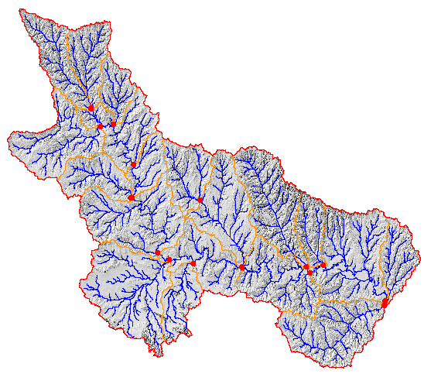
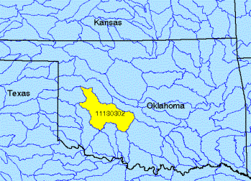
Watershed Boundary Dataset
ftp://ftp.ftw.nrcs.usda.gov/wbd/WBD_Latest_Version_June2013/
National Program by USDA (NRCS) and USGS
Boundaries for 10- and 12- digit watersheds
First cut is by automated delineation from NED
Hand checked and edited

Slide 18
Now what?
We have hydrography information about the water system
We have topographic information about the land system and watershed boundaries
How to put them together?????
  A long period of uncertainty
The “vector” side won – take mapped streams and watershed boundaries, and adapt the DEM to derive drainage areas for them
This led to NHDPlus Version 1 and now Version 2 (2004 to present)

Slide 19
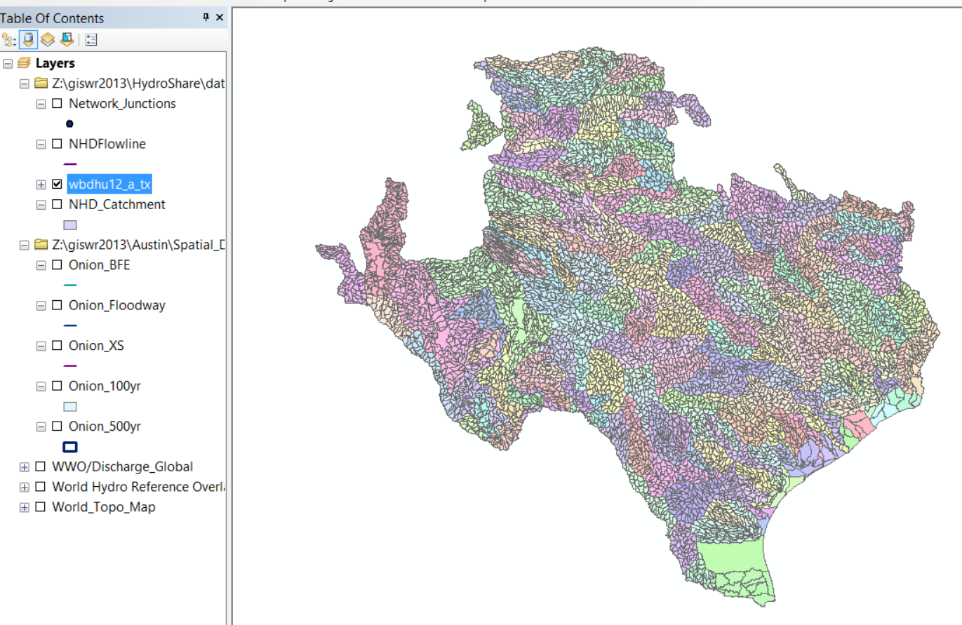
Watershed Boundary Dataset
(we used this in Exercise 2)

Slide 20
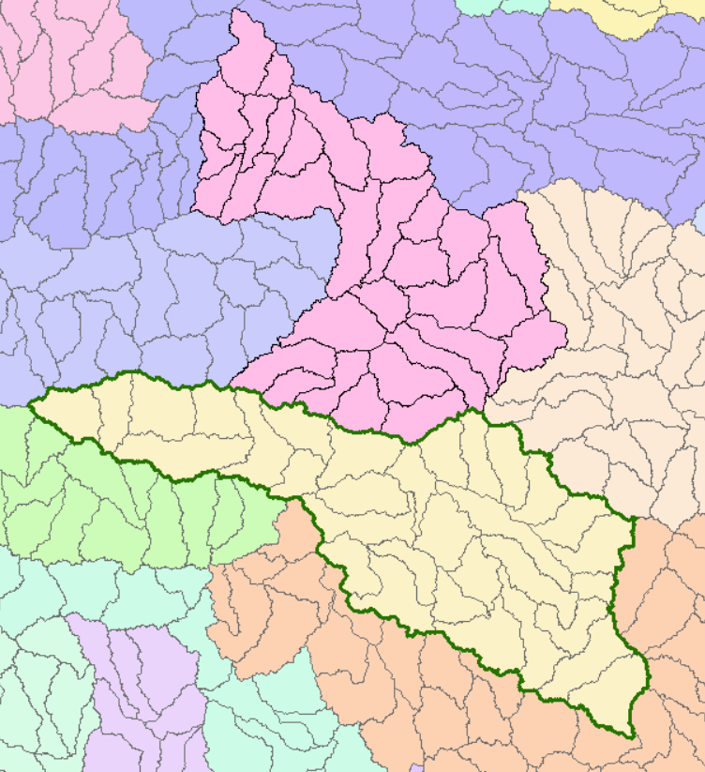
HUC-8 Subbasins
HUC-8 = 12090205
Austin-Travis Lakes
HUC-8 = 12100203
San Marcos

Slide 21
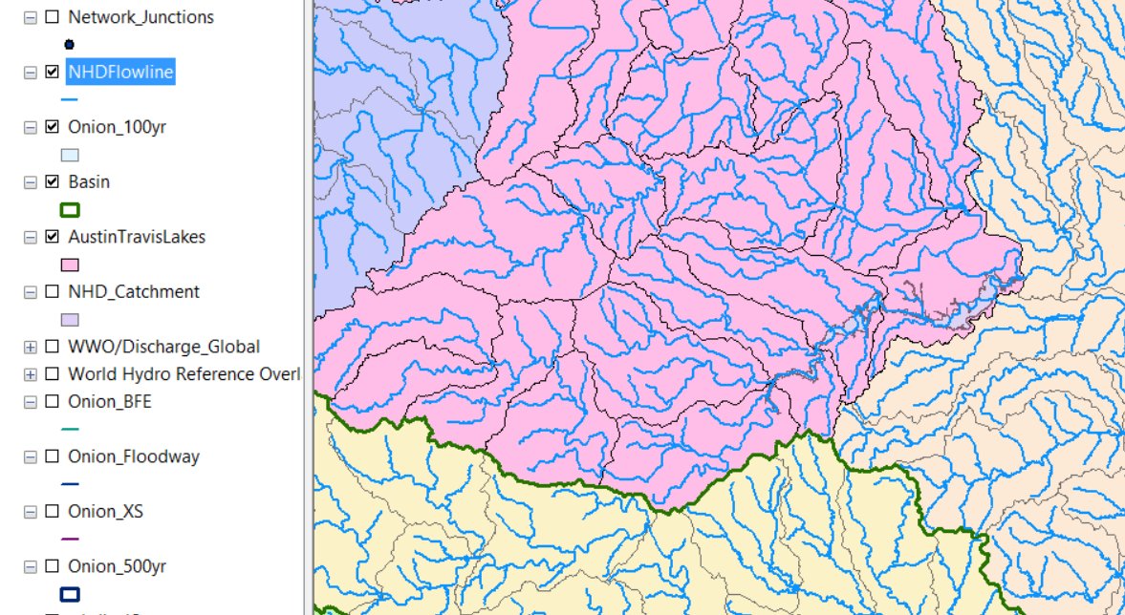
NHD Flowlines

Slide 22
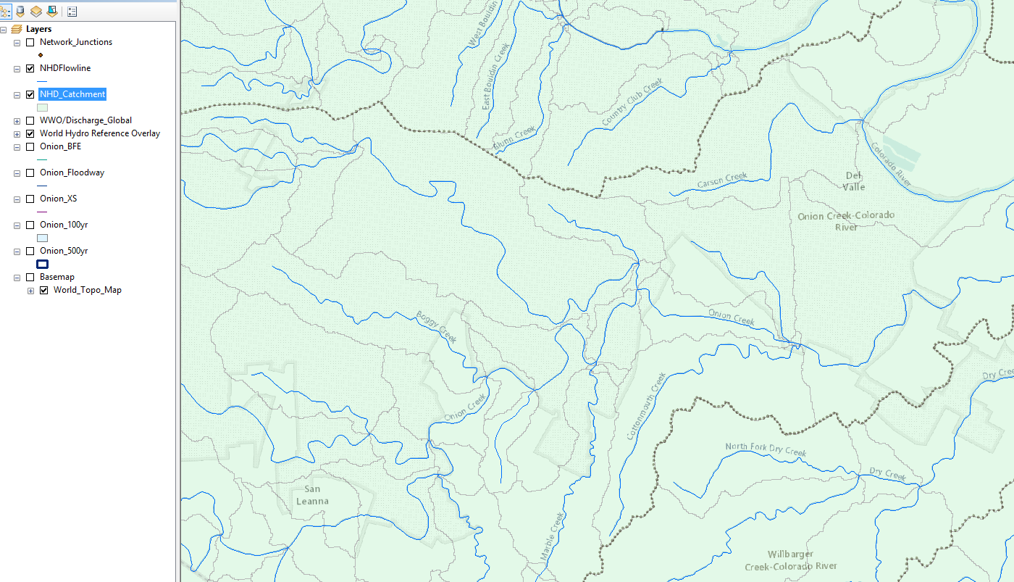
NHDPlus Catchments for each flowline

Slide 23
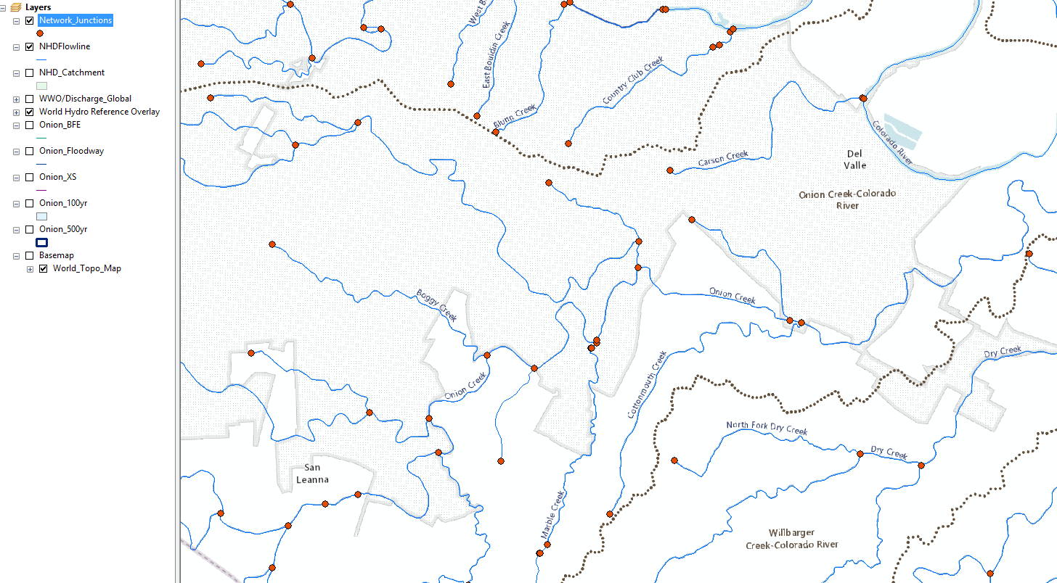
Geometric network of water flow

Slide 24
But, there was a complication….
NHDPlus was developed from
  1:100,000 scale Hydrography
  1:24,000 scale Topography
Not surprisingly, these don’t always agree!
1:24,000 hydrography was not used because there were too many reaches to be accounted for
And then there came the great era of LIDAR from about 2003, stimulated by FEMA Flood Mapping

Slide 25
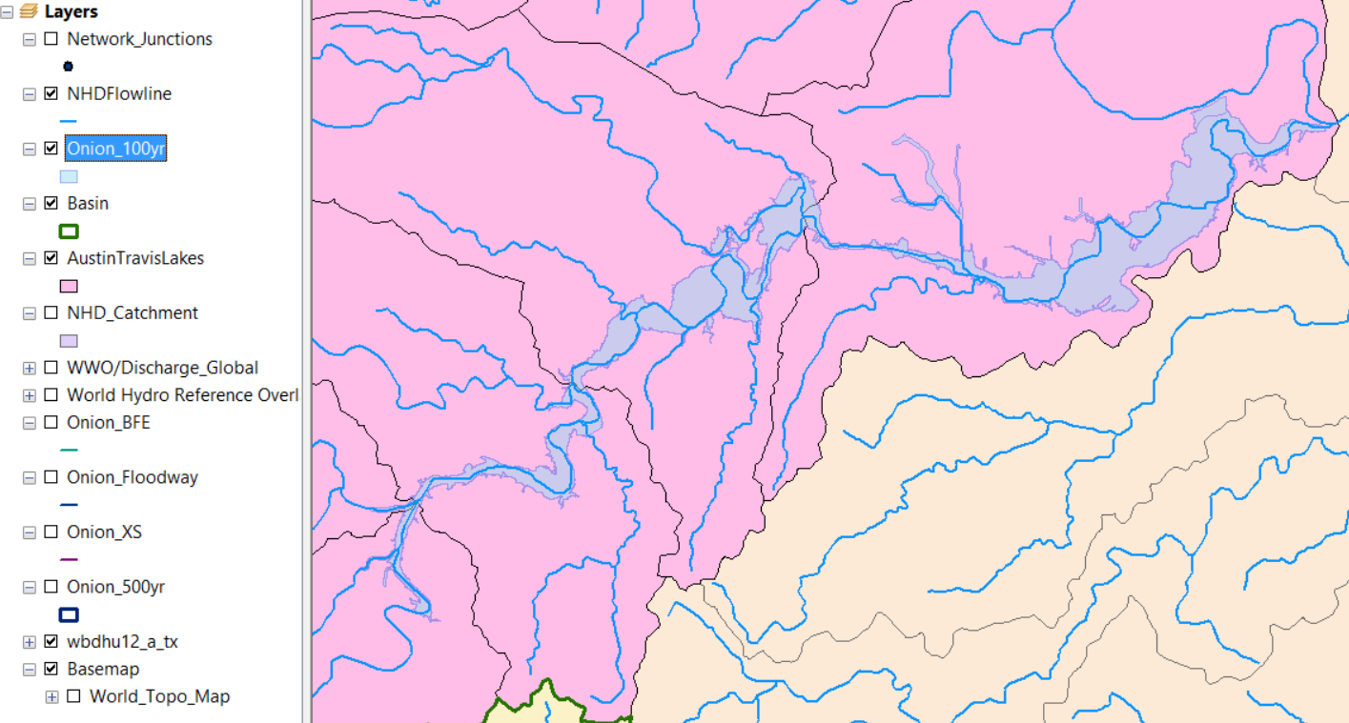
100 Year Floodplain Map of Onion Creek

Slide 26
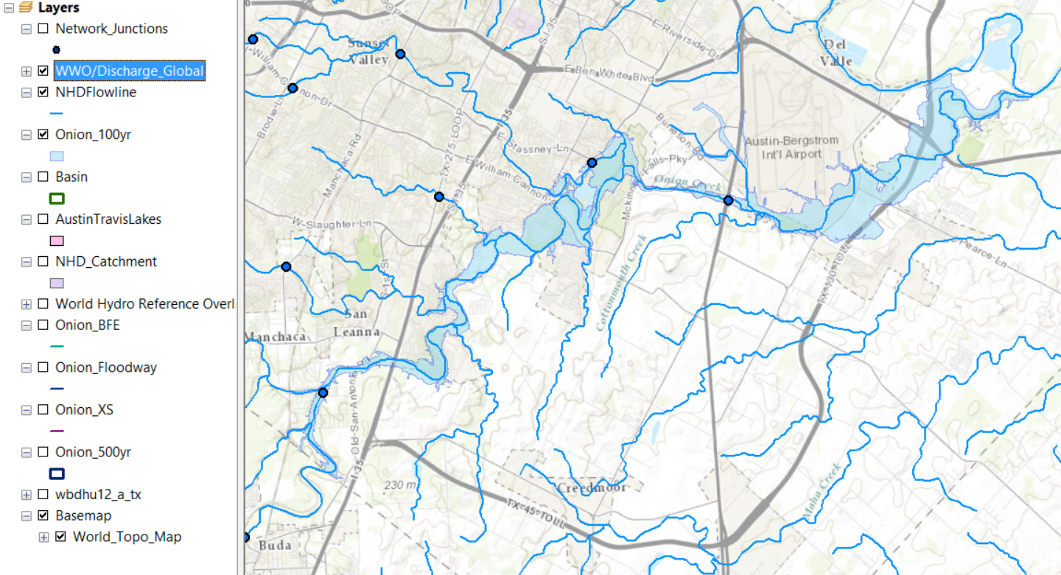
World Water Online Streamgage points
Onion Creek at Highway 183

Slide 27
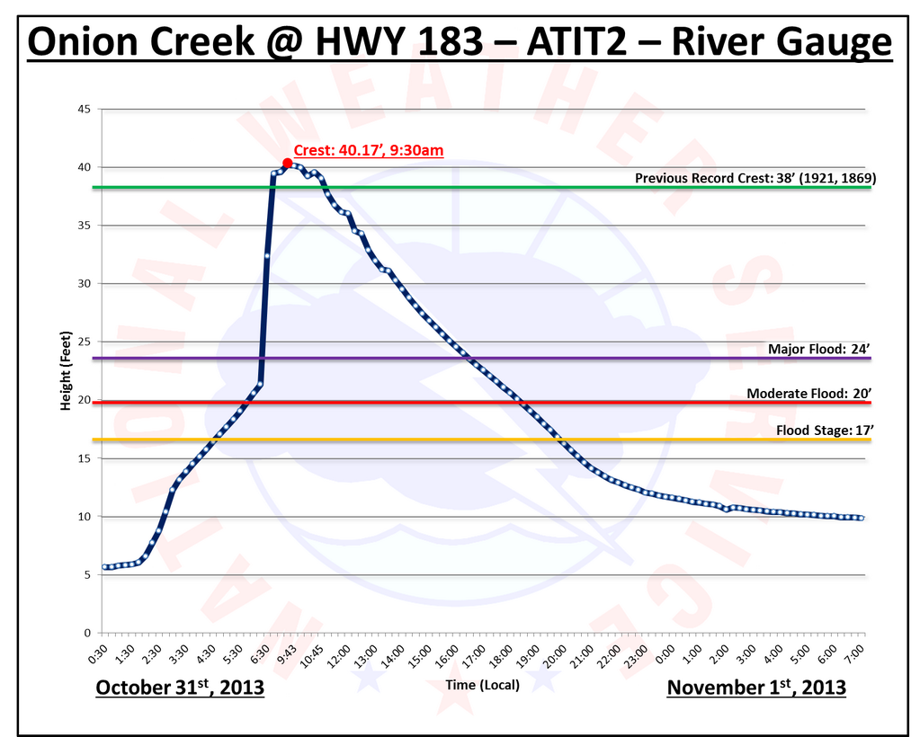
Flood Elevation – 16 ft above “Major Flood” stage for Oct 31, 2012 flood

Slide 28
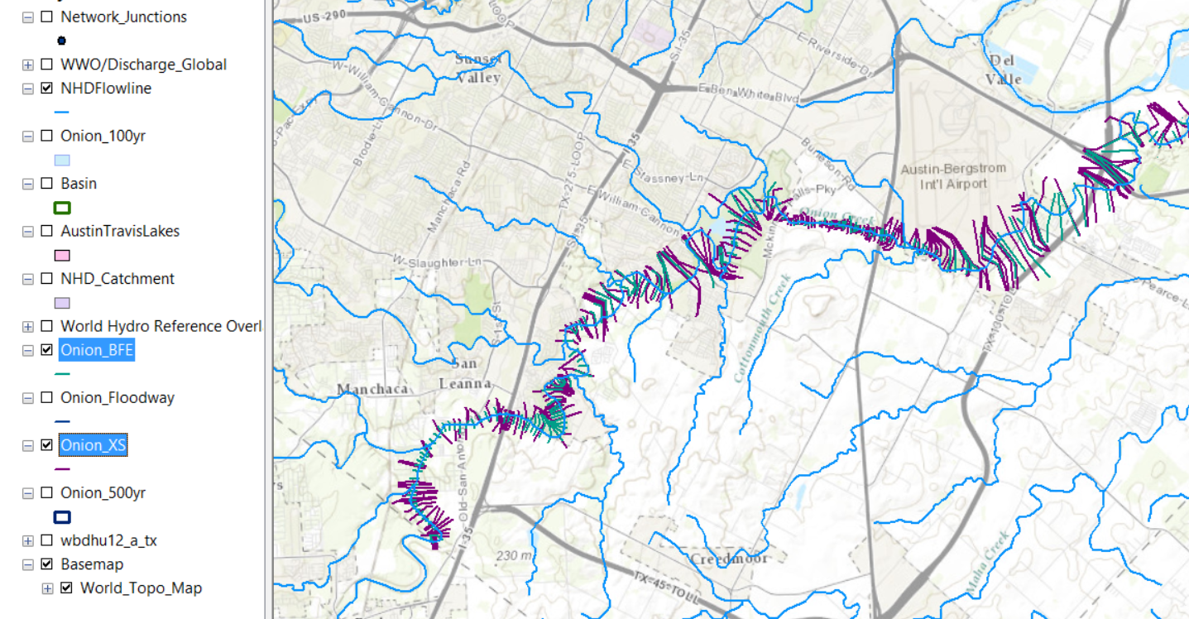
Cross-Sections and Base Flood Elevations

Slide 29
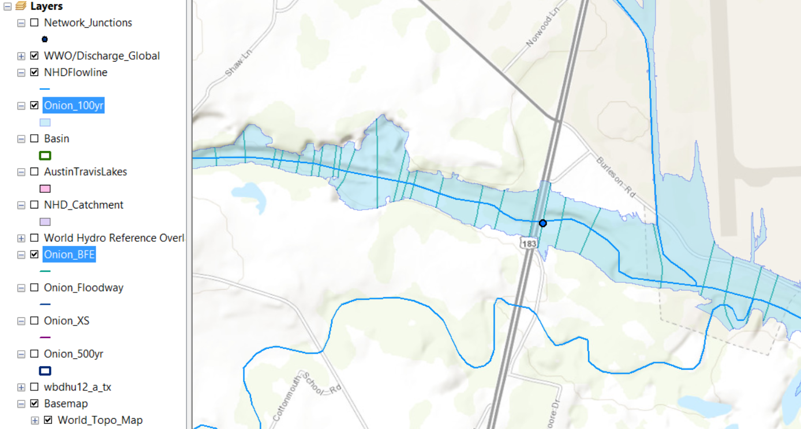
Base Flood Elevations (100 yr flood)
Highway 183
489’
485’
487’
483’
488’
484’

Slide 30
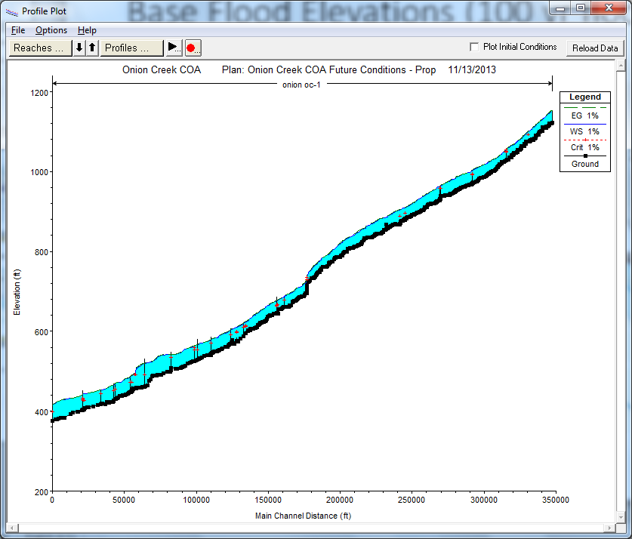
HEC-RAS Longitudinal Profile of Base Flood Elevation on Onion Ck
Elevation above datum
Distance from lower end of channel

Slide 31
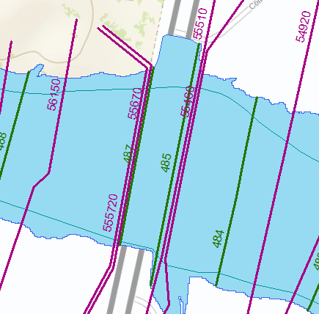
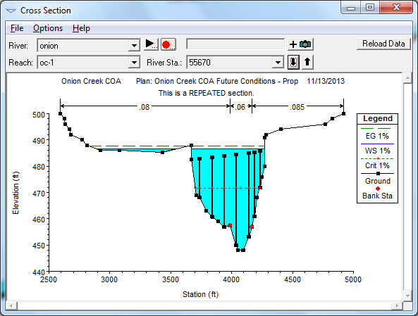
Cross-Section 55670 in HEC-RAS
Elevation of 100 year flood is 487 ft above datum
at cross-section 55670 ft from lower end of channel

Slide 32
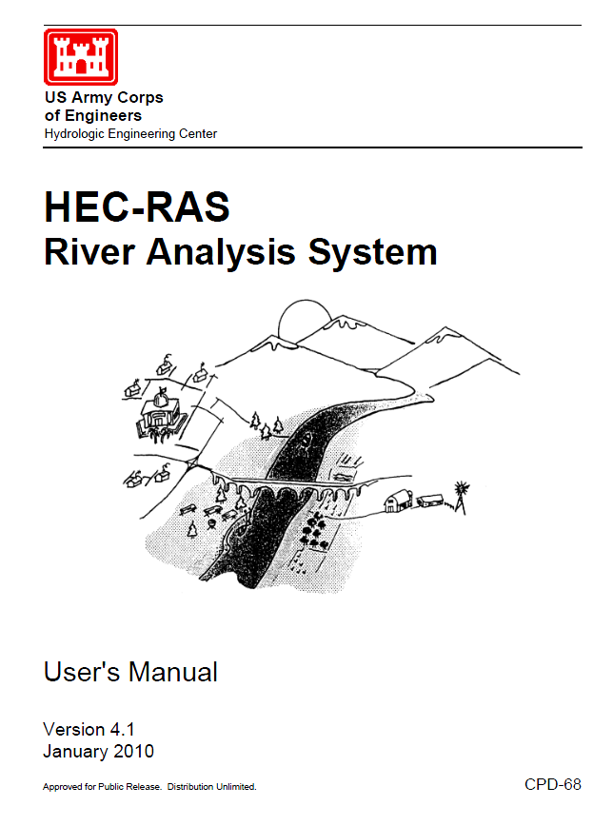
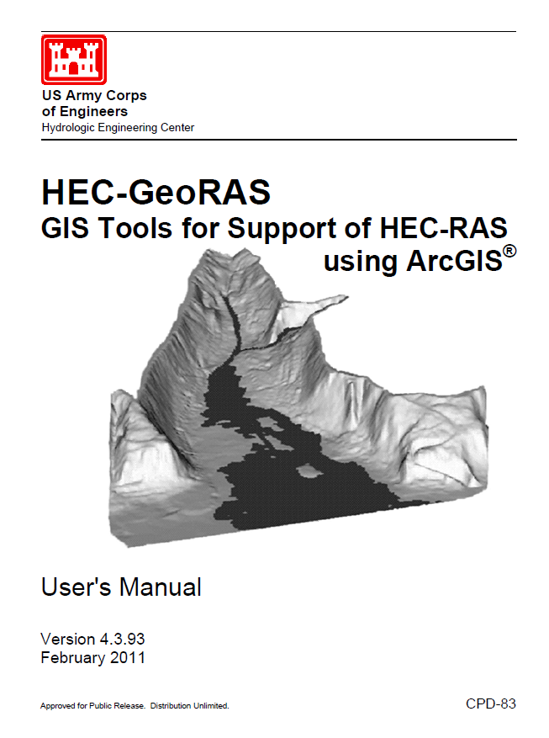
HEC-GeoRAS

Slide 33
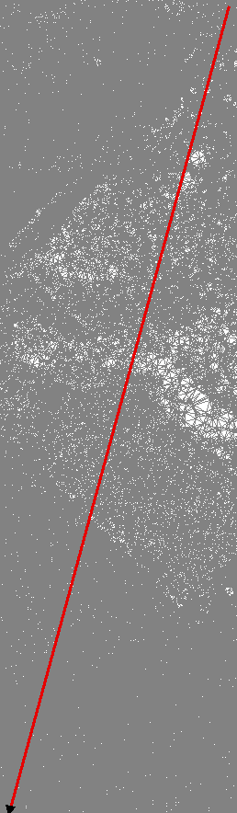
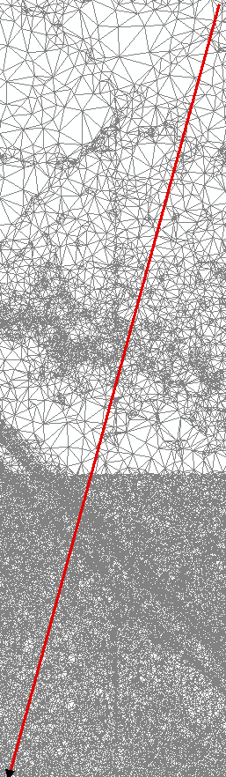
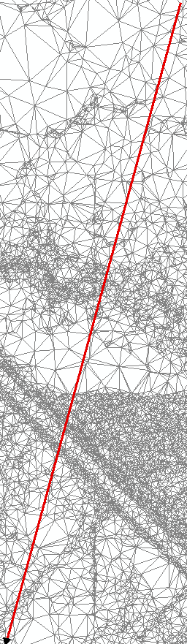
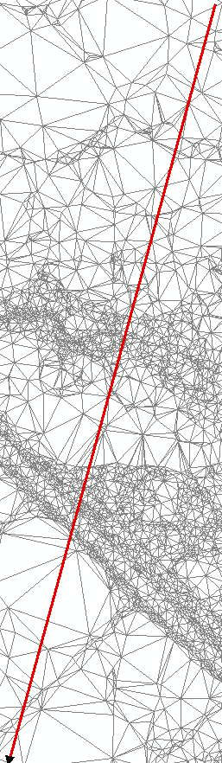
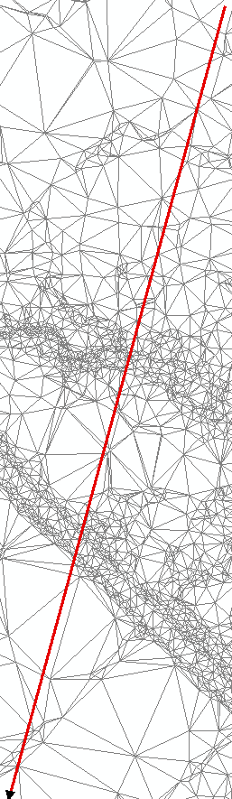
TINs based on Z-tolerance (Erin Atkinson)
“Sta/Elev” = number of vertices in the cross-section
Z-tol = 0.00’
Sta/Elev = 1792
Z-tol = 0.25’
Sta/Elev = 541
Z-tol = 0.50’
Sta/Elev = 223
Z-tol = 0.75’
Sta/Elev = 156
Z-tol = 1.00’
Sta/Elev = 110

Slide 34
Profile Comparisons
– smoothed profiles give nearly the same result

Slide 35
HydroShare – Channel
From the NSF project proposal: “As an exemplar for advancing data access, we will establish a national repository within HydroShare for river channel cross section data: a new data type not presently supported by CUAHSI HIS. Since 2003, the United States has spent more than $2 billion on digital flood map modernization. A great deal of river channel cross-section, morphology and hydraulic modeling data has been developed to support this mapping and some of that could be repurposed to advance water science. This repository will include a mechanism for voluntary submission of information and it will provide access to this data in a standard way such that it is easy to run hydraulic models that use this data on either local or HPC environments.”

Slide 36
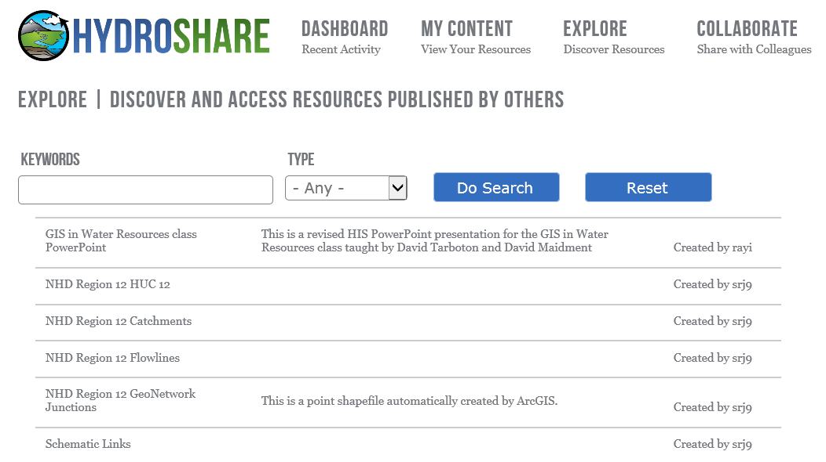
Regional HydroData

Slide 37
Arc Hydro Data Model
Drainage System
Hydro Network
Flow
Time
Time Series
Hydrography
Channel System

Slide 38
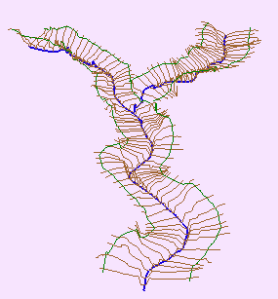
Channel Cross-Section
Direction of Flow
Channel
Cross-Section
Notes:
Before we get into detail let’s quickly define a channel and a cross-section. A river of stream Channel is a conduit or water course carrying water flow under gravity.
A Cross-Section refers to the section of a channel taken normal to the direction of the flow.

Slide 39
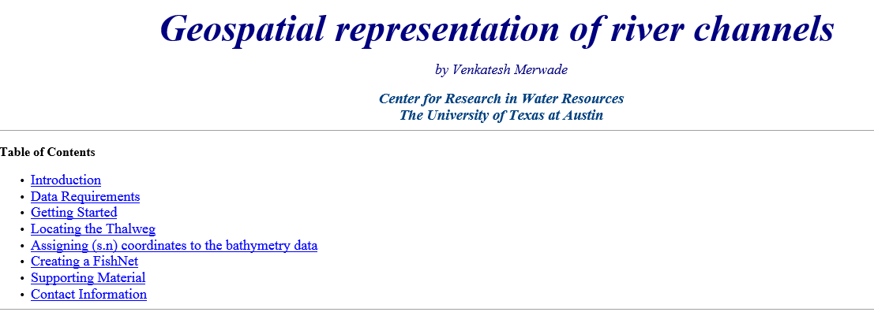
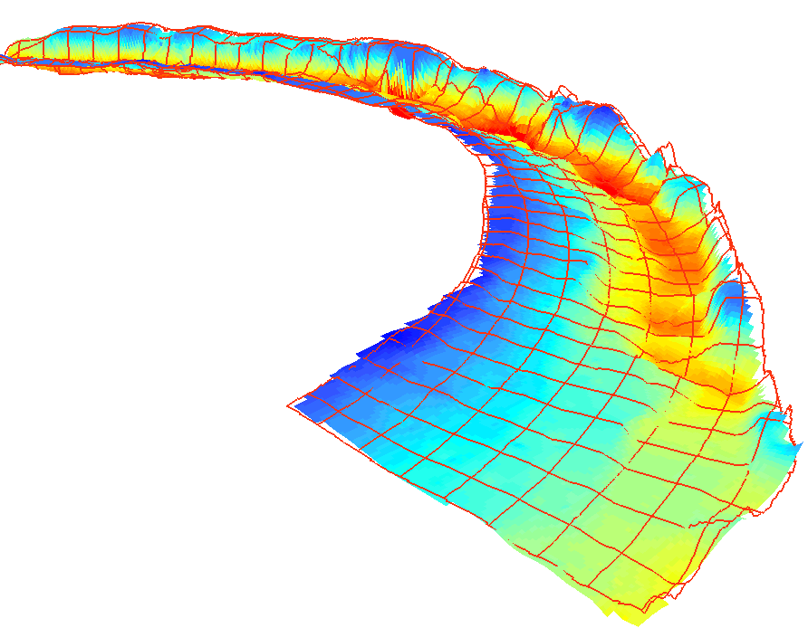
River Channel Morphology Model

Slide 40
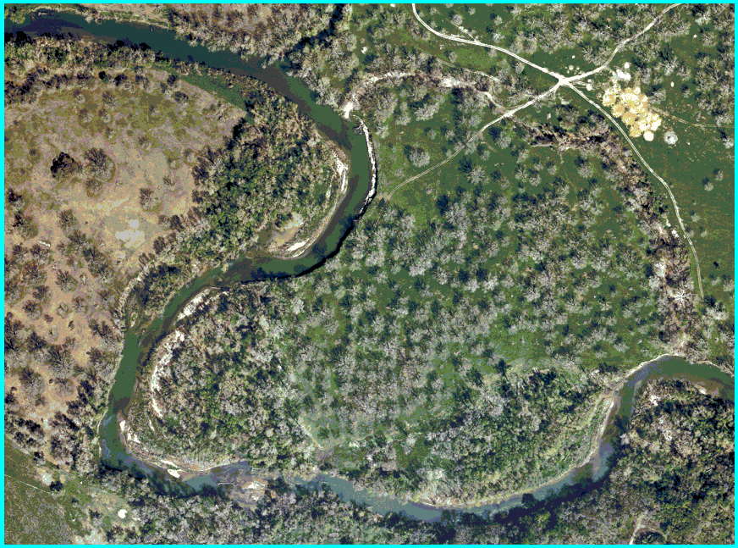
Study Area (Guadalupe river near Seguin, TX)
1/2 meter Digital Ortho Photography

Slide 41
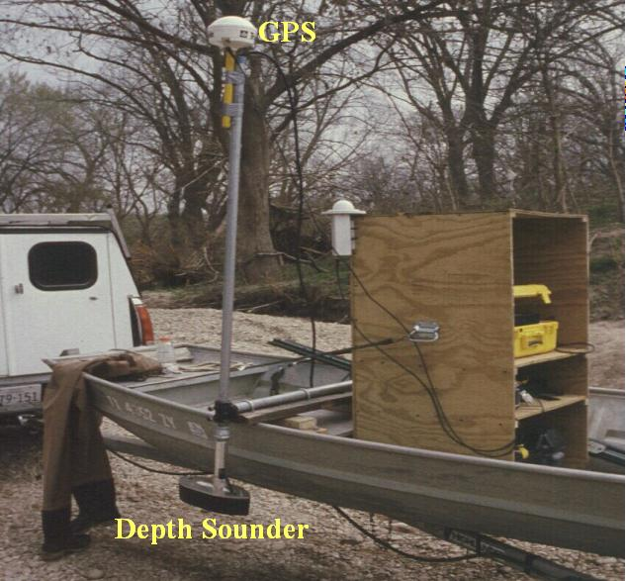
Boat setup for data collection

Slide 42
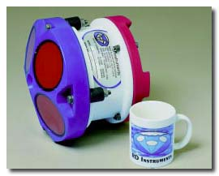
Accoustic Doppler Current Profiler
Provides full profiles of water velocity and direction in the ocean, rivers, and lakes. Also used for discharge, scour and river bed topography.

Slide 43
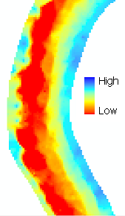
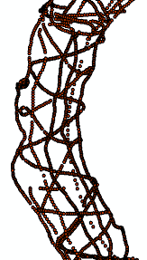
Data analysis
Centerline/Thalweg
Cross-sections
ProfileLines
Start with points
Create surface from points
Extract all the necessary information
How do we do this…….

Slide 44
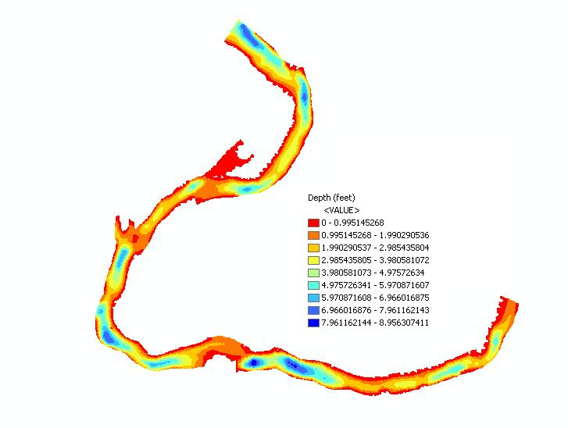
Interpolation
Points are interpolated in ArcMap to produce a continuous surface.

Slide 45
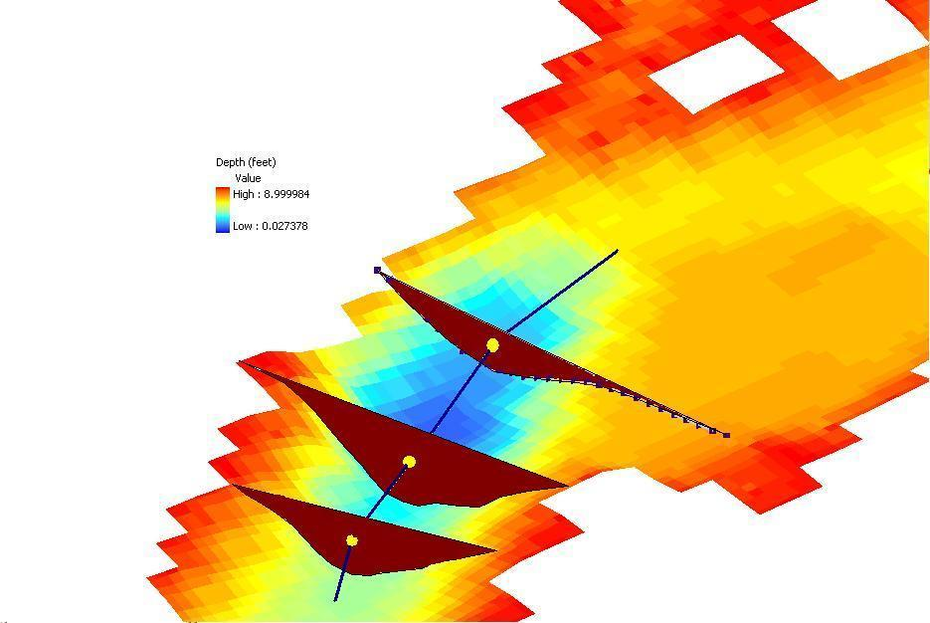
Centerline
Define the centerline along the thalweg of the channel

Slide 46
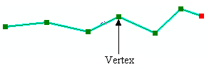
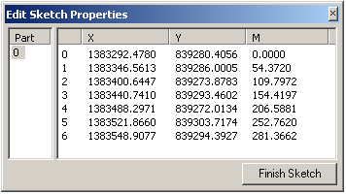
Measure in ArcGIS
Measures are assigned in meters
54.37
154.41
0
281.36
A PolylineM can store m-values at each vertex along with x and y coordinates.

Slide 47
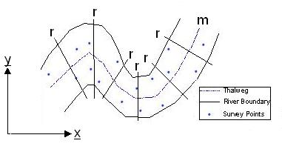
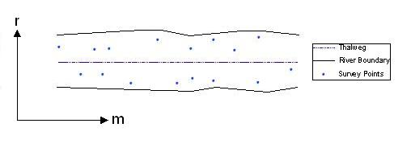
Coordinate Transformation
m is measure along the centerline
r is distance across the river from the centerline
Sinuous river becomes straight when transformed into (m,r) co-ordinates.

Slide 48


Coordinate Transformation
Straightened river
Profile line and cross-sections
Sinuous river

Slide 49


Straightened River in 3D

Slide 50



Data back to x,y coordinates
Original river in X,Y
Profile lines and cross-sections in (x,y) created using FishNet in (m,r).

Slide 51

Profile Lines and Cross Sections in 3D
Each point has five dimensions: x, y, z, r, m
Geographic (x, y, z)
Hydraulic (r, m, z)

Slide 52



Slide 53

VLSI simulation models for electric circuit design…..
….. adapted to apply to river networks

Slide 54


SPRINT
SPRINT (Simulation Program for RIver NeTworks) is an high performance river network simulator developed at IBM Research Austin. It provides fully dynamic solutions to large scale St Venant equations, from large networks of river branches.
Network of Nodes
SPRINT Output
(Water Depth at each node at each time step)

Slide 55

Merging HEC-GeoRAS and SPRINT
Combine Strengths
HEC-GeoRAS
  Network Creation
  Cross Section Generation
  Elevation and Attribute Extraction
  Georeferencing
  Visual Representation
SPRINT
  Dynamic WSEL Modeling of very large networks
Regional HEC-GeoRAS Model with Automated Cross Sections

Slide 56
Tentative Conclusions
Take small, simple steps to achieve progress
Really two separate problems
  Storing a project scale database about river channels in a small area in HydroShare
  Developing a landscape-scale representation for river channels
The XML interchange between HEC-RAS and HEC-GeoRAS is a channel description similar in concept to WaterML1.0 for time series data
This could be developed into an OGC-compliant language called RiverML to facilitate exchange of river channel information

Slide 57




Representing River Geometry in HydroShare
LiDAR
Cross Sections Attached to River Network
Cross Sections
Hydraulic Calculations

Slide 58

Modular design, linking river geometry, catchment geometry, network topology, and time series observations
  Data is linked by common reference points along the river, which can be represented as point or cross section shapefiles and shown on a map.
  Based on OGC HY_Features Model

Slide 59

RiverML vs. WaterML
RiverML is multi-directional
  Data Users create, share, modify, and reuse information
RiverML is like the cabinets in a shared kitchen
  Each user needs to be able to find and accurately identify data
  New data must be added in a way that everyone can find and understand
  Some users are only interested in the contents of a single cabinet, others need contents of all cabinets
Sample Workflow
RiverML
Data User
Data User
This means that RiverML must be significantly more robust than WaterML in its ability to merge related files

Slide 60
Conclusions
What we have now in NHDPlus Version 2 are 2D networks developed from 1:100K Hydrography and 1:24K DEM’s – they don’t fit well together
We would like to have a 3D river network model with definition of the river channel as a 3D surface not just a stream centerline -- use LIDAR to define this
The information for this may come from many sources
  Need a common exchange language – RiverML
We’ll need a national repository to store all this river channel information – HydroShare

