Slide 1
Watershed Characteristics and Polycyclic Aromatic Hydrocarbons in Urban Lake Sediments
Evan Dart

Slide 2
Polycyclic Aromatic Hydrocarbons (PAHs)
Compounds produced during carbon combustion processes
Several classified as suspected or probable human carcinogens by the U.S. EPA
Van Metre et al. 2000

Slide 3
Coal-tar Sealant PAH Contribution to Urban Lake Sediment
Van Metre and Mahler, 2010

Slide 4
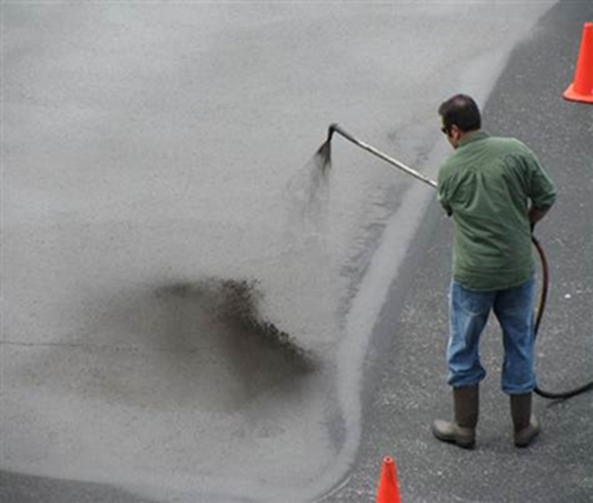
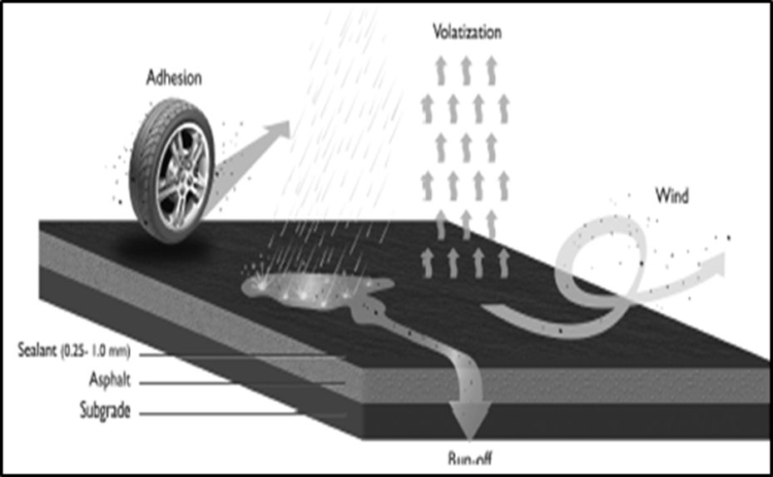
Coal-Tar Based Sealant
Liquid sealant used to protect and beautify pavement
Highly concentrated in PAHs (10% by weight)
USGS; Van Metre, 2010

Slide 5
Study
Determine if certain watershed characteristics affect coal-tar sealant contribution of PAHs in urban lake sediments
Twenty lakes selected from study by Mahler and Van Metre, 2010

Slide 6
Analysis
Geospatial Data
Average Annual Precipitation
Average Slope
Impervious Fraction
Average Slope of Stream Network
Statistical Analysis: Spearman’s Rank Correlation
Between PAH concentration data from the study and the watershed geospatial data
Coal-Tar Sealant PAH Mass Contribution

Slide 7
Data Sources
National Elevation Dataset (NED30m)
Watershed Delineation
Average Hydrologic Slope
Stream Network Average Slope
USA Mean Rainfall
Average Annual Rainfall
National Land Cover Dataset (NLCD Impervious)
Impervious Fraction
Sediment PAH Data (Van Metre and Mahler, 2010)

Slide 8
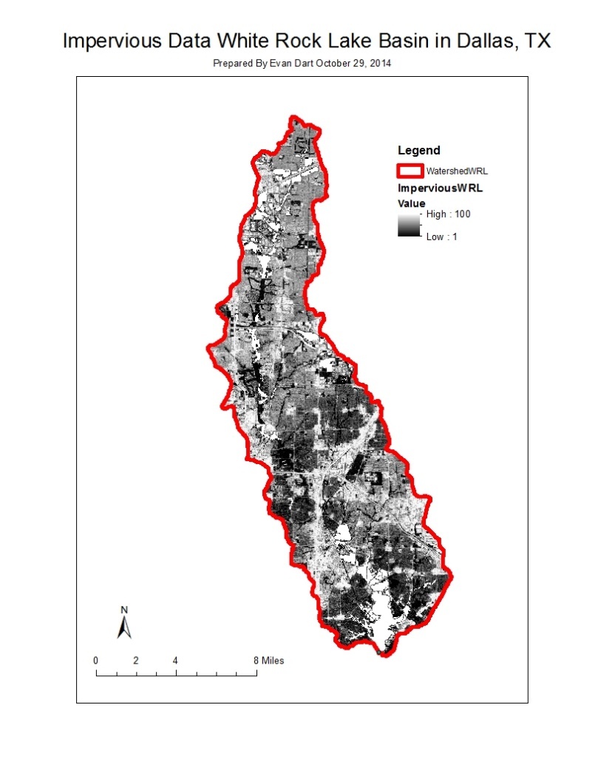
Geospatial Data Example

Slide 9
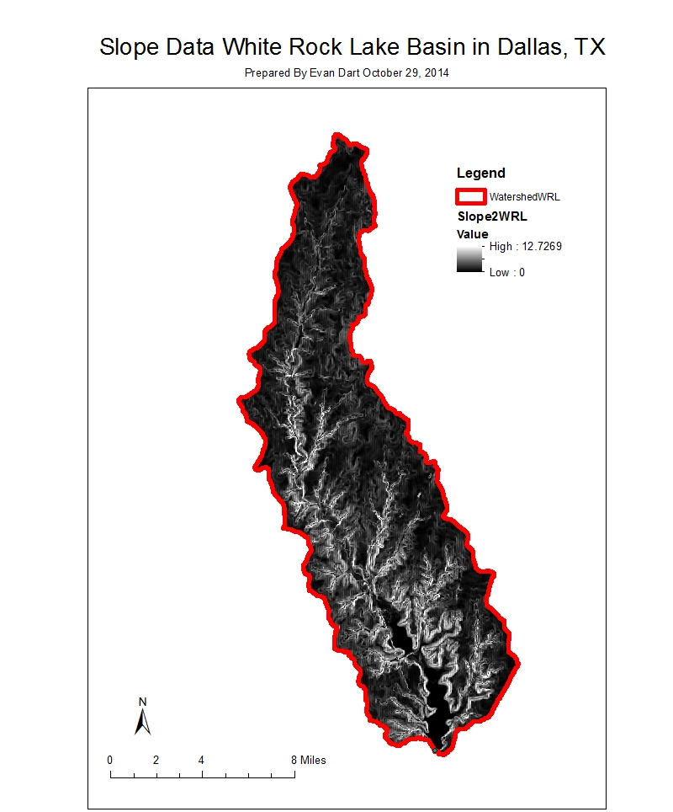
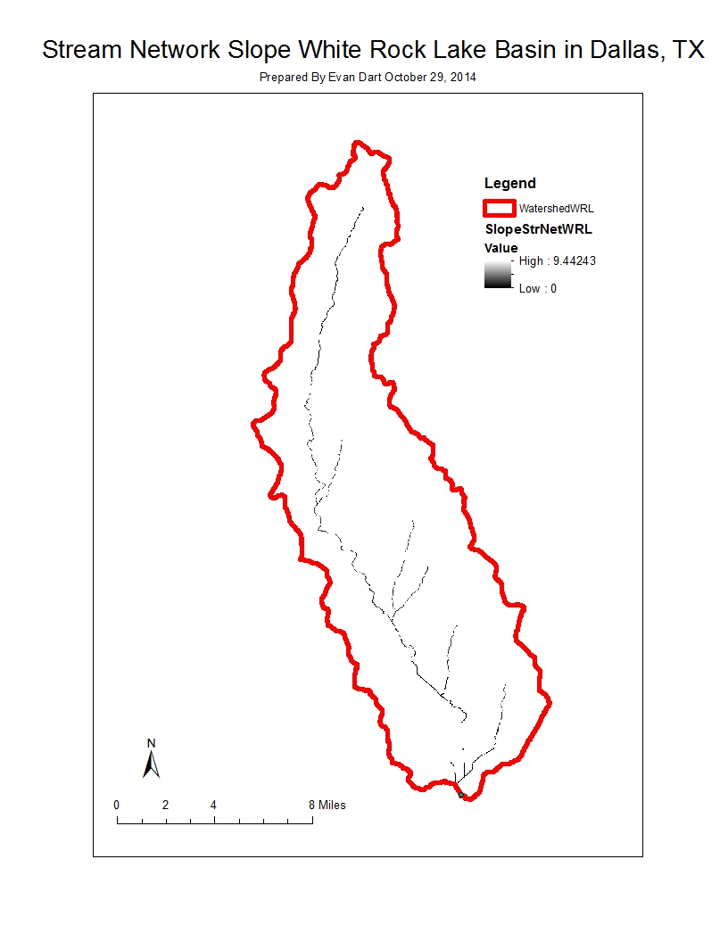
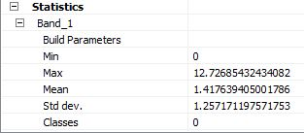
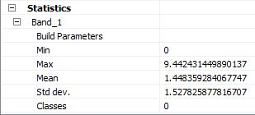
Geospatial Data Example

Slide 10
Spearman’s Rank Correlation Analysis
Measures the association between two variables
Does not assume a linear relationship
Spearman’s Rank Correlation Coefficient, ρ
$ρ=−1 to 1$
Strong Negative Correlation = -1
Strong Positive Correlation = 1

Slide 11
Average Annual Precipitation
Spearman’s Rank Correlation Coefficient, ρ = 0.041

Slide 12
Average Slope
Spearman’s Rank Correlation Coefficient, ρ = -0.418

Slide 13
Impervious Fraction
Spearman’s Rank Correlation Coefficient, ρ = 0.277

Slide 14
Average Stream Network Slope
Spearman’s Rank Correlation Coefficient, ρ = -0.599

Slide 15
Conclusions
No strong correlations between geospatial data categories and sediment PAH data
Unexpected trends
Possible Improvements
Larger sample size
Other geospatial data categories to consider
Coal-Tar Sealant Geospatial Data

Slide 16
References
Van Metre P, and Mahler B. Contribution of PAHs from coal-tar pavement sealcoat and other sources to 40 U.S. Lakes. Science of the Total Environment 2010; 409: 334-344.
Van Metre P, Mahler B, Furlong, E. Urban Sprawl Leaves Its PAH Signature. Environmental Science and Technology 2000; 34: 4064-4070.

