Slide 1
Visualization of SUNTANS model Using ArcGIS
——Dongyu Feng

Slide 2
Outline:
Introduction
Model Setup
The visualization of Model Output
Discussion and Conclusion
Future Research

Slide 3
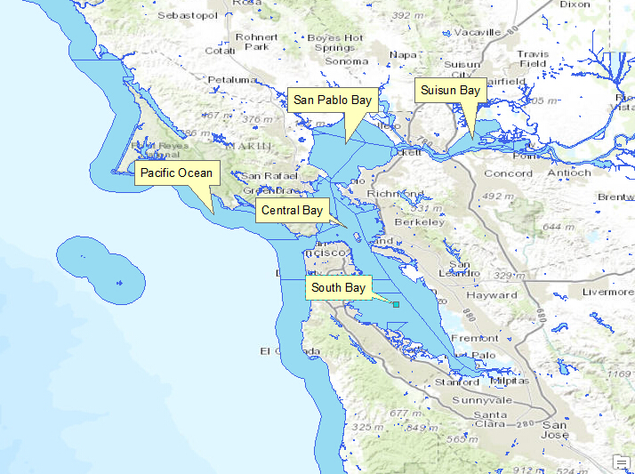
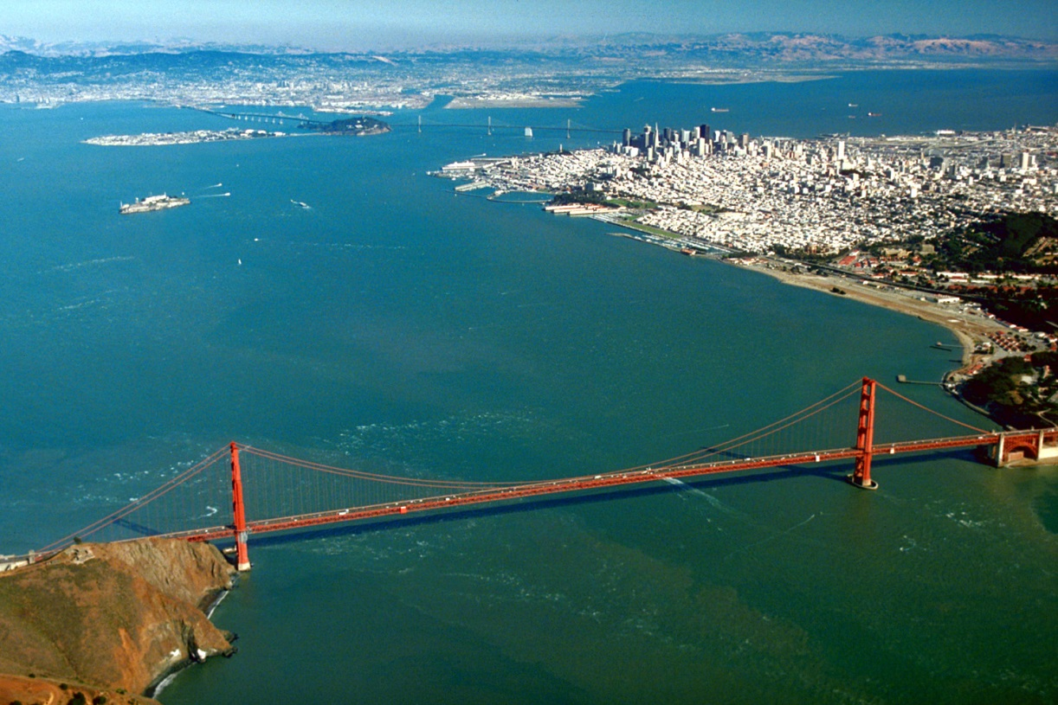
1. San Francisco Bay is important place with several three big cities and several famous companies. 2. San Francisco Bay is mainly composed of five bay systems and its estuarine systems are complex. 3. A mecca for sailors.
Introduction
(San Francisco Bay)
(http://en.wikipedia.org/wiki/San_Francisco_Bay)
Notes:
The study domain of this project is the whole San Francisco Bay area.
San Francisco Bay is in the U.S. state of California, surrounded by a contiguous region known as the San Francisco Bay Area (often simply "the Bay Area"), dominated by the large cities San Francisco, Oakland, and San Jose. The waterway entrance to San Francisco Bay from the Pacific Ocean is called the Golden Gate.
San Francisco Bay is composed of five systems, including Suisun Bay, San Pablo Bay, Central Bay and South Bay.

Slide 4
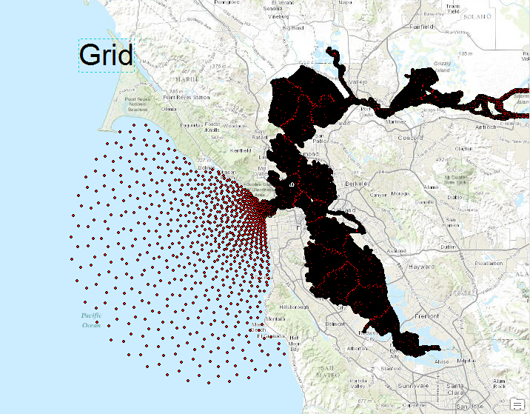
1. A three dimensional unstructured non-hydrostatic numerical model, SUNTANS, is used to implement this study. 2. The grid has a higher resolution inside the bay and a lower resolution in the near coast.
Model Setup
Notes:
Before running a numerical model, GIS serves as a tool to check the input grid and bathymetry files.
The data projection datum used by SUNTANS is "NAD\_1983\_UTM\_Zone\_ 10N" , and the earth datum is "D\_North\_American\_1983". SUNTANS is a triangle unstructured model, comprised of Delaunay triangle grid, with Voronoi points at the nearly centered points. Since the centered points of each triangle is the computing points of different water properties, I will not visualize the triangle grid in GIS. Instead, the Voronoi points of the San Francisco Bay are visualized

Slide 5
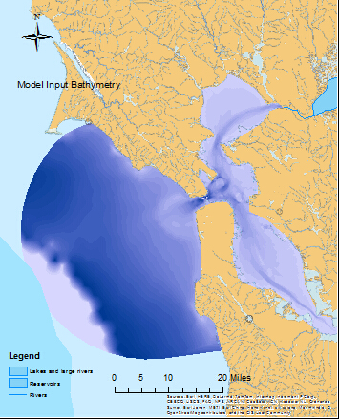
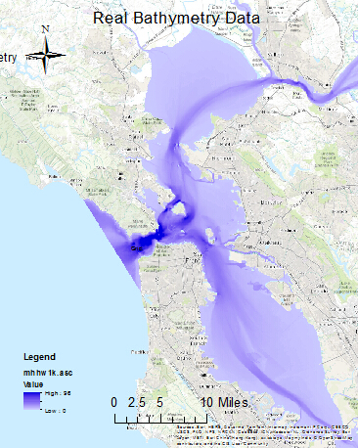
Model Setup
(Bathymetry)

Slide 6
This study case is an example case in SUNTANS, with simplified boundary and initial conditions. 1. Boundary: There are two river discharge: Sacramento river and San Joaquin. The background salinity is 32 psu, and temperature is 0. The harmonic analysis of tide is implemented. 2. Initial Condition: the temperature and salinity are assumed to change linearly as the location approaches inland
Model Setup
(Boundary and Initial Conditions)
Notes:
Boundary

Slide 7
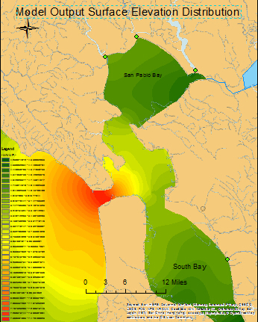
Visualization of Model Output
(Free surface Elevation)

Slide 8
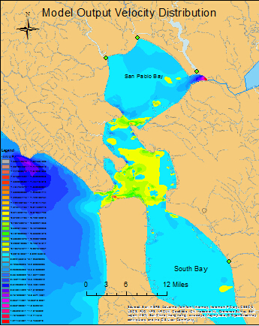
Visualization of Model Output
(Horizontal Velocity)

Slide 9
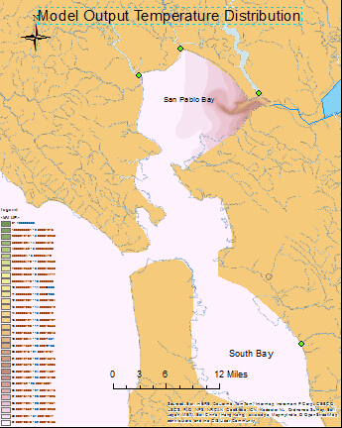
Visualization of Model Output
(Temperature)

Slide 10
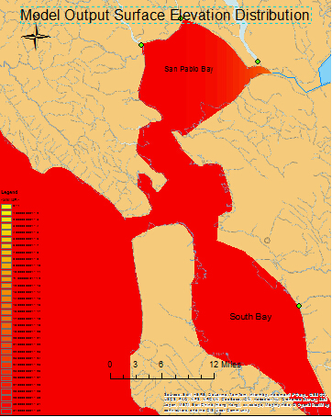
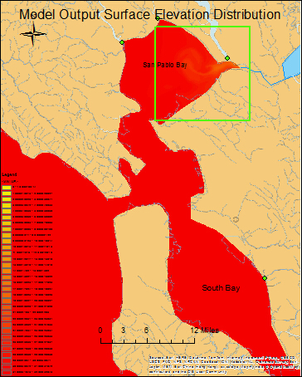
Visualization of Model Output
(Salinity Distribution)

Slide 11
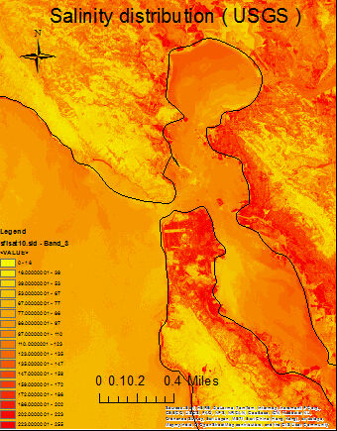
Discussion and Conclusion
(Salinity Data From USGS)

Slide 12
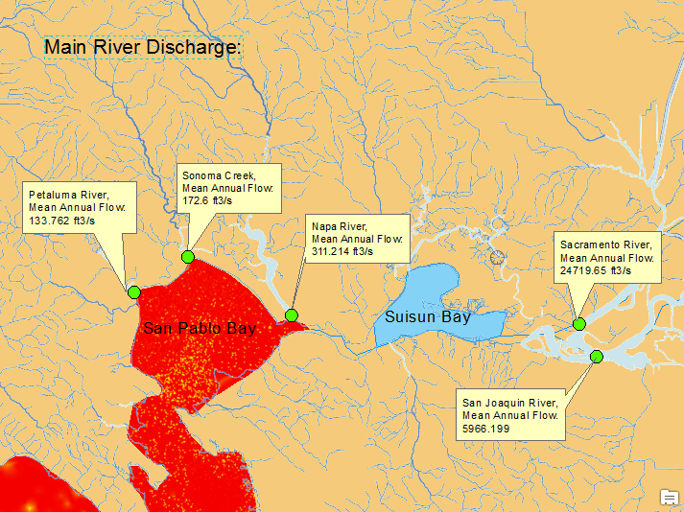
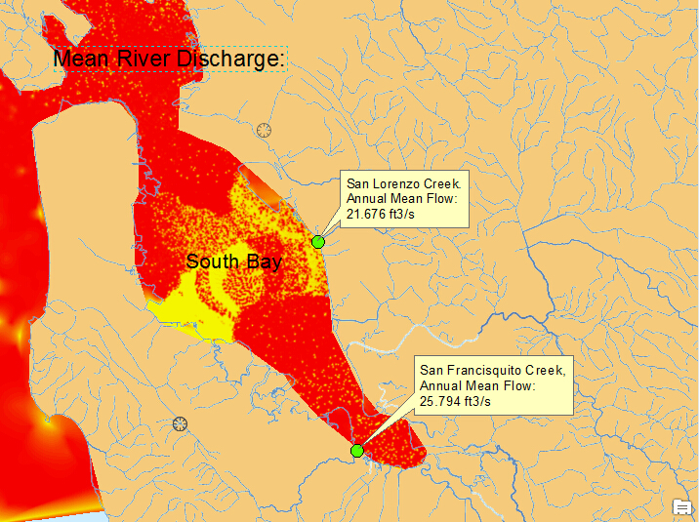
Discussion and Conclusion
(Main River Discharge data from NHDPlus)
1. In San Pablo Bay, Sacramento River and San Joaquin River are counted, but Petuluma River Sonoma Creek and Napa River are not. 2. In South Bay, San Lorenzo Creek and San Francisquito Creek are not considered.

Slide 13
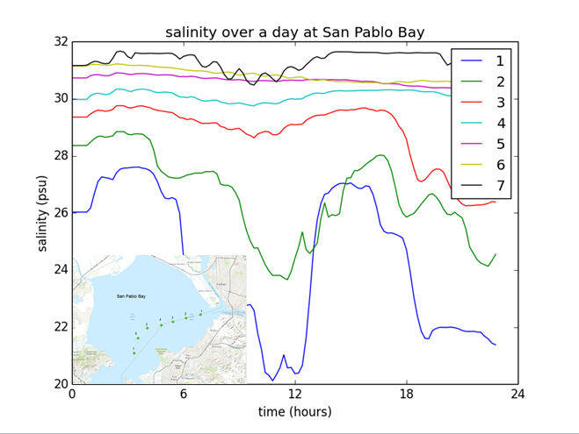
Discussion and Conclusion
(Time Variation of Salinity)
The periodic trend to salinity variation is clear near the mouth of river discharge.

Slide 14
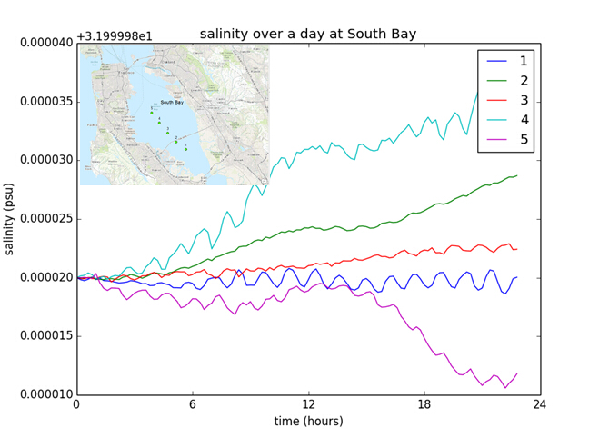
Discussion and Conclusion
(Time Variation of Salinity)
Look at the Y coordinate, there is barely salinity variation in South Bay.

Slide 15
Discussion and Conclusion
ArcGIS did a great job in checking the model grid, input bathymetry. And ArcGIS provides a direct and more efficient way of analyzing the output of SUNTANS and studying the hydrodynamics in San Francisco Bay.
By comparing the salinity distribution and variation in San Pablo Bay and South Bay, we are able to see that river discharge plays an important role. Tidal effect is seen in San Pablo Bay but not in South Bay. This may be because of the improper boundary condition.
Notes:
The fresher way presents at a certain time of the ebb tide.

Slide 16
Future Research
1. More accurate boundary and initial conditions should be applied in this kind of study. More freshwater discharge and real-time tidal data should be used.
2. Since I live in Texas and my project is about Galveston Bay, I will apply the same method (ArcGIS and SUNTANS) to the study of Galveston Bay.

Slide 17
Acknowledge
Thanks to Dr. Maidment for the inspiration and guidance of this study, and the great lectures throughout this semester.

Slide 18
Thank you for your attention!

