Slide 1
Modeling bacteria flow from wildlife in the Leon River Basin, TX
Sonny Kwon

Slide 2
Background / problem
Section 303(d) of the 1972 Federal Clean Water Act (CWA) requires that each State identify water bodies that do not meet the State’s water quality standards and create a priority ranking of the impaired waters based on the severity of pollution and the water body’s intended use.
The Leon River basin was Initially placed on the list of impaired waters in 1996 due to bacteria levels.
It was analyzed that between 41 and 55% of all bacteria in the Leon originated from wildlife.

Slide 3
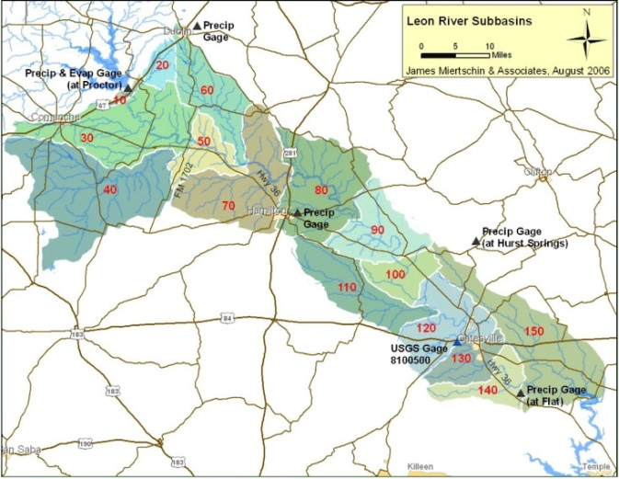
Study area / objective

Slide 4
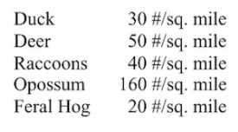
Methods (1/5)
First attempt: land cover (forest + rangeland)
adjacency to water body
wildlife density known!
Problem: forest + rangeland = 98% of basin

Slide 5
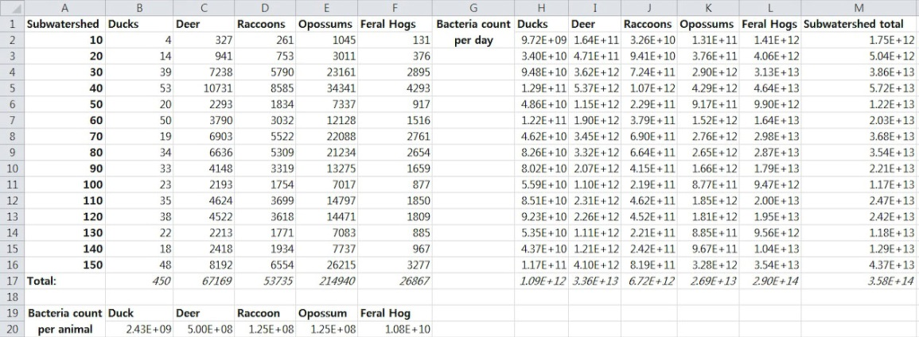
Methods (2/5)
Second attempt: Leon TMDL final modeling report (2006)
Texas Parks and Wildlife Dep’t data (2004)
EPA Fecal Tool (2000)

Slide 6
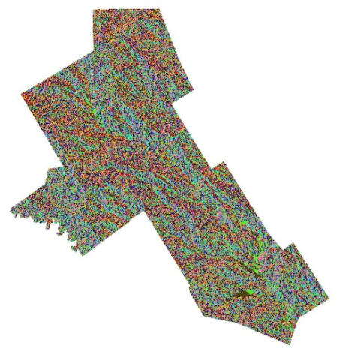
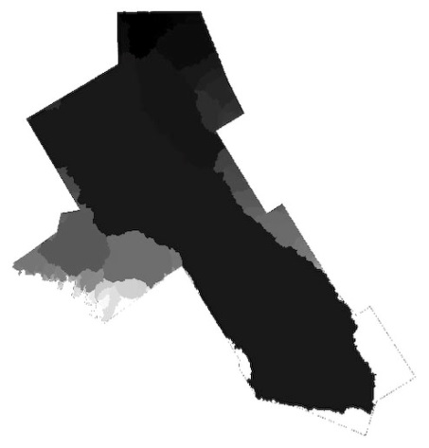
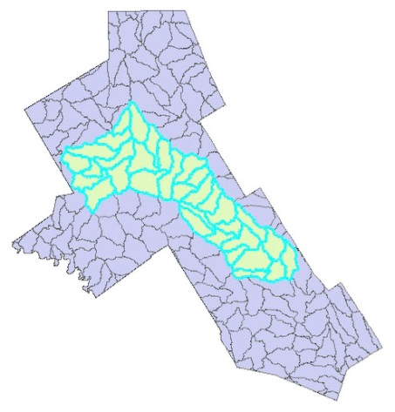
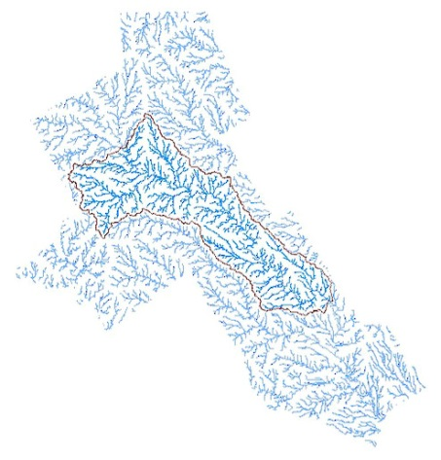
Methods (3/5)
Watershed delineation (NED 30m), Counties, HUC12
Fill sinks, flow direction, flow accumulation, drainage basin, polygon conversion with HUC12’s, raster calculator

Slide 7
Methods (4/5)

Slide 8
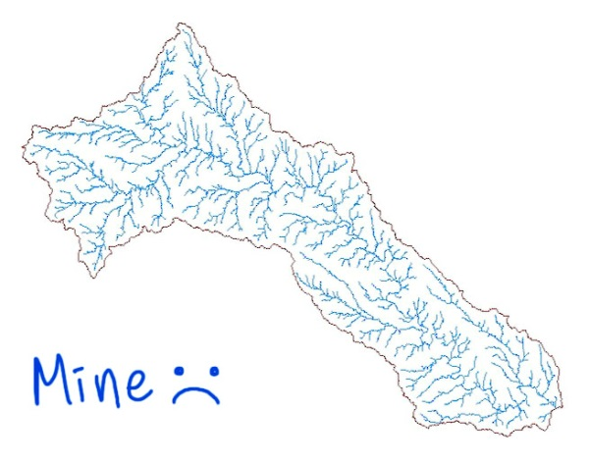
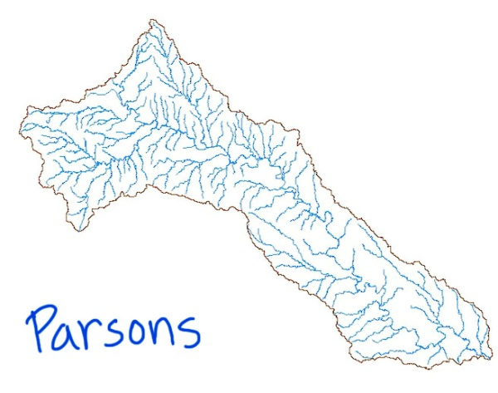
Methods (4/5)

Slide 9
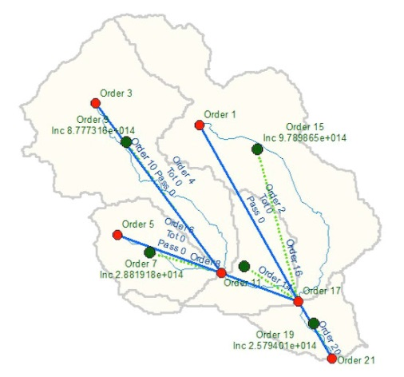
Methods (5/5)
Schematic Processor
Arc Hydro Tool for Schematic Networks

Slide 10
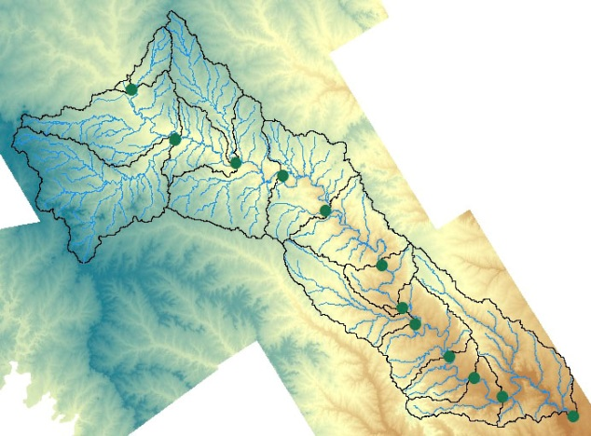
Work left:
Assign nodes and links
Edit python op
Run model!

Slide 11
Acknowledgements
I would like to thank Parsons Inc. for providing the data,
and Dr. Maidment for developing the tool.

