Slide 1
Florida Traffic Volume Analysis
Vivek nath

Slide 2
Original Objective
Identify spatio-temporal patterns between traffic volume and
Weather patterns
Traffic impediments
Gasoline price
Use hydrology techniques on traffic flow
Modified due to
Unavailability of data
Incompatibility of hydrology tools with traffic data

Slide 3
Modified Objective
Visualize traffic volume in Florida
Inspect for correlation between traffic signal density and traffic volume
Inspect for correlation between county population and traffic volume
Data used
AADT (Annual Average Daily Traffic)
Traffic Signal
County Population Density

Slide 5
Traffic Signal Density vs AADT

Slide 6
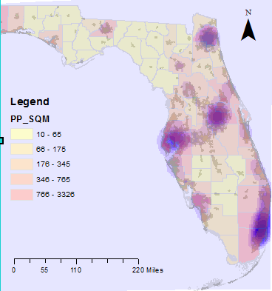
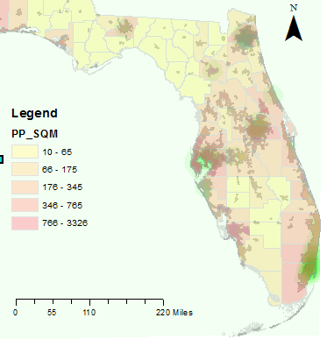
AADT Intensity
Traffic Signal Intensity

Slide 7
Observations
Bridges tended to have higher AADT
Strong correlation between truck traffic and overall traffic
High truck traffic on freight routes
Slight verifiable correlation between traffic signal density and traffic volume within urban regions

