Slide 1
Impact of Dairies on Surface Water Quality in the Lower Yakima Valley, WA
Emily Palmer

Slide 2
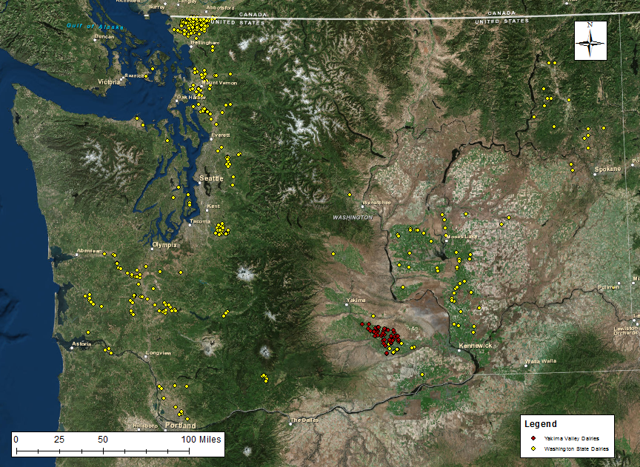
Dairies in Washington

Slide 3
Introduction
High nitrates have been documented in groundwater in the Lower Yakima Valley for the past 30 years
In 2010 the EPA began a study to locate the source of the contamination
Dairies were found to be the culprit
Some of the nutrients from the dairies travel into the surface waters as well
High nutrient loading can cause eutrophication
TN: 1000 – 2000 μg/L
TP: 30 – 100 μg/L

Slide 4
Data Sources
Data | Source
Dairy Locations, 303(d) listed waters, HUC10, Stream Gages | Washington State Department of Ecology
Land Cover | National Land Cover Database
Nitrogen and Phosphorous Pollution Data Tool | Environmental Protection Agency
NED30m DEM | USGS National Elevation Dataset
NHDPlus V2 | Environmental Protection Agency

Slide 5
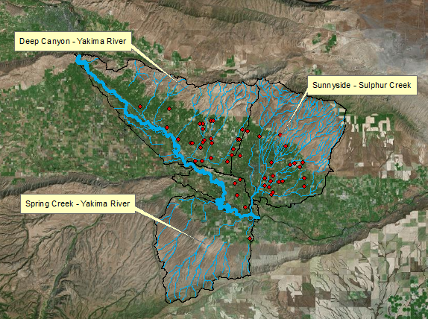
HUC10 Watersheds

Slide 6
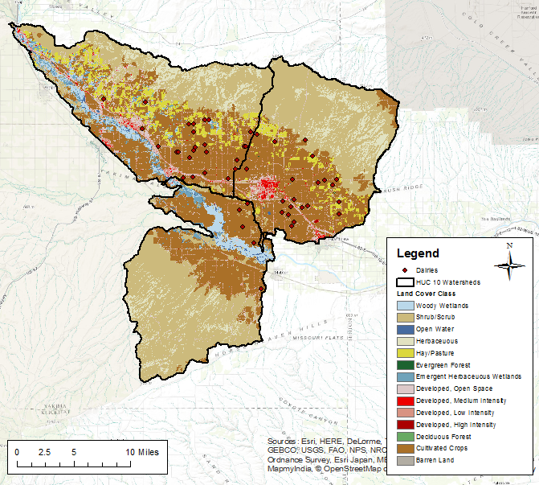
Land Use

Slide 7
N/P Loading Estimates by Dairy Size
Loading Calculations:
Nitrogen Load = .675 * Dairy Size * .2
Phosphorous Load = .105 * Dairy Size * .2
Size Ranges:
Small: 0-199
Medium: 200-699
Large: 700+
Dairy Size: | Estimate
 | Low | Medium | High
Small | 50 | 100 | 150
Medium | 300 | 450 | 600
Large | 750 | 900 | 1050

Slide 8
Load per Watershed
Watershed | Total Nitrogen Load [lbs/day] |  |  | Total Phosphorous Load [lbs/day]
 | Low | Medium | High | Low | Medium | High
Spring Creek Yakima River | 445.5 | 546.75 | 648 | 69.3 | 85.05 | 100.8
Sunnyside - Sulphur Creek | 1782 | 2200.5 | 2612.25 | 278.25 | 342.3 | 406.35
Deep Canyon Yakima River | 1789 | 2227.5 | 2673 | 277.2 | 346.5 | 415.8

Slide 9
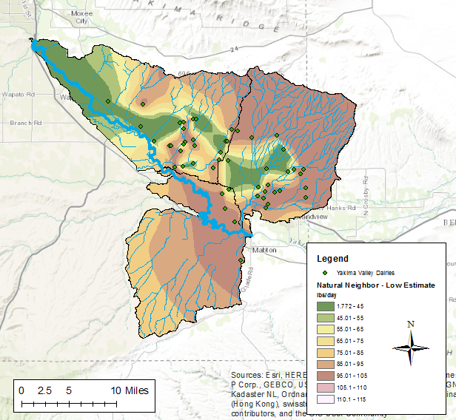
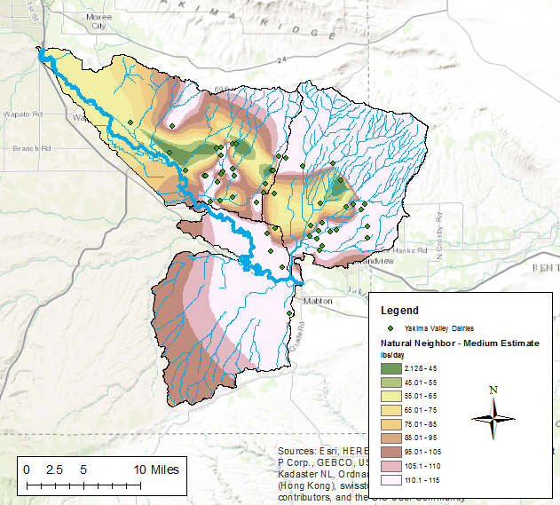
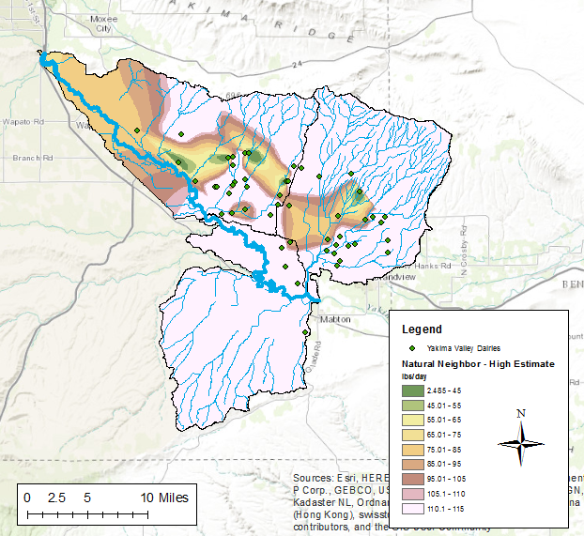
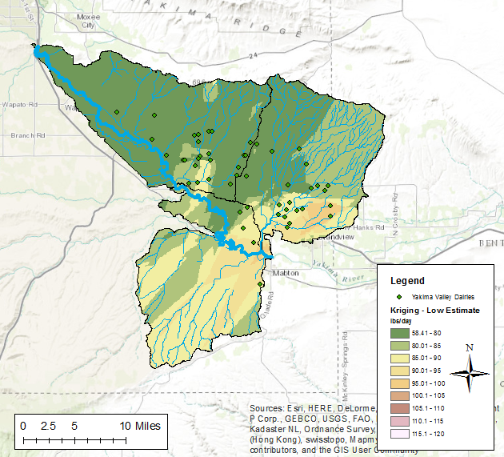
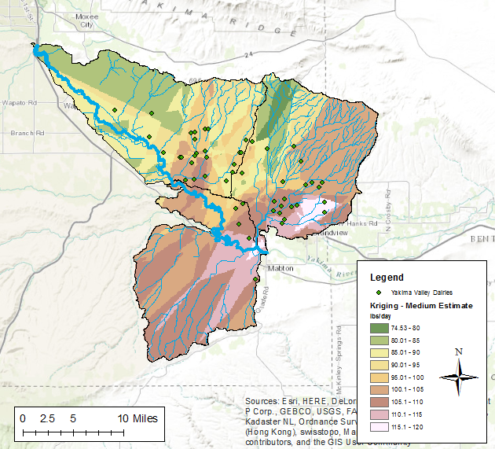
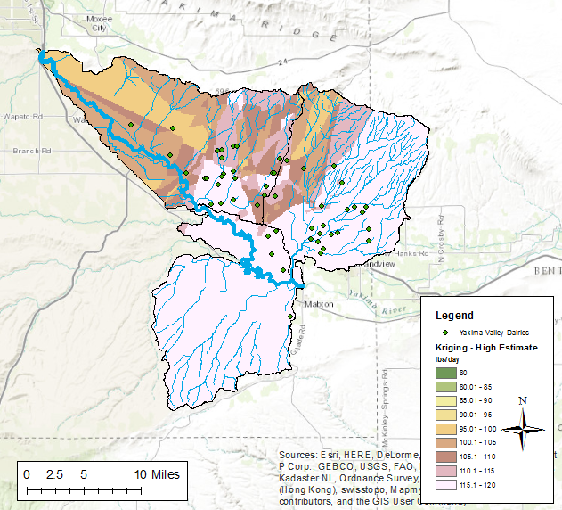
Interpolation - Nitrogen
Natural Neighbor
Kriging

Slide 10
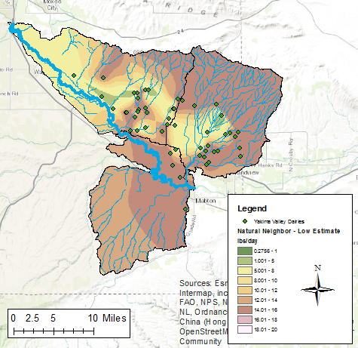
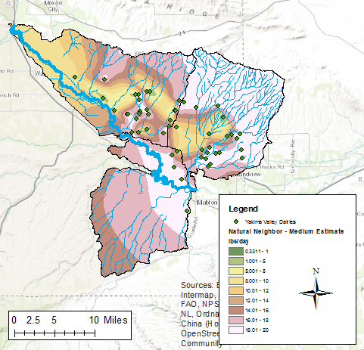
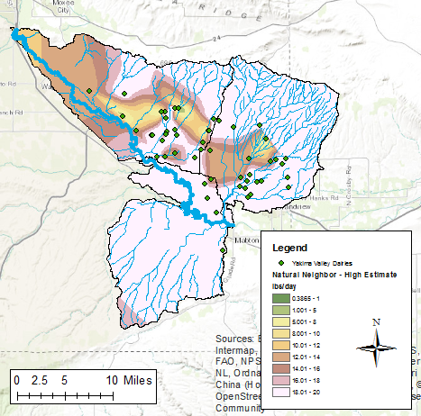
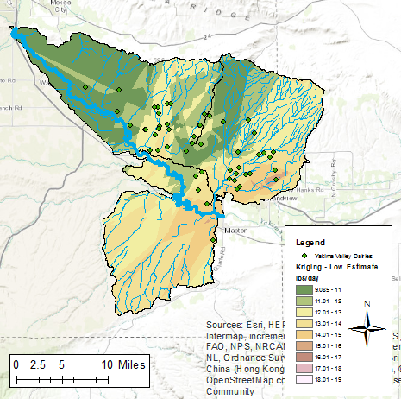
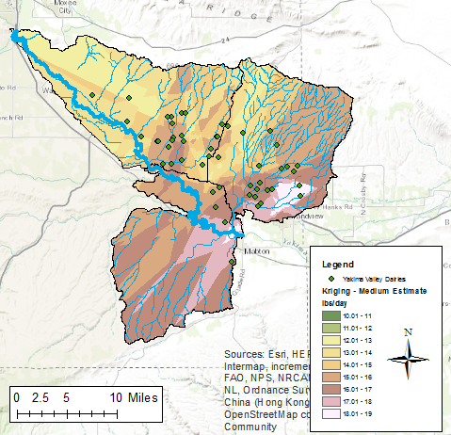
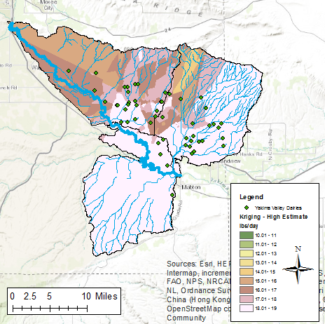
Interpolation - Phosphorous
Natural Neighbor
Kriging

Slide 11
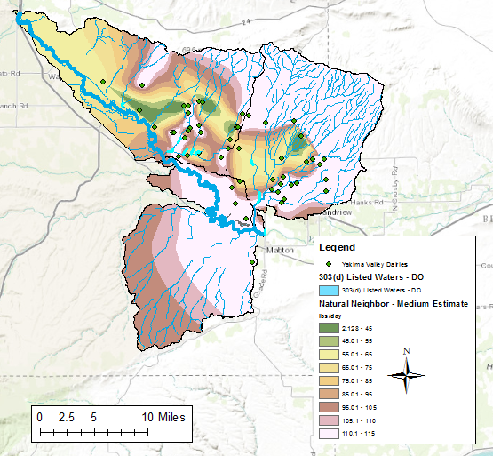
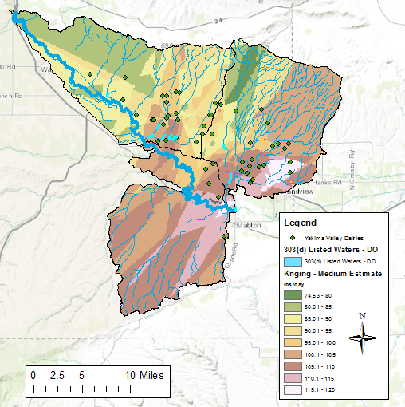
N - Interpolation & 303(d) listed waters

Slide 12
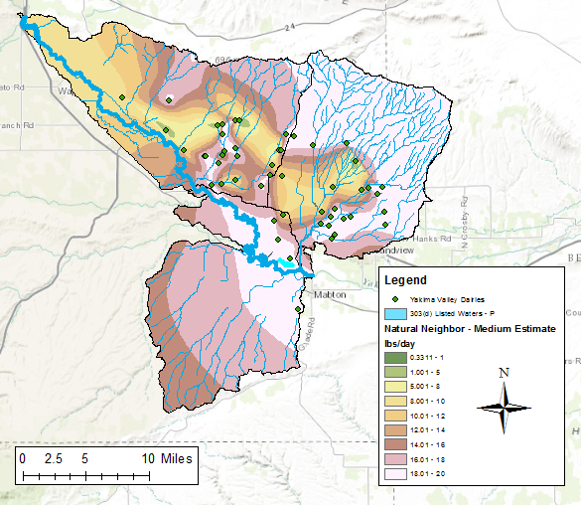
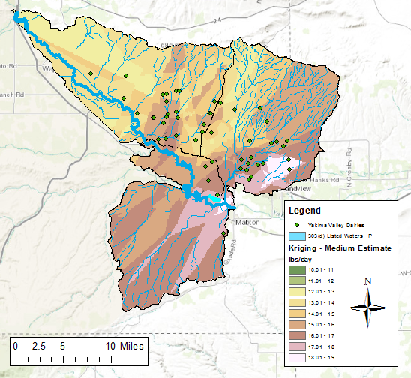
P – Interpolation & 303(d) listed waters

Slide 13
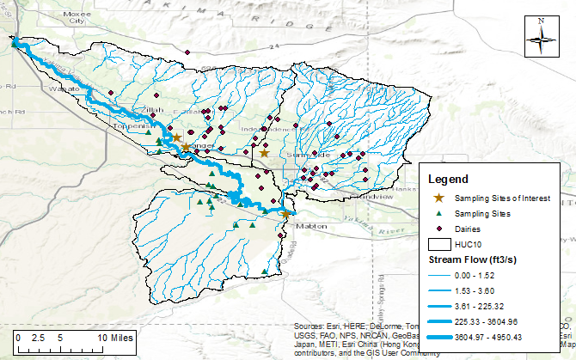
Government Sampling Sites

Slide 14
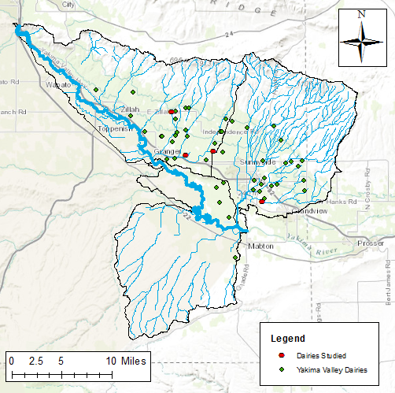
Dairies Individual Contribution to Nutrient Loading

Slide 15
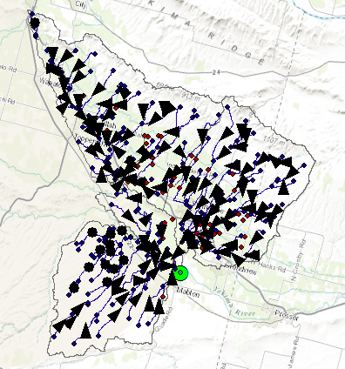
NHDPlus V2 + DEM Flowlines

Slide 16
Individual Dairy Nutrient Loading
Dairy | Size | Number of Cows | Distance to River [m] | N conc [ug/L] | P conc [ug/L]
Frieslandia Dairies LLC | Large | 900 | 137.27 | 0.0105 | 0.0016
Deruyter Bros Dairy | Large | 900 | 15.86 | 0.0357 | 0.0056
Harrison | Medium | 450 | 154.76 | 0.0066 | 0.0010
Liberty | Small | 100 | 82.9 | 0.0086 | 0.0013
Suncrest | Medium | 450 | 121.26 | 0.0155 | 0.0024

Slide 17
References
Animal Manure Management (1995). Natural Resources Conservation Service RCA, Issue Brief #7.
Childs, C. (2004). Interpolating Surfaces in ArcGIS Spatial Analyst. ArcUser, 32-35.
Hribar, C., and Schultz, M. (2010). Understanding Concentrated Animal Feeding Operations and Their Impact on Communities. National Association of Local Boards of Health. Bowling Green, OH.
Monitoring Well Installation and Data Summary Report, Lower Yakima Valley (2013). Yakima County, Washington, EPA.
Relation Between Nitrate in Water Wells and Potential Sources in the Lower Yakima Valley, Washington. (2012a). EPA-910-R-12-003, EPA, 2012a.
Relation Between Nitrate in Water Wells and Potential Sources in the Lower Yakima Valley, Washington. (2013). EPA-910-R-13-004, EPA.
Yang, et al. (2008). Mechanisms and assessment of water eutrophication. Univ Sci B, 9(3):197-209.

Slide 18
Acknowledgements
Professor Maidment
Gonzalo Espinoza Davalos

Slide 19
Questions?

