Slide 1
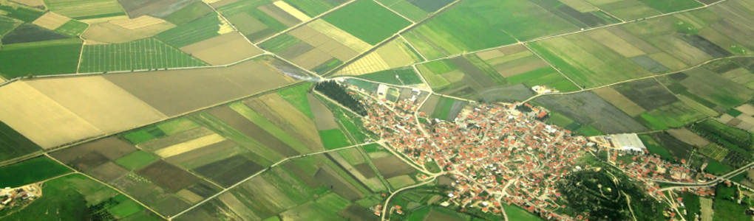
Development and Land Use Change: Central Potomac River Watershed
GIS for Water Resources
Rebecca Posa
December 2, 2014
Image Credit: Maryland Land Advisors

Slide 2
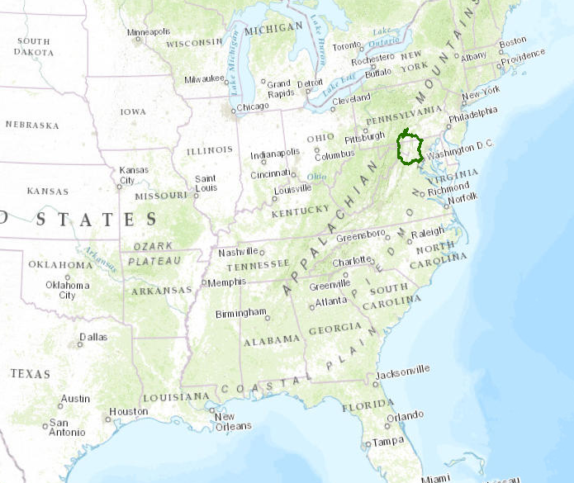
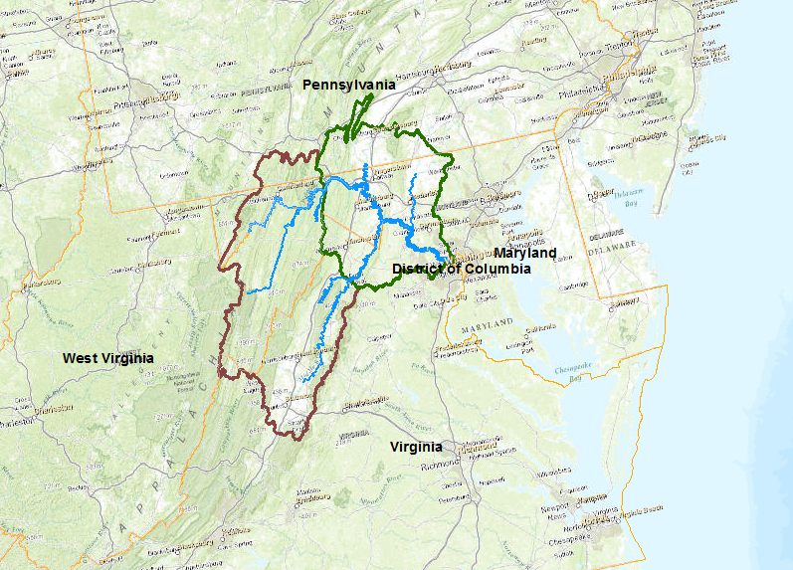
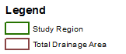
Study Area
6.9 million residents in 2010, additional 2.3 million by 2040 (+33%)
Can rural-to-suburban development be seen from national-scale datasets?

Slide 3
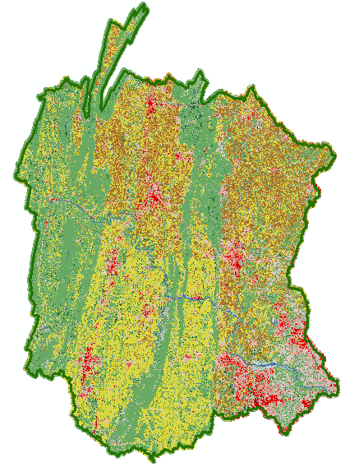
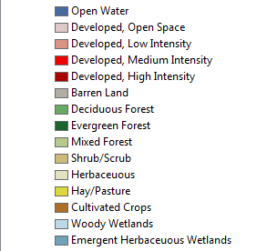
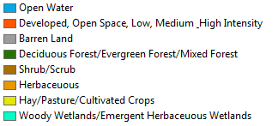
The Data
National Land Cover Dataset:
1992, 2001, 2006, 2011

Slide 4
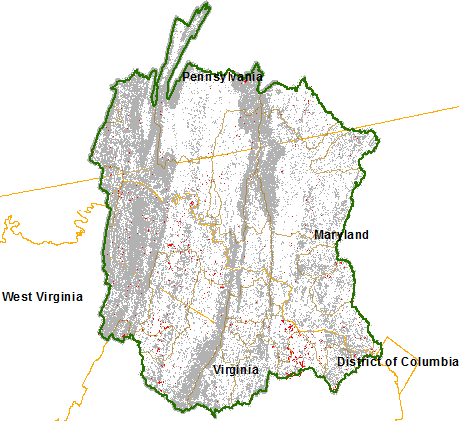
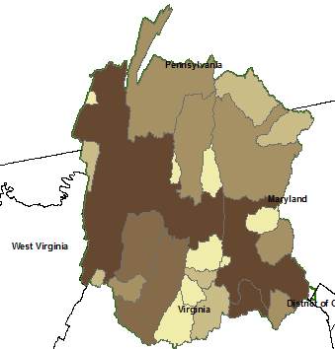
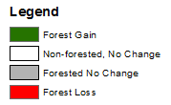
Analysis Example: Change in Forest, 2001-2011
Forest = Deciduous + Evergreen + Mixed
Extract Forest
Forest 2001 – Forest 2011
Raster of Change in Forested Land
Analyze using Zonal Statistics
Zones are USGS Stream Gage Catchments

Slide 5
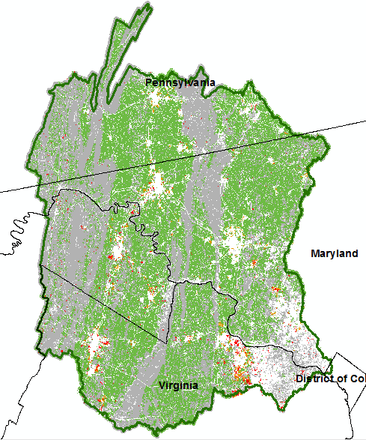
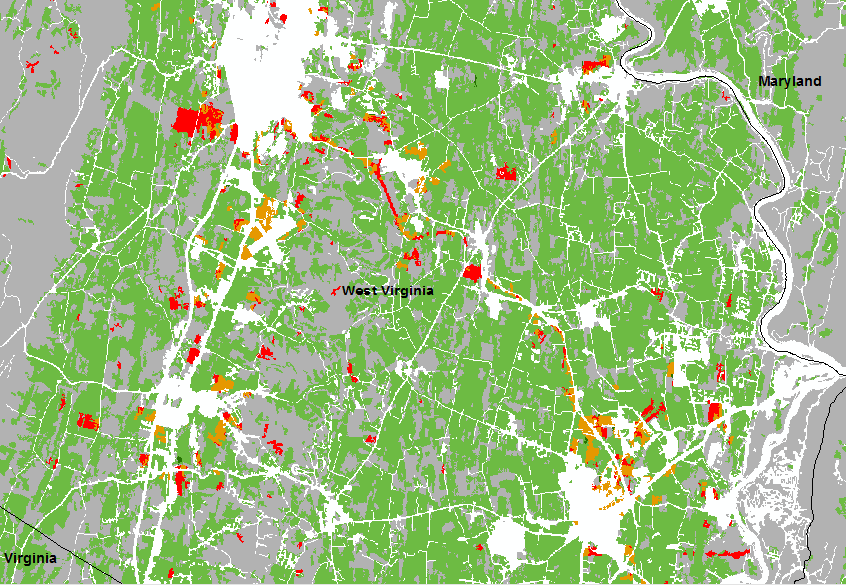
Land Cover
Change
Cropland & Forest Land
Development Intensity
Impervious Cover
Runoff Ratio
?

Slide 6
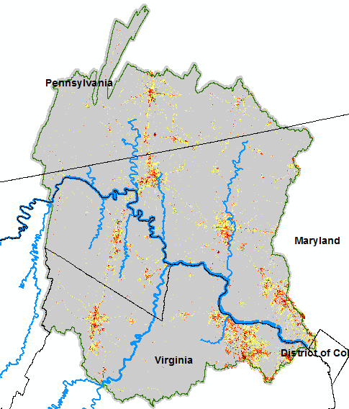
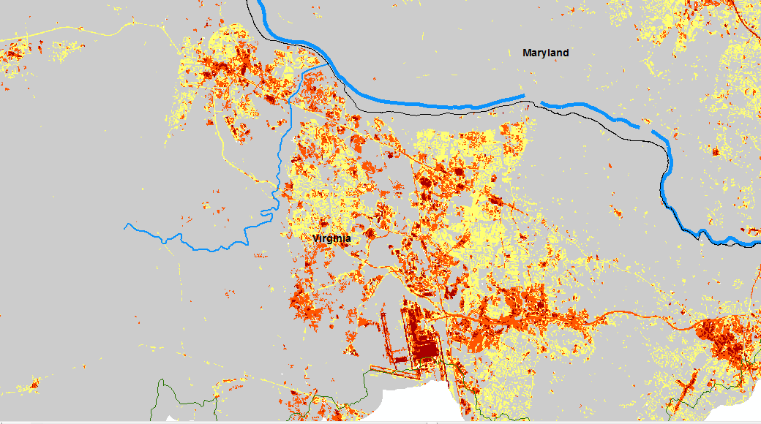
Land Cover
Change
Cropland & Forest Land
Development Intensity
Impervious Cover
Runoff Ratio
?

Slide 7
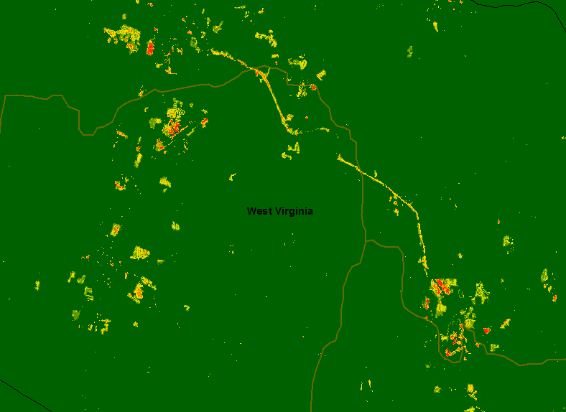
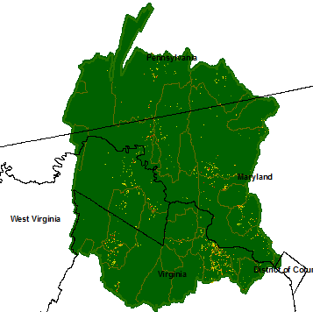
Land Cover
Change
Cropland & Forest Land
Development Intensity
Impervious Cover
Runoff Ratio
?

Slide 8
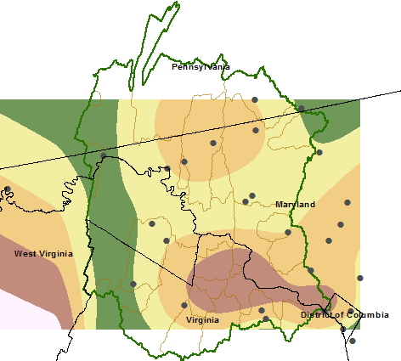
Land Cover
Change
Cropland & Forest Land
Development Intensity
Impervious Cover
Runoff Ratio
?

Slide 9
Conclusions
Development can be seen and quantified from the NLCD
Different metrics of land change provide a different picture of what is happening
Difficult to relate runoff to land cover using precipitation gages
Future work: quantify results by stream gage catchment
The way you make your map can say a lot about your perspective!

Slide 10
