Slide 1
GIS in Water Resources - Drought in southern California
Cheng-Wei Yu
Dec, 2nd, 2014

Slide 2
Introduction
Study Area
Methodology
- Soil Water Content Balance Equation
- NDVI – Evapotranspiration
- Precipitation
- GRACE
- LDAS Model
Still Working
Conclusion

Slide 3
Introduction
Drought has became a serious problem in United State, especially for California and Texas state.
There is a severe drought happened in early 2014, the historic drought already caused more than 2 billion loss in agriculture.
This report will use GIS to estimate the soil moisture, by using the soil water content, we can roughly estimate the drought area.

Slide 5
US Drought Monitor

Slide 7
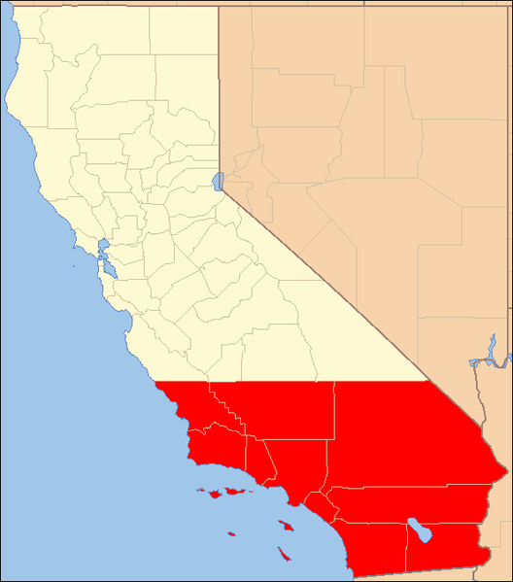
Study Area
The study area of this project is at Southern California, including 10 counties: Los Angeles, San Diego, Ventura, Imperial, Santa Barbara, Riverside, San Bernardino, San Luis Obispo, Kern and Orange.

Slide 8
Study Area
The climate type of Southern California is Mediterranean climate.
Area with this climate receive almost all of their precipitation during the winter and spring season, and may go anywhere from 4 to 6 months during the summer without having any significant precipitation.

Slide 9
Methodology - Soil Water Content Balance Equation
The main purpose of this project is to estimate the soil water content.
Soil water content is decided by two factors: input water and output water.
Change in Soil Water = Input Water – Output Water

Slide 10
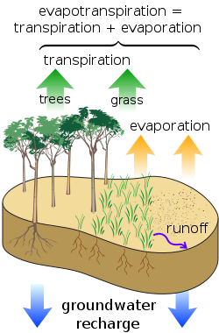
Methodology - Soil Water Content Balance Equation
Water Input = P + I + C
P = Precipitation
I = Irrigation
C = Groundwater Recharge
Water Output = ET + RO + D
ET = Evaporation + Transpiration
RO = Runoff
D = Infiltration into Groundwater

Slide 11
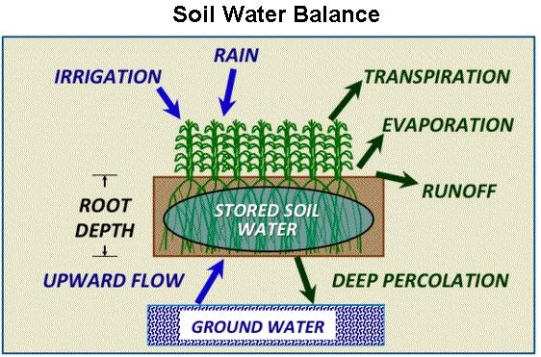
Methodology - Soil Water Content Balance Equation

Slide 12
Methodology – NDVI & Evapotranspiration
NDVI is the ‘Normalized Difference Vegetation Index’.
It is the index of the amount of near infrared light that is reflected from the vegetation, compared to the visible light that is absorbed by vegetation during photosynthesis.
Normally, 0 ≤ NDVI ≤ 1

Slide 13
Methodology – NDVI & Evapotranspiration

Slide 14
Methodology – NDVI & Evapotranspiration

Slide 15
Methodology –NDVI & Evapotranspiration
We also can use the “land use map” to compare with NDVI map.
From the evapotranspiration map and NDVI map, it is pretty clear that Southern California vegetation coverage is relatively low compare with Northern California.
The vegetation coverage will accelerate the evapotranspiration, so vegetation coverage might be an important factor.

Slide 16
Methodology - Precipitation
Precipitation is the main input water in the water balance model.
Retrieved precipitation data form GATEWAY.
The precipitation is monthly data from 1968 – 2010

Slide 17
Methodology - Precipitation

Slide 18
Methodology - Precipitation

Slide 19
Methodology - Precipitation

Slide 20
Methodology – GRACE Satellite Data
GRACE measures total water storage in the earth‘s surface and will be used to examine droughts.

Slide 21
Methodology – NLDAS Model
LDAS tool is a soil moisture model developed by Prof. Maidment and Gonzalo.
NLDAS includes the NOAH land surface hydrology model that provides gridded estimates of the hydrologic water through a combination of observations and modeling.

Slide 22
Result
This figure is the water deficit map, basically the Northern California experiences worse situation than Southern California.

Slide 23
Still Working on
I’m currently working on NLDAS model to retrieve data and will use the NLDAS result to compare with the result that I have.

Slide 24
Conclusion
By using GIS, the soil moisture model can roughly estimate the soil water content, which is helpful for irrigation strategy.
The groundwater and snow water effect were neglected, however, the groundwater and snow water could be an important sink/source for soil water content.
According to historical data, the drought condition in Northern and Central California is more severe than Southern California.

Slide 25
Conclusion

Slide 26
Thank you for your attention
Question?

