Slide 1
Using geothermal energy for brackish water desalination in Texas
Catherine Birney
CE 394K
December 4, 2014

Slide 2
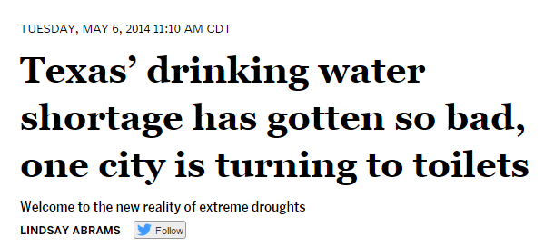
The Problem
More than 600 people move to Texas every day

Slide 3
A Possible Solution
Brackish groundwater [1]:
Texas has 2.7 billion acre-feet
46 brackish water desalination facilities in Texas
Desalination capacity of 123 MGD
Can we use geothermal energy to desalinate groundwater?

Slide 4
Geothermal Energy
Different Types
Hot water/steam used directly to produce electricity
Binary-Cycle: Hot water heats second fluid, which vaporizes and turns turbine
Notes:
Binary: Water is pumped out and runs through a heat exchanger which transfers heat to a second fluid with a lower boiling point (isobutane), which vaporizes. The vapors drive the turbine which generates electricity and water is pumped back into the ground

Slide 5
Borehole Temperatures
Data:
Southern Methodist University – Geothermal Laboratory

Slide 6
Borehole Temperature: Kriging

Slide 7
Well Locations
Data:
Texas Water Development Board Brackish Groundwater Database

Slide 8
Total Dissolved Solids (TDS)
TDS Concentration: 1000 – 30,000 mg/L
Notes:
Brackish water: 1000 – 10,000 mg/L. Seawater > 35,000 mg/L

Slide 9
Well Depth
Well Depth: 100 – 12,000 feet (30.5 – 3658 m)

Slide 10
Power Production/Consumption
Production: Geothermal Energy
$$P_{geo}=C_{p}∗Q_{g}∗∆T∗η_{g}−P$$
Consumption: Desalination by Reverse Osmosis
$$P_{desal}= \frac{Q ∗γ ∗WD }{η_{d}}+[Q ∗0.08 ∗\left({TDS}_{in}−{TDS}_{out}\right)]$$

Slide 11
Combined Equation
$$Q= \frac{C_{p}∗Q_{g}∗∆T∗η_{g}}{\frac{γ∗WD}{η_{d}}+0.08({TDS}_{in}−{TDS}_{out})}$$
Notes:
TDSout = 500 mg/L

Slide 12
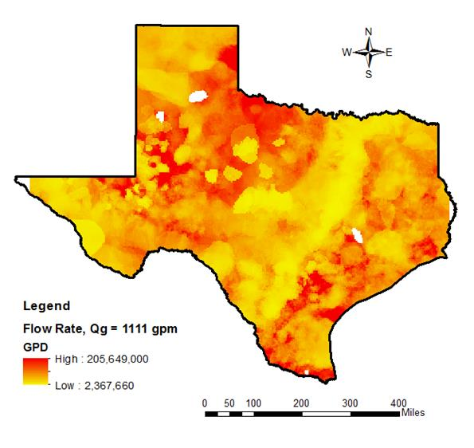
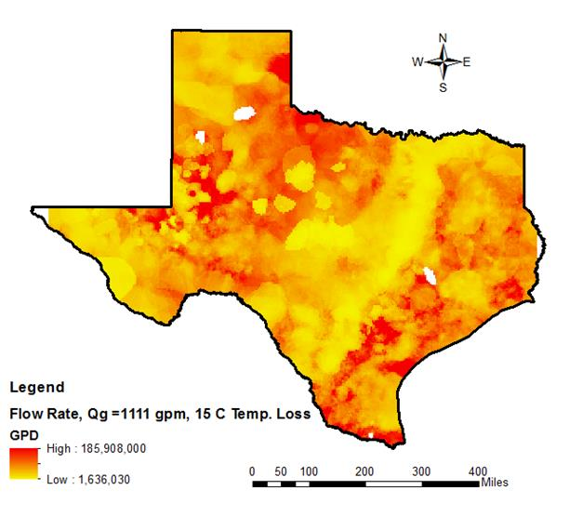
Results

Slide 14
Results
 | Qg = 1.5 gpd No Temp. Loss | Qg = 1.5 gpd Temp. Loss of 15°C | Qg = 1111 gpd No Temp. Loss | Qg = 1111 gpd Temp. Loss of 15°C
Low Flow Rate (MGD) | 0.003 | 0.002 | 2.36 | 1.64
High Flow Rate (MGD) | 0.278 | 0.251 | 205 | 186
Average design capacity: 1.6 MGD

Slide 15
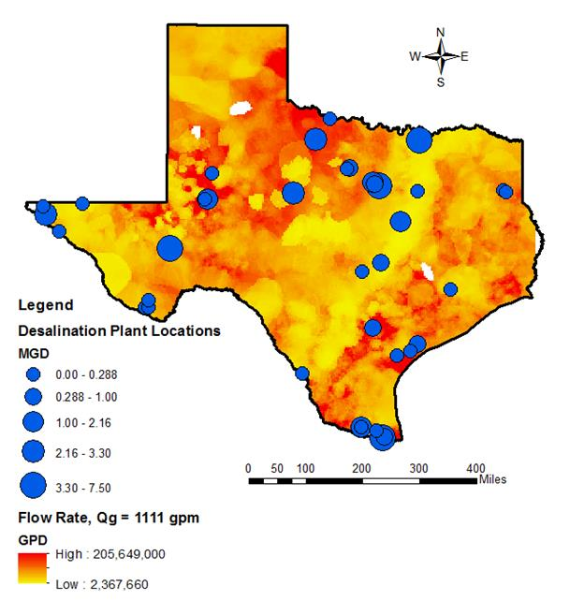
Current Desalination Plants

Slide 16
Conclusion
Based on preliminary results, utilizing geothermal energy for brackish water desalination may be worthwhile
Next steps:
Improve assumptions made in equation
Analyze cost of geothermal systems

Slide 17
Questions?

Slide 18
Sources
http://www.twdb.state.tx.us/publications/state_water_plan/2012/2012_SWP.pdf
Data:
Southern Methodist University – Geothermal Laboratory
Texas Water Development Board – Brackish Groundwater Database

