Slide 1
An analysis of lignite mining, water use & demographics in two Texas counties
[Rusk and Webb Counties]

Slide 2
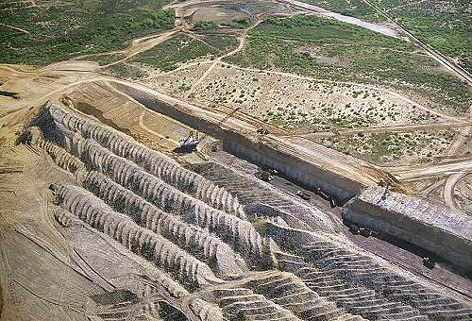
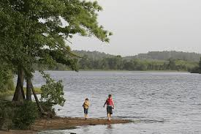
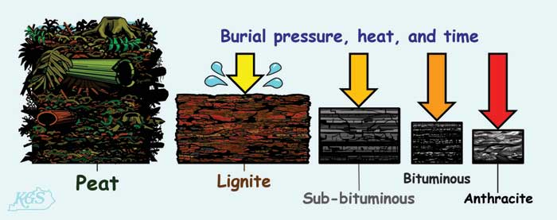
Lignite Mining
[TPWD]
[Airphoto]
[TPWD]
[Kentucky Geological Society, UKY]

Slide 3
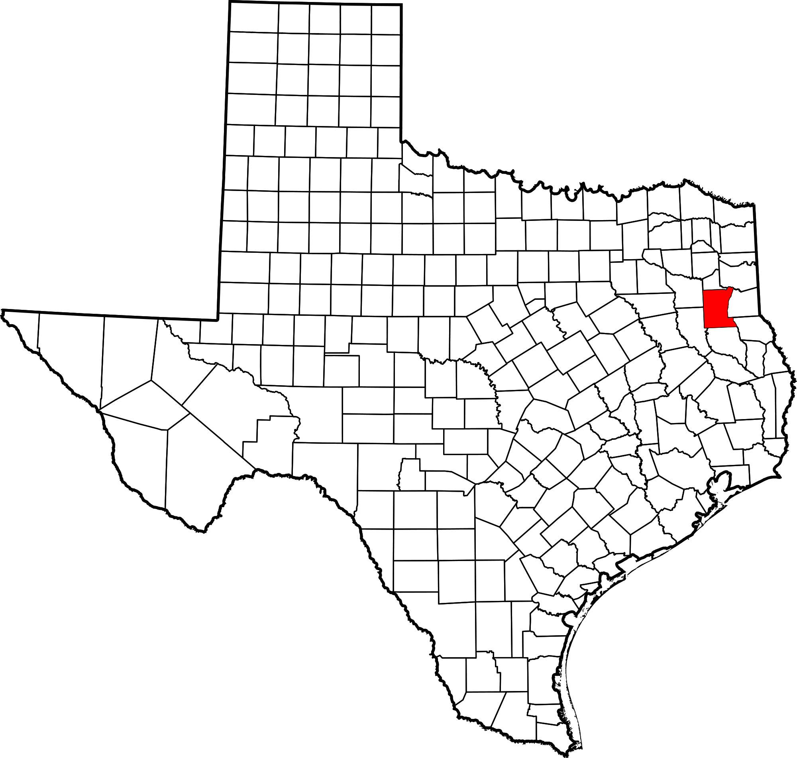
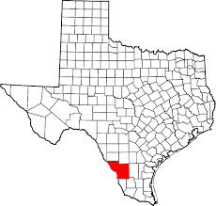
Texas Lignite
[TSHA]
[TSHA]
[BEG, UT-Austin]

Slide 4
Lignite and water?

Slide 5
Texas Geology & Major Aquifers

Slide 6
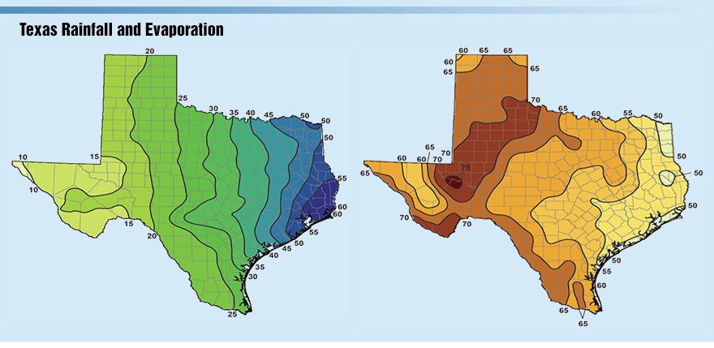
Current Conditions
[TCEQ]

Slide 7
Rusk County Watersheds
Texas Piney Woods
939 mi² – 15mi² water
Rainfall: 45in/yr
Deep sandy loam with clay & lignite
Martin Lake Watershed
Reclamation created lake → State park

Slide 8
Martin Lake – Luminant Operations

Slide 9
Rusk County Demographics
Population: 53,330
Education Attainment
80.1% H.S. graduate
Under 25, 5% Bachelor’s
3.1% Male, 7.6% Female
Median Income: $46,220
Employment
Total: 21,659
Agriculture, Forestry, Fishing/Hunting & Mining: 2,368
Mining: Oil, Gas, Lignite, etc.
15.3% below the poverty level

Slide 10
Movement: Rusk County

Slide 11
Webb County Watersheds
3,363 mi2
Flat and dry terrain
Grasses, mosses, cacti, thorny shrubs
Clay and loamy soils
Rainfall: 20in/yr
Carricitos Creek
Entirely reclaimed by Farco Mining

Slide 12
Webb County Demographics
Population: 250,304
Education Attainment:
64.1% H.S. graduate
Under 25, 4.3% Bachelor’s
Over 25, 12.4% Bachelor’s
Employment
Total: 96,893
Agriculture, Forestry, Fishing/Hunting & Mining: 2,479
Mining: Oil, Gas, Lignite, etc.
30.6% below poverty line

Slide 13
Movement: Webb County

Slide 14
Migration: inbound

Slide 15
Migration: outbound

Slide 16
Conclusions
Lignite operations
+water availability
+water use
Reclamation + water quality
Lower education attainment + “mining”
Movement is low in Rusk County
Movement is high in Webb County

Slide 17
Acknowledgements
Dr. Michael E. Webber
Dr. David R. Maidment
James Littlefield, Director of Operations, Luminant Mining

Slide 18
Faith S. Martinez
Graduate Research Assistant
MGPS, Lyndon B. Johnson School of Public Affairs
EER, Jackson School of Geosciences
fmartinez@utexas.edu

