Slide 1
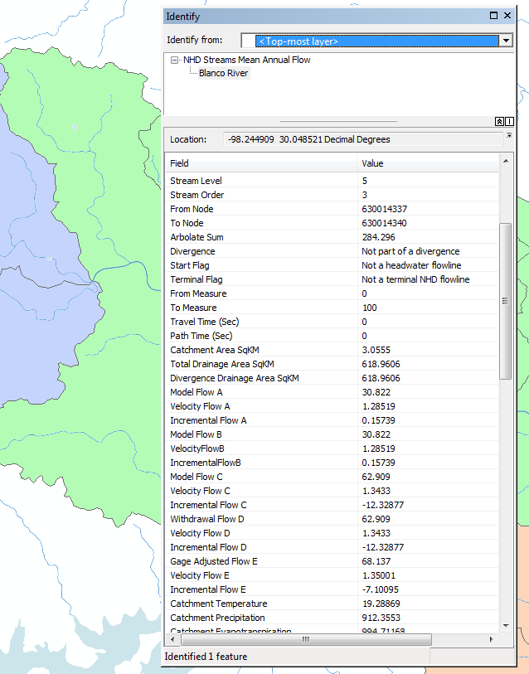
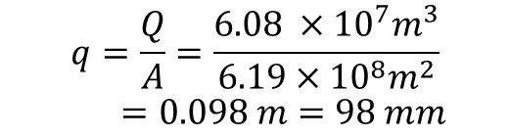

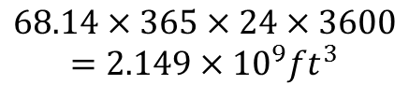
Mean annual flow per unit area calculation
Upper Blanco
Total Drainage Area: 619 km²
Incremental Area: 619 km²
(No upstream inflows)
Mean Annual Flow: 68.14 ft³/s
Precipitation: 912 mm
Annual Flow Volume
$$68.14×365×24×3600$$
$$=2.149×{10}^{9}ft^{3}$$
$$2.149×{10}^{9}ft^{3}×{\left(0.3048 m/ft\right)}^{3}$$
$$=6.08 ×{10}^{7}m^{3}$$
Annual Flow per unit area
Flow is about 10% of Precipitation. This makes sense
$$q=\frac{Q}{A}=\frac{6.08 ×{10}^{7}m^{3}}{6.19×{10}^{8}m^{2}}$$
$$=0.098 m=98 mm$$

Slide 2
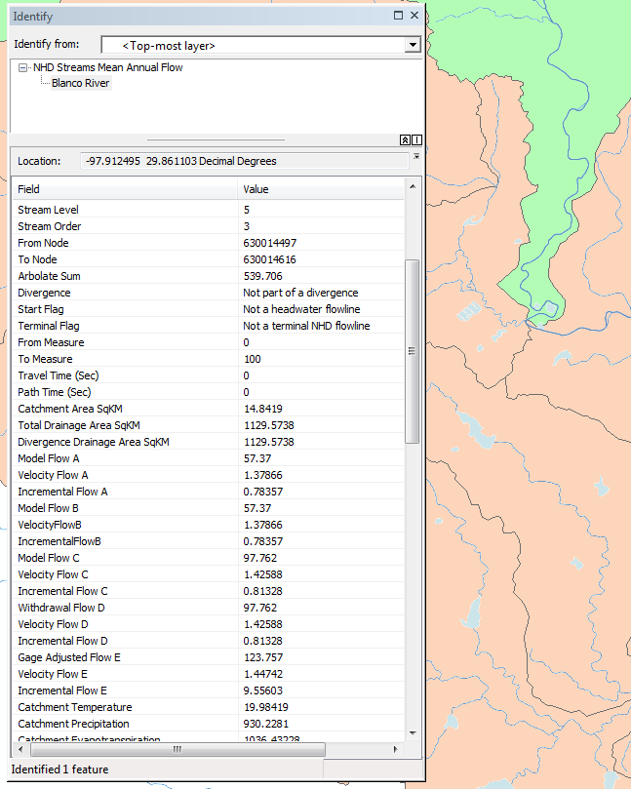
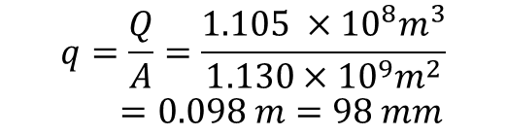

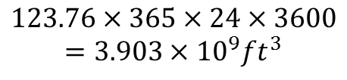
Mean annual flow per unit area calculation
Lower Blanco
Total Drainage Area: 1130 km²
Incremental Area: 511 km²
(1130-619 from Upper Blanco)
Mean Annual Flow: 123.76 ft³/s
Precipitation: 930 mm
Annual Flow Volume
$$123.76×365×24×3600$$
$$=3.903×{10}^{9}ft^{3}$$
$$3.903×{10}^{9}ft^{3}×{\left(0.3048 m/ft\right)}^{3}$$
$$=1.105 ×{10}^{8}m^{3}$$
Annual Flow per unit area
$$q=\frac{Q}{A}=\frac{1.105 ×{10}^{8}m^{3}}{1.130×{10}^{9}m^{2}}$$
$$=0.098 m=98 mm$$

