Slide 1
Guidance for Homework 1 on Geodesy, Map Projections and Coordinate Systems

Slide 2
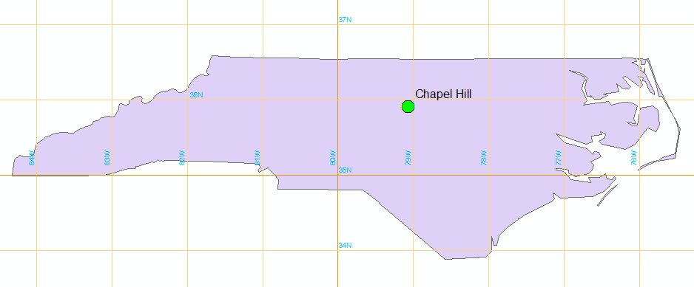
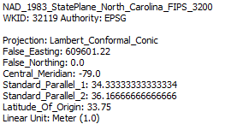
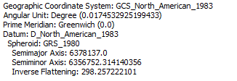

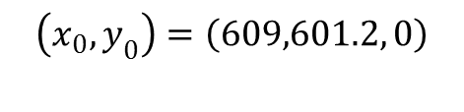
North Carolina State Plane System
Std Parallel 2
Std Parallel 1
Latitude of Origin
Origin
$$\left(φ_{0},λ_{0}\right)=\left(33.75° N, −79.0 W\right)$$
Central Meridian
$$\left(x_{0},y_{0}\right)=\left(609,601.2, 0\right)$$

Slide 3
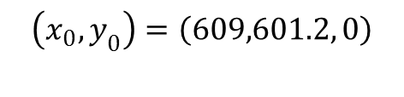

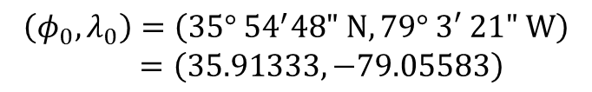


North Carolina State Plane System
$$\left(φ_{0},λ_{0}\right)=\left(35° {54}^{′}48" N, 79° 3′ 21" W\right)$$
$$=\left(35.91333, −79.05583\right)$$
$$∆y$$
$$∆x$$
Latitude of Origin
Origin
$$\left(φ_{0},λ_{0}\right)=\left(33.75° N, −79.0 W\right)$$
Central Meridian
$$\left(x_{0},y_{0}\right)=\left(609,601.2, 0\right)$$
$$∆y=\left(35.91333−33.75\right)∗\frac{π}{180}∗6371=240.5513 km$$
$$∆x=\left(−79.05583−(−79.0)\right)∗\frac{π}{180}∗6371∗\cos\left(35.91333\right)=−5.0279 km$$
Projected coordinates (approx.)
$$\left(x,y\right)=\left(609,601.2−5027.9, 0+240551.3\right)=\left(604573.3, 240551.3\right) meters$$

